Slide 1
Session 4.2:
CEOS Interoperability Terminology Report
Committee on Earth Observation Satellites
LSI-VC-8
Anchorage, Alaska, USA
4-6 September 2019

Slide 2
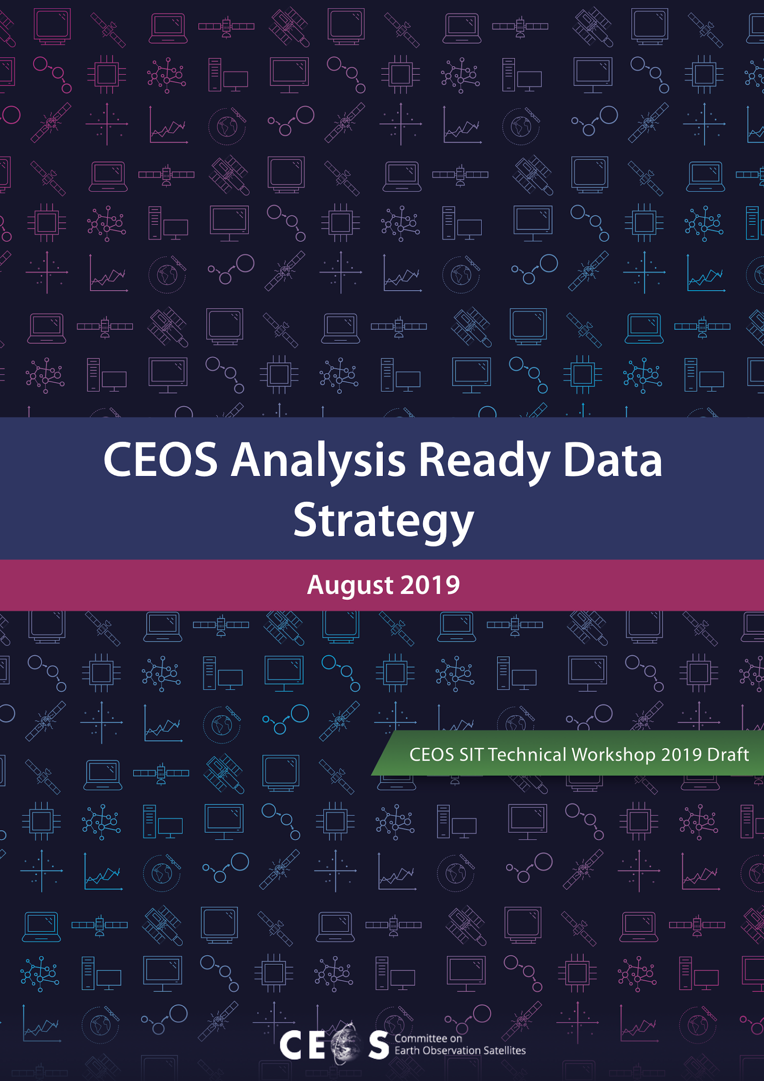
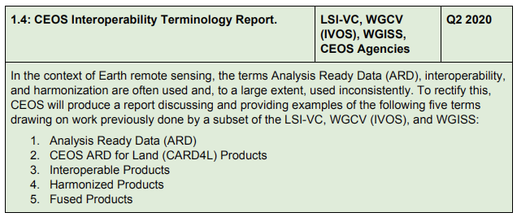
CEOS Interoperability Terminology Report
CEOS ARD Strategy Task 1.4:
CEOS Interoperability Terminology Report

Slide 3
CEOS Interoperability Terminology Report
LSI-VC has already completed its own definition document
This task was suggested by LSI-VC as a means for broader CEOS review, input and endorsement
There are other efforts ongoing in WGISS and WGCV IVOS regarding terminology definition that need to be connected – ensure consistency across CEOS
ACTION: Need an LSI-VC person/team to take this forward to completion by ~Q2 2020

Slide 4
Session 4.3:
CEOS Position Paper on the Interplay of Industry and CEOS ARD
Committee on Earth Observation Satellites
LSI-VC-8
Anchorage, Alaska, USA
4-6 September 2019

Slide 5
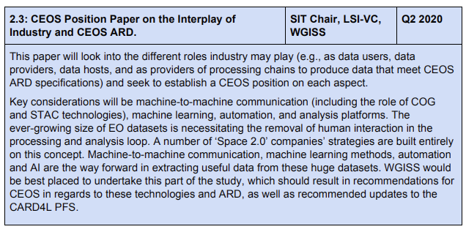
CEOS Position Paper on the Interplay of Industry and CEOS ARD
CEOS ARD Strategy Task 2.3:
CEOS Position Paper on the Interplay of Industry and CEOS ARD

Slide 6
CEOS Position Paper on the Interplay of Industry and CEOS ARD
Industry role in CEOS ARD as data users, data providers, data hosts – our chance to communicate how we see this working in an ideal world.
Proposed to cover machine-to-machine communication (including the role of COG and STAC technologies), machine learning, automation, and analysis platforms.
WGISS best placed to undertake this part of the study?
Result: recommendations for CEOS in regard to these technologies and CEOS ARD – need to be involved
ACTION: Decide the role LSI-VC would like to have in this task, responsibilities, and confirm next steps with SIT Chair 2020-2021

Slide 7
Session 5.1:
CEOS–Industry ARD Workshop
Committee on Earth Observation Satellites
LSI-VC-8
Anchorage, Alaska, USA
4-6 September 2019

Slide 8
CEOS–Industry ARD Workshop
CEOS ARD Strategy Task 4.2:
CEOS–Industry ARD Workshop

Slide 9
CEOS–Industry ARD Workshop
Proposal: co-locate ARD3 workshop (i.e., the next Planet ARD workshop) with LSI-VC-10 / 2020 SIT TW and CEOS–Industry ARD Workshop
Objective of co-locating ARD3 would be for CEOS to participate and be seen to be a co-leader in the ARD space that the first two workshops have established
Reached out to Sinergise who are willing to co-host a meeting in Ljubljana (Slovenia)
Industry, close relationship with ESA
Positive initial reaction, but needs to be coordinated
Would need to reach out to Planet regarding the co-continuation of the series they co-started with USGS

Slide 10
CEOS–Industry ARD Workshop
What do we think of this idea?
LSI-VC to take the lead with support from SIT Chair Team 2020-2021?
Objectives for such a meeting? e.g.
Promotion of PFS uptake; sharing plans; encouragement of self-assessment
Hearing from industry on ARD definition and practice
Location, discoverability, distribution, and amplification of ARD flows
Encouraging interoperability between solutions
Addressing emerging topics such as Machine Learning
Considering if/where joint ways forward may make sense...
ACTION: Assign team members to write a concept note for iteration within LSI-VC-all, and then for further consultation with stakeholders?

Slide 11
Session 5.2:
Promotion of CEOS ARD to Standards Organisations
Committee on Earth Observation Satellites
LSI-VC-8
Anchorage, Alaska, USA
4-6 September 2019

Slide 12
Promotion of CEOS ARD to Standards Organisations
CEOS ARD Strategy Task 4.4:
Promotion of CEOS ARD to Standards Organisations

Slide 13
Promotion of CEOS ARD to Standards Organisations
What is our collective ambition with regard to the CEOS PFS being used as the basis for community standards?
What are the benefits?
Is there a demand?
Who would be the most likely target? ISO, OGC, others?
Is anyone else pursuing this?
ARD Working Group in OGC already?
Industry?
Do we want to have an active role?
Future meetings and conferences for promotion?
Next steps?

