Slide 1
LSI-GEOGLAM, LSI-Forests & Biomass, CEOS ARD Strategy, Loose Ends & Wrap-up
LSI-VC-9 Teleconference #4

Slide 2
Overview
LSI-GEOGLAM
LSI-Forests & Biomass
CEOS ARD Strategy stocktake
CEOS interoperability terminology work and status
Evaluating CARD4L supply, user access, and user experiences
Review lessons and experiences from Digital Earth Africa
Reflect on the requirements and feedback from external groups (if presented at SIT-35)
Discuss opportunities for pilots
WGCapD collaboration discussion
Wrap-up

Slide 3
LSI-GEOGLAM

Slide 4
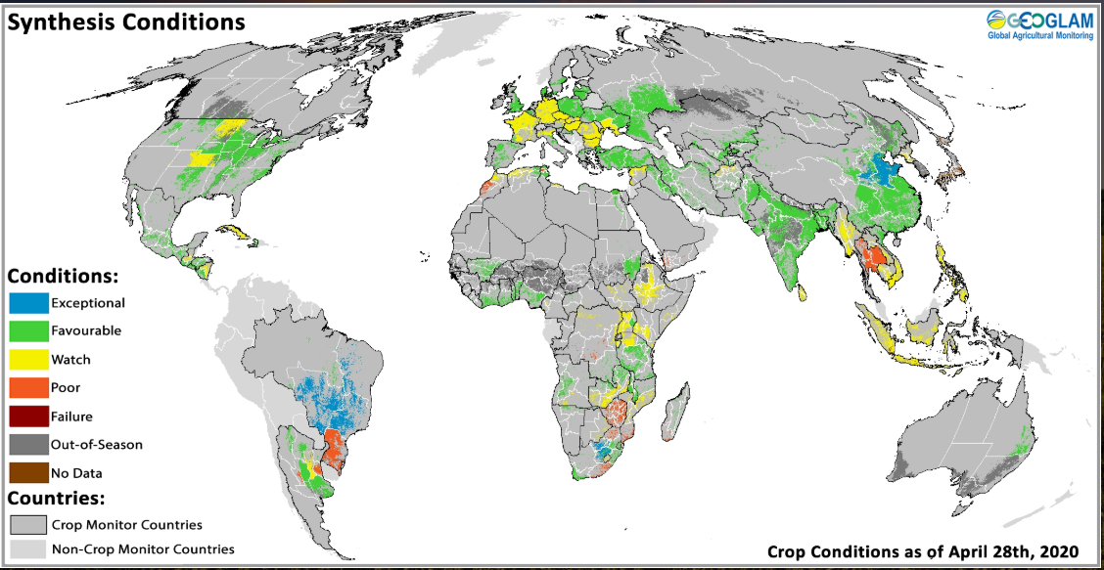
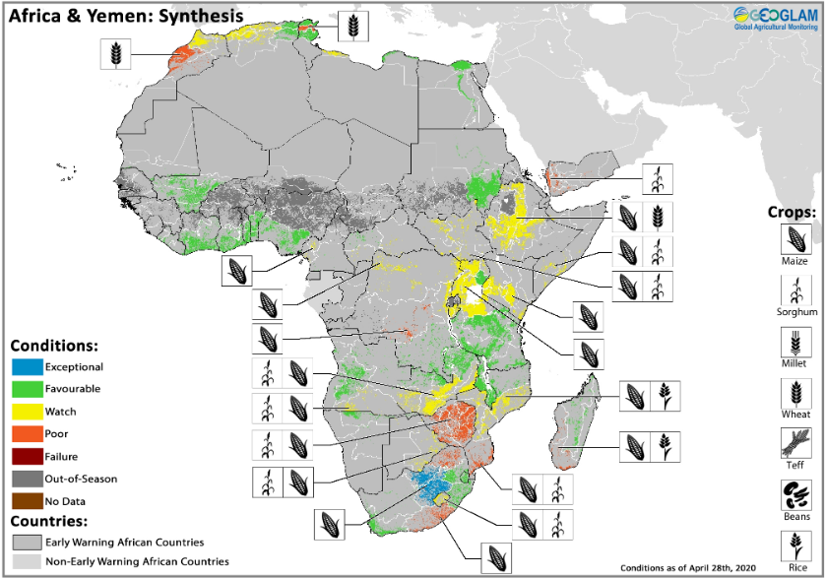
GEOGLAM Top Highlights Since Sep 2019
GEOGLAM Response to COVID 19:
The usual array of bio-physical challenges are being exacerbated by supply chain disruption-Recipe for a food security disaster World Food Program Insight
The GEOGLAM Crop Monitors are more important than ever, along with the need for more quantitative metrics
G20 Extraordinary Agriculture Ministers Meeting Special Statement on COVID 19
Featured in Bloomberg Green
GEOGLAM tracking COVID-19 impacts on food security
May 2020

Slide 5
GEOGLAM Top Highlights Since Sep 2019
Updates from Relevant Working Groups:
GEOGLAM CapDev Team best-practices document in process
Linked to CEOS and GEO CapDev Working Groups
GEOGLAM Infrastructure Working Group – Federated Approach to ICT
Cube, cloud, data access, tools, etc…
GEOGLAM EAV WG held 3 day workshop in October 2019
Variables selected and aiming to have completed this year. Stewards Identified
Stewards call 12 May, Beta Version by end Summer 2020
Impact assessment on downstream data needs and data processing (ARD, ARD+)
Considering participation in the Carbon AFOLU initiative (Ag land use state and change)

Slide 6
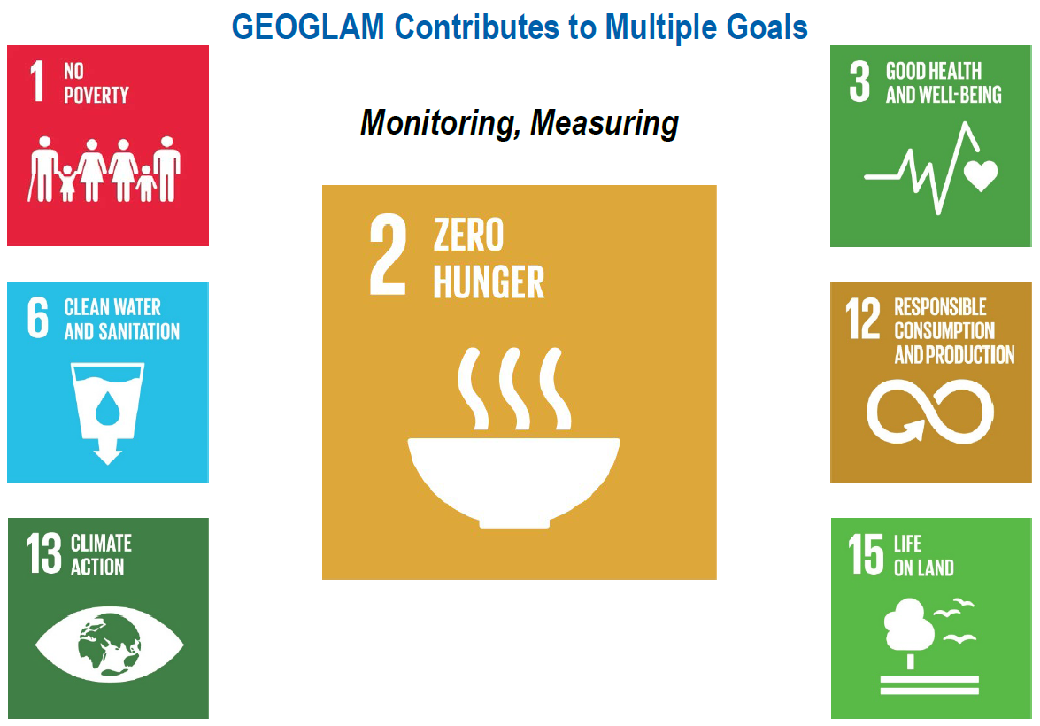
How is GEOGLAM Dealing with the Complexity of the Policy Landscape?
Lots of success with in season crop condition, but policy landscape has shifted
Information produced by the GEOGLAM community can support a multitude of policy targets (create once use many places)
Almost all targets and goals require information integrated across multiple science communities
Need for a common approach across communities to enable integration and information sharing
GEOGLAM believes Essential Agricultural Variables (EAV’s) are the way forward

Slide 7
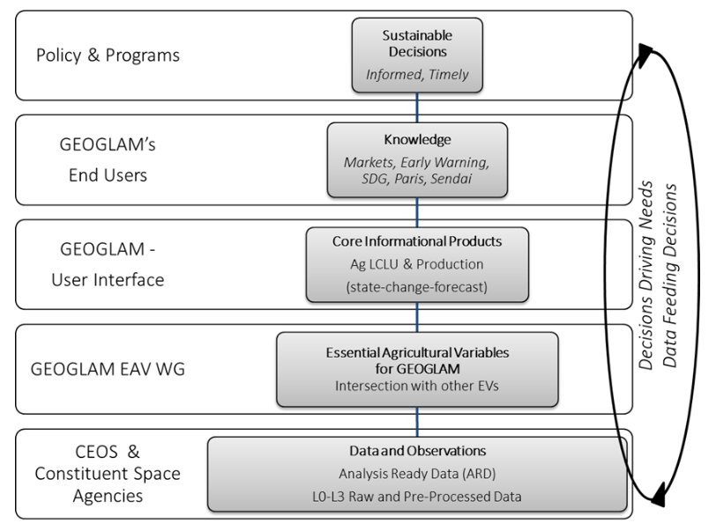
Essential Variables in Support of Multiple Policy Drivers
Essential Agricultural Variables for GEOGLAM
The concept of Essential Variables (EV’s) suggests a minimum set of fundamental variables required to characterize state and change in a system
In the continuum of Data to Decisions we see GEOGLAM in the middle, in partnership linking space agency data products to the information that drives better policy and program decisions
List of preliminary EAV’s in Annex

Slide 8
Implications for CEOS
GEOGLAM’s Vision:
1. EAV’s are fundamental to driving data needs that address community activities and ultimately inform policy
2. EAV’s drive observation needs and by extension they have implications for ARD-ARD+
3. EAV's drive the R&D priorities (incl. new data streams, new missions)
4. EAV’s can help address many policy drivers, but much integration is required across science disciplines…The LSI-VC CARD4L can be a step towards understanding integrated requirements

Slide 9
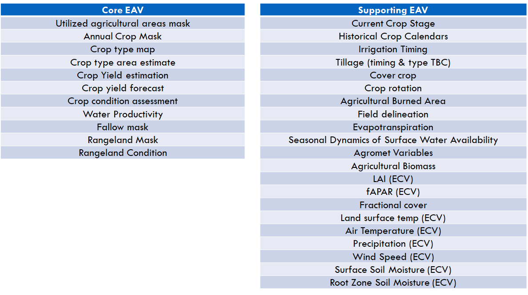
ANNEX – Preliminary List of Core and Supporting EAV’s

Slide 10
LSI-VC Forests & Biomass Team
Brief Update May 2020

Slide 11
Update from Forests & Biomass Team
Biomass Workshop
CEOS Biomass Protocol
AFOLU Roadmap
F&B team WP

Slide 12
Biomass Workshop
Hosted by SIT Chair in Canberra in early March
35 key scientists and practitioners from the CEOS LPV biomass validation team to representative from in-situ biophysical measurement networks from around the world. Some outcomes of the workshop include the potential extension of the population of biomass validation reference sites to fill critical gap in the tropics and Asia with contributions from partners such as ISRO, JAXA and the willingness of ecosystem networks such as TERN or ICOS to work with the earth observation land product validation communities to extend the number of variables measured and to adapt their protocols for earth observation validation purposes
Presentations etc available here

Slide 13
CEOS Biomass Protocol
The Biomass Validation Team within WGCV LPV has been working on the development of a good practices protocol for validation of above ground biomass products to ensure users are able to access quantitative and seamless data across these missions
Protocol now expected mid-year
Scope and purpose previewed at SIT-35 Virtual Meeting
Working team assembled to develop a business case to put to Principals at Plenary for support for measures to realise the full benefits of the Protocol and ensure max. policy relevance for our new datasets
Draft will be presented at SIT TW 2020 Virtual Meeting

Slide 14
AFOLU Roadmap
Short paper on
The opportunity for CEOS & space agencies presented by Global Stocktake process
What datasets might be valuable for land sector
What is in train and could be suitably directed, or what needs work
Volunteer team based on LSI F&B: JAXA (Osamu), ESA (Frank-Martin), USGS (Steve L), NASA (TBC), UK (Shaun Quegan?), SEC
GFOI keen on collaboration
GEOGLAM engagement and Ag. scope TBD

Slide 15
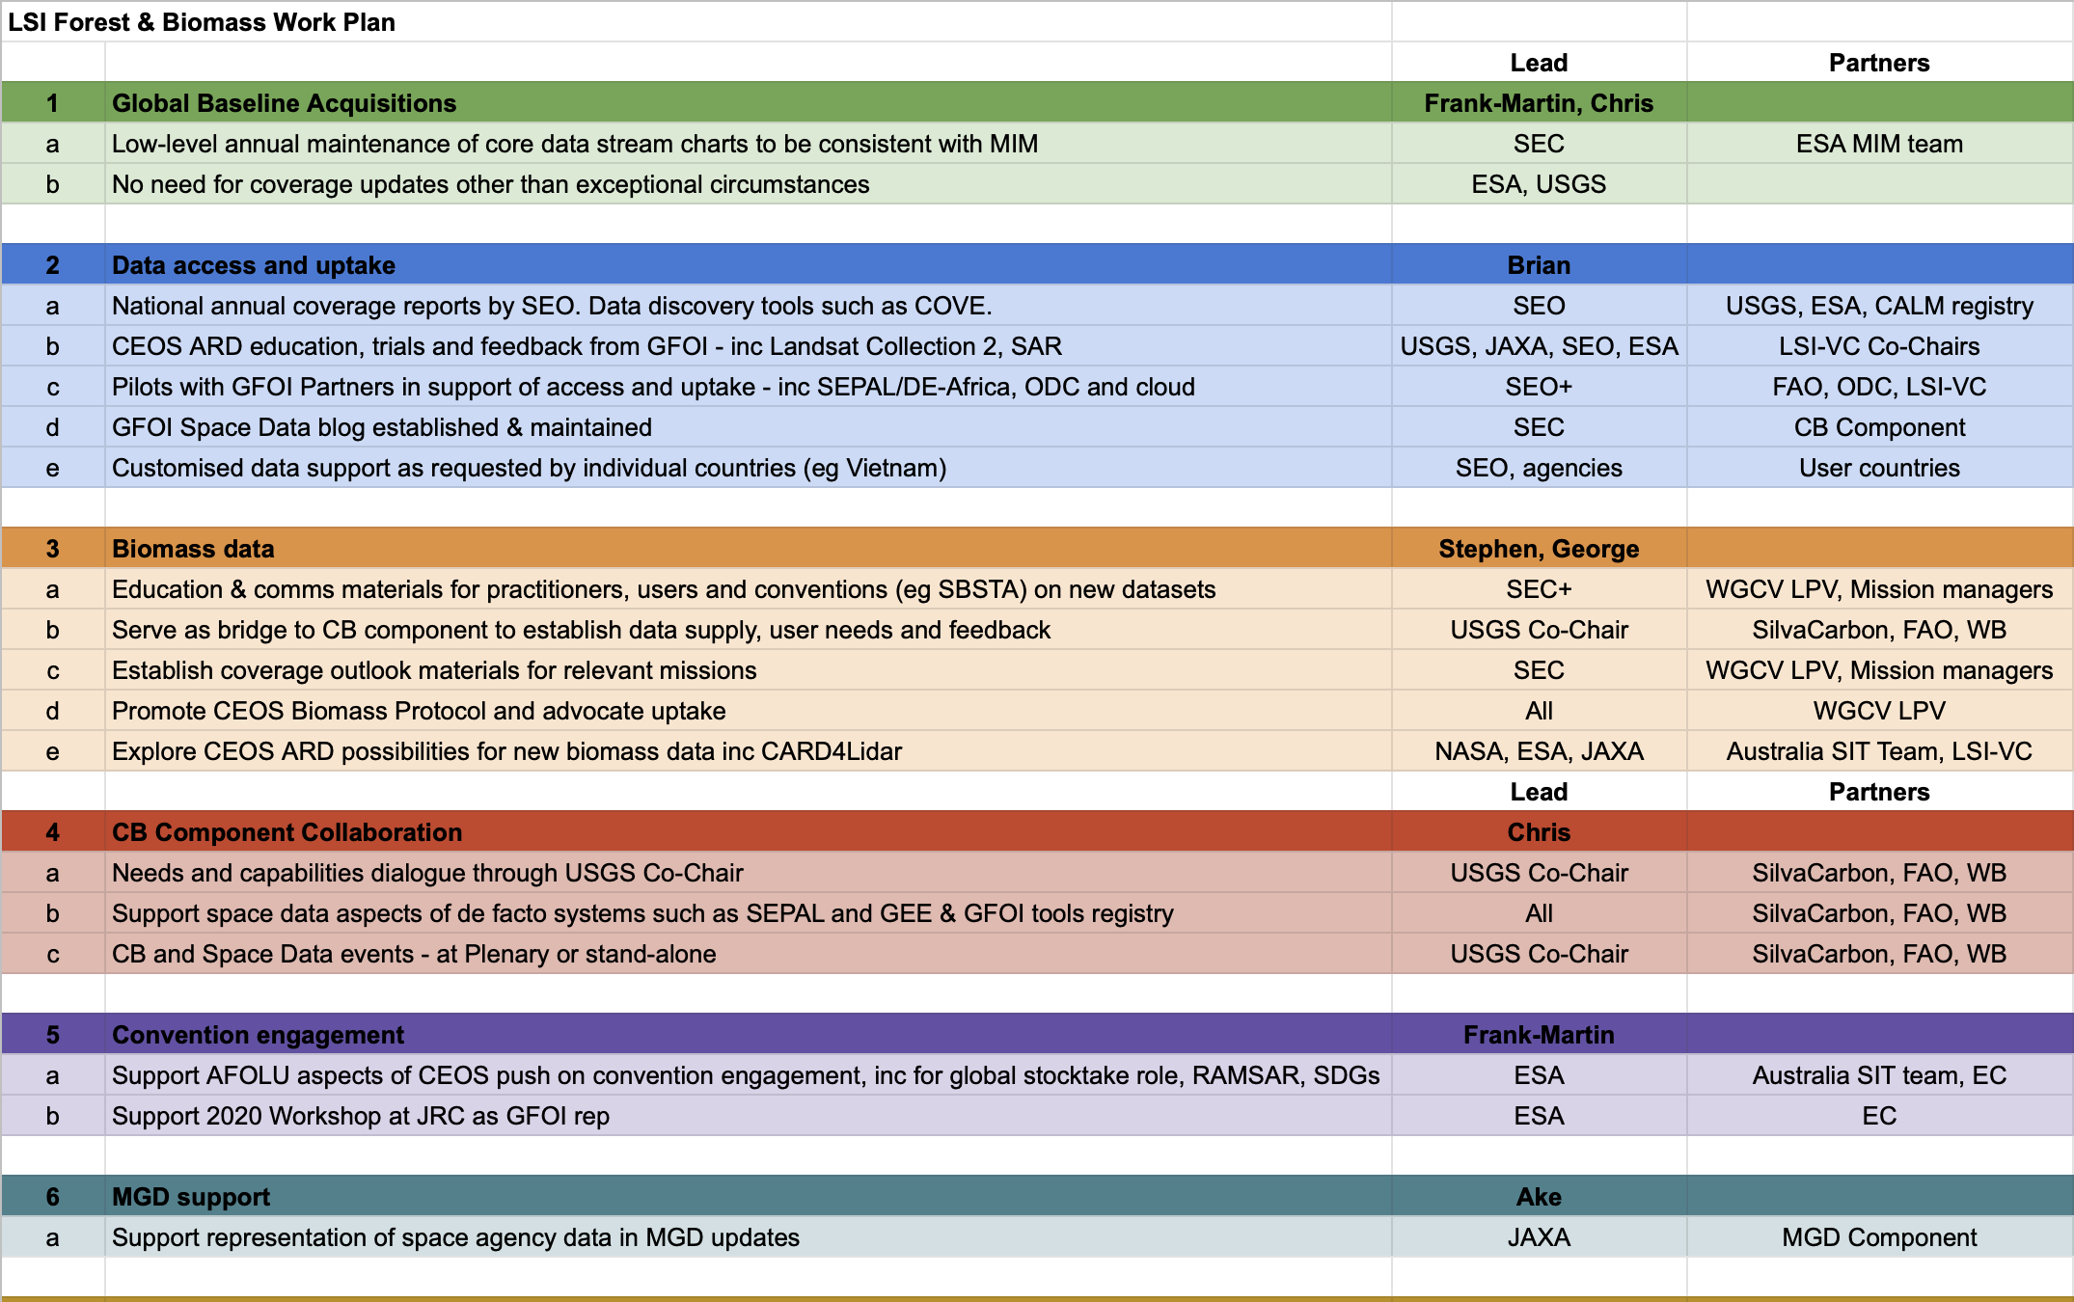
F&B Team WP
USGS Rep & support TBC

Slide 16
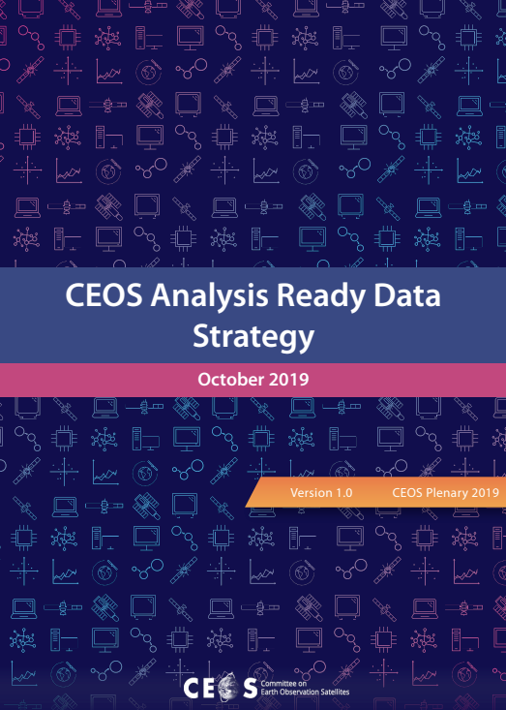
CEOS ARD Strategy Stocktake
M. Steventon
http://ceos.org/ard/files/CEOS_ARD_Strategy_v1.0_1-Oct-2019.pdf

Slide 17
1.1 Continue development of the CARD4L Product Family Specifications
✔
– SR, ST, NRB SAR, POL SAR
– Interferometric and Geocoded SLC SAR in development
– Aquatic Reflectance PFS
– LIDAR terrain and canopy height PFS in early stages of discussion

Slide 18
1.2 Identify the need for and prioritise development of future target products as the basis for new CEOS ARD specifications
– SST-VC proposed a new CEOS WP Task to survey state of ARD-like products in ocean communities. Focusing first on the SST and OCR-VC, adding other VCs to the review in the second half of 2020.
– CEOS-COAST uptake of ARD will be driven by findings from SST-VC.
– Expect SST-VC to approach LSI-VC for guidance at some point.

Slide 19
1.3 Develop further CEOS ARD technical specifications based on established need and prioritisation
– Need to push for some kind of consistency in ARD approach across the domains (e.g., CARD4L Framework and PFS approach)
– SIT-35-08: The SIT Chair Team to consider the potential for an activity to prototype the CEOS ARD approach for one exemplar ocean variable and one exemplar atmospheric variable.

Slide 20
1.4 CEOS Interoperability Terminology Report
– CEOS Glossary of Terms Related to Analysis Ready Data, Future Data Architectures, and Interoperability – added to CEOS WP with WGISS as lead.
– Discussed later on this call

Slide 21
2.1 Engage Big Data hosts and aggregators and establish formal pipelines and procedures to promote CEOS ARD hosting and uptake on their platforms
– Nothing done at CEOS-level
– USGS working with AWS on Collection 2

Slide 22
2.2 Facilitate discovery of and access to CEOS Agency ARD
2.3 Survey users’ needs with regard to ARD accessibility and provide feedback to all data providers
2.4 CEOS Paper on the Interplay of Industry and CEOS ARD
– WGISS task
✔

Slide 23
3: Pilots and Feedback
3.1 Production of CEOS ARD and supply to data aggregators and platforms
– Landsat and Sentinel-2 progressing through the CARD4L assessment process
– USGS Collection 2 AWS example

Slide 24
3.2 – 3.6: CEOS ARD Pilots
Digital Earth Africa:
Paper proposed on DEAfrica lessons learned, requirements and recommendations for CEOS
Discussed later
GFOI Pilot: Awaits DEAfrica and FAO progress
GEOGLAM Pilot: Nothing to report
Mekong Data Cube Pilot: Preliminary 'ARD' from Landsat and ALOS-2 provided during 2019 CEOS Chair year.
Other Pilots: UNCCD LDN? CEOS-COAST. WGDisasters GEO-LEO-SAR Flood Pilot?

Slide 25
4: Communication & Promotion
✔
4.1: GEO Week Side Event: Analysis Ready Data
4.2: CEOS–Industry ARD Workshop Webinar
4.3: CEOS ARD stocktake and outlook – on hold, awaiting assessments
4.4: Engagement with standards organisations – to be decided today
4.5: Promotion of CEOS ARD to data providers
4.6: Communication with CEOS ARD users

Slide 26
CEOS Interoperability Terminology
S. Labahn

Slide 27
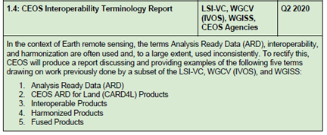
Background & History
In 2018-2019, ESA and USGS partnered to define an initial set of interoperability related definitions and an interoperability continuum, as follows:
Analysis Ready Data (ARD)
CEOS ARD for Land (CARD4L) Products
Interoperable Products
Harmonised Products
Fused Products
At the 2019 LSI-VC-7 meeting in Hanoi, LSI-VC endorsed these definitions
As part of the broader CEOS ARD
Strategy led by the current SIT Chair
Team, a comprehensive CEOS
Interoperability Terminology Report is
now desired (and needed!)

Slide 28
Recent Activities
In late 2019, a multi-disciplined team led by WGISS and including LSI-VC and WGCV IVOS was formed to address the broader interoperability related terminology challenge
WGISS met and mostly adopted the previous LSI-VC work (retitled the document and made one word change) and expanded it to include additional aspects:
Analysis, Access, and Analysis Ready Data
Cloud Data Formats and ARD in the Cloud
1) Cloud-friendly formats, 2) Cloud-native formats, 3) Cloud data access API
Types of Analysis Interoperability
1) Executable code, 2) Source code, 3) Algorithm
IVOS-32 met in March 2020 and conducted a survey amongst the attendees on what the definition of interoperability was - quite a range of ideas (supports need for better understood and adopted definition)
Planned to re-circulate survey across IVOS and include commercial entities
Several definitions introduced new terms that would need to be defined
Interoperability definition needs to recognize that it is application-specific

Slide 29
Next Steps
Continuing to learn about previous work done and to identify overlaps with existing industry standard definitions (i.e., ISO, OGC, IEEE) - data vs. services difference
OGC: Capability to communicate, execute programs, or transfer data among various functional units in a manner that requires the user to have little or no knowledge of the unique characteristics of those units ISO 2382-1. "The ability for a system or components of a system to provide information portability and interapplication, cooperative process control. Interoperability, in the context of the OpenGIS Specification, is software components operating reciprocally (working with each other) to overcome tedious batch conversion tasks, import/export obstacles, and distributed resource access barriers imposed by heterogeneous processing environments and heterogeneous data. (http://defs.opengis.net/elda-common/ogc-def/resource?uri=http://www.opengis.net/def/glossary/term/Interoperability)
WGISS: The capability of the user interface and administrative software of one instance of a service to interact with other instances of same type of services. Services are said to be interoperable if they allow for interoperability as previously defined. And systems are said to be interoperable if they are effective implementations of interoperable services. (http://ceos.org/document_management/Working_Groups/WGISS/Documents/WGISS_CEOS-Interoperability-Handbook_Feb2008.pdf)
WGISS plans to begin circulating the latest draft report through its team along with the most interested/engaged parties (LSI-VC, WGCV, IVOS, SIT Chair Team)
Another recommendation is to pursue a few follow-on pilot activities (CEOS-COAST, Landsat/Sentinel-2 HLS/Sen2Like, DEAfrica, others?) to test each of the types/items in the report

Slide 30
CARD4L Supply, User Access, User Experiences
A. Lewis

Slide 31
CARD4L Supply, User Access, User Experiences
Review lessons and experiences from Digital Earth Africa
Reflect on the requirements and feedback from external groups (if presented at SIT-35)
Discuss opportunities for pilots (UNCCD, WGDisasters GEO-LEO-SAR, CEOS-COAST)

Slide 32
Feedback
There is little structured feedback because we have not yet ‘asked’ in a structured way.
The copernicus Sentinel Data Access Annual Report is one exception. In 2018 the report noted that “Due to the ramp up of (sentinel-2) L2A production over the year, there has been an even larger increase in the Archive Exploitation Ratio”. This indicates a user-preference toward analysis ready data rather than lower levels of processing.
The widespread interest in analysis ready data from across communities indicates that this is an important concept.
Informal discussion with users in forests (Sepal) “do a BRDF correction”.

Slide 33
Opportunities for pilots
UNCCD - Convention on Combating Desertification
Driving methods around Land Degradation Neutrality
Active community, resourced, well organised, committed to rigour in data sources
Driving from data through to formal UN reporting
Wishing to connect with CEOS / CARD
Key meeting in March 2020 cancelled ? - Andreia to engage...
WGDisasters
?
GEO-LEO-SAR
Experience shows that interoperability is key, but we don’t have a clear way forward
CEOS-COAST
Aquatic Reflectance provisional product is a great opportunity for a pilot in the coastal zone

Slide 34
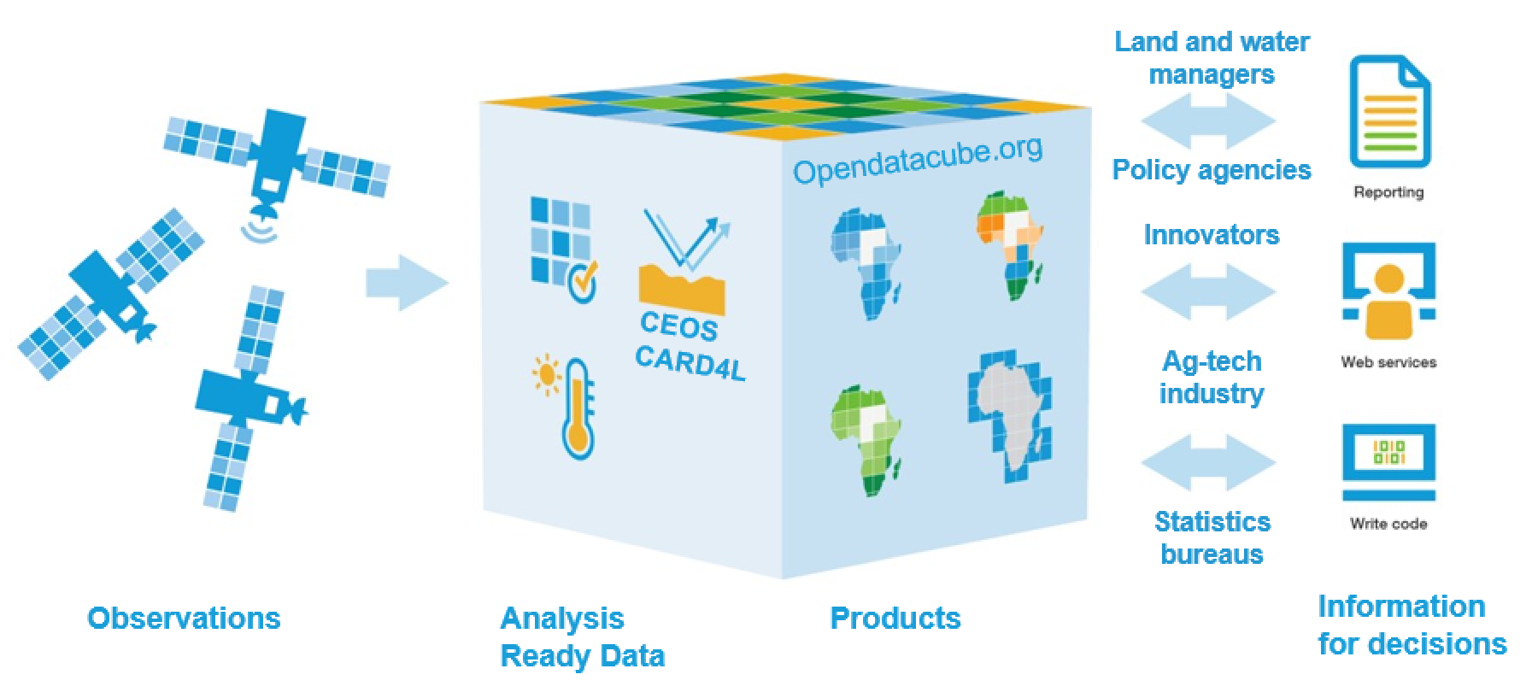
Digital Earth Africa (DE Africa) (A. Lewis)
Reliable supplies of CEOS ARD are vital if Earth Observation is to have impact in Africa, supporting Agenda 2063: The Africa We Want.
Digital Earth Africa is based on the ODC Model
DE Africa has / will use continental ~CARD :
ALOS continental PALSAR mosaics - NRB (JAXA)
Provisional Landsat-Collection-2 - Surface Reflectance (USGS)
From May 4th, Sentinel-2 - Surface Reflectance (*DIY)
From July?, Landsat Collection-2 - Surface Reflectance (USGS)
From Late 2020?, Sentinel-1 - NRB, with Sinergise (*DIY) *DIY = “Demonstrate-It-Yourself”

Slide 35
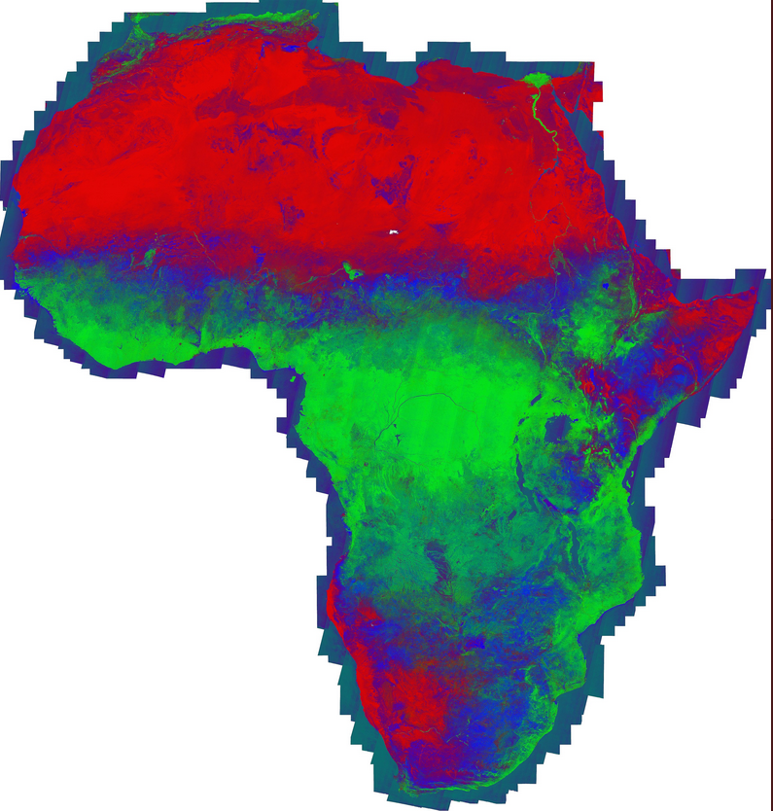
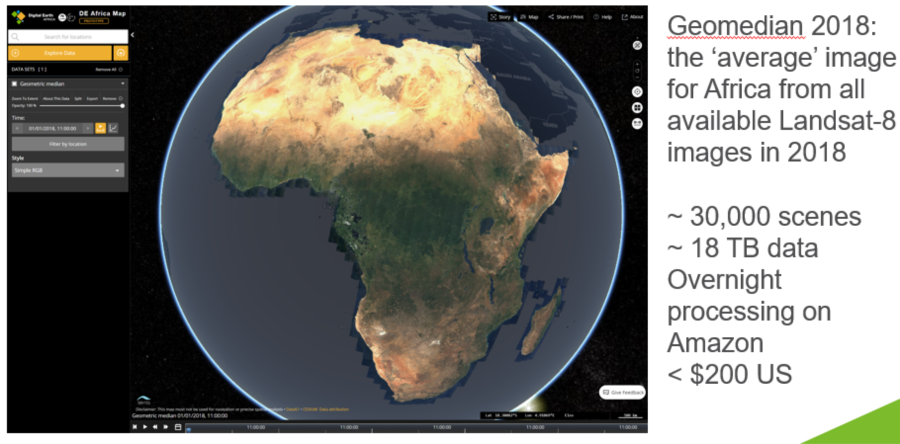
To have impact with EO data, we need to be able to
Produce operational full-resolution products like this: (fractional cover, Peter Scarth, May 2020), or This (median surface reflectance, 2018, DE Africa):

Slide 36
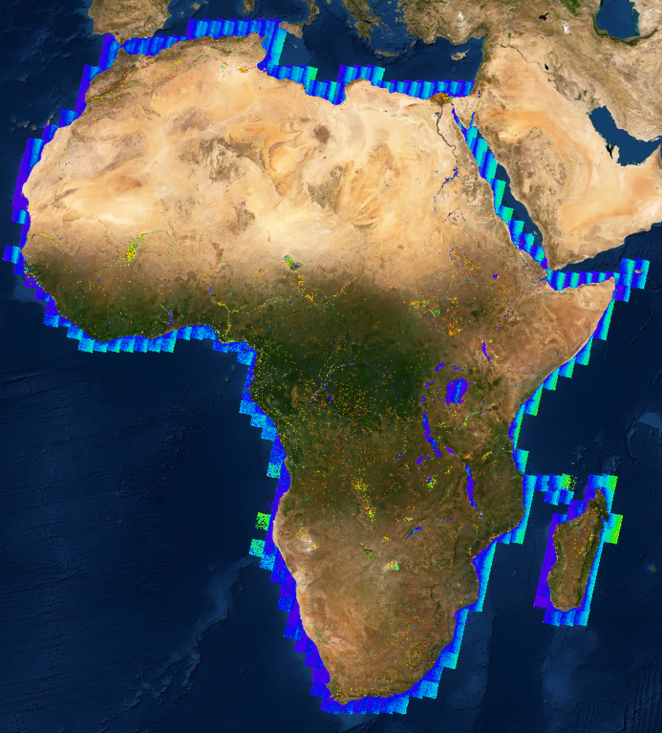
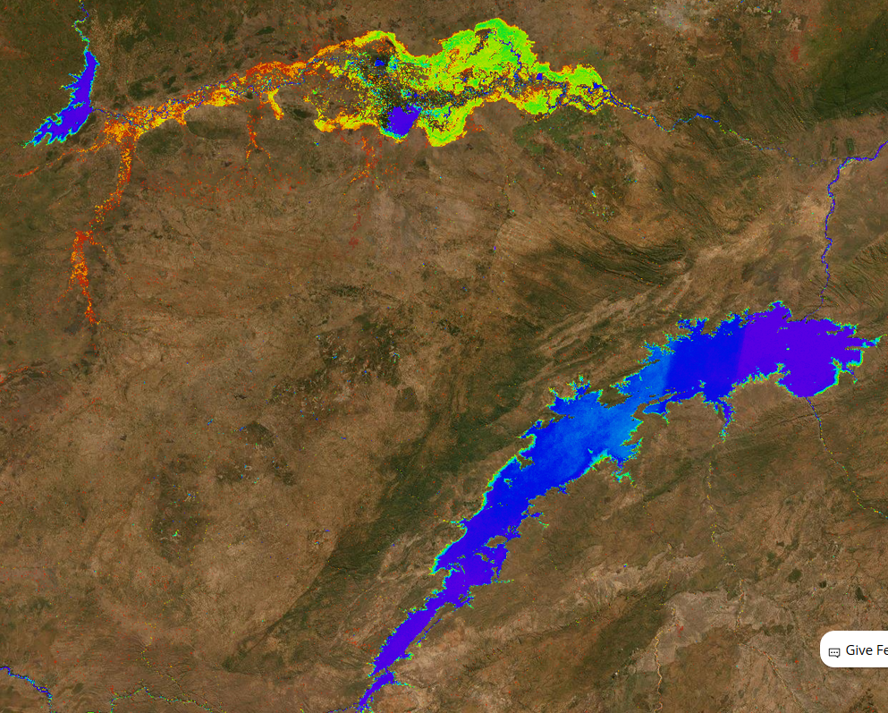
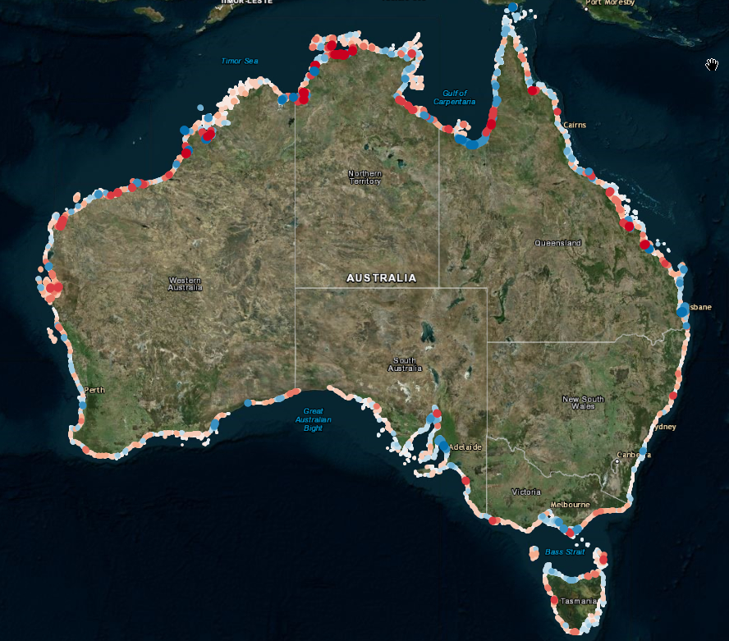
… in order to generate unique continental-scale information
Like this: (automatic, continental water summary, Africa, routinely updated)
Or this: (automatic, continental assessment - measurement - of coastal change, Australia)

Slide 37
… or rapidly produce site-specific information such as:
Like this: (Measuring, and visualising, the area of water, bare soil, dry vegetation, green vegetation through time)

Slide 38
We need CEOS-ARD pipelines!
Sinergise: Access & process
Committing to using USGS Landsat Collection-2
Demonstrating the necessary Sentinel data pipelines:
Free and open data
Full coverage (all of continent, all passes)
Low latency
Consistent processing with authoritative and available methods
Cloud-performant formats (cloud optimised geotiff; STAC)
Cloud-accessible
Assured supply of consistent product
Considering a study of user preferences for levels of processing
Do user behaviours, business models, or case studies indicate that analysis ready data is advantageous to users?
Interested in your views on such a study!
Element-84: File format, COG, STAC, CARD4L?
Amazon: Cloud storage
DE Africa
Data Cube

Slide 39
WGCapD Collaboration
Z. Szantoi

Slide 40
What is Working Group on Capacity Development and Data Democracy (WGCapD)?
Created in 2011, WGCapD undertakes activities based on the four pillars of the Data Democracy Initiative Mission and aims to unify CEOS efforts toward:
Providing wider and easier access to Earth Observation data
Increasing the sharing of software tools such as the use of open source software and open systems interface
Increasing data dissemination capabilities and transferring relevant technologies to end users
Providing intensive capacity building, education, and training (including awareness and outreach) for enabling end users to gather the information they need and for increasing communication on achieved results
Past collaborations between LSI-VC and CapD groups include:
None. CEOS WGCapD has provided training events on agriculture, which is related to GEOGLAM AHT which is now part of LSI-VC.
9th Working Group on Capacity Building and Data Democracy Annual Meeting
Identifying Opportunities for Synergies and Innovation (10 to 12 March 2020)

Slide 41
WGCapD Objectives
Establishing effective coordination and partnerships among CEOS Agencies offering EO education/training
Partner with locally-based partners to increase effectiveness
Use threads to build capacity through discussion of a focused subject (CARD4L?)
Focus on user needs for data and capabilities, including IT infrastructure, to inform actions/plans for delivering the appropriate data and training for the effective use of EO data
Conduct remote sensing workshops and seminars to foster the use of EO and increase workforce capacity
Working with CEOS entities to address data accessibility
Publicize resources, datasets, and software made available to under-served communities
Promote the use of dissemination systems (e.g. GEONETCast and other systems) to effectively reach areas that lack consistent internet access or redundant systems in case of emergencies
Organize workshops and training activities to provide individual and institutional capacity to effectively use available Earth Observation resources
Work with other capacity building networks to build capacity

Slide 42
Opportunities for current and future collaborations
● Planned joint deliverables
○ CB-44: CARD4L Awareness Webinar
○ CB-50: Capacity Development Guidance Document for GEOGLAM
● Future CB Deliverables of interest to LSI-VC:
○ CB-56: SAR training for forest and rice monitoring
○ CB-58: CB support to AGEOS on forest monitoring
○ CB-60: Regional training in South Asia on forest biomass

Slide 43
Seed Questions
Could WGCapD support piloting CEOS ARD? This is in LSI-VC's tasks: "Evaluate CARD4L supply, user access, and user experiences via pilot activities". Feedback based on WGCapD experience is welcomed.
Also, as we are looking for future target products, feedback from the groups WGCapD works with regarding user needs/demand would be helpful.
Possible interest for additional collaboration
CEOS Paper on the Interplay of Industry and CEOS ARD (CEOS ARD Strategy – Item 2.4)
VC-X5: CEOS–Industry ARD Workshop (CEOS ARD Strategy – Item 4.2)
VC-X7: Communication with CEOS ARD Users (CEOS ARD Strategy – Item 4.6)

Slide 44
Wrap-up
M. Steventon

Slide 45
Actions and Decisions So Far...

Slide 46
Actions and Decisions So Far...
Make sure we have a seat at the table for all existing fora: LSI-VC should be directly involved in JACIE, VH-RODA, and IVOS, among others. Leverage these existing meetings as much as possible for CEOS ARD industry engagement.
Actions? Leads to meet with OC for ARD20
Ferran Gascon to follow up VH-RODA organiser Valentina Boccia of ESA to check whether there is the possibility of including more CEOS ARD related topics in support of industry engagement and also whether the meetings might be held more frequently going forward.
LSI-VC Leads to ask the SIT Chair Team for their assistance providing oversight and coordination of CEOS engagement with industry regarding ARD.
There are currently multiple avenues, which may be confusing (IVOS, JACIE, LSI-VC, VH-RODA, etc.)

Slide 47
Actions and Decisions So Far...
Replace CEOS-Industry ARD Workshop with online webinar
Matt to initiate planning for an initial CEOS-Industry ARD webinar, building on the original plan for the workshop and tailoring content to fit the format. This will include preparing presentation materials, compiling a list of invitees, an informational page on the website for advertisement, etc.
Late June
Webinars should be lightweight and invite significant Q&A and discussion
Approximately one hour in duration
Two more webinars will be targeted over the months following
Broaden participation
WGCapD collaboration?
Various offers of support to help distribute the announcement - thanks!

Slide 48
Actions and Decisions So Far...
SR and ST updates shared via the LSI mailing lists last week
https://tinyurl.com/y8empss3
Details on each update:
Surface Reflectance: https://tinyurl.com/y8qxblhd
Land Surface Temperature: https://tinyurl.com/y84ftwmz
Action to please send all feedback to Andreia by May 22.
Virtual endorsement via email targeted for June 2020.

Slide 49
Actions and Decisions So Far...
NRB PFS v4.8 endorsed
USGS to undertake editorial check of NRB v4.8, before advancing the document to v5.0
Matt to post NRB v5.0 on ceos.org/ard

Slide 50
Actions and Decisions So Far...
POL PFS v2.9 endorsed
USGS to undertake editorial check of POL v2.9, before advancing the document to v3.0
Matt to post POL v3.0 on ceos.org/ard
Matt and Ake to revisit action on hosting and linking sample datasets for SAR products.

Slide 51
Actions and Decisions So Far...
Aquatic Reflectance PFS
All to consider nominations for the Aquatic Reflectance PFS Science expert review planned by end-June.
Steve to send Ferran some more information regarding how USGS is handling the Landsat Aquatic Reflectance provisional products and how the approach differs from land cover observations.

Slide 52
Actions and Decisions So Far...
LSI-VC Leads to coordinate a communication from LSI-VC to EC/Copernicus regarding the need for Sentinel-1 NRB CARD4L as a core product, citing examples of various ‘ad hoc’ efforts ongoing to create Sentinel-1 NRB CARD4L – as evidence of demand for this type of product.
Zolti to confirm best approach.
Brian and Adam to share their examples (e.g., Sinergise, DEAfrica, other use cases) to help inform
Convincing Copernicus services of utility could be another approach
Steve/USGS to follow up NASA LSI-VC contacts regarding the possibility of assessing MODIS and VIIRS products against the CARD4L specifications.

Slide 53
Actions and Decisions So Far...
Andreia to set up a telecon between the LSI-VC Leads and WGCV contacts to review the points on slide 55 of the LSI-VC-9 Telecon #3 presentation (Summary of Feedback from CARD4L Evaluation)
Steve to share USGS Collection 2 work done around COG and STAC (including the format study, slides from ARD19) to support other agencies interested in working in this direction (e.g., ESA/Ferran, EC/Zolti) – including any user feedback / examples of demand. Inputs from others also welcome.

Slide 54
Revisiting Some Decisions and Discussions...

Slide 55
Revisiting Some Decisions and Discussions...
On standardisation:
A best practices document through OGC could be a good middle ground
Standards process seems like a big investment, and it isn’t clear it will definitely help us achieve our goal (uptake and impact)
Standards don't necessarily keep pace with current innovation rates
“Pseudo-standards” which fill a gap are just as valued and used (e.g., the WGCV Protocols)
DECISION NEEDED

Slide 56
Revisiting Some Decisions and Discussions...
On industry engagement:
JACIE
Additional JACIE 2020 topics if there is something we would like to raise related to CEOS ARD?
Possibility of bringing the JACIE and Planet ARD workshops closer together?
ACTION?

Slide 57
Revisiting Some Decisions and Discussions...
DECISION: Do we need to consider adding ‘Advisory Notes’ as a fourth component of the CARD4L Framework to address data policy, data formats, interoperability, etc.?

Slide 58
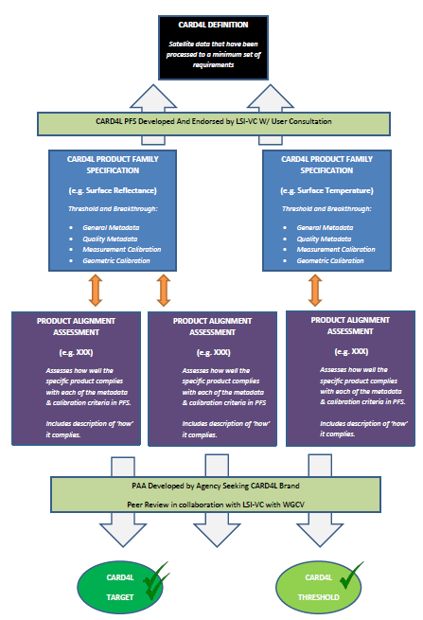
LSI-VC CARD4L Framework http://ceos.org/ard/
Analysis Ready Data is about improving interoperability ->
(comparability of observations through time, between instruments, and across space)
Product Family Specifications ask that we deliver a geophysical measurement, at a known place and time, and with known uncertainty or methods.
But is that enough? So far we have set certain questions to one side:
Data policy
Data supply assurance
Data format
Data interoperability
Standards
“So with that general context, in the paper itself I think "Section 3.2, Matters Not Covered in the Specifications" undermines the whole goal of ARD. “

Slide 59
CARD and Interoperability
For ocean and atmosphere communities (GHRSST), the need is less on the measurement and more on some of these other aspects:
Data policy
Data supply assurance
Data format
Data interoperability
Standards
The ‘IT innovators’ (Radiant, Planet, Element84, etc.) are evolving standards for data formats and catalogs that support machine to machine interoperability and performance in the cloud:
Cloud Optimised GeoTiffs (COG)
Spatio-Temporal Asset Catalog (STAC)

Slide 60
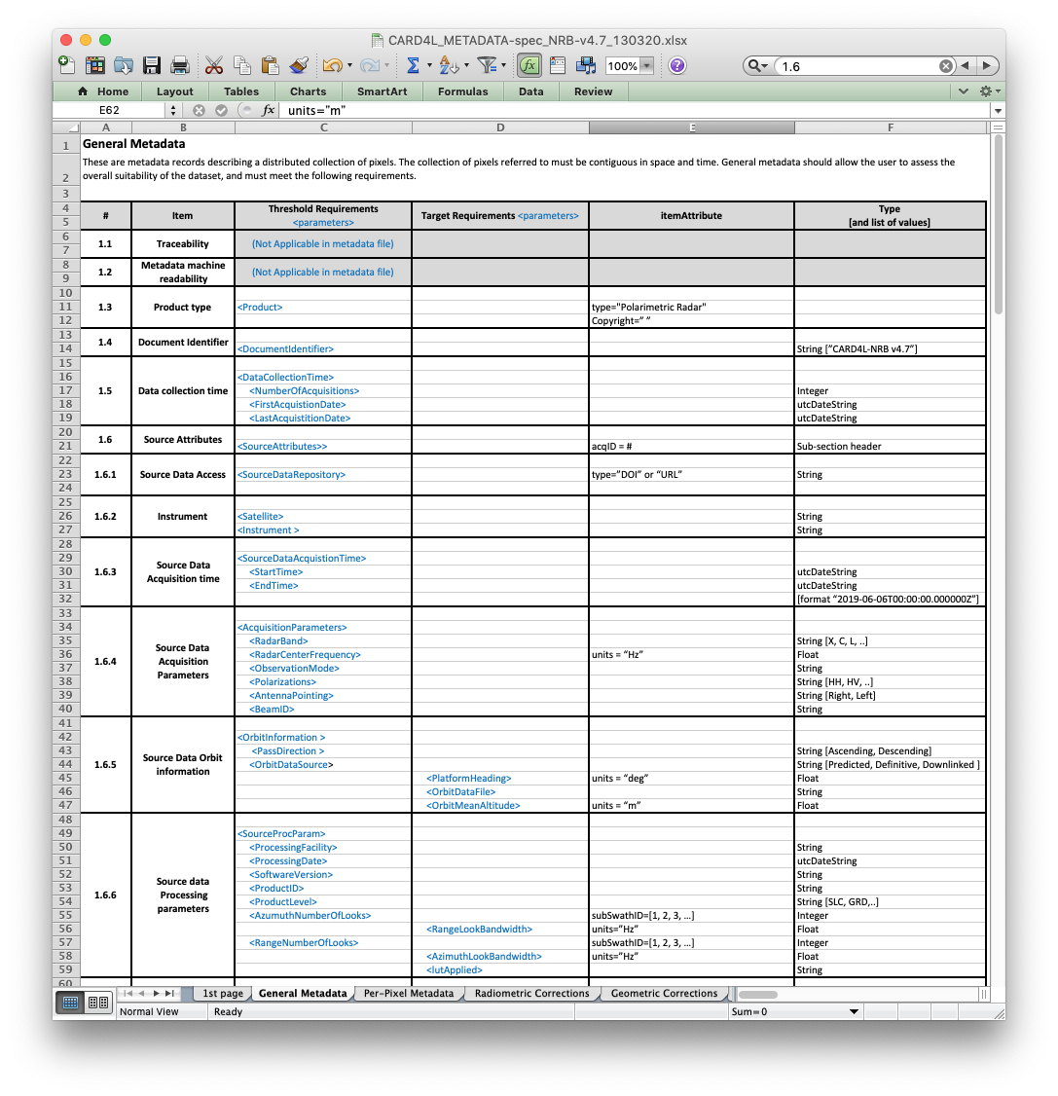
CARD4L SAR
NRB Metadata Specs
Metadata Specifications
Metadata specification developed to accompany the NRB PSF
Specs for XML format but data provider may select other metadata formats (yaml, json, etc.)
Non-mandatory (Target req.)
Alignment with IEEE or ISO standards to be considered (possibly by LSI-VC-11 – TBC)

Slide 61
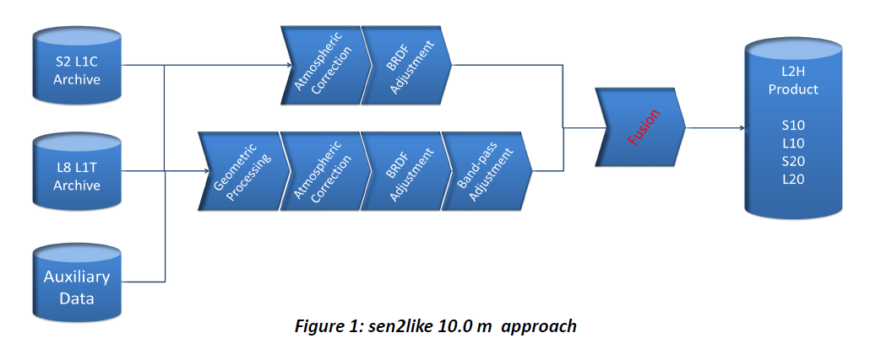
CARD and Interoperability
Interoperability (Sen2Like, HLS) needs this …
CARD4L stops here

Slide 62
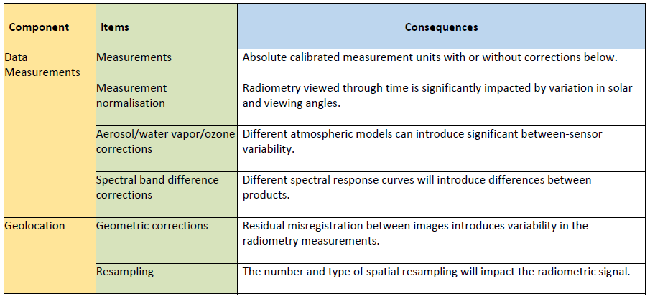
CARD and Interoperability
Interoperability consequences
MRI study looks at the interoperability consequences of our decisions

Slide 63
LSI-VC CARD4L Framework http://ceos.org/ard/
What do we need to add to this framework?
NOT proposing to change the PFS
Industry paper:
“Although the matters above are not included in the CEOS specifications, given their importance both within CEOS and to industry and other stakeholders, CEOS may choose to address them within the broader CEOS Strategy for ARD. For example additional advice elements could be included alongside the specifications, and indeed the Radar specifications are already including such advice. Advice might relate for example to preferred data formats, or to the use of Spatio Temporal Asset Catalogue (STAC), to open data licences, or to the provisioning of data as ‘on-demand’ v. ‘pre-processed’. “
Who should we work with - in CEOS. Outside CEOS?

Slide 64
Revisiting Some Decisions and Discussions...
On accommodating lower and higher resolution datasets under the existing PFS:
Clearly a need to revisit the specifications in this regard
Don’t see this being a major departure from what has been established, rather a small tweak to what we already have.
The PFS have, to date, been resolution agnostic and we wouldn’t wish to move away from that approach.
DECISION NEEDED

