Slide 1

Future Data Access & Analysis Architectures (FDA)
Ad Hoc Team (AHT)
Committee on Earth Observation Satellites
FDA AHT Co-Leads
Steve Labahn, USGS
Nick Hanowski, ESA
Alex Held, CSIRO
2017 CEOS Chair Initiative
SIT-32 Agenda Item #8
ESA Headquarters – Paris, France
26th-27th April 2017

Slide 2

FDA AHT Objectives
CEOS FDA AHT was initiated at the 2015 CEOS Plenary meeting and was tasked with developing a report on the current status of data supply, access, processing, and delivery to provide guidance to CEOS on the potential that new high-performance, cloud-computing technologies can provide.
2016 FDA AHT assessed the potential of new technologies and approaches to bridge the gap between the enormous volumes of Earth Observation (EO) data and the users developing applications to tackle key environmental, economic, and social challenges.
2017 FDA AHT continuing the excellent work from 2016 by pursuing pilot architectures, obtaining end user feedback / best practices / lessons learned, generating CARD4L products, and addressing strategic questions:
  What should CEOS agencies do together?
  When should CEOS focus on supporting agencies to do their own things better (e.g., best practices)?
  What should be ‘outside scope’?

Slide 3
Significant Change…
Significant Opportunities
  FDA Driving Themes:
  Satellite data volumes and variety are increasing
  Satellite data demand and expectations of EO value are increasing
  Users want data systems and analysis tools that allow easy access and use of satellite data
  Many users desire ARD to minimize data preparation time and knowledge requirements
  Substantial growth expectation in the EO based digital economy across Industry and Government
  Step change in EO satellite capability leading to new applications
  Freely available data and Cloud computing combine to create new industries
  New applications from new capabilities in EO
  Increased awareness leads to more (non-EO expert) users
  Users expect near real-time, locally relevant EO derived information
  Higher spatial resolution
  Greater diagnostic capability through increased spectral resolution (hyperspectral) and new modalities (active and passive radar)
  New capabilities in monitoring through increased acquisition rate and through new payloads (e.g. altimetry, atmosphere)

Slide 4
FDA Strategic Assessment
One of the 2017 FDA AHT’s key tasks is to establish a consensus on ‘What’ the CEOS strategic focus should be for future data access and analysis architectures
In February 2017, an FDA Strategic Assessment Survey was distributed
  Responses were received from 14 organizations (CNES, CSA, CSIRO, DLR, EC, ESA, EUMETSAT, GA, INPE, ISRO, UKSA, USGS, CEOS SEO and CEOS WGISS)
  Questions included: What should agencies do together or alone? What actions have the greatest potential benefit? What are the most significant barriers?
Many common responses and desires
  Simplify EO data uptake and application for many users
  Definition and automated delivery of interoperable ARD (e.g., CARD4L)
  Exploit cloud computing for storage and processing (e.g., exploitation platforms and data cubes)
  Algorithm portability
  Solutions that enable scalability from local (e.g. institutional) to global
  Open source tools alongside commercial – complementarity

Slide 5
FDA
‘What’ should CEOS members do jointly?
Pursue CARD4L interoperability by:
  Proceeding with systematic generation of CARD4L-compliant products for optical data (e.g., S2, L8)
  Developing examples of CARD4L-compliant SAR products reflecting user demand
  Exploring further development of ARD-on-the-fly production through data handling tools
Develop interoperable Open Source tools to stimulate satellite data use enabling exploitation of EO data and to build local, national, regional, and global capabilities:
  Coordinate development of data and computational infrastructures ensuring complementarity and interoperability across CEOS agencies (e.g., EU DIAS, CEOS Open Data Cubes, AGDC, LCMAP)
  Instantiate data cubes engaging key GEO initiatives (such as GFOI and GEOGLAM) and user agencies to ensure scalability/sustainability of user-defined analysis workflows
Capture user feedback and user statistics on FDA implementations in a structured way which allows analyses and extraction of lessons learned
Ensure availability and promote uptake of data and processing standards when appropriate and implement standardization when necessary
Adapt the potential FDA solutions to the profile of diverse users accommodating analytical processing capabilities

Slide 6


Future Data Architectures
Overview
Data & Information Access Service
(DIAS)
[on behalf of EC Copernicus]
Exploitation Platforms = virtual working environments
→ user only needs a web interface
EO mission #1
data products (e.g.
Level 1, L2 products)
Thematic Exploitation Platforms (TEPs)
(Forestry, Geohazards, Urban, Hydrology, Coastal, Polar, Food Security)
ARD
Few enabling interoperable EO Data Platforms
(i.e. data storage
+ data processing capabilities)
could hold global datasets or regional datasets,
coordinated at CEOS and GEO level
Visualisation tools
Visualisation tools
+ basic data analytics
EO mission #2
data products (e.g.
Level 1, L2 products)
image visualisation
basic image rendering
image mosaicking
Visualisation tools
+ data analytics
for expert communities
Heterogeneous missions
(i.e. not only optical
EO data)
- Product algorithm lab
Data reprocessing
Data validation tools
number of users
ARD
Data Cube = particular instantiation of an exploitation platform focused on deep time series analysis
ARD
same type of EO data in a common geometric grid
time series analysis
machine learning
EO mission #n
data products (e.g.
Level 1, L2 products)
ARD
ARD
[general public]
[e.g. public services]
[e.g. scientists]
increasing platform complexity/flexibility
ARD could be generated as input to the data platforms, but also as a tool within the dedicated virtual working environments for specific tailoring

Slide 7
Measuring Success
By CEOS agencies working together on the agreed FDA actions described on slide 5 (the “what”), the following outcomes will be realized:
The number of users able to engage with EO data, with less need for expertise in ‘satellite data’, and use multi-mission/multi-agency data ‘by default’ WILL INCREASE
The range of technologies available to meet diverse user needs – both as open source and commercial WILL INCREASE
Collaboration and sharing of new products, algorithms, techniques and services that exploit satellite EO data between users and intermediaries (e.g., product developers) WILL INCREASE
The number of sustainable operational exploitation environments for GEO and other user-lead initiatives, the quantity of data collected, and the methodologies developed WILL INCREASE
Due to the availability of data, the tools to use it, the reduction of sovereign risks, and targeted capacity building, the number of countries integrating EO data into critical decision processes WILL INCREASE

Slide 8
LSI-VC CARD4L Background
The Land Surface Imaging Virtual Constellation (LSI-VC) was tasked (Nov 2015) to “Define intercomparable Analysis-Ready Data (ARD) products within the context of land surface imaging”.
CEOS Analysis Ready Data for Land (CARD4L) are satellite data that have been processed to a minimum set of requirements and organized into a form that allows immediate analysis with a minimum of additional user effort, and, interoperability both through time and with other datasets.
CARD4L is intended to lower barriers to use and engage new communities of users. CARD4L will underpin many CEOS activities including Data Cubes and other future data distribution architectures.

Slide 9
LSI-VC CARD4L Framework
The high-level definition of CARD4L was endorsed at CEOS-30.
CARD4L Product Family Specifications (PFS) detail threshold and target requirements for specific product types. 3 are being prepared for SIT TW (surface reflectance, land surface temperature, SAR backscatter).
A CARD4L Assessment Framework will be developed to aid the assessment of product compliance.
In 2017, LSI-VC is also coordinating the trial production of CARD4L for the CEOS Future Data Architectures pilots.

Slide 10
Pilot Projects
Location | Colombia | Switzerland | Vietnam | USA | Europe [global location] | Australia AGDC + Industry Hub
CEOS Lead | SEO (Brian K.) | SEO (Brian K.) | CSIRO (Alex H.) | USGS (Brian S.) | ESA (S. Loekken) | CSIRO, GA (Rob, Adam)
Partners | IDEAM | UN-GRID Geneva | VNU, VNSC | BU, USGS EROS | Forest: Mexico, Finland Urban: DLR Geohazards: CEOS DRM, INGV | NCI
User agencies | Colombia Gov. | Swiss Gov. | FIPI, Vietnam Govt. | U.S. Gov. and Public | Researchers and value-adders | Australian Govt., Industry, and Public
Application(s) | Forest (GFOI), Change Detection (CCDC, BFAST), Water | Land Change, Water | Water, Agriculture, Disasters, Forestry (priority order) | LCMAP and CCDC (6 national test sites) | Forestry TEP Urban TEP Geohazards TEP | Land Change, Water
ARD requirements | L-5,7,8, MODIS, SRTM/ASTER Future: S1, S2 | L-5,7,8. Future: S1, S2. | L-5,7,8 + S1 + ALOS-1/2. Future: S2 | L-4,5,7,8 S-2 (future) Resourcesat-1, -2 (future) | S1, S2 Envisat, ERS, L-5,7,8, (+ Eur EO data) | L-5,7,8, MODIS, S-1,2, SRTM
Other Information | Open Source AWS Demo Analysis to Data | Open Source AWS Demo Analysis to Data | Open Source AWS Demo Analysis to Data | Data Download | Open Source Analysis to Data | Open Source Analysis to Data

Slide 11

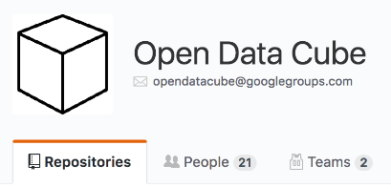
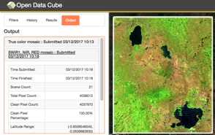
CEOS Open Data Cube
Based on an open source operational system: Australian Geoscience Data Cube (AGDC)
Open Data Cube, is a comprehensive solution that builds the capacity of global users to apply CEOS satellite data
Based on Analysis Ready Data (ARD) products that contribute to the increased uptake and impact of growing data volumes
Coordination between GA, CSIRO, NASA, USGS to manage an open source software repository: https://github.com/opendatacube
Scalable solution targeting 20 countries by 2022 with the support of key global stakeholders (e.g., GEO, World Bank)
Current prototype testing in Colombia, Switzerland, and Vietnam with more planned
Free/Open demo available on Amazon AWS with 14 sample data cubes and 7 applications: http://www.tinyurl.com/datacubeui

Slide 12
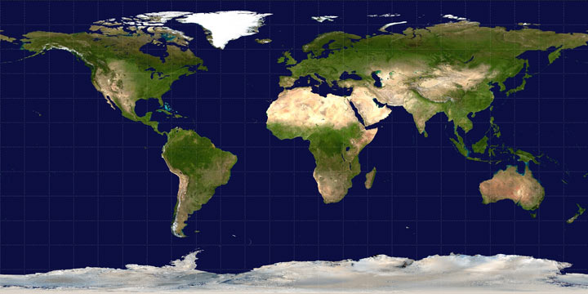
Growing a Network of Compatible Open Data Cubes
AWS Demo
Fully Operational
Under Development
Planning Phase
Under Review
Expressed Interest

Slide 13
Next Steps
With CEOS SIT-32 concurrence on the ‘What’, the FDA AHT will work on the ‘How’ and ‘When’ next steps from the Strategic Assessment
  To be proposed and refined at 2017 CEOS SIT TW
  To be finalized and briefed at 2017 CEOS Plenary
Continue working with CEOS space agencies on provisioning of CARD4L-compliant products, supporting the pilot projects
  Explore other VC’s interest in participating beyond just land (marine, atmosphere, etc.)
Engage user community on pilot projects and obtain feedback
Document lessons learned and develop best practices

Slide 14
Background Material

Slide 15
FDA Strategic
Assessment Questions
What should CEOS agencies do together?
What should CEOS encourage that individual agencies do better on their own (e.g., best practices, etc.)?
What should be considered ‘out of scope’ for CEOS?
Which aspect of FDA has the biggest potential to transform how satellite data is exploited?
When you first read the interim report, what struck you as the action CEOS should most urgently take in the FDA area?
Which of CEOS’s strategic priorities could benefit most from the application of FDA?
From the perspective of a user, where is coordinated effort by CEOS agencies on FDA most critical?
What is one thing your agency is already doing in this area that you would like to see contribute to future CEOS efforts in this area?
What could be the key blockers that prevent your agency from participating in CEOS efforts to promote the benefits of FDA?
What might be the main technical barriers?

Slide 16
FDA User Summary
What are the user categories and their characteristics?
# | User Type | Examples | Data Volume | Knowledge Capacity | Computing Capacity | ARD Requirement
1 | General Public | Developing Countries, New Users | Low | Low | Low (PC, cluster) | Typically desired
2 | Public Services | Copernicus services Google/AWS | High | Medium to High | High (cloud, HPC) | ARD welcomed though they will grab what is available
3 | Scientists | Researchers, Analyses | Low to High | High | Medium (PC, cluster, cloud) | Varies … some desire ARD, others do not

Slide 17

Visualizing Future Data Architectures
→ related activities at ESA / EC
Data & Information Access Service
(DIAS)
[on behalf of EC Copernicus]
Exploitation Platforms = virtual working environments
→ user only needs a web interface
EO mission #1
data products (e.g.
Level 1, L2 products)
Mission toolboxes
(e.g. Sentinels)
Thematic Exploitation Platforms (TEPs)
(Forestry, Geohazards, Urban, Hydrology, Coastal, Polar, Food Security)
Thematic Exploitation Platforms
(Forestry, Geohazards, Urban, Hydrology, Coastal, Polar, Food Security)
ARD
Few enabling interoperable EO Data Platforms
(i.e. data storage
+ data processing capabilities)
could hold global datasets or regional datasets,
coordinated at CEOS and GEO level
Visualisation tools
Visualisation tools
+ basic data analytics
Proba-V
Mission Exploitation Platform
Visualization services
(e.g. Sentinels, Heritage missions)
EO mission #2
data products (e.g.
Level 1, L2 products)
Visualisation tools
+ data analytics
for expert communities
Heterogeneous missions
(i.e. not only optical
EO data)
- Product algorithm lab
Data reprocessing
Data validation tools
number of users
ARD
image visualisation
basic image rendering
image mosaicking
same type of EO data in a common geometric grid
time series analysis
machine learning
ARD
EO mission #n
data products (e.g.
Level 1, L2 products)
Sentinel-2 L2A
ARD
ARD
Data cube projects in Europe
+ related technology developments
[general public]
[e.g. public services]
[e.g. scientists]
Joint ESA/NASA BIOMASS/NISAR Missions Exploitation Platform
[future project]
increasing platform complexity/flexibility
ARD could be generated as input to the data platforms, but also as a tool within the dedicated virtual working environments for specific tailoring

Slide 18
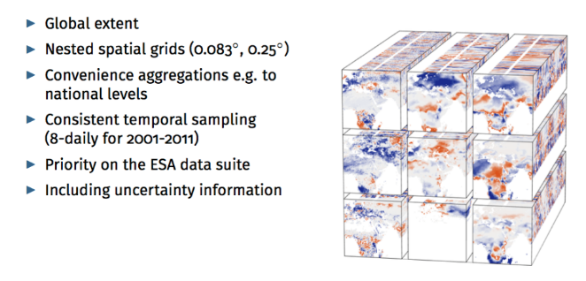

Data Cube Projects in Europe
Non-exhaustive list
EarthServer
European Optical HR Data Cube
www.earthserver.eu
eodatacube.eu
EarthServer delivers new services by enhancing existing data archives with flexible, scalable query functionality, whose results will form a substantial contribution to GEOSS and Copernicus.
Services cover several scientific domains with distinct data and end user requirements.
EarthServer builds upon a consortium that consists of Europe’s leading data centers large-scale trans-European facilities and technology oriented SMEs.
EarthServer provides distinct entry points for the different domains and showcases a combined federated service, allowing scientists to query/analyse multiple Petabyte scale datasets spread over multiple data providers using a single query, a truly novel service.
Operational Data Cube facility hosted at EODC (Vienna) and operated by MEEO (Italy)
Powered by RASDAMAN
Available since July 2016
Data Coverage:
      Image2006 Reference Dataset
      Europe/N-Africa Landsat TM time series starting L4
      Europe/N-Africa Landsat-8 L1T available in NRT
      S-2/other Third Party missions planned
Fully OGC-compliant WCS and WCPS service available
Earth System Data Cube
earthsystemdatacube.org

Slide 19
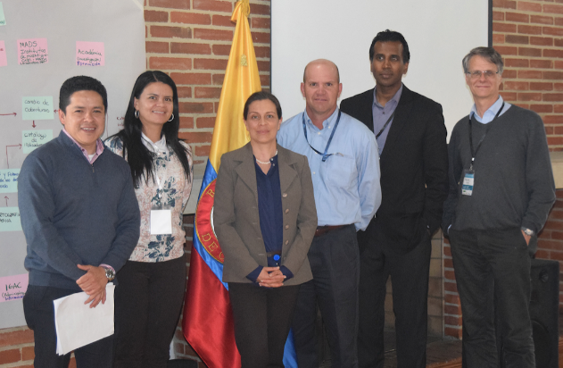
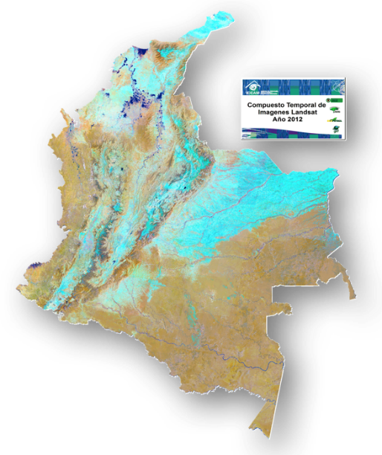
Colombia Prototype
The Government (IDEAM) and University (Andes) have made considerable progress in learning how to create and use Data Cubes!
A complete country-level Landsat Data Cube (25,000 scenes back to year 2000) was completed in Dec 2016.
Forest mapping and land change detection are the primary application needs.
Future plans to add more datasets and applications.
The SEO will continue to support IDEAM and the University of Andes in the coming year.

Slide 20
Colombia Actions
Issues running WOFS (memory overload).
Desire to merge SEO UI and Colombia UI.
Cloud mask issues (CFMASK). Colombia to provide GeoTIFF (input), GeoTIFF (output) and cloud mask samples. SEO to explore “machine learning” options.
SEO to help Colombia test the median mosaic algorithm on their Data Cube.
SEO to explore WMS data cube links to QGIS.

Slide 21







Switzerland Prototype
SEO was approached by UNEP GRID Geneva and the Univ. of Geneva to develop a Data Cube pilot project. Significant computing and programming resources exist, so little effort was needed to get them started.
SEO visited UNEP GRID Geneva on February 14 to discuss the progress of the project. The group has made excellent progress installing a small data cube within the country and attaching the application user interface.
The meeting resulted in several actions that the group will pursue in the coming year. These actions are focused on Landsat data, data cube creation, and application testing.

Slide 22
Switzerland Actions
SEO will ask USGS about missing Landsat data from 1991-1998
SEO will investigate how to remove portions of a Data Cube (time or space)
SEO will modify the ingestion code to allow use of the Swiss geographic projection
SEO will provide methods for parallel processing during ingestion and analysis
SEO will investigate adding the Pan Band (15m) to the Landsat ingestion code
Swiss team will investigate modifying the SLIP landslide code to use the Swiss DEM
Swiss team will test and validate the WOFS algorithm results over mountain/snow regions
Swiss team will investigate removing mountain shadows using DEM data. May improve WOFS?
Swiss team to identify potential users of Sentinel 1 data

Slide 23
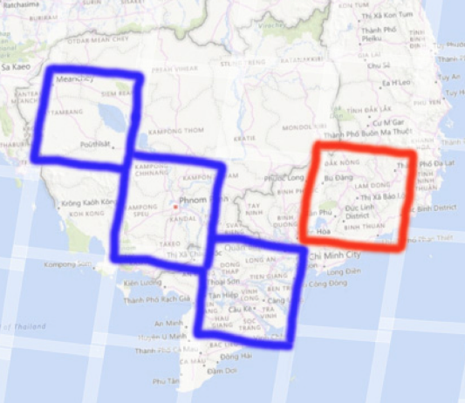
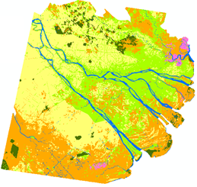
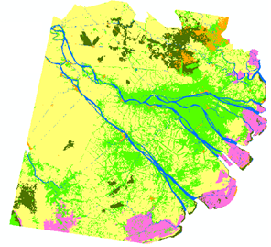
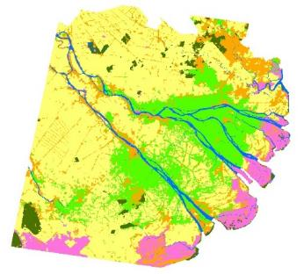
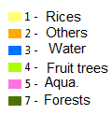
Vietnam Prototype
SEO and CSIRO developing plans for a Vietnam Data Cube. The primary applications are rice and water management.
Two sample data cubes are under development with links to SERVIR (blue) and GFOI (red).
BLUE: Mekong Basin cube for Cambodia and Vietnam for SERVIR testing.
RED: Vietnam cube to support initial deployment training and a data interoperability study.
Datasets include: Landsat-7 (2000-2016), Landsat-8 (2015-2016), Sentinel-1 (2015-2016), JERS mosaic (1996), ALOS mosaics (2007, 2008, 2009, 2010, 2015, 2016).
1996
2005
2014

Slide 24
Vietnam Plans
Coordination between CSIRO, SEO, and Symbios to hire a Python programmer and complete the first local deployment in April.
SEO to put ARD and processed Data Cubes on a disk for delivery to Vietnam at the April GFOI meeting.
SEO to put SERVIR (Mekong Basin) and Vietnam (Ho Chi Minh City) Data Cubes on Amazon (AWS).
SEO will provide face-to-face training in Hanoi for a Vietnam Python programmer.
Vietnam will investigate putting their S1 rice monitoring code into Python and release to the Data Cube open source community.

Slide 25
Open Data Cube
Lessons Learned
The Open Data Cube pilot projects have resulted in a number of key “lessons learned” that will improve the success of future deployments, which include:
Users want “customer service” and on-demand help to resolve issues, especially during initial deployment
Users prefer ARD to reduce processing burden, but they still have many issues getting old or new data
Most users want to use QGIS as their GIS tool
Switzerland has a preferred DEM, that is local, not public
Colombia has issues with cloud masking and does not like the standard Landsat CFMask flag

Slide 26
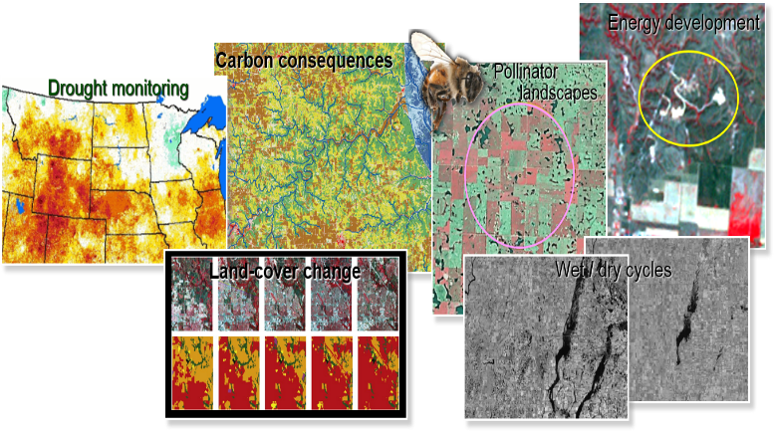
USGS Land Change Monitoring, Assessment, and Projection (LCMAP)
A capability to continuously track and characterize changes in land cover, use, and condition and translate such information into assessments of current and historical processes of change as a science foundation to support evaluations and decisions relevant to environmental management and policy
Basic foundational elements include:
  Analysis-Ready Data (ARD) archive
  Land change and land cover data derived from all available cloud- and shadow-free pixels
  Independent reference data for validation and area estimation
  Assessments focused on land change processes, characteristics, and consequences
  Scenario driven projections of future LULC extents and patterns

Slide 27
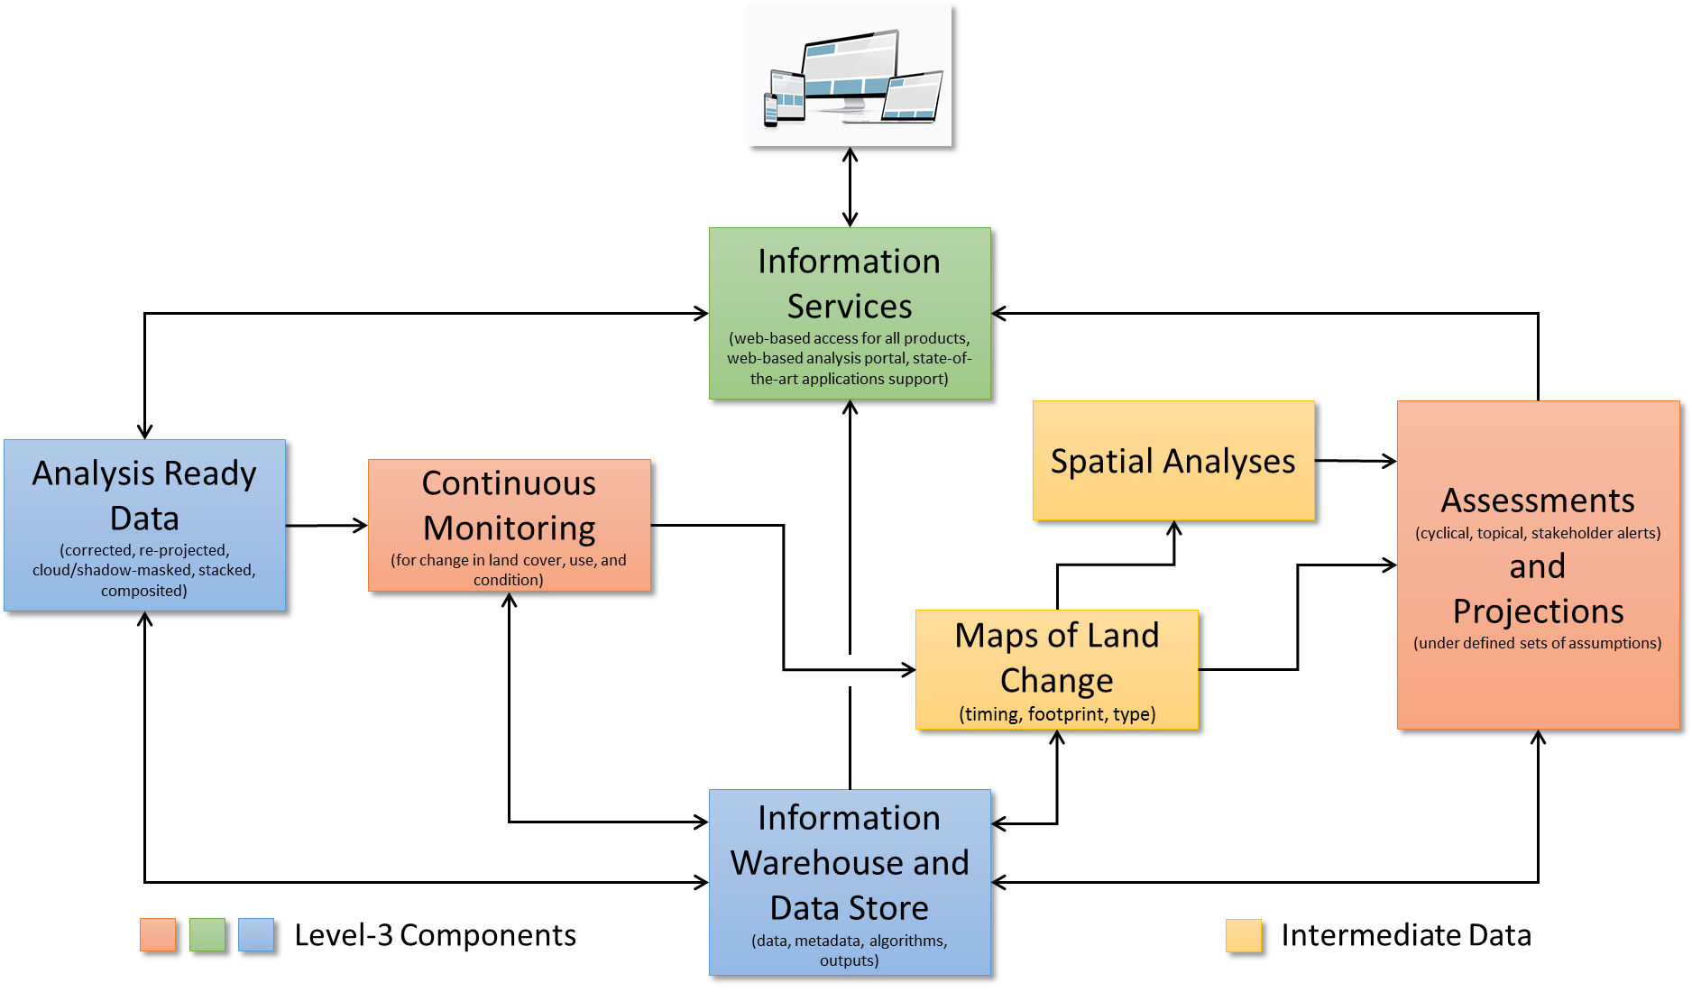
LCMAP System Schematic

Slide 28
LCMAP Status & Plans
System Status
  Information Warehouse and Data Store
    Using Cassandra in-house in hybrid cloud environment to store U.S. ARD
    API (RESTful interface) developed for access to ARD
    Ingested Landsat ARD over six U.S. test sites
    Plan to ingest the full U.S. ARD in the upcoming months
  Science Execution Environment
    Using MESOS, Marathon, and other tools in-house in hybrid cloud environment
    Currently running Continuous Change Detection to generate products for science evaluation over six U.S. test sites
    Plan to produce an initial set of U.S. Land Change Products this year
  Access and Exploration
    Using Time-series Tools (TSTools), QGIS, ARC GIS for evaluation and verification of products
    Plan to place Land Change Products into Earth Explorer for download (https://earthexplorer.usgs.gov/)
    Evaluating use cases for pixel-level public access of ARD and derived products
Contributing to Open Data Cube in collaboration with SEO, GA, and CSIRO
  Considering Open Data Cube architecture for global capabilities and future U.S. data cube expansion

Slide 29
LCMAP Lessons Learned
To ensure that the systems, products, and information meet end-user needs and are of the expected quality, obtaining user input and incorporating a robust product evaluation and validation process is critical.
  User involvement is critical and products need to be evaluated through a robust process to obtain the desired benefits.
The technology and systems necessary to ingest, warehouse, and allow access to pixel-level satellite data can become quite complex. System scaling and the effort required to develop these architectures should not be underestimated. Incorporating many new technologies at the same time increases risk and can delay results.
  Across the CEOS community, we need to work together rather than everyone doing their own thing.
  Consider implementation phasing.
The traditional distinctions, or boundaries, between product generation and storage, access and visualization, and delivery (of results) have clearly changed.
  Architecture and teaming approaches must shift to meet demands.

