Slide 1
CEOS / WGCV / ACSG Activities
Jean-Christopher Lambert and Bojan Bojkov
CEOS WGCV Plenary # 42
USGS, Sioux Falls, SD
May 16-19, 2017

Slide 2
What is CEOS / WGCV / ACSG?
The CEOS Working Group on Calibration and Validation (CEOS/WGCV) Mission is to ensure long-term confidence in the accuracy and quality of Earth Observation data and products and provide a forum for the exchange of information about calibration and validation, coordination, and cooperative activities.
The CEOS WGCV Atmospheric Composition Sub-Group (CEOS/WGCV/ACSG) Mission is to ensure the accurate and traceable calibration of remotely-sensed atmospheric composition radiance data and validation of higher level products for application to atmospheric composition and in conjunction to climate research.
Notes:
Good cooperative activities with GAC in US, WMO/SCOPE-CM and EC-FIDUCEO

Slide 3
AC-VC Linkage
Interaction with CEOS AC-VC since WGCV-41
ACSG contributes validation support to cross-agencies harmonization efforts in all AC-VC key topics
Protocols for harmonization of data validation, incl.:
Advances in error assessment of ozone trend estimates (SI2N) and follow-on SPARC activities
AC-VC/ACSG formulation of Geophysical Validation Needs for the future GEO-AQ Constellation (2nd iteration ongoing)
Participation in AC-VC-12 in 2016/10 at Yonsei U. in Seoul: Air Quality Constellation, Ozone Trends, GHG Constellation
Participation in ACVE-5 at ESRIN 2016/10
Participation in AC-VC-13 in 2017/06 at CNES HQ (Paris)

Slide 4
GSICS Linkage
Interaction with GSICS
Joint GSICS GRWG-UVSG / CEOS WGCV ACSG Workshop on Calibration in October 2015 at NOAA (College Park)
GSICS-EP17 in June 2016 in Antibes
Possible areas of common interest:
Solar spectrum: Work together to include the UV-Vis aspects/needs for the new CEOS WGCV solar spectrum recommendation.
Calibration in the UV-Vis: Avoid duplication in Level-1 work and benefit from independent/standardised Level-2 product validation activities (i.e., develop best practices for the L2➜L1 feedback for the calibration).
Atmospheric characterisation: Work on methodologies (forward calculations), selection of “target areas”, integration of Fiducial Reference Measurements, radiative transfer intercomparisons, etc.
See GSICS UV WG report on Thursday

Slide 5
FRM for Atmospheric Composition
Support / develop Fiducial Reference Measurements (FRMs) for atmospheric composition
Support the calibration, harmonization, traceability, characterization and documentation of major validation data sources
Development of PANDORA/PANDONIA
Development of new (low-cost) instrumentation
In cooperation with networks and other coordinating bodies: EARLINET, GAW/WMO, GRUAN, NDACC, TCCON…
Suite of ESA FRM projects
EU QA4ECV and GAIA-CLIM projects: 40+ EU partners + involvement of ACSG, ESA, EUMETSAT, NASA, NOAA, WMO/Space
Copernicus CAMS and C3S FRM procurement contracts with support to FRM related work

Slide 6
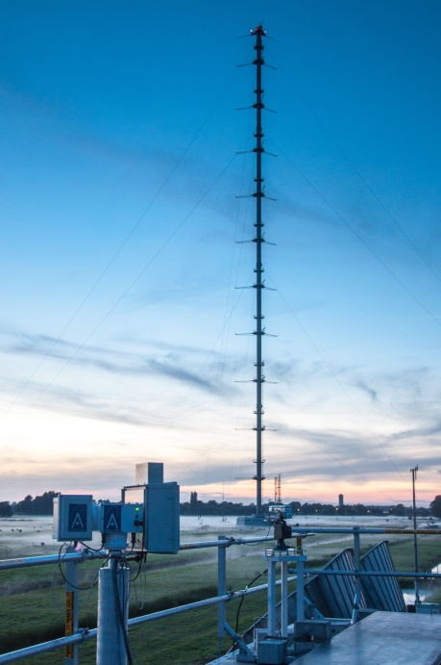
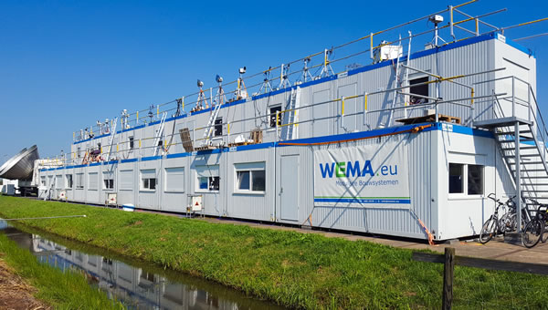
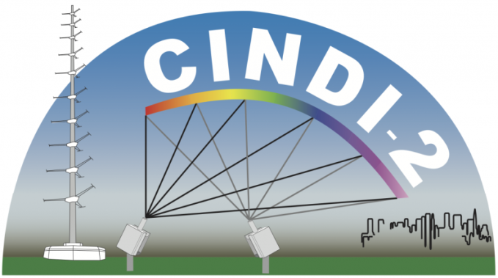
FRMs for Atmospheric Composition
CINDI-II Campaign
Cabauw (NL), September 2016
40 MAX-DOAS (30+ groups) + ground-/balloon-based: Pandora, sondes, lidar, in-situ, aerosols
Satellites: OMI, GOME-2A/B
Preparation of S-5p validation: NO2, HCHO, SO2…
NDACC certification campaign for (MAX-)DOAS
Funding: NSO, ESA FRM4DOAS, EU QA4ECV, others
http://www.tropomi.eu/science/cindi-2

Slide 7
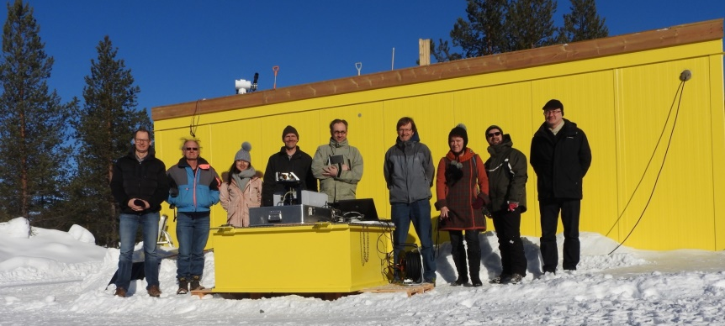
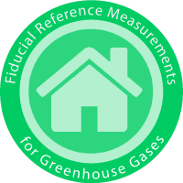
FRMs for Atmospheric Composition
FRM4GHG Campaign
Sodankylä (FI), April to October 2017
Targets: CO2, CH4, CO + other GHGs
Satellites: S-5p, GOSAT, OCO-2
5 instruments, TCCON standard (Bruker 125HR FTS)
Test of new low cost instruments
Regular AirCore launches
Funding: ESA, national agencies
http://frm4ghg.aeronomie.be

Slide 8
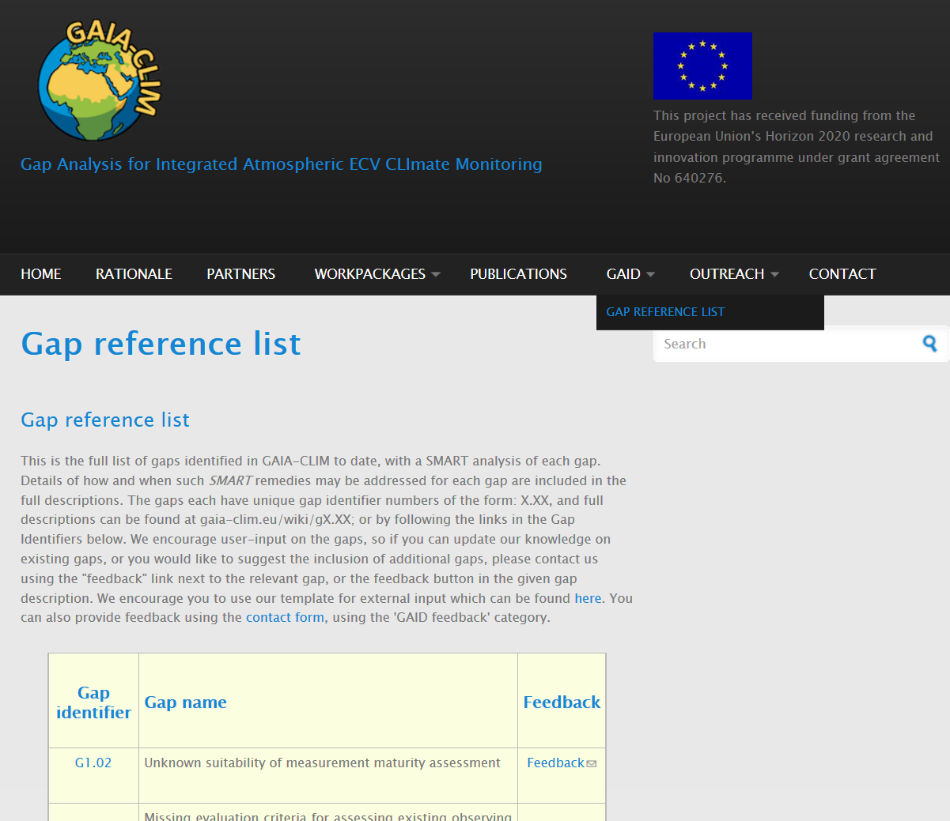
FRMs for Atmospheric Composition
GAIA-CLIM Gap Analysis and Impact Document (GAID)
Collaborative project: monitoring networks + space agencies + coordinating bodies GCOS, WMO…
SMART analysis of gaps in satellite validation capabilities
Proposes remedies for key stakeholders
Living tool
Feel encouraged to register new gap(s) !
http://www.gaia-clim.eu

Slide 9
FRMs for Atmospheric Composition
Feel encouraged to register new / missing gap(s) !
http://www.gaia-clim.eu

Slide 10
WGCV Cross-cutting activities
ACSG participation in cross-cutting activities within WGCV
February 2015 Radebeul workshop follow-on: Selected 2-year studies (to follow QA4EO principles) to support EO applications:
Atmospheric Correction for land and ocean parameter retrievals: ACIX
Harmonised cloud screening approach (and nomenclature): Cloud masking task team
Digital Elevation Model (DEM) characterization

Slide 11
WGCV Cross-cutting activities
ISSI WG on EO Across Scales
- Atmosphere, Terrestrial, Ocean
- Team: experts from SAFs, WGCV SGs, GB networks, DA
- 2 meetings in Bern (CH), Jan/Oct 2016
- Extends previous ECV CDR validation practices review by Zeng et al.
- Paper submitted to Rev. Geophys.

Slide 12
Cross-agencies/cross-domain
Transmission of WGCV experience (incl. QA4EO) to CDRs:
Pragmatic implementation in satellite data and algorithm evolution, in trace gases validation infrastructures, ESA CCI, Copernicus C3S data procurement (atmospheric ECVs)…
EU FP7 QA4ECV (ACSG, IVOS and TMSG joint venture): generic QA framework applicable to all ECVs, guidance on tools and methods like traceability chains and maturity matrix, specific tools and methods, Atmospheric ECV Validation Server, Land-Atmosphere synergies (workshop 2016/10)…
Efforts towards common terminology and definitions for data product validation and reporting of uncertainties
Cross FP7/H2020 Copernicus workshop on “Dealing with uncertainties”, Brussels, Sep. 2016
New and emerging SPARC activities with Cal/Val flavor

Slide 13
Cross-agencies/cross-domain
SPARC activities (www.sparc-climate.org)
Current, new and emerging SPARC activities with Cal/Val flavor
Trace Gas and Aerosol Climatologies - SPARC Data Initiative
CCMI − Chemistry-Climate Model Initiative
WAVAS II - Water Vapour Phase II
LOTUS – Long-term Ozone Trends and Uncertainties in the Stratosphere
1st workshop Paris 2017/03
TUNER - Towards Unified Error Reporting
1st workshop Saskatoon 2017/06
OCTAV-UTLS – Observed Composition Trends And Variability in the Upper Troposphere and Lower Stratosphere
Comparison metrics in the UTLS

Slide 14
Cross-agencies/cross-domain
SPARC activities (www.sparc-climate.org)
LOTUS, OCTAV-UTLS and TUNER follow-on SPARC/IO3C/IGACO-WMO/NDACC (SI2N) on changes in ozone profile trends
ACSG related:
Harmonization of retrievals, data reporting, calibration issues
Calculation and expression of uncertainties
Issues of data comparisons and merging
Uncertainties on trend assessments (single-/multi-mission, L2/L3…)
Validation of L3 and higher level products

Slide 15
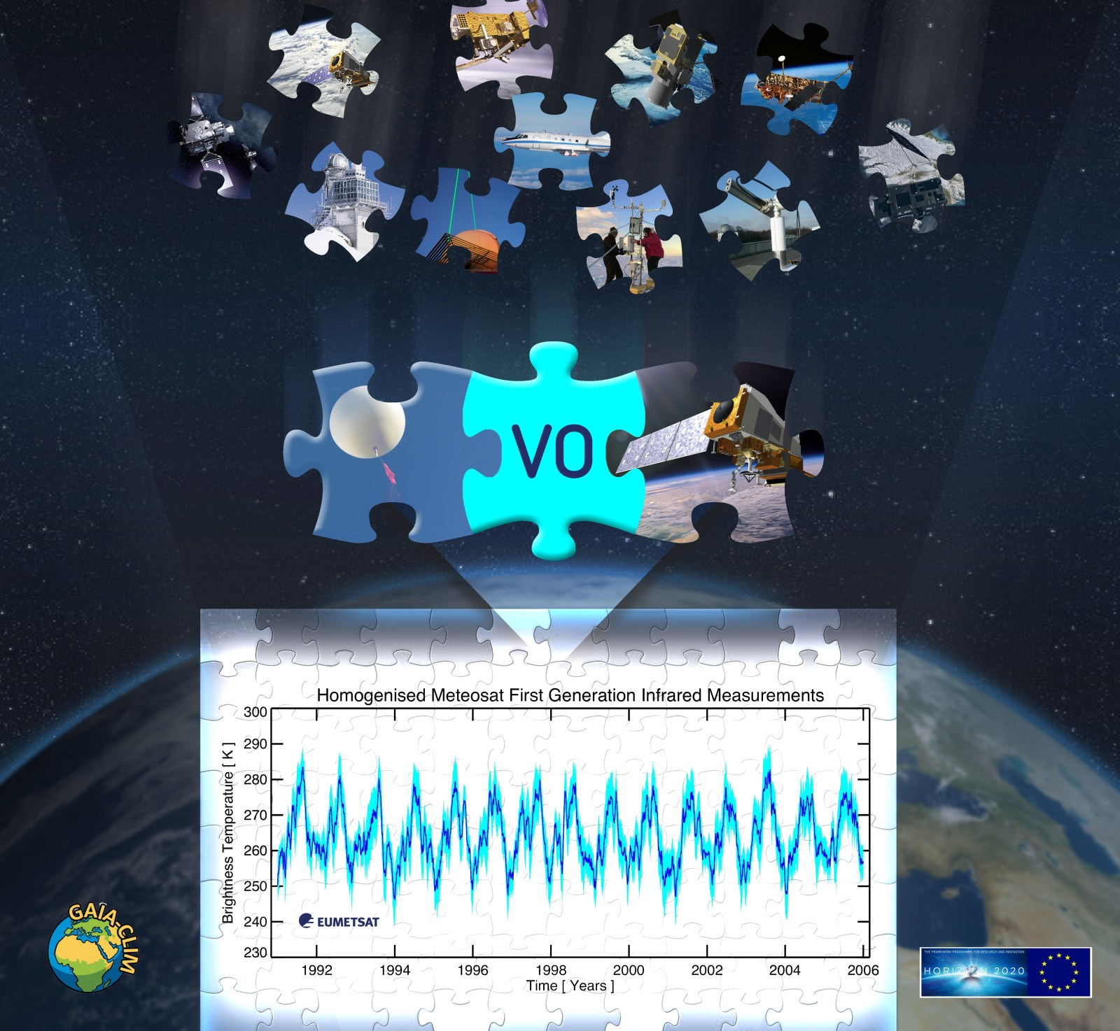
Cross-agencies/cross-domain
Exchanges of good practices between
(semi-)automated validation servers:
CAMS-NDACC (BIRA-IASB/s[&]t)
GECA (ESA, heritage), HARP tools (s[&]t)
ICARE (CNES/CNRS/NPDCRC/U. Lille)
Multi-TASTE (BIRA-IASB/ESA)
NPROVS (NOAA)
QA4ECV AVS (BIRA-IASB)
S-5p MPC/IDAF (KNMI/ESA)
S-5p MPC/VDAF (BIRA-IASB/ESA)
Prototype implementation of best commonalities into GAIA-CLIM Virtual Observatory (incl. comparator) at EUMETSAT :

Slide 16
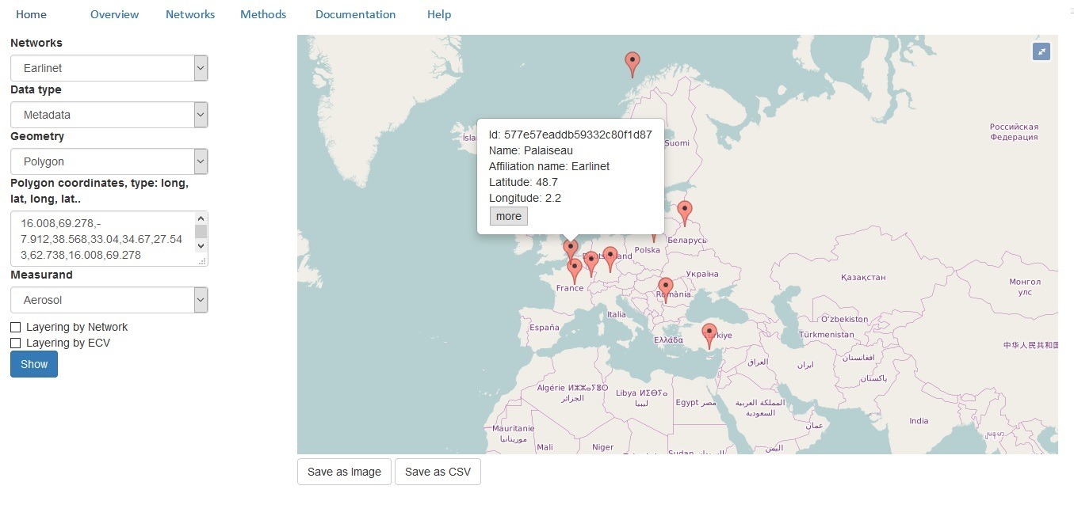
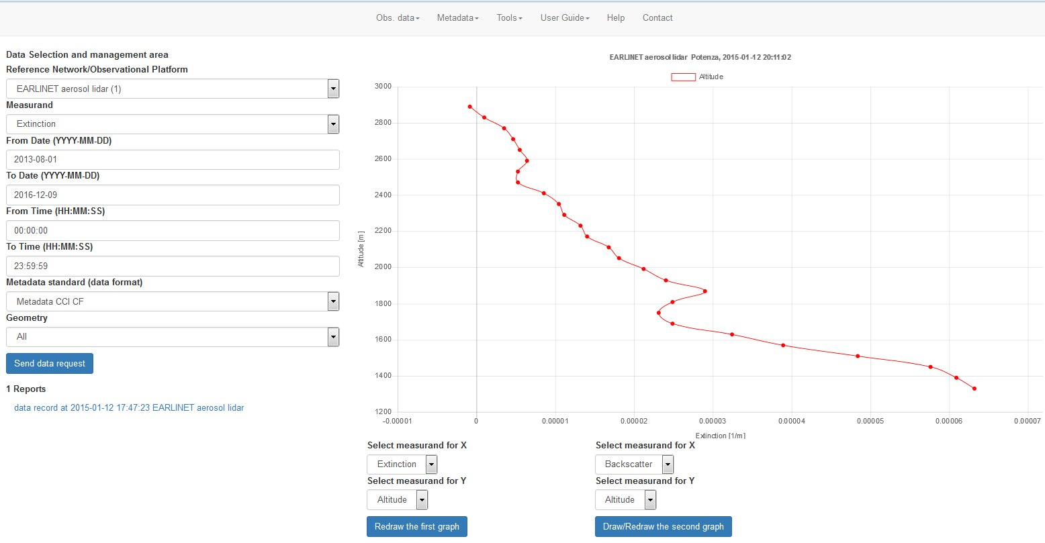
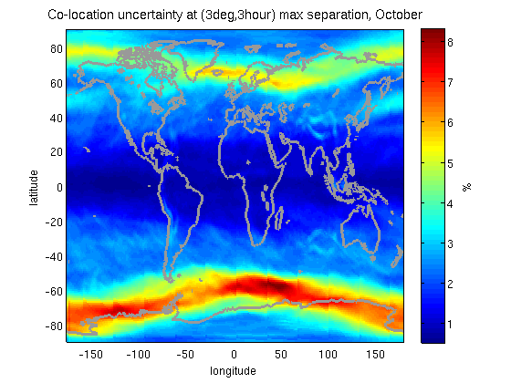
Cross-agencies/cross-domain
GAIA-CLIM Virtual Observatory

Slide 17
Thank you!
WGCV ACSG points of contact:
B. Bojkov (EUMETSAT) and J.-C. Lambert (BIRA-IASB)

