Slide 1
CAL/VAL
JAXA Agency Report
CEOS WGCV-42 Working Group on Calibration & Validation
May 17, 2017
SDSU
Notes:
1

Slide 2
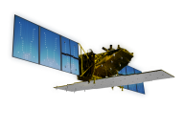

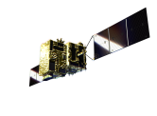







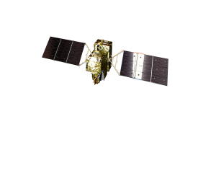
JAXA Earth Observation Satellite Lineup
Targets (JFY) |  | 2008 | 2009 | 2010 | 2011 | 2012 | 2013 | 2014 | 2015 | 2016 | 2017 | 2018 | 2019 | 2020
Disasters & Resources
Climate Change & Water Water Cycle
Climate Change
Greenhouse gases
ALOS-2 PALSAR-2
ALOS/PALSAR
[Land and Disaster monitoring]
Advanced Optical Satellite
ALOS
ALOS/PRISM/AVNIR2
Advanced Radar Satellite
TRMM
TRMM/PR
GPM / DPR
Aqua
[Precipitation]
Aqua/AMSR-E
GCOM-W / AMSR2
[Wind, SST , Water vapor]
[Vegetation, aerosol, cloud, SST, ocean color]
250m, multi-angle, polarization
GCOM-C / SGLI
[Cloud and Aerosol 3D structure]
EarthCARE / CPR
[CO_{2,} Methane]
[CO_{2,} Methane, CO]
GOSAT
GOSAT-2
Mission status
Terminated
On orbit
Under Development

Slide 3
Updates since the 41th meeting in Tokyo
GOSAT :Estimating GHG Flux from column amount density data. 2017, June 9th joint annual vicarious calibration and validation campaign with NASA-OCO-2
SGLI on GCOM-C : Ready for launch
EarthCARE : Cloud Profiling Radar (CPR) delivered to ESA
Himawari 9: lunched Nov. 2016 and AHI initial test completed in Feb. 2017
AMSR follow on: Study started
GOSAT-III : Study started

Slide 4
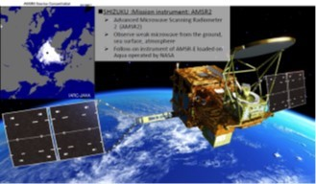
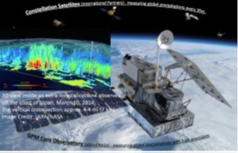
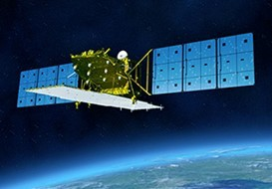
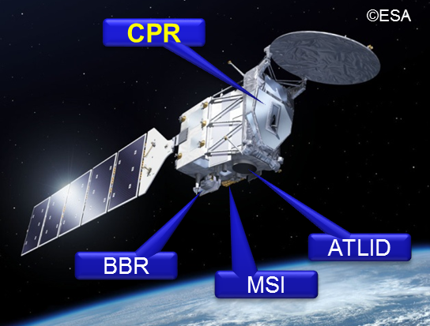
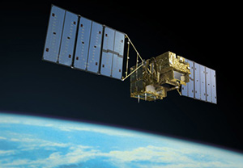
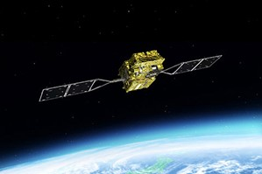
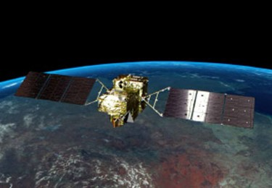
JAXA’s earth observing instruments from space
On orbit and under development: GCOM-C is ready to launch
Non-optical
AMSR2 on GCOM-W (2012-)
DPR on GPM (2014-)
SAR on ALOS-2 (2014-)
CPR on EarthCARE (Fy2019)
AMSR follow-on
Optical
GOSAT-3 (Fy2023)
New spectrometer
GOSAT (2009-)
GCOM-C (2017)
GOSAT-2 (Fy2018)
Advanced
Optical (Fy2019)

Slide 5
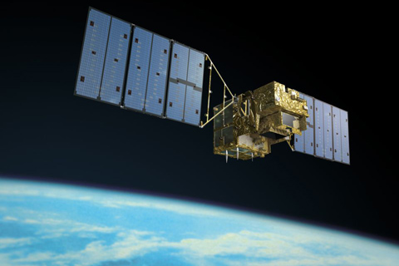
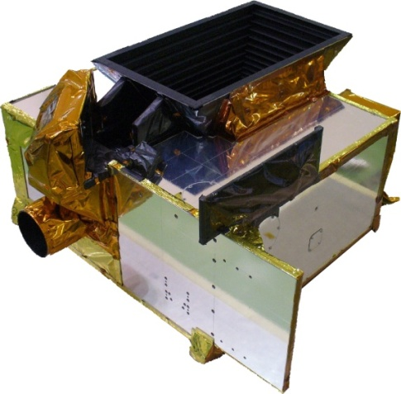
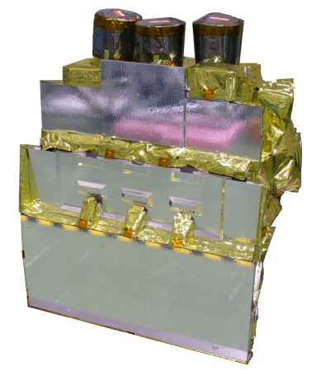
GOSAT
GOSAT
Size | Main body | 3.7m(H) x1.8m(W) x 2.0m(D)(Except attachment)
 | Wing Span | 13.7 m
Mass | Total | 1,750 kg
Power | Total | 3.8KW(EOL)
Design Life | 5 years
Orbit | Sun Synchronous Orbit
 | Local time |  | 13:00±0:15 12:46- shifting to 12:55 (April 2917)
 | Altitude, inclination, period, revisit |  | 666±0.6 km, 98.0±0.1 deg, 98.1 min, 3 days (44 rotations)
Launch | Vehicle, date |  | H-IIA, Jan. 23, 2009
FOV | IFOV 15.8 mrad (10.5 km on the ground at nadir) Coverage (cross track ±35 deg, along track ±20deg
Aperture, Speed | 68 mm, 4 sec/interferogram
MOPD | ±2.5 cm (both sides) (maximum optical path difference)
band | 1P, 1S | 2P, 2S | 3P, 3S | 4
Coverage (cm⁻¹) | 12900-13200 | 5800-6400 | 4800-5200 | 700 -1800
Resolution (cm⁻¹) | 0.5 | 0.2 | 0.2 | 0.2
Detector | Si | InGaAs | InGaAs | PC-MCT
SNR(prelaunch)(Measured） | >340 | >320 | >410 | >280
Onboard Calibration | Solar irradiance, Deep Space, Lunar（radiance） Diode laser(ILS) |  |  | Black body, deep space (Radiance)
Thermal And Near infrared Sensor for carbon Observation (TANSO-FTS)

Slide 6
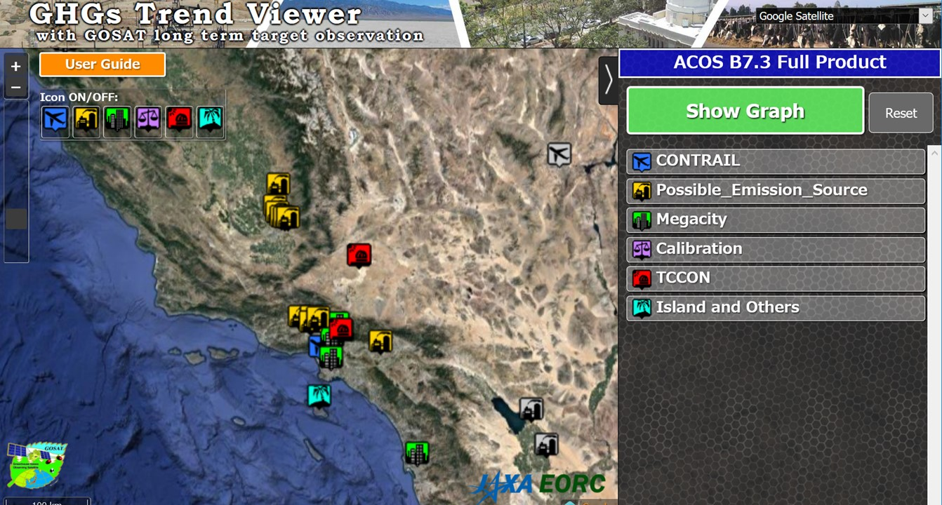
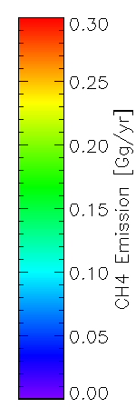
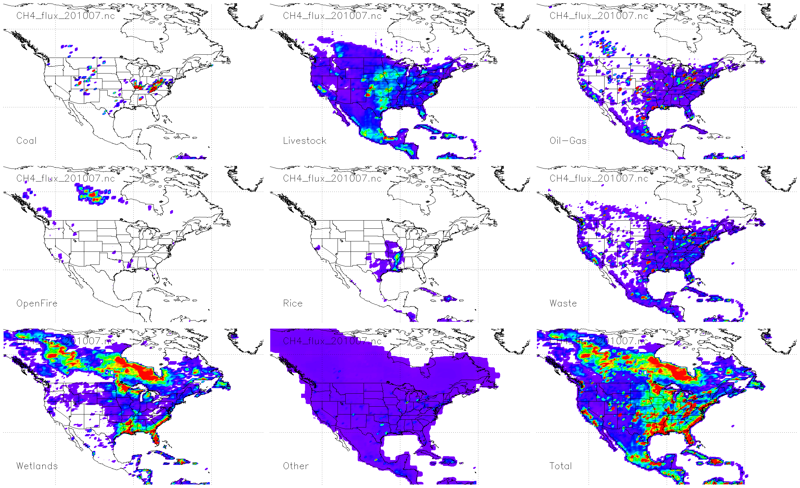
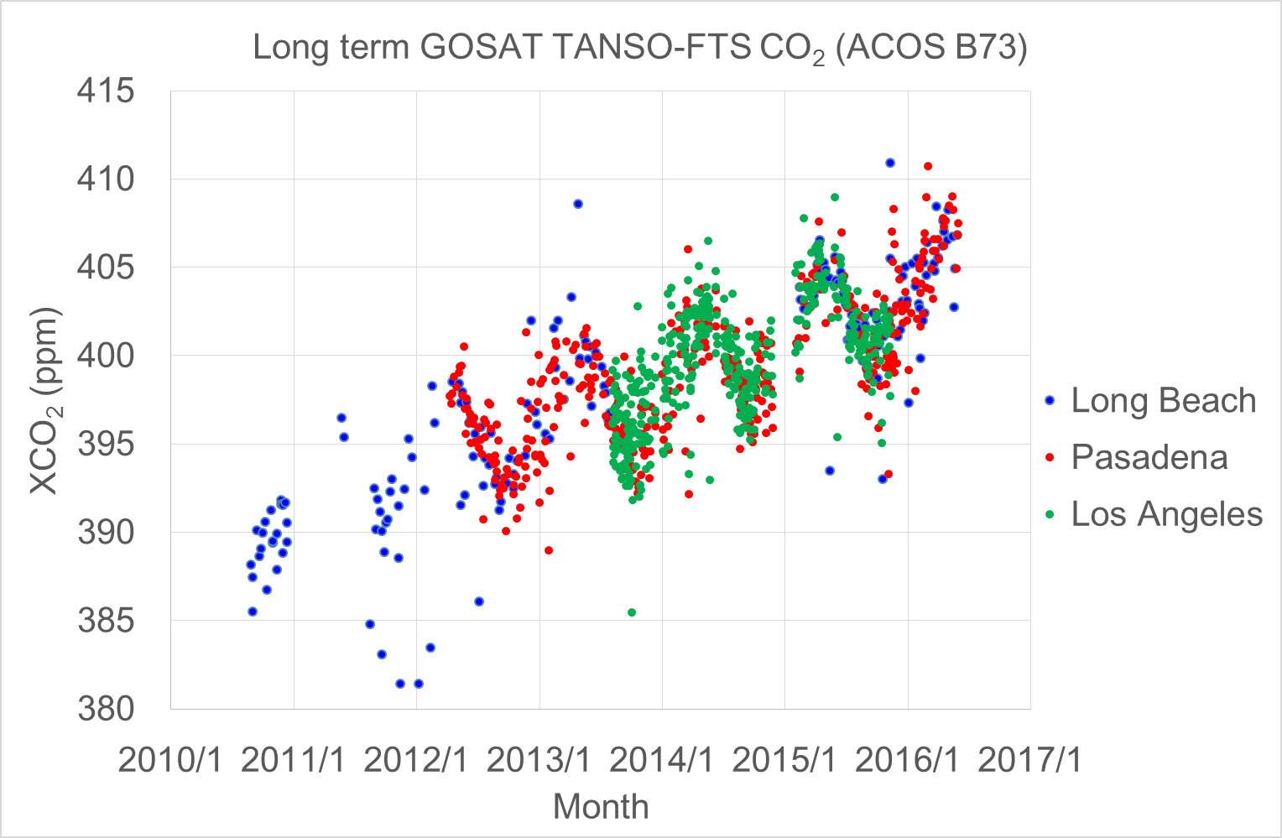
GHG trend viewer 8 year data of selected target points
CMS (Carbon Monitoring System) Methane (CH4) Flux for North America 0.5 degree x 0.667 degree
NASA GES DISC
The CMS Methane (CH4) Flux for North America data set contains estimates of methane emission in North America based on an inversion of the GEOS-Chem chemical transport model constrained by Greenhouse Gases Observing SATellite (GOSAT) observations .
July 2017
https://mirador.gsfc.nasa.gov/
CH4 emission (Gg/year）
http://www.eorc.jaxa.jp/GOSAT/CO2_monitor/index.html
Coal
Livestock
Oil /Gas
Fire
Rice
Waste
Wetland
Other
Total

Slide 7
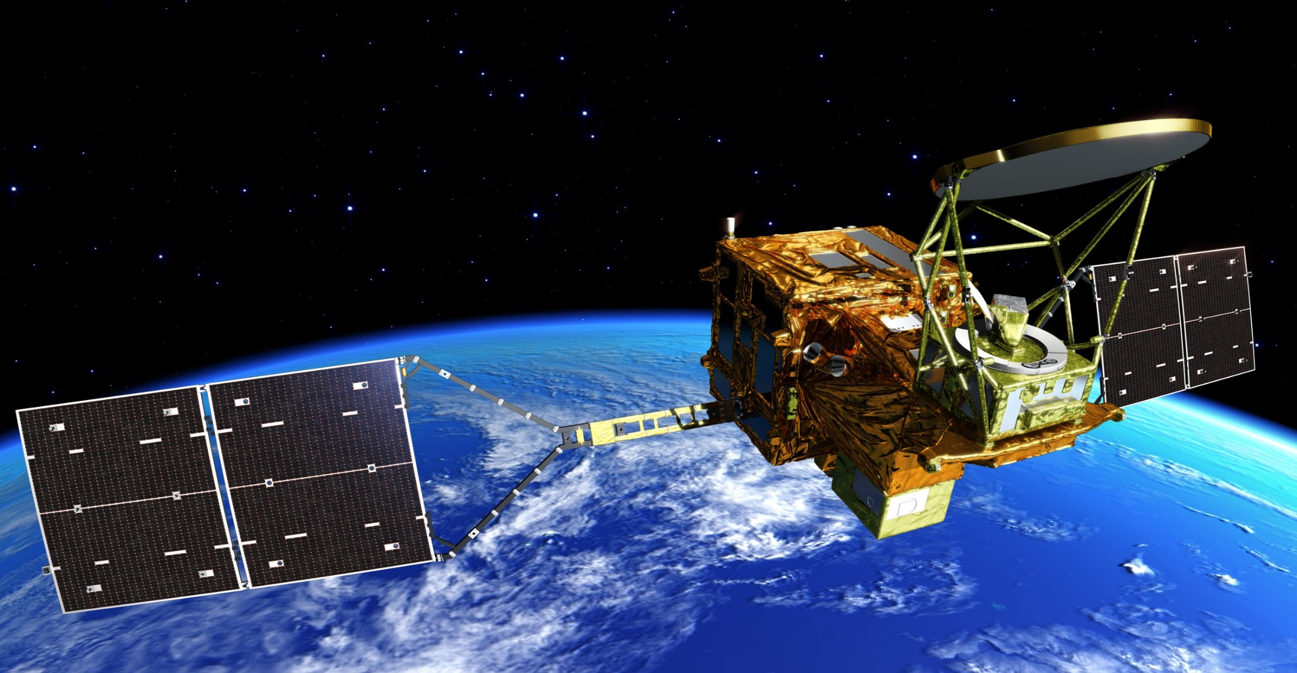
GCOM-W
GCOM-W “SHIZUKU”: Medium size satellite
  Weight: Approx. 2 tons
  Size: 5.1m（L）×17.5m（W）×3.4m（H)
  Power generation: Approx. 4000W
Mission instrument: AMSR2
  Advanced Microwave Scanning Radiometer 2 (AMSR2)
  Observe weak microwave from the ground, sea surface, atmosphere
  Follow-on instrument of AMSR-E loaded on Aqua operated by NASA
  Improvement from AMSR-E in accuracy and spatial resolution

Slide 8
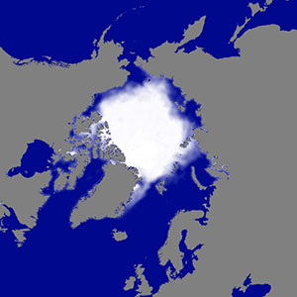
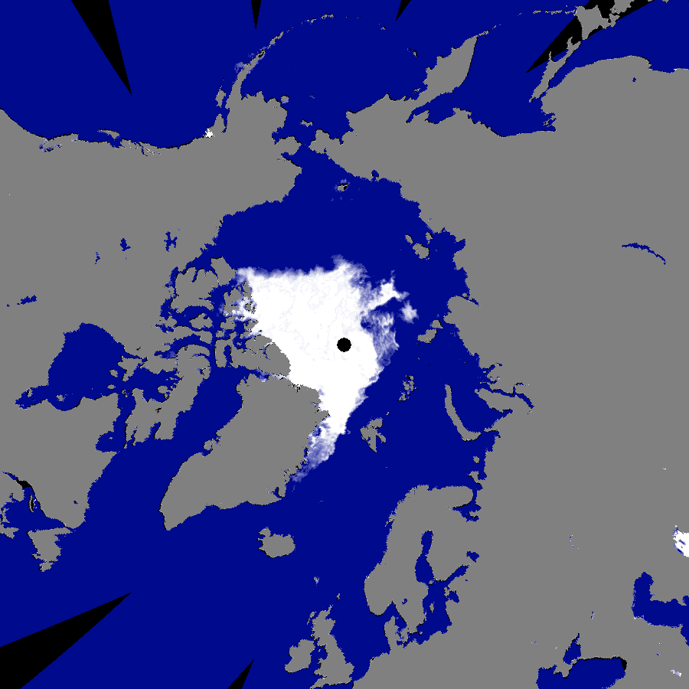
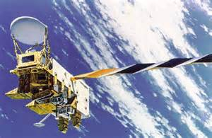

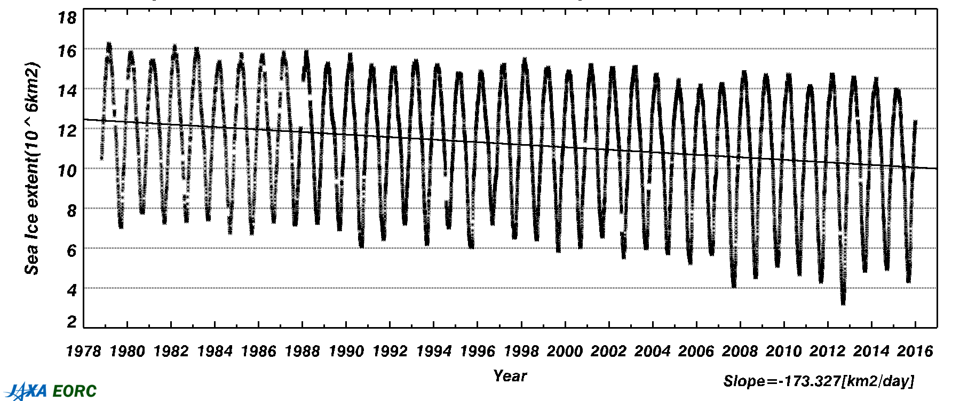
Long-term Arctic Sea Ice Dataset
AMSR-E on Aqua (NASA satellite)
2002.6 – 2011.10
AMSR2 Observation on 16 Sep 2012
(Minimum area in observation history: 3,490,000 km²)
Average Distribution in the September minimum period of the 1980s
AMSR2 on GCOM-W
2012.7 – Current
AMSR
AMSR2
Change in sea ice area in the Arctic ocean (since1978)
SSM/I
Second lowest
Lowest
→ Contribution to Climate and Global Warming Studies

Slide 9
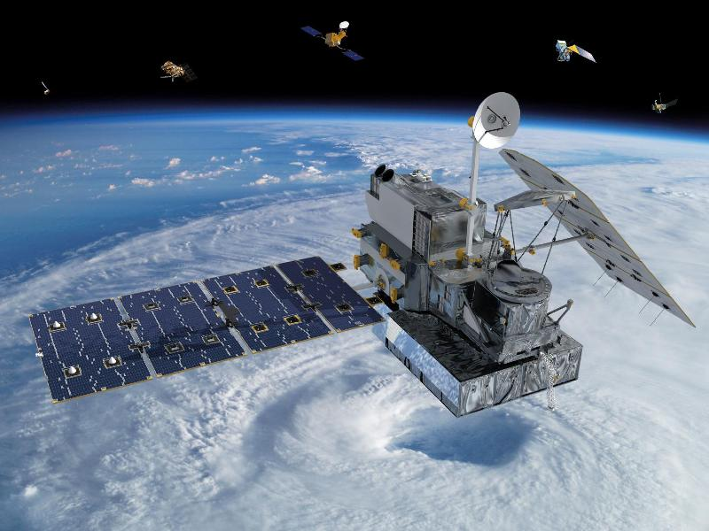
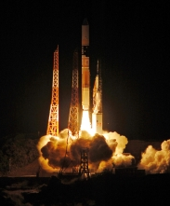
GPM
Global Precipitation Measurement Mission (GPM) is US-Japan space cooperation for monitoring global precipitation. GPM core satellite with DPR was launched on February 28, 2014.
Notes:
GPM core satellite was launched last February by JAXA’s H-II launch vehicle. GPM is a US-Japan space cooperation to monitor global precipitation. JAXA developed DPR for the satellite.

Slide 10
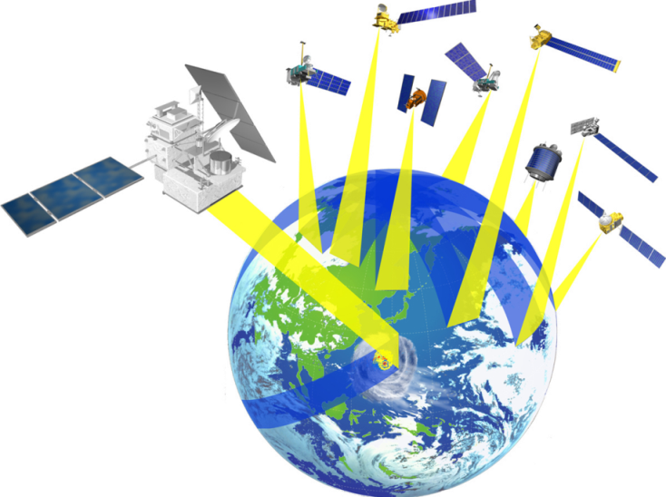
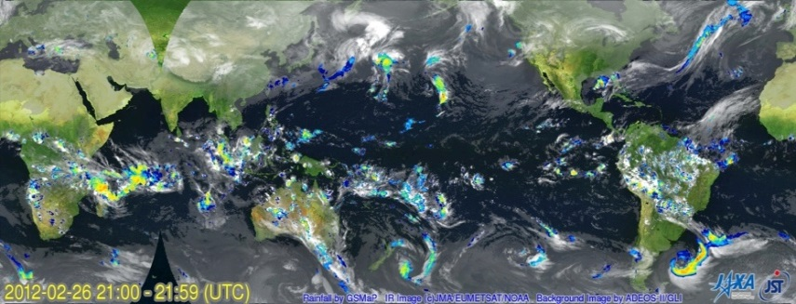


Flood Warning System establishment
Participating countries: Bangladesh, the Philippines, and Viet Nam
Global Satellite Mapping of Precipitation (GSMaP)
Core Observatory
by NASA-JAXA
Calibration
Flood Forecasting System
GSMaP ＋ rain gauges data
Rain Gauges
SMS distribution system
Flood Warning
Direct distribution of information
Improvement of the flood warning lead time from 3 days to 5 days (Bangladesh)
Notes:
Let me introduce an example of potential practical use of satellite observation data for giving early warnings against water-related disasters. In Asia, water related disaster risks such as drought or flood are increased because of climate change. To provide early warning information for a possible flood of a river, it is important to collect information such as the water level, the amount of rainfall, topography, land use around the river. As for international transboundary river like the Mekong river, one country cannot fully monitor the situation of the river. Since GSMaP shows the distribution of precipitation on a global scale, it can observe what is and will be happening to the river and countries around the river can share the data very easily.
Flood warning system integrating satellite based rainfall information named “GSMaP” with rain gauge information and hydrogical model were implemented under ADB and UNESCO projects in Asia. In ADB project, flood warning information is disseminated by cell phone to citizens. In Bangladesh, since an upstream of target river flows through India and Nepal and it is difficult to collect river information, the lead time of existing flood warning is only three days with using only rain gauge information in the country. By using “GSMaP” to provide upstream rainfall information in India and Nepal, the target of this project is to improve the flood warning lead time date from 3 days to 5 days to protect not only human life but also their asset such as living stock and crop production.
次に、観測網が不十分な地域に対し、衛星観測データによる水災害の予・警報の社会実装につながる可能性を示した事例を紹介したい。
アジア地域で気候変動により、水災害である洪水とかんばつが増加。その中で、国際河川の洪水予・警報の発信にむけた予測は、河川流域全体における水の情報、降水の情報や河川水位の情報、地形の情報が重要となっている。国際河川といわれる複数の国にまたがる河川の場合には、このような情報の収集や共有が、各国の都合によりむずかしい状況が発生している。
アジア開発銀行やUNESCOのプロジェクトとして、雨量計や地形など地上データと人工衛星の降水データ（GSMaP）にモデルをあわせて、水位変化（洪水）を予測し、市民へメッセージを発信する仕組みを構築した。
具体的な例としては、バングラデッシュでは、上流がインド、ネパールであり、雨量の取得がむずかしく、バングラの国内のデータのみを用いて予測を出すと、３日前までしか予報をだせなかったのをGSMaPを活用することで上流の降雨情報の入力が可能となり、５日前に予報を出すことが可能となった。この結果、洪水の下流（農村地域）においては、３日では人が避難するのみしかできなかった状況から、洪水予報による被災前の農作物収穫、家畜の避難など資産の保護等の対策が可能となった。

Slide 11
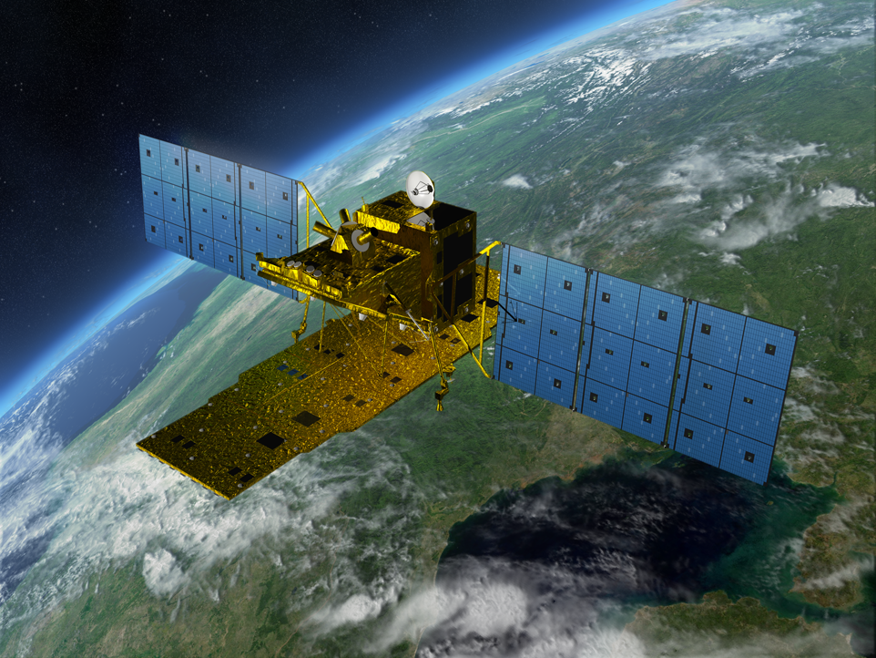
ALOS-2
Application | Disaster, Land, Agriclture, Natural Resources, Sea Ice & Maritime Safety
L-band SAR (PALSAR-2) | Stripmap: 3 to 10m res., 50 to 70 km swath ScanSAR: 100m res., 350km/490km swath Spotlight: 1×3m res., 25km swath
Orbit | Sun-synchronous orbit Altitude: 628km Local sun time : 12:00 +/- 15min Revisit: 14days Orbit control: ≦+/-500m
Life time | 5 years (target: 7 years)
Launch | JFY2013, H-IIA launch vehicle
Downlink | X-band: 800Mbps(16QAM) 400/200Mbps(QPSK) Ka-band: 278Mbps (Data Relay)
Experimental Instrument | Compact InfraRed Camera (CIRC) Space-based Automatic Identification System Experiment 2 (SPAISE2)
Carries L-band Synthetic Aperture Radar (PALSAR-2)
Notes:
ALOS-2 carries L-band Synthetic Aperture Radar called PALSAR-2.
The local sun time is at noon in order to complement other SAR satellites which are in dawn-dusk orbits. The revisit time is shortened from that of ALOS and the orbit is controlled within 500m tube for interferometry.
The observation data is transmitted either directly to a ground station via X-band at 800Mbps or through inter-satellite communication via Ka-band at 278Mbps.
ALOS-2 will contribute to Disaster monitoring, Land monitoring, Agricultural monitoring, Natural Resource Exploration and Global Forest monitoring as ALOS did.
And potential use such as maritime safety will be expected.

Slide 12
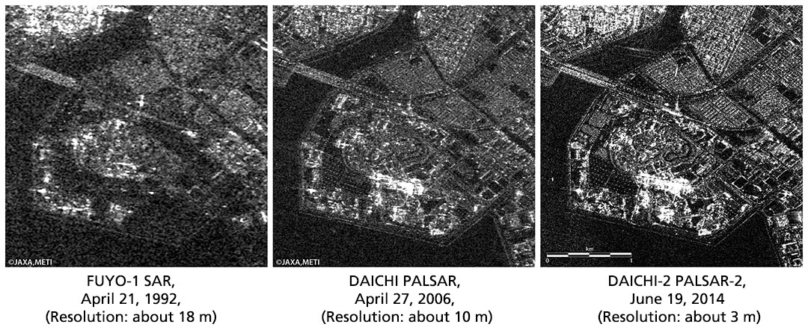
History of L-band SAR improvement
(Urayasu City, Tokyo Disney Land Area)
The images of the same area taken by two other L-band synthetic aperture radars are also displayed. One was shot by the ALOS, which was launched in 2006 and acquired the image in the same year, and the other is the Japanese Earth Recourse Satellite-1 (JERS-1 or FUYO-1), which was launched in 1992 and observed the area in the same year.
You can see the resolution of the DAICHi-2 is higher compared to past satellites.

Slide 13
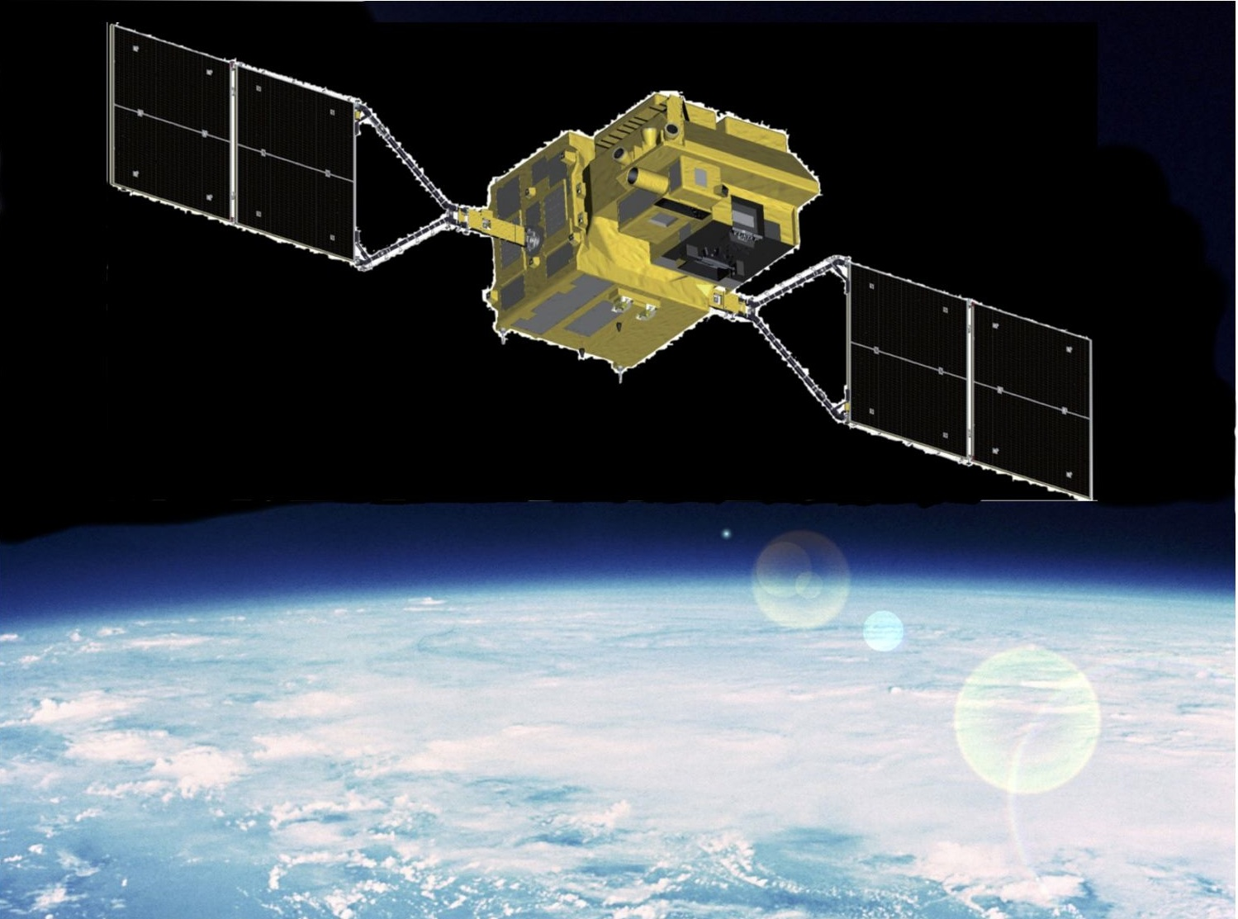
GCOM-C: Climate
shortwave & thermal Infrared (T) Scanner (IRS)
Polarization (along-track slant) radiometer (P)
Visible & Near infrared push-broom Radiometer (VNR)
GCOM-C SGLI Characteristics (Current Baseline)
Orbit | Sun-synchronous (local time: 10:30) Altitude: 798km Inclination: 98.6 deg.
Launch | 2017
Power/Mass | About 4kw/798kg
Mission Life | 5 years
Scanning | Push-broom electric scanning Wisk-broom mechanical scanning
Digitalization | 12 bit
Polarization | 3 Polarizations angles
Sensor | SGLI (Second Generation Land Imager) Band: 380nm～12μm (19 bands) Resolution: 250m～1km Swath: 1150～1400km
・Multi-band Imaging Radiometer
(Near UV ~ TIR)
・Polarimetry
・Tilt Observation
Notes:
I will briefly introduce the other GCOM program: GCOM-C (climate). The satellite will conduct surface and atmospheric measurements related to the carbon cycle and radiation budget, such as clouds, aerosols, ocean color, vegetation or snow/ice. By providing these data, GCOM-C will aim to contribute to improving accuracy of climate change models and better understanding of climate change itself.

Slide 14
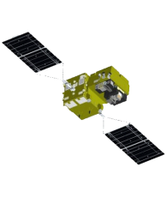
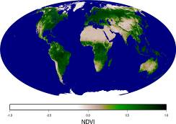
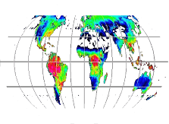
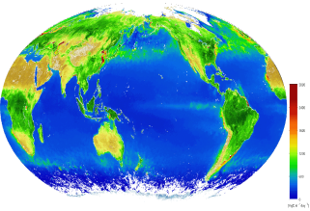
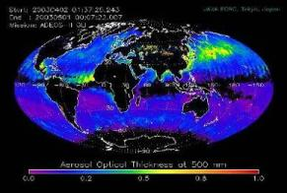
Main targets of GCOM-C
Polarization and forward-backward observation function
・Forward or backward polarization
・Along-track slant view (1km res: 2 chs)
Nadir multi-channel observation
17 channels in the visible, NIR, and thermal infrared wavelength ranges
(250m res：11 chs,
500m res：2 chs,
1km res： 4 chs）
Estimation of marine production, Obs. of vegetation, clouds, water flow, or ocean currents
Understanding changes
in biomass,
aerosols or land cover
Orbit Direction
Swath：1150km（Visible・Near-infrared, Polarization）
1400km（Short-wavelength infrared・Thermal infrared）
⇒SGLI observes the whole globe at least once every 2 days.
SGLI monitors changes of vegetation biomass on a long-term by using its forward-backward observation function, which improves accuracy in measuring biomass production. It also observes ground aerosols by polarimetry observation and estimates the impact of aerosols and clouds on the Earth’s radiation budget.
⇒Contributing to improving numerical climate models by clarifying ecosystem processes and microphysical processes in the atmosphere
Notes:
ＧＣＯＭ－Ｃは、２５０ｍから１ｋｍの中分解能で、１９波長の観測を行い、特に偏光と二方向の観測チャンネルにより、アエロゾル、雲による放射特性の観測や、土地利用分類を高精度を行うことができます。また、海色の観測チャンネルを持っており、海洋の基礎生産力の観測や沿岸域の環境監視が期待されています。

Slide 15
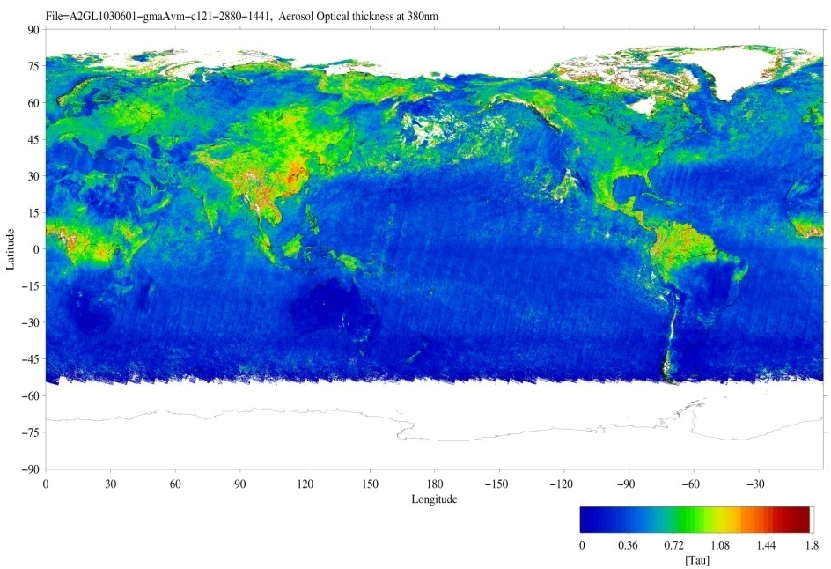
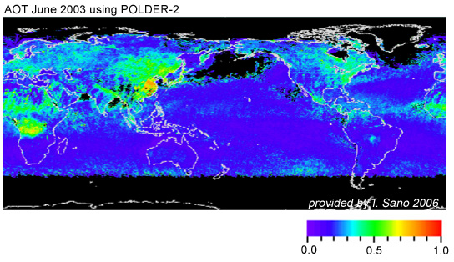
GCOM-C Observation Products
Land aerosol by Near-UV and polarization
Not only over the ocean, SGLI will estimate land-area aerosols using near-UV (380nm) and polarization channels which are more sensitive to atmosphere scattering rather than land surface reflection
Combination of aerosol absorption by Near-UV and fine-mode aerosol properties by polarization
They will improve the atmospheric correction
Near-UV aerosol
Polarization aerosol
JAXA/EORC
Global aerosol optical thickness in June 2003 using the GLI Near-UV (380nm) channel (NIR is used for the ocean area)
Global aerosol optical thickness in June 2003 using POLDER-2 polarization reflectance (provided by T. Sano, Kinki Univ.)

Slide 16
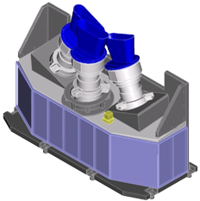
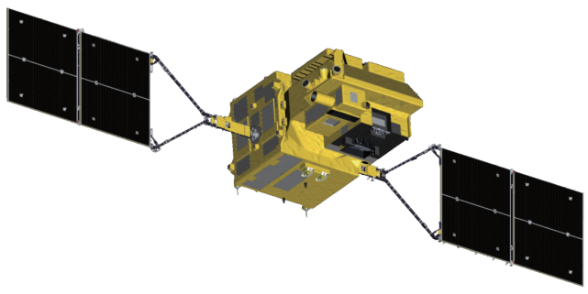
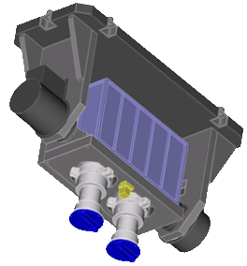
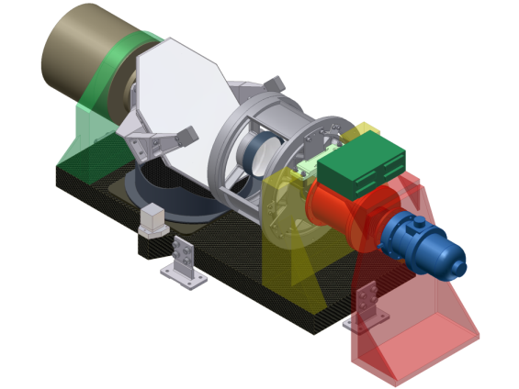
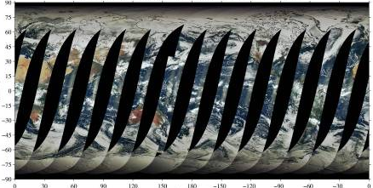
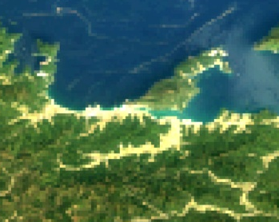
SGLI sensor system and onboard calibration system
Earth
Total FOV: 70deg
= 24deg × 3 telescopes
(~1150km@nadir)
Orbit
Solar diffuser
Earth direction
Visible and Near-infrared Radiometer
(SGLI-VNR)
Orbit
Non-polarization three telescopes
Each has the same 11 channels
GCOM-C
satellite
Polarization two (670nm and 865nm) telescopes
Each has tree polarization-angle filters
FOV: 55deg
(~1150km@±45deg along-track slant)
InfraRed Scanner
(SGLI-IRS)
Solar calibration window
approx. 1.3m
approx. 1.7m
Internal lamp (PD)
±45deg
Earth view
window
FOV: 80-deg
Orbit
Earth
Earth
±45deg along-track slant observation
Orbit
SWIR detector
Deep space
window
mechanical cooler
approx. 1.4m
Scan mortar
approx. 0.6m
Black body
GCOM-C SGLI characteristics
Orbit | Sun-synchronous (descending local time: 10:30), Altitude: 798km, Inclination: 98.6deg
Launch Date | JFY 2017
Mission Life | 5 years (3 satellites; total 13 years)
Scan | Push-broom electric scan (VNR: VN & P) Wisk-broom mechanical scan (IRS: SW & T)
Scan width | 1150km cross track (VNR: VN & P) 1400km cross track (IRS: SW & T)
Spatial resolution | 250m, 500m, 1km
Polarization | 3 polarization angles for POL
Along track tilt | Nadir for VN, SW and TIR, & +/-45 deg for P
Optical bench
TIR detectors
SGLI/VNR daily coverage
250m resolution
Notes:
The Second-generation Global Imager (SGLI) on the Global Change Observation Mission -Climate (GCOM-C) is a multi-band optical imaging radiometer in the wavelength range from 380nm to 12000nm.
It consists of two main components, the Visible and Near Infrared Radiometer (SGLI VNR) and the Infrared Scanning Radiometer (SGLI IRS).

Slide 17
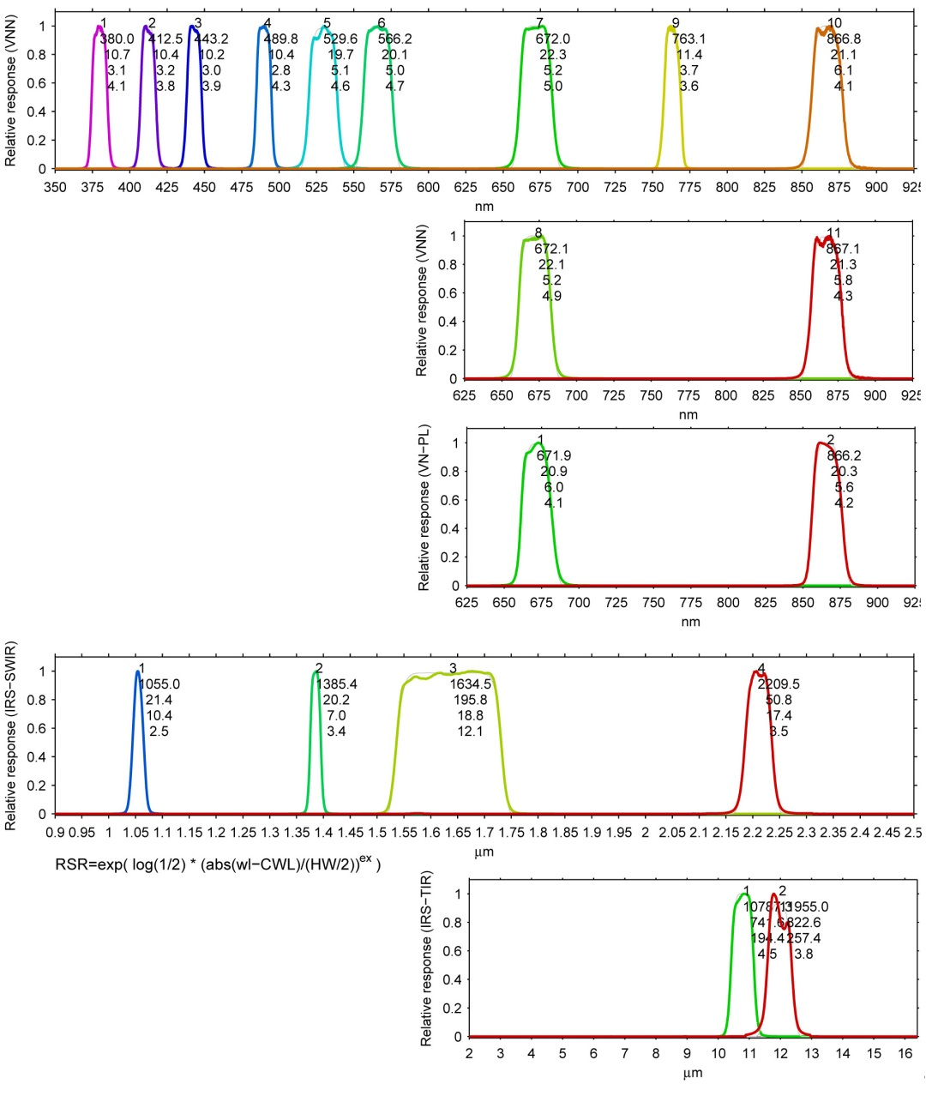
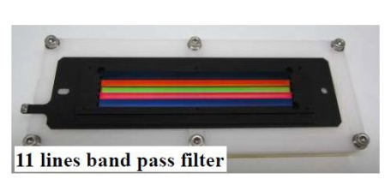
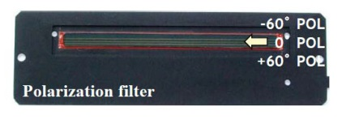
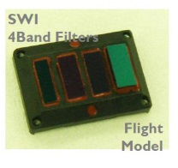
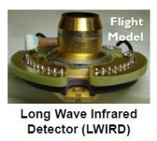
SGLI spectral bands
Characteristics of SGLI spectral bands
CH | λ | Δλ | L_{std} | L_{max} | SNR@L_{std} | IFOV
 | nm |  | W/m²/sr/μm K: Kelvin |  | - K: NEΔT | m
VN1 | 380 | 10 | 60 | 210 | 250 | 250 /1000
VN2 | 412 | 10 | 75 | 250 | 400 | 250 /1000
VN3 | 443 | 10 | 64 | 400 | 300 | 250 /1000
VN4 | 490 | 10 | 53 | 120 | 400 | 250 /1000
VN5 | 530 | 20 | 41 | 350 | 250 | 250 /1000
VN6 | 565 | 20 | 33 | 90 | 400 | 250 /1000
VN7 | 673.5 | 20 | 23 | 62 | 400 | 250 /1000
VN8 | 673.5 | 20 | 25 | 210 | 250 | 250 /1000
VN9 | 763 | 12 | 40 | 350 | 1200* | 250 /1000*
VN10 | 868.5 | 20 | 8 | 30 | 400 | 250 /1000
VN11 | 868.5 | 20 | 30 | 300 | 200 | 250 /1000
POL1 | 673.5 | 20 | 25 | 250 | 250 | 1000
POL2 | 868.5 | 20 | 30 | 300 | 250 | 1000
SW1 | 1050 | 20 | 57 | 248 | 500 | 1000
SW2 | 1380 | 20 | 8 | 103 | 150 | 1000
SW3 | 1630 | 200 | 3 | 50 | 57 | 250 /1000
SW4 | 2210 | 50 | 1.9 | 20 | 211 | 1000
TIR1 | 10800 | 700 | 300K | 340K | 0.2K | 250/500/1000
TIR2 | 12000 | 700 | 300K | 340K | 0.2K | 250/500/1000
VNR-NP
high-gain bands
VNR-POL
POL bands
Multi-angle obs. for 674nm and 869nm
SGLI-IRS
Uchikawa, T., K. Tanaka, Y. Okamura, S. Tsuida, and T. Amano, "Proto Flight Model (PFM) performance and development status of Cisible and Near Infrared Radiometer (VNR) on the Second-generation Global Imager (SGLI)", SPIE Asia-Pacific Remote sensing, Beijing, China, 9264-27, 2014.
Tanaka, K., Y. Okamura, T. Amano, T. Hosokawa, and T. Uchikita, "The development status of Second Generation Global Imager Infrared Scanning Radiometer (SGLI-IRS)", SPIE Asia-Pacific Remote sensing, Beijing, China, 9264-15, October, 2014.

Slide 18

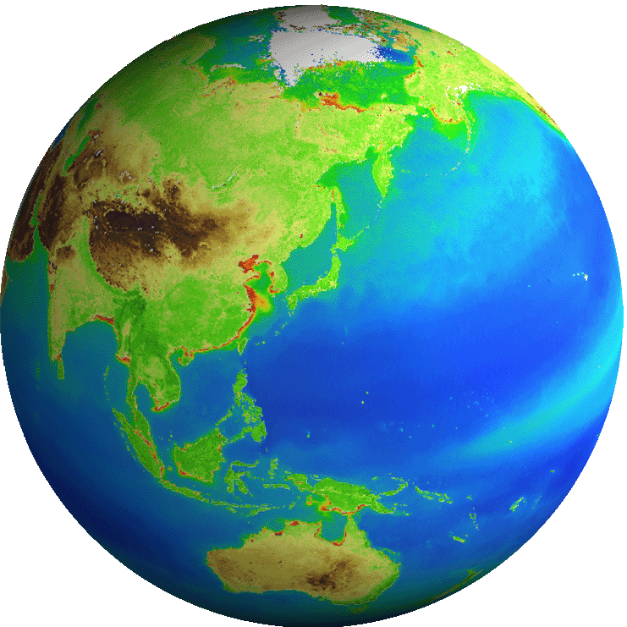
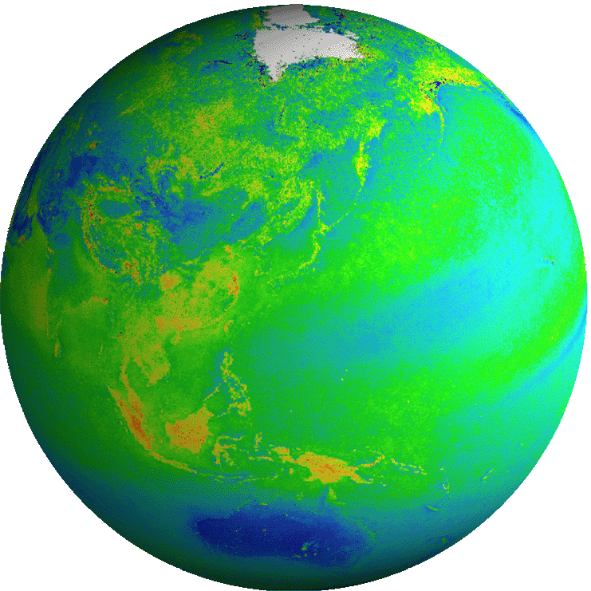
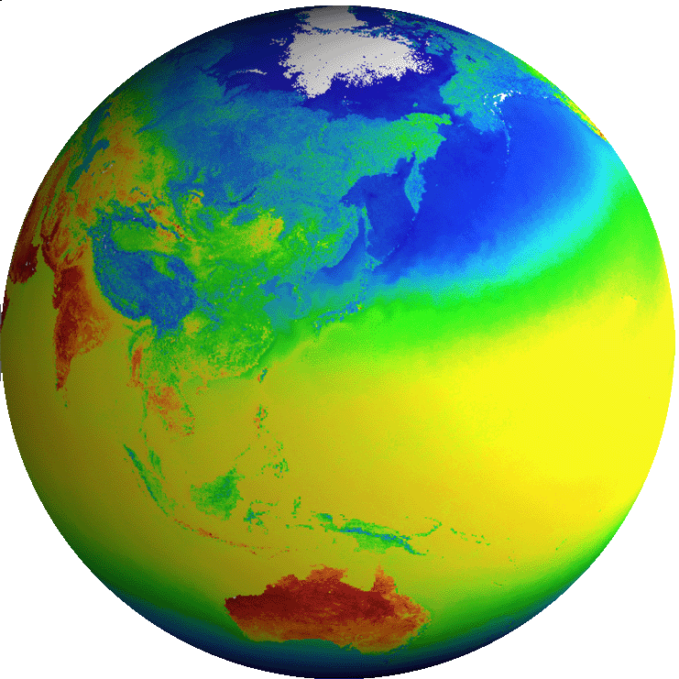

GCOM-C Observation Products
Standard and research products
ECV: Essential Climate Variables
Common
Radiance | TOA radiance (including system geometric correction)
Radiation budget by the atmosphere-surface system
Carbon cycle in the Land and Ocean
Land
Surface reflectance | Precise geometric correction
 | Atmospheric corrected reflectance
Vegetation and carbon cycle | Vegetation index
 | Above-ground biomass
 | Vegetation roughness index
 | Shadow index
 | Fraction of Absorbed Photosynthetically available radiation
 | Leaf area index
Temp. | Surface temperature
Application | Land net primary production
 | Water stress trend
 | Fire detection index
 | Land cover type
 | Land surface albedo
Atmosphere
Cloud | Cloud flag/Classification
 | Classified cloud fraction
 | Cloud top temp/height
 | Water cloud optical thickness /effective radius
 | Ice cloud optical thickness
 | Water cloud geometrical thickness
Aerosol | Aerosol over the ocean
 | Land aerosol by near ultra violet
 | Aerosol by Polarization
Radiation budget | Long-wave radiation flux
 | Short-wave radiation flux
Ocean
Ocean color | Normalized water leaving radiance
 | Atmospheric correction parameter
 | Photosynthetically available radiation
 | Euphotic zone depth
In-water | Chlorophyll-a conc.
 | Suspended solid conc.
 | Colored dissolved organic matter
In-water | Inherent optical properties
Temp. | Sea surface temp.
Application | Ocean net primary productivity
 | Phytoplankton functional type
 | Redtide
 | multi sensor merged ocean color
 | multi sensor merged SST
Cryosphere
distribution | Snow and Ice covered area
 | Okhotsk sea-ice distribution
 | Snow and ice classification
 | Snow covered area in forest and mountain
Surface properties | Snow and ice surface Temperature
 | Snow grain size of shallow layer
 | Snow grain size of subsurface layer
 | Snow grain size of top layer
 | Snow and ice albedo
 | Snow impurity
 | Ice sheet surface roughness
Boundary | Ice sheet boundary monitoring
ECV
ECV
ECV
ECV
ECV
ECV
ECV
ECV
ECV
ECV
ECV
ECV
ECV
Blue: standard products
Red: research products
ECV

Slide 19









GCOM-C Observation Products
Integrated use of different sensors and parameters
  Data merger through sensor cross-calibration and product cross-validation
    Sensor cross-calibration in cooperation with CEOS/WGCV/IVOS
    Product cross-validation in cooperation with CEOS/OCR-VC, IOCCG..
GCOS
requirements
GCOM-C observation
Algorithm
feedback
SGLI VNR one-day coverage
NPP/VIIRS
Surface albedo
and land cover
Surface solar irradiance and
Photosynthetically available radiation
Aerosol amount and properties
synthetic use of the global data
Sentinel-3/ OLCI
Geophysical
connection
Land vegetation,
ocean chlorophyll-a,
and primary production
Sea and Land surface temperature
Cloud fraction and properties
19

Slide 20

GOSAT-2
TANSO-FTS-2
Characteristics
Life | 5 years
Orbit | Sun-Synchronous (628km)
Mass | About 2 t
Launch | FY 2018
Observation Valuables | CO₂, CH₄ and CO Accuracy: 0.5 ppm (CO₂) and 5 ppb (CH₄) at 500-km mesh over earth’s surface
TANSO-CAI-2
TANSO-FTS-2
TANSO-CAI-2 (radiometer)
Notes:
We are developing a follow-on mission to GOSAT and the satellite is called GOSAT-2. With cooperation MOE and NIES, GOSAT-2 will be capable of observing greenhouse gases emissions more accurately and with new functions to monitor other air pollutants that were previously hard to detect like CO. By providing GOSAT’s long-term and accurate data of GHG emissions, JAXA will contribute to solving climate change and policies that were adapted at COP 21.
GOSAT-2 mission requirement
・Upgrade of CO₂ and CH₄ observation accuracy
・Reduction of net flux estimation uncertainty
・Anthropogenic source estimation
・Upgrade of natural emissions estimation
・Monitoring of large emission sources to reduce global carbon dioxide

Slide 21


EarthCARE
Earth Cloud, Aerosol and Radiation Explorer : To reduce the uncertainties in global warming prediction by measuring the three dimensional structure of clouds and aerosols, which are most uncertain parameter in the numerical climate models.
Characteristics
Life | 3 years
Orbit | Sun-Synchronous (around 400km)
Mass/Power | About 2.2 t/ about 3.4 kw
Launch | FY 2019 (TBC)
Instruments | CPR: Cloud Profiling Radar (JAXA/NICT) ATLID: Atmospheric Lidar (ESA) MSI: Multi-Spectral Imager (ESA) BBR: Broadband Radiometer (ESA) Satellite bus: Airbus DS Satellite launch: ESA
  CPR (Cloud Profile Radar)
21
Notes:
JAXA is developing Clorud Profile Radar for the ESA’s ＥａｒｔｈＣＡＲＥ satellite. Together with the Atmospheric Lidar being developed by ESA, EarthCARE will observe the cloud and aersol which are considered largest uncertainity for climate prediction.

