Slide 1

Geoscience Australia
Report on Cal/Val Activities
Medhavy Thankappan
Geoscience Australia
WGCV Plenary # 42
Sioux Falls
May 15-19, 2017

Slide 2
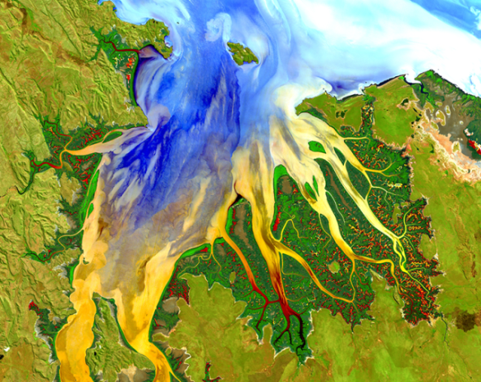
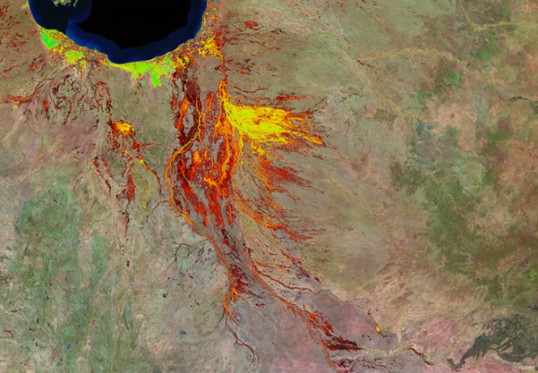
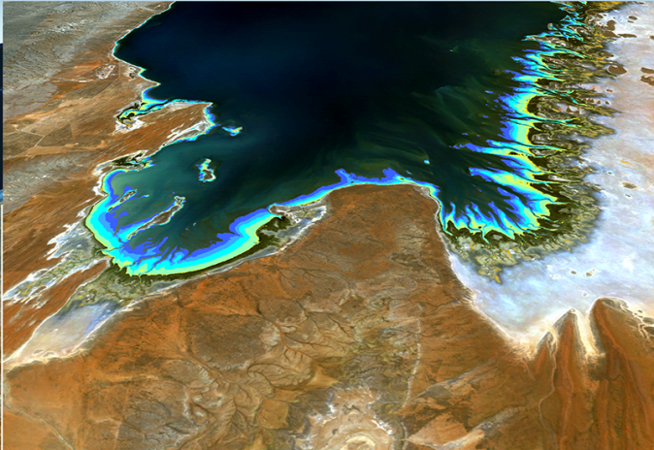
Digital Earth Australia
Geoscience Australia
Report on Cal/Val Activities
WGCV Plenary # 42
Australian Government investing $15.3M over two years, in the Digital Earth Australia (DEA) initiative at Geoscience Australia
Builds on the Australian Geoscience Data Cube - 2016 Content Platform of the Year at the Geospatial World Leadership Awards
Will benefit government with information on health and productivity of Australia’s landscape; enable the Australian spatial industry to exploit the full EOS information potential to grow the digital economy
Focus on calibration / validation to support the initiative (QA4EO, WGCV, LPV, GSICS, TERN)

Slide 3
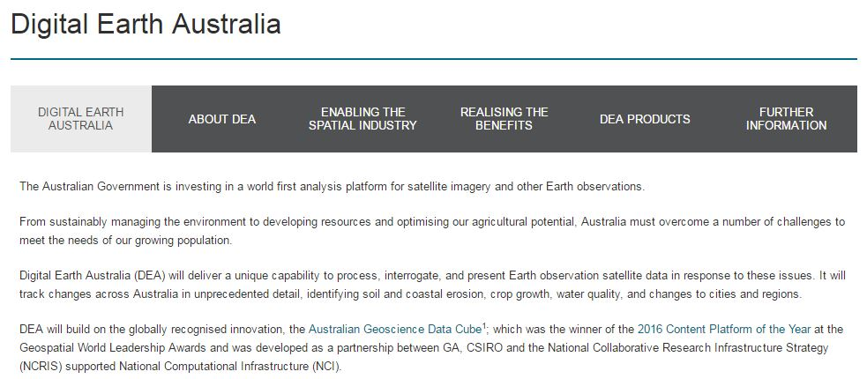

Geoscience Australia
Report on Cal/Val Activities
WGCV Plenary # 42
http://www.ga.gov.au/about/projects/geographic/digital-earth-australia

Slide 4
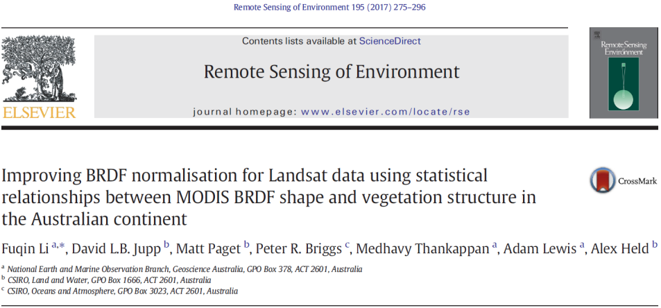
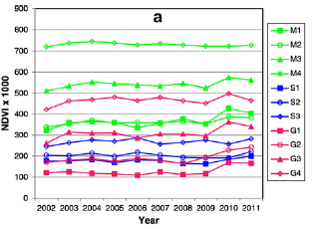
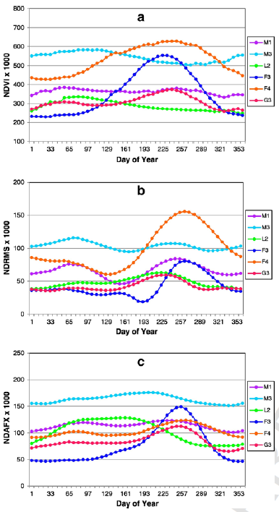
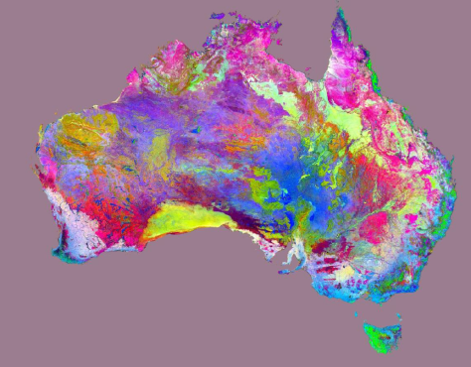
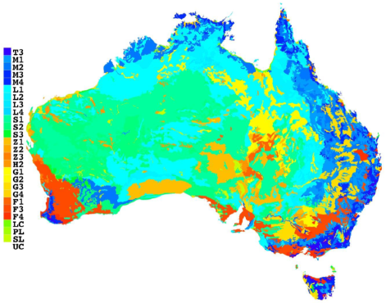
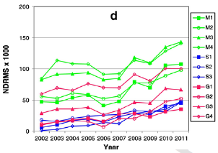
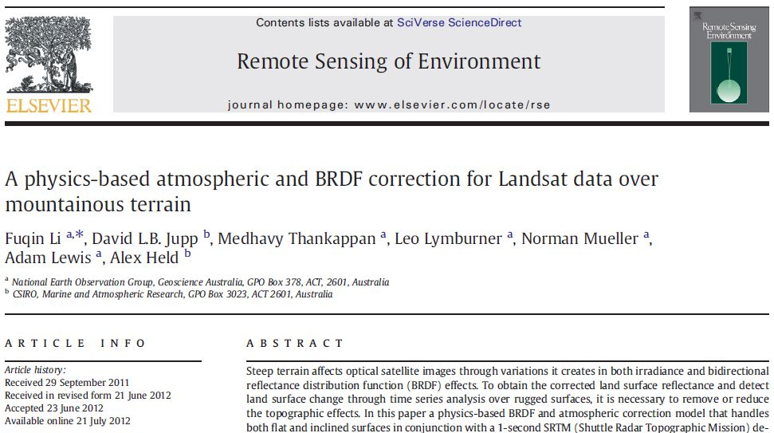
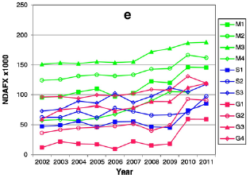
Geoscience Australia
Report on Cal/Val Activities
WGCV Plenary # 42
BRDF Correction

Slide 5
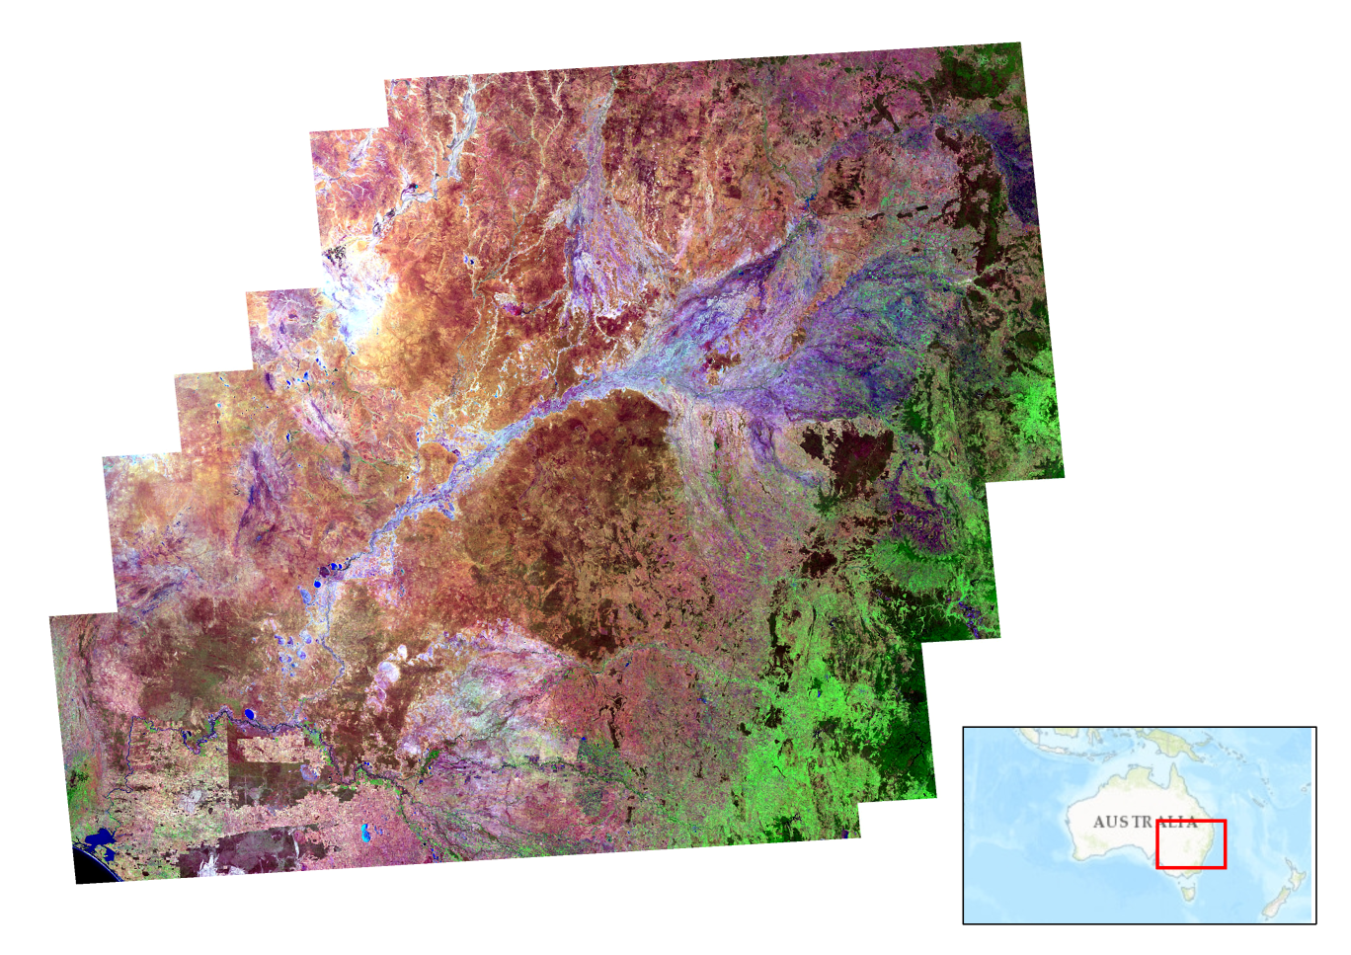
Geoscience Australia
Report on Cal/Val Activities
WGCV Plenary # 42
Geomedian Landsat-8

Slide 6
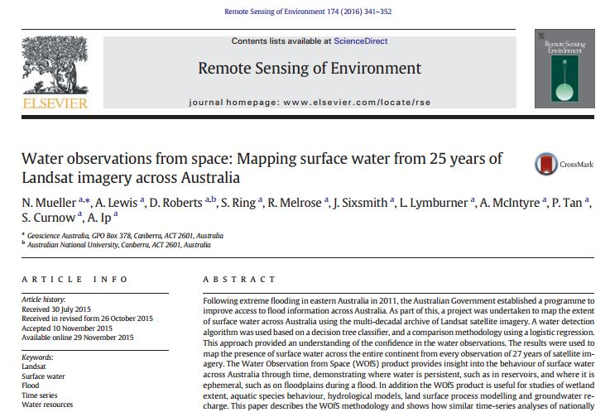
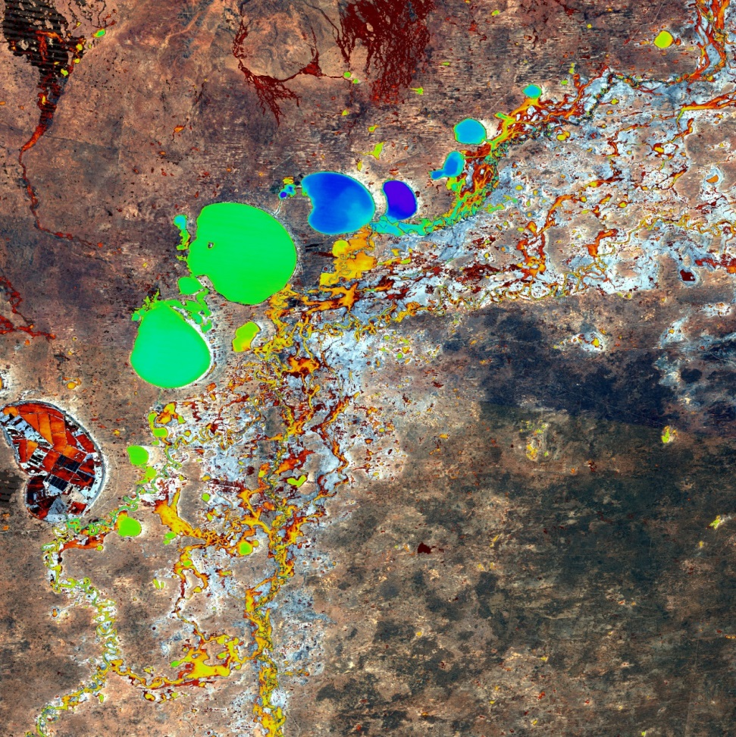
Geoscience Australia
Report on Cal/Val Activities
WGCV Plenary # 42
    Water Observations from Space (WOfS)
Satellite based water observations over 27 years, in a grid of 25m by 25m cells covering Australia

Slide 7
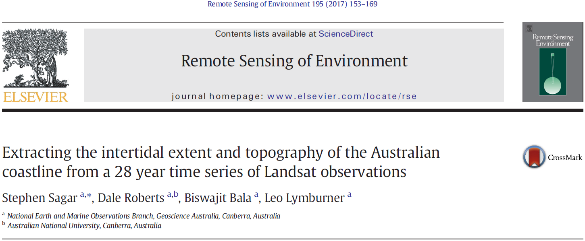
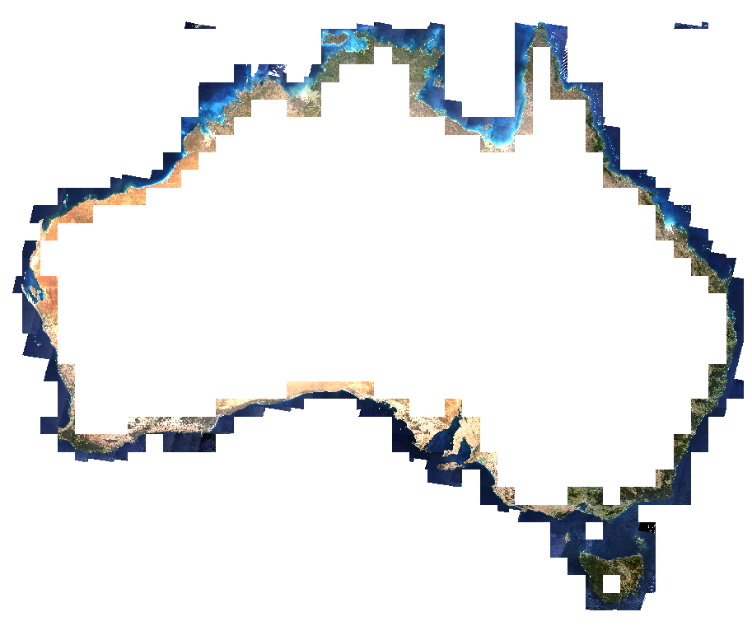
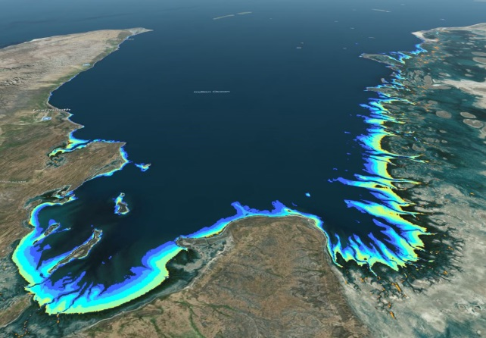
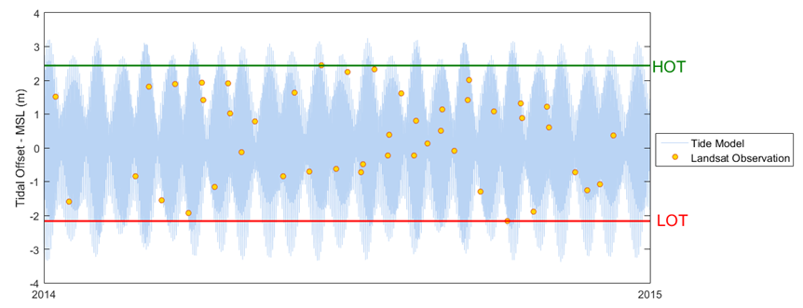
Geoscience Australia
Report on Cal/Val Activities
WGCV Plenary # 41
Intertidal Extents Model
Gridded dataset characterising the spatial extents of the exposed intertidal zone, at intervals of the observed tidal range. Utilises all Landsat observations (5,7, and 8) for Australian coastal regions between 1987 and 2015

Slide 8
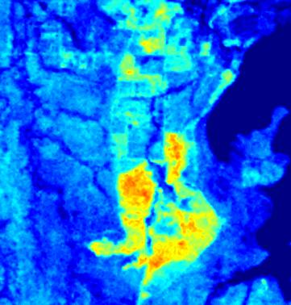
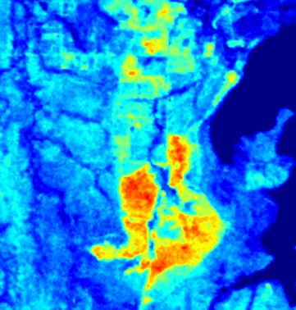
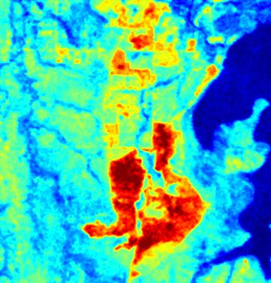
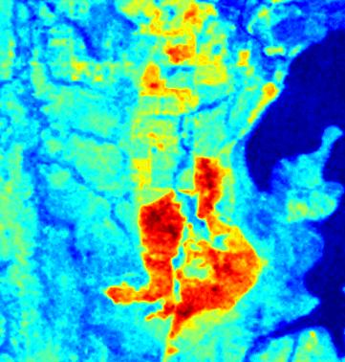
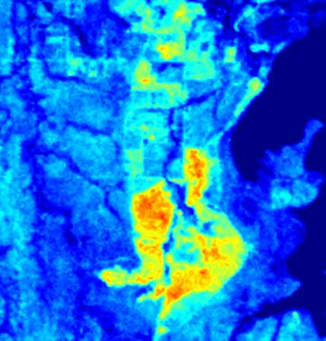

Land Surface Brightness Temperature (K) from Landsat
Li et al., MODSIM 2015 Land surface brightness temperature retrieved from Landsat data
Geoscience Australia
Report on Cal/Val Activities
WGCV Plenary # 42
Balloon
NCEP1
NCEP2
MERRA
ECMWF
NCEP1, NCEP2, MERRA and ECMWF generally give satisfactory T_{B} products meeting 1 K accuracy demanded by many practitioners
The ECMWF data set performs best; Root Mean Square Difference (RMSD) for 9 days and 3 test sites are within 0.4 K compared to T_{B} products estimated using ground-released radiosonde measurements.

Slide 9

Geoscience Australia
Report on Cal/Val Activities
WGCV Plenary # 42
Development of Aus-SPECCHIO was led by University of Wollongong (UoW), supported by ANDS funding.
Consolidation of s/w versions has been completed; migration of field spectral data + SPECCHIO from UoW to GA is being discussed.
As a useful national resource for EO calibration and validation, long-term management plan of field spectral data in SPECCHIO fits with GA’s role as the custodian of national datasets.
National Spectroscopy Database

Slide 10
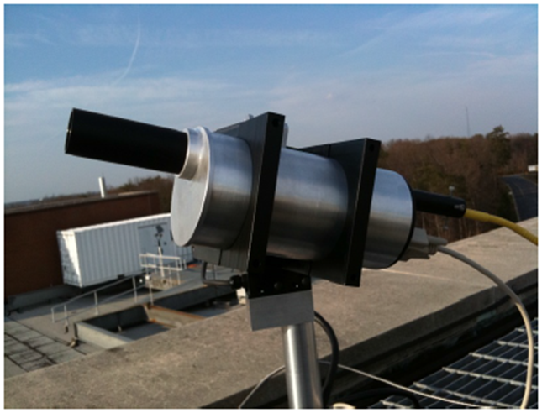
Ground Based Spectrometers
Geoscience Australia
Report on Cal/Val Activities
WGCV Plenary # 42
An ESA proposal for collaborative operation of two spectrometers in Australia (Canberra and Alice Springs) was signed between GA and ESA recently; the instruments hosted by GA will support cal/val, which will benefit both the Australian the global Earth observation data user community.
The spectrometers when installed (Q4 2017), will measure direct solar irradiance and enable atmospheric characterisation to support validation of a number of space-based atmospheric observations.

Slide 11
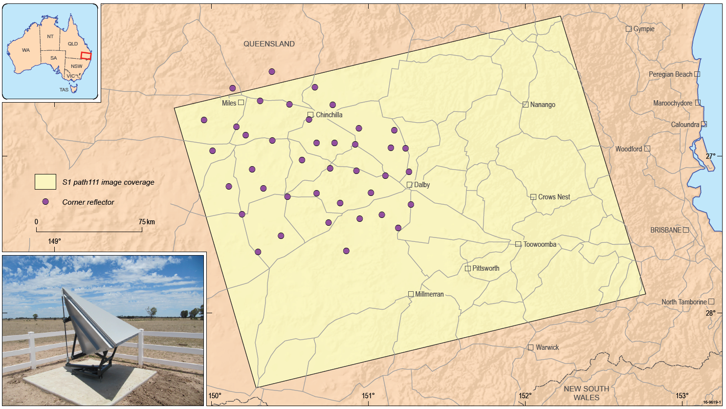
Corner Reflectors for SAR calibration
Geoscience Australia
Report on Cal/Val Activities
WGCV Plenary # 42
40 corner reflectors spread over 100km x 100km
Details of individual CR sites available from the Point and Distributed Targets Database maintained by the CEOS WGCV SAR Subgroup at http://sarcv.ceos.org/targets/target_group/4/

Slide 12
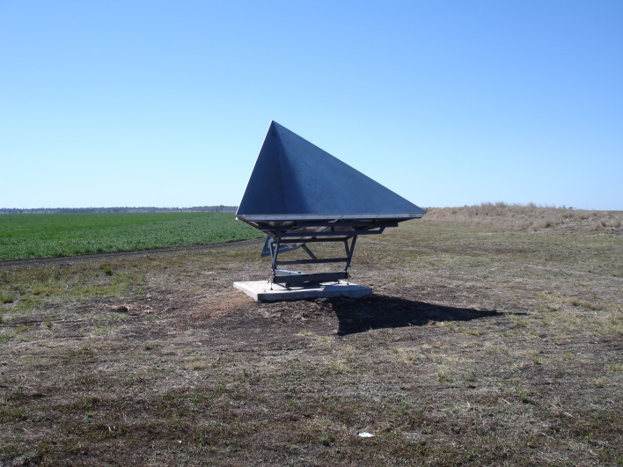
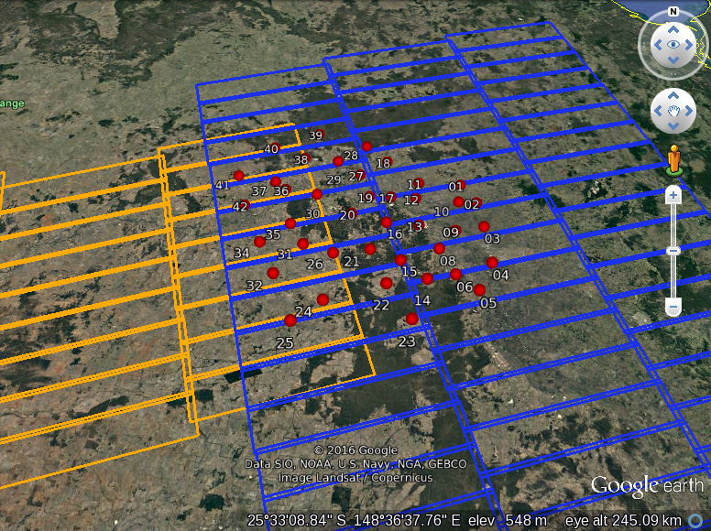
Sentinel-1 Geometric Cal/Val
Geoscience Australia
Report on Cal/Val Activities
WGCV Plenary # 42
40 permanently deployed corner reflectors in QLD
Active research for routine S1 geometric cal/val under ESA “FRM4SAR” project (DLR, University of Zurich, TUM, GA)
CR position errors recently identified and corrected
Two independent ALE analyses of S1 data confirms consistency (next slide)
Current work to compare S1 IWS data and TSX ScanSAR data for the CR array
Image courtesy C. Gisinger, TUM

Slide 13
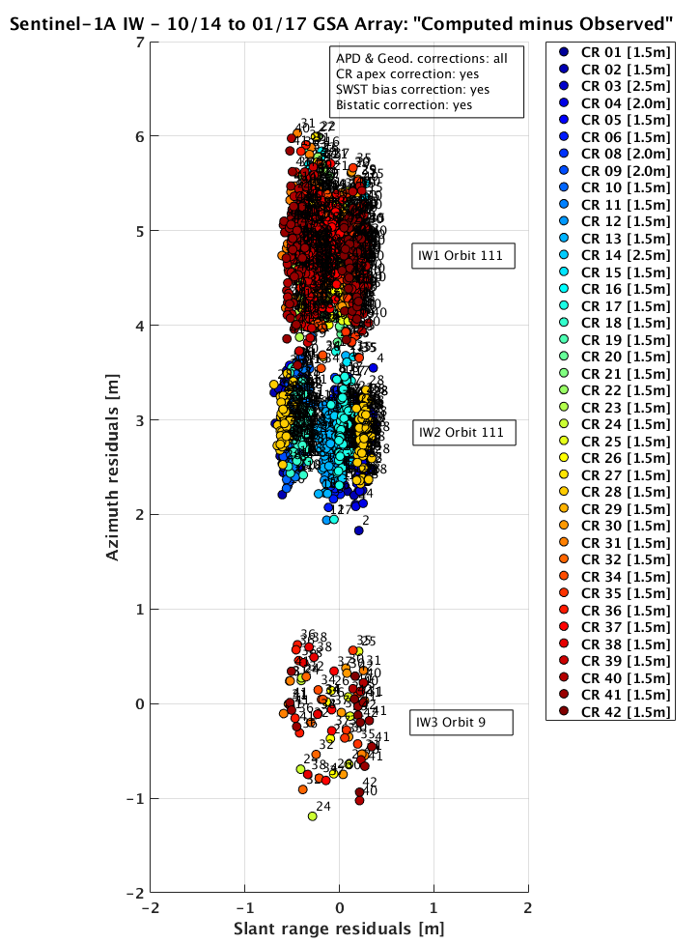
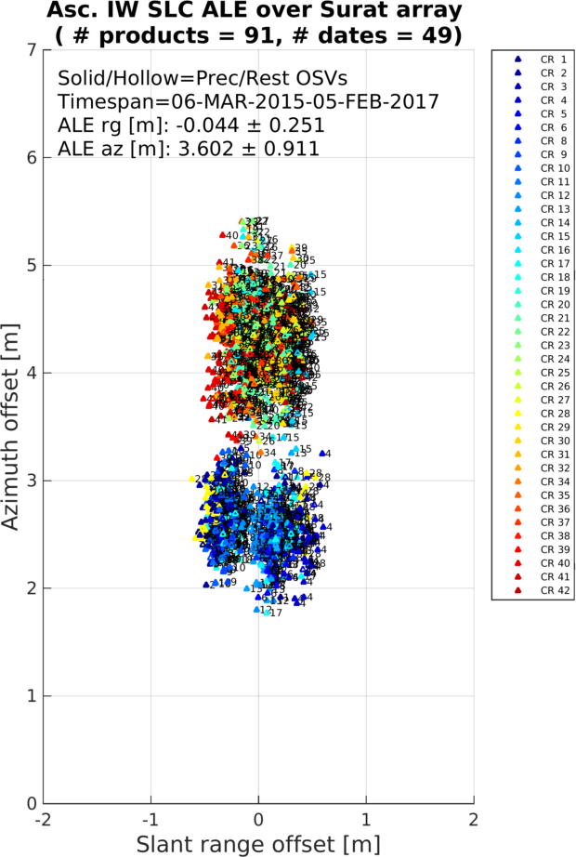
Geoscience Australia
Report on Cal/Val Activities
WGCV Plenary # 42
Sentinel-1 IWS Absolute Location Error measured at QLD corner reflectors
Independent analysis by U Zurich and TUM/DLR
Image courtesy C. Gisinger, TUM
Image courtesy A. Schubert, U. Zurich

Slide 14






Geoscience Australia
Report on Cal/Val Activities
WGCV Plenary # 42
International collaboration
European Space Agency (ESA): Active discussion to collaborate on cal/val for Copernicus, GA to host Pandora Spectrometers; work on geometric calibration with corner reflectors dedicated for Sentinel-1 (joint work with DLR)
USGS / NASA: Collaboration on data cubes; GA representation on LTWG, LGSOWG, Landsat Science Team
ISRO: Collaborative agreement for SAR calibration support using corner reflectors
CEOS: Executive Officer, ACIX and SAR workshops

Slide 15
Geoscience Australia
Report on Cal/Val Activities
WGCV Plenary # 42
Open Data Cube
Initiated though a CEOS Data Cube meeting in Canberra in February 2017.
Building off active collaborations between GA, CSIRO, NCI, USGS, NASA and CEOS.
The foundation of Project participation is openness and transparency.
Software developed using tools like github, released under open source license to support local regional national and international capabilities.
The community governs itself through:
    a Steering Council made up of active contributors (i.e.
    individuals, not institutions)
    engagement in public forums to discuss and debate the direction
    of the Project.

Slide 16
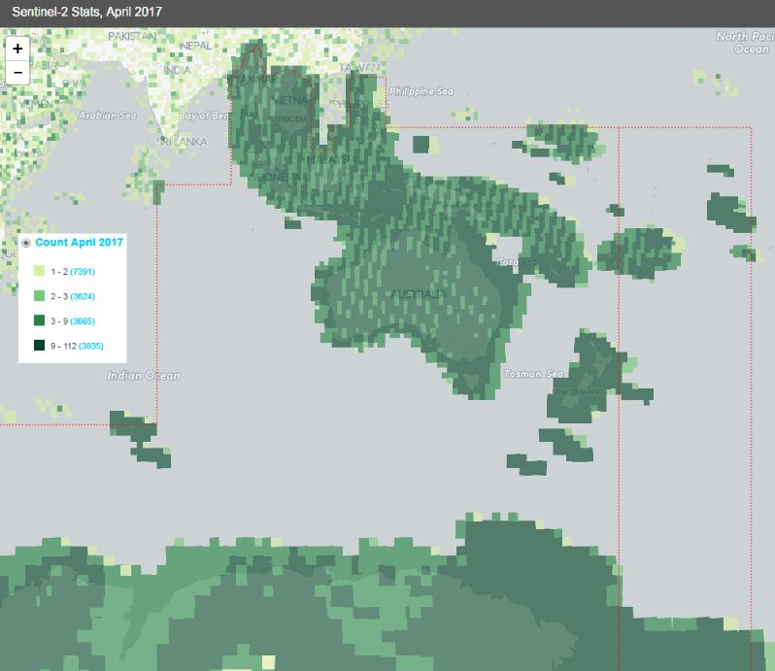
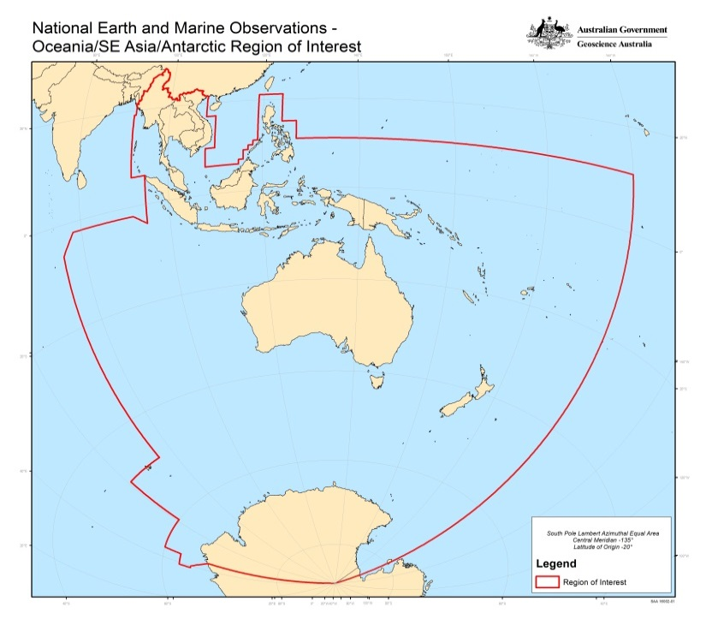














Australia’s Regional Copernicus Data Hub
Geoscience Australia
Report on Cal/Val Activities
WGCV Plenary # 42
Archive size & growth (end of April 2017)
All Sentinel Products For
  Data Size (TB) Change (TB) Files
Sentinel-3 | 218 | +51 | n.a.
Sentinel-2 | 117 | +14 | 103,420 (2017) 89,285 (2016) 3,012 (2015)
Sentinel-1 | 221 | +42 | n.a.
Supporting
Consortium
Partners
Collaborators

Slide 17
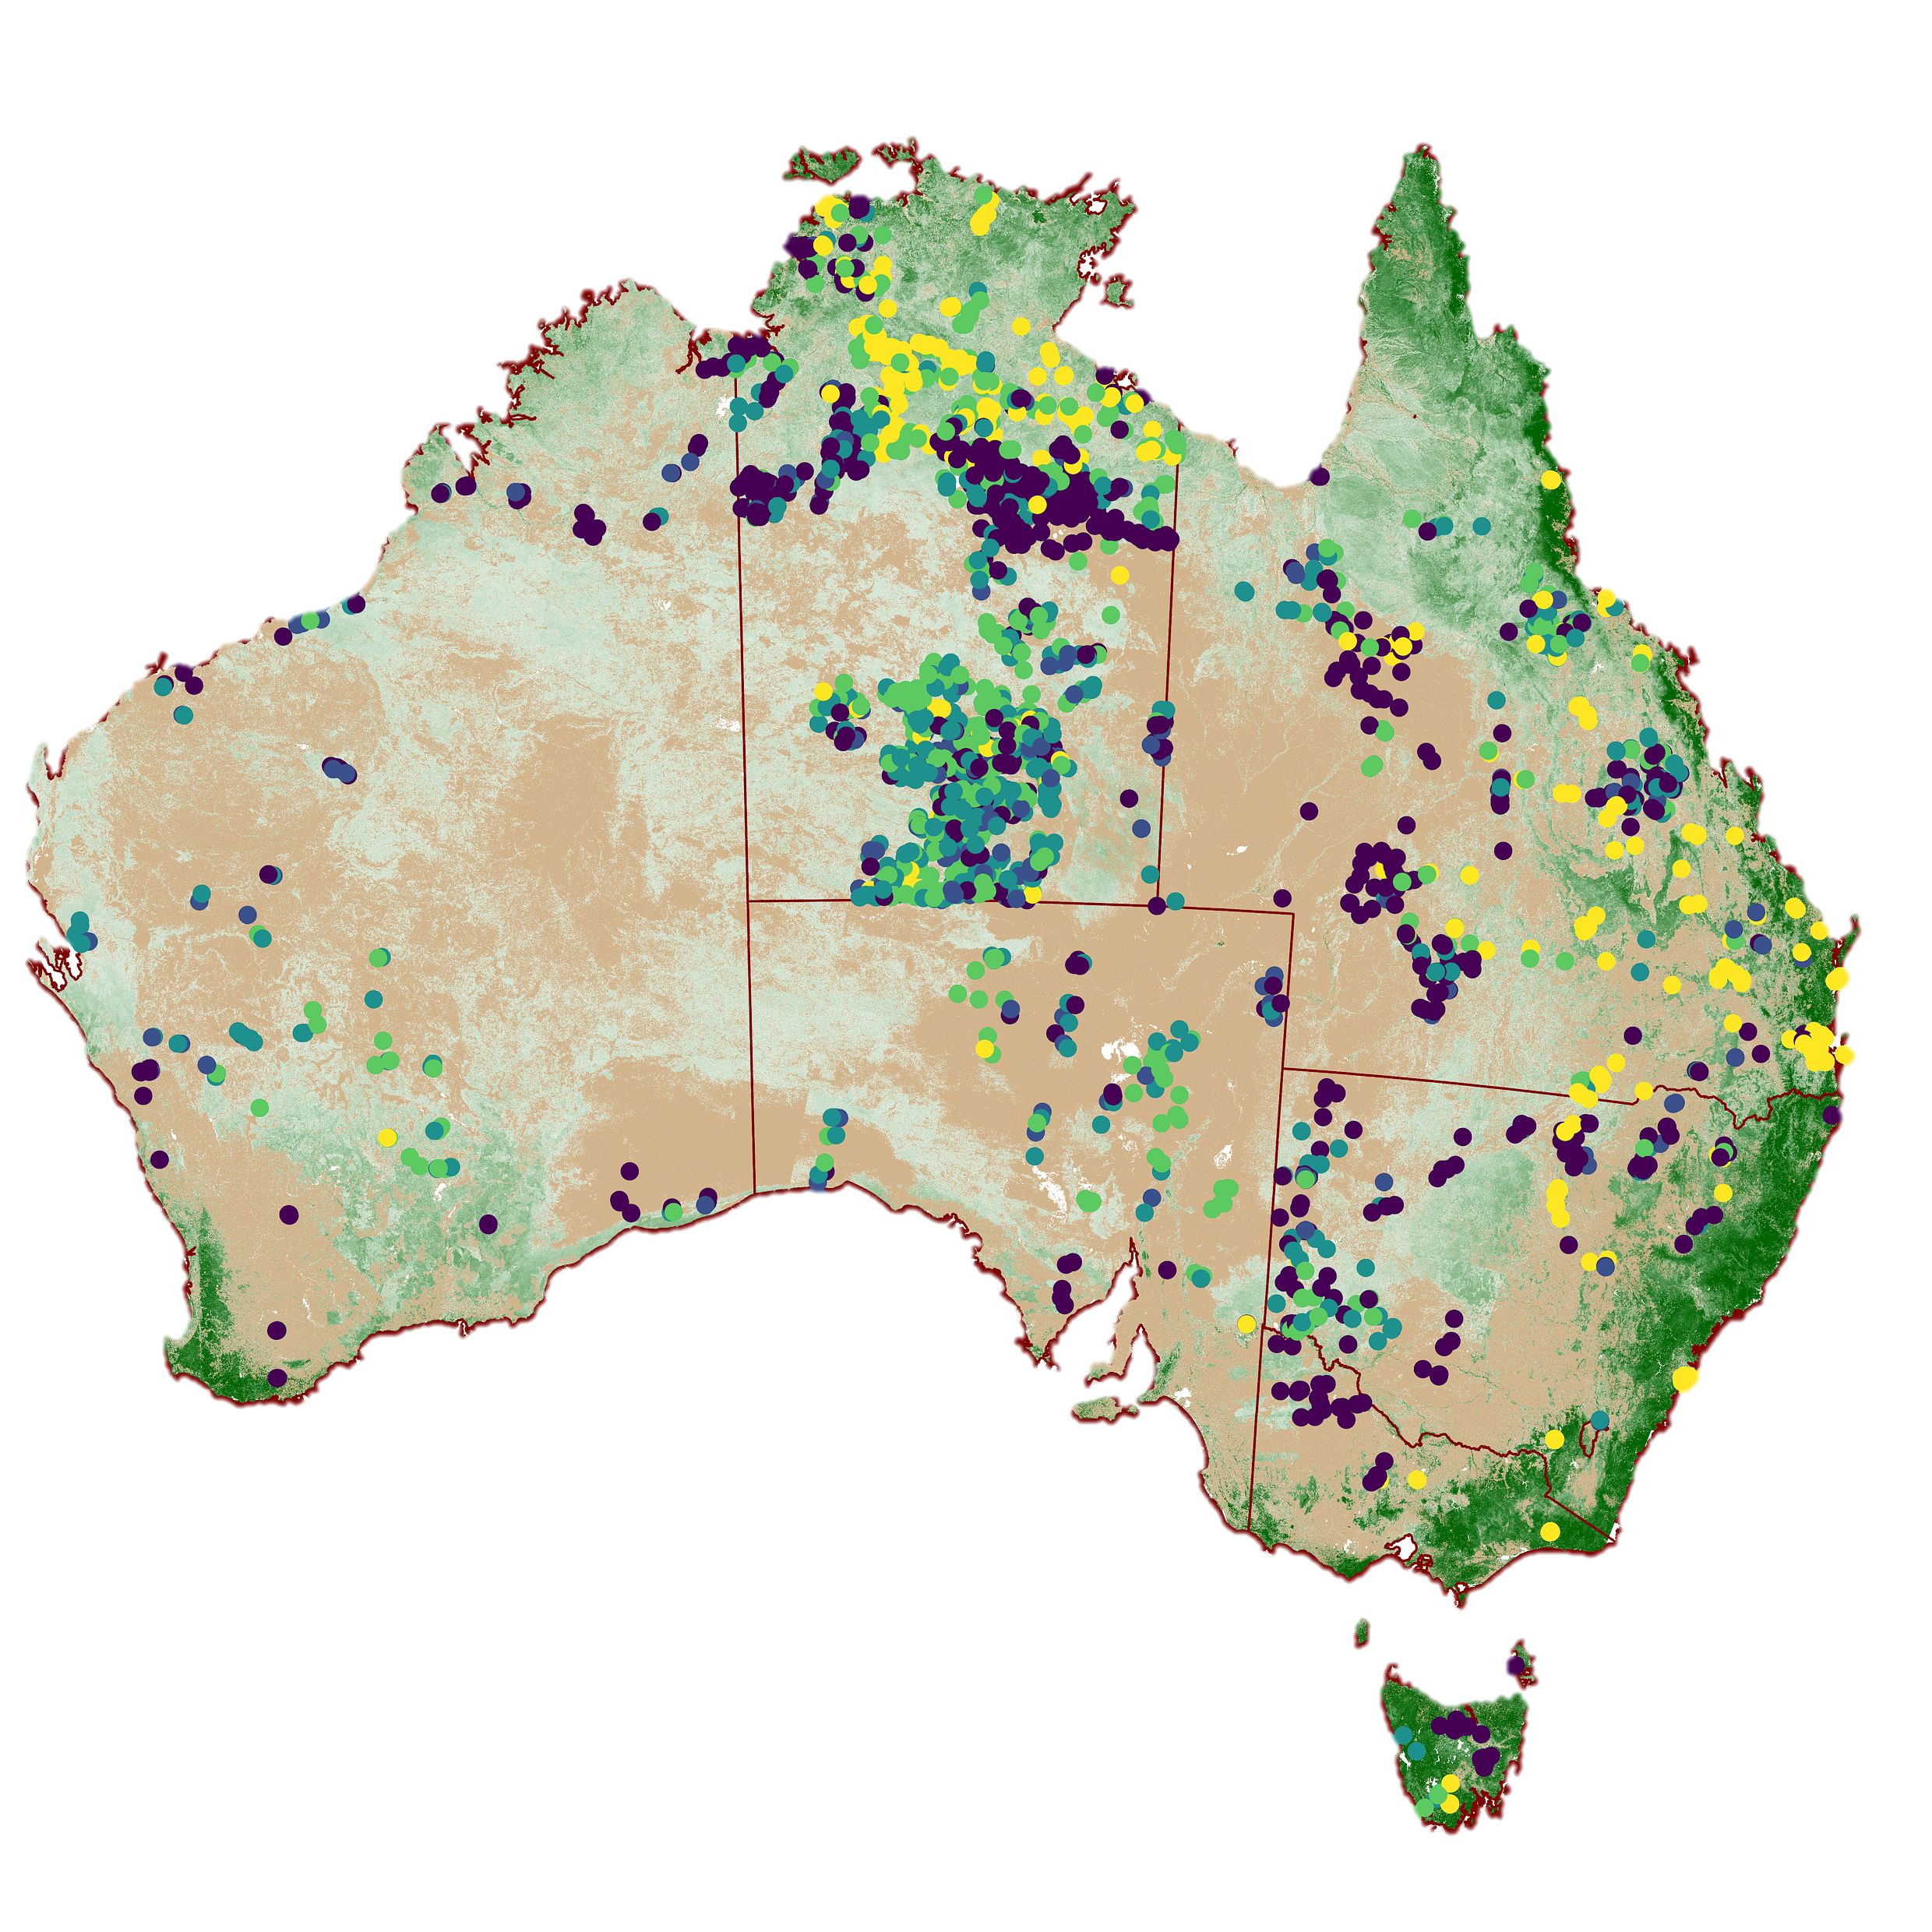
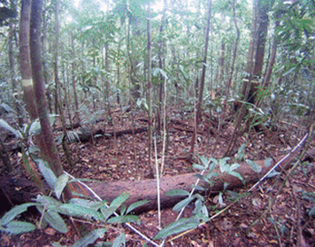
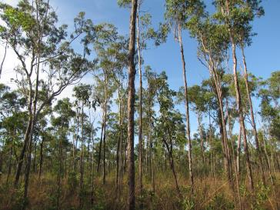
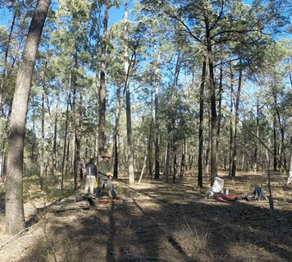
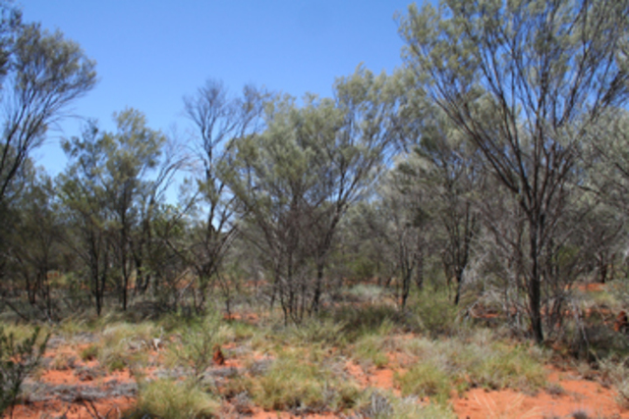
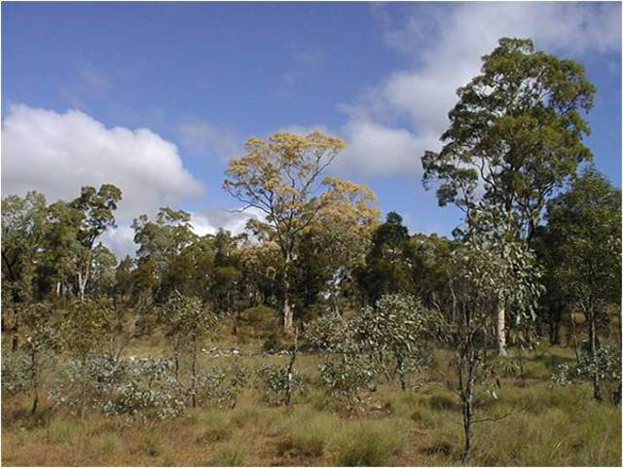
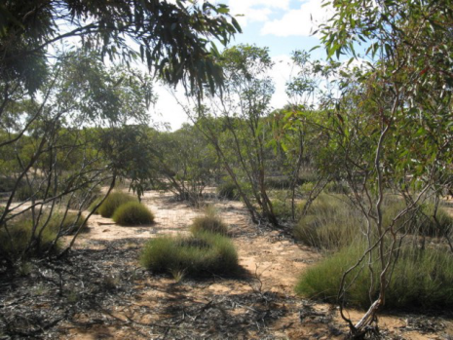
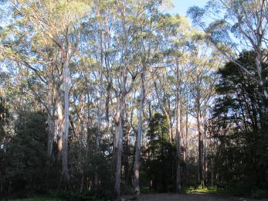
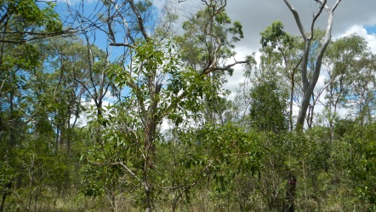
Geoscience Australia
Report on Cal/Val Activities
WGCV Plenary # 42
3100 vegetation cover and strata transects for landcover Cal Val Peter Scarth et al
Primarily collected by State Agencies and hosted by ABARES and TERN AusCover

Slide 18
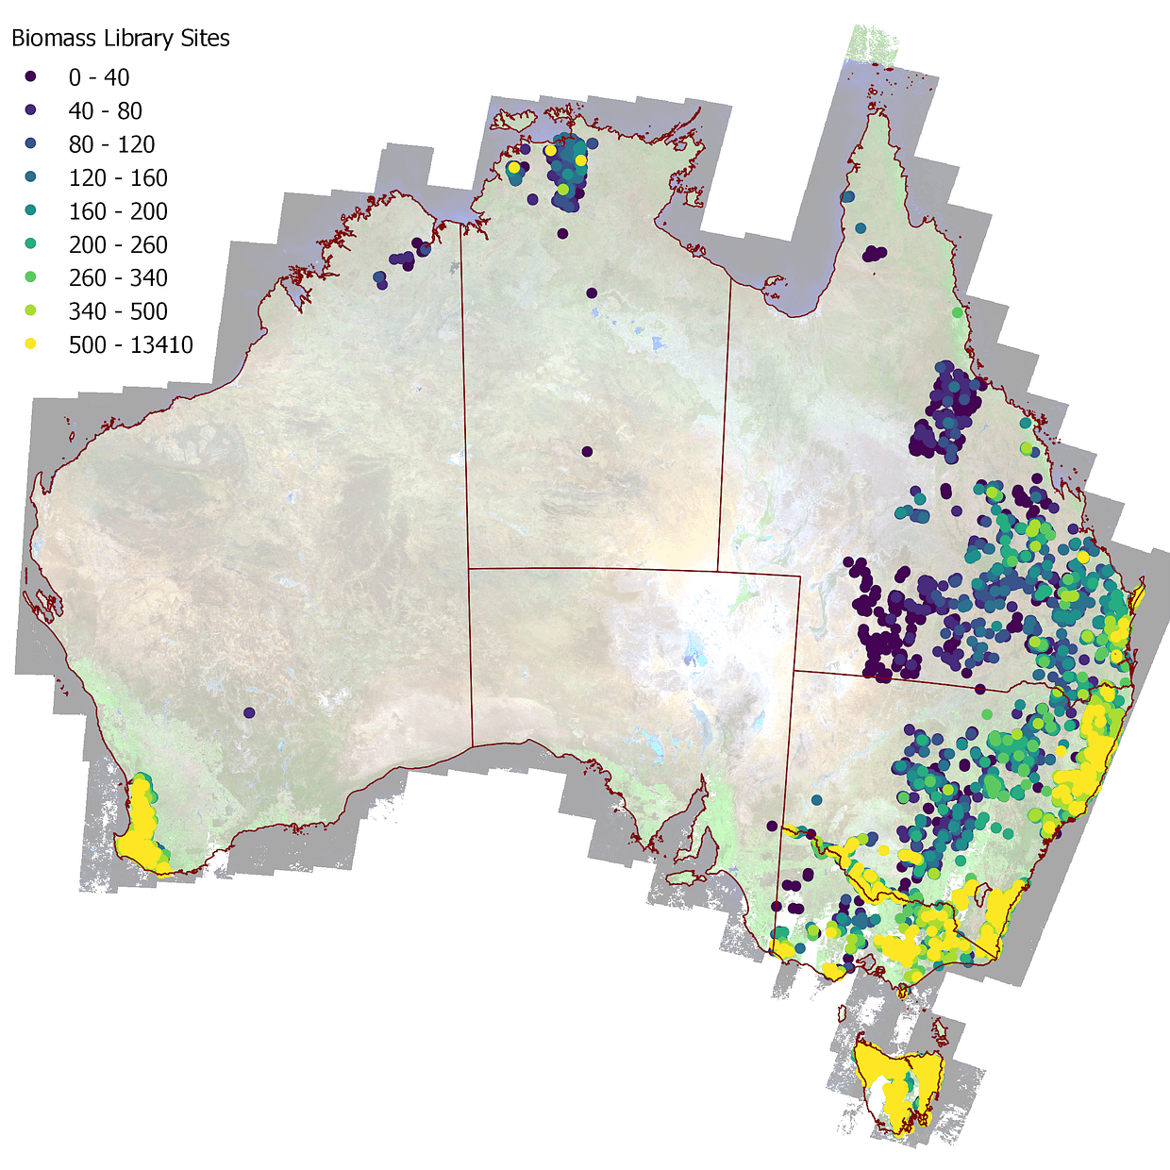
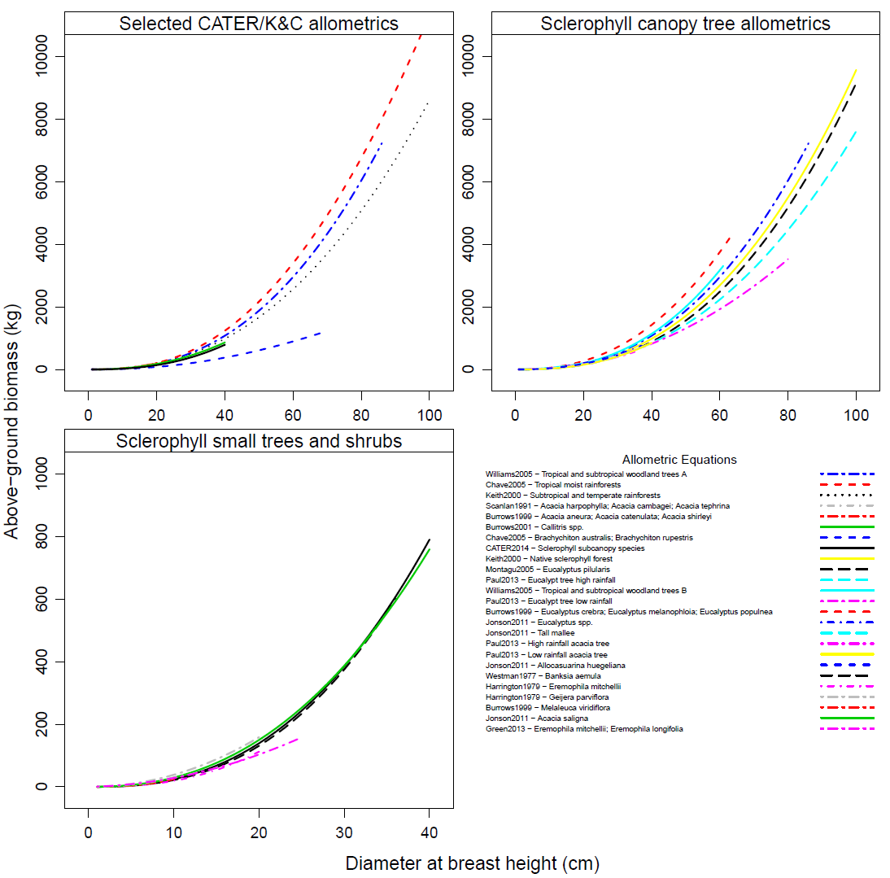
Geoscience Australia
Report on Cal/Val Activities
WGCV Plenary # 42
National Above-Ground Biomass Library Peter Scarth et al
The Biomass Plot Library is a collation of stem inventory data across federal, state and local government departments, universities, private companies and other agencies. It was motivated to the need for calibration/validation data to underpin national mapping of above-ground biomass from integration of Landsat time-series, ICESat/GLAS lidar, and ALOS PALSAR backscatter data under the auspices of the JAXA Kyoto & Carbon (K&C) Initiative (Armston et al., 2016). At the time of Version 1.0 publication 1,073,837 hugs of 839,866 trees across 1,467 species had been collated. This has resulted from 16,391 visits to 12,663 sites across most of Australia's bioregions. Data provided for each project by the various source organisation were imported to a PostGIS database in their native form and then translated to a common set of tree, plot and site level observations with explicit plot footprints where available
Notes:
18

Slide 19
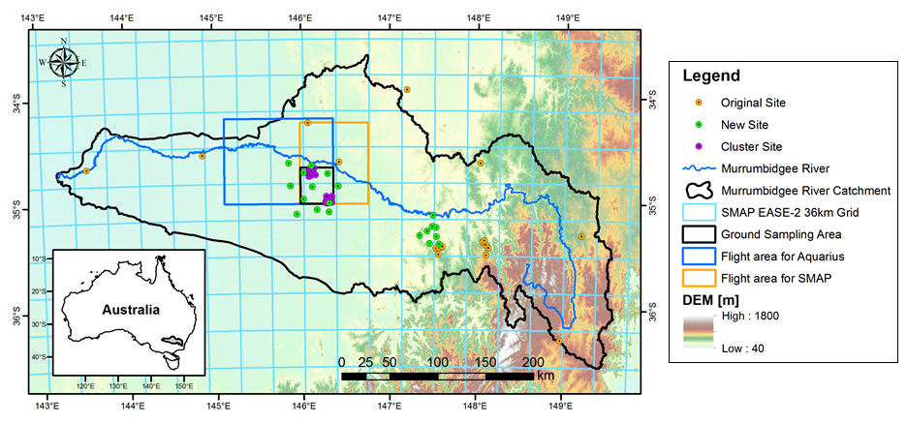
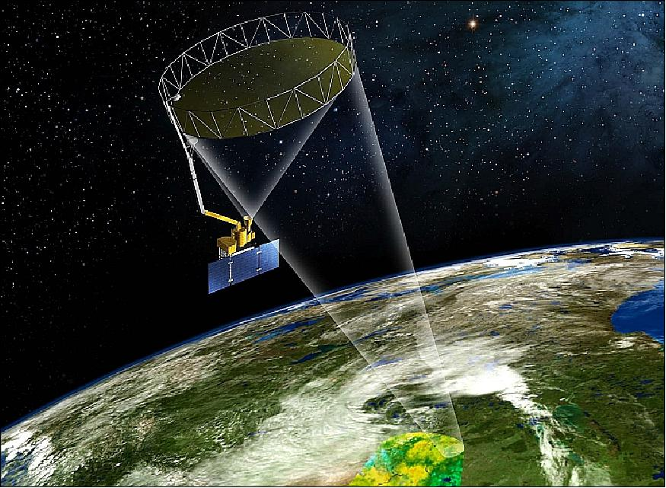
SMAP experiments (SMAPEx)
Jeff Walker, Ye Nan, et. al.
Geoscience Australia
Report on Cal/Val Activities
WGCV Plenary # 42
Murrumbidgee
Soil Moisture Active and Passive satellite
Kyeamba
Yanco
SMAPEx is series of five airborne field experiments in the Murrumbidgee River Catchment, southeast of Australia. Airborne radar and radiometer observations at L-band were collected together with intensive ground sampling during the campaigns (http://smapex.monash.edu.au).
SMAPEx-1 to -3 were conducted before SMAP launch from Jul 2010 to Sep 2011 to develop/test SMAP baseline radar and radiometer soil moisture retrieval and downscaling algorithm.
SMAPEx-4 and -5 were conducted after SMAP launch from May and Sep 2015 to evaluate SMAP radar and radiometer observations, inter-compare between airborne, SMAP, Aquarius, and SMOS radiometer and radar observations, validate SMAP SM_P, SM_A, SM_AP retrieval algorithms using airborne soil moisture retrieval results (SMAPEx) and monitoring network (OzNet http://www.oznet.org.au), and develop/test alternative spatial enhancement algorithms.

Slide 20
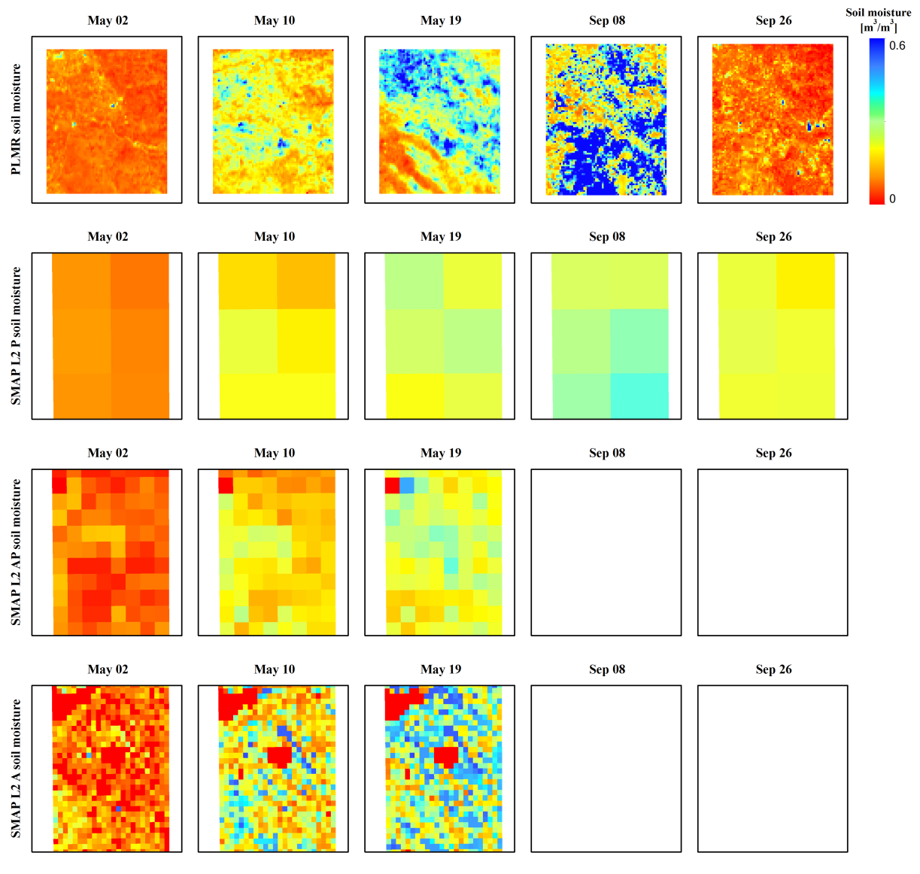
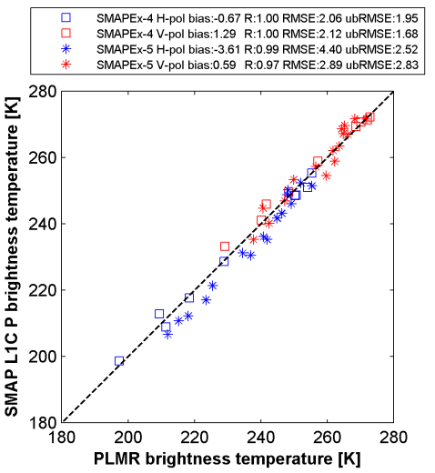
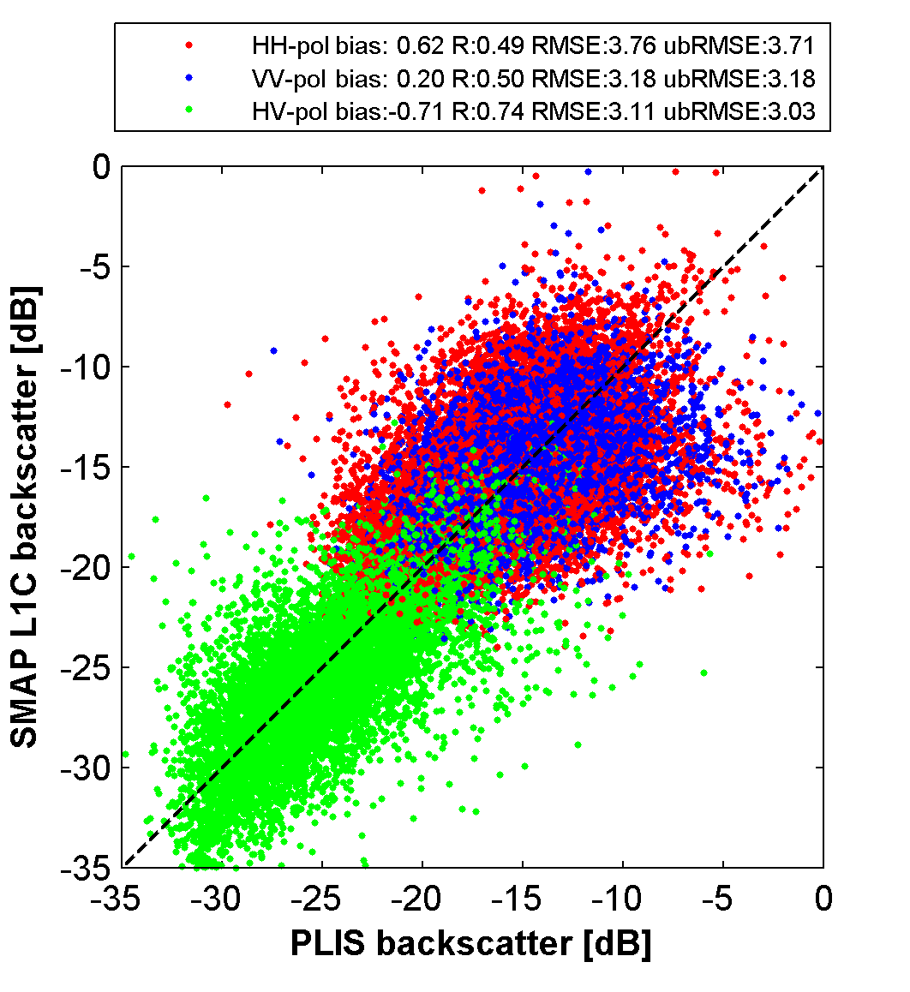
Key outcomes
Geoscience Australia
Report on Cal/Val Activities
WGCV Plenary # 42

Slide 21
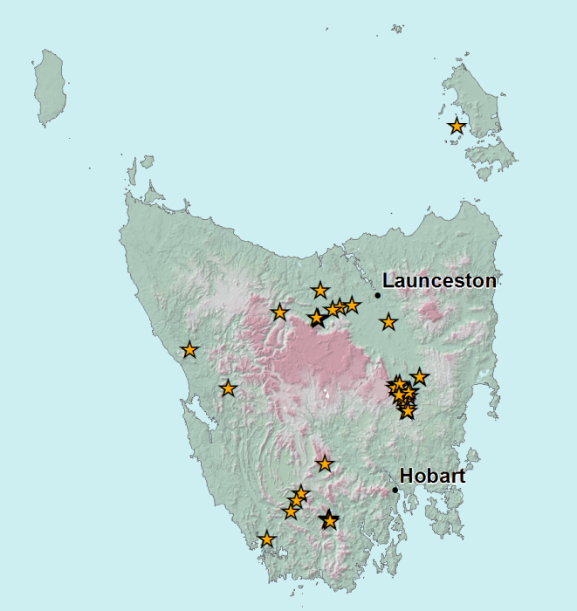
Geoscience Australia
Report on Cal/Val Activities
WGCV Plenary # 42
EO Calibration & Validation in Tasmania – 2017
Lindsay Mitchell, et. al.
67 star transect field sites have been collected within Tasmania as part of the Land Cover Program. The majority of sites (61) have been in non-forested environments and a focus on forested sites (particularly high canopy cover) sites has been identified for future campaigns. All data is publicly available via the AusCover website.
At least 10 -15 new star transects are planned for each summer with a spread across all vegetation communities (alpine to coastal).
Available LiDAR coverage for the state has recently been expanded through the acquisition of data commissioned by Forestry Tasmania. This data will also be explored and shared for validation purposes.
A collaborative arrangement is currently been progressed with the University of Tasmania to further research into UAS technology as a means of EO validation.
Tasmanian EO Calibration & Validation activities

Slide 22
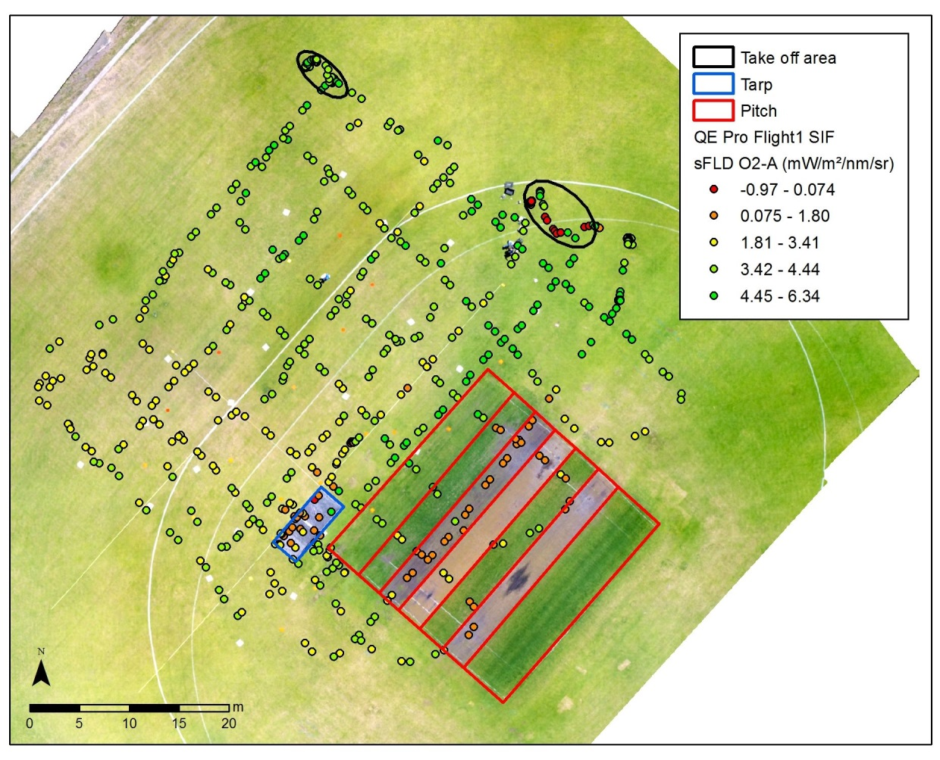
Results of the first SIF UAS test flight Arko Lucier et al
Geoscience Australia
Report on Cal/Val Activities
WGCV Plenary # 42
Source: Juliane Bendig

Slide 23
Thank you
Geoscience Australia
Report on Cal/Val Activities
WGCV Plenary # 42
medhavy.thankappan@ga.gov.au

