Slide 1

NASA
Report on Cal/Val Activities
K. Thome
NASA/GSFC
Agency Report
WGCV Plenary # 42
September 5-7, 2016

Slide 2
NASA ESD Flight Portfolio through 2022
SAGE III launched to ISS
The Earth Systematic Missions (ESM) development missions in this period include:
  ICESat-2, GRACE-FO, SWOT, Landsat-9, RBI, TSIS-1 and -2, OMPS-Limb, NISAR, PACE, Jason CS/Sentinel 6A and -B, CLARREO Pathfinder
The Earth Systematic Missions (ESM) on-orbit* missions include:
    SMAP (>2021), DSCOVR (2019), S-NPP (>2021), GPM (>2021), LDCM (>2021), Terra (>2021), Aqua (>2021), Aura (>2021), OSTM (>2021), QuikScat (2015), SORCE (2017), and EO-1 (2016); also RapidScat (2017) and CATS (>2016)
    Many have recently completed their Senior Review process
The Earth System Science Pathfinder (ESSP) development missions in this period include:
  OCO-3, CYGNSS, TEMPO, GEDI, ECOSTRESS, EVS-2 and -3 and Venture Technology selections (GrAOWL, Tempest), EVM-2 & 3, EVI-3, 4, 5, and 6
The Earth System Science Pathfinder (ESSP) on-orbit missions include:
  OCO-2 (>2021), GRACE (2018), CALIPSO (>2021), CloudSat (2018), Aquarius (>2021)

Slide 3



























Formulation
Implementation
Primary Ops
Landsat 9
Extended Ops
PACE
NI-SAR
SWOT
TEMPO
JPSS-2 (NOAA)
RBI, OMPS-Limb
Sentinel-6A/B
GRACE-FO (2)
ICESat-2
Earth Science Instruments on ISS:
RapidScat, CATS,
LIS, SAGE III (on ISS), TSIS-1, OCO-3, ECOSTRESS,
GEDI, CLARREO-PF
CYGNSS
ISS
SORCE,
TCTE (NOAA)
NISTAR, EPIC
(NOAA’S DSCOVR)
QuikSCAT
Landsat 7
(USGS)
EO-1
SMAP
Terra
Suomi NPP (NOAA)
Aqua
Landsat 8
(USGS)
CloudSat
CALIPSO
GPM
Aura
GRACE (2)
OSTM/Jason 2
(NOAA)
OCO-2

Slide 4
Formulation
Implementation
Primary Ops
Landsat 9
Extended Ops
PACE
NI-SAR
SWOT
TEMPO
JPSS-2 (NOAA)
RBI, OMPS-Limb
Sentinel-6A/B
GRACE-FO (2)
ICESat-2
Earth Science Instruments on ISS:
RapidScat, CATS,
LIS, SAGE III (on ISS), TSIS-1, OCO-3, ECOSTRESS,
GEDI, CLARREO-PF
CYGNSS
EO-1 (Hyperion and ALI) was turned off in March 2017
ISS
SORCE,
TCTE (NOAA)
NISTAR, EPIC
(NOAA’S DSCOVR)
QuikSCAT
Landsat 7
(USGS)
EO-1
SMAP
Terra
Suomi NPP (NOAA)
Aqua
Landsat 8
(USGS)
CloudSat
CALIPSO
GPM
Aura
GRACE (2)
OSTM/Jason 2
(NOAA)
OCO-2

Slide 5
Formulation
Guidance in President’s FY18 budget proposes significant changes in the funding and schedule of PACE and three other missions
Implementation
Primary Ops
Landsat 9
Extended Ops
PACE
NI-SAR
SWOT
TEMPO
JPSS-2 (NOAA)
RBI, OMPS-Limb
Sentinel-6A/B
GRACE-FO (2)
ICESat-2
Earth Science Instruments on ISS:
RapidScat, CATS,
LIS, SAGE III (on ISS), TSIS-1, OCO-3, ECOSTRESS,
GEDI, CLARREO-PF
CYGNSS
EO-1 (Hyperion and ALI) was turned off in March 2017
ISS
SORCE,
TCTE (NOAA)
NISTAR, EPIC
(NOAA’S DSCOVR)
QuikSCAT
Landsat 7
(USGS)
EO-1
SMAP
Terra
Suomi NPP (NOAA)
Aqua
Landsat 8
(USGS)
CloudSat
CALIPSO
GPM
Aura
GRACE (2)
OSTM/Jason 2
(NOAA)
OCO-2

Slide 6
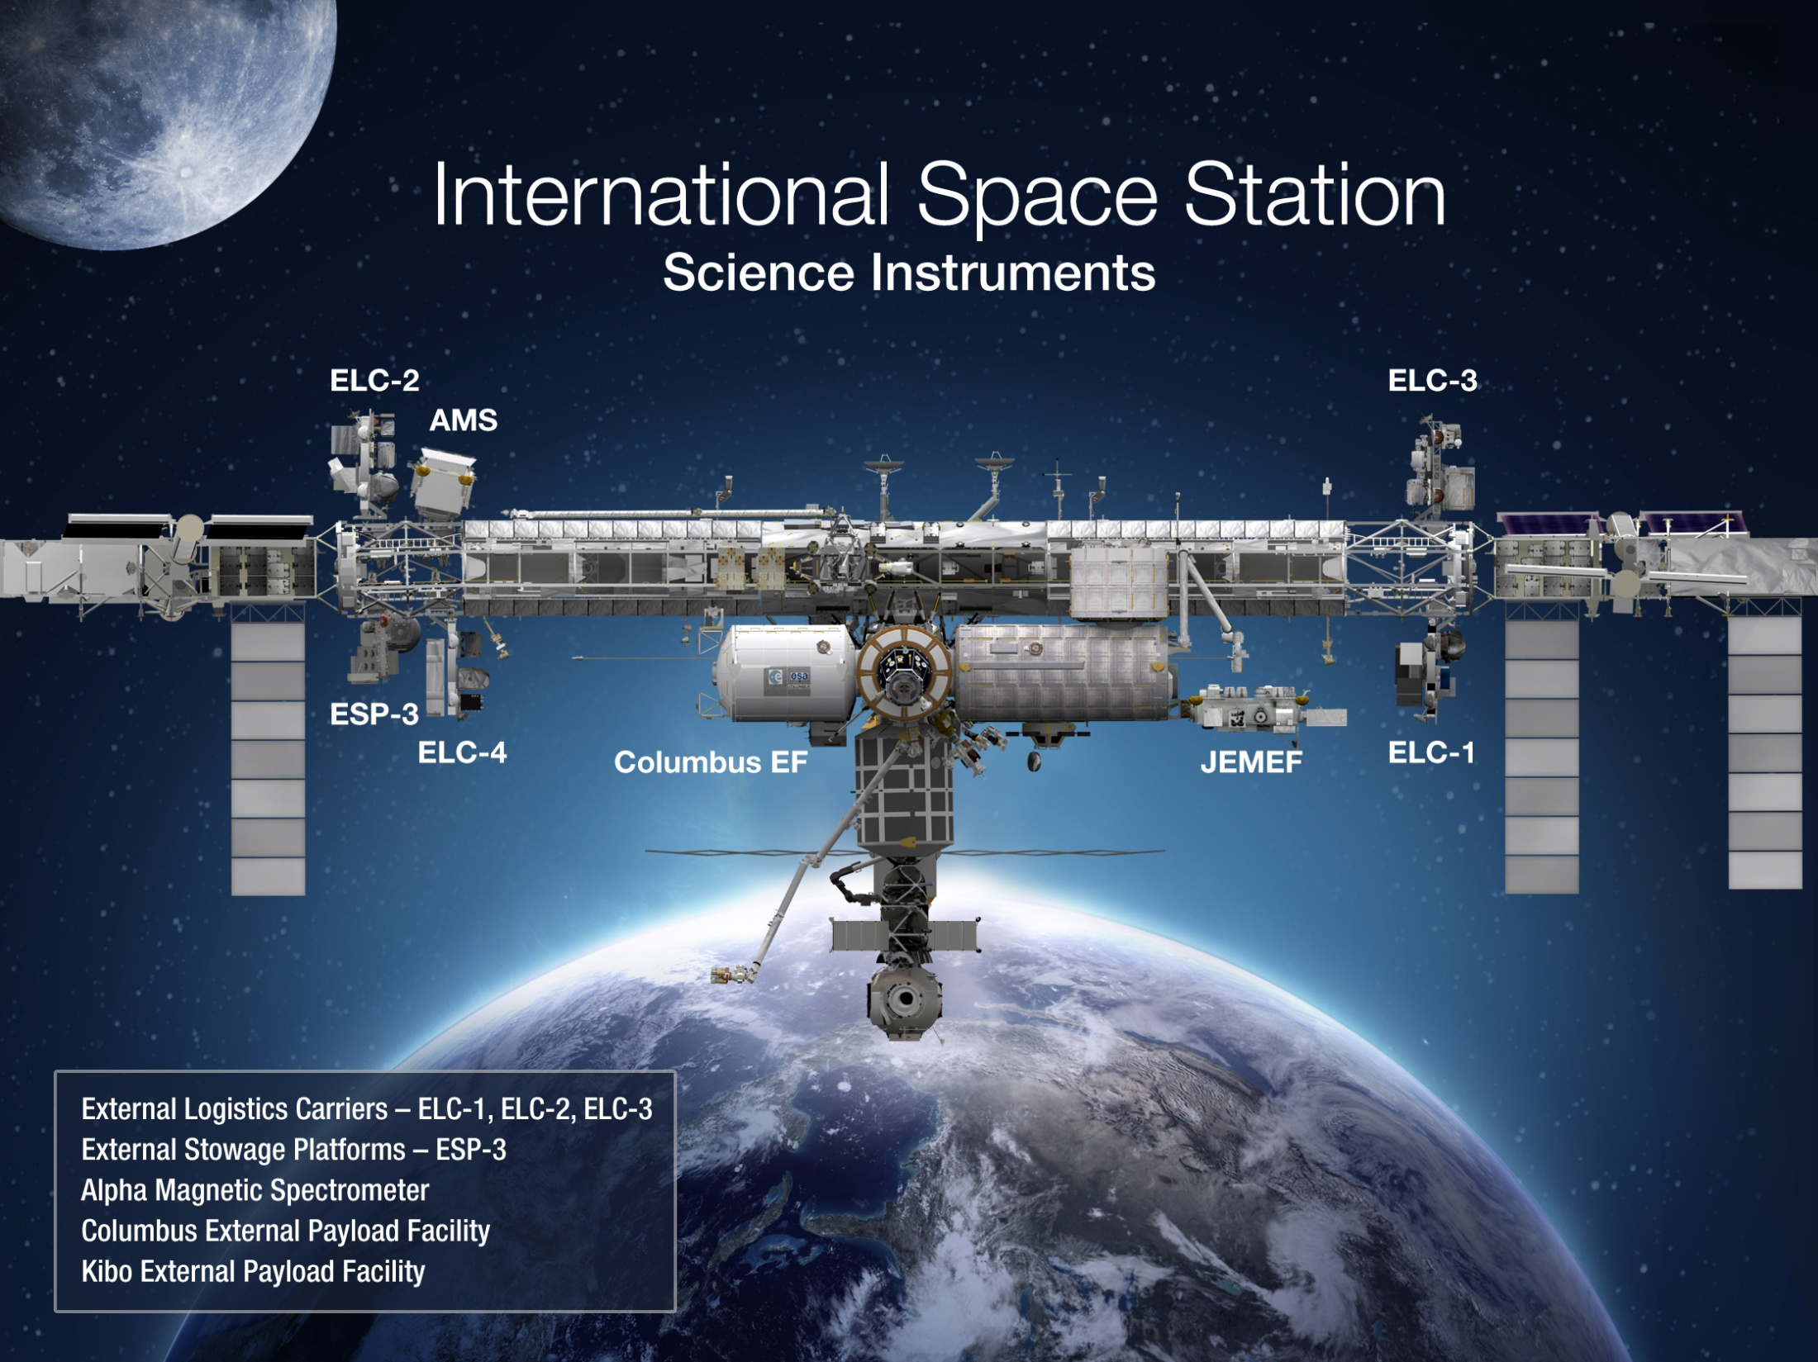
Earth
LIS (2016)
SAGE III (launched)
ISERV (2012)
CATS (2014)
OCO-3 (2017)
GEDI (>2018)
ECOSTRESS (>2018)
RapidSCAT (2014)

Slide 7
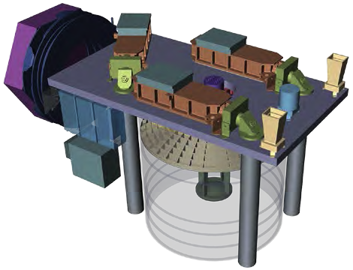
Venture Class Activities - GEDI
Mission type: Class C, ISS
12 GEDI Lidar: Global Ecosystem Dynamics Investigation Lidar
PI: Ralph Dubayah
Mission & Science Team:
Principal Investigator: Ralph Dubayah, UMD
Project Manager: TBD, GSFC
Instrument System Engineer: Cheryl Salerno, GSFC
Deputy PI Instrument / Instrument Scientist: Bryan Blair, GSFC
Deputy PI Science: Scott Goetz, WHRC
Instrument Deputy Project Manager: Thomas Johnson, GSFC
Mission & Science Team:
University of Maryland, College Park
Goddard Space Flight Center Woods Hole Research Center
US Forest Service Brown University
Mass = 230 kg
Pwr_{Orb Avg} = 516 W
Volume = .xx m³
Data rate_{avg} = 2.1 Mbps
Mission:
GEDI will characterize the effects of changing climate and land use on ecosystem structure and dynamics, enabling improved understanding of Earth’s carbon cycle and biodiversity. GEDI will provide the first global, high-resolution observations of forest vertical structure.
Goals:
GEDI will address the following questions:
What is the above-ground carbon balance of the land surface?
What role will land surface play in mitigating atmospheric CO2?
How does ecosystem structure affect habitat quality and biodiversity?
GEDI measurements will quantify the following:
Distribution of above-ground carbon at fine spatial resolution
Changes in carbon resulting from disturbance and subsequent recovery
Spatial and temporal distribution of forest structure and its relationship to habitat quality and biodiversity
Sequestration potential of forests over time w/changing land use, climate
Instrument: Lidar
Heritage: HOMER (laser); GLAS, CALIPSO (optics); IceSat, (detectors)
Instrument Details:
Self-contained laser altimeter
3 lasers are split into 7 beams dithered to produce 14 ground track spot beams.
Beams have a 25 meter footprint and are spaced 500 m cross-track and 60 m along-track to produce fine grids of forest structure.
70 cm diameter telescope/receiver.
Detector has 75% transmission and 50% quantum efficiency.
Si:APD detectors: Near-photon-noise limited, >500:1 dynamic range
IFOV matched to contain return spot beams
GPS, IMU, Star Trackers give precise ranging, attitude and position.
A single-axis mechanism rotates the instrument about the roll axis, providing off-nadir pointing for global coverage.
Canopy profile accurate to 1 m
Geolocation < 10 m for plot calibration
• Biomass error < 20% at pixel level
FY16 Cost: $94.034M, $18.652M reserve, $2.815 contribution
Descopes: Reduce lasers from 3 to 2, elim. dithering unit.: $11.4M (FY16 $)
Threshold: Acquire canopy vertical profile to estimate above-ground woody carbon density for vegetated areas at <1 km.
Schedule: 40.5 mo. A/B/C, 19.5 mo. E/F, 12 weeks reserve
Notes:
7

Slide 8
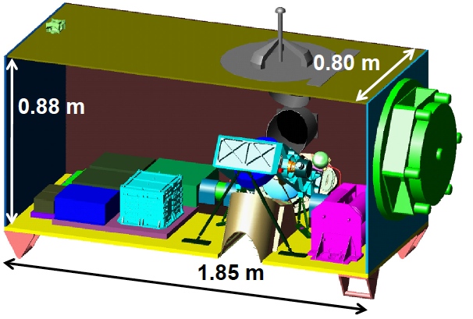
Venture Class Activities - ECOSTRESS
Mission type: Class C, ISS
ECOSTRESS: ECOsystem Spaceborne Thermal Radiometer Experiment on Space Station PI: Simon Hook
Mission & Science Lead:
Principal Investigator: Simon Hook, JPL
Major Partners:
Jet Propulsion Laboratory
Mass = 266 kg
Pwr_{Orb Avg} = 527 W
Volume = 1.30 m³
Data Rate_{avg} = 2.32 Mbps
Instrument Details:
Thermal infrared radiometer
Cross-track whisk broom scanner
Swath width: 384 km (51°)
Spatial resolution: 38 m x 57 m (nadir) pixels
Five thermal IR bands between 8.3 and 12.1 microns
Noise equivalent delta temperature: ≤ 0.1 K
Two COTS cryocoolers for 60 K focal plane
Typical revisit of 90% of CONUS every 4 days at varying times over diurnal cycle
Mission:
An Earth Venture Instrument-2 selection, ECOSTRESS will provide the first high spatiotemporal resolution thermal infrared measurements of Earth’s surface from ISS. Measurements at varying times over the diurnal cycle will reveal answers related to water stress in plants and how selected regions will respond to future climate changes.
Goals:
• Identify critical thresholds of water use and water stress in key climate-sensitive biomes.
• Detect the timing, location, and predictive factors leading to plant water uptake decline and/or cessation over the diurnal cycle
• Measure agricultural water consumptive use over the contiguous United States (CONUS) at spatiotemporal scales applicable to improve drought estimation accuracy
Heritage:
Prototype Hyperspectral Infrared Imager (HyspIRI) Thermal Infrared Radiometer (PHyTIR; a laboratory instrument); Algorithms: ASTER, MODIS, Landsat
Notes:
8

Slide 9
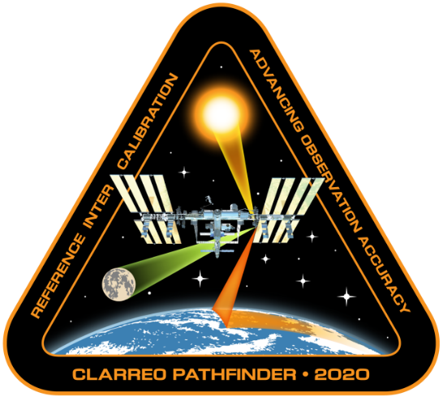
CLARREO Pathfinder is in Phase A and moving towards Phase B later this summerr
Demonstrate
  Essential measurement technologies for the Reflected Solar portion of the full Tier 1 Decadal Survey-recommended CLARREO mission
  On-orbit, high accuracy, SI-Traceable calibration
  Ability to transfer calibration to operational sensors
Formulation, implementation, launch to ISS, and operation of a Reflected Solar (RS) Spectrometer
Class D Mission with Nominal 1-year mission life
Additional 1 year science data analysis
One of the missions specifically identified in the

Slide 10
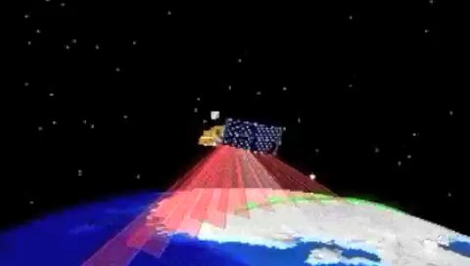
Terra Gymnastics

Slide 11
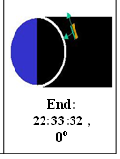
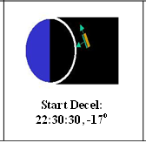
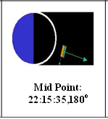
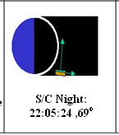
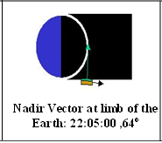
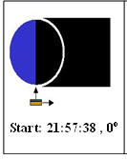
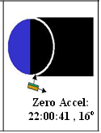
Background
DSC Concept Diagram - Animation
Note: The Blue block on S/C is the Instrument Deck.

Slide 12
Terra lunar manuever
Geometry - ASTER Science Team determined several opportunities in 2016 and 2017 for which the geometry is close to that of April 2013
  Lunar reflectance varies with phase angle, libration, and nutation
  Terra FOT and PSO were evaluating Terra end of mission fuel use scenarios in 2016
  Next best options are July and August 2017 with August more closely mathcing the the April 2003 geometry
  More similar geometry provides better relative agreement between the two data points
ASTER TIR -Most ASTER TIR detectors saturated in April 2003
  TIR response has degraded since 2003
  Only Band 10 will be saturated
  Non-saturated Lunar image provide an additional calibration source to the OBC

Slide 13
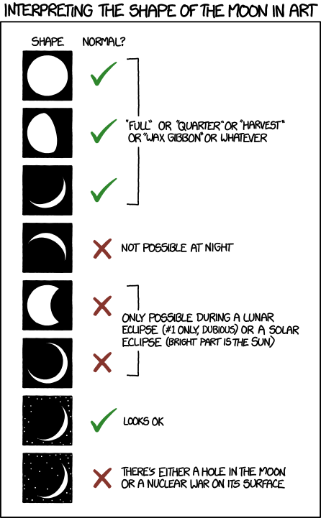
Why now? - Moon is better understood
Lunar models providing better absolute and relative knowledge
Two new NASA projects have been funded to measure the lunar irradiance from high altitude and space
USGS Robotic Lunar Observatory (ROLO) model combined with meteorological sensors have improved phase, nutation, and libration corrections
French and Japanese sensors have provided additional on-orbit measurements of lunar radiance

Slide 14
Science Gain from 2017
Second lunar view will provide key data for ASTER, MISR, MODIS radiometric calibration
MODIS will view the moon with a near-nadir view
  Monthly collects are at edge of scan (possible with a platform roll maneuver)
  Provides a validation point for the MODIS scan mirror response versus scan
MISR will obtain another evaluation of band-to-band and camera-to-camera differences
CERES will use deep space for zero-radiance
ASTER VNIR calibration degradation model will be validated
ASTER VNIR calibration differs between OBC and vicarious
Two lunar points are enough to determine whether the OBC is valid
Only requires knowledge of the lunar reflectance in a relative sense
Comparison is more precise if the 2003 geometry is replicated
ASTER TIR calibration can be evaluated

Slide 15
Recommendations- For Cross-cutting tasks and Sub-group projects
None

