Slide 1
RadCalNet/Landnet process for adding new sites
K. Thome
NASA
WGCV Plenary # 42
May 16-19, 2017

Slide 2
RadCalNet is very close to being publicly available
Landnet has suffered from lack of oversight for too long
Need to finalize steps needed to allow open access to RadCalNet portal
Develop a method to allow incorporation of new sites
Use the RadCalNet effort as a means to update Landnet
Incorporate Landnet maintenance as part of the same group overseeing RadCalNet membership
Improve definitions of the purpose of Landnet

Slide 3
Landnet issue raised several years ago by CSIRO
The selection of original sites was very ad hoc
Many of the sites are no longer active
There is a lack of understanding regarding the purpose of the Landnet sites
Some of the information should be updated

Slide 4
Landnet description from Cal/Val portal
The LANDNET Sites are a set of Land Equipped Sites (LES) endorsed by CEOS as standard reference sites for the post-launch calibration of space-based optical imaging sensors. During the CEOS IVOS-19 Meeting, held in Phoenix AZ, eight instrumented sites have been selected.
These instrumented sites are primarily used for field campaigns to obtain radiometric gain and these sites can serve as a focus for international efforts, facilitating traceability and cross-comparison to evaluate biases of in-flight and future sensors in a harmonized manner.
USGS-based web site on these sites is more extensive

Slide 5
Goals for Landnet
Assume we wish to continue Landnet?
Do we want to reboot/restart the site?
Redefine purpose
Repopulate using published literature
RadCalNet Admission Panel (coming up) would evaluate Landnet status on a yearly basis
Identify sites that are no longer active
Yearly email to site administrator receives no response
No published results within a three-year period
Evaluate proposals from sites wanting to be added to LandNet
Five years of demonstrated use for a single application or sensor
Use of site for a minimum of three sensors, one of which provides globally-available products

Slide 6
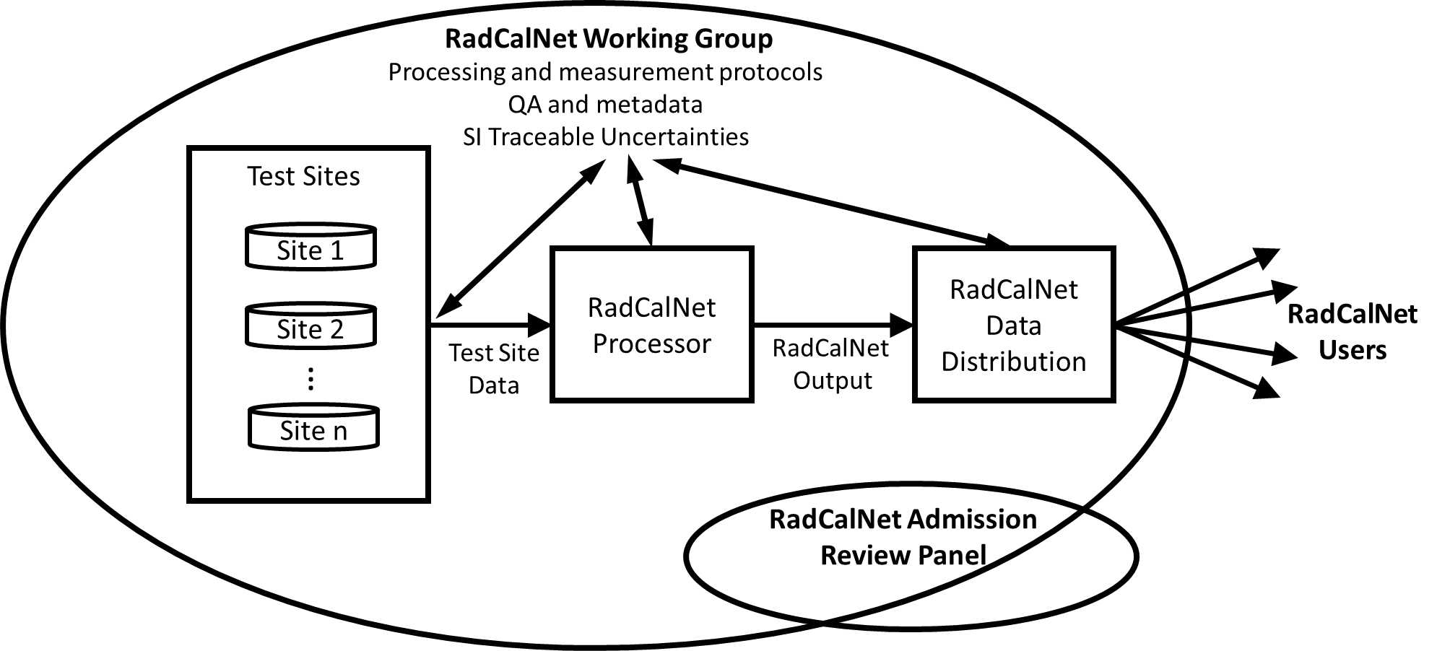
One view of RadCalNet structure

Slide 7
Guidance that will be provided by RadCalNet Working Group to prospective test sites – NOTE: draft version

Slide 8
Process for approval of a RadCalNet site at WGCV level
Steps 1 and 2
Prospective site manager documents that they meet requirements for membership
RadCalNet group will provide advice and guidance to prospective sites
Submission of documentation to a RadCalNet Admission Review Panel
Panel made up of five WGCV members
Panel members distributed geographically

Slide 9
Process for approval of a RadCalNet site at WGCV level
3) Panel formulates a recommendation to be carried forward to the WGCV membership
A recommendation for approval requires concurrence by majority of panel
Much of the evaluation process can take place via telecon/email
4) WGCV plenary acts on the recommendation either via email or at a WGCV meeting
Recommendation is accepted at a WGCV meeting unless three members that are present indicate disapproval
To act on the recommendation outside a WGCV meeting
Panel recommendation forwarded to full WGCV membership with at least one month for evaluation
Recommendation is accepted unless five members register disapproval by email

Slide 10
RadCalNet and Landnet
RadCalNet Panel will evaluate RadCalNet admissions
Also evaluate Landnet
RadCalNet panel can recommend changes to the requirements, admissions criteria, admissions evaluation
Recommendation would be evaluated by WGCV
Allows for iterative improvements

Slide 11
What do we need to do today?
Agree upon the process
Five member panel
Approval approach
Voting levels
Agree on panel membership (Proposed make up below)
Panel Lead – is representative from RadCalNet WG
Two members from IVOS
Chair
Member at large
Two members from WGCV at large
Select the WGCV members that will serve on the panel

