Slide 1
EUMETSAT Agency Report
CEOS WGCV Plenary #42
Rosemary Munro

Slide 2
Outline
Overview of EUMETSAT: Missions, activities, structure
Calibration activities at EUMETSAT
Fiducial Reference Measurements (FRM)
Summary

Slide 3
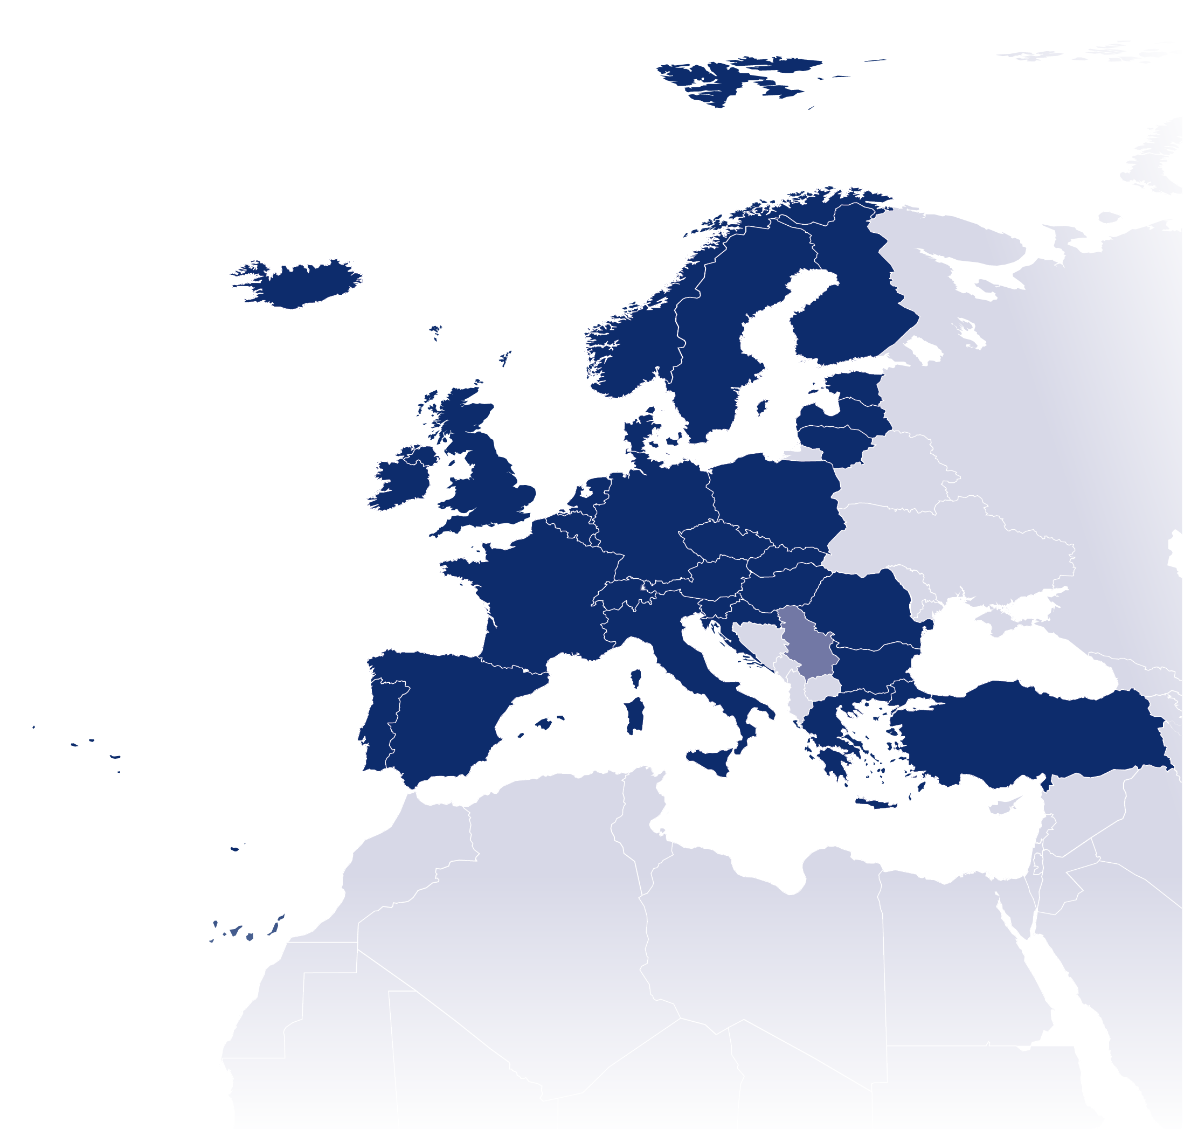

EUMETSAT is an intergovernmental organisation with
30 Member States and 1 Cooperating State
Member States
Cooperating States
AUSTRIA
BELGIUM
BULGARIA
CROATIA
SERBIA
CZECH REPUBLIC
DENMARK
ESTONIA
FINLAND
FRANCE
GERMANY
GREECE
HUNGARY
ICELAND
IRELAND
ITALY
LATVIA
LITHUANIA
LUXEMBOURG
THE NETHERLANDS
NORWAY
POLAND
PORTUGAL
ROMANIA
SLOVAK REPUBLIC
SLOVENIA
SPAIN
SWEDEN
SWITZERLAND
TURKEY
UNITED KINGDOM

Slide 4
EUMETSAT’s mission
To establish, maintain and exploit European operational meteorological satellite systems, while considering the recommendations of WMO as much as possible
A further objective is to contribute to operational climate monitoring and detection of global climate changes
By fulfilling these objectives, contribute to environmental monitoring, where interactions with the ocean and the atmosphere are involved

Slide 5






Current EUMETSAT satellite fleet
Sentinel -3a
(LOW-EARTH, SUN-SYNCHRONOUS ORBIT)
Copernicus Global Marine and Land Environment Mission
Operated by EUMETSAT
METOP -A and -B
(LOW-EARTH, SUN – SYNCHRONOUS ORBIT)
EUMETSAT POLAR SYSTEM/INITIAL JOINT POLAR SYSTEM
JASON-2, -3
(LOW-EARTH, 63° INCL. NON SYNCHRONOUS ORBIT)
OCEAN SURFACE TOPOGRAPHY MISSION
METEOSAT SECOND GENERATION -9, -10, -11
(GEOSTATIONARY ORBIT)
TWO-SATELLITE SYSTEM:
- METEOSAT-11: IN-ORBIT BACKUP
- METEOSAT-10: FULL DISK IMAGERY MISSION AT 0° (15 MN)
- METEOSAT-9: RAPID SCAN SERVICE OVER EUROPE AT 9.5°E (5 MN)
METEOSAT -8 (2nd GENERATION)
(GEOSTATIONARY ORBIT)
INDIAN OCEAN DATA COVERAGE MISSION
AT 40° E (TBD June 2016)

Slide 6
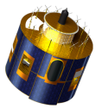
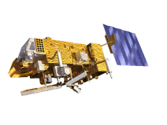
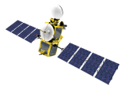
EUMETSAT programmes overview
YEAR...
03
04
05
06
07
08
09
10
11
12
13
14
15
16
17
18
19
20
21
22
23
24
25
26
27
28
29
30
31
32
33
34
35
36
37
38
39
40
METEOSAT FIRST GENERATION
METEOSAT-7
Extended lifetime
2021-2022
METEOSAT SECOND GENERATION
METEOSAT-8
…Extended lifetime ........................................
METEOSAT-9
…Extended lifetime ...........................................
METEOSAT-10
…Extended lifetime ...
METEOSAT-11 …….............………..
Mandatory Programmes
Currently scheduled
for launch 10/2018
EUMETSAT POLAR SYSTEM (EPS)
METOP-A
…Extended lifetime ..............
METOP-B
…Extended lifetime ..............
METOP-C
…Extended lifetime ..............
Launched
17.01.2016
Operational Development
Launched 16.02.2016
JASON
JASON-2
JASON-3
Optional and Third Party
Programmes
COPERNICUS
SENTINEL-3
YEAR...
03
04
05
06
07
08
09
10
11
12
13
14
15
16
17
18
19
20
21
22
23
24
25
26
27
28
29
30
31
32
33
34
35
36
37
38
39
40

Slide 7
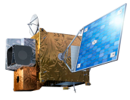

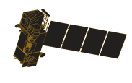
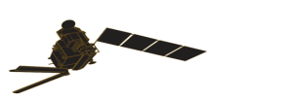
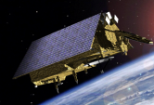
EUMETSAT programmes overview
YEAR...
03
04
05
06
07
08
09
10
11
12
13
14
15
16
17
18
19
20
21
22
23
24
25
26
27
28
29
30
31
32
33
34
35
36
37
38
39
40
METEOSAT FIRST GENERATION
First launch
2020
METEOSAT-7
METEOSAT SECOND GENERATION
METEOSAT-8
…Extended lifetime ........................................
METEOSAT-9
…Extended lifetime ...........................................
METEOSAT-10
…Extended lifetime ...
MSG-4/METEOSAT-11 ……………..
METEOSAT THIRD GENERATION
Mandatory Programmes
MTG-I-1 : IMAGERY
First Launch
2021
MTG-S-1: SOUNDING
MTG-I-2: IMAGERY
MTG-I-3: IMAGERY
EUMETSAT POLAR SYSTEM (EPS)
MTG-S-2: SOUNDING
METOP-A
…Extended lifetime ..............
MTG-I-4: IMAGERY
METOP-B
…Extended lifetime ..............
METOP-C
…Extended lifetime ..............
METOP SECOND GENERATION
METOP-SG-A1
METOP-SG-B1
METOP-SG-A2
METOP-SG-B2
Operational Development
Current Launch year 2020
METOP-SG-A3
METOP-SG-B3
JASON
JASON-2
JASON-3
Optional and Third Party
Programmes
JASON CONTINUITY OF SERVICE (JASON-CS)
COPERNICUS
SENTINEL-3
SENTINEL-4 ON MTG-S
SENTINEL-5 ON EPS-SG
YEAR...
03
04
05
06
07
08
09
10
11
12
13
14
15
16
17
18
19
20
21
22
23
24
25
26
27
28
29
30
31
32
33
34
35
36
37
38
39
40

Slide 8
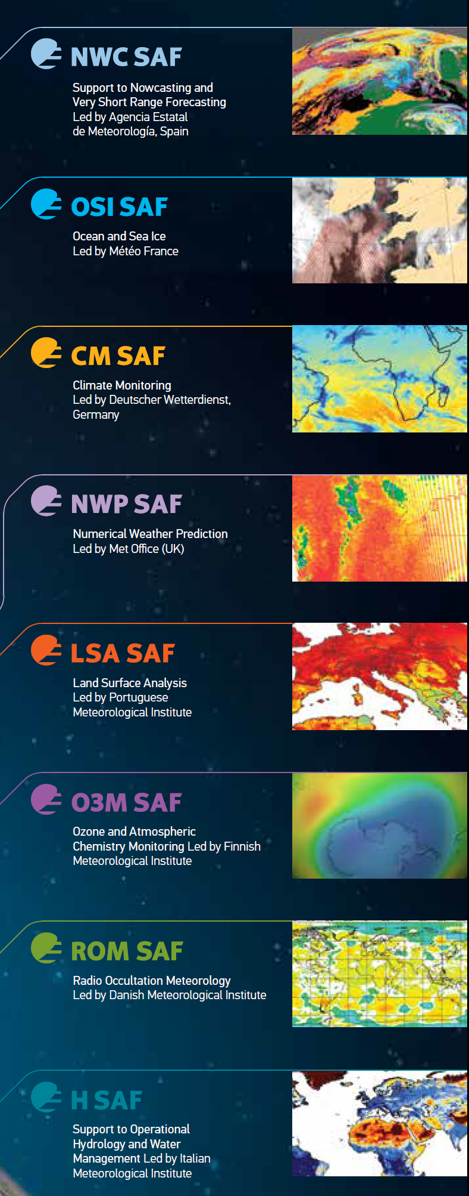
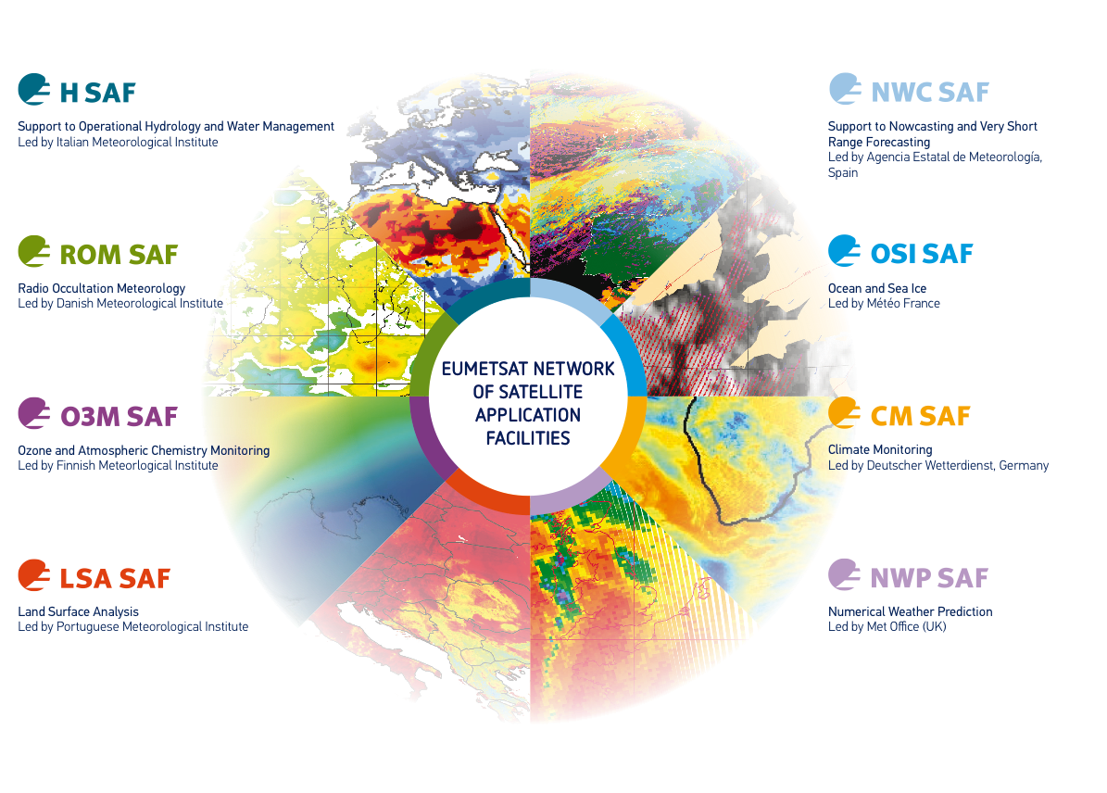
EUMETSAT SAF network across Europe

Slide 9
Calibration Activities at EUMETSAT
Operational near-real time calibration in ‘level 0 to 1 product processors’ – instrument specific and strongly linked to on-ground instrument characterisation and in-flight calibration measurements.
Off-line operational inter-calibration to selected reference using GSICS methodology and off-line vicarious calibration.
Near-real time monitoring and reanalysis of calibration performance.
Focus on traceability, interoperability, and long-term continuity across similar instrument types and similar spectral regions.

Slide 10
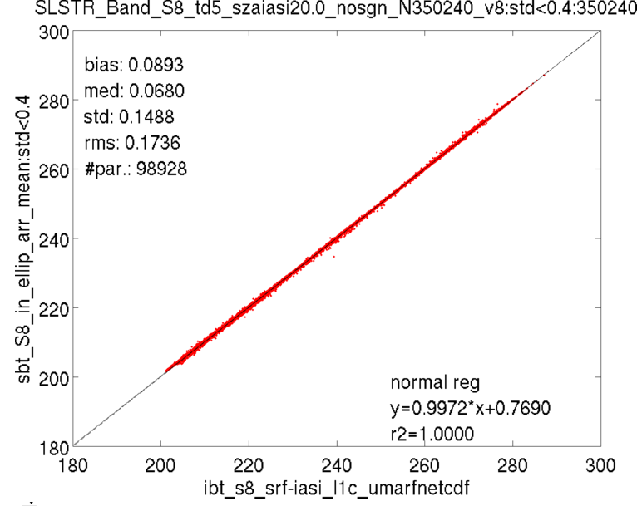
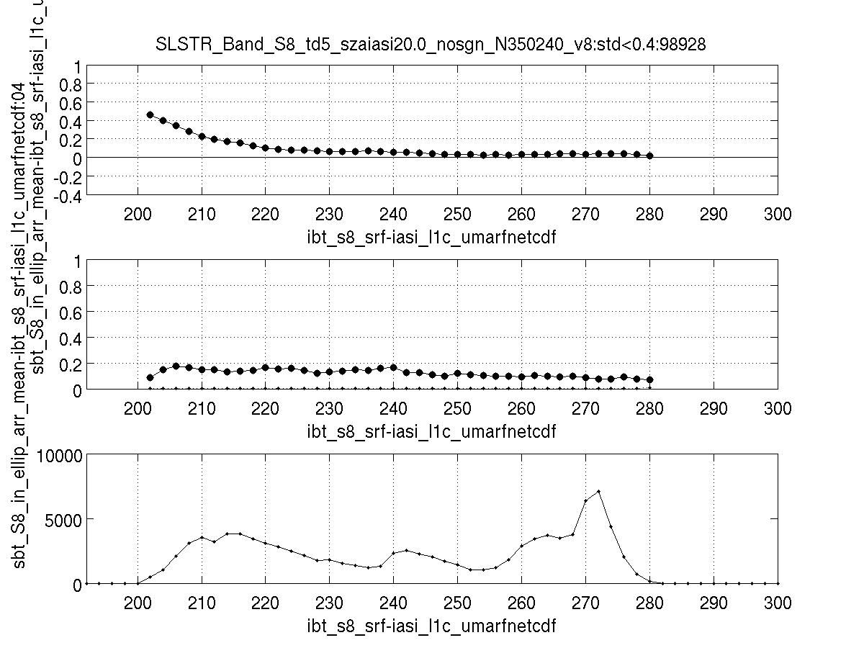
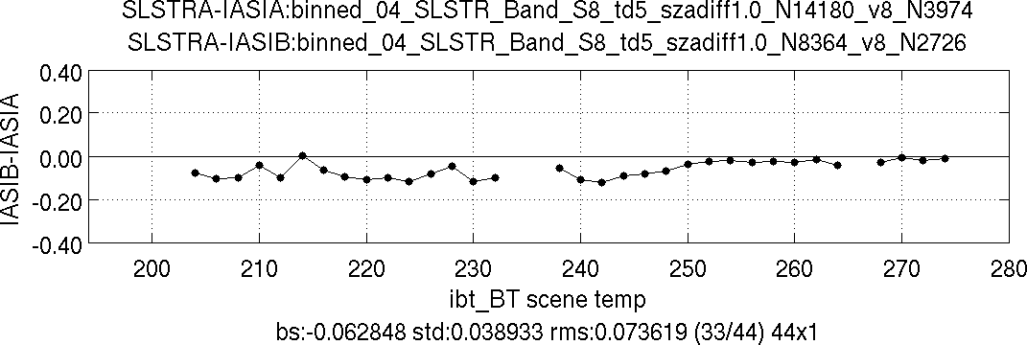
LEO-LEO TIR radiometric calibration (L1)
L1: IASI/SLSTR – on going work
  GSICS methodology
  SNOs & QSNOs (for < 280 K)
  IASI@Metop A/B → double differences
  Future collaboration on SLSTR/CrIS@Suomi NPP
e.g. Tomazic et al, 2016, GSICS Quarterly

Slide 11
Mission Integrated Calibration Monitoring
Inter-Calibration System (MICMICS)
MICMICS will allow near-real-time monitoring and re-analysis
  of the onboard and vicarious calibration systems,
  as well as analysis of their medium- to long-term trends,
  for all channels of EUMETSAT imaging instruments
  and selected third party reference instruments:
    to support scientific enhancements to improve accuracy
    to act as inter-calibration references
MICMICS will not address requirements for monitoring other aspects of instrument performance:
  Short-term variations in onboard calibration
  (between calibration intervals)
  Radiometric Noise
  Housekeeping parameters (temperatures, voltages)
  Geometric factors (including stray light)
  Navigation

Slide 12
MICMICS
Cal Coefficient Injectors
L1 data
Reference Instruments’
L1 data
OPS DBs
Schematic Diagram of Mission Integrated Calibration Monitoring Inter-Calibration System (MICMICS) Concept
Prototype work focusing on:
Data Acceptance Modules
Wrappers for Calibration Processing Modules:
  SSCC
  LCS
  GEO-LEO IR inter-cal
Calibration Output Database
Defining Interfaces
Requirements for Data Analysis & Reporting
Data Acceptance Modules
Inst. Info
Ext Data
Cal Data Buffer
Calibration Processing Modules
GSICS
Calibration Output Database
Site Data
Data Analysis and Reporting
MICMICS Boundary
Reports
Web
Alerts
Events
Reprocessing

Slide 13
Potential Instruments for MICMICS
Satellite Programme | Sensor | Function | Deployment phase
MSG | SEVIRI | Monitor & inter-calibrate Calibrate VIS/NIR | Prototype
Sentinel-3 | OLCI | Calibrate & inter-calibrate | Prototype
Sentinel-3 | SLSTR | Monitor | Prototype
JPSS | VIIRS | Reference | Prototype
EPS | IASI | Reference | Prototype
Terra/Aqua | MODIS | Reference | Prototype- TBD
MTG | FCI | Monitor & inter-calibrate | Phase 1
JPSS | CrIS | Reference | Phase 1 – TBD
EPS | AVHRR | Monitor | Phase 1 – TBD
EPS | GOME-2 | Reference | Phase 1 – TBD
MFG | MVIRI | Recalibrate | Phase 1 – TBD
MTG | LI | Calibrate & inter-calibrate | Phase 2
EPS-SG | METimage | Monitor | Phase 2
EPS-SG | 3MI | Calibrate & inter-calibrate | Phase 2
EPS-SG | IASI-NG | Reference | Phase 2
EPS-SG | MWI/ICI | Monitor | Phase 2 - TBD
Sentinel-4 | UVN | Monitor & Reference | Phase 3 - TBD
MTG | UVNS | Monitor | Phase 3 - TBD
MTG | IRS | Monitor | Phase 3 - TBD
Deployment phases:
  Prototype: 2017/18
  Phase 1: 2018/19
  Phase 2: 2020/21
  Phase 3: 2022/23
Role of MICMICS for each instrument to:
  passively monitor
  actively calibrate
  use as a reference
  inter-calibrate

Slide 14
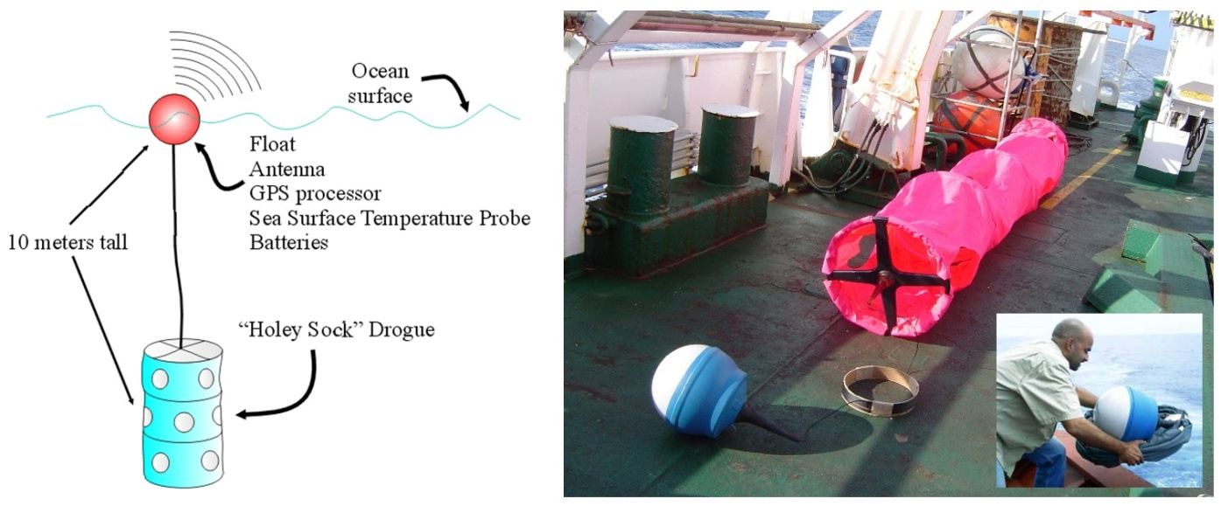
Copernicus / EUMETSAT – FRM drifters
New project to provide measurements from a significant number of drifting buoys equipped with additional digital SST probes in order to achieve a better calibrated capability, plus near surface water pressure sensor for better understanding of buoy depth.
“Assess and establish the benefit of improved HRSST-2 capability of drifting buoys for satellite SST validation”
“Well calibrated, towards traceable drifting buoys, HRSST-FRM”
Include assessment through Sentinel-3 SST Cal/Val activities, and together with GHRSST.
Endorsed by S3VT meeting, February 2017
GTS and ftp data access

Slide 15
Summary
EUMETSAT maintains a fleet of satellites in support of operational meteorology, climate and environmental monitoring.
Extensive calibration activities with a focus on interoperability, traceability, and long-term continuity guarantee the production of high quality products.

