Slide 1


Global DEM Update / Discussion
Dean Gesch (gesch@usgs.gov)
U.S. Geological Survey, Earth Resources Observation and Science Center (EROS), Sioux Falls, South Dakota, USA
CEOS WGCV Plenary
May 16 to 19, 2017
U.S. Department of the Interior
U.S. Geological Survey

Slide 2
→ WGCV / Terrain Mapping Subgroup
→ GEO Global DEM Task
→ ISPRS WG IV/3 – Global DEM Interoperability
Activities:
  - SRTM workshop / PE&RS special issue
  - ASTER GDEM evaluation / IGARSS session
  - ISPRS sessions (2008, 2010, 2012, 2014, 2016)
Key Participants:
  - J-P. Muller (UCL), R. Crippen & M. Kobrick (NASA/JPL), T. Tadono (JAXA), D. Gesch (USGS), C. Carabajal (NASA/GSFC), M. Bernard (SPOT/Airbus), J. Slater (NGA)
ETOPO5 10 km
SRTM flight
ASTER GDEM v1 30 m
ASTER GDEM v3 30 m
ALOS World 3D 5 m
1988
1996
2000
2005
2009
2011
2015
2016
2017
TanDEM-X 12 m
NASA-DEM 30 m
GTOPO30 1 km
SRTM 90 m 30 m
ASTER GDEM v2 30 m
GMTED2010 250 m, 500 m, 1 km
1985
2020

Slide 3
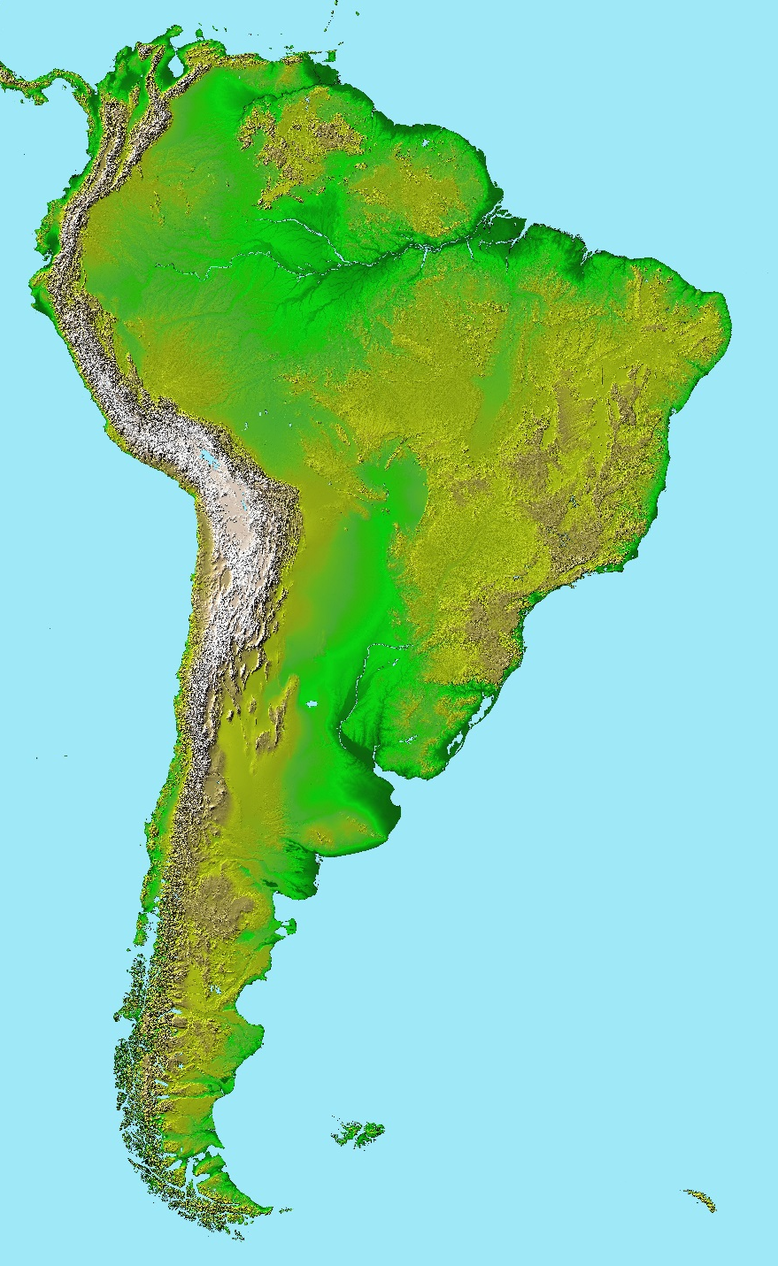
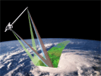
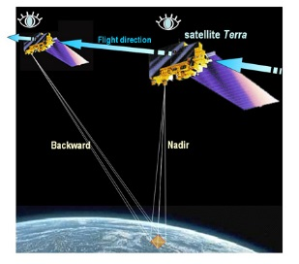
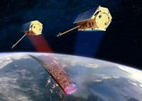
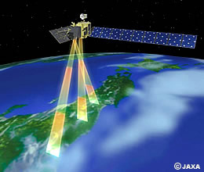
Which global DEM is the best?
TanDEM-X / WorldDEM
Shuttle Radar Topography Mission (SRTM)
PRISM / ALOS World 3D
ASTER Global Digital Elevation Model (GDEM)

Slide 4
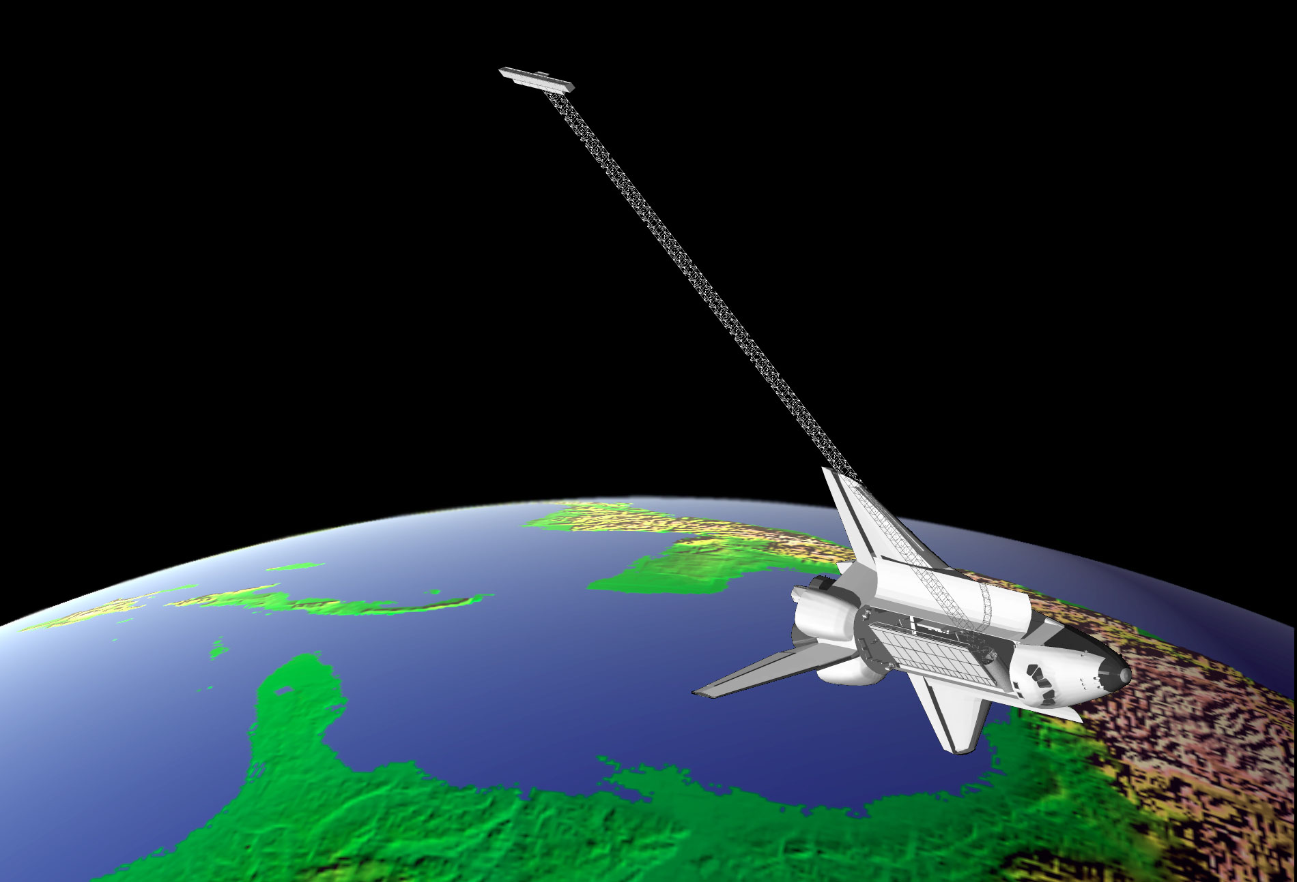

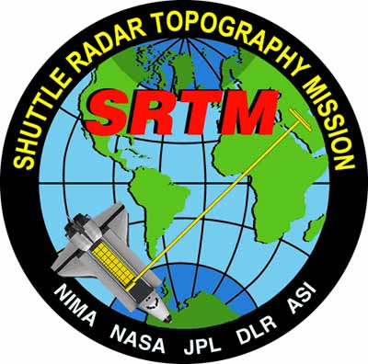


SRTM
Shuttle Radar Topography Mission
Archive
Distribution
Applications
Archive
Distribution
Applications

Slide 5
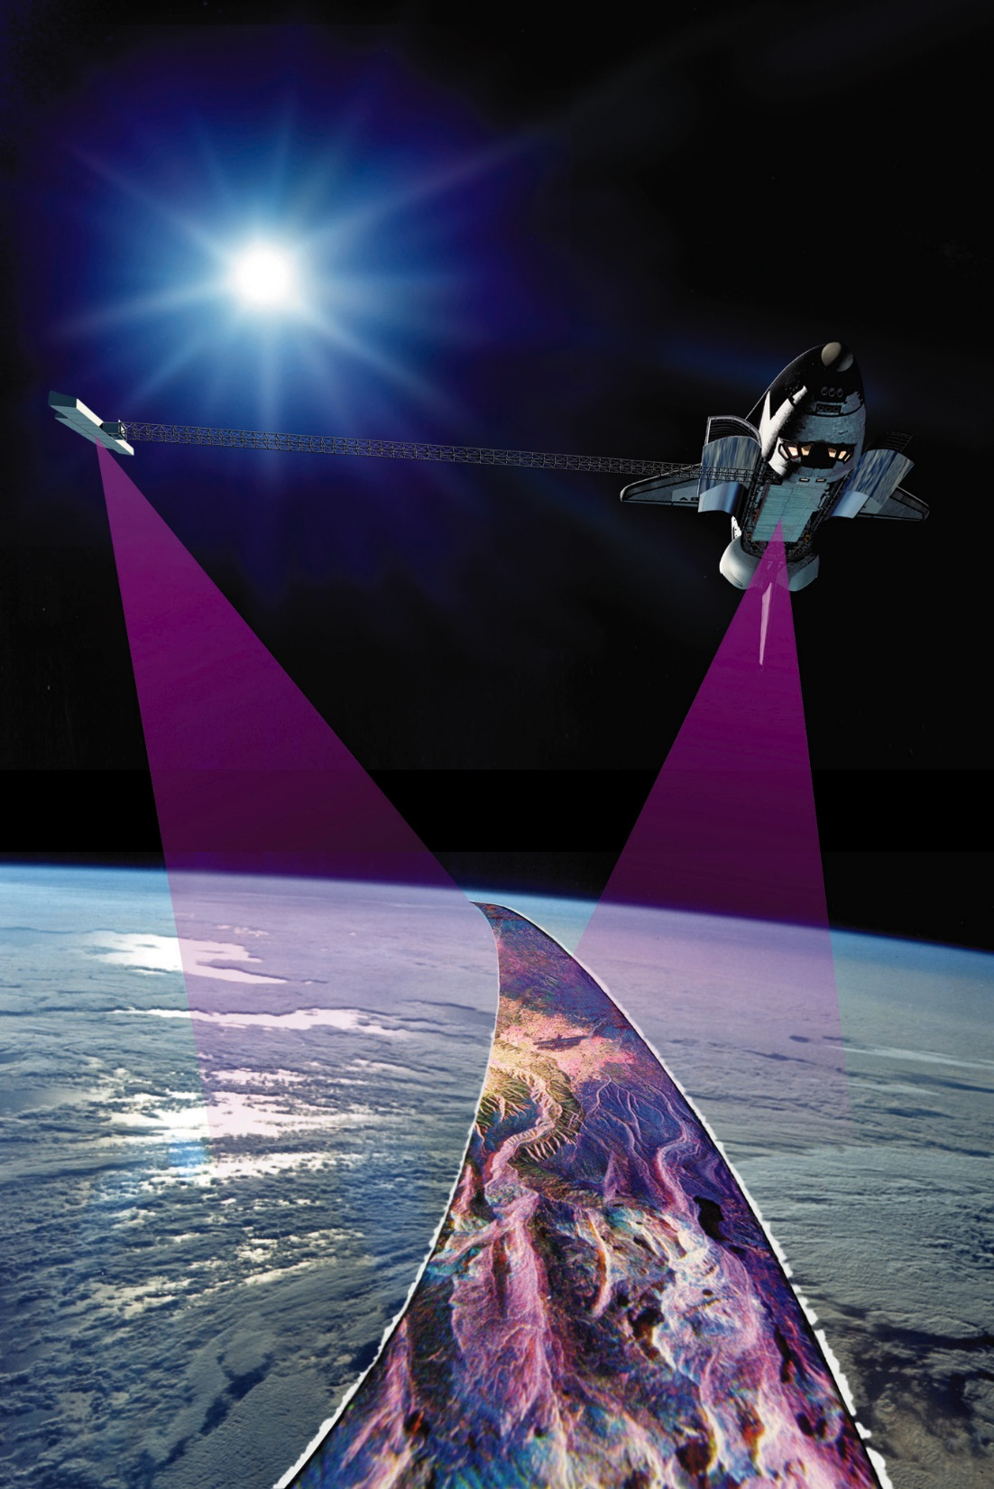
SRTM – Mission Overview
11-day Space Shuttle Endeavour mission in February 2000
Based on SIR-C/X-SAR imaging radar flown in April and October 1994
Joint NASA – NGA project to produce digital topographic data
  Data points spaced every 1-arc-second (30-meters) for 80% of Earth’s land surface
  Absolute vertical accuracy specification: 16 meters (at 90% confidence)
(http://www2.jpl.nasa.gov/srtm/index.html)

Slide 6


Slide 7
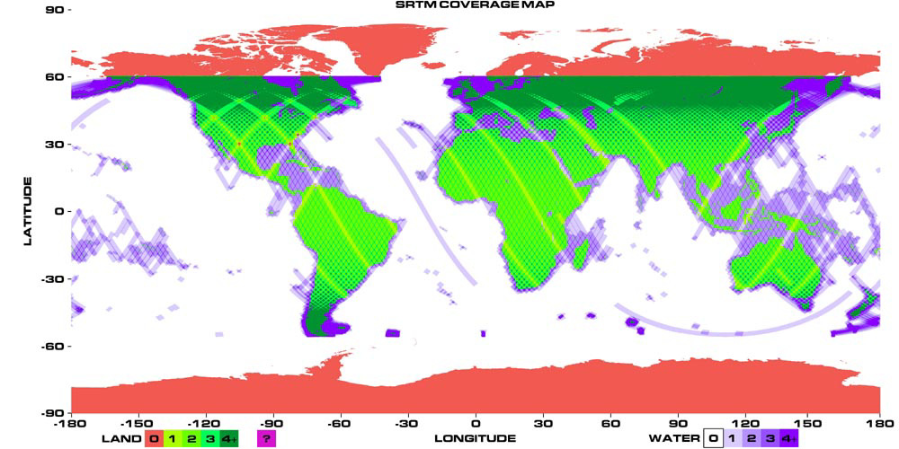
SRTM – Mission Overview
SRTM collected nearly 80% of the Earth’s land surface (60ºN to 56ºS latitude)

Slide 8
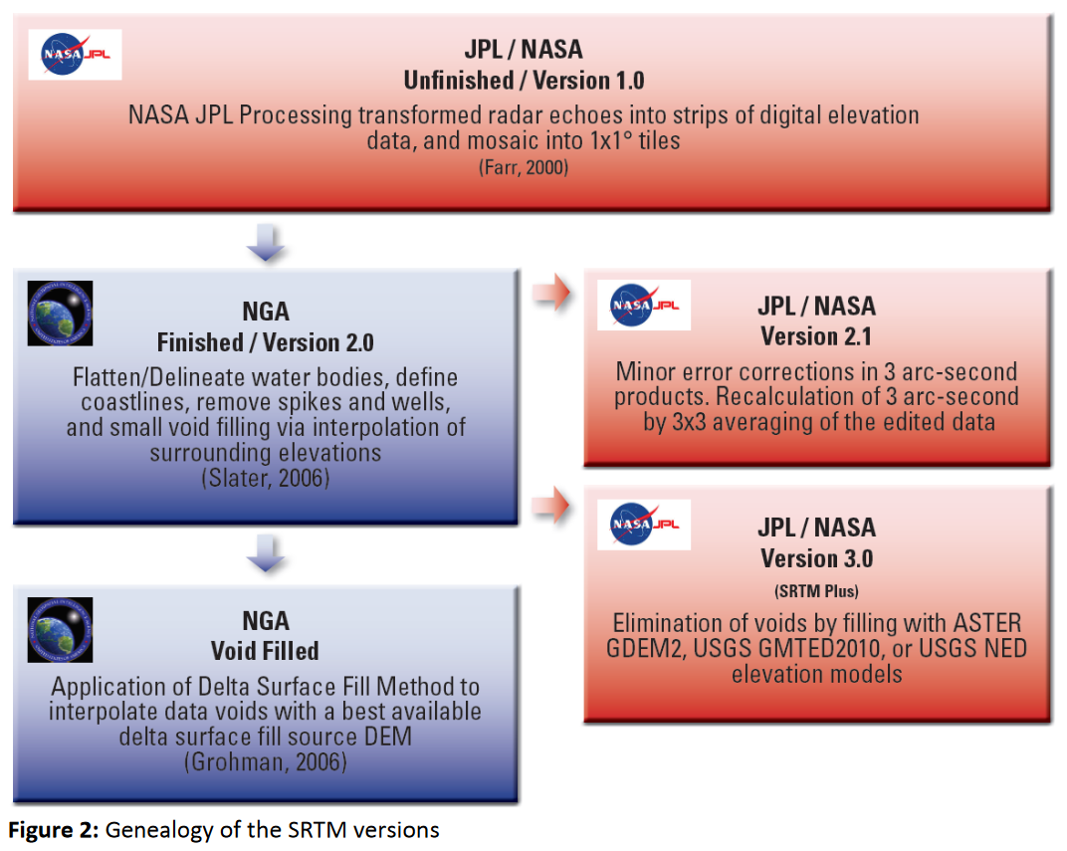
https://lpdaac.usgs.gov/sites/default/files/public/measures/docs/NASA_SRTM_V3.pdf

Slide 9
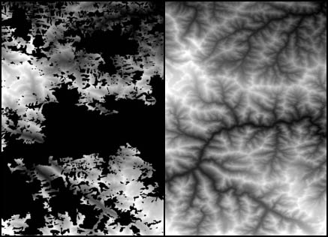
“SRTM Plus” Digital Elevation Model
(SRTM NASA Version 3)
LPDAAC Release November 20, 2013
Shuttle Radar Topography Mission
DEM was void-filled primarily
with the ASTER GDEM.
A novel error-detector was used
to avoid cloud glitches in GDEM.
The USGS GMTED2010 or
National Elevation Dataset (NED)
was then used as the secondary fill.
A modified “Delta Surface Fill”
algorithm produced the
seamless DEM merger at
one-arc-second postings.
(Released at 3-arc-seconds)
SRTM Version 2
with voids
“SRTM Plus”
(Voids filled)
N36 E78: Southwest China
Elevation shown as brightness
Crippen / Kobrick, JPL

Slide 10
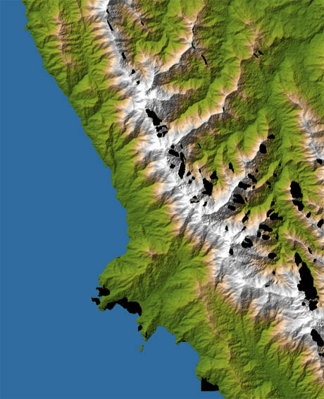
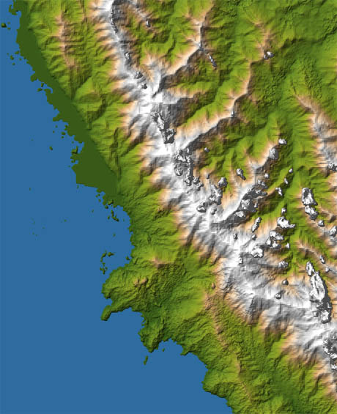
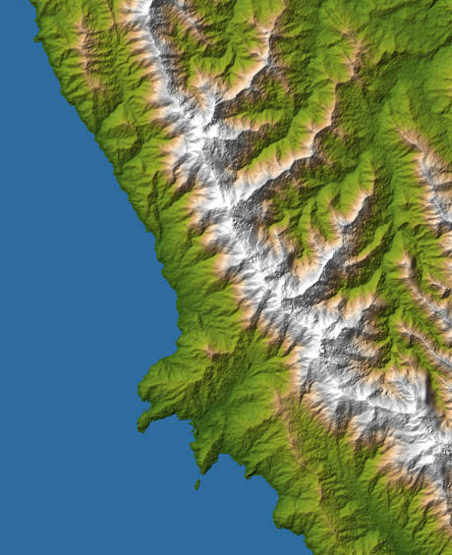
“SRTM Plus”: Synergism of inputs for a superior DEM
SRTM Version 2
GDEM
“SRTM Plus”
Voids &
Water-Mask Errors
Clouds &
Shoreline Errors
Clean Shoreline,
No Clouds
“SRTM Plus” also includes a ‘NUM’ (number) file that identifies the data source
and number of data takes (ASTER scenes or SRTM swaths) for each pixel.
Southeast Panama
Crippen / Kobrick, JPL

Slide 11
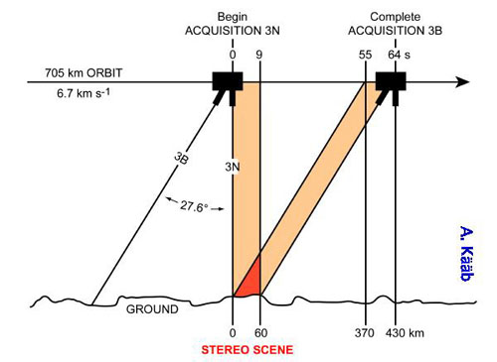
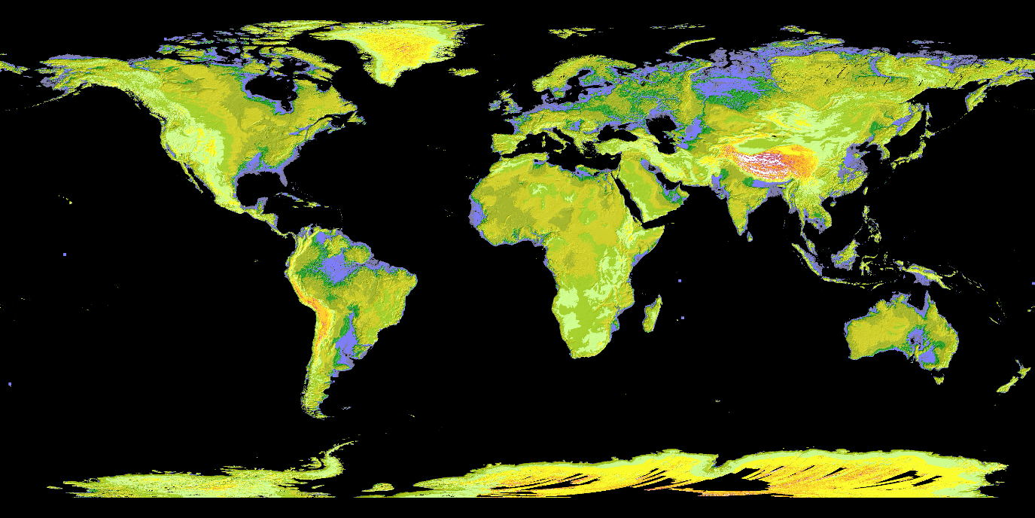
ASTER Global Digital Elevation Model (GDEM)
1-arc-sec (30-m) data for land areas ±83°
  Release dates:
    Version 1 – 2009
    Version 2 – 2011
    Version 3 – 2017?

Slide 12
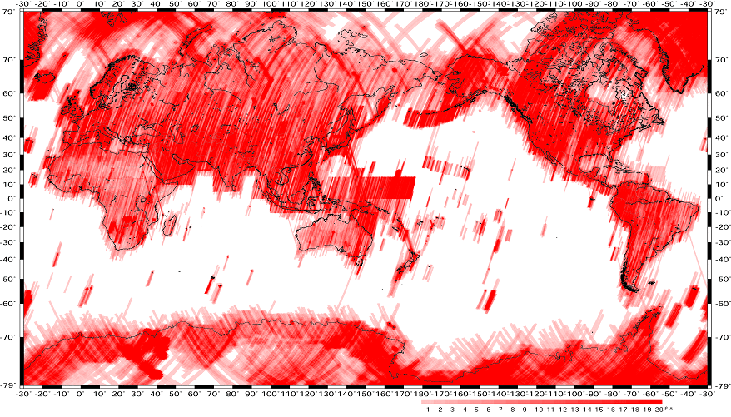
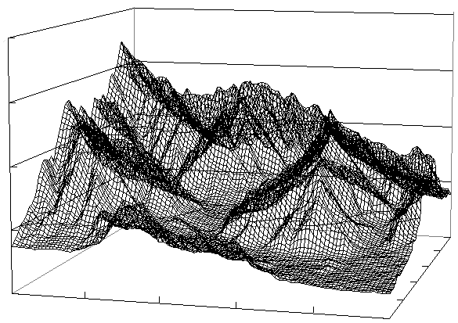
Methodology
1. Stereo-correlate entire ~ 1.5 million scene ASTER Archive; 2. Cloud mask to remove cloudy pixels;
3. Stack all DEMS & remove residual bad values and outliers; 4. Partition data into 1º x 1º tiles ---
ASTER scene
(60km x 60km)
SRTM3 coverage
Tile (1 arc degree square)
Automated processing
Generation of a seamless tile of DEM using all ASTER data ever acquired over the tile
ASTER coverage (~1.5 million scenes in summer 2008)
Deeper red indicates more data accumulated.
Contribution to
GEOSS
ASTER GDEM
Both US and Japan committed to contribute to GEOSS
at Capetown Summit 2007.
Global coverage
A seamless Tile of DEM
(Courtesy of B. Bailey)
Notes:
These 3 components of land remote sensing also are important parts of an “energy flow” known as the energy path concept. The energy path concept describes the flow of energy from its source to the points where it is detected and recorded by the remote sensing system – or sensor.
(read each of the steps list – then discuss each step with the graphic on the next slide.)

Slide 13
(Courtesy of T. Tachikawa)

Slide 14
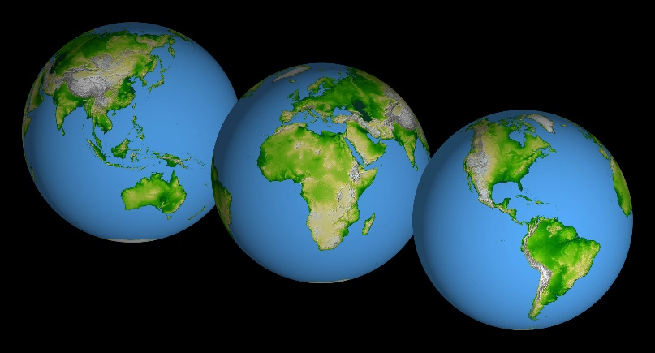
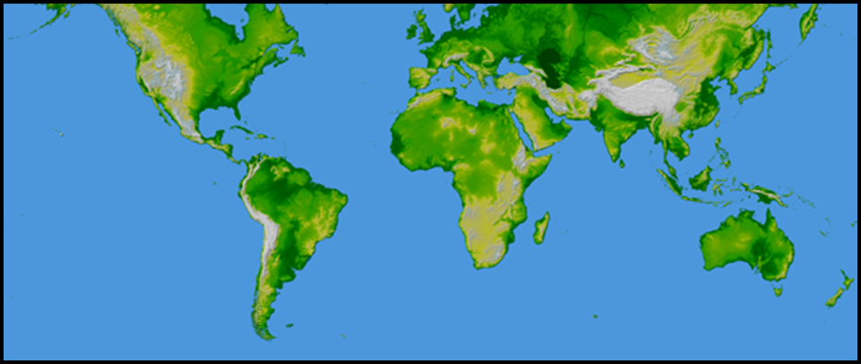
Question: What is a deep, dark secret about global DEMs?
Answer: Grid spacing ≠ true spatial resolution!

Slide 15
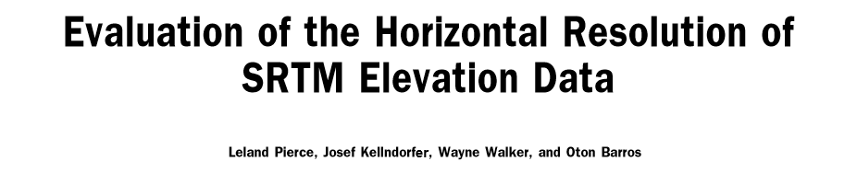
Smith and Sandwell, 2003
Guth, 2006
Pierce et al., 2006

Slide 16
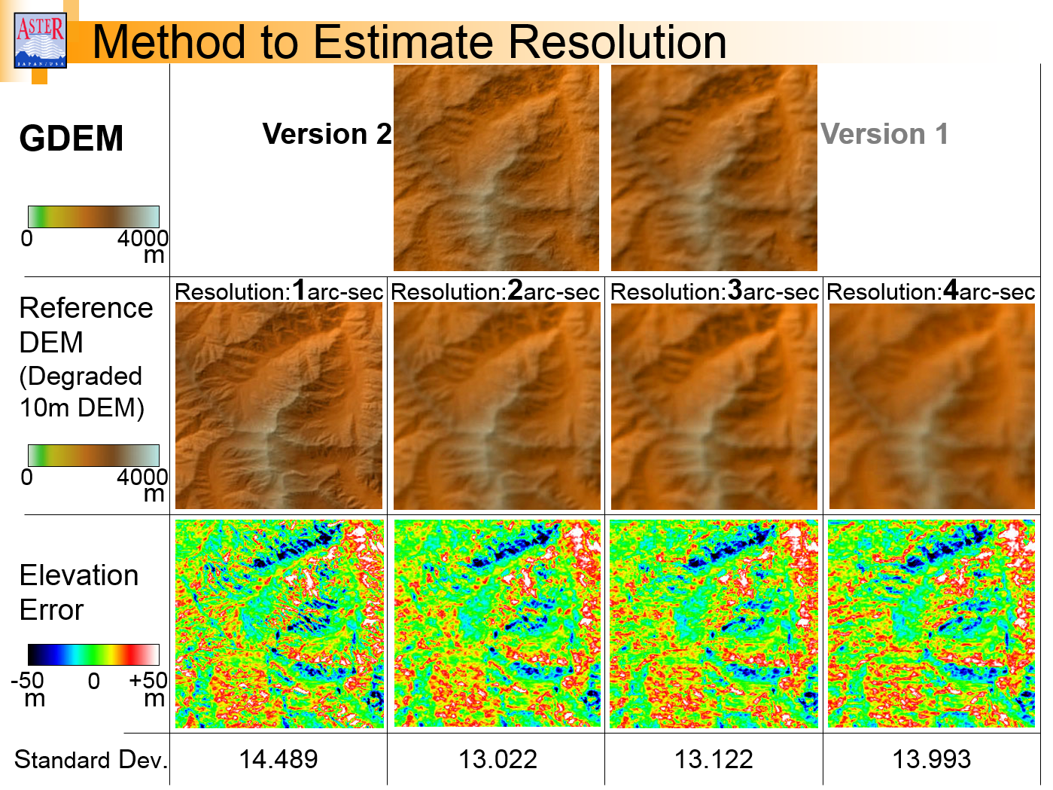
(Courtesy of T. Tachikawa)

Slide 17
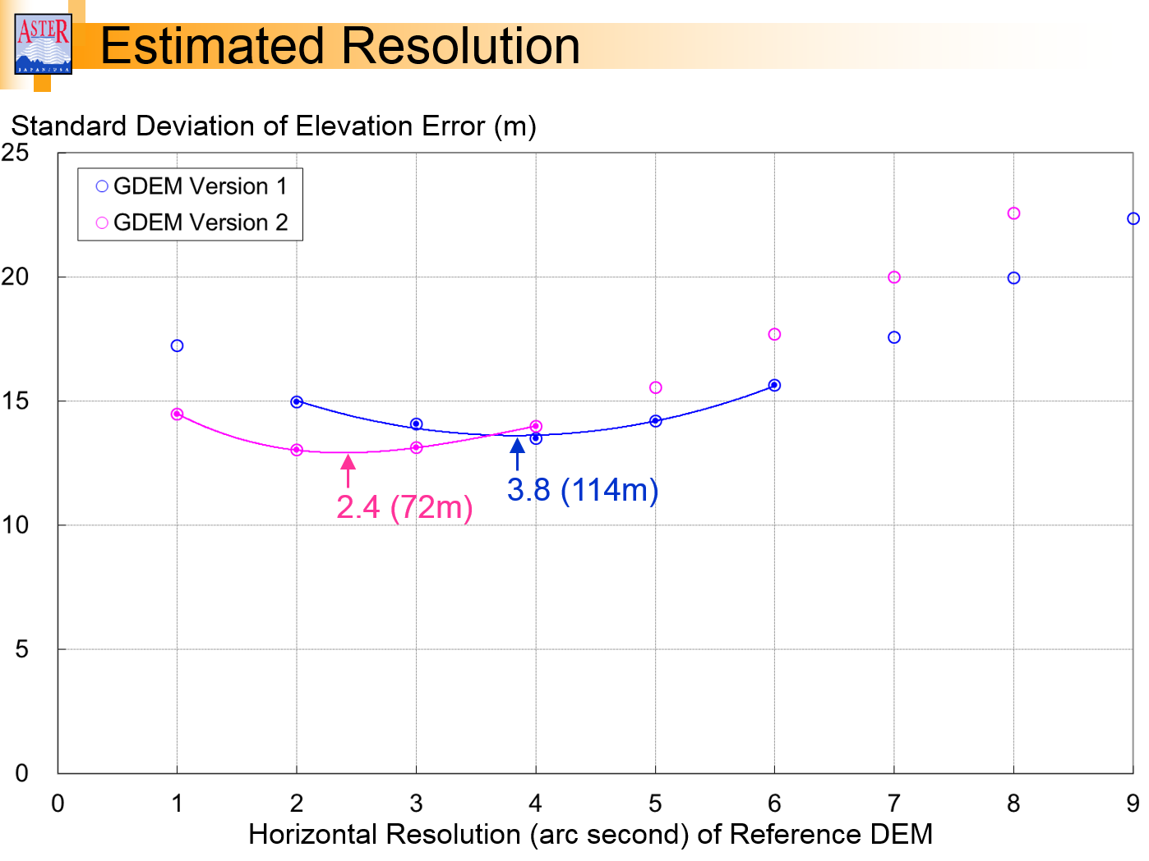
(Courtesy of T. Tachikawa)

Slide 18
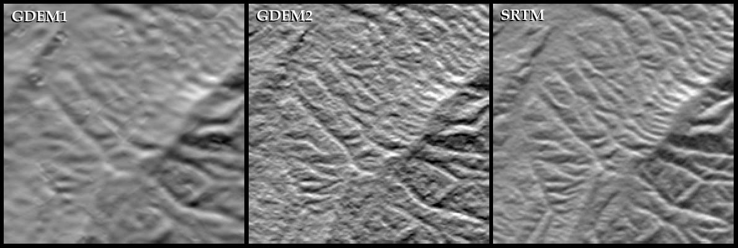
Resolution
GDEM1
GDEM2
SRTM
9x9 kernel
5x5 kernel
Res =
121 m
82 m
77 m
West Virginia: Keyser-Romney area
But at its best, GDEM2 nearly matches SRTM 1-arc-second data.
(Courtesy of R. Crippen)

Slide 19
Global Multi-resolution Terrain Elevation Data (GMTED2010)
A global DEM to replace GTOPO30:
  Multiple elevation layers at three grid spacings: 30-arc-sec (1 km), 15-arc-sec (500 m) 7.5 arc-sec (250 m)
  Derived from “best available” higher resolution data:
    SRTM (void-filled), 1-arc-second
    Canadian Digital Elevation Data (CDED), 0.75 and 3-arc-second
    U.S. National Elevation Dataset (NED), 1 and 2-arc-second
    Digital Terrain Elevation Data (DTED®), 3-arc-second
    SPOT Reference3D®, 15-arc-second
    Australia GEODATA, 9-arc-second
    University of Bristol Greenland radar altimeter DEM, 30-arc-sec
    University of Bristol Antarctica ERS-1 radar altimeter and ICEsat laser altimeter DEM, 30-arc-second

Slide 20
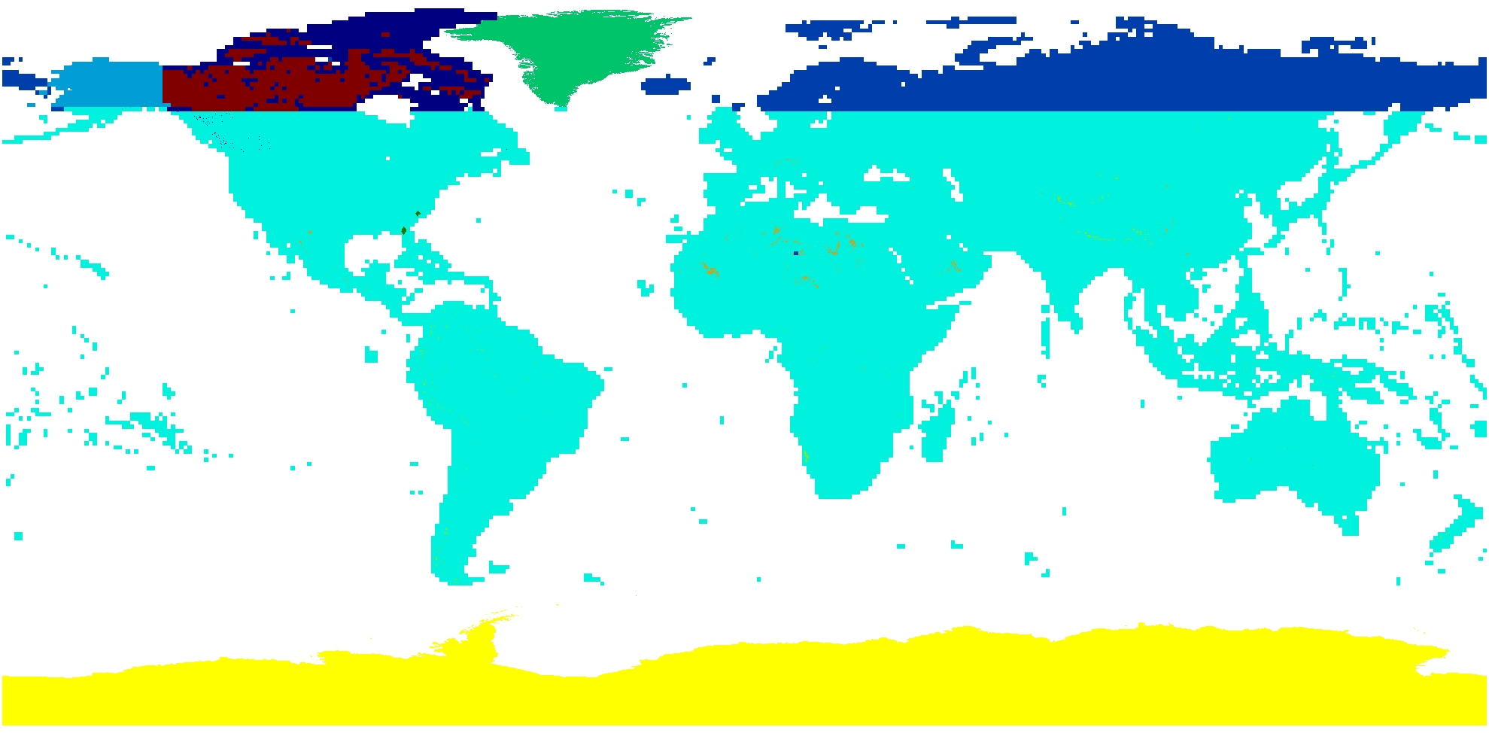

GMTED2010 Source Data
(Courtesy of J. Danielson)
Notes:
GOS
Harvesting requirements – clearing house for metadata?
Data Requests and Planned Acquisitions

Slide 21
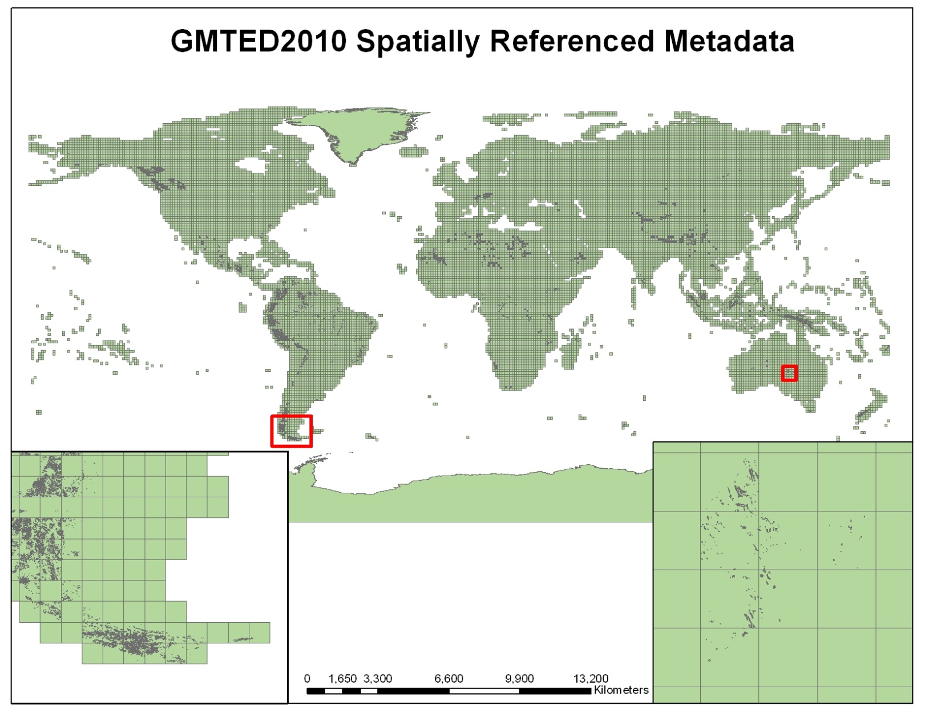
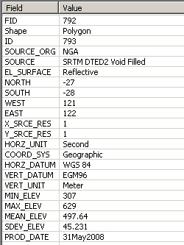
GMTED2010 Spatially Referenced Metadata
Metadata fields and values captured at full resolution from the input source data
(Courtesy of J. Danielson)
Notes:
GOS
Harvesting requirements – clearing house for metadata?
Data Requests and Planned Acquisitions

Slide 22
GMTED2010 vs. GTOPO30
Min.
Min.
Min.
Max.
Max.
Max.
“Representative Elevation”
Mean
Mean
Mean
Std.Dev.
Std.Dev.
Std.Dev.
30 arc-sec
(1-km)
Median
Median
Median
Sample
Sample
Sample
A mix of systematic subsampling, median value generalization, breakline emphasis generalization, bilinear resampling, and vector-to-raster interpolation
Breakline
Breakline
Breakline
30 arc-sec
(1-km)
15 arc-sec
(500-m)
7.5 arc-sec
(250-m)
Notes:
GOS
Harvesting requirements – clearing house for metadata?
Data Requests and Planned Acquisitions

Slide 23
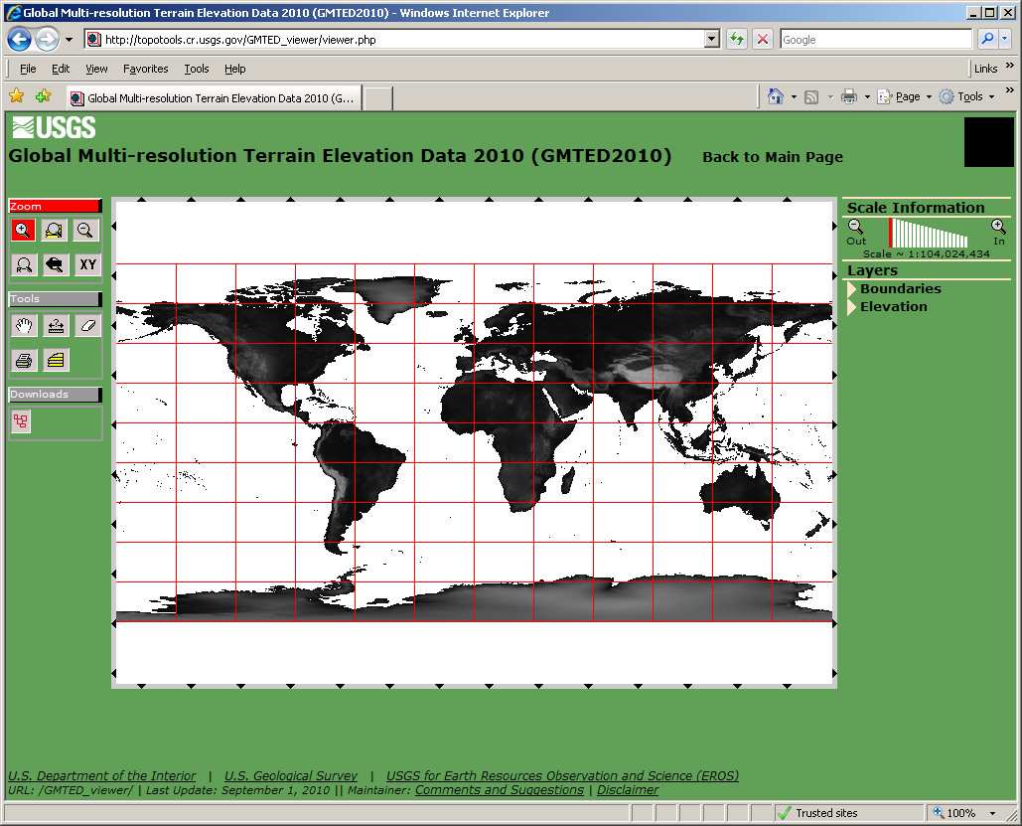
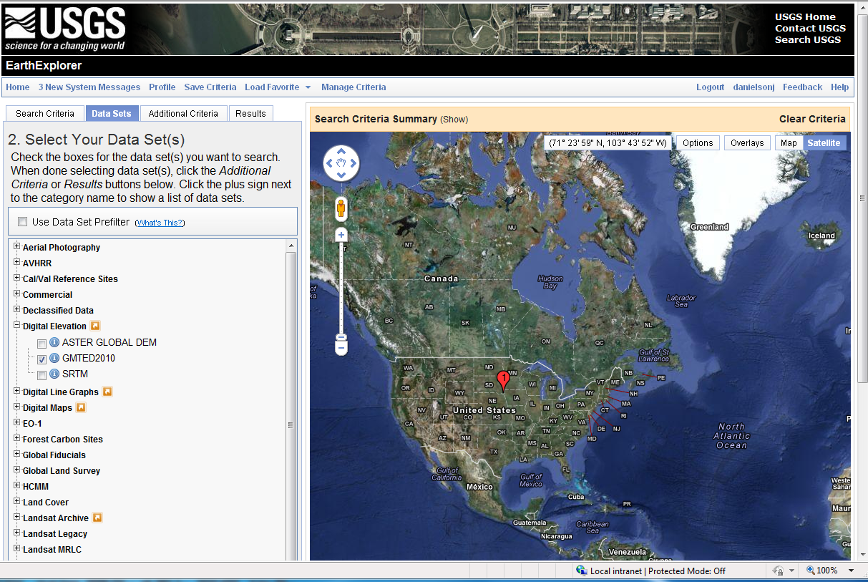
GMTED2010 - Public Release in August 2011
GMTED2010 Viewer
Earth Explorer
https://lta.cr.usgs.gov/GMTED2010
http://topotools.cr.usgs.gov/GMTED_viewer/
http://earthexplorer.usgs.gov/
(Courtesy of J. Danielson)

Slide 24
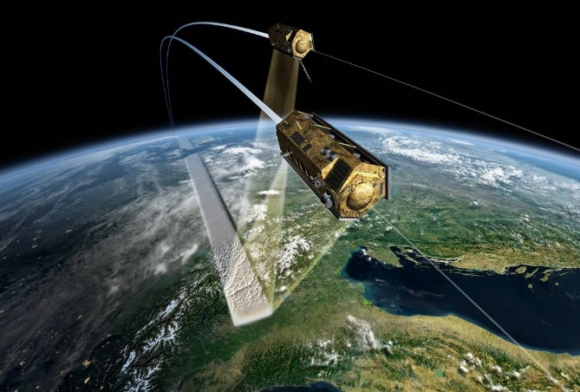
TanDEM-X
(TerraSAR-X add-on for Digital Elevation Measurement)
TanDEM-X is an extension of the TerraSAR-X mission with a second satellite flying in close formation
  X-band SAR interferometry system
  Flying in formation since 2010, collected data for global DEM for four years
  Completion of global DEM in 2016

Slide 25
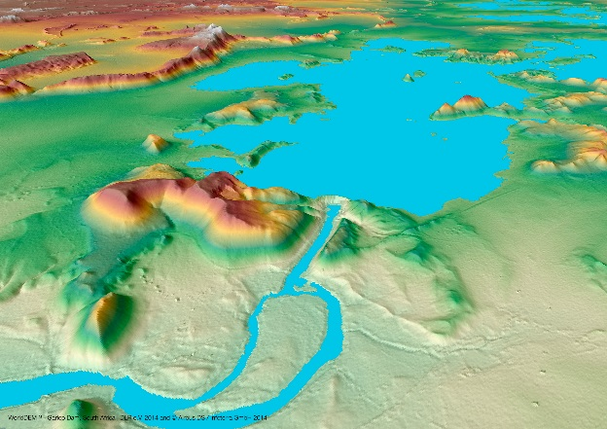
TanDEM-X
Mission objective:
  Global DEM at 0.4-arc-second (12-m) grid spacing
    90-m free version to be available
  Accuracy specifications:
    Absolute vertical: 10 m (linear error at 90% confidence)
    Relative vertical (point-to-point within 1°x1° tile):
      2 m (slopes < 20%)
      4 m (slopes > 20%)

Slide 26
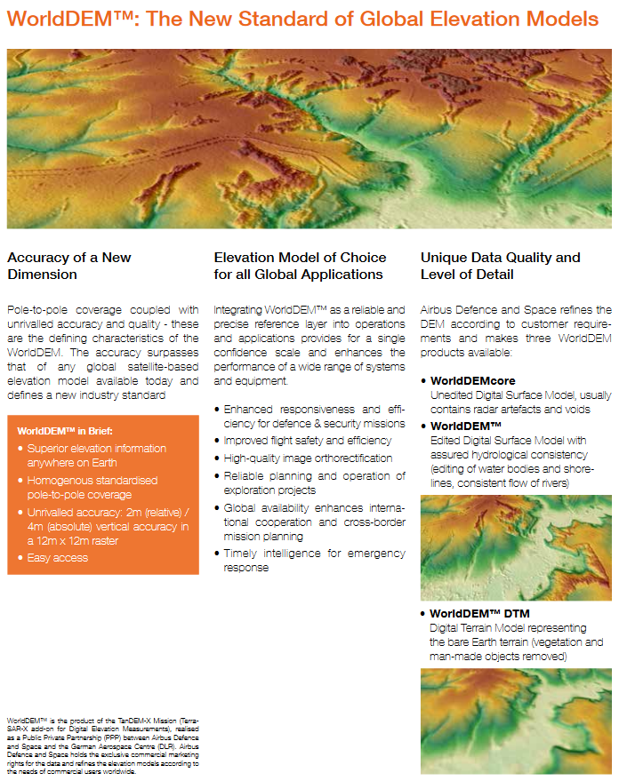
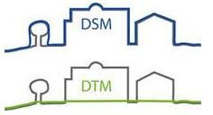

Slide 27
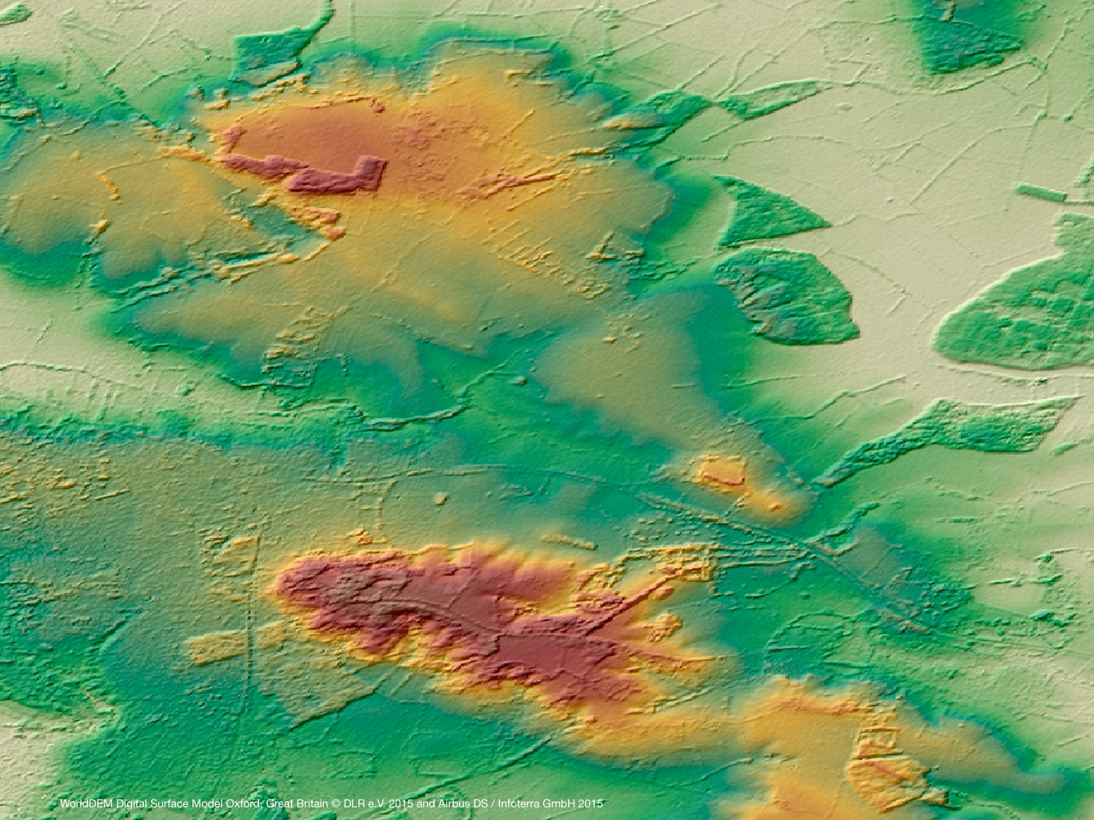
WorldDEM DSM

Slide 28
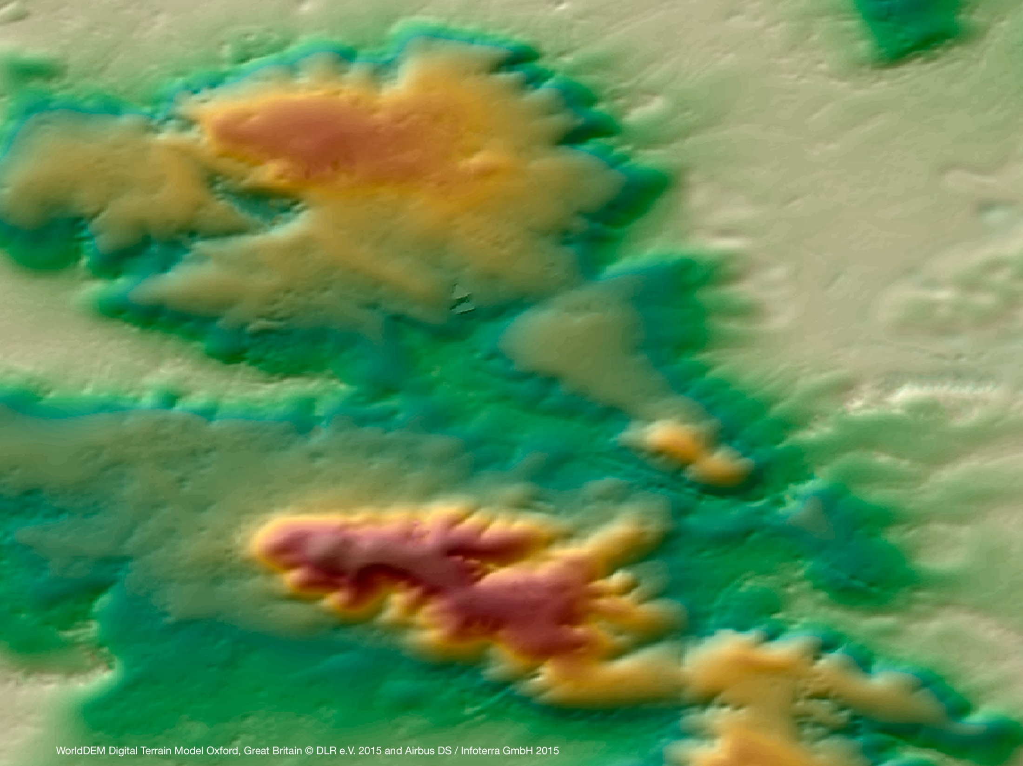
WorldDEM DTM

Slide 29
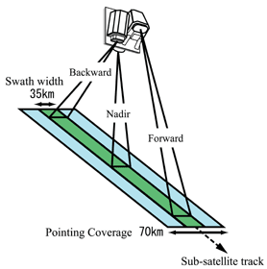
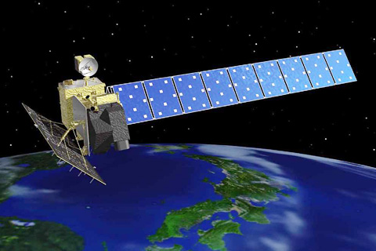
ALOS World 3D
(AW3D)
PRISM (Panchromatic Remote-sensing Instrument for Stereo Mapping)
  On board ALOS (Advanced Land Observing Satellite)
  Stereo-optical image data (2.5-m resolution)
    Stereo triplets: nadir, +23.8°, -23.8°

Slide 30
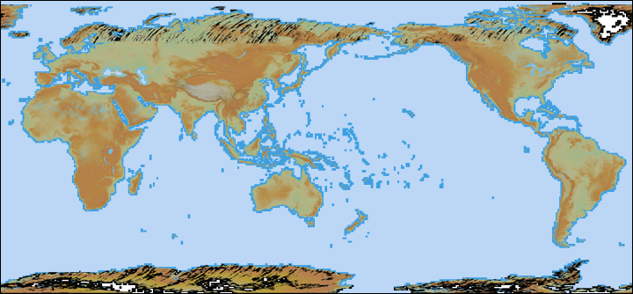
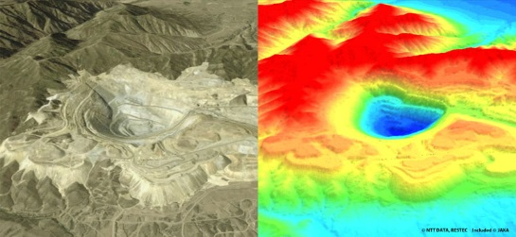
ALOS World 3D
(AW3D)
PRISM collected 3 million scenes (<30% cloud cover) across the globe in 2006-2011
Global DEM (DSM) specifications:
  Grid spacing = 0.15-arc-sec (5-m)
    30-m free version is available
  Absolute vertical accuracy = 5 m (RMSE)
  Absolute geolocation accuracy = 5 m (RMSE)
  Production uses stacking (averaging) method
  Completion of global DEM in 2016

Slide 31
PRISM Stereo Scenes for AW3D
(Courtesy of T. Tadono)

Slide 32
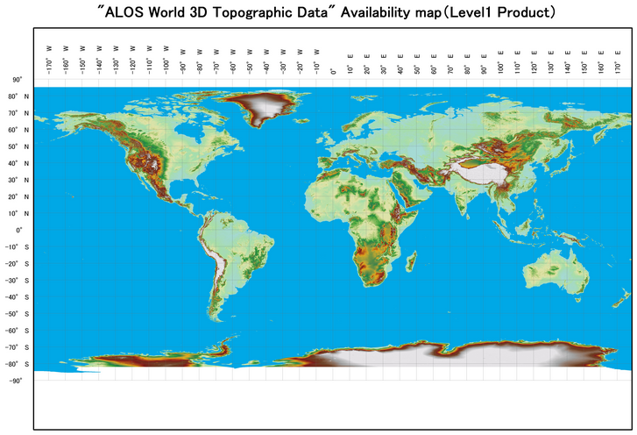
ALOS World 3D – Current Coverage
Data are distributed commercially by NTT DATA Corporation and RESTEC

Slide 33
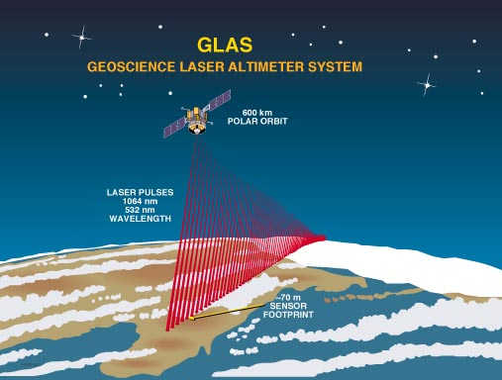

ICESat (Ice, Cloud, and land Elevation Satellite) -
GLAS (Geoscience Laser Altimeter System)
Operated 2003 – 2009 (±86 degrees latitude)
70-m laser footprint spaced every 170 m along profile
  Better than 10-cm vertical accuracy in best cases, usually around a meter or better in many cases
Used extensively for validation of global DEMs
  SRTM, ASTER GDEM, GMTED2010, PRISM (AW3D), TanDEM-X
Used for production processing of global DEMs
  PRISM (AW3D), TanDEM-X, NASADEM

Slide 34
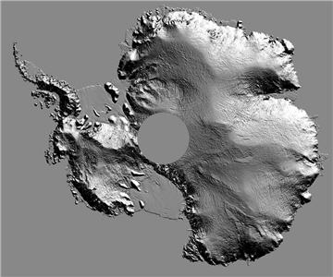
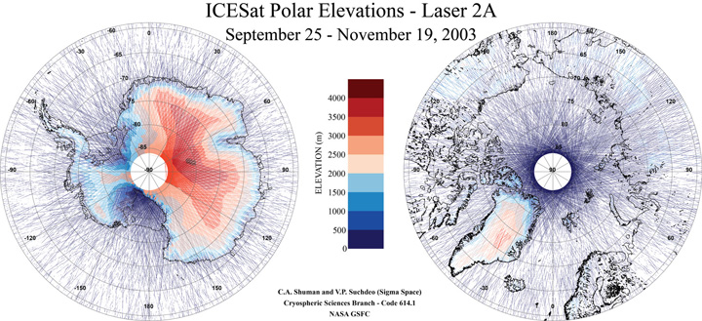
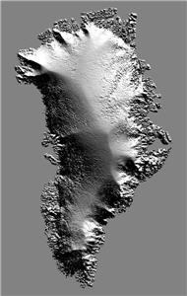
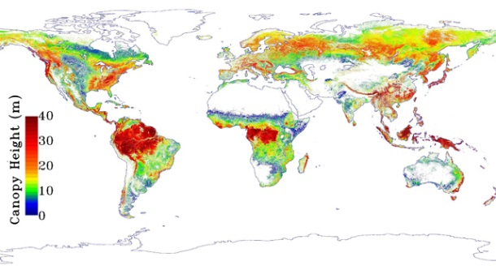
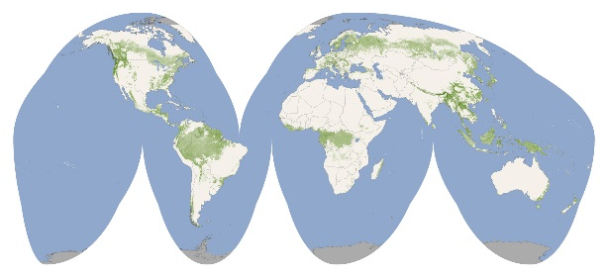
ICESat / GLAS
Convergence of ICESat’s orbital paths near the poles resulted in close spacing of laser profiles allowing for generation of gridded continuous surface DEMs
ICESat full waveform data can be processed to derive multiple surfaces within the laser footprint (ground level and vegetation canopy top), which has been exploited for global forest height mapping
Antarctica 500-m DEM
Greenland 1-km DEM
(Lefsky, 2010)
(Simard et al., 2011)

Slide 35
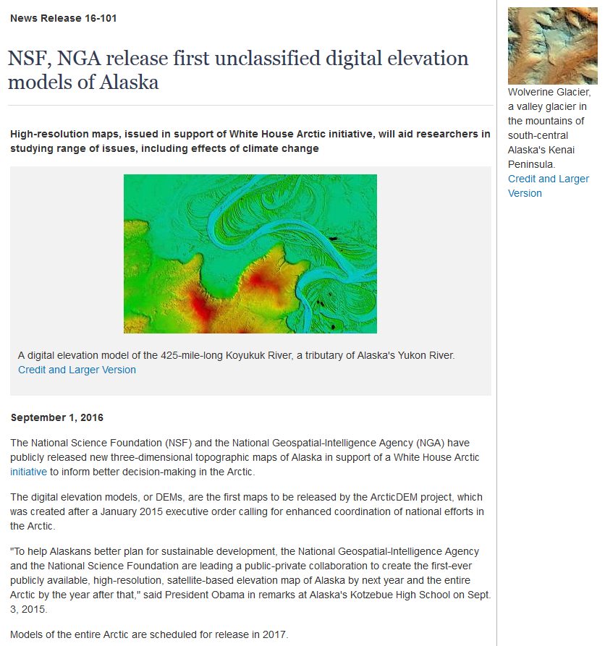
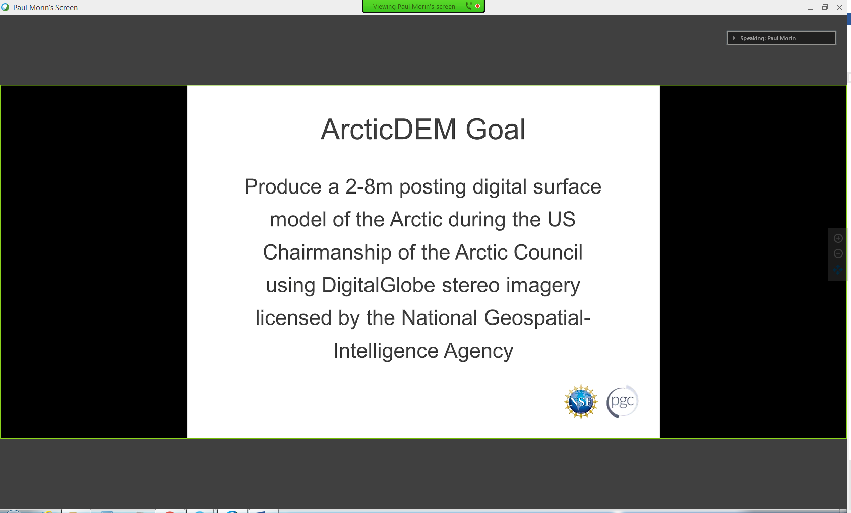

Slide 36
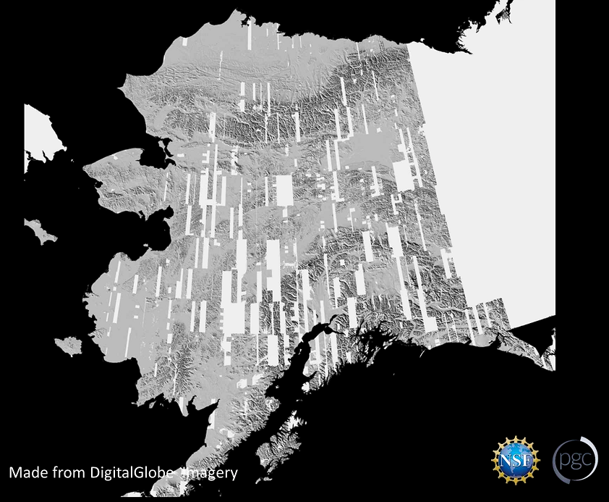
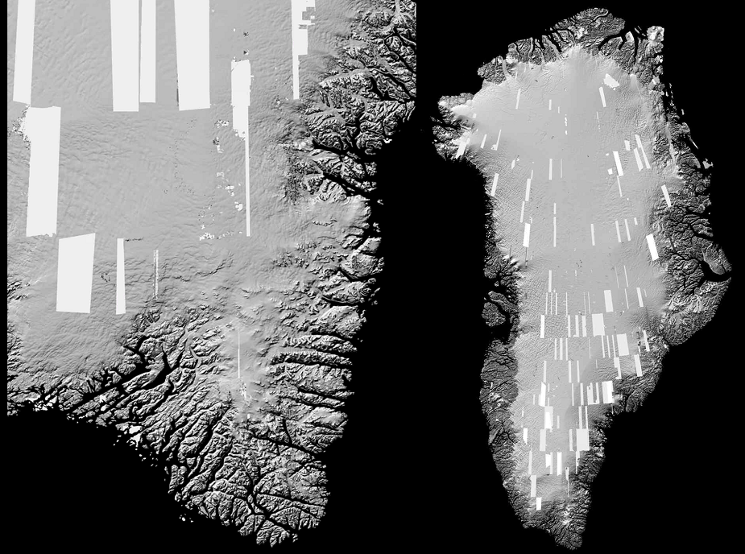
4-m vertical accuracy
Based on 2012 – 2016 imagery
Digital surface model (DSM)
Alaska release in 2016
Arctic release in 2017
Unrestricted data
(Courtesy of P. Morin)

Slide 37



Slide 38
Comparison of Global DEMs
DEM | Grid spacing (m) | Absolute vertical accuracy specification (m)
 |  | RMSE | LE90 | LE95
SRTM | 30 | 9.7 | 16 | 19.07
ASTER GDEM | 30 | 10.2 | 16.78 | 20
TanDEM-X (WorldDEM) | 12 | 6.08 | 10 | 11.92
PRISM (AW3D) | 5 | 5 | 8.22 | 9.8
RMSE = Root Mean Square Error
(RMSE is equivalent to the standard deviation [1σ] when errors are normally distributed and the mean error = 0)
LE90 = Linear Error at 90% confidence = RMSE * 1.6449
LE95 = Linear Error at 95% confidence = RMSE * 1.96
References:
Greenwalt and Shultz, 1962
Maune et al., 2007

Slide 39

NASADEM - A New NASA Digital Topographic Data Set
Jet Propulsion
Laboratory
Raw radar echoes
ASTER GDEM2
NASADEM
Artifact removal
SAR processing (updated)
Current SRTM
Global DEM
Modified GDEM2
Updated strip DEMs
Void-fill
SRTM
Metric Data
Continental Adjustment
(mostly) void-
filled SRTM (ver3)
Remaining
void map
IceSAT
Data Set
Acquire new
ASTER DEMs
‘New’ SRTM Global DEM
NED, CDED, et al
LPDAAC
SRTM Water
Body Data
New ASTER DEMs
Artifact removal
Modified DEMs
Merge corrected DEMs
Key:
Pink: New data set or process
NASADEM + associated products:
Slope, Aspect, Curvature, Images,
Errors, Correlation
Yellow: Existing data set or process
(Courtesy of R. Crippen)
Process

Slide 40

SRTM
Reunion Island
(Courtesy of R. Crippen)

Slide 41

GDEM
Reunion Island
(Courtesy of R. Crippen)

Slide 42

NASADEM
- Complete re-processing of SRTM radar data
- To be completed and released in 2017
- 30-m freely available void-filled DEM
- Includes error map and derivative products
Reunion Island
(Courtesy of R. Crippen)

Slide 43



NASADEM Project Overview
Andes Mountains in Chile and Bolivia
Create an improved global NASA DEM and associated products
  Reprocess SRTM raw sensor data
  Merge with recent elevation data
  Release at one arcsecond
SRTM processing changes
  Improve phase unwrapping
  Reduce height ripples
  Use ICESat as control
New / additional data layers
  Height error layer (precision est.)
  Correlation
  DEM slope/aspect and curvature
  Veg bias estimates (experimental)
Deliver provisional products to LPDAAC by continent with potential update at project end
Existing 3 arcsec
Planned 1 arcsec
DEM height ripples over Australia from unmeasured boom motion.
Criss-cross pattern comes from merging SRTM strips. Difference of original SRTM & ripple removal demo.
(Courtesy of S. Buckley)

Slide 44
NASADEM Products
Product* | Brief Description | Delivery Format | Approx. # Files | Uncompressed & Compressed Size
Void-Filled DEM | Elevations in 1x1-degree tile | 16-bit signed int, meters | 15,000 | 370 GB | 105 GB
NUM Files | Identifying data source, # inputs | 8-bit | 15,000 | 185 GB | 3 GB
Topographic Slope | Derived from void-filled DEM | 16-bit unsigned int, hundredth degree | 15,000 | 370 GB | –
Slope Aspect | Derived from void-filled DEM | 16-bit unsigned int, hundredth degree | 15,000 | 370 GB | –
Profile Curvature | Derived from void-filled DEM | 16-bit unsigned int, hundredth 1/meter | 15,000 | 370 GB | –
Plan Curvature | Derived from void-filled DEM | 16-bit unsigned int, hundredth 1/meter | 15,000 | 370 GB | –
Radar Images | Per image, subswath & tile | 8-bit | 175,000 | – | 195 GB
Radar Incidence Angle | Per image, subswath & tile | 16-bit unsigned int, hundredth degree | 175,000 | – | 391 GB
Merged Radar Images | Per tile | 8-bit | 15,000 | – | 55 GB
Radar Image Times | For each image tile | ASCII text file | 1 | Several MB
Merged Radar Image NUMs | Number of images merged per pixel | 8-bit | 15,000 | – | 55 GB
Height Error | Height precision estimate | 16-bit unsigned int, millimeters | 15,000 | 370 GB | –
Radar Correlation | Per image, subswath & tile | 16-bit unsigned int | 175,000 | Several hundred GB
ICESat Single Shot Data | Control, assessment | ASCII text file | 2 | Several GB
Vegetation Bias Maps | One for each DEM tile | 16-bit signed int, meters | 15,000 | 370 GB | –
SRTM-Only DEM | Wrt ellipsoid, unaltered water hgts | 32-bit floating point, meters | 15,000 | 740 GB | –
* Bold refers to products also produced as part of MEaSUREs 2006 project
(Courtesy of S. Buckley)

Slide 45
Expected Delivery Dates to LPDAAC (as of Jan 2017)
Feb 2017
Jul 2017
Aug 2017
May 2017
Mar 2017
Island Groups: Sep 2017
Remaining products: Sep 2017
Recent info (R. Crippen, JPL):
On target for 2017 completion
AW3D 30-m is primary fill source, GDEMv3 is secondary
North of SRTM footprint (> 60°N) may be filled if time allows (AW3D, GDEM, possibly CDED)
(Courtesy of S. Buckley)

Slide 46






Future Missions
ICESat-2 (scheduled for late-2018 launch)
  ATLAS: Advanced Topographic Laser Altimeter System
    14-m laser footprints spaced very closely (0.7 m) along profile
    Centimeter-level vertical accuracy; ground and canopy products
GEDI (scheduled for 2019 launch)
  Global Ecosystem Dynamics Investigation
  Lidar on board the International Space Station
  Targeting forests between 50°N and 50°S latitude
NISAR (scheduled for 2020 launch)
  NASA-ISRO Synthetic Aperture Radar
  Dual L-band and S-band polarimetric SAR with 12-day repeat pass interferometry capability

Slide 47

Characteristics Common to Global DEMs
Voids
  Stereo-optical sources:
    Clouds
    Areas of low image contrast (low illumination, shadows, smooth / homogenous surfaces)
  IFSAR:
    Steep terrain causing shadowing, foreshortening, layover
    No radar return from smooth surfaces
  Fix voids by:
    Interpolation
    Fill with other data sources
    Additional data collection (stacking / averaging)

Slide 48
Characteristics Common to Global DEMs
“First return” – DSM
  Processing required to get to bare earth DTM
Vertical accuracy varies spatially
  By land cover conditions
  By slope and relief conditions
Effective spatial resolution
  Often true resolution is much less than grid spacing
  Influenced by data processing algorithms (e.g., kernel size in image matching, window size for smoothing functions)

Slide 49


Interdependence of Global DEMs
Incremental improvement as newer global DEMs make use of existing DEMs in production processes for:
  Systematic offset adjustment
  Calibration
  Anomaly detection
  Reference data for QA/QC
  Accuracy assessment
Links:
  SRTM used DTED®
  ASTER GDEM used SRTM
  TanDEM-X uses ICESat and SRTM
  AW3D uses ICESat, SRTM, and ASTER GDEM

Slide 50
Which global DEM is the best?
TanDEM-X / WorldDEM
Shuttle Radar Topography Mission (SRTM)
PRISM / ALOS World 3D
ASTER Global Digital Elevation Model (GDEM)
30 m
90 m
30 m
The DEM should be “fit for use”:
-Vertical accuracy (absolute & relative)
- DSM vs. DTM
- True resolution
- Date (stack / avg.)
12 m
30 m
90 m
5 m
30 m

Slide 51

Thank You
Questions?
&
Discussion
gesch@usgs.gov

