Slide 1
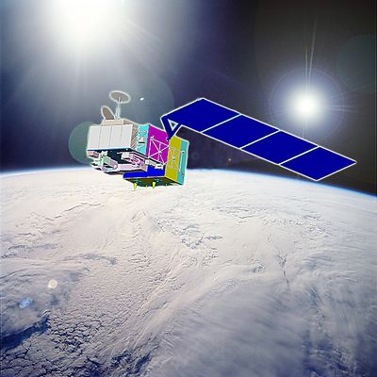
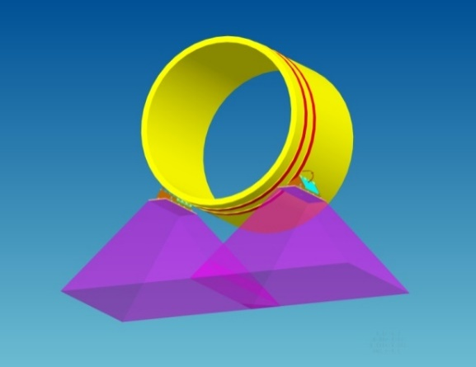
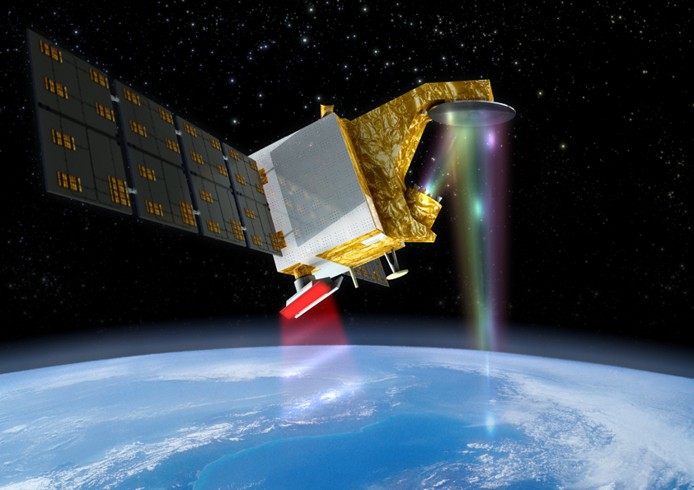
NSSC Update of EO Missions and CAL/VAL
Xiaolong DONG
National Space Science Center
Chinese Academy of Sciences
(NSSC,CAS)
CEOS WGCV-43
INPE@ São José dos Campos, SP, Brazil
April 10-13, 2018

Slide 2
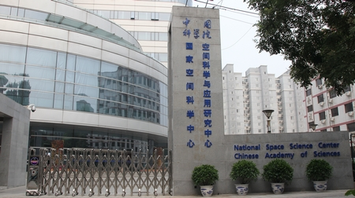

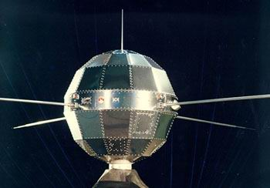
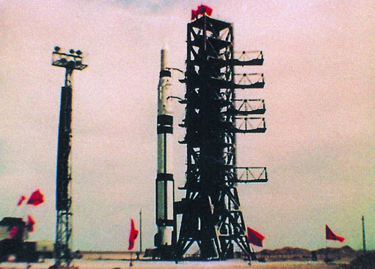
NSSC,CAS
National Space Science Center
Chinese Academy of Sciences
Planning, Development, Management & Operation
of Space Science Missions
(2011~)
Research & Development of
Space Science and Frontier Technology（1958~)

Slide 3




CAS General System Department for Lunar and Deep Space Explorations
Space Science Study Center
Mission Management Center
Satellite Operation Center
Assurance
and Test Center
Space Science Mission Planning, Development and Operation
Research and Development of Space Science and Frontier Technology
Department of
Space Science
Department of
Space Technology
Department of
Space Environment
GNSS Occultation & Reflection Sounder
Department of
Microwave
Remote Sensing
Radar & Radiometric Techniques
SKL of
Space Weather
CSKL of
Space Integrated Electronics
CSKL of Space Situational Awareness
CSKL of Microwave Remote Sensing

Slide 4
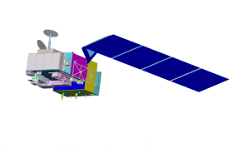
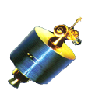


National Program for Fengyun Meteorological Satellite 2011-2020
2013FY-3C(Op)
2014FY-2G(Op)
2016FY-4A (R&D)
2012FY-2F(Op)
2017FY-3D(Op)
2010FY-3B (R&D)
2018FY-2H(Op)
2019 FY-3E(Op)
2019FY-4B (Op)
2020FY-3F(Op)
2021FY-4C(Op)
2020FY-RM(Op)
2021 FY-3G(Op)
7 satellites will be launched within this decade

Slide 5




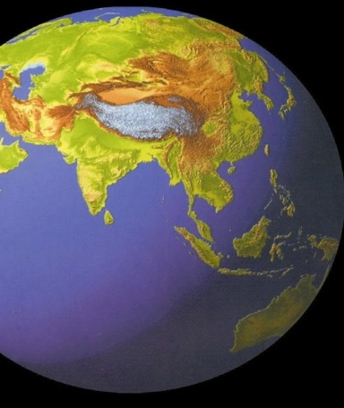



Chinese ocean satellite missions in the future
HY–2A(2011)
GF-3(2016)
HY-2A(2011)
HY-3A(2019)
CFOSAT (2018,Joint mission)
HY– 1A
HY-2B(2018,polar)
HY-3B(2020)
HY– 1B
HY-2C(2019,low inclined A)
HY-2D(2020, low inclined B)
HY-1C(2018)
ocean color constellation
HY-3C(2022,GEO ocean color)
HY-2E(2022,polar)
HY-1D(2019)
ocean dynamic environment constellation
HY-2F(2023, low inclined C)
HY-1E(2023, new)
HY-2G(2024,low inclined D)
HY-3D(2025,GEO SAR)
ocean monitoring and surveillance satellties
HY-2H(2022,new generation)
HY-1F(2024,new)
In-orbit
Approved
Experimental
Considered
HY-XX(2020,Salinity)

Slide 6
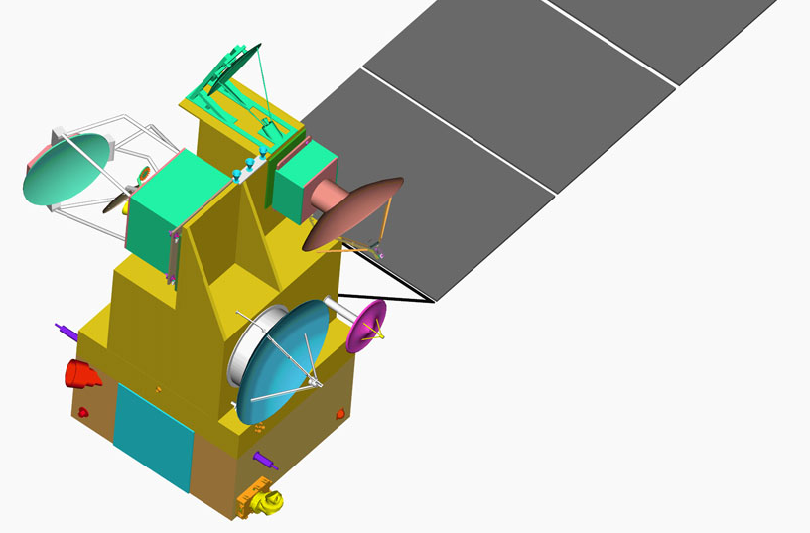
NSSC: Contributions to Oceanographic and Meteorological Satellites
Oceanography and Meteorology
  HY-2 (A, B, C and Follow-on): ALT+ACMR
  COSM: MICAP
  FY-3 and follow-on:
  MWHS/MWHTS(MWHS-II), GNOS,TOU
  SEM (space environment monitoring package)
  CFOSAT: radar scatterometer
  FY-4 (optical and microwave):
  Microwave imager, space environment package

Slide 7
NSSC 2017 EO mission update
FY-3D launched on Nov 15, 2017
CFOSAT SCAT flight model delivered
HY-2B DFRA, ACMR flight model delivered
TanSAT handover
TG-2 InRA in orbit commissioning completed

Slide 8
CFOSAT update
Payloads:
  SWIM: multiple beam radar for ocean surface wave spectrum (Ku band, by CNES)
  SCAT: rotating fan-beam scatterometer of ocean surface wind vector (ku band, by NSSC)
Schedule
  delivery of flight model: 2017.06-07
  Launch schedule: September 2018

Slide 9
HY-2 update
HY-2A：in orbit >5yrs (2011.08.16)
  New version of ALT data
HY-2B：flight model delivered
  DFRA: dual frequency radar altimeter：Ku (13.58GHz) & C (5.25GHz)
  ACMR: atmospheric correction microwave radiometer: 18.7，23.8，37GHz
  SCAT: radar scatterometer: Ku-band (RF switch network & receiver
HY-2C：flight model started
Launch Plan:
  HY-2B: 2nd half of 2018
  HY-2C: 1st half of 2019 (inclined orbit)

Slide 10
COSM update
Chinese Ocean Salinity Mission
Mission requirements:
– 0.1psu, 200km, monthly
– With Simultaneous observation of ocean surface roughness and SST
Schedule
– 2011~2014: grounddemonstration
on different payload technology
– 2015~2006: mission definition, preliminary design, risk mitigation
– 2017: pre-study acceptance
– 2018: kick-off implementation
– Planned launch: 2021
2 payloads:
MICAP: microwave imager combined active passive (L, C, K band) (NSSC)
MiR2D: microwave 2-D interferometric imager (CAST-Xian)

Slide 11
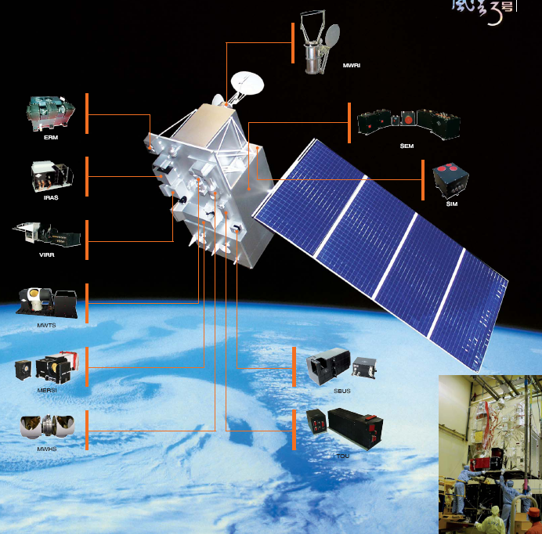
The FY-3A/B/C/D Instrument Suite
Infrared
Atmospheric Sounder
(IRAS)
20 channels
ok
Microwave
Radiation Imager
10 channels
Microwave
Temperature
Sounder (MWTS)
4 channel (FY-3A/B)
13 channels (FY-3C/D)
GNSS
GNSS-Occultation
Sounder (GNOS)
(GPS, Beidou)
(FY-3C/D)
Microwave
Humidity
Sounder (MWHS)
5 channel (FY-3A/B)
15channels with channels@118 GHz (FY-3C/D)
TOU
Total Ozone Unit
(FY-3A/B/C)
11
Notes:
11
11
11
11

Slide 12
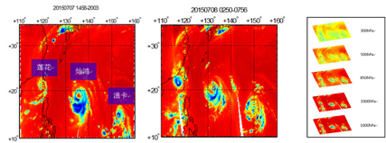
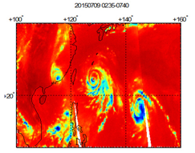
FY-3 update
FY-3A/B
  MWHS: Microwave humidity Sounder
  5 Channels: 150GHz: H, V-pol; 183GHz: 3channels for vapor
  FY-3A ended (launched 2008)
  FY-3B in good status (from 2010)
FY-3C/D
  MWHTS: Microwave Humidity and Temperature Sounders
  15Channels: 90GHz, 150GHz, 118GHz, 183GHz
  FY-3C: MWHTS, GNOS in good status since 2013
  FY-3D: launched on November 15, 2017

Slide 13
HY-2 Follow-On Pathfinder Mission:
Tiangong-2 Interferometric Imaging Radar Altimeter
Interferometric Imaging Radar Altimeter (InIRA)
  Ku-band (13.58GHz) wide swath inteferometric radaer altimeter
  Flown on Chinese Tiangong-2 space laboratory
  Launched on September 15, 2016
Objectives:
  wide-swath sea surface height at mesoscale and sub-mesoscale, sea waves and sea winds.
  Inland waters, e.g., lakes and rivers, coasts.

Slide 14
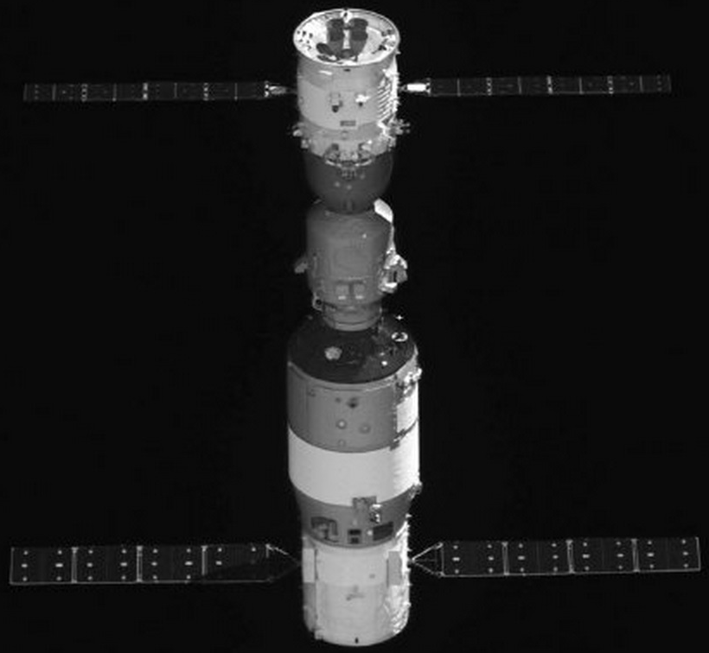
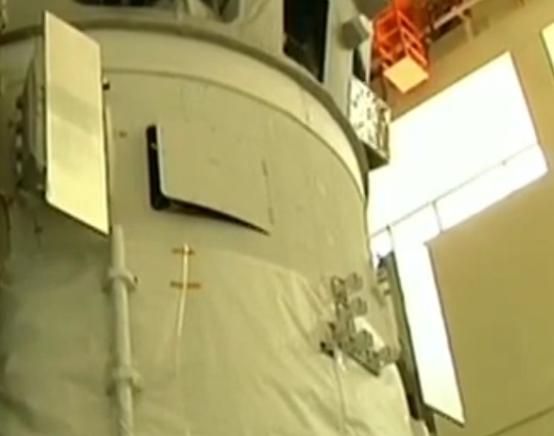
Parameters of Tiangong-2 InIRA
Frequency | Ku band
Bandwidth | 40MHz
Range resolution | 200m~30m
Azimuth resolution | 30m
Swath | 30-35km
Orbit error | 20cm
Vertical accuracy of sea surface | 25cm absolute vertical accuracy in a 5km × 5km raster
Vertical accuracy of land surface | 1~5m absolute vertical accuracy in a 200m × 200m raster
Accuracy of wave direction | 15º
Shenzhou XI manned spaceflight
Tiangong-2
space laboratory
Antennas of Tiangong-2 InIRA

Slide 15
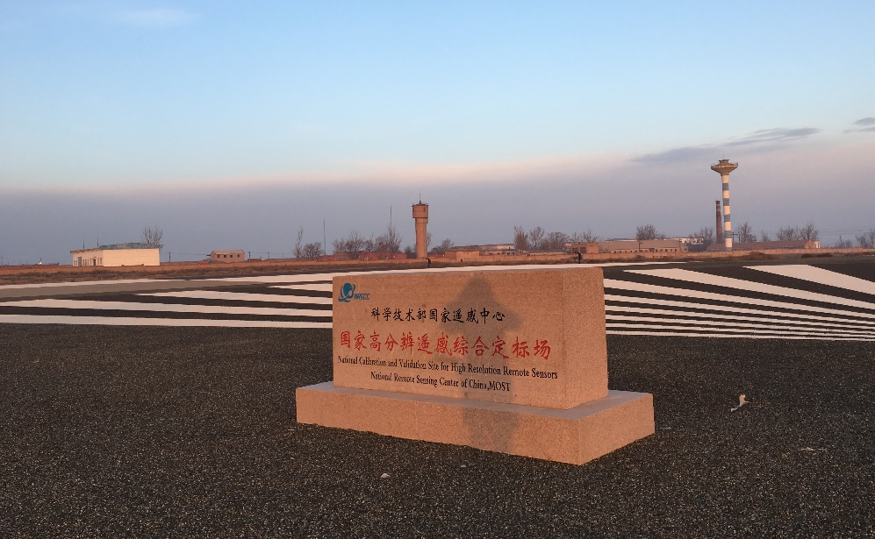
Calibration Experiment (Collaboration with AOE, CAS)
Reflector | Number | RCS(dBsm) | S-C-R
0.8m triangle | 1 | 35.50 | 4.5
1.0m triangle | 9 | 39.37 | 8.37
1.2m triangle | 1 | 42.54 | 11.54
1.5m triangle | 9 | 46.38 | 15.38
2.0m rectangular | 2 | 60.92 | 29.92
1st Experiment
2nd Experiment
Background NRCS：-3dB；
InIRA surface resolution： 50m X 50m

Slide 16
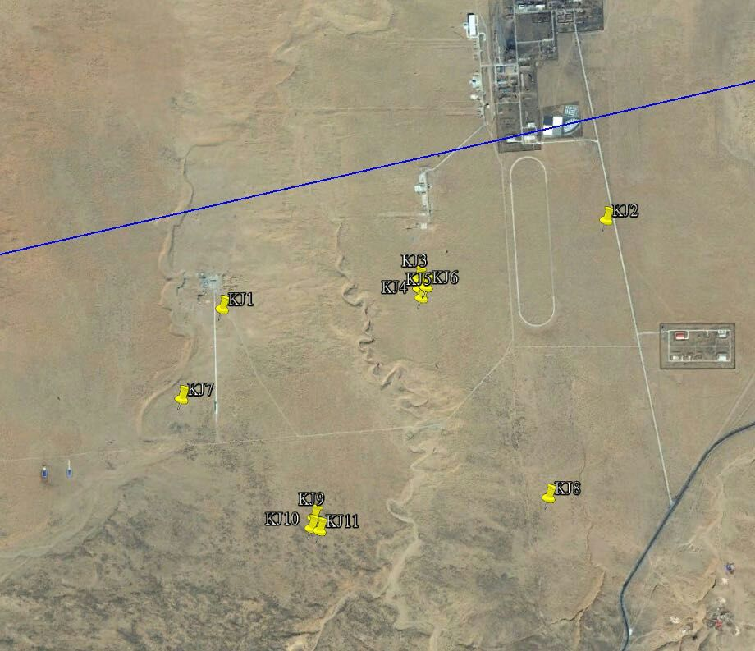
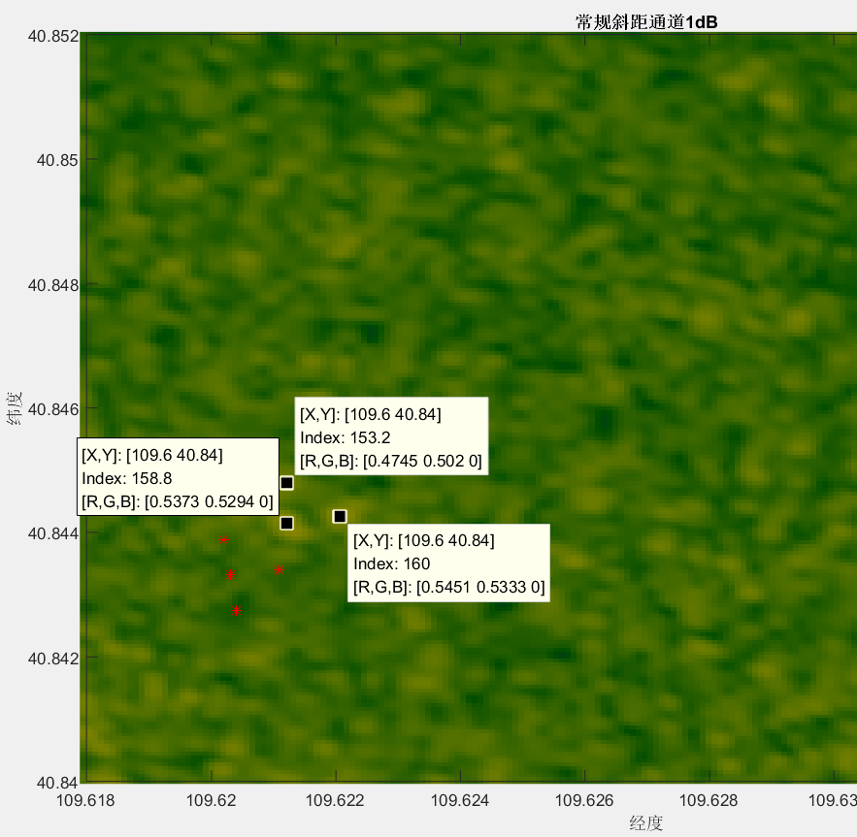
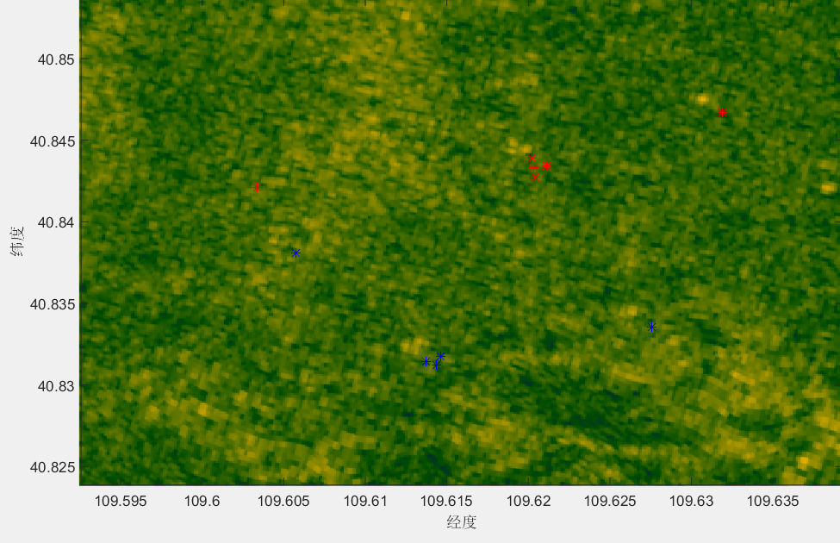
1st Experiment reflector distribution

Slide 17
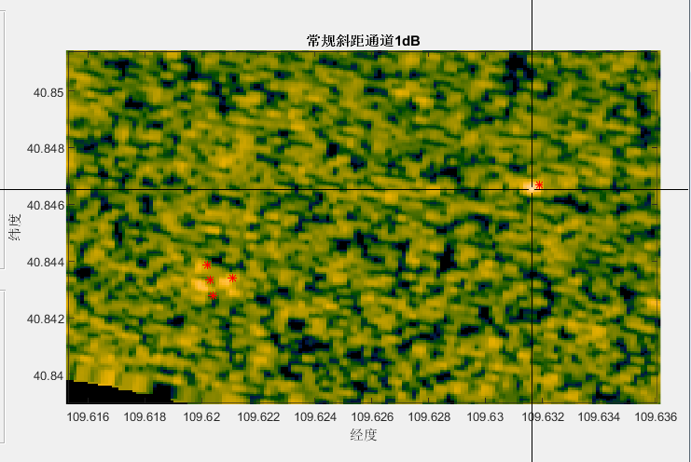
1st Experiment DEM result
No | InIRA (m) (WGS84 ) | GPSm (85高程基准)
1 | 1281.77488920 | 1275.683
2 | 1299.21366239 | 1290.444
3 | 1298.86098894 | 1289.867
4 | 1300.20181014 | 1290.641
1
3
4
2
No | InIRA relative (m) | GPS relative (m) | Bias (m)
1-2 | -17.4388 | -14.7610 | -2.6778
1-3 | -17.4388 | -14.1840 | -3.2548
1-4 | -18.4269 | -14.9580 | -3.4689
2-3 | 0.3527 | 0.5770 | -0.2243
2-4 | -0.9881 | -0.1970 | -0.7911
3-4 | -1.3408 | -0.7740 | -0.5668
Bias：-1.8306m，
Std：1.465m

Slide 18
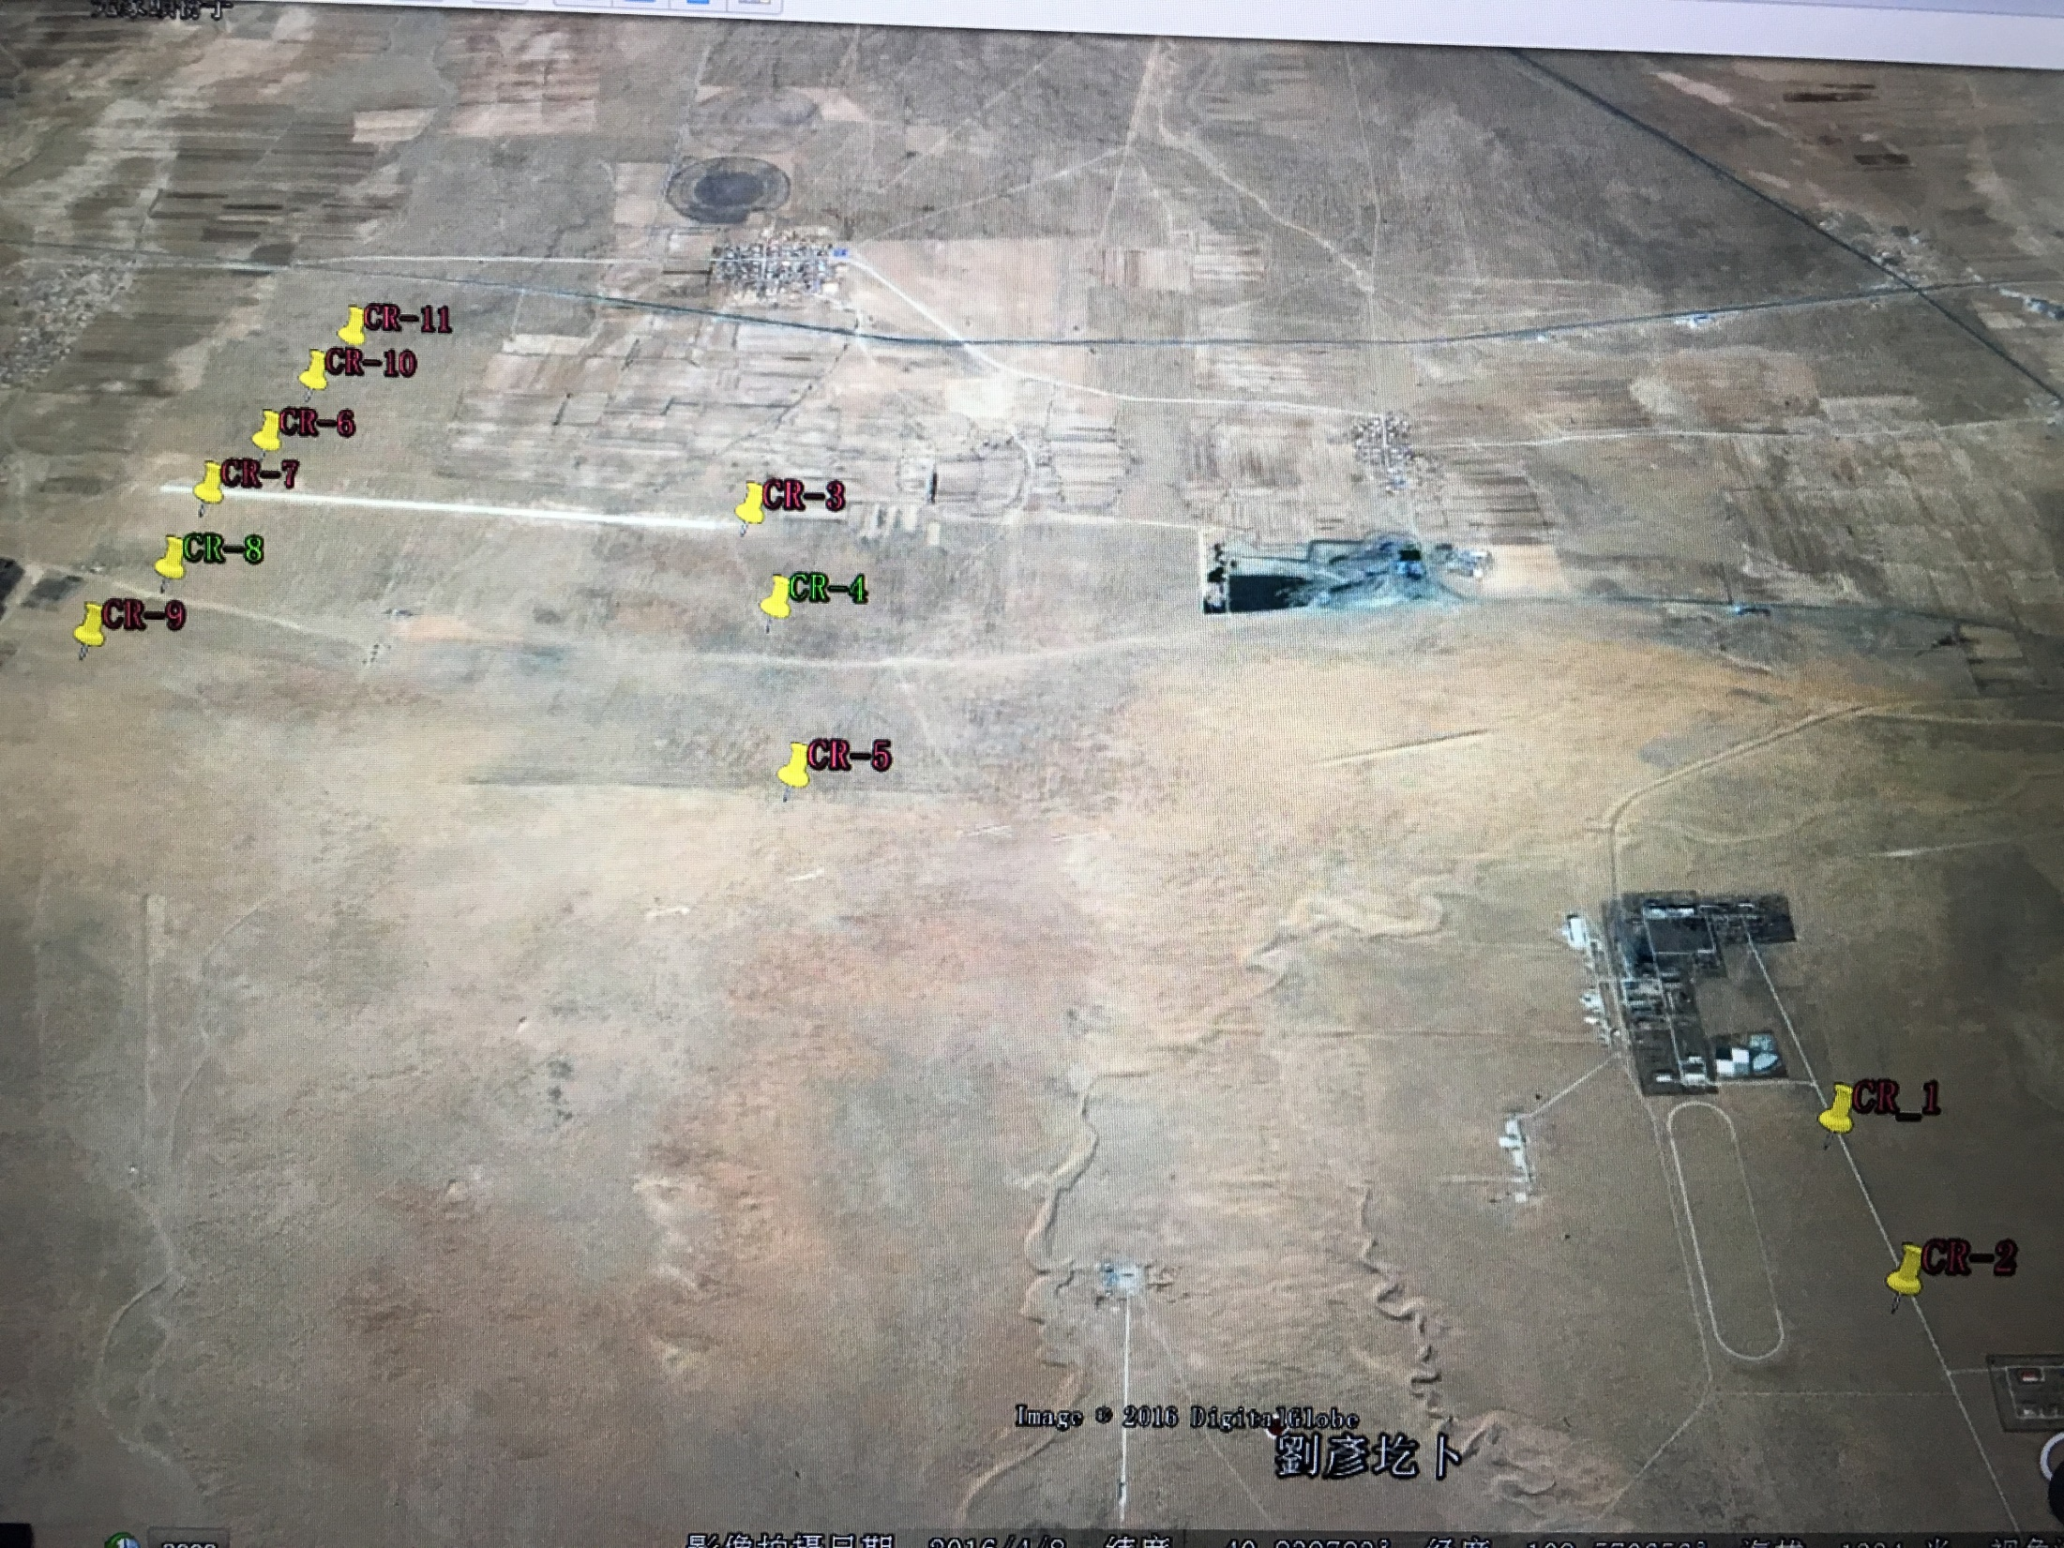
2nd Experiment reflector distribution

Slide 19
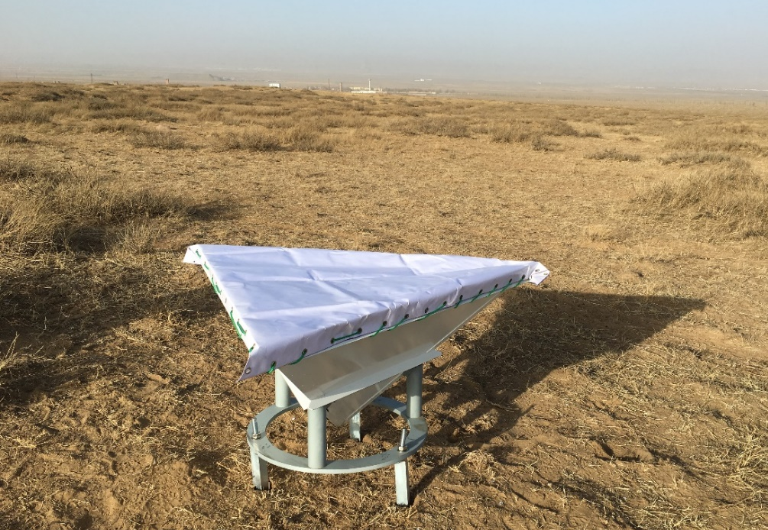
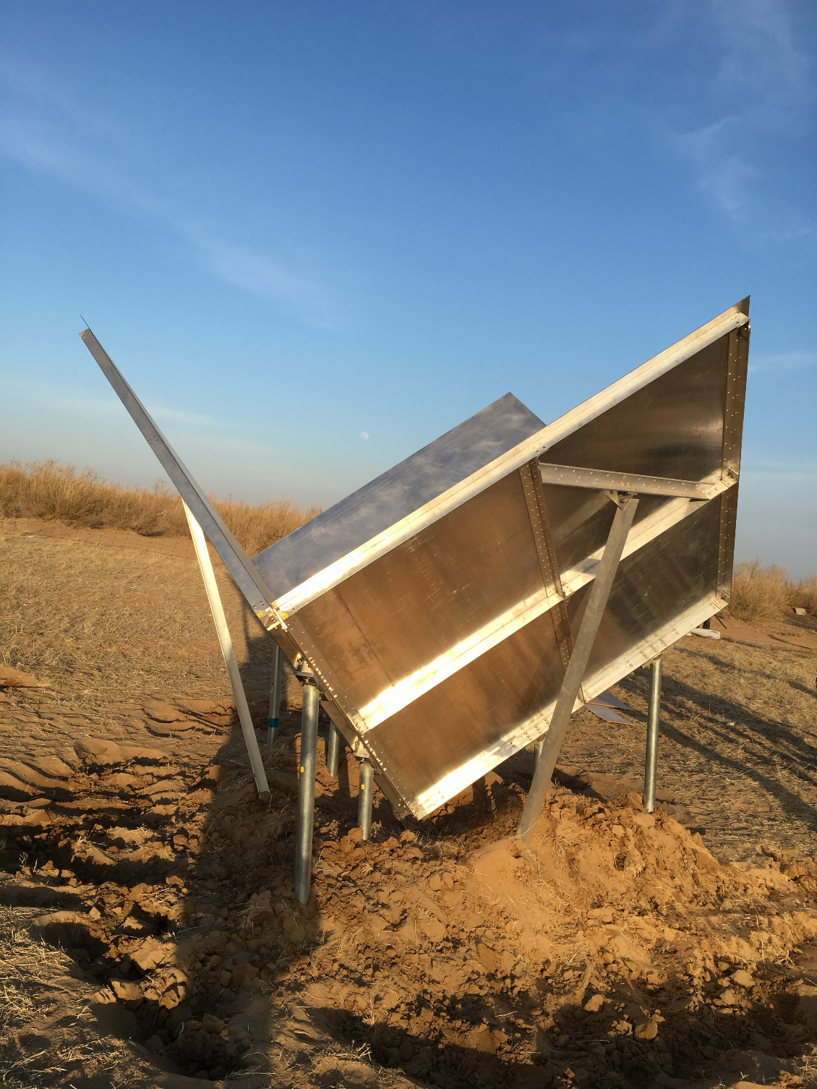
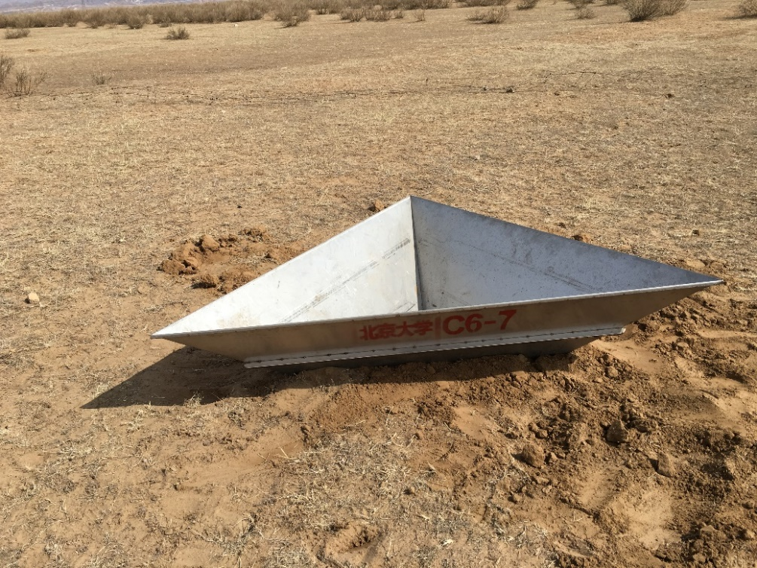
钢钎固定
挖坑固定
底座固定

Slide 20
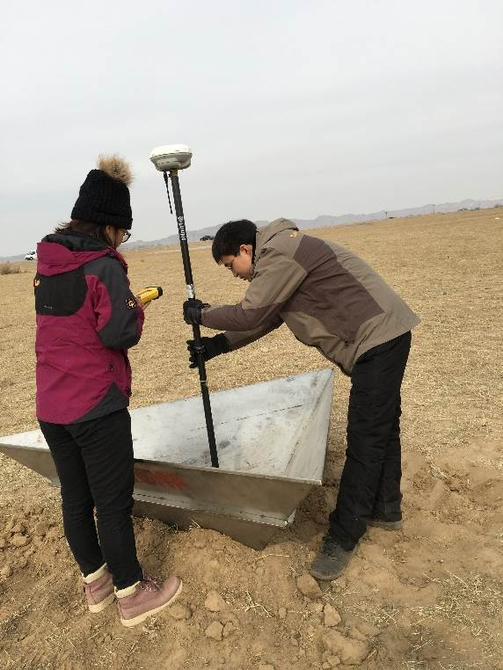
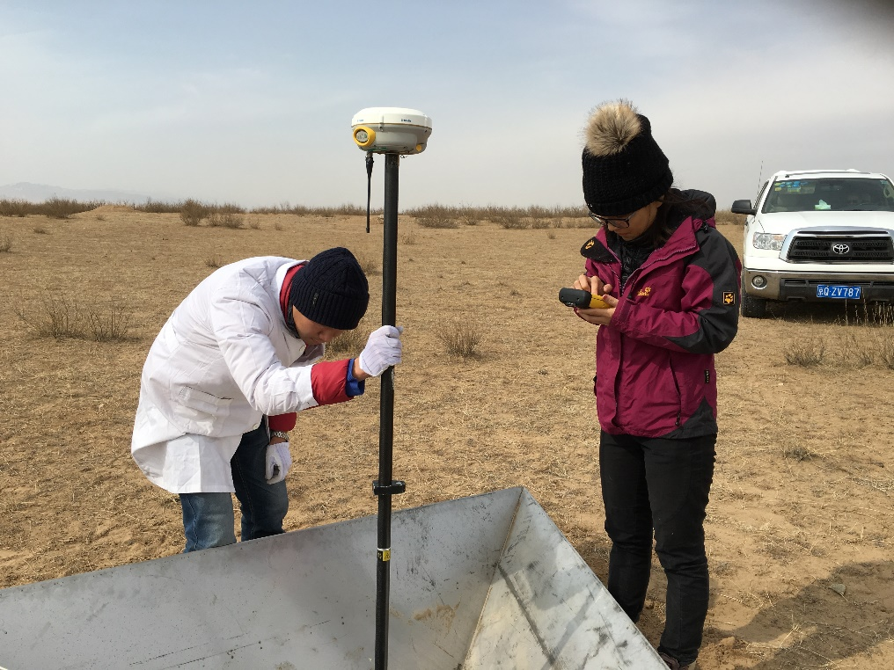
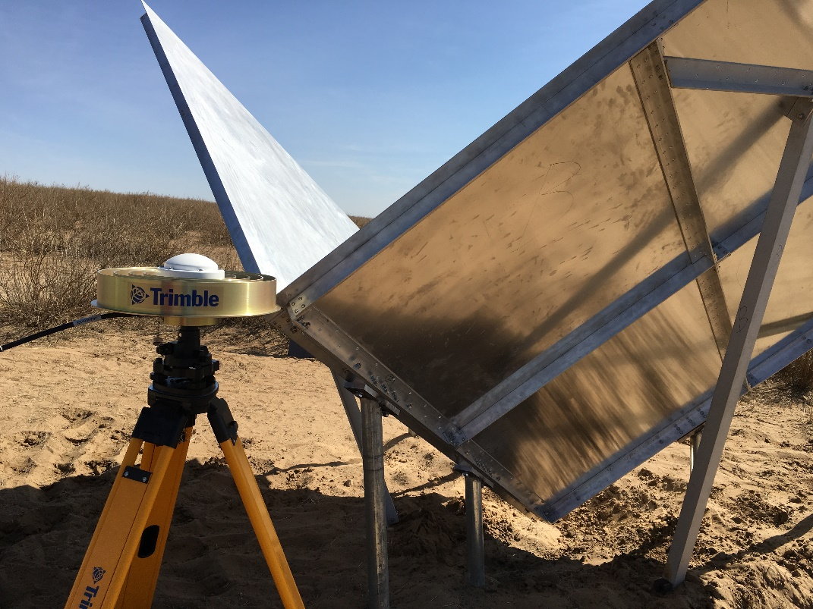
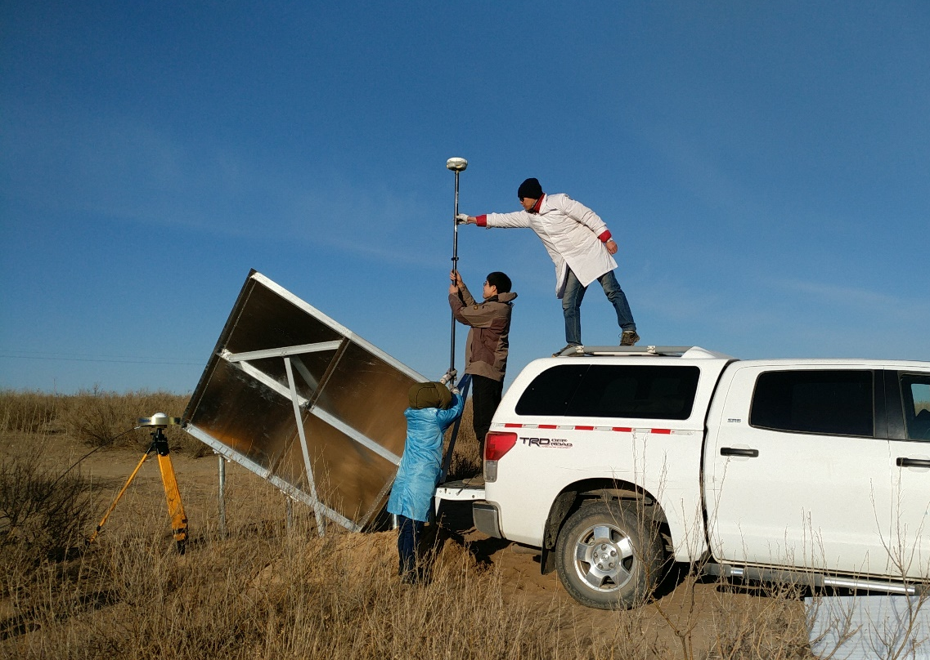
Phase Center determiantion

Slide 21
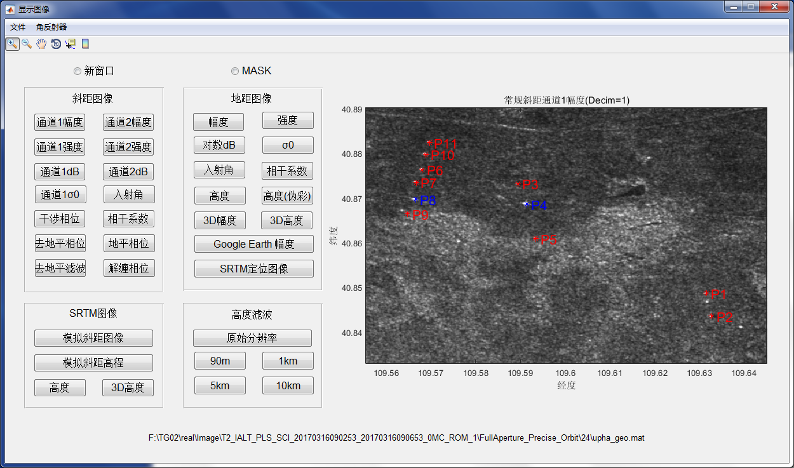
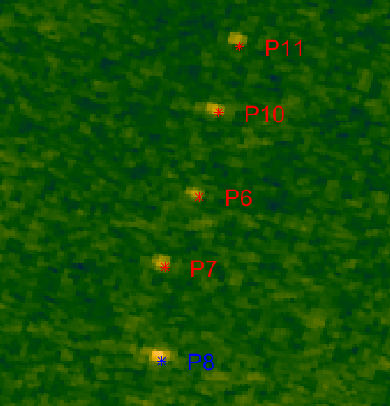
2nd Experiment Imaging of relfectors

Slide 22
 | InRA（m） | Static GPS（m） | Bias （m） | RCS relative(dB)
P1（1.5m） | 1277.9139 | 1274.3707 | 3.5432 | 8.494
P2（1.5m） | 1285.6256 | 1282.2367 | 3.3889 | 8.734
P3（1.5m） | 1279.3402 | 1279.0957 | 0.2445 | 6.568
P4（2.0m） | 1271.8319 | 1273.5137 | -1.6818 | 23.43
P5（1.5m） | 1275.6960 | 1275.4807 | 0.2153 | 8.405
P6（1.5m） | 1276.4786 | 1276.6887 | -0.2101 | 11.90
P7（1.5m） | 1272.0699 | 1272.8907 | -0.8208 | 12.67
P8（2.0m） | 1270.6294 | 1269.6437 | 0.9857 | 19.08
P9（1.5m） | / | / | / | 9.586
P10（1.5m） | 1280.6327 | 1280.6147 | 0.0180 | 14.01
P11（1.5m） | 1282.5860 | 1284.3187 | -1.7327 | 11.38
Absolute bias ≤1.0m

Slide 23
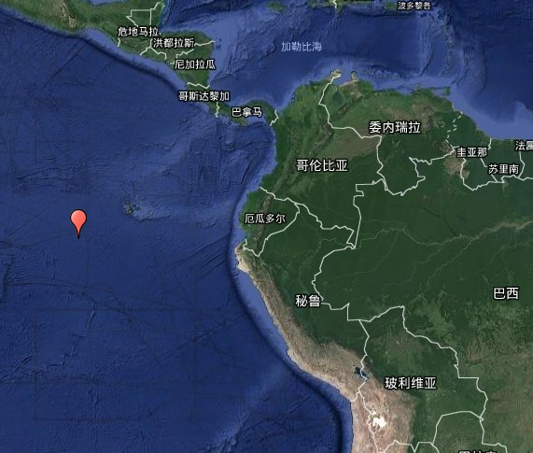
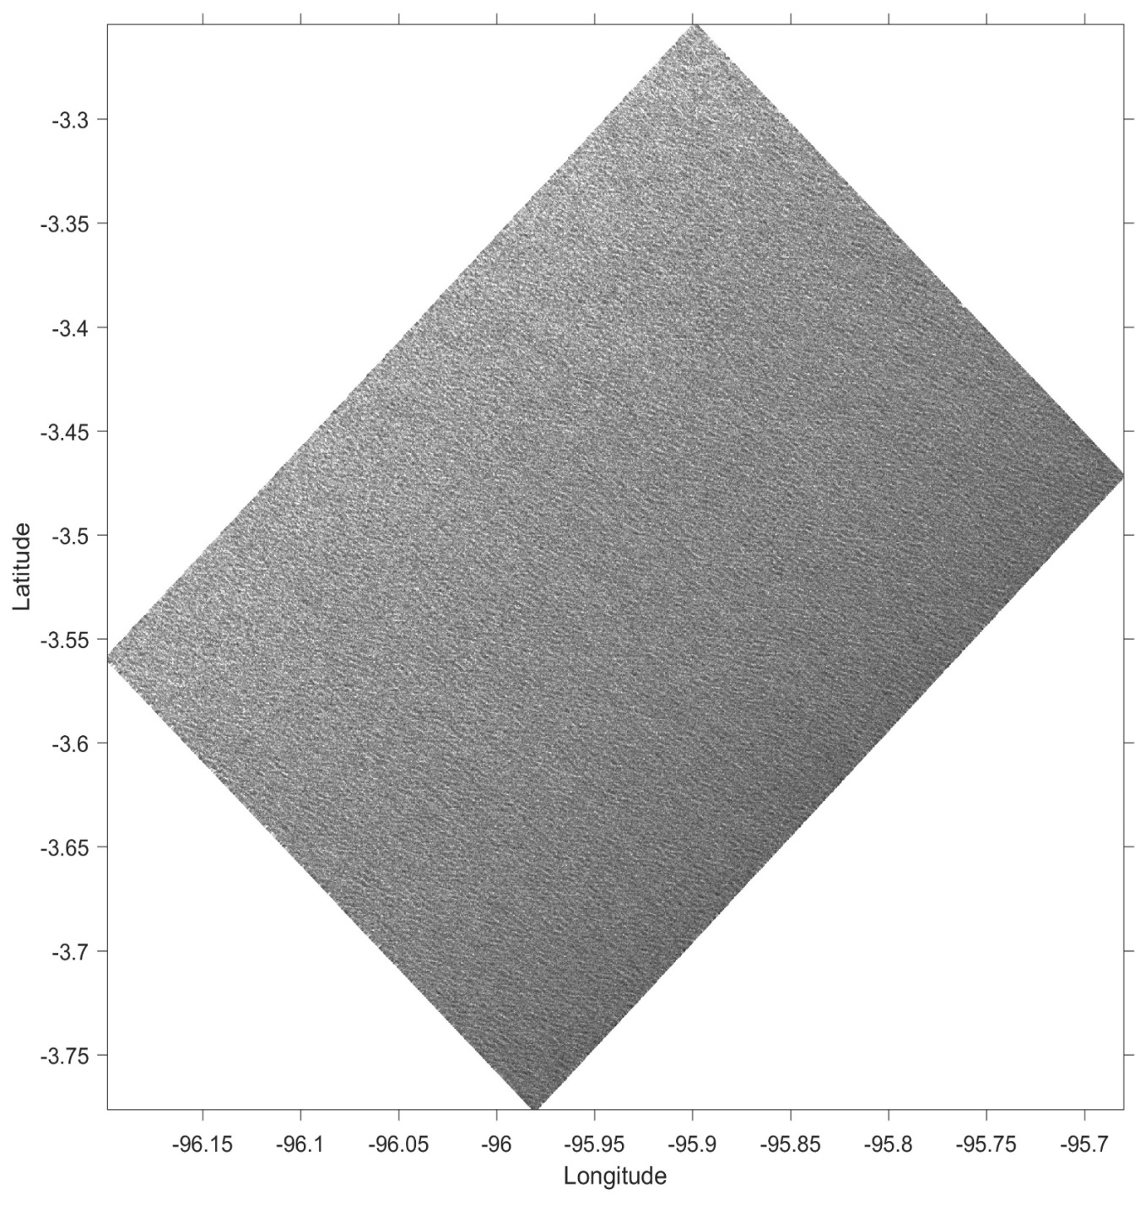
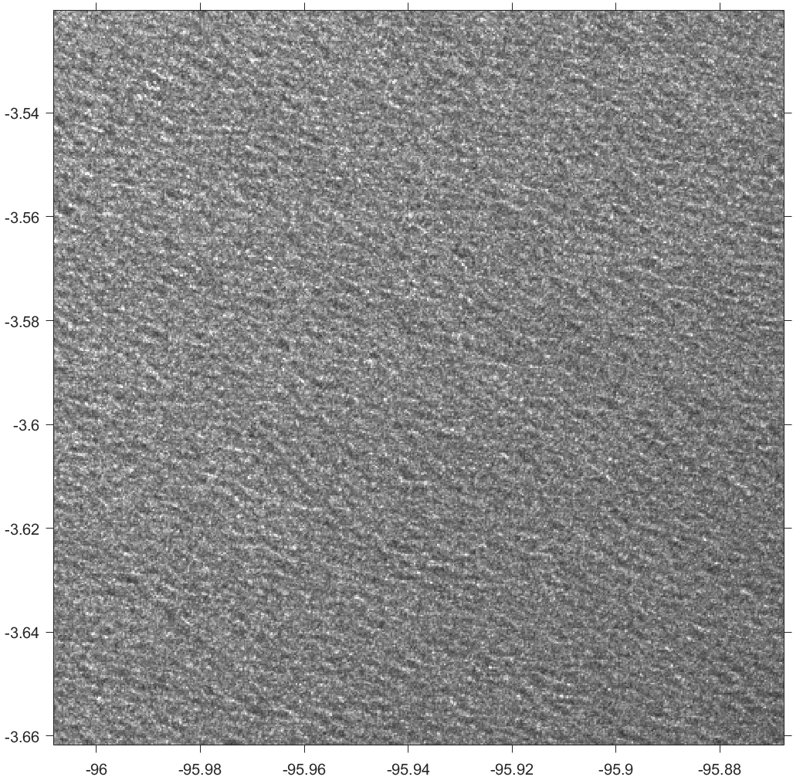
Tiangong-2 InIRA Image: Pacific Ocean
(-95.95,-3.5)
Ocean waves
Eastern Pacific Ocean at about 1800km west of Ecuador, South America
Observation time:
2016.09.23, 10:14
Notes:
20160923235109_000_0MC_ROM_1tg156_ampHRa

Slide 24
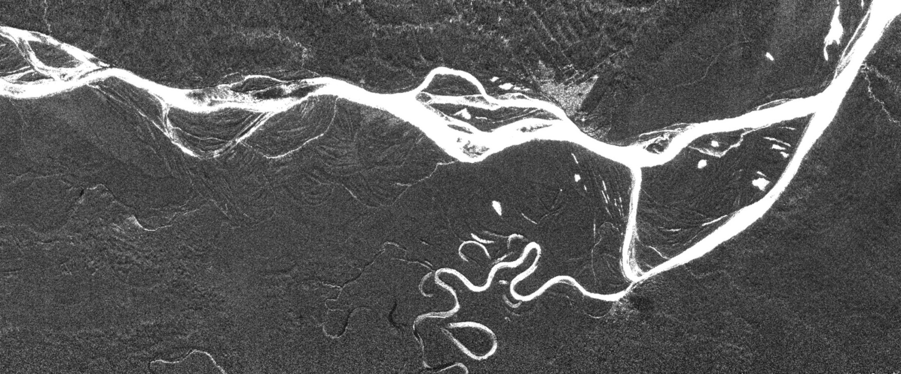
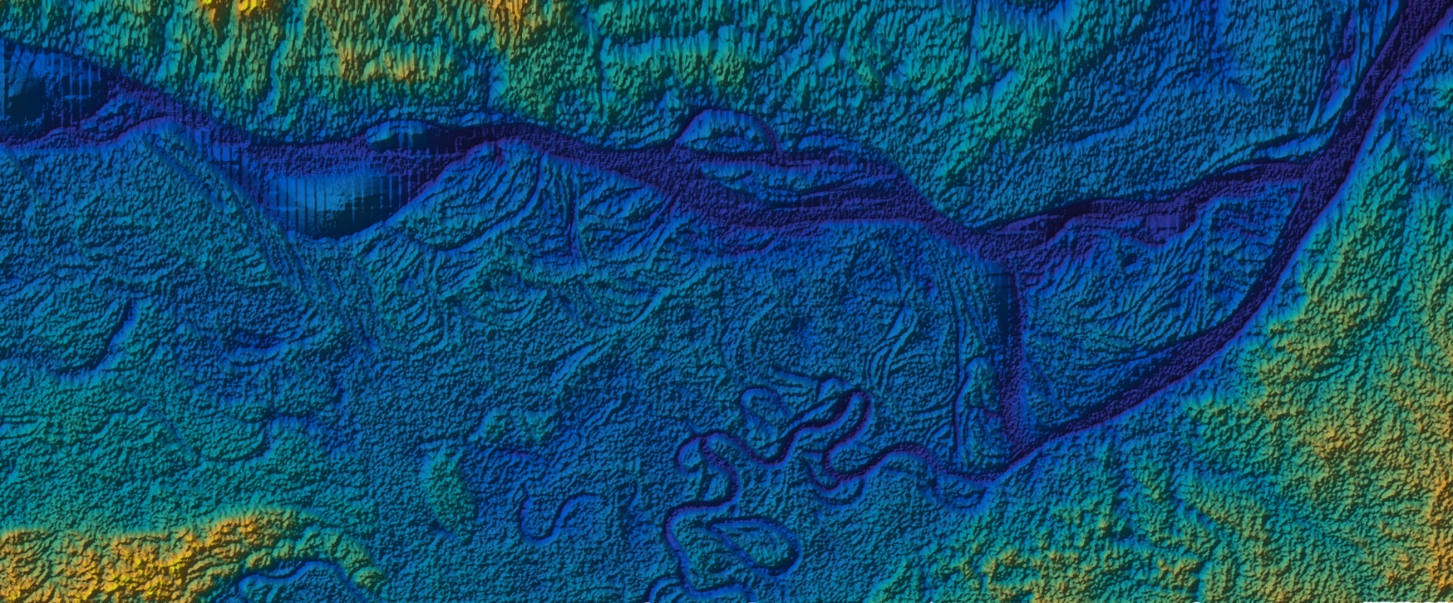
Tiangong-2 InIRA Image: Inland river
Colombia
N
S
Amazon River
Brazil
Amazon River
Rainforest
Peru
Brazil
Amplitude
Amazon River
Amazon River
Rainforest
Amazon rainforest at the junction of Brazil, Peru and Colombia
Image Size: 79.3km x 33.6km
Latitude and longitude of image center: (70.0533W, 4.2122S)
Observation time: 2016.09.23, 10:56
DEM
Notes:
20160923105609_000_0MC_ROM_1南美tg3_ampHRs

Slide 25
Tiangong-2 InIRA Image: Sea surface topography (spatial resolution 2km × 2km)
South Pacific
19
Notes:
I:\TG2_Results\TS_TG02_IALT_PLS_SCI_20160924011611_20160923233510_20160923235109_000_0MC_ROM_1\FullAperture_Precise_Orbit\156

Slide 26
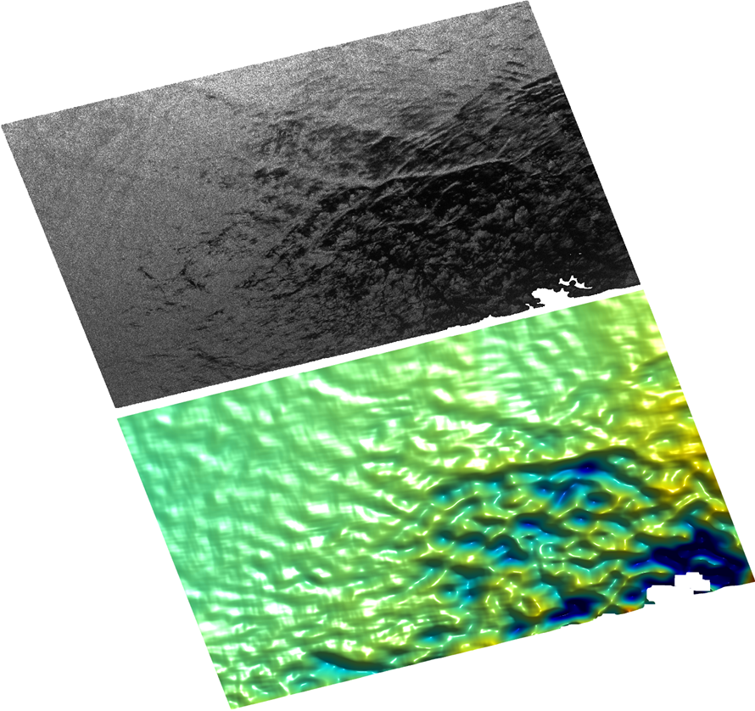
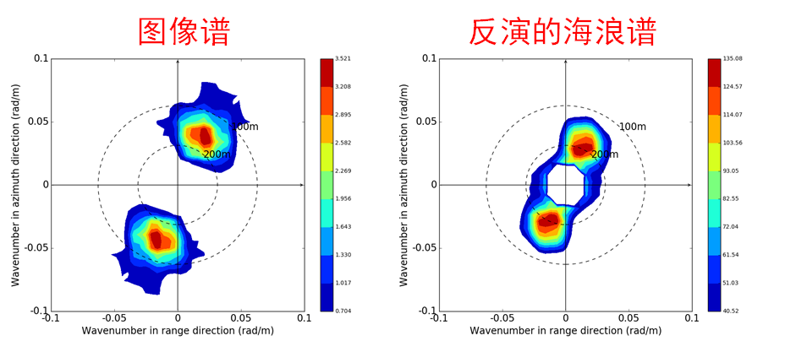
Wave Spectrum by InIRA

Slide 27
Preparation of CFOSAT calibration
Amazon forest sigma 0 statistics for Ku-band
Amazon forest sigma 0 incident angle profile regression
NWP ocean calibration preparation

Slide 28
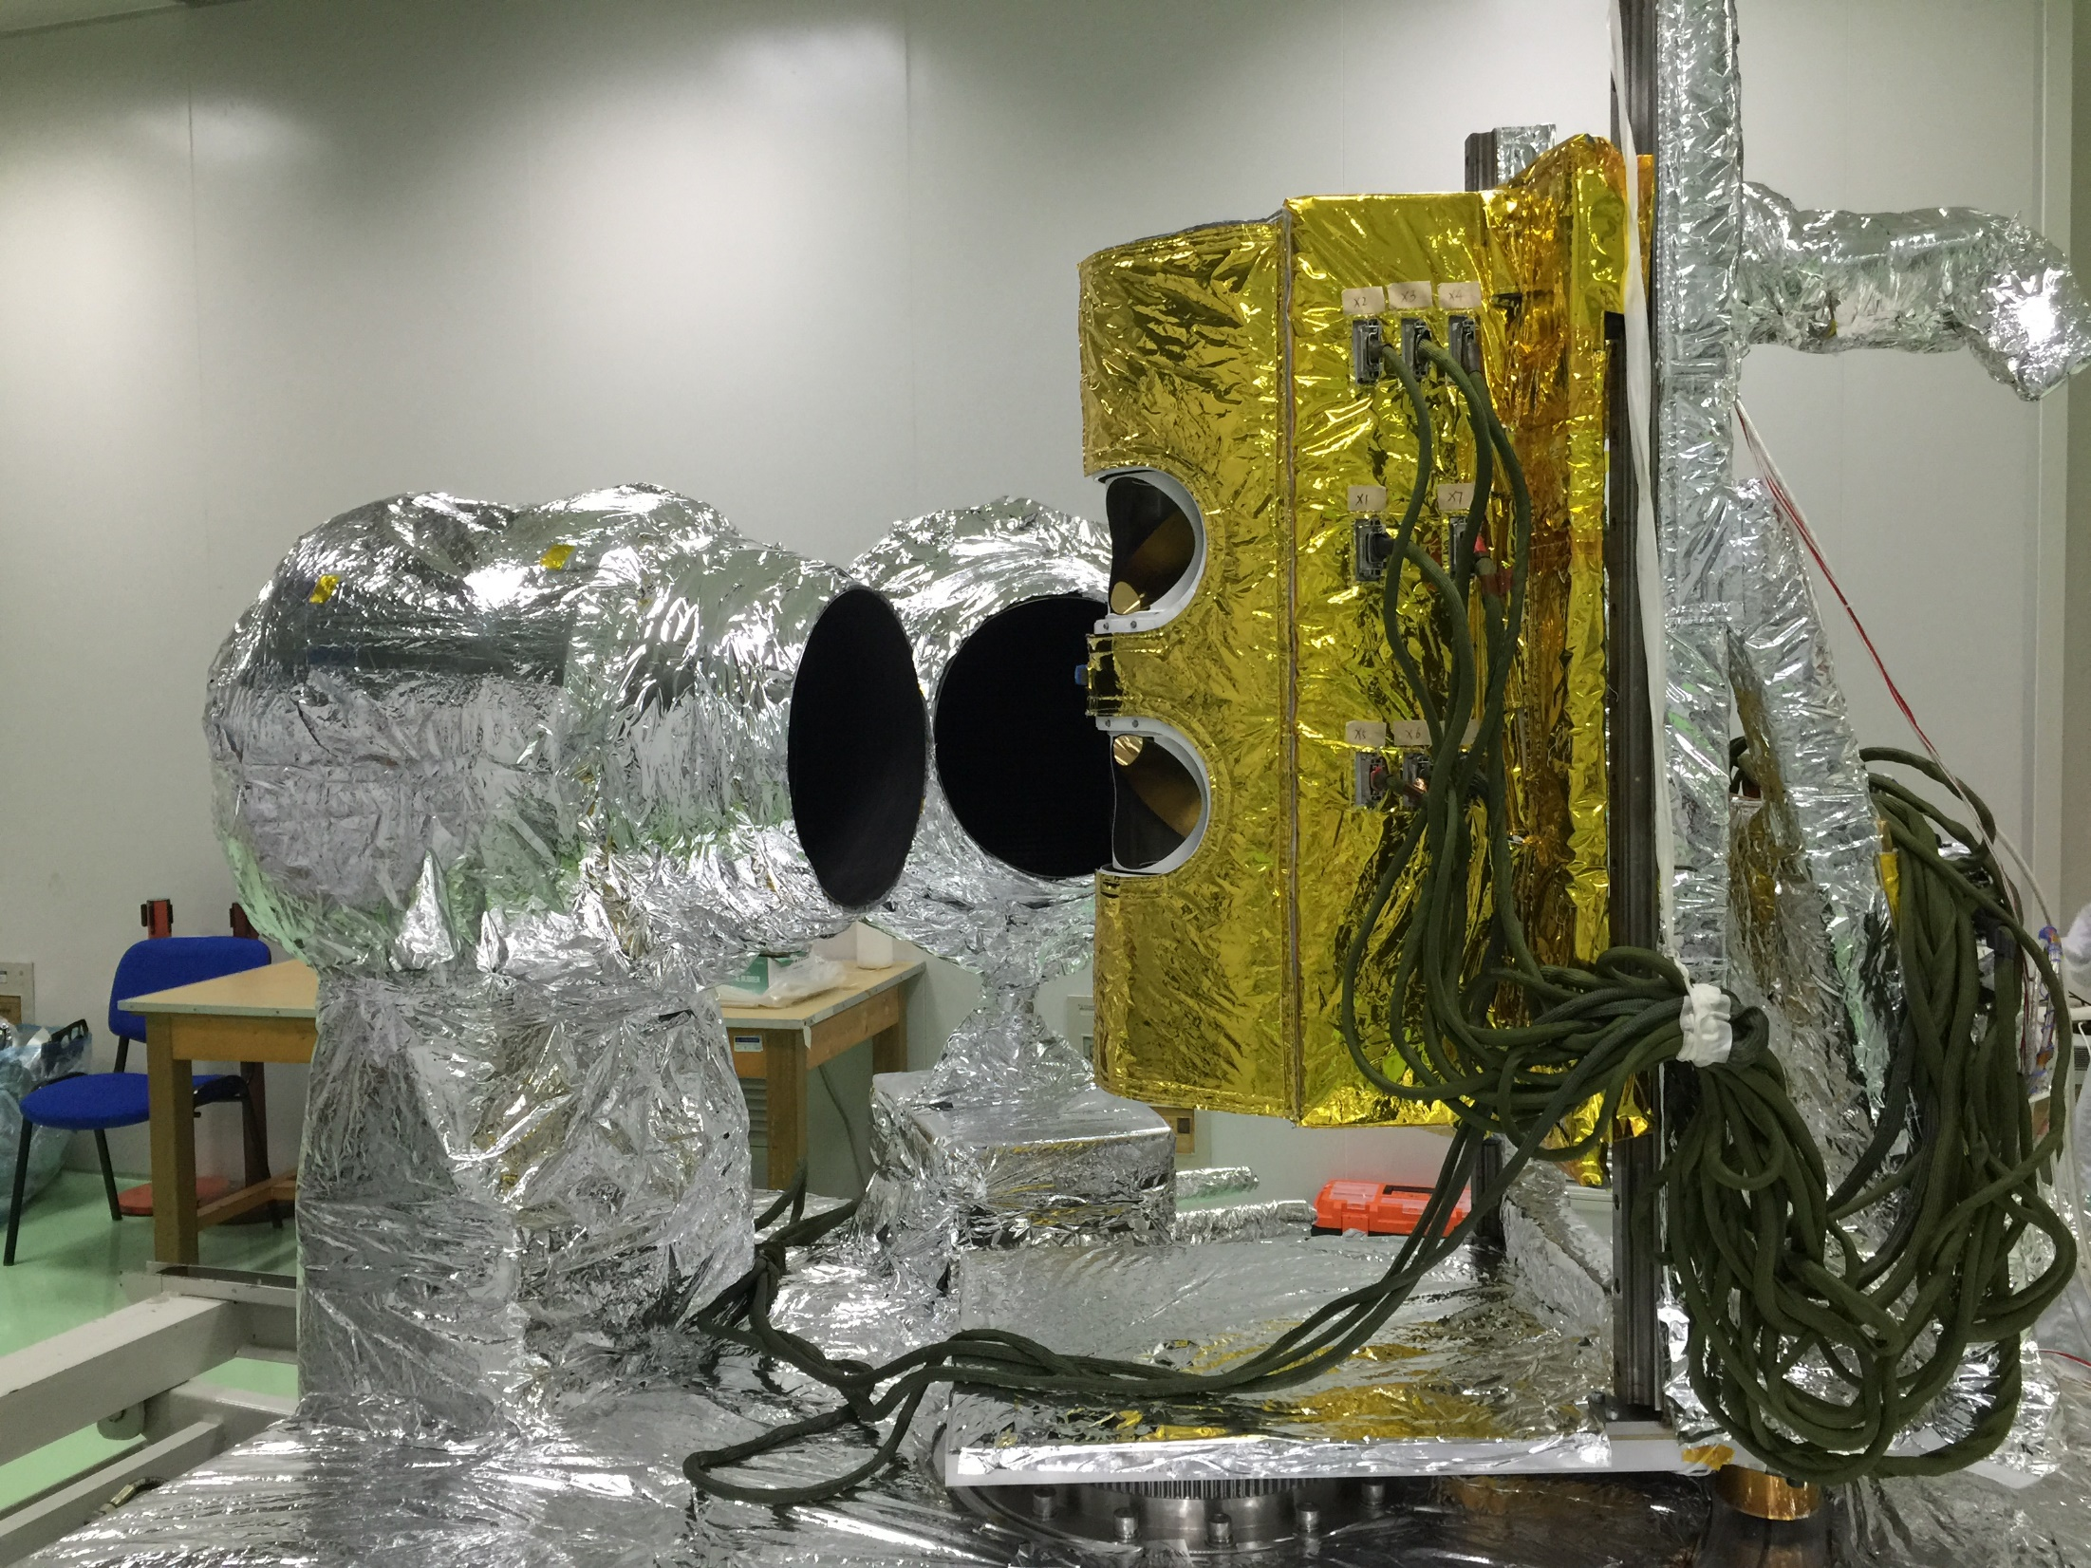
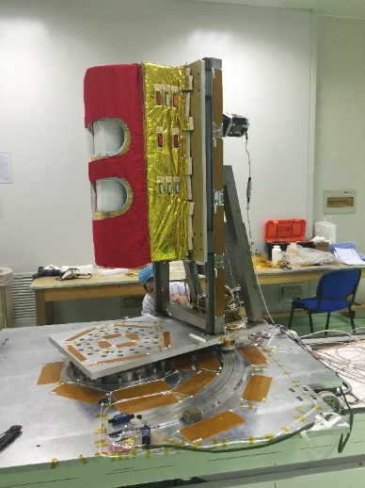
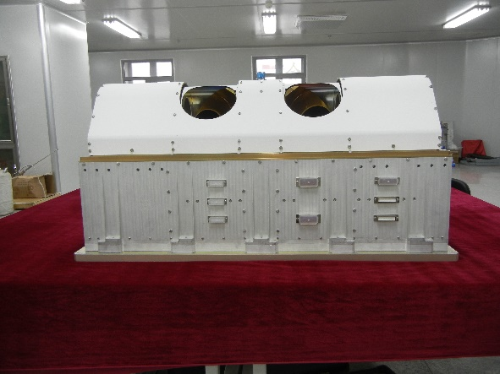
T/V calibration/Test of FY-3D MWHTS
FY-3D satellite was launched at Nov 2017
Prelaunch calibration was conducted at the same vacuum as the previous tests;
Multi-angle Cal. Configuration was designed for testing if the scanning angle variations would lead to the calibration precision, which was found by comparing in-orbit measurements with simulated TB by RTM, such as RTTOV or CRTM.

Slide 29
Essential calibration coefficients such as cold bias, hot bias and nonlinearity coefficients and calibration results like calibration residual error, sensitivity and calibration accuracy of MWHTS are all obtained and analyzed in MWHTS’s six observing positions.
The measured sensitivity values of channel 2 is 1.5K while the measured sensitivities of the others range from 0.18 K to 0.57K.
The calibration accuracies of channel 2 is 1.6K while the calibration accuracies of the others range from 0.22 K to 0.64K.
The problems met in data processing such as radiation leakage at channel 14 and response lag at channel 15 for special channels are minutely analyzed.
Moreover, the measurements of the T/V test with fast changing instrument temperatures are analyzed and the applicability of nonlinearity coefficients obtained in T/V test for in-orbit calibration is verified.
Summarily, MWHTS meets the basic design requirements, and the changing of MWHTS observing position does not impact the calibration nonlinearity coefficients and calibration residues.
Radiation leakage analysis of channel 14
Response lag of channel 15 when observing the Earth target

Slide 30
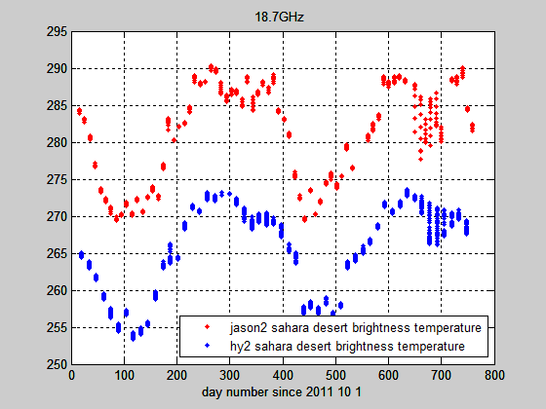
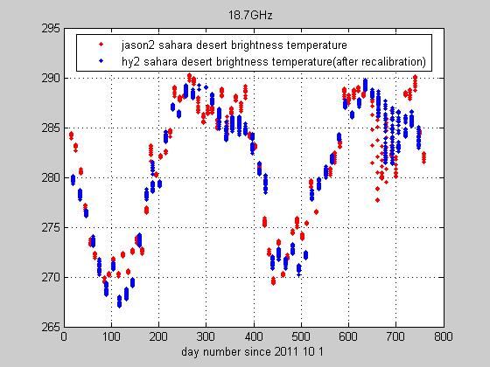
Postlaunch calibration/Validation of FY-3 MWHS
Calibration consistency study on FY-3A,3B,3C microwave radiometers were supported.
Combining with FY-3D launched last year, a series of sounders and imagers database will be recalibrated by cross- or inter- calibration, and finally a set of consistent datasets will support the studies on climate and related applications.
FY-3 Satellite | Interval of the measurements | Calibration Precision | Period (s)
MWHS/MWHTS | FY-3A:2008.6.4--2014.5.5 |  | 8/3
 | FY-3B:2011.11---- |  | 8/3
 | FY-3C:2013.9---- | 0.88-2.09K | 8/3
MWRI | FY-3A:2008.6.4 |  | 1.7
 | FY-3B:2011.11.11-- |  | 1.7
 | FY-3C:2013.9.29-- | 2.23-8.72 | 1.7
MWTS | FY-3A:2008.6.4--2012.12.21 |  | 16
 | FY-3B:2011.11--2014.1.22 |  | 16
 | FY-3C:2013.9--2014.5 |  | 8/3
The same plans are planning for HY-2 satellite for microwave scanning radiometer, altimeter and scatterometer.
Atmospheric Correction MR cross-cal. with JMR shows below.
Before cal.
Zou, C.-Z., and W. Wang (2011), Intersatellite calibration of AMSU-A observations for weather and climate applications, J. Geophys. Res., 116, D23113, doi:10.1029/2011JD016205
After cal.

Slide 31
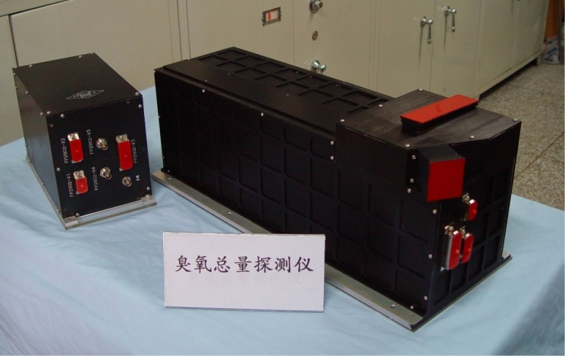
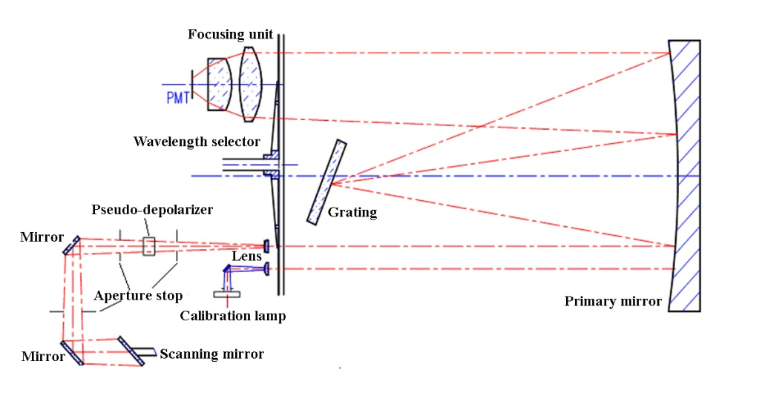
FY-3 TOU cross-validation （HM Wang, NSSC)
Instrument Characteristics
Parameter | Value
Detector | Multiplier Tube detector (PMT)
FOV | 3.6°×3.6°
Spatial Resolution | 50km at Nadir
Swath width | 2908km
Number of samples/scan | 31 points in 8.16s
Operation modes | 1. Normal scan 2. Wavelength monitoring 3. Radiometric Calibration
Scientific objectives | Total column ozone, Aerosol, volcanic SO₂
Picture of FY-3A/TOU:optical assembly and eletronical unit
Spectral propterties
Channel | Central wavelentgh (nm) | Band width (nm)
1 | 308.68±0.15 | 1.0+0.3, -0.0
2 | 312.59±0.15 | 1.0+0.3, -0.0
3 | 317.61±0.15 | 1.0+0.3, -0.0
4 | 322.40±0.15 | 1.0+0.3, -0.0
5 | 331.31±0.15 | 1.0+0.3, -0.0
6 | 360.11±0.25 | 1.0+0.3, -0.0
It has a single, fixed Ebert-Fastie monochromator with a fixed grating and an array of exit slits

Slide 32
FY-3A/TOU: 5th and 6th channel ‘s higher about 17-20%,caused by reflectivity of satellite coat
FY-3B/TOU: all channels have good agreement, about 2%
FY-3C/TOU: atmospheric radiance mode work well, but solar irradiance mode has problem,
Comparisons for clear sky earth’s radiance and solar irradiance for FY-3B/C

Slide 33
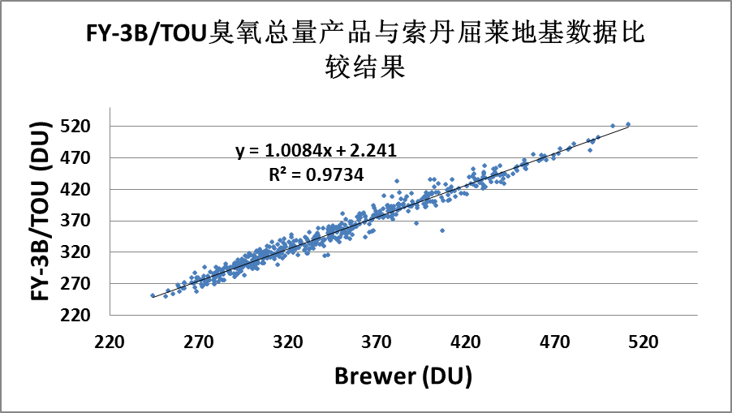
Comparison of total ozone between FY-3B/TOU and Brewer (Finland).
Mean deviation: 1.45%，RMS Deviation: 2.65%，
R²: 0.9866
Comparison of total ozone between FY-3B/TOU and Metop-B/GOME-2.
R²:0.9937
(Results by Wang Weihe,CMA)

Slide 34
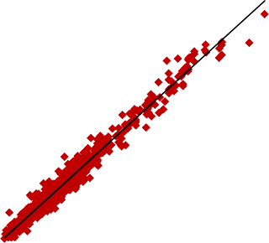
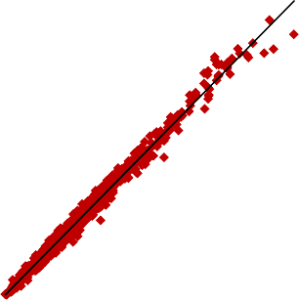
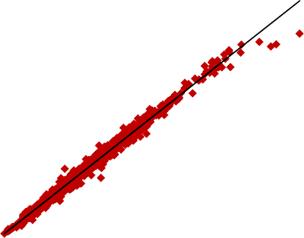
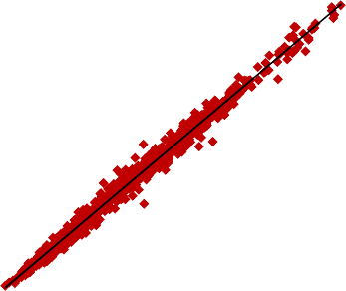
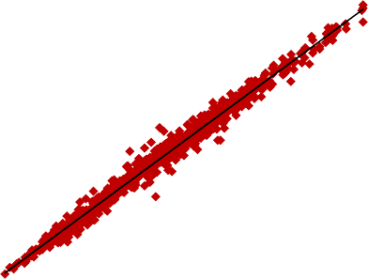

FY-3A/TOU vs NPP/OMPS L1B (2013.10.1-13）
0.4
0.35
0.3
0.25
0.2
0.15
0.1
0.05
0
1.2
3
y = 1.1216x + 0.0075 R²= 0.9711
y = 1.059x + 0.0064 R²= 0.9883
OMPS (μW/cm²/nm/sr)
1
2.5
y = 1.1071x + 0.0187 R²= 0.9883
OMPS (μW/cm²/nm/sr)
0.8
2
OMPS
0.6
1.5
308 nm
0.4
312 nm
1
317 nm
0.2
0.5
0
0.1 0.2 0.3
TOU (μW/cm²/nm/sr)
0.4
0
0
0
0.5
1
1.5
0
0.5 1 1.5
TOU (μW/cm²/nm/sr)
2
2.5
TOU
3.5
7
9
8
7
6
5
4
3
2
1
0
3
y = 1.1477x + 0.0194 R²= 0.9884
6
y = 1.0427x + 0.0314 R²= 0.9861
OMPS (μW/cm²/nm/sr)
OMP (μW/cm²/nm/sr)S
y = 0.9476x + 0.069
R²= 0.9806
2.5
5
OMPS (μW/cm²/nm/sr)
2
4
1.5
3
1
322 nm
2
331 nm
360 nm
0.5
1
0
1 2
TOU (μW/cm²/nm/sr)
0
0
3
0
2 4
TOU (μW/cm²/nm/sr)
6
0
2
4 6
TOU (μW/cm²/nm/sr)
8
10

Slide 35





FY-3C/TOU vs Metop-B/GOME-2 L1B (2016.11.1-5)
2.5
4.5
4
3.5
3
2.5
2
1.5
1
0.5
0
6
5
4
3
2
1
0
2
y = 1.5274x + 0.0052 R²= 0.9974
y = 1.6111x + 0.007 R²= 0.9968
y = 1.7127x - 0.0151 R²= 0.9965
FY-3C/TOU
(μW/cm²/nm/sr)
FY-3C/TOU
(μW/cm²/nm/sr)
FY-3C/TOU
(μW/cm²/nm/sr)
1.5
1
0.5
312 nm
0.5 1 1.5
MetopB/GOME-2 (μW/cm²/nm/sr)
322 nm
1 2 3
MetopB/GOME-2 (μW/cm²/nm/sr)
0
317 nm
0
2
0
1 2
MetopB/GOME-2 (μW/cm²/nm/sr)
3
0
4
9
8
7
6
5
4
3
2
1
0
12
10
8
6
4
2
0
y = 1.665x - 0.0648 R²= 0.9957
y = 1.713x - 0.0223 R²= 0.9942
FY-3C/TOU
(μW/cm²/nm/sr)
FY-3C/TOU
(μW/cm²/nm/sr)
331 nm
360 nm
2 4 6
MetopB/GOME-2 (μW/cm²/nm/sr)
0
2 4
MetopB/GOME-2 (μW/cm²/nm/sr)
6
0
8

Slide 36





FY-3C/TOU vs Metop-B/GOME-2 L1B (2016.7.15-20)
1.6
1.4
1.2
1
0.8
0.6
0.4
0.2
0
3.5
3
2.5
2
1.5
1
0.5
0
5
4.5
4
3.5
3
2.5
2
1.5
1
0.5
0
FY-3C/TOU
(μW/cm²/nm/sr)
y = 1.4523x - 0.0228 R²= 0.9693
y = 1.5171x - 0.0491 R²= 0.96
y = 1.645x - 0.1164
R²= 0.953
FY-3C/TOU
(μW/cm²/nm/sr)
FY-3C/TOU
(μW/cm²/nm/sr)
312 nm
317 nm
0.5 1 1.5
MetopB/GOME-2 (μW/cm²/nm/sr)
322 nm
0
0.5 1
MetopB/GOME-2 (μW/cm²/nm/sr)
1 2
MetopB/GOME-2 (μW/cm²/nm/sr)
0
2
0
3
10
9
8
7
6
5
4
3
2
1
0
14
12
10
8
6
4
2
FY-3C/TOU
(μW/cm²/nm/sr)
y = 1.6133x - 0.2752 R²= 0.9466
y = 1.6756x - 0.3019 R²= 0.9559
FY-3C/TOU
(μW/cm²/nm/sr)
331 nm
360 nm
2 4 6
MetopB/GOME-2 (μW/cm²/nm/sr)
0
2 4
MetopB/GOME-2 (μW/cm²/nm/sr)
6
0
0
8
Almost all R²>0.95

Slide 37
(1) FY-3A/TOU vs Metop-B/GOME-2
< 6.6 μW/cm²/nm/sr
1.6
1.4
1.2
1
0.8
Equation slope
2013/2/1
2013/6/1
2013/10/1
2014/2/1
Date
2014/6/1
2014/10/1
2015/2/1
TOU 312
TOU 317 TOU 322
TOU/GOME-2
TOU 331
TOU 360

Slide 38
(2) FY-3C/TOU vs NPP/OMPS
The slope of equation (Radiance to Radiance)
1.2
1
0.8
0.6
TOU
20140223
20140319
20140413 20140513
OMPS
322 nm 331 nm
20140604
20140709
312 nm
317 nm
360 nm
308 nm

Slide 39

(3) FY-3C/TOU vs Metop-B/GOME-2
The slope of equation (Radiance to Radiance)
1.8
1.6
1.4
1.2
1
0.8
0.6
TOU
Metop-B/GOME-2
322 nm 331 nm
312 nm
317 nm
360 nm

Slide 40



Full polarized calibration method and standard
full-polarized calibration target was tested and applied for digital-correlation microwave polarimeter.

Slide 41






Active calibration Load for Low Frequency MWR
L and C band active calibration loads ColdFET were tested with a LN cold target, and shown that the TB were at
L- ColdFET
C noise TB & physical temp.
Stability of L-ColdFET to LN
Stability of C-ColdFET
L noise TB & physical temp.
C- ColdFET

