Slide 1
WGCV/GSICS pre-flight & on-board Cal & Characterisation workshop (optical domain) Nigel Fox on behalf of IVOS
Committee on Earth Observation Satellites

Slide 2
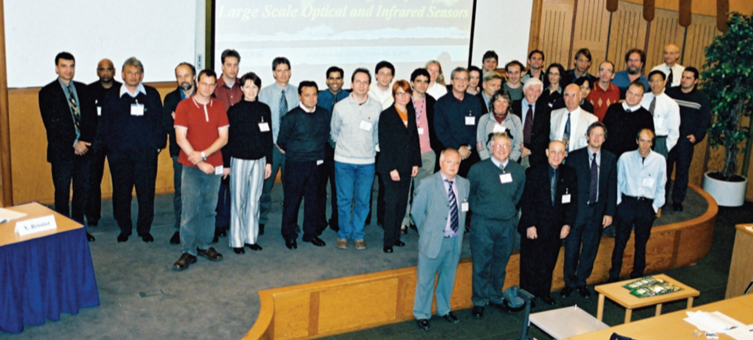
Background
Next Meeting
Following highly successful IVOS workshop at Estec in 2005?
Discussions and recommendations from IVOS ~2012 timely for new workshop
Parallel interest from GSICS
Needed to support science and engineering objectives and also to make visible/encourage access to info not always readily supplied by builders
As optical sensors spanned into Spectroscopy sensors of AC sub-group WGCV proposed workshop to be held and planned as WGCV perhaps with bigger scope
- WGCV agree that first step be limited to optical domain
Sub elements happen in regions/conferences e.g. SPIE, Utah, ESA 2017 but
need a CEOS/GSICS event with agencies and industry

Slide 3
Scope
span the spectral range UV – TIR (if needing to be limited to prioritise the solar reflective)
cover both radiometric and spectral (inc spectroscopic) calibration and characterisation (e.g. stray light, Spectral response, polarisation etc) but not geometric
and should concentrate on pre-flight including of on-board systems but not necessarily on use of on-board systems except where needed to demonstrate why the pre-flight characterisation was necessary.

Slide 4
Structure
Meeting should probably be around 2.5/3days
Organised to emphasise technical state of art but to include science/engineering context and discussion i.e. the why is X specification needed.
Meeting be fully open to all wishing to attend
Structured in part at least by invited speakers/leads of/into sessions with facilitated discussion where possible on challenges and limitation possibly by a presentation on current norm and then new on what might be possible
Aim to have good practises and/or to provide input to new IEEE committee on hyperspectral as an example summary or workshop on Cal/Val portal

Slide 5
Timing and Location
Given length of meeting should be organised as independent meeting
2019 target late spring, summer, Autumn (need approx. 9 months min to get optimium audience.
Europe is easiest for Chinese to attend and probably neutral to US industry.
Location TBD (needs to be attractive but not attractive and readily accessible
Next steps:
Agree to move forward with urgency
Need to form an organisation team. Then define location and timing

