Slide 1

Cal & VAL for Greenhouse Gases Observation Spectrometers
Committee on Earth Observation Satellites
Akihiko KUZE
(Earth Observation Research Center
Japan Aerospace Exploration Agency
CEOS WGCV 43
São José dos Campos, SP, Brazil
April 10-13, 2018

Slide 2
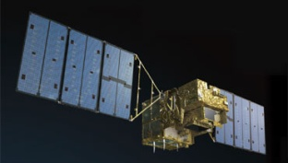
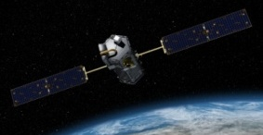
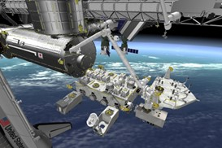
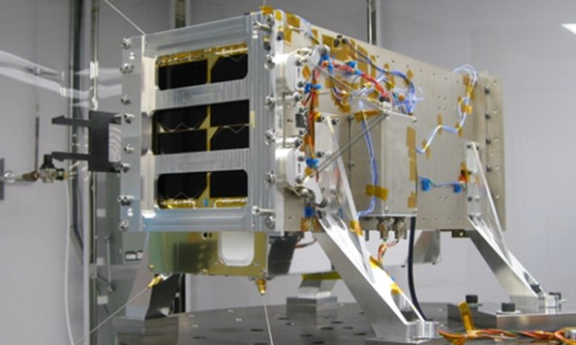
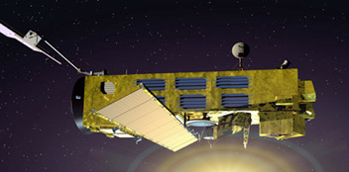
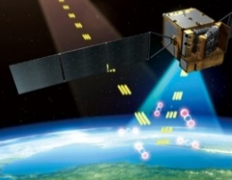
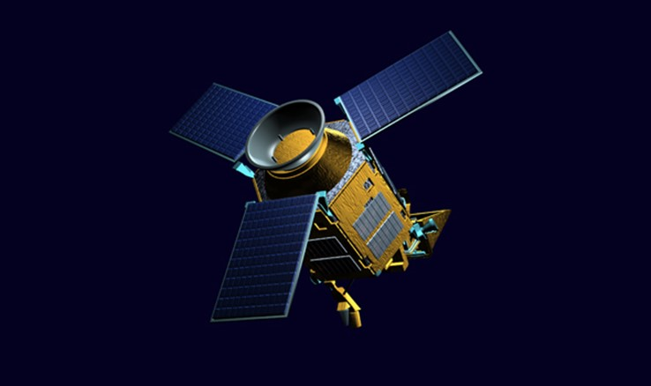
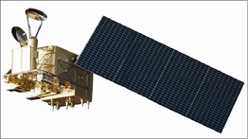
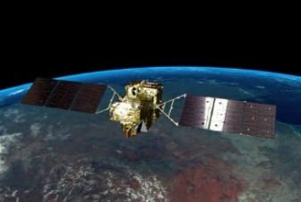
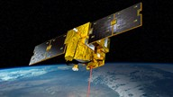
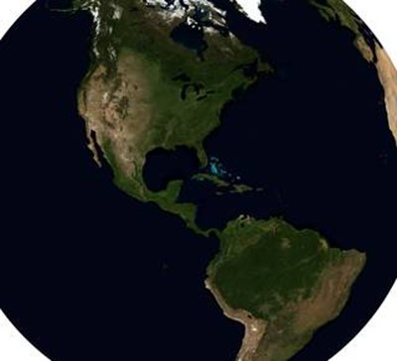
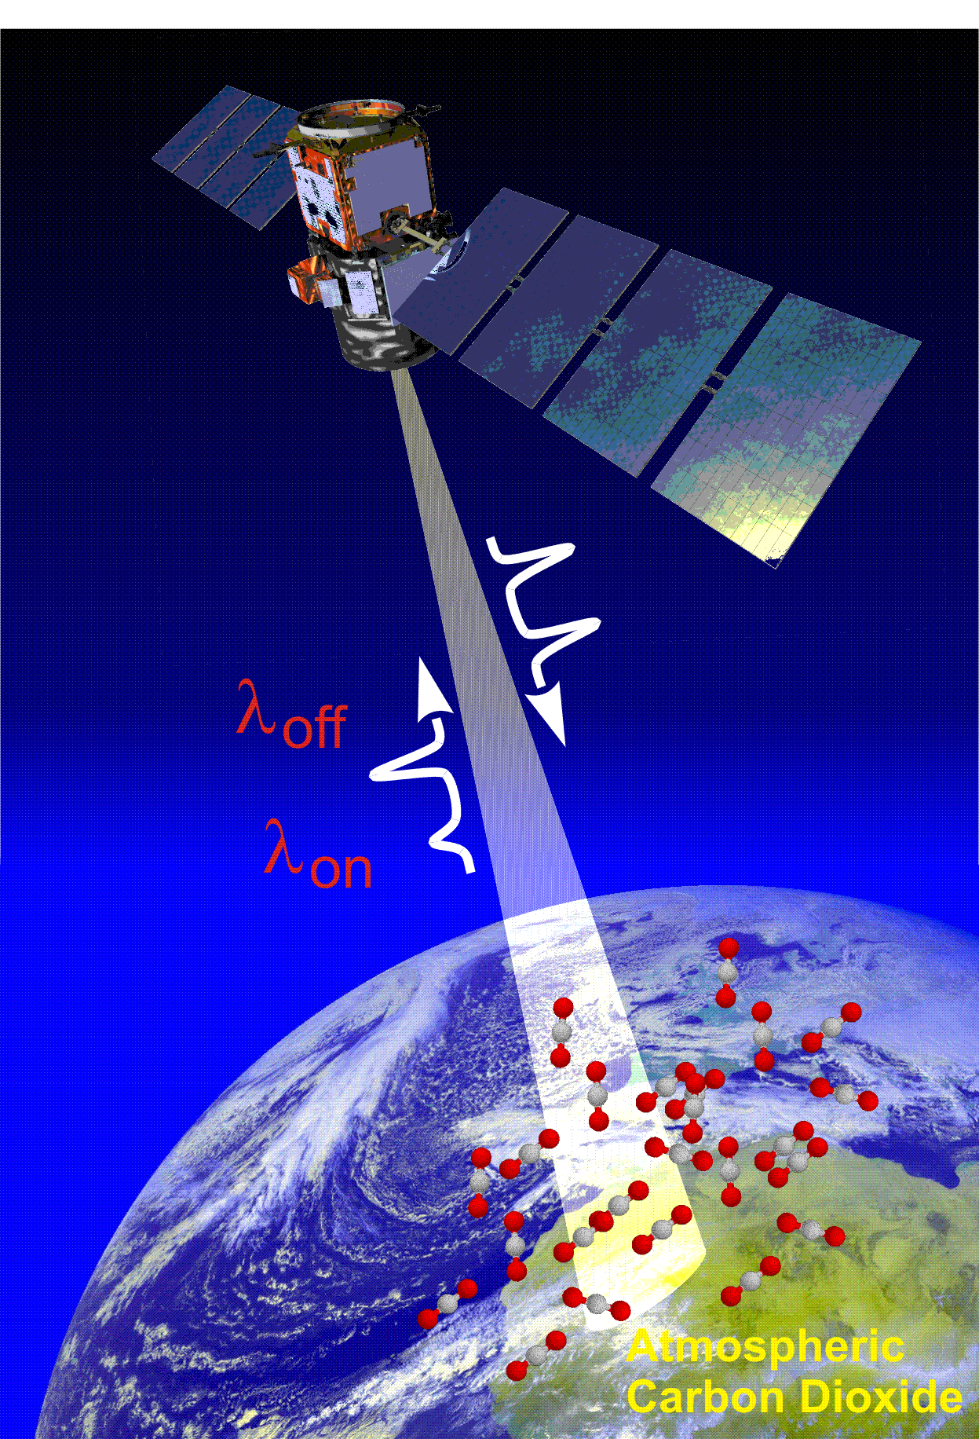
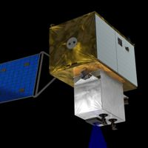
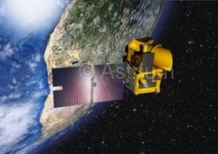
GHG Measurements from Space
SCIAMACHY (2002 - 2012) | GOSAT (2009 - ) | OCO-2 (2014-) OCO-3 (2019-) |  | GHGsat (2016-)
TanSat (2016-) | S5P TROPOMI (2017) | FY-3D (2017-) FY-3G (2020-) |  | GOSAT-2 (2018-)
MERLIN (2020) | GeoCARB | MicroCarb (2020) | ASCENDS (2021) | CarbonSat (2022)
2

Slide 3
Background
Both top-down satellite data and bottom-up emission inventories will be crucial to climate policy.
The reliability of CHG remote sensing from space has to be demonstrated.
Since 2002, GHG monitoring has started with space-borne high spectral resolution spectrometer (SCIAMACHY) and number of projects has rapidly-increased recently.
The interpretation of the data from the near-future satellites with unique instrument designs from different space agencies.
International Community, Long term and consistent data set.
3

Slide 4
Intercomparison between Instruments
Challenges
Pre-launch
<Radiometric Standard: Lamp >
Non-linearity correction for FTS
Radiance Spectra
<Instrument: Grating, FTS..>
High spectral resolution data
with different type of spectrometers
(2) Topography, Observation geometry, aerosol scattering, instrument degradation
(3) Validation of partial column density
(vertical profile)
GHG Column Density
Global and Regional Flux
<Transport model>
Selection spatio-temporal sampling Pattern from
limited number of data and spatial resolution
Wind speed and direction have large uncertainty
4

Slide 5
Present Spectral radiance Intercomparison
FTS vs. Grating Spectrometer
FTS (GOSAT) vs FTS (S-HIS)
Make similar instrument line shape (spectral resolution) by truncating the interferogram before I-FFT
FTS (GOSAT) vs Grating (OCO-2)
Comparison window channel only. Difficult to compare fine absorption structure.
Needs comparison of retrieved parameters
Calibrated GOSAT and OCO-2 radiance spectra agrees within 5% for all bands (386 match up data).Katoka et al. (2017 MDPI, Remote Sensing)
5
window channel for comparison

Slide 6

Long Term and Global Intercomparison
Topography
2014/09～2016/05 XCO₂ Level2 matchup
Agreement: (ACOS-GOSAT B7.3 vsOCO-2 B7)
< 0.18 ppm over Ocean
< 0.57 ppm over Land (high gain)
< 0.19 ppm over Land (desert)
The time series of $∆$ XCO₂ from Sep. 2014
Kataoka et al. (2017)
6

Slide 7
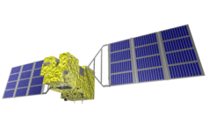
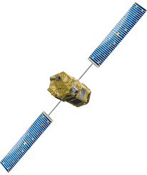

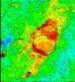
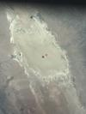





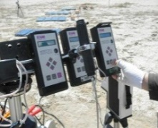
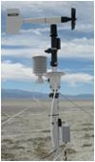
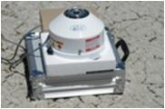
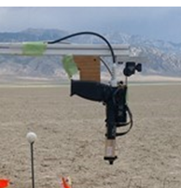
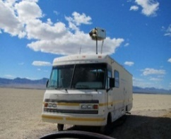
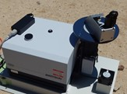


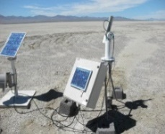
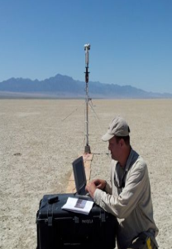
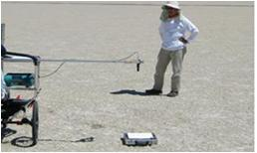
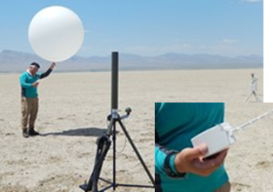
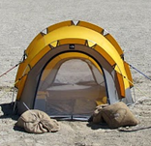
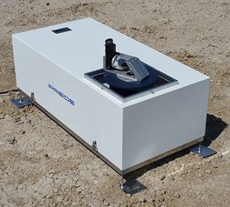
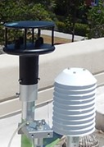
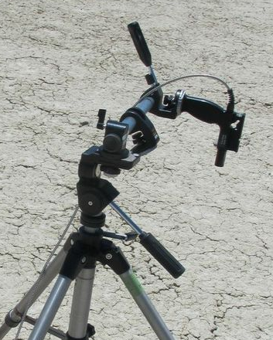
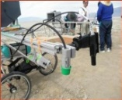
Present Vicarious Calibration
Almost all the geophysical parameters in radiative transfer have been measured
Railroad valley, NV, USA, No topography, BRDF is still challenging item.
from West
33.0deg
from East
25deg
19deg
19.9deg
High altitude
TOA Spectral radiance
Horizontal
CO₂ CH₄
Vertical
CO₂ CH₄ O₃
Surface Thermal radiation
Surface and Profile
of Pressure, Temperature, Humidity
Aerosol Optical Depth
Surface
CO₂ CH₄ CO O ₃ Wind speed
Surface Spectral Reflectance
UV-SWIR
BRDF
Variability
7
Notes:
1

Slide 8

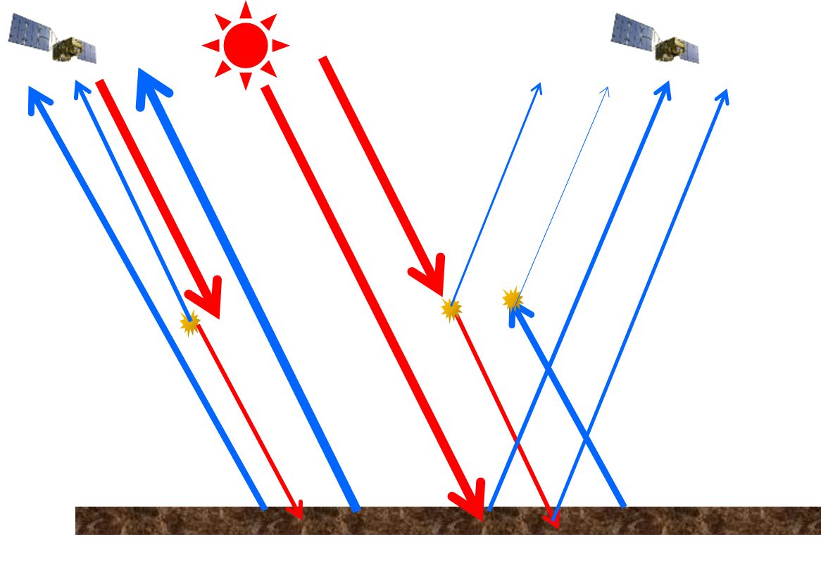
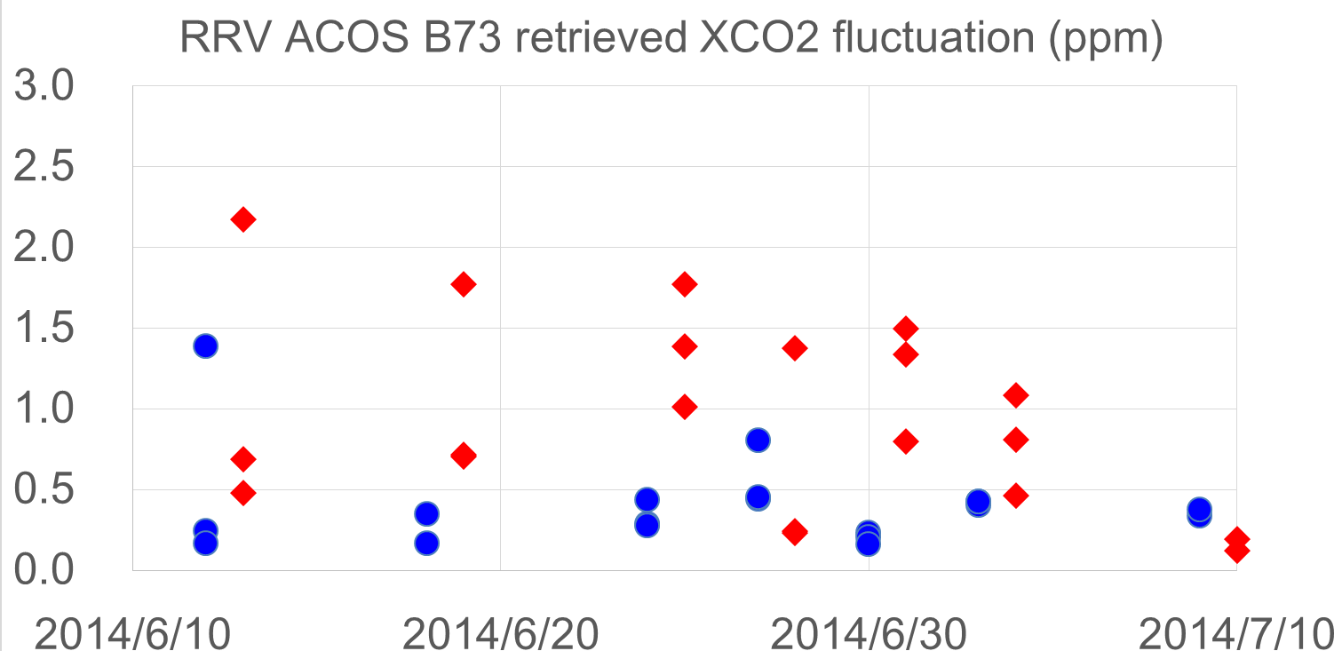

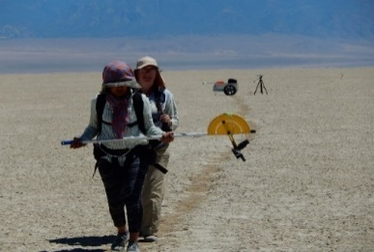
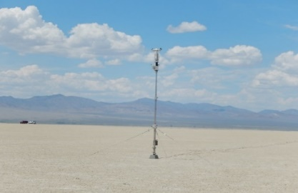
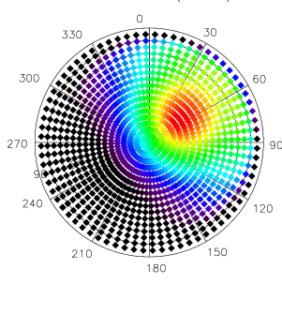
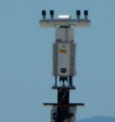


Why aerosol and BRDF matter in GHG observations
Aerosol Scattering phase function and BRDF
One of the largest uncertainty in retrieval
Backward scattering is brighter but larger uncertainty.
How to express BRDF? Kernel model is good but not perfect.
Under estimated GHG
Over estimated GHG
High altitude thin cloud
High altitude dust
Multiple Scattering
From west backward, from east forward
MODIS band6 (1640 nm)
MCD43B1.A2015177.h08v05.005.2015194084624.hdf
In addition, high resolution spectrometer has generally larger footprint. It is difficult to measure the entire footprint on the ground. BRDF database is needed for vicarious calibration.
Dark Surface
Bright desert
8

Slide 9
Measured parameters for GHG CAL-VAL
Candidates of CEOS sites for GHG Calibration
Dunhuang, Namibia, Libya
To be updated
9

Slide 10
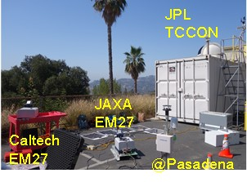
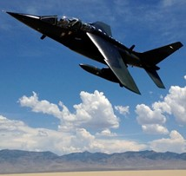
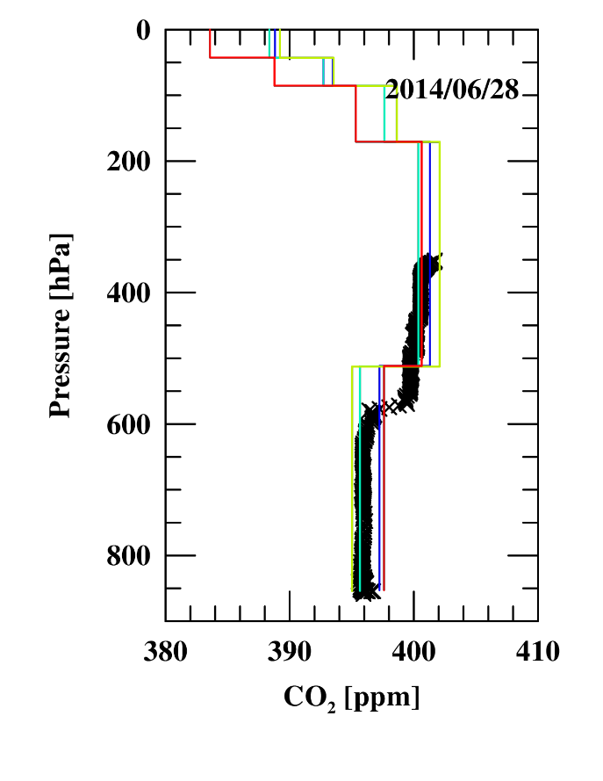
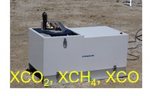
Validation for background and enhancement for GHG
Present: The Total Carbon Column Observing Network (TCCON)(Ground-based large FTS) is well characterized however number of sites is still limited.
Recent improvements: portable FTS calibrated with TCCON .
Needs for partial column of lower troposphere (LT)
Larger enhancement from local emission source
Remove influx in upper troposphere
Recent algorithms provide partial column of LT
Lower troposphere from absorption line shape (Kulawik et al.)
Use both TIR and SWIR (Kikuchi et al.)
Number of vertical profile data (especially coincident data) was limited.
Recent progress: Airplane campaign (NASA ASCENDS/ABoVE, DLR-CNES CoMET etc.)
Coutesy of R. Kawa
AJAXA vertical profile vs. 4 GOSAT retrieval at RRV, NV
10

Slide 11
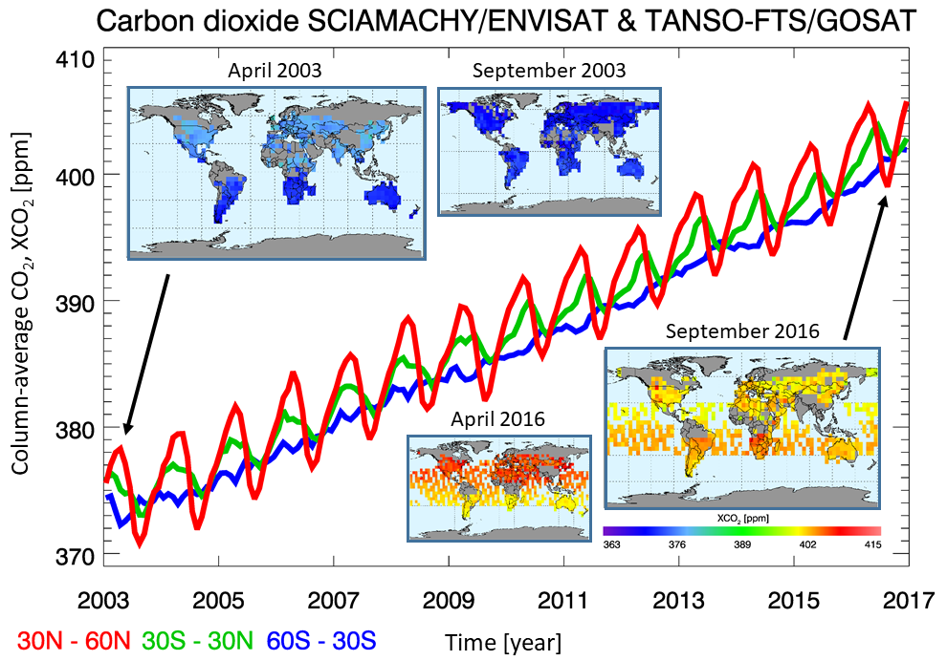
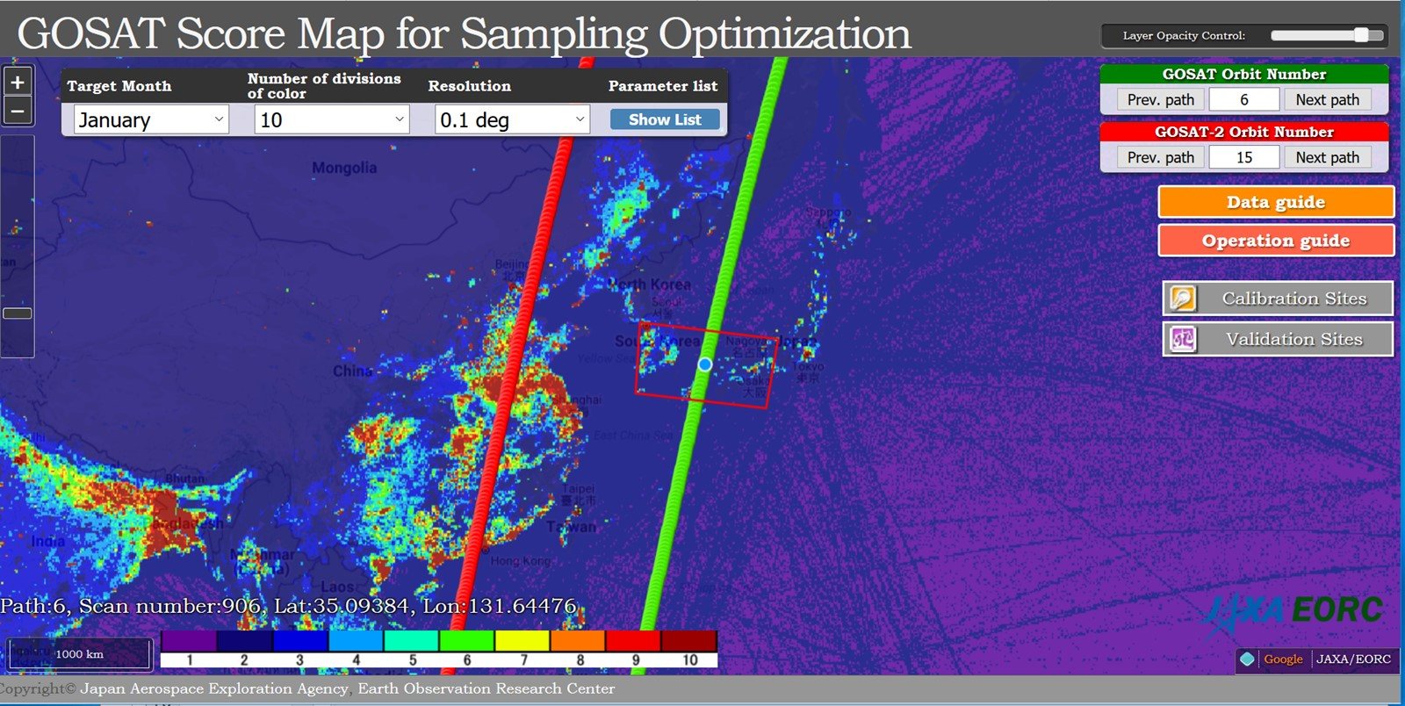
Long tem and consistent GHG dataset from different instruments and algorithms
Column CO₂ Retrieval intercomparison
Seamless dataset
Buchwitz et al., European Space Agency's (ESA)
The Greenhouse Gas Climate Change Initiative (GHG-CCI)
Common database for GHG observation instruments from space :
Match up database of radiance spectra that include data quality, uncertainty, time, location of each instrument (GOSAT-OCO-2, GOSAT-AIRS, ……)
Match-up point check tool
http://www.eorc.jaxa.jp/GOSAT/GOSAT_Optimization/index.html
11

Slide 12
Common Standards and Data for
Calibrations and Retrieval (updates from WGCV42)
 |  | Common standards and data | Notes
Calibration | Prelaunch | Cross-calibrated radiometers | Viewing common radiometric standard
 | Onboard | Solar data
 | Vicarious | CEOS site (RRV etc.) | Annual campaign
Retrieval Algorithm | Parameters | Molecular spectroscopy A priori model (Aerosol)
 | Input | Calibrated spectra at 0.76, 1.6, 2.0μm Observation geometry and condition | Level 1
 | Output | Retrieved column amount GHG Simultaneously retrieved parameters (aerosol optical depth, Solar-induced plant chlorophyll fluorescence (SIF)) | Level 2
Validation | Ground Site | High resolution spectrometer mobile spectrometer | TCCON, mobile-FTS
 | Vertical profile | In situ measured data | Airplane, Balloon
 | Match up | Land type and Ocean | Viewing Common sites

Slide 13
Back up and MEMO

