Slide 1
DEM update and discussion
K. Thome
NASA
WGCV Plenary # 44
EUMETSAT, Darmstadt, Germany
August 28-31, 2018

Slide 2
Reminder – Motivation for studying DEMs
DEM differences cause differences in product inter-comparisons (for example during QA4EO SnowPEX)
Optical sensors with IFOV≤1km and any off-nadir directional viewing ≥30 m require terrain relief correction to co-align pixels
Atmospheric correction requires calculation of path radiance which depends on altitude
Land cover classification of VIS/ SWIR multispectral/hyperspectral imagery require hill-shading correction to minimize misclassification errors
All land (ToA & BoA) VIS/SWIR products require geo-radiometric correction (e.g. Sentinel-2 requires 30 m DEM)

Slide 3
Original points from the DEM Task Group
Recognition that a global DEM is required for the georadiometric correction of EO sensors
EO-derived DEMs now available to meet this need
Need to quantify geometric and radiometric requirements for current and future EO sensors for 10-15m, 30m & 90m DEMs
Need to assess whether spaceborne DEMs are “fit for purpose” and whether CEOS users need “bare earth” or can work with heights “somewhere in the canopy-top”
Need more thorough quantification of the error characteristics of candidate DEM sources
Need ability to display information content of DEM source
Need ability to inter-compare DEM sources against other independent sources such as RA, ICESAT, higher–resolution EO-DEMs (e.g. PRISM, TerraSAR-X stereo) and national mapping sources (e.g. DEMqis)

Slide 4
Task team “Global DEM for georadiometric correction of EO data”
Objective: To define validated solutions for geo-radiometric correction of EO data using Global DEMs
Original team leads: JP Muller / Dean Gesch (USGS)
Early discussions led to identification of GMTED2010 as being globally validated for coarse resolution > 250 m spatial resolution
No DEMs are available that have been globally validated and no straightforward path to a recommended baseline solution for global DEM
Still need a consolidated plan to validate SRTM3 v3.0 for resolutions between 30 and 250 m
Very high resolution DEM sources are becoming available but not global or not freely available

Slide 5
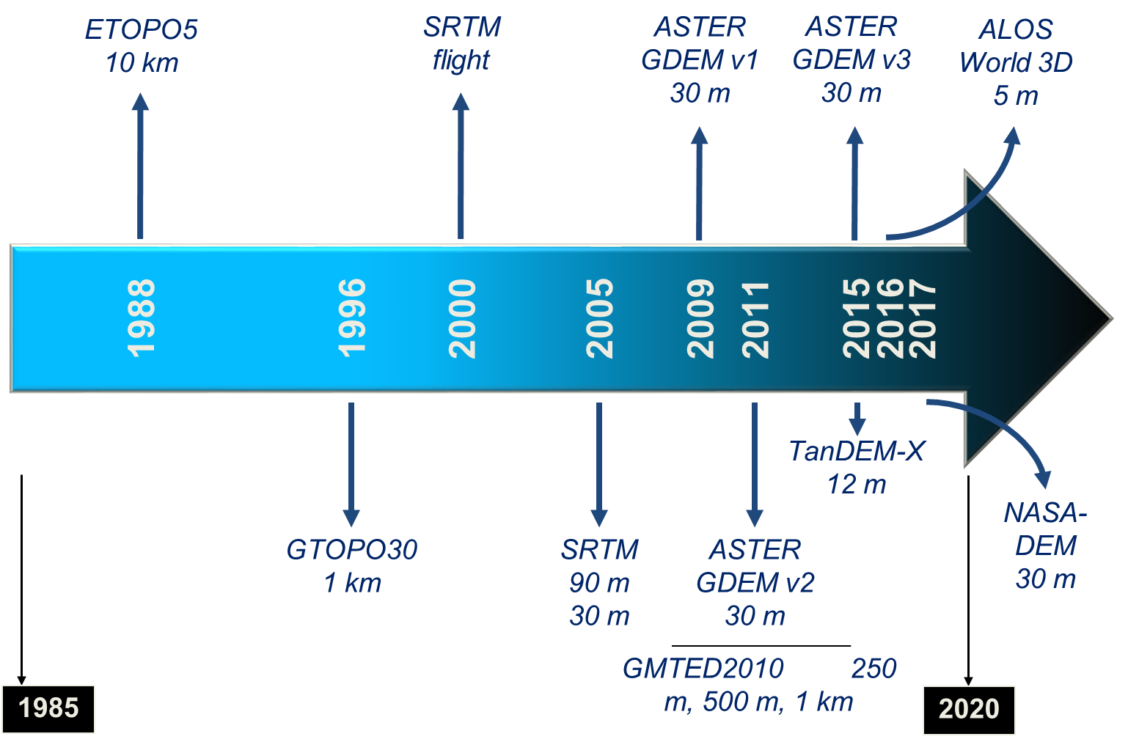
WGCV-42 presentation was highly informative on current state of the art in DEMs and their availability
Pointed to the issue of lack of availability of DEM experts to help assess the validation state of DEMs
DEMs continue to improve in resolution and availability
Demonstrating that they are validated is key effort
Declaring a best is highly dependent on use
DEM | Grid spacing (m) | Absolute vertical accuracy specification (m)
 |  | RMSE | LE90 | LE95
SRTM | 30 | 9.7 | 16 | 19.07
ASTER GDEM | 30 | 10.2 | 16.78 | 20
TanDEM-X (WorldDEM) | 12 | 6.08 | 10 | 11.92
PRISM (AW3D) | 5 | 5 | 8.22 | 9.8

Slide 6
What to do next
Easy first step is to add cross-reference on the WGCV web page to GMTED2010 for coarse resolution sensor geometric and radiometric calibration
Clears an action from WGCV-39
Could help point out the current state of DEM knowledge and gaps in global validation
Next steps more difficult
Limited availability of experts to assess the “best” DEM
Many have expressed willingness to help but not to lead

Slide 7
List three possible options – others exist as well
Let DEM Task Team fade away – technically only had a two-year lifetime so could be viewed as non-existent
Volunteer to lead and organize the DEM experts to revive the task team
DEMIX?
Concentrate on the impact of DEM choices rather than selecting the best DEM
Would still require significant modeling efforts
Follows from the points of the original effort to
Quantify geometric and radiometric requirements for current and future EO sensors for 10-15m, 30m & 90m DEMs
Assess whether spaceborne DEMs are “fit for purpose” and whether CEOS users need “bare earth” or can work with heights “somewhere in the canopy-top”
Sentinel-2 study could be a model for further work

Slide 8
Let us not forget Terrain Mapping Subgroup
Could be reorganized as Global DEM Subgroup
Proposed originally by J-P Mueller
Recommended inviting and supporting a small team of experts to define requirements, work on simulation, test different DEM fusion methods, assess impact of non “bare-earth” DEM retrieval
Does it become absorbed within one of the other subgroups?
Truly cross-cutting since it relies on various sensors approaches
Would still suffer from no expert lead
Survey WGCV agency leads for their DEM/geolocation experts as a means to determine if there is sufficient numbers to warrant a subgroup
If so, a non-expert could be selected as subgroup lead in an effort to revive the sub-group
DEMIX could be a way to organize this

Slide 9
Last thoughts
DEM discussion can become wrapped up in the interoperability, ARD, and data cube arenas
Impact of DEM is one of the proposed evaluations within ACIX
DEM could be rolled into further work related to CARD4L efforts
So as for the DEM Task Team concept
Should it stay or should it go?
Of course - If it goes, there could be trouble, but if it stays it could be double

