Slide 1
Day 1 Summary
K. Thome
NASA
WGCV Plenary # 44
EUMETSAT, Darmstadt, Germany
August 28-31, 2018

Slide 2
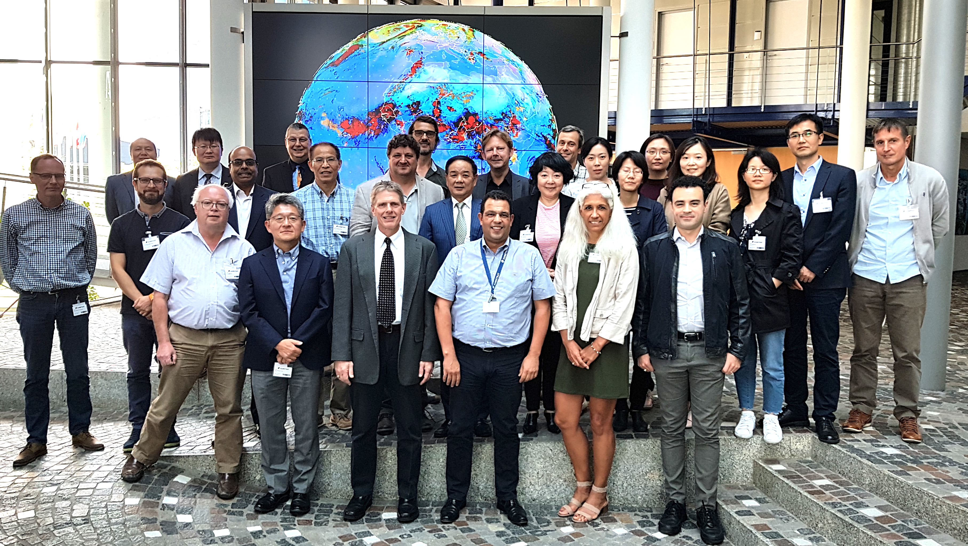

Slide 3
Perspective from the USGS related to CEOS, WGs, and VCs
Actions identified from the discussions
WGCV-44-01
Survey recent results from Surface Reflectance ARD efforts within LSI-VC to determine current DEMs being used.
Stensaas
WGCV-45

Slide 4
Perspective from the USGS related to CEOS, WGs, and VCs
Actions identified from the discussions
WGCV-44-02
Draft an approach that could quantify the geometric and radiometric uncertainties from DEMs of varying spatial postings and vertical resolutions.
Thome
WGCV-45

Slide 5
Perspective from the USGS related to CEOS, WGs, and VCs
Actions identified from the discussions
WGCV-44-03
ACSG Chair to provide a proposed reorganized structure to ACSG to accommodate the validation of GHGs as part of the subgroup
ACSG Chair
Draft provided before close of WGCV-44 with reorganized structure provided prior to SIT-33

Slide 6
Perspective from the USGS related to CEOS, WGs, and VCs
Actions identified from the discussions
WGCV-44-04
A small group of WGCV membership (3 to 5) to be organized to propose a labeling and web hierarchy for WGCV test sites and provide list to Cal/Val portal and for presentation at WGCV-45.
Thome
WGCV-45

Slide 7
Perspective from the USGS related to CEOS, WGs, and VCs
Actions identified from the discussions
WGCV-44-05
A small subset of selected terms from the IVOS vocabulary/thesaurus project will be provided placed on the WGCV web site for comment and editing by WGCV membership
IVOS Chair
WGCV-45

Slide 8
Key points from Day 1
CEO report
September 30 deadline for updates to tracking tool
November/December time frame for inputs to next Work Plan
DEM task team
Vigorous discussion of the importance of DEMs but again no clear champion to lead the effort
Will rely on collaborations with LSI-VC on surface reflectance ARDs to help keep the process alive
Greenhouse Gas efforts
Agreed on importance of validation of GHGs
Collaboration with AC-VC should be encouraged
ACSG will take lead in initial efforts to address references used for GHG validation
RadCalNet is now open to public

Slide 9
Key points from Day 1
WGCV test sites
Landnet served its original purpose of highlighting sites to be acquired by CEOS Agency’s sensors and for providing guidance on processes for collecting and evaluating data at test sites
Landnet archive should remain available
It is a good time to update the structure of Landnet based on changes in the past decade on the numbers and uses of test sites for calibration and validation
Communication of terminology
Makes sense to provide this service to CEOS community
Attempt to avoid too much duplication of efforts
Subgroups will help to provide terminology at the WGCV level that is common to all subgroups with pointers to more detailed material at the subgroup level

