Slide 1


The Joint CEOS/CGMS Working Group on Climate
Albrecht von Bargen, DLR, Member on behalf of
Jörg Schulz, EUMETSAT
Chair Joint CEOS/CGMS Working Group on Climate
Notes:
CEOS (the Committee on Earth Observation Satellites): September, 1984 is made up of 55 Agencies from all around the world committed to coordinating their satellite Earth observation programs and sharing data for a more sustainable and prosperous future. These satellite observations are critical for environmental monitoring, meteorology, disaster response, agriculture and many other applications (take a look at these case studies) that can improve life on Earth and save lives.
CEOS organizations currently operate 112 satellites. These satellites and their related systems operate simultaneously and serve both interdisciplinary and international activities; therefore, international discussion and cooperation are critical to their success.
CGMS: 19 September 1972, 16 members + 6 observers, coordinates the meteorological observing system. The main goals of the coordination activities of the Coordination Group for Meteorological Satellites are to support operational weather monitoring and forecasting as well as climate monitoring, in response to requirements formulated by WMO, its programmes and other programmes jointly supported by WMO and other international agencies.

Slide 2

Short History
2010
CEOS Working Group on Climate endorsed at CEOS Plenary in 2010;
The joint development of the high-level architecture for climate monitoring from space led to the formation of the Joint CEOS/CGMS WGClimate endorsed by CEOS and CGMS Plenaries in 2013 (when EUM was leading CEOS):
Major Task is: Coordinate and encourage collaborative activities between the space agencies in the area of climate monitoring.
JWGClimate
Chair: Jörg Schulz (EUMETSAT)
Vice Chair: John Dwyer (USGS)

Slide 3
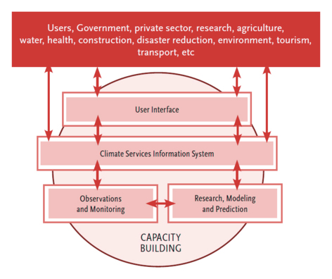


Global Framework for
Climate Services (GFCS)
2011
The Vision of GFSC:
“Enable better management of adaptation to climate change through the development and incorporation of science-based climate information and prediction into planning, policy and practice“
Space Agency contribution
Notes:
The Vision of GFCS
“Enable better management of the risks of climate variability and change and adaptation to climate change, through the development and incorporation of science-based climate information and prediction into planning, policy and practice on the global, regional and national scale."

Slide 4
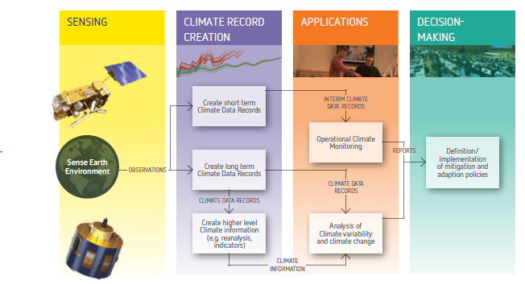


The Architecture for Climate Monitoring from Space
2013
http://ceos.org/document_management/Working_Groups/WGClimate/WGClimate_Strategy-Towards-An-%20Architecture-For-Climate-Monitoring-From-Space_2013.pdf

Slide 5
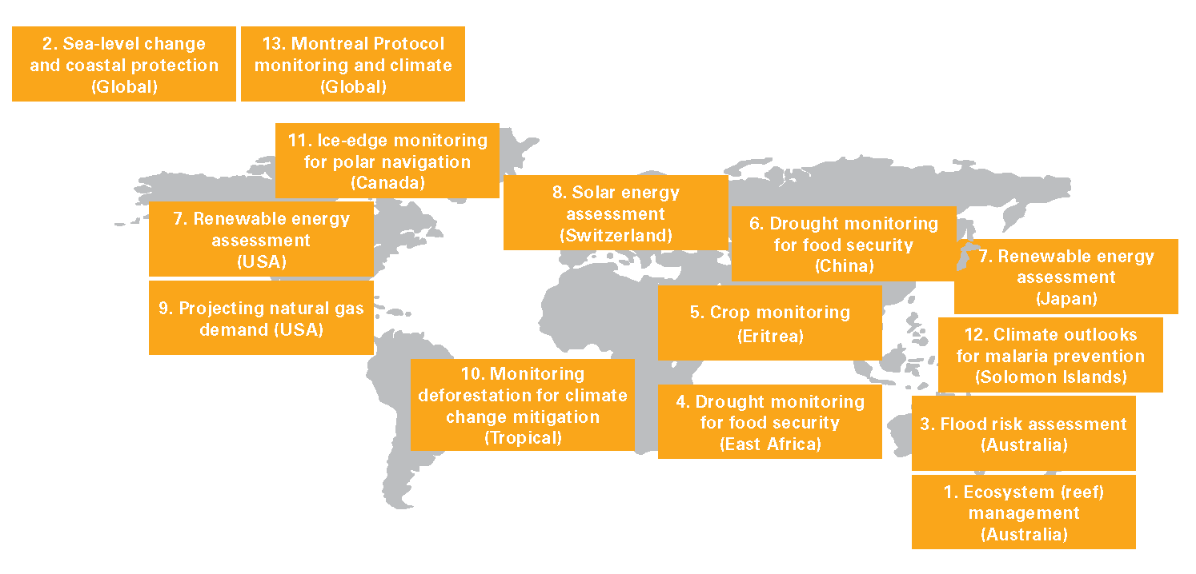
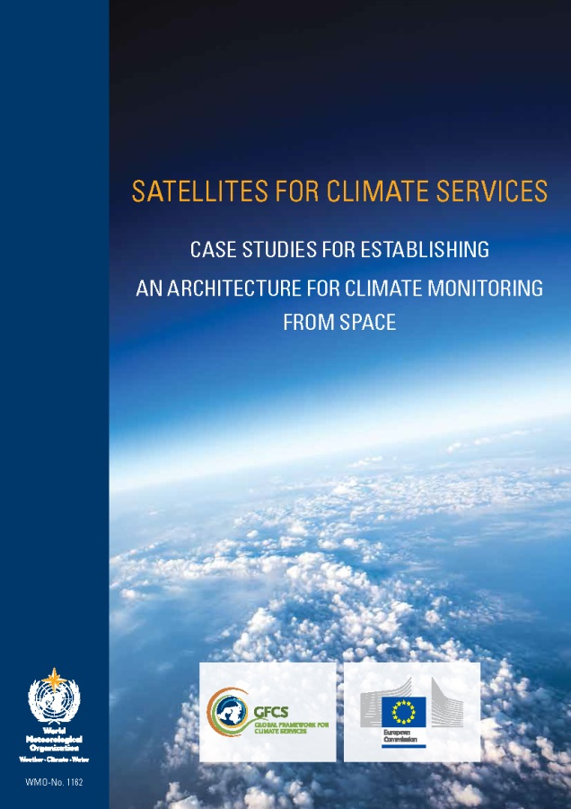



Enhancing use of climate data records
Courtesy of Bojinski et al.; 2015
2015
http://library.wmo.int/pmb_ged/wmo_1162_en.pdf

Slide 6



UNFCCC/GCOS – CEOS/CGMS Relations
COP-21 Paris Agreement: Adaptation (Article 7(c)):
Strengthening scientific knowledge on climate, including research, systematic observation of the climate system and early warning systems, in a manner that informs climate services and supports decision-making.
2015
Reports on Progress
@ SBSTA/COP
Needs and Requirements
Coordinated Response

Slide 7

GCOS Implementation Plan
2016

Slide 8
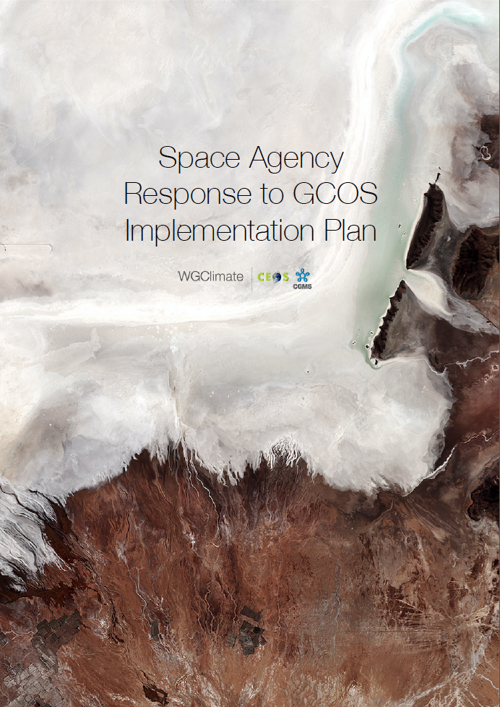
The Comprehensive Answer
Addresses GCOS Actions with space relevance;
Structure of response is similar to the plan itself;
Contains status and plans for 11 (32) general, 19 (40) atmospheric, 17 (57) oceanic and 48 (72) terrestrial actions;
Allows reporting on progress to GCOS and UNFCCC.
2017

Slide 9
Resource for Coordinated Response
http://climatemonitoring.info/ecvinventory
ECV Inventory fully describes current and planned implementation arrangements
(ECV-by-ECV) within the Architecture;
Almost 1000 data records including direct
access in many cases;
Content fully verified;
Updated annually with approval from CEOS and CGMS;
Recommendations and Coordinated Actions inform space agency planning, improves availability and interoperability of climate data;
Feeds material for all future responses to the GCOS IP.
Action Plan & Creation of conditions to deliver CDRs
ECV Inventory
Gap Analysis & Recommendations
2018

Slide 10
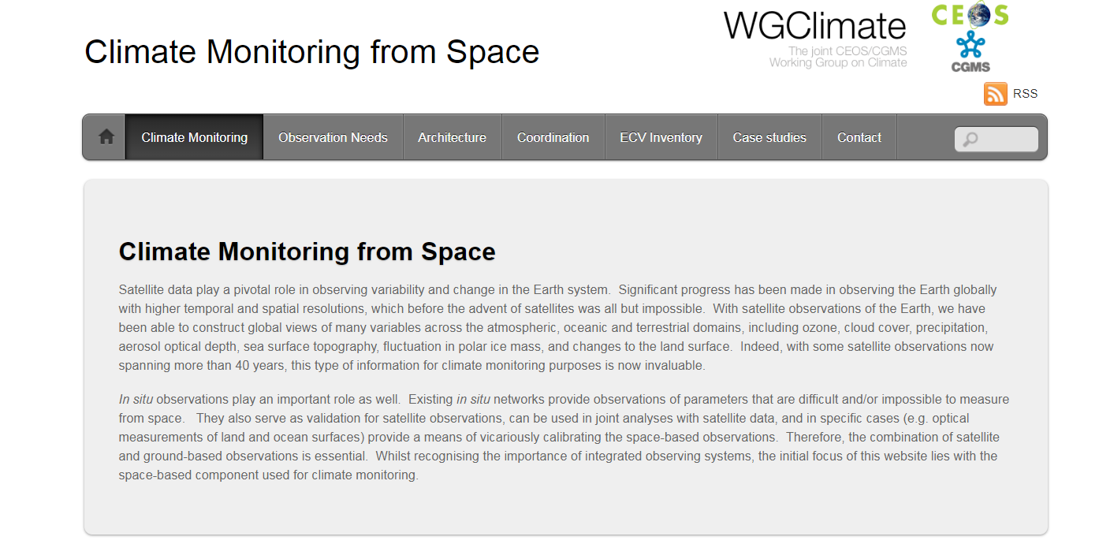
The ECV Inventory
Public access to Inventory via climatemonitoring.info
Users can:
  Download the ECV Inventory content for own analysis;
  Find direct access points to all CDRs in the Inventory;
  Get access to WGClimate gap analysis results and planned actions;
  Can access case studies analysing the use of CDRs for applications.
2018

Slide 11
Relevant Recommendation and Action for collaboration with WGCV
Recommendation #6: WGClimate to develop a white paper on what is needed for the validation of climate data records including uncertainty information and stability aspects.
Action #8: CEOS and CGMS agencies with interest in the development of climate data records will sponsor or co-sponsor one or more workshops (and require a written report) to define the needs for validation of climate data records. This shall include consideration of fiducial reference measurements. The workshops will be conducted in collaboration of CEOS WGClimate with WGCV and relevant CGMS / GSICS.
WGClimate expects proposals for such workshops or maybe summer school and will contact Chair of WGCV for providing inputs to such a workshop and potentially supporting the organization.

Slide 12
Conclusion
Joint CEOS/CGMS WGClimate is the focal of point of space agencies to address GCOS requirements and is the single coordinated voice towards UNFCCC;
The ECV Inventory provides a resource for the whole community that wants to use and create climate data records – Use it to find data for applications, examples provided!
WGClimate has the tools for effective analysis of space agency data holdings and plans, to optimise utilisation of existing measurements and planning of new measurements for climate monitoring;
The implementation of the architecture requires an ongoing analysis of every pillar of the architecture and their interactions.

