Slide 1
Collaborative Environment for CalVal
CEOS WGCV Meeting #44 30/08/2018
Andrea Della Vecchia (ESA), Damiano Guerrucci (ESA)

Slide 2
Introduction
Collaborative Environment
Example of current Collaborative Environments
Thematic Exploitation Platform
Mission Exploitation Platform
Joint ESA-NASA Multi-Mission Analysis Platform
ESA Common Service Proposal

Slide 3
Collaborative Environment
EO collaborative environment is a virtual working environment providing access to EO data and analysis tools, processors, information and Communication Technology resources required to work with them, through one coherent interface.
A collaborative environment aims to change the paradigm from
“data to user“ to “user to data”

Slide 4
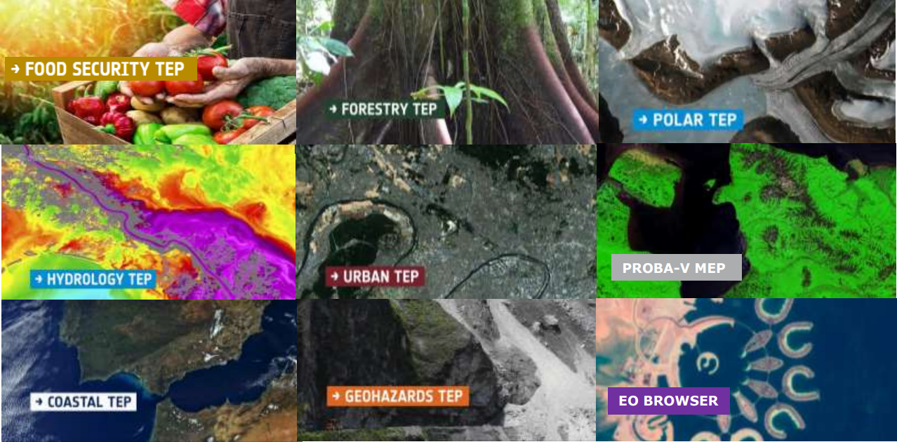
Thematic Exploitation Platform - TEP
https://tep.eo.esa.int/
In this context ESA has started in 2014 the EO Exploitation Platforms (EPs) initiative, a set of R&D activities that in the first phase (up to 2017) aims to create an ecosystem of interconnected Thematic Exploitation Platforms (TEPs) on European footing, addressing:
Coastal
Forestry
Hydrology
Geohazards
Polar
Urban themes
Food Security (under definition)
TEP presentation at CEOS WGISS#44

Slide 5
PV Mission Exploitation Platform – MEP
The PROBA-V Mission Exploitation Platform (PV-MEP) is an ESA pathfinder project aiming to:
Build and operational Exploitation Platform
Give full access to PROBA-V data repository (@VITO PDF)
Integrate, correlative data and derived products addressing the wider vegetation user community with the final aim to ease and foster the use of PROBA-V data.

Slide 6

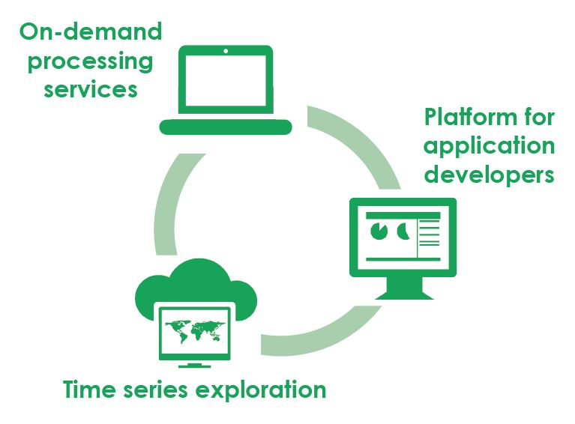
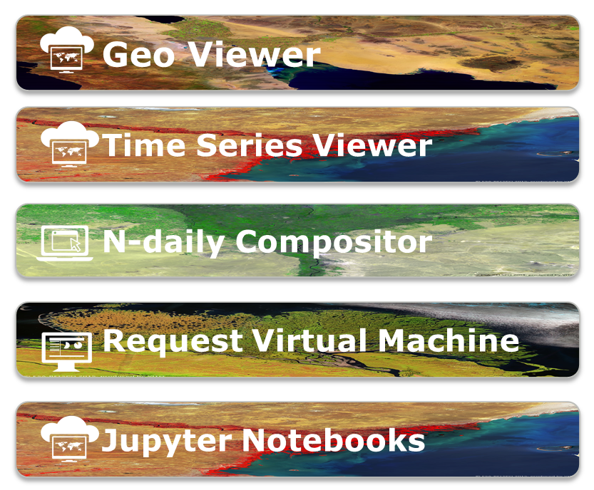
Proba-V MEP – Tools
https://proba-v-mep.esa.int/
(*) only operations & EC funded – limited to viewers
(**) http://viewer.globalland.vgt.vito.be/viewer/
http://viewer.globalland.vgt.vito.be/tsviewer/
Copernicus Global Land (*) (**)
SPOT-VEGETATION
Proba-V

Slide 7






Joint ESA-NASA
Multi-Mission Analysis Platform (MAP)

Slide 8

Joint Biomass-NISAR-GEDI MAP
Transparent access to the content of both platforms
ESA NASA MEP
NASA Mission
Data
NASA Mission
Tools&Visu
ESA-NASA
Missions
Community
ESA Mission
Data
ESA Mission
Tools&Visu
NASA Mission
Processing
resources
ESA Mission
Processing
resources
Up to date data and algorithms
Cohesive community

Slide 9
Joint ESA-NASA MAP Objectives
To provide to the users a common virtual working environment
Federation of two (or more) platforms to allow to both US and European users a transparent access to the content of both platforms, CEOS WGISS guidelines shall be considered
To allow end-users to access up-to-date data and algorithms for biomass estimation and to increase the cohesion of the P/L-band SAR and biosphere communities
The capabilities envisioned for the MAP will enable for the first time efficient and tailorable intercomparison, cross-calibration, and fusion of data from these missions for a broad class of scientists and other users (notably with respective ground segments and cal/val activities)

Slide 10
ESA Collaborative Environment
To provide the ESA PDGS with a set of interoperable and federated services permitting the users to:
Access to missions/platforms information supported by a common ontology
Discovery and direct download of EO data:
  Copernicus Missions (e.g., Sentinels)
  Third Party Missions - TPMs (e.g. SPOT, Landsat …)
  Heritage Missions - HMs (e.g., ERS-1/2, ENVISAT instruments …)
  Earth Explorer – EEs (e.g., SMOS, Cryosat, SWARM, …)
  International repositories (e.g., NASA CMR, CEOS IDN)
Discovery and access to basic services (e.g., datacube):
  Browse/visualization tools and time series extraction
  EO data extraction, resampling and reprojection
Hosted Processing for authorised users/communities (e.g., CAL/VAL)

Slide 11
M2M Interfaces
EO Data Visualization and pre-analysis clients
Catalogue Clients
Remote Desktop Access
  - CAL-VAL Activities
  - Access Point for Application Platforms
International EO Gateway Information Page:
- CEOS IDN
Specific Web Portal:
  - SWARM
  - SMOS
  - Cryosat
  - External
ESA PDGS Data Cube
Query
Data Access
Information Page:
- ESA EO Gateway
Multi Mission Portal
– ESA eoli
Population
Distribution Facility
Thesauri Service
Data/Service Catalogue
Hosted Processing
Online Data Storage
VM – CAL/VAL Processors
Web Service Interface (e.g., OADS, ftp, http)
VM – Browse Images Generation
VM – DataCube Engine/API
TPMs
EO-SIP
ESA
EO-SIP
HMs
EO-SIP
EEs
EO-SIP
Core Services close to the data

Slide 12
M2M Interfaces
EO Data Visualization and pre-analysis clients
Catalogue Clients
Remote Desktop Access
  - CAL-VAL Activities
  - Access Point for Application Platforms
International EO Gateway Information Page:
- CEOS IDN
Specific Web Portal:
  - SWARM
  - SMOS
  - Cryosat
  - External
ESA PDGS Data Cube
Query
Data Access
Information Page:
- ESA EO Gateway
Multi Mission Portal
– ESA eoli
Population
Distribution Facility
Thesauri Service
ESA Catalogue
TTO by Q1 2019
Data/Service Catalogue
Hosted Processing
Online Data Storage
VM – CAL/VAL Processors
Web Service Interface (e.g., OADS, ftp, http)
VM – Browse Images Generation
VM – DataCube Engine/API
TPMs
EO-SIP
ESA
EO-SIP
HMs
EO-SIP
EEs
EO-SIP
Core Services close to the data

Slide 13
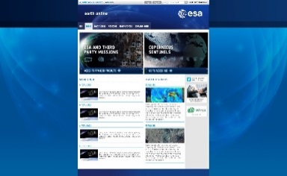
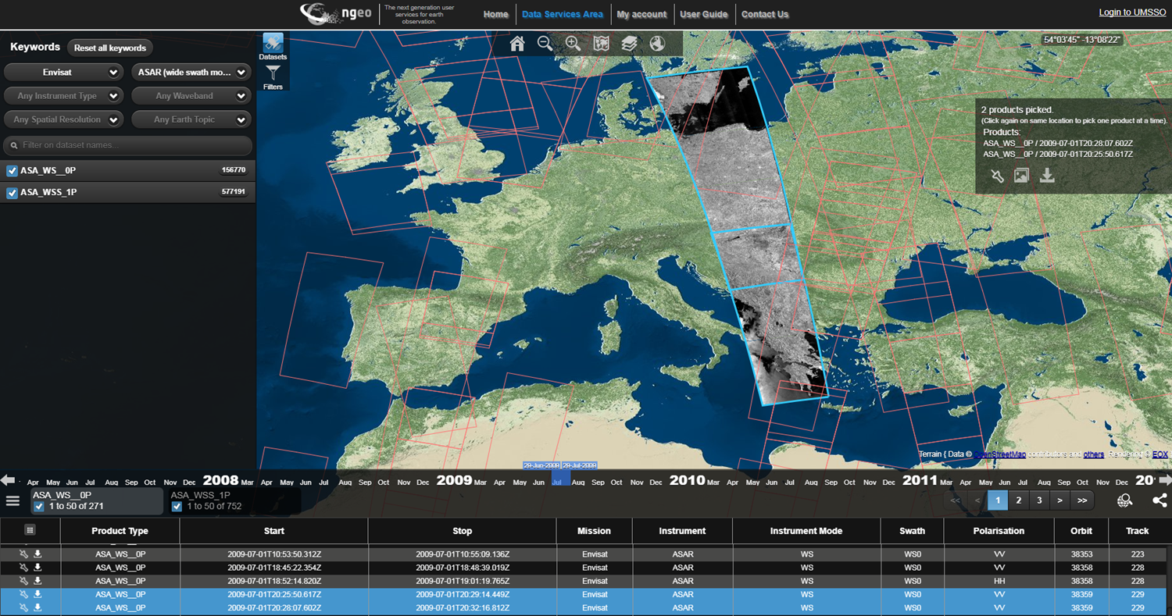

ESA TTO by Q1 2019
Catalogue Clients
ESA Earth OnLine
ESA Map Viewer
Google/Qwant
Search
Visualisation Layer
Catalogue API publicly available:
OGC OpenSearch Specification
CEOS WGISS OpenSearch Best Practice
Distribution Facility
EO Products
Discovery
ESA Gateway &
Collection Catalogue
Metadata Layer
SciHub
Sentinel-1/2/3
ESA
Third Party & Earth Explorer & Heritage Missions
Copernicus Dataset
Online Data Storage
Data Layer
Sentinel Data Repository
LANDSAT
SPOT
OCEANSAT
TROPFOREST
SEASAT
IKONOS
ERS SAR
ENVISAT ASAR
SMOS
CRYOSAT-2
CCMs
Repositories

Slide 14
M2M Interfaces
EO Data Visualization and pre-analysis clients
Catalogue Clients
Remote Desktop Access
  - CAL-VAL Activities
  - Access Point for Application Platforms
International EO Gateway Information Page:
- CEOS IDN
Specific Web Portal:
  - SWARM
  - SMOS
  - Cryosat
  - External
ESA PDGS Data Cube
Query
Data Access
Information Page:
- ESA EO Gateway
Multi Mission Portal
– ESA eoli
Population
Prototyping phase
by Dec ‘18
Distribution Facility
Thesauri Service
Data/Service Catalogue
Hosted Processing
Online Data Storage
VM – CAL/VAL Processors
Web Service Interface (e.g., OADS, ftp, http)
VM – Browse Images Generation
VM – DataCube Engine/API
TPMs
EO-SIP
ESA
EO-SIP
HMs
EO-SIP
EEs
EO-SIP
Core Services close to the data

Slide 15

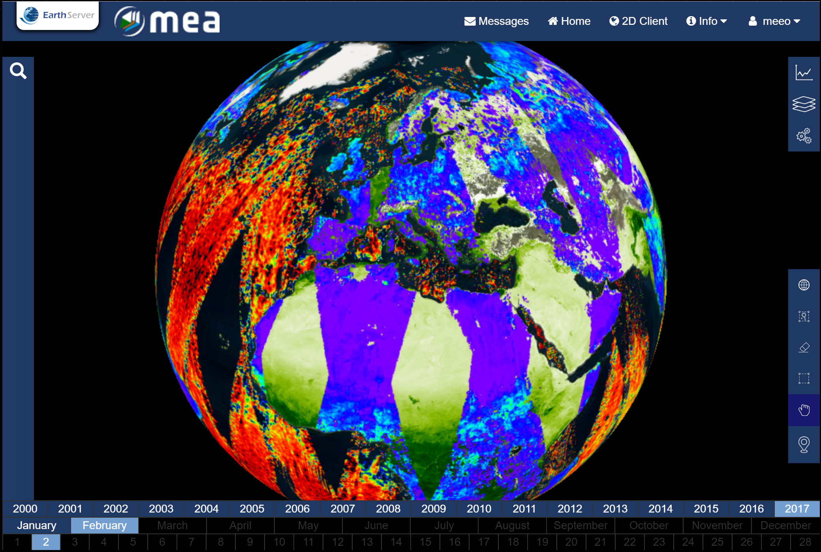





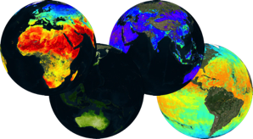
Web based GUI
(including third-party applications)
Jupyter Notebook
CLI / REST API
EO Data Visualization and pre-analysis clients
M2M Interfaces
Visualization layer
Standardised data access interfaces allow connecting a wide range of user interfaces
Hosted Processing
Datacube Engine/API VMs
The deployment of DAS in front of each data source enables effective access services
Online Data Storage
Data layer
Data remain at their own location (multiple data centers) with the original data format
Mission-specific data
Thematic data
Other geospatial data

Slide 16
ESA TPM Heritage Mission Datacube Pilot
MEA (https://eodataservice.org) is a proof of concept activity to investigate about how a datacube can help the data dissemination, access and exploitation of TPM and HM missions.
Available Collections
High Resolution optical satellite data (Level 1)
Sentinel 2 (10m, global, since 2015)
Landsat 8 (30m, Europe, since 2013)
Landsat 4/7 (30m, Europe, since 1984)
Land Products (Level 2+)
Vegetation Indexes (250m - 10m, 2000)
Land Surface Temperature (1Km, 2000)
Soil Moisture (100Km - 10km, 1978)
Land Cover type (1km, 2000)
HM Data (ongoing)
ERS-1/2 – ASAR – MERIS – AATSR
Atmospheric products (Level 2+ Numerical Model)
Air Temperature (12.5 - 1km, 1979)
Precipitation (100km - 4.5km, 1979)
Aerosol Optical Thickness (1km, 2000)
Ocean products (Level 2+ Numerical Model)
Sea Surface TEMPERATURE (5km, 2017)
OCEAN Salinity (10Km, 2010)
Chlorophyll data (5km, 2010 – 2013, Europe)
Sea Surface Height (12km, 1993 – 2017, Europe)
Sea Surface Velocity (12km, 1993 – 2017, Europe)

Slide 17
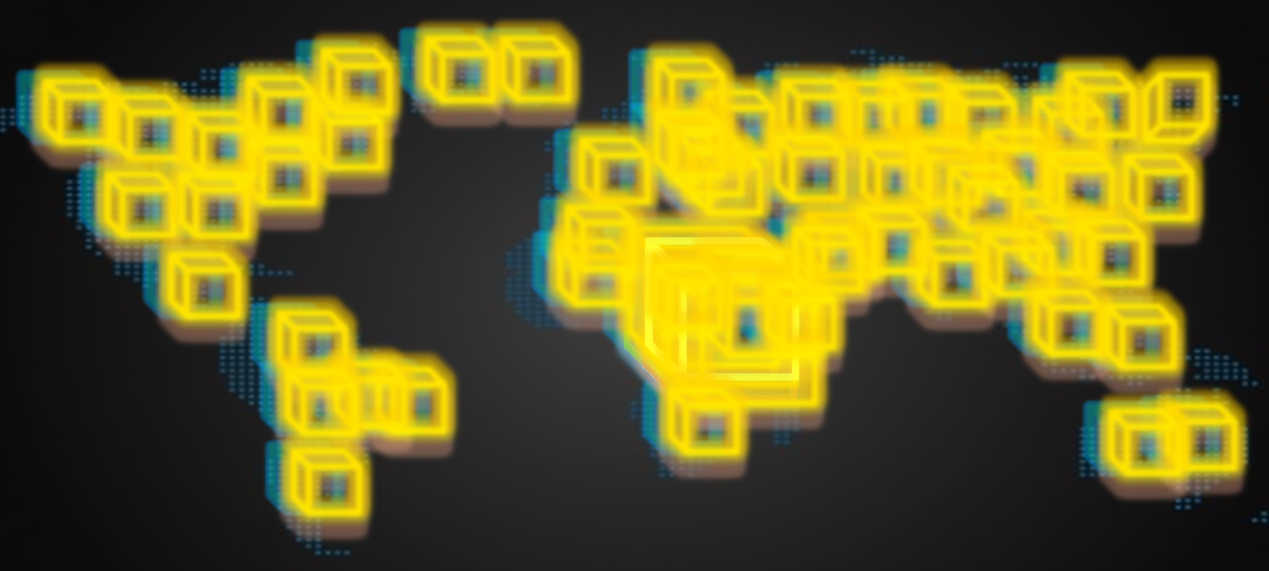
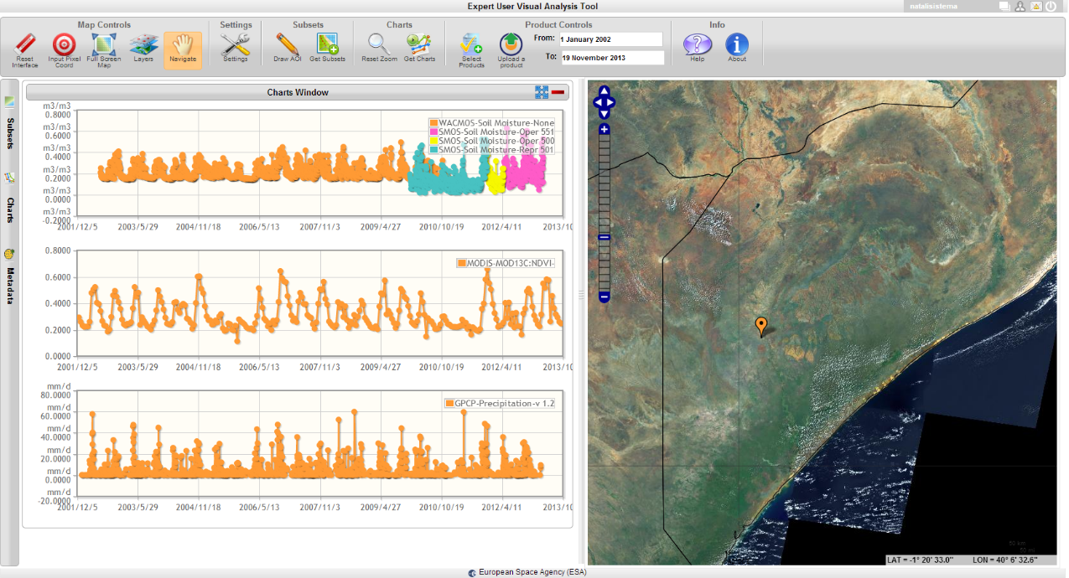

Effective Data Subsetting
Let’s assume we want to study drought in Eastern Africa in the last 17 years.
We want to use time series of Vegetation Index (NDVI), Precipitation (P) and Soil Moisture (SM).
Full collection
(NDVI + P + SM) > 5 TB
Soil Moisture
17 years, one point
(NDVI + P + SM) < 1MB
Vegetation
Identification of anomalies
Cross-fields correlation
Identification of similar areas
Precipitation
In real time

Slide 18
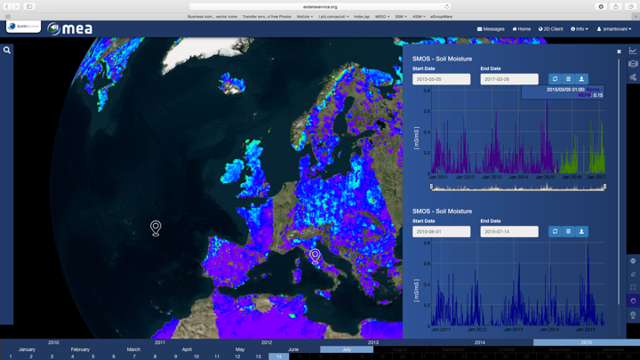
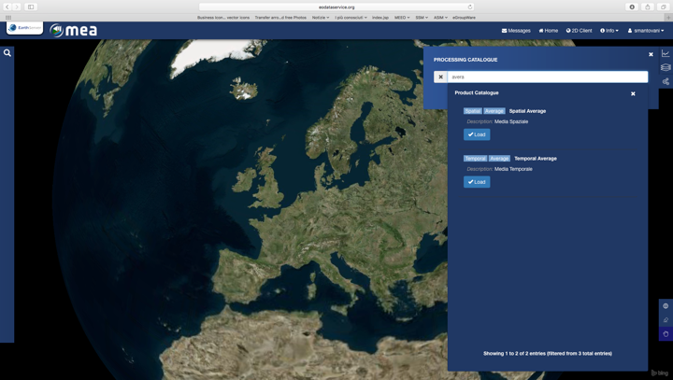
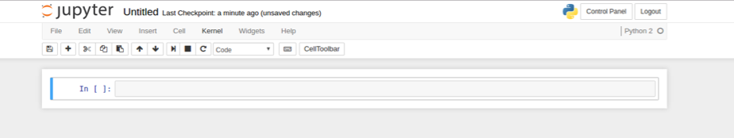
GUI
Versioning Comparisons
Processing
Time series
Map Viewer

Slide 19
CLI / API Interface
OpenSearch and WCS services offer standard requests for discovery and access services
Simple python utilities to obtain access token and query secure WCS endpoint (cli_examples.py) can be found here
  $ ./ meeo_sso_cli.py [-h] -u USERNAME [-p PASSWORD]
  $ ./cli_examples.py [-h] -u USERNAME [-p PASSWORD]

Slide 20
OGC OpenSearch for for Discovery
http://<endpoint>/opensearch?
&service=CSW
&version=2.0.2
&request=GetRecords
&elementsetname=full
&typenames=csw:Record
&resulttype=results
&q=<ID>
&bbox=<UL,LR>
&time=<t₁,t₂>
OGC-standardised catalogue service
OpenSearch

Slide 21
OGC WCS for Coverage Access
http://<endpoint>/wcs2?
service=WCS&Request=GetCapabilities
&version=2.0.0
http://<endpoint>/wcs2?
service=WCS&Request=DescribeCoverage
&version=2.0.0
&CoverageID=<ID>
http://<endpoint>/wcs2?
service=WCS&Request=GetCoverage
&version=2.0.0
&CoverageID=<ID>
&SubsetX=x(x₁, x₂)
&SubsetY=y(y₁,x₂)
&SubsetT=t(t₁, t₂)
&format=<#####>
&colortable=<ID>
&scale=<nn>
&size=<output raster size>
WCS
WCS
List of available datasets with some basic information
Detailed information for a specific collection (dimensions and ranges, supported output data formats, …)
WCS
Data (raster, xml)

Slide 22
OGC WCS Query Example
GetCapabilities operation
https://eodataservice.org/test/wcs?service=WCS&Request=GetCapabilities&version=2.0.0
describeCoverage operation
https://eodataservice.org/test/wcs?service=WCS&Request=DescribeCoverage&version=2.0.0&coverageID=MOD11C1_LSTDAY_4326_005
getCoverage: Time series of LST over Tokyo from 2017-01-01 00:00:00 to 2017-12-06T00:00:00 in xml format (times provided in unix time
https://eodataservice.org/test/wcs?service=WCS&Request=GetCoverage&version=2.0.0&coverageID=MOD11C1_LSTDAY_4326_005&format=application/xml&subset=Long(139.5104,139.5104)&subset=Lat(35.6900,35.6900)&subset=t(1483228800,201512518400)
getCoverage: Same as above, but times provided in ANSI format https://eodataservice.org/test/wcs?service=WCS&Request=GetCoverage&version=2.0.0&coverageID=MOD11C1_LSTDAY_4326_005&format=application/xml&subset=Long(139.5104,139.5104)&subset=Lat(35.6900,35.6900)&subset=unix(2017-01-01T00:00:00,2017-12-06T00:00:00)

Slide 23
OGC WCS Query Example
getCoverage: Global Sea Surface Salinity image for the day 2017-06-01 in png format, colored full size
https://eodataservice.org/test/wcs?service=WCS&Request=GetCoverage&version=2.0.0&coverageID=OceanSalinity_4326_01&subset=t(1496275200,%201496361599)&format=%20image/png&colortable=NCV_rainbow2
getCoverage: Same as above but scaled (small 300px thumbnail)
https://eodataservice.org/test/wcs?service=WCS&Request=GetCoverage&version=2.0.0&coverageID=OceanSalinity_4326_01&subset=t(1496275200,%201496361599)&format=%20image/png&colortable=NCV_rainbow2&size=300
getCoverage: landsat NDVI subset for the day 2017-12-04 09:58:54 in geoTiff format
https://eodataservice.org/test/wcs?service=WCS&Request=GetCoverage&version=2.0.0&coverageID=LC8_NDVI_32632_30&subset=N(4900000,4910000)&subset=E(600000,610000)&subset=t(1512381534,1512381534)&format=image/tiff
Getcoverage: Sentinel 2A with ANSI time and scale factor=0.1 – full image
http://185.52.194.236/wcs?service=WCS&Request=GetCoverage&version=2.0.0&subset=unix(2018-01-29T00:00:00,2018-01-29T23:00:00)&mgrs_tile=T30TVK&format=image/png&scale=0.1&CoverageId=S2A_MSIL1C_vRGB

