Slide 1
CSIRO Commonwealth Scientific Industrial Research Organisation
CSIRO Energy
Ong, C.
CEOS WGCV 45, 17 July 2019
Perth, Western Australia

Slide 2
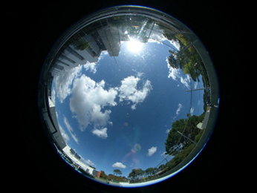
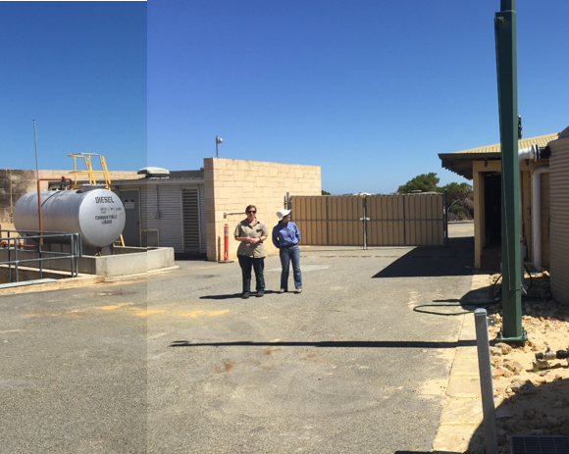
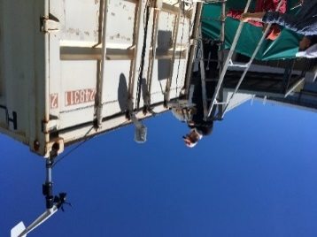
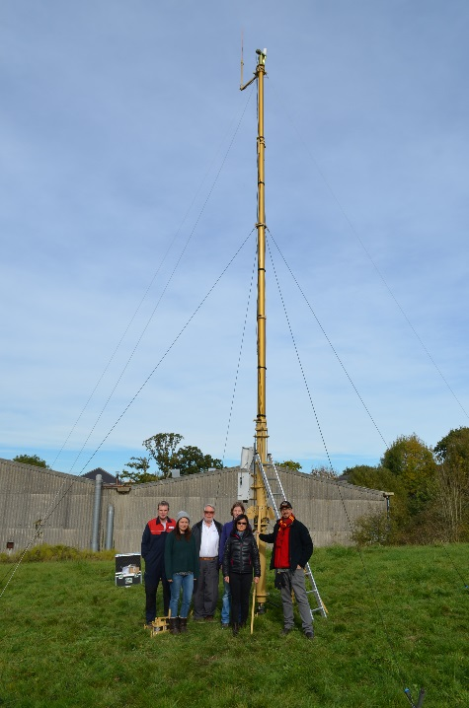
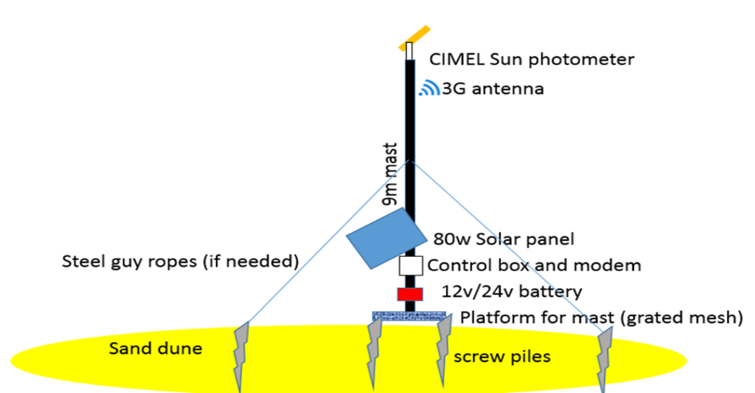
Progress at Pinnacles
To be augmented in the future to DFOV VNIR-SWIR spectrometer and/or multiple radiometers
AIST contribution

Slide 3
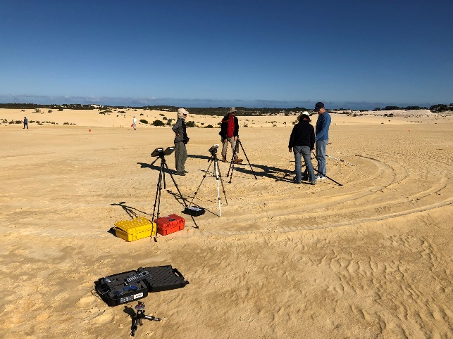
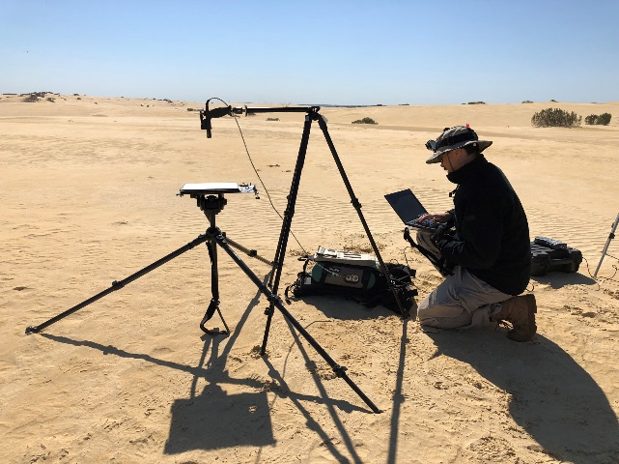
Joint Campaign with NASA & Chilean Air Force August 2018
Calibration of Chilean FASat;
Comprehensive site characterisation of Pinnacles Desert;
Evaluation of 2 methods for field measurements;
Investigation of dual field of view concepts;

Slide 4
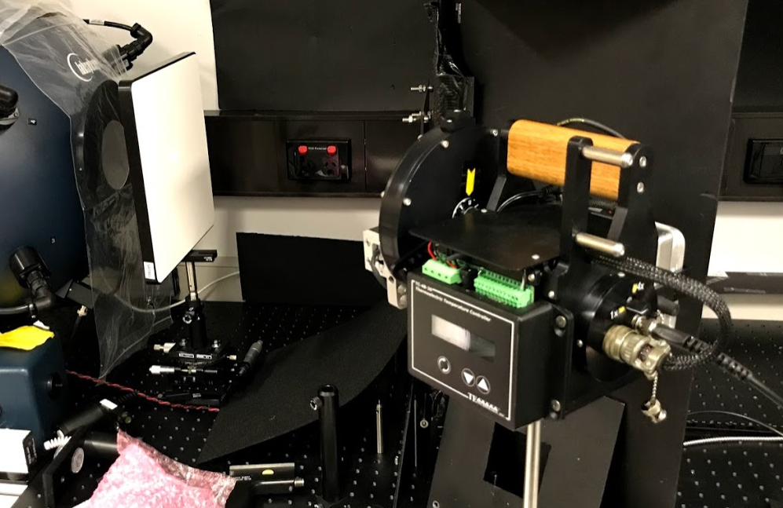
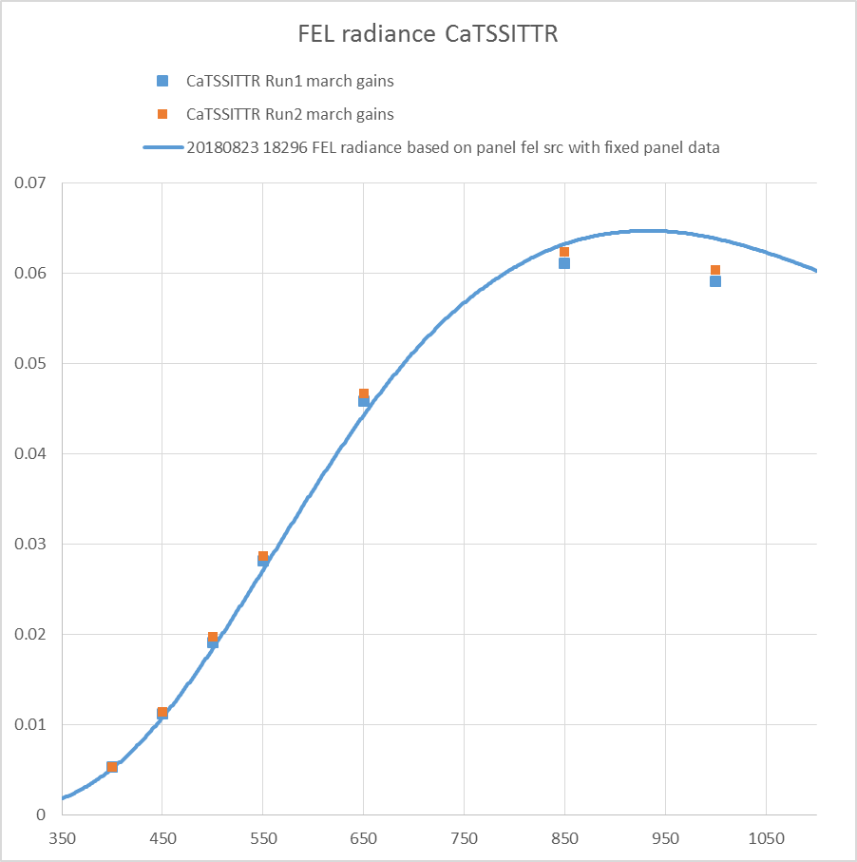
NASA CaTSITTR Collaboration
Evaluation of Calibration Test Site Système International (SI)-Traceable Transfer Radiometer (CaTSSITTR) developed by University of Arizona;
Beta testing and development of protocol for it’s usage;
Laboratory comparison;
Field deployment concurrent with field spectral measurements;

Slide 5
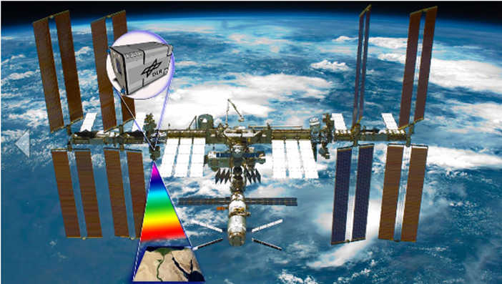
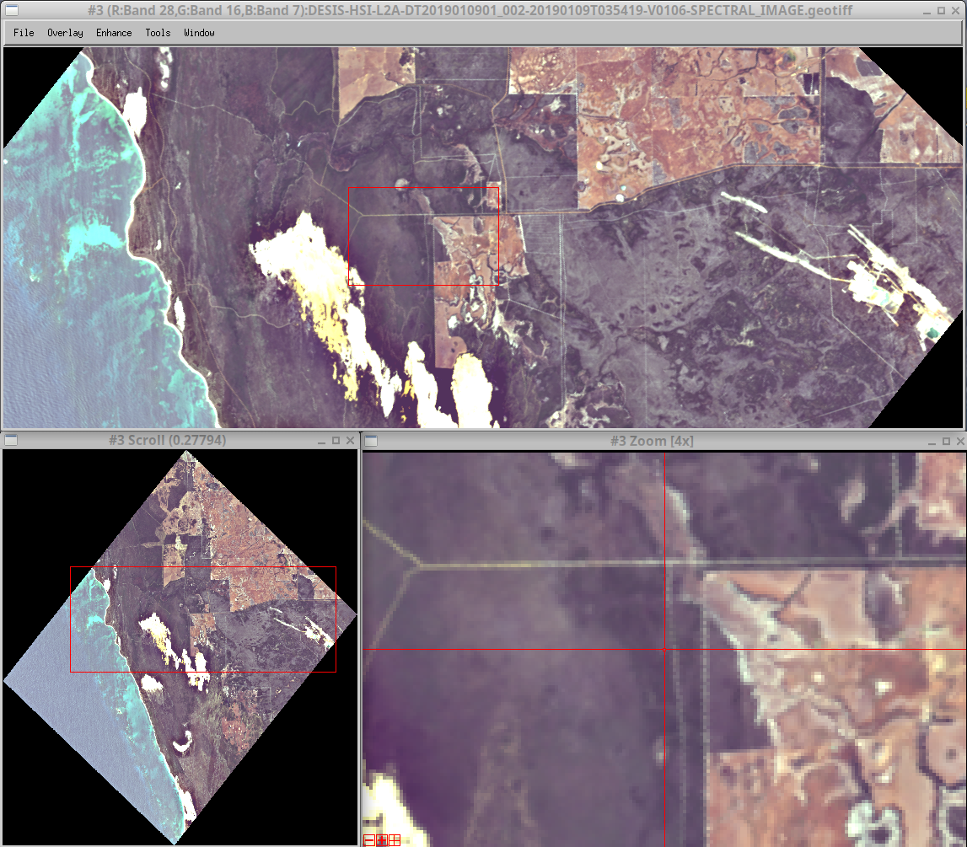
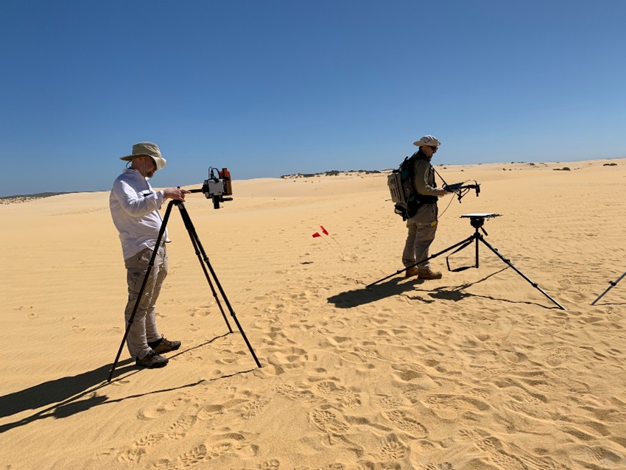
DESIS (@ ISS), WV2 Calibration and Field Inter-Comparison of CATSITTR (March 2019)
4 Nov 2018, 27 Dec 2018

Slide 6
High-Performance Multi-Sensor Data Analytics Platform for Earth Observation Science
Cindy Ong, Alex Held, Michael Caccetta, + many others
9 July 2019
CSIRO

Slide 7
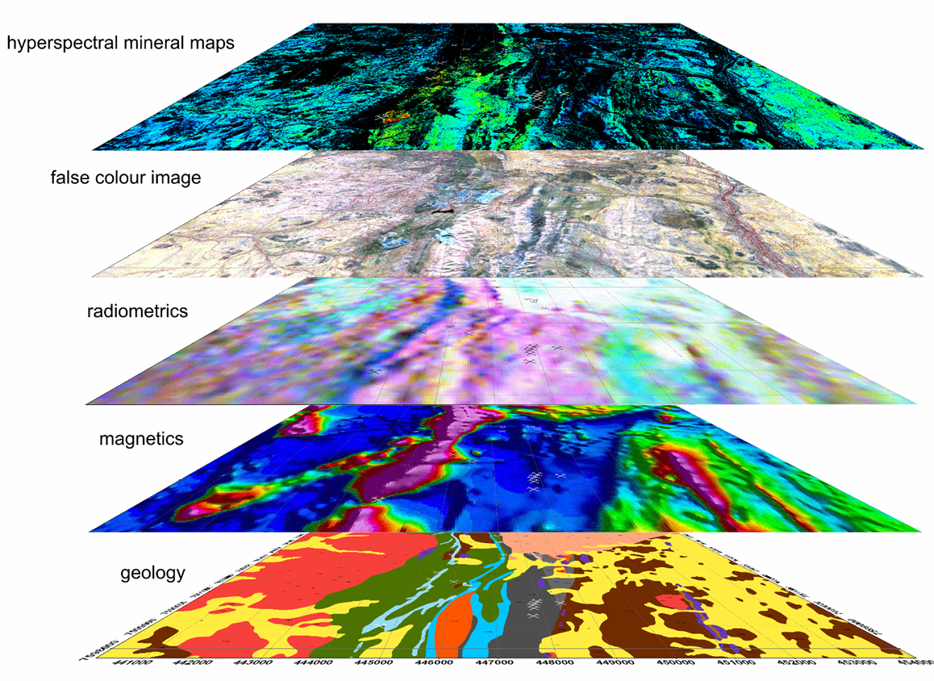
Why?
Increasing user requirements to solve challenges using a combination of existing, new and future datasets;
Build an infrastructure that captures those requirements and is driven by the users (application scientists);

Slide 8
Coastal zone monitoring (Malthus, et al)
Coasts are dynamic, highly variable
Needs high temporal, spatial and spectral resolution
No single sensor achieves it, but we have sensors that satisfy each requirement
Can we combine these to satisfy what we need?
Variety of methods possible
Spectral-temporal (eg Homogenisation? Qin (2018), Bachmann (2017), Cacetta (2013))
Spatial-temporal fusion
ML / AI
High temporal frequency
Himawari 8
10 minutes
Low spatial, low spectral
Freq
HSR
30 m
High spectral resolution
High spatial resolution
Sentinel 3 OLCI
~15 bands
Low spatial
Sentinel 2 MSI
Landsat 8 OLI
20 – 30 m
Low temporal

Slide 9
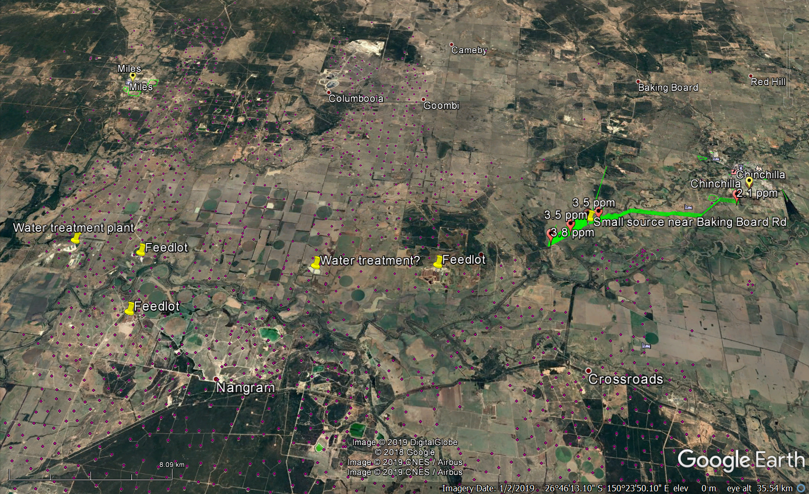
Assessing climate related impacts of gas industry (Ong, et al)
Emission sources
Many, varying sources that cannot be directly attributed to gas industry;
Vary from very small to large spatially and in concentration (concentrated & diffused);
Continuous, temporally dynamic;
Often overlapping and challenging to distinguish between each other;
No single sensor or technological fit

Slide 10
Improved quantification of carbon stock for Savanna Forest & Mangroves (Levick, et al)
SAR (NovaSAR1/others)
Wall to wall, temporal coarse biomass & structure
GEDI
High spatial but sparse vertical profiles & biomass
GHG satellite (OCO3)
Coarse spatial res, high temporal fluorescence & GHG
Drivers: carbon trading, offsets, sequestration;
Large uncertainties persist in quantification of standing carbon stocks and their dynamics;
Solution requires coupling of multiple EO datasets with ecosystem modelling;
Potential related outcome: improved quantification of GHG related to fires;
Imaging Spectroscopy (DESIS/others)
Medium spatial res, potentially temporal vegetation types, dry/green, soils
Notes:
HyperScout: To overcome limited downlink capacity (a very pressing limitation for hyperspectral imagers on small platforms) the system contains a powerful on-board processing module which converts the raw data into derived map products. Only these need to be transmitted to earth, which makes the system vastly more efficient.

Slide 11
The start .....
At least 2-5 spaceborne imaging spectroscopy sensors will be launch in the next 2-3 years;
Question: How do we hasten uptake of these data especially with traditional optical sensor users?
Tested ingestion of airborne HyMap data into Open Data Cube (ODC);
Why ODC?
High international adoption (currently 39);
Legacy – have been involved since inception (AGDC) & continue to be on steering committee;
Open source;
What we found
supports 2D layers, provides gridded and stitched data and allows for temporal 2D searches;
does not support
multiple dimensions such as spectral information and 4D point clouds for LiDAR data;
Multiple pixel sizes;
Irregularly gridded datasets;

Slide 12
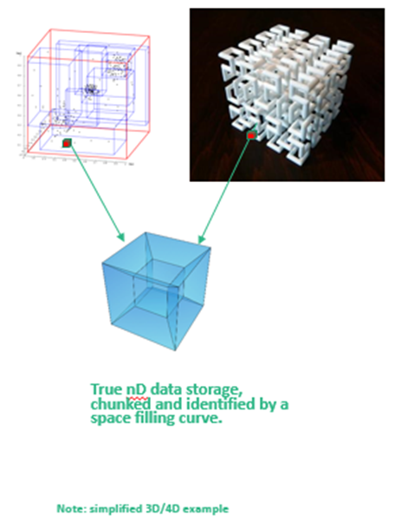
Way forward …..
Remove restrictions on the number of dimensions and types of data;
Provid gridded and stitched data;
Support for hyperspectral (4D) and LiDAR (4D/point-cloud) data;
Allow for pixel sizes and distance to be non-linear (different pixel sizes);
Data will be indexed for distributed key-value or file based storage;
Support for sparse datasets;
Support for metadata queries as well as data; and,
Fast n-D search in parallel.

Slide 13
Things to think about …..
Dealing with the radiometric, spectral (contiguous vs discrete, resolutions, etc), spatial disparity/discontinuity;
Is Analysis Ready Data (ARD) – (gridded, usable data mask, pixel alignment, atmospheric (± BRDF) correction) sufficient?;
Standardisation between ARDs or at least an assimilator/translator?;
Spectral, radiometric, spatial alignment?
Harnessing data from other datacubes;
Interoperability between datacubes;
Standards/translators?;
Federated/virtual datacubes;
Security;
Performance;
Integration/assimilation of datasets
When, What, How to do it?

