Slide 1

WGCV CARD4L Peer Review
Medhavy Thankappan
WGCV-45
July 15-19, 2019

Slide 2

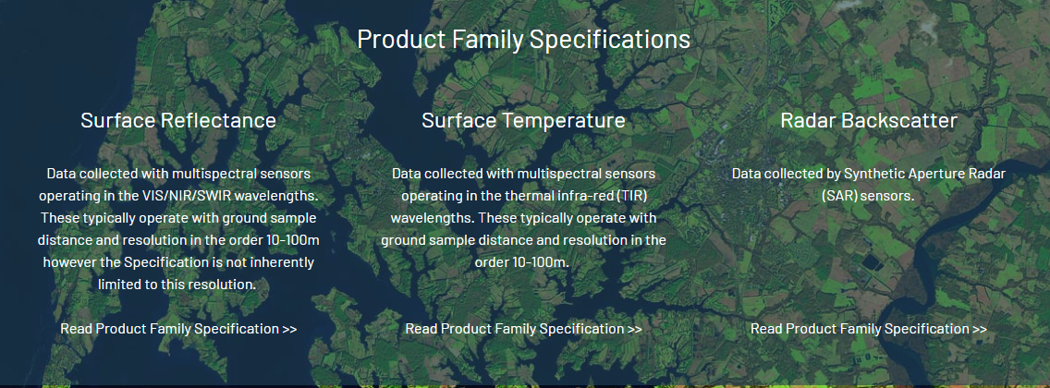
CEOS ARD for Land (CARD4L)
ceos.org/ard

Slide 3
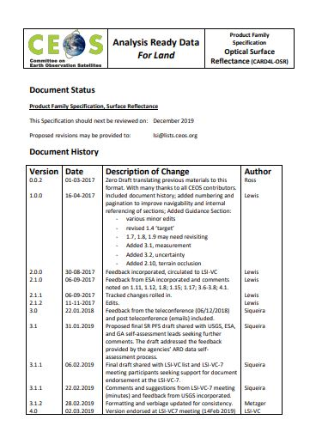
CARD4L framework components
Three components: Definition, Product Family Specifications, and Product Alignment Assessment
‘Threshold’ and ‘Target’ requirements for candidate products in the Product family include:
General metadata
Per-pixel metadata
Radiometric and atmospheric correction
Geometric correction
CARD4L specifications for three initial products have been reviewed by expert community groups, and endorsed at LSI-VC7 (Feb 2019)

Slide 4
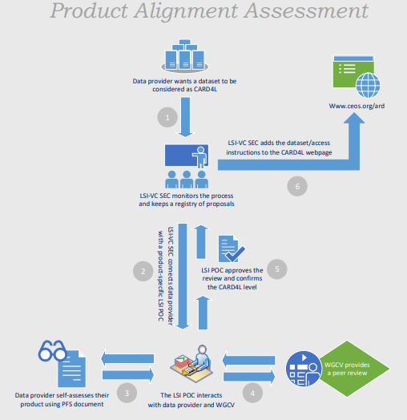
CARD4L product alignment assessment
A process to assess products that are CARD4L compliant has been defined
Data providers proposing products for CARD4L assessment would do a self-assessment of products against the CARD4L specs as the first step
Data providers would then approach LSI-VC for endorsement of a product as CARD4L compliant
LSI-VC would work with WGCV to assess the product against CARD4L specifications

Slide 5
CARD4L Peer Review: WGCV role and current status
To assist with CARD4L product reviews, WGCV has a process workflow
Self assessment of surface reflectance and radar backscatter products derived from Landsat, Sentinel-2 and ALOS were completed by: USGS, ESA, JAXA, GA and outcomes reported at LSI-VC7 (February 2019)
Feedback provided to LSI-VC about experience with the process, description of the metadata parameters and need for clarity in some cases.
Feedback about CARD4L specifications for Surface Reflectance was sought from the WGCV membership - written feedback from N Fox on potential improvements.

Slide 6
ESA Sentinel-2 self assessment at Threshold
“General Metadata”:
9/10
“Per-pixel metadata”:
7/7
“Radiometric and atmospheric corrections”:
1/3
“Geometric corrections”:
0/1

Slide 7
USGS Landsat SR self assessment at Threshold
“General Metadata”:
8/10
“Per-pixel metadata”:
6/7
“Radiometric and atmospheric corrections”:
3/3
“Geometric corrections”:
1/1

Slide 8
GA Landsat SR self assessment at Threshold
“General Metadata”:
8/10
“Per-pixel metadata”:
7/7
“Radiometric and atmospheric corrections”:
3/3
“Geometric corrections”:
1/1

Slide 9
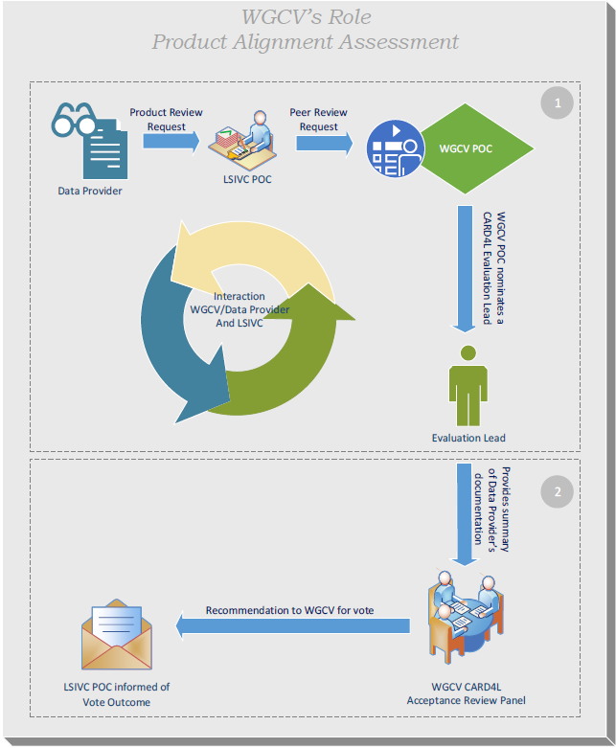
Steps in the peer review process
CARD4L peer review request from LSI-VC to WGCV PoC
WGCV Evaluation Lead nominated
Evaluation Lead verifies data provider's documentation and makes it available to the WGCV CARD4L Acceptance Review Panel
Acceptance Review Panel considers documentation and provides the final recommendation for vote to the WGCV membership
Outcome of the vote communicated to the LSI-VC PoC

Slide 10
Proposed WGCV CARD4L assessment process
K. Thome, C. Ong, M. Thankappan
NASA/CSIRO/GA
LSI VC-6
JRC, Ispra, Italy
Sept. 4-7, 2018

Slide 11
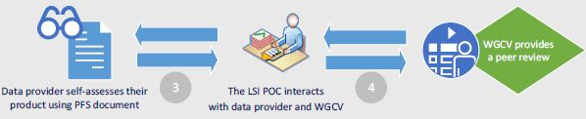
Proposed approach for CARD4L
Data provider expresses interest to LSI-VC for product review
LSI sends requests to
WGCV CARD4L Lead
WGCV CARD4L puts Data Provider and LSI POC in contact with WGCV evaluator
WGCV interacts with Data Provider and LSI POC on the documentation
LSI-VC informed by WGCV CARD4L Lead of peer review outcome
CARD4L Review Panel provides recommendation to WGCV for vote
Summary of Data Provider’s documentation provided to WGCV CARD4L Review Panel

Slide 12
Basic approach for proposed WGCV CARD4L peer review
Details are provided on subsequent charts
Data provider documentation is provided to a WGCV CARD4L evaluation lead
CARD4L evaluation lead puts the data provider and LSI POC in touch with a WGCV evaluator to work with the provider and LSI POC on documenting the validation process
WGCV evaluator provides a summary of the data provider’s validation documentation along with the full package to a CARD4L Review Panel
Panel formulates recommendation carried forward to WGCV membership
WGCV plenary votes to approve or reject recommendation
CARD4L Evaluation Lead provides LSI POC and Data Provider with result of WGCV vote

Slide 13
Initial contact between LSI-VC and WGCV
A single POC, WGCV CARD4L Evaluation Lead is used within WGCV to simplify the process for LSI-VC
WGCV CARD4L Evaluation Lead will typically also be the POC between LSI-VC and WGCV
  CARD4L Evaluation Lead would be a WGCV member
  Approved to a two-year term at a WGCV plenary meeting but there would be no service limits
  M. Thankappan was approved at WGCV-44 as POC between LSI-VC and WGCV
Evaluation Lead determines the best person within WGCV with the appropriate expertise to provide a detailed evaluation of the data provider’s documentation

Slide 14
WGCV Evaluator does the assessment
Evaluation of the data provider’s documentation to determine if appropriate validation and uncertainty methodologies followed
Evaluator could come from WGCV membership or subgroups
  Helps to prevent the burden falling on a small number of people
  Gives better access to necessary expertise for the assessment
  Also a means to engage early career members with WGCV
The Evaluator becomes the POC from this point forward
  May seem to add complexity but key is that initial contact for LSI-VC is always the same person regardless of the product
  CARD4l Evaluation Lead will also be engaged with LSI-VC activities overall

Slide 15
WGCV Evaluator does the assessment
Evaluation process is an interaction between the WGCV representative, the Data Provider, and the LSI-VC POC
Collaborative process much like WGCV has for RadCalNet
  Help ensure documentation follows accepted nomenclature
  Clear demonstration of necessary quality
  Goal is to help Data Provider move toward documentation that leads to acceptance
Ultimately, it is the Data Provider’s choice whether to move forward with documentation to WGCV’s CARD4L Acceptance Review Panel
Documentation can move forward without the WGCV representative’s approval

Slide 16
WGCV Evaluator does the assessment
WGCV Evaluator supplies their summary evaluation of the Data Provider’s documentation to the CARD4L Review Panel
CARD4L Review Panel consists of five members
  WGCV CARD4L Evaluation Lead (panel lead)
  One member from WGCV membership
  Three members from either WGCV or subgroup
  Not more than one subgroup volunteer from a single subgroup
Serve two year (TBR) terms but without service limits
Review panel evaluates the full documentation package with help from the evaluator’s summary

Slide 17
WGCV Evaluator does the assessment
CARD4L Acceptance Review Panel evaluates the summary from the WGCV evaluator and formulates a recommendation
Recommendation of approval requires concurrence by majority of panel
Evaluation process can be done via telecons and email
Evaluation will take place within 6 weeks from receiving the evaluator’s summary
Recommendation is carried forward to the WGCV membership
Panel’s recommendation be either approval or disapproval

Slide 18
WGCV Evaluator does the assessment
WGCV membership votes on the panel recommendation
WGCV either via email or at a WGCV meeting
Recommendation is accepted by WGCV unless
  Three members present at WGCV Plenary indicate disapproval
  Five members express disapproval when vote is done via email
Default process is to wait until next WGCV Plenary meeting unless Data Provider requests the process be done via email
In both cases, the documentation and panel recommendation forwarded to full WGCV membership at least a one month prior to the vote
Result of vote is forwarded to LSI-VC by the CARD4L Evaluation Lead

Slide 19
Summary and further comments
WGCV views the peer review of the CARD4L data products as a supportive process
  Documentation work is the responsibility of the data provider
  Validation of PFS metrics is the data provider’s responsibility
  WGCV process is an attempt to ensure the consistency of the documentation process across providers and data product families
WGCV recognizes that the initial implementations of this assessment process will (and should) lead to iterations on the PFS
WGCV will offer comment and suggestions regarding the PFS in addition to the data provider’s documentation

Slide 20
Discussion
What’s next?
Arrangements for setting up the WGCV Acceptance Review Panel
Communication to the LSI-VC

