Slide 1

SIT-Workshop, CEOS Plenary, CEOS Work Plan
C. Ong
CSIRO
WGCV # 48
Virtual Meeting
October 28, 2020

Slide 2
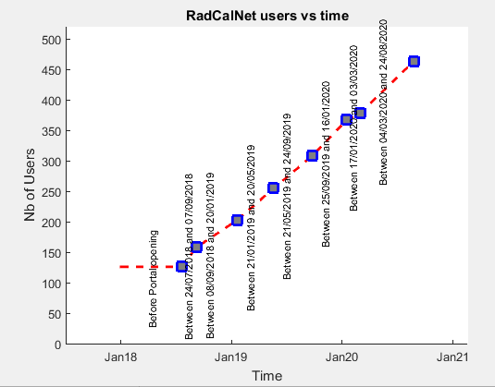
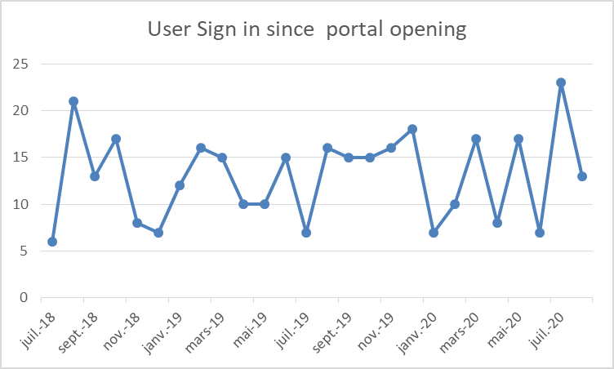
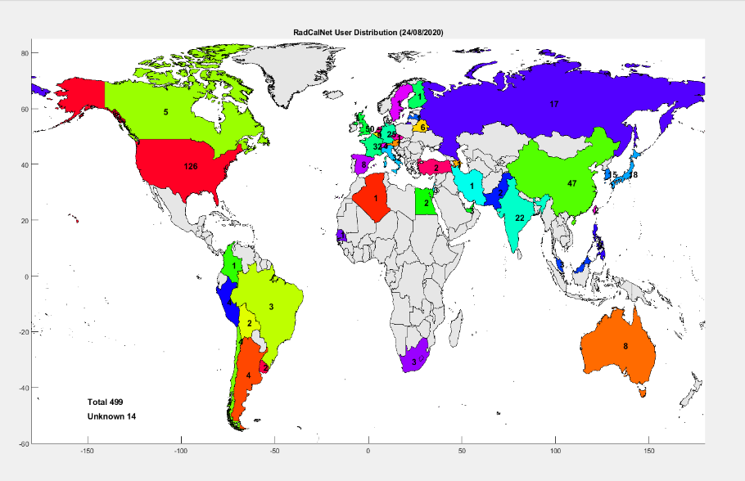
Uptake of RadCalNet since going public
RadCalNet’s value as a CEOS Service

Slide 3
CARD4L submissions for peer-review
USGS Landsat Surface Reflectance (Collection 2)
USGS Landsat Surface Temperature (Collection 2)
ESA Sentinel-2 Surface Reflectance (for Threshold only)
USGS Landsat Surface Reflectance (Collection 2 – updated PFS)
USGS Landsat Surface Temperature (Collection 2 – updated PFS)
Separate CARD4L Review Panels for Landsat and Sentinel-2 products
Notes:
Out of a total of five CARD4L peer-review submissions to the WGCV so far, reviews for two products have been completed

Slide 4
For Information: CEOS WGCV LPV Biomass Validation Protocol
3.6: CEOS WGCV LPV Biomass Validation Protocol
  Open for feedback until 15 December 2020;
  Seeking endorsement at SIT meeting March 2021;

Slide 5
Ongoing
New Number | Old Number | Title | Status | Creation Year | Completion Date
CV-14-03 | CV-3 | Workshop on state of the art for pre-flight calibration techniques | Open | 2014 | 2021 Q2
CV-16-02 | CV-14 | Report on application of approaches for cloud masking | Open | 2016 | 2020 Q2
CV-17-01 | CV-15 | L1 top-of-atmosphere interoperability | Open | 2017 | 2019 Q4
CV-18-02 | CV-18 | Greenhouse gas reference standards for interoperability | Open | 2018 | 2021 Q4
CV-18-03 | CV-19 | Biomass validation protocols | Open | 2018 | 2021 Q1
FDA-18-05 | FDA-12 | Inventory of space data product formats used by CEOS agencies. | Open | 2018 | 2021 Q4
 | CV-9 | Radiometric Calibration Network (RADCALNET) | Open | 2014

Slide 6
New
New Number | Old Number | Title | Status | Creation Year | Completion Date
CV-20-01 | CV-XX | Surface Reflectance measurements Intercomparison exercise for vegetation (SRIX 4Veg) | New | 2020 | 2022 Q4
CV-20-02 | CV-XX | Biomass Retrieval Inter-comparison eXercise (BRIX-2) | New | 2020 | 2021 Q4
CV-20-03 | CV-XX | Digital Elevation Model Inter-comparision (DEMIX) | New | 2020 | 2021 Q4
CV-20-04 | CV-XX | SAR Calibration inventory and joint use assessment | New | 2020 | 2021 Q4
CV-20-05 |  | standards and metrics for scatterometers and wind retrievals |  | 2020 | 2021 Q4

