Slide 1
CEOS WGCV SAR subgroup report
Bruce Chapman
Chair, CEOS WGCV - SAR subgroup
Dirk Geudtner
Co-Chair, CEOS WGCV - SAR subgroup

Slide 2
OUTLINE
Website status
Meetings
SAR calibration inventory and joint use assessment
  SARCALNET

Slide 3
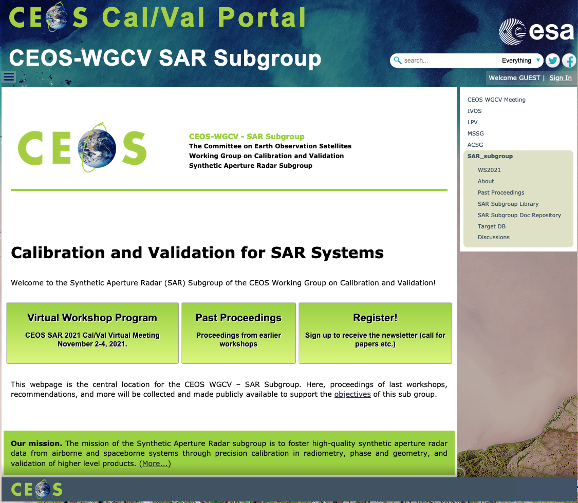
Website has been fully ported to ESA administration, and it has been a huge improvement in terms of time required to manage it. Many thanks are due to Paolo Castracane and ESA.

Slide 4
Workshop 2020
First virtual meeting for this group
October 6-8, 2020
Stephane Cote from CSA was a virtual host, and helped Dirk Guedtner and I host the meeting.
Three discussions sessions:
  SAR Cal/Val Targets
    Split into two sessions to accommodate different time zones
  CARD4L
    Review of specifications
  Operating mission updates
Staggered times to facilitate global attendance
Typically 40-70 were in attendance

Slide 5
Workshop 2020
Draft outline of “Requirements for SAR calibration targets” discussed during meeting and subsequent meetings.
However – this document would require a lot of work to complete.
Outline:
  Introduction and scope/goals
  Calibration objectives
    Internal calibration
    Geometric calibration
    Radiometric calibration
    Polarimetric calibration
    Insar calibration
    Relative calibration between sensors
    Mode dependencies

Slide 6
Workshop 2020
  Continued:
  Overview of target types
    Artificial
      Passive
      Active
    Natural
    Wavelength dependencies
  Properties of artificial targets
    Passive
    Active
  Properties of natural targets
  Measurement metrics for artificial targets
  Propagation issues
  Recommendations
  References

Slide 7
Workshop 2021
November 2-4, 2021
Stephane Cote from CSA has volunteered again to help with virtual hosting. 2022 meeting to be held in person at CSA.
Tentative agenda
  SARCALNET and draft requirements for SAR calibration targets
  Updates from operating missions
  Upcoming mission updates

Slide 8
SAR calibration inventory and joint use assessment
Existing SAR Target database:
Contains positions of reflectors from various agencies
  Additional information would make this database more useful
Contains Radarsat swaths over natural targets

Slide 9
SARCALNET
Currently, most missions design their own external targets, typically a combination of natural and artificial calibration targets
Like Radcalnet, there is a desire to have an established network of calibration sites that would facilitate collaboration between sensors by using the same calibration references.
Publish calibration results to facilitate joint use and cross calibration
There are three types of external calibration targets used by SAR
  Natural targets
  Artificial passive targets
  Artificial active targets
VH-RHODA 2021

Slide 10
Types of image calibration
Radiometric calibration (both natural and artificial targets)
  Corner reflectors have known brightness
  Over large radar-bright uniform areas, the antenna pattern can be validated
Polarimetric (both natural and artificial targets)
  Phase difference between HH and VV over CRs is well known
  Channel imbalance between polarimetric channels
  ”cross talk” corrections
Geometric (artificial targets)
  over artificial (point) targets of known position
Interferometric (ideally artificial targets)
  Measure phase stability
Instrument parameters and performance (natural and artificial targets)
  Impulse response (resolution, ambiguities)
  Range delays
  Digital beam forming
  Pointing
  Noise level
VH-RHODA 2021

Slide 11
Natural targets
Typically large, uniform SAR backscatter areas are needed
  Spanning image swath (now often > 150 km)
  Amazon, Dome C in Antarctica, doldrums, …
  The uniformity of the area in the SAR image may depend on the frequency band and the polarization
Sites such as these can be used to monitor SAR image calibration over time
  The SAR backscatter at these sites may naturally vary with frequency band and polarization
  Seasonality may need to be considered
Shapefiles to delineate each natural target area
VH-RHODA 2021

Slide 12
Natural targets
The time history of SAR backscatter measured at different frequency bands and polarizations by different instruments at “SARCalnet sites” should be hosted on CEOS WGCV SAR webpage but currently is not
In addition
  The methods and source data used for calculating the time series results should be provided.
This information, along with the specific location of the area of the target, would be useful for cross comparison of calibration results.
VH-RHODA 2021

Slide 13
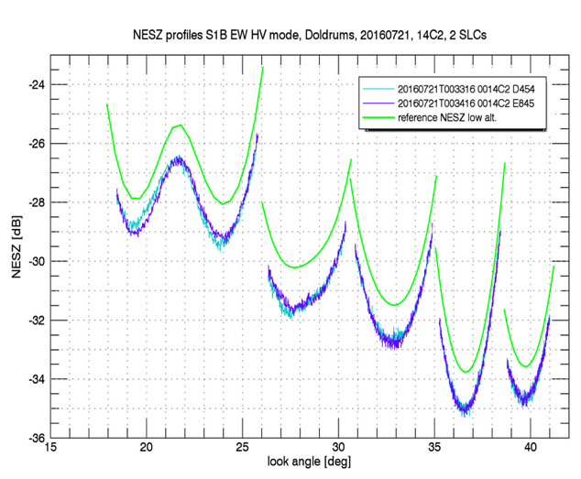
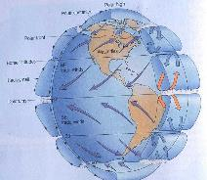
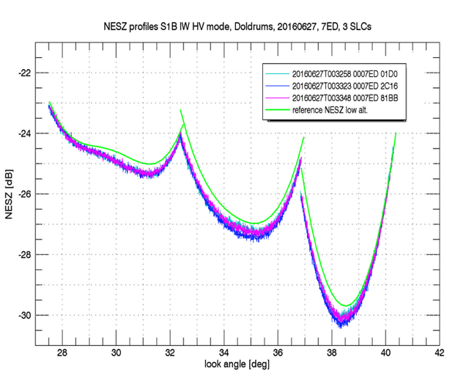
Sentinel-1 Noise Equivalent Sigma Zero (NESZ)
Measured over the doldrums
VH-RHODA 2021

Slide 14
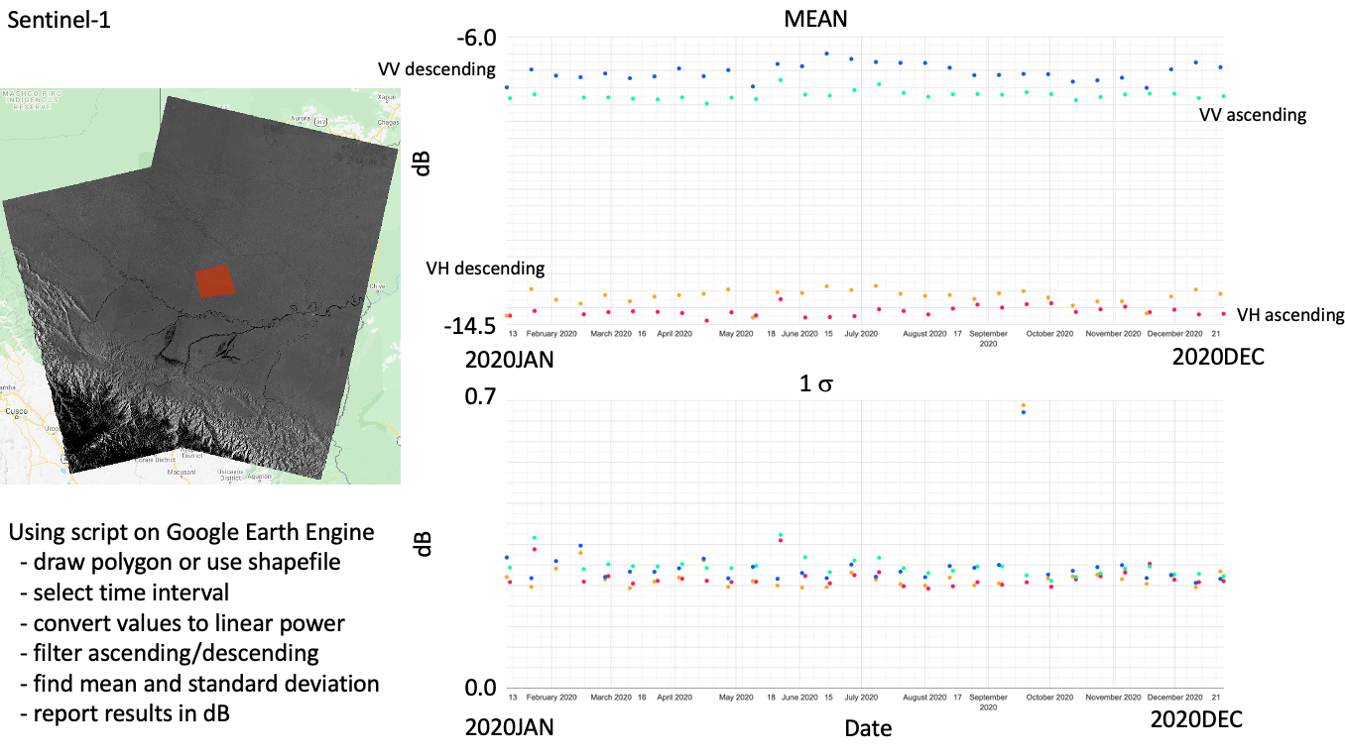
Incidence Angle effects: Ascending vs Descending orbits
VH-RHODA 2021

Slide 15
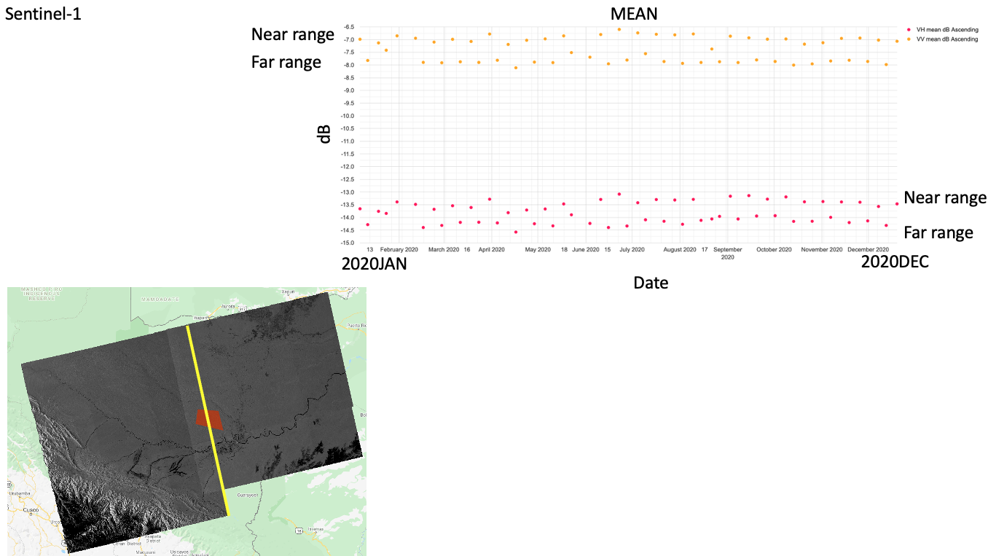
Incidence Angle effect: near/far range overlap
VH-RHODA 2021

Slide 16
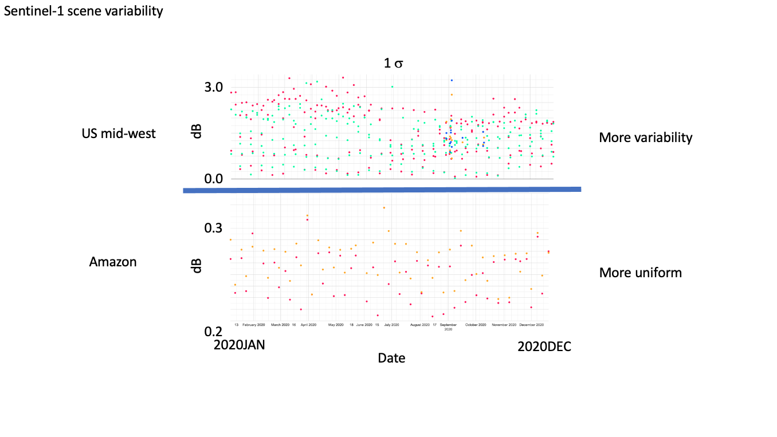
VH-RHODA 2021

Slide 17
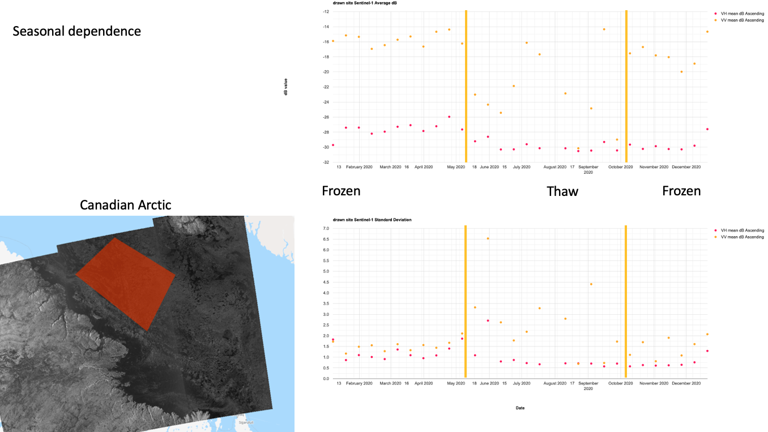
Sentinel-1
VH-RHODA 2021

Slide 18
Plan for Natural Targets
Develop a plan for new target database section of subgroup webpage
  specifically defined regions defining natural target areas
    Select a group representing different agencies to define these areas
  monitor results from different sensors over these sites
    Agencies with operating sensors will be responsible for this contribution
    Include incidence angle information
  To be discussed in greater detail at next meeting
Initiate monthly call with interested members to coordinate the work

Slide 19
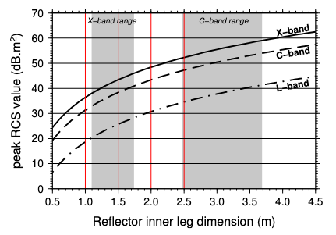
Artificial Passive Targets
These targets are point targets with known brightness
Can be used to assess image radiometric calibration, geolocation accuracy, resolution, and more
Frequency bands dictate the size and material (ie longer wavelengths can utilize perforated materials)
Typically deployed by a mission during their commissioning/calibration period. They are not always kept in operation.
Persistently maintained arrays can be costly
  Resurvey costs
  Other maintenance
  Land rights
Garthwaite et al, 2013
VH-RHODA 2021

Slide 20
Artificial Passive Targets
Characteristics vary with band
  Size, mounts, materials
Typical measurements of the reflector
  Heading, elevation angle, orthogonality, flatness, accuracy of measurements
Typically oriented parallel to the SAR path
  Most targets are oriented for right looking, polar orbits, but not all
  Depending on target type, the orientation may need to be adjusted
Might not be permanently deployed
VH-RHODA 2021

Slide 21
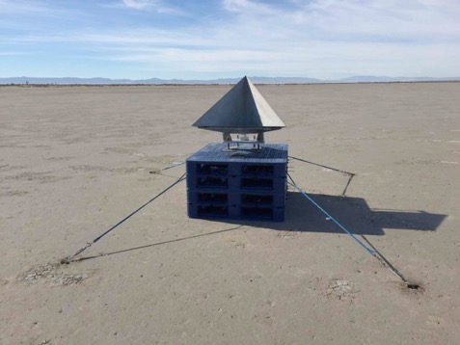
JPL 0.7 m corner reflector on Rosamond Lake Bed for Ka-band
VH-RHODA 2021

Slide 22
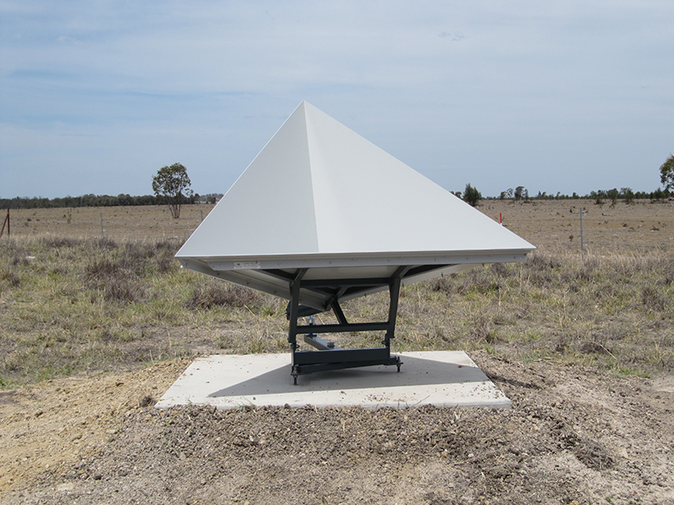
AuScope Australian Geophysical Observing System C/X-band 1.5 m
VH-RHODA 2021

Slide 23
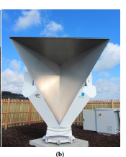
2.8 m DLR reflector
in stowed position
VH-RHODA 2021

Slide 24
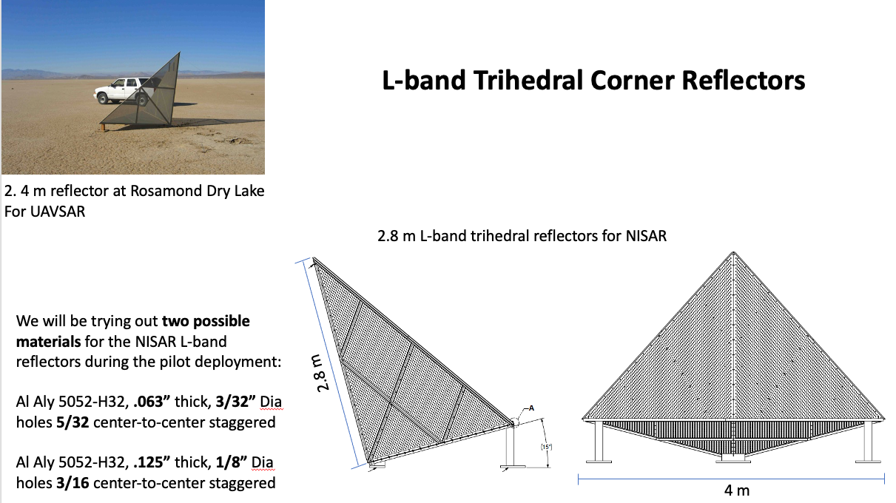
NISAR
VH-RHODA 2021

Slide 25
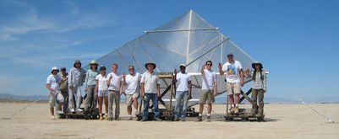
JPL P-band reflector 4.8 m at Rosamond Dry Lake
VH-RHODA 2021

Slide 26
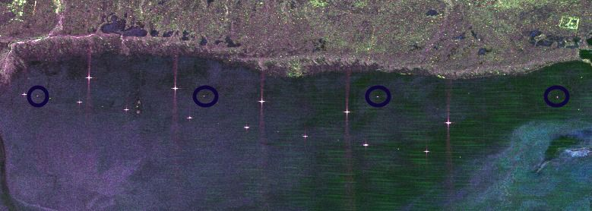
NASA/JPL Rosamond Corner Reflector Array
Southern California
4.8 m
0.7 m
2.4 m
RFI
L-band UAVSAR image
VH-RHODA 2021

Slide 27
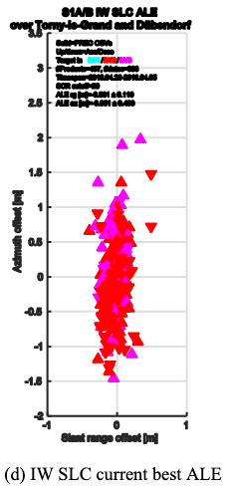
Sentinel-1
Example of geolocation of SAR imagery over Swiss corner reflector site by University of Zurich, RSL
VH-RHODA 2021

Slide 28
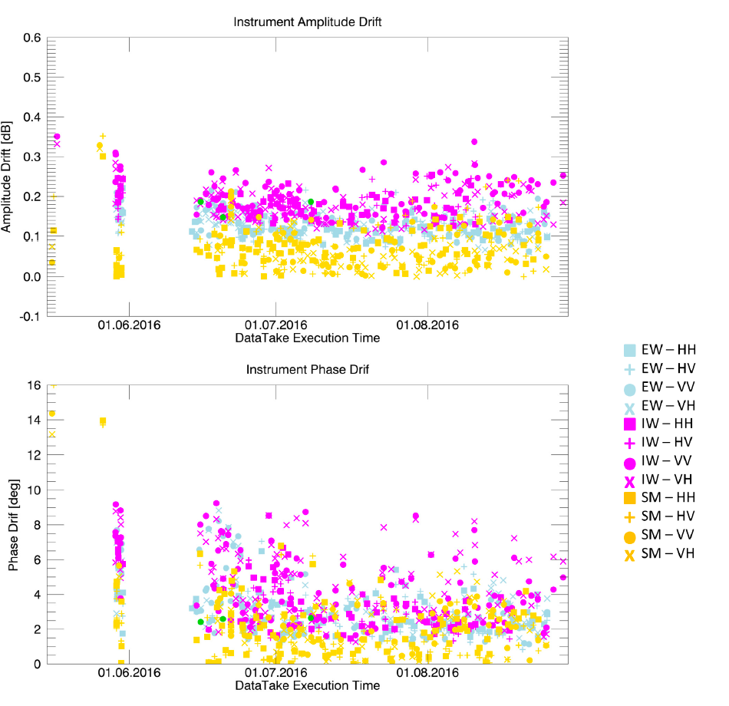
Sentinel-1B
Monitoring amplitude and phase stability
Schwerdt et al, 2017
VH-RHODA 2021

Slide 29
Corner Reflectors
Typically, when a reflector has been deployed and the agency responsible is open to sharing of the reflector for calibration, the size, position, and orientation is provided.
But in addition what is needed:
  The measured RCS for each reflector over time by their SAR, and other SARs.
  Survey accuracy, date of survey, deployment date, any termination date, or gap in deployment.
  Characterization of the background SAR backscatter over time for the region, such as by their SAR and others.
If reflectors are deployed N/S, they may be suitable for both right and left looking observations with only minimal loss to RCS. This will result in the reflectors being slightly less bright, but more broadly usable.
VH-RHODA 2021

Slide 30
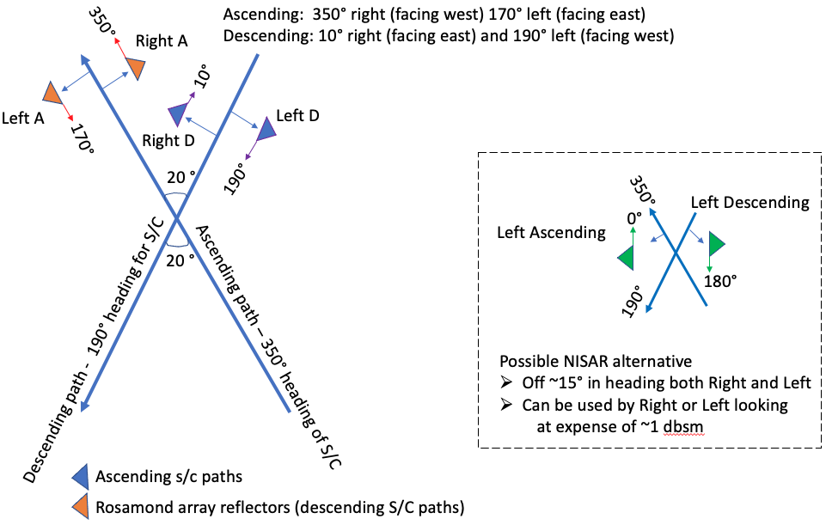

Slide 31
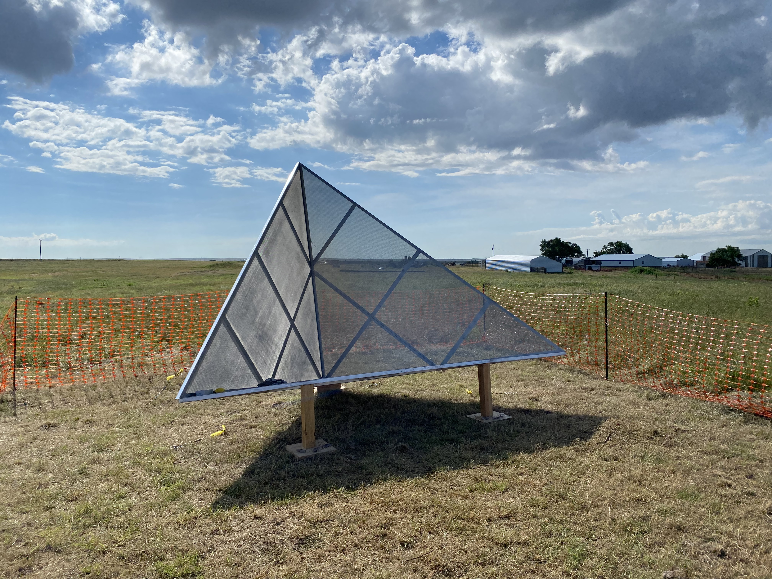
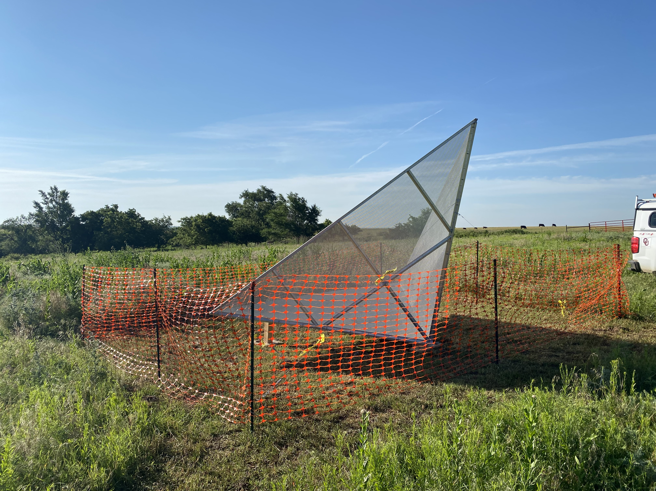
N01K facing East
N03K facing West
Deployed in Oklahoma on June 3, 2021

Slide 32
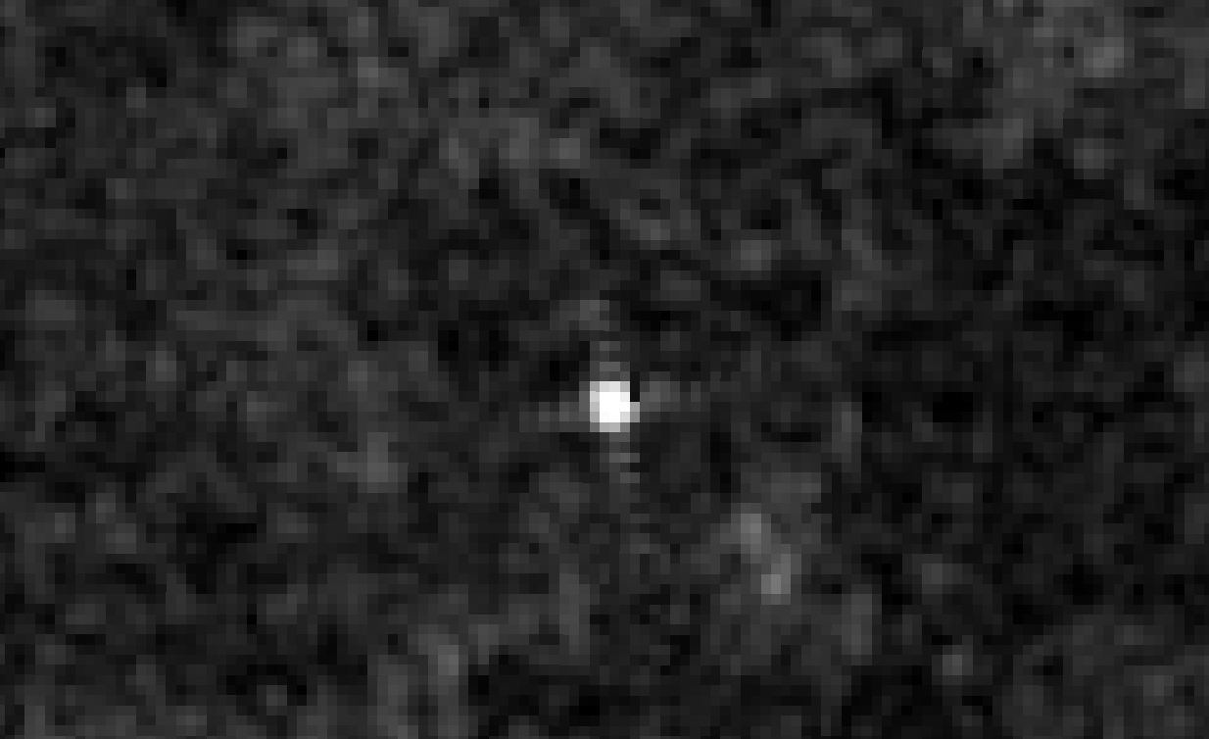
Sentinel-1 ascending orbit, right looking
June 14, 2021
GRD image in Google Earth Engine
NISAR N03K

Slide 33
Passive artificial targets
Set standards for measurements
Guidelines for size and materials
Strategies for collaboration
  N/S orientation for left and right looking at some latitudes
  Sufficient and stable RCS for multiple wavelengths
  Up to date inventories

Slide 34
Artificial Active targets
Band specific
Retransmits the received signal
Can be polarimetric
Requires power and needs to be powered on for the satellite overpass
Must be characterized
  Stability, antenna pattern, gain
The costs are higher for these devices, and their availability is more limited than for passive devices.
VH-RHODA 2021

Slide 35
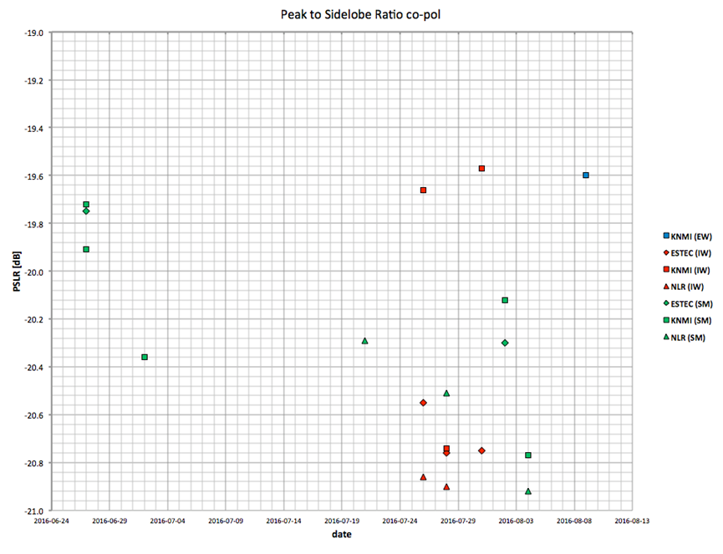
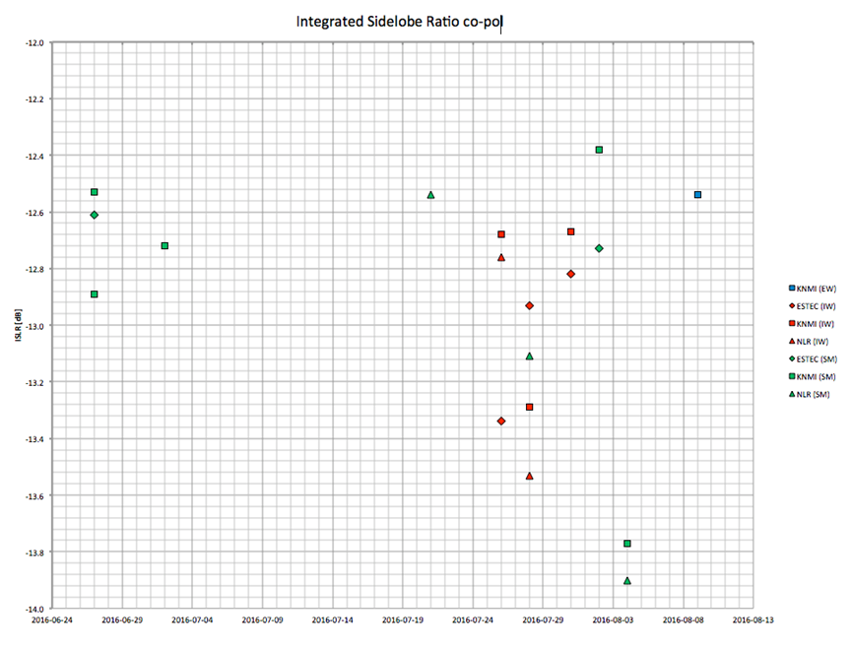
Impulse Response - using 3 ESA transponders
Geudtner et al, 2020
VH-RHODA 2021

Slide 36
Sentinel-1A Absolute Radiometric Accuracy from DLR C-band transponders
VH-RHODA 2021

Slide 37
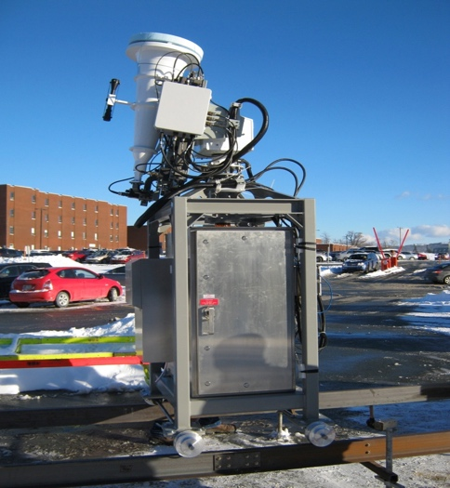
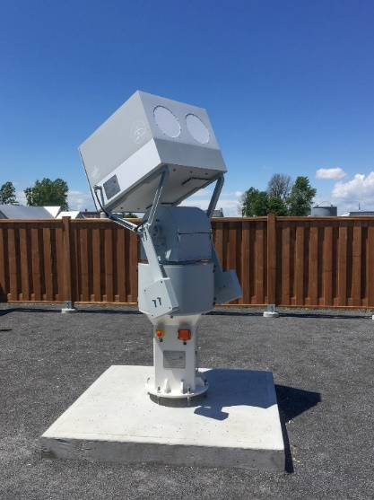
ESA Transponder
DLR Transponder
VH-RHODA 2021

Slide 38
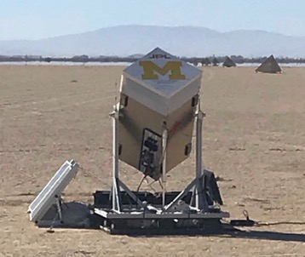
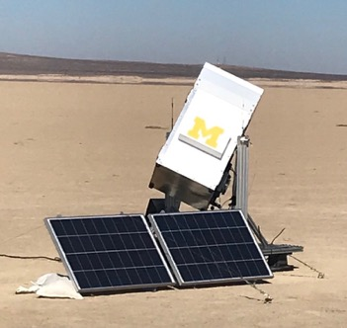
JPL L-band PARC from University of Michigan
VH-RHODA 2021

Slide 39
Conclusions
There is a demand for well-defined calibration targets for SAR calibration
  These targets are used to calibrate the data from these missions
  Currently, in most cases these targets are defined differently for each SAR mission.
There are three main category of targets
  Natural Targets *** first priority
  Artificial Passive Targets
  Artificial Active Targets
“SARcalnet” is in the early stages of formulation by the CEOS WGCV SAR subgroup.
  It would be an established network of calibration sites that would facilitate collaboration between sensors by using the same calibration references.
VH-RHODA 2021

