Slide 1
Working Group on Calibration and Validation Land Product Validation subgroup
CEOS WGCV LPV subgroup report
Michael Cosh (USDA), Chair
Fabrizio Niro (ESA), Vice Chair
Fernando Camacho (EOLAB), Past Chair
CEOS WGCV-50 Meeting, Virtual – 22/03/2022

Slide 2
Outline
New Vice-Chair
CEOS LPV action plan (2019-2022) wrap up (Fernando Camacho)
CEOS LPV on-going activities plans (Mike Cosh)

Slide 3
LPV Action Plan (2019-2022) Wrap Up
LPV Strategy (2019-2022) agreed in Milan 2019 : https://lpvs.gsfc.nasa.gov/LPV_Meetings/LPV_plenary2019.html
Development of Good Practices Protocols
Promoting validation and intercomparison exercises
Improving ground references: data, sites, uncertainties
34 actions:
6 CEOS WP actions
27 LPV actions
Improving LPV communication
Notes:
Current focus area leads are responsible for producing a validation protocol for their respective variables describing current methods and good practices within their respective communities. Some of these documents have been produced, and the following are in the pipeline:
Biomass protocol (contribution to CEOS CARBON strategy, CARB-16 and WGCV-19) under internal evaluation. Expected in Q4 2019.
Soil Moisture, Vegetation Indices, Land Cover, Active Fire and Phenology validation protocols are beginning development now. The objective is to have them ready for community review in about two years from now.
LAI protocol needs to be updated to cover new in-situ tools and good practices for high resolution products. The protocol document can also be updated to incorporate FAPAR as well. Expected for Q4 2021.
Surface Reflectance protocols need to be written. ESA is developing protocols for fiducial references and product validation under the FRM4Veg project. Similar exercises are being conducted by the Australian government. Moreover, the WGCV IVOS subgroup proposed that validation of surface reflectance to be subject of a new task force or extension of ACIX (IVOS R-2018-1). This is of strategic need also for LPV subgroup as surface reflectance is the input for most of our land products.

Slide 4
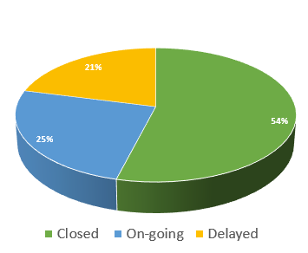
LPV Action Plan (2019-2022) Wrap Up
34 actions
https://lpvs.gsfc.nasa.gov/PDF/Telecons/LPV_01Feb2022_telecon_notes.pdf
Notes:
Current focus area leads are responsible for producing a validation protocol for their respective variables describing current methods and good practices within their respective communities. Some of these documents have been produced, and the following are in the pipeline:
Biomass protocol (contribution to CEOS CARBON strategy, CARB-16 and WGCV-19) under internal evaluation. Expected in Q4 2019.
Soil Moisture, Vegetation Indices, Land Cover, Active Fire and Phenology validation protocols are beginning development now. The objective is to have them ready for community review in about two years from now.
LAI protocol needs to be updated to cover new in-situ tools and good practices for high resolution products. The protocol document can also be updated to incorporate FAPAR as well. Expected for Q4 2021.
Surface Reflectance protocols need to be written. ESA is developing protocols for fiducial references and product validation under the FRM4Veg project. Similar exercises are being conducted by the Australian government. Moreover, the WGCV IVOS subgroup proposed that validation of surface reflectance to be subject of a new task force or extension of ACIX (IVOS R-2018-1). This is of strategic need also for LPV subgroup as surface reflectance is the input for most of our land products.

Slide 5
LPV Action Plan (2019-2022) Wrap Up
Development of Good Practices Protocols
Endorsed in 2020
Endorsed in 2021
Endorsed in 2019
Good Practices Protocols for Vis, Land Cover, and Phenology on going

Slide 6
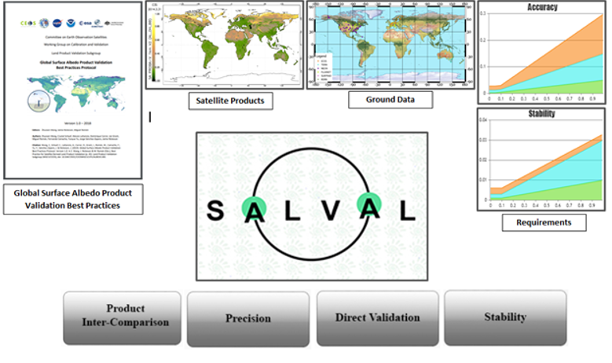
LPV Action Plan (2019-2022) Wrap Up
Validation and Intercomparison exercises
LPV Action Plan: 19-LPV-10
Validation and intercomparison of Albedo products
Surface Albedo Validation tool (SALVAL)
online tool for validation of SA products, following principles that the previous CEOS OLIVE tool
https://www.salval.eolab.es/
Could be hosted in WGVC cal/val portal (TBD)
Standardized Outputs

Slide 7
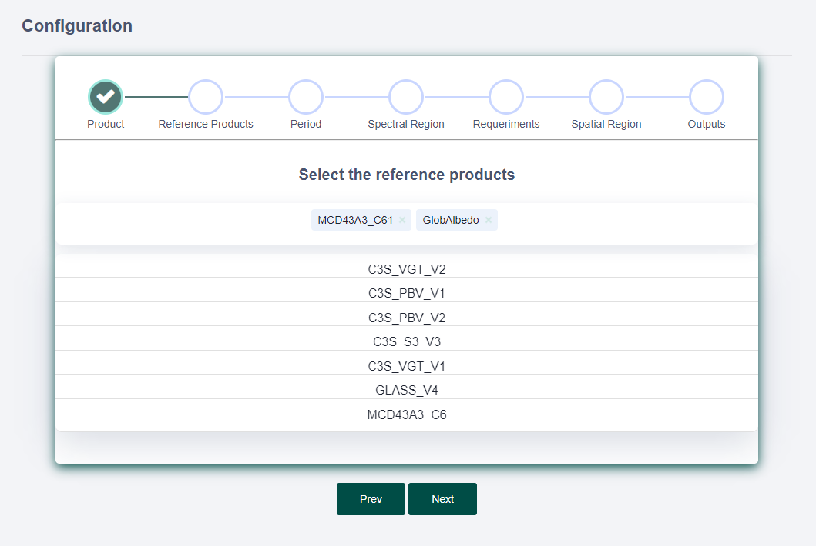
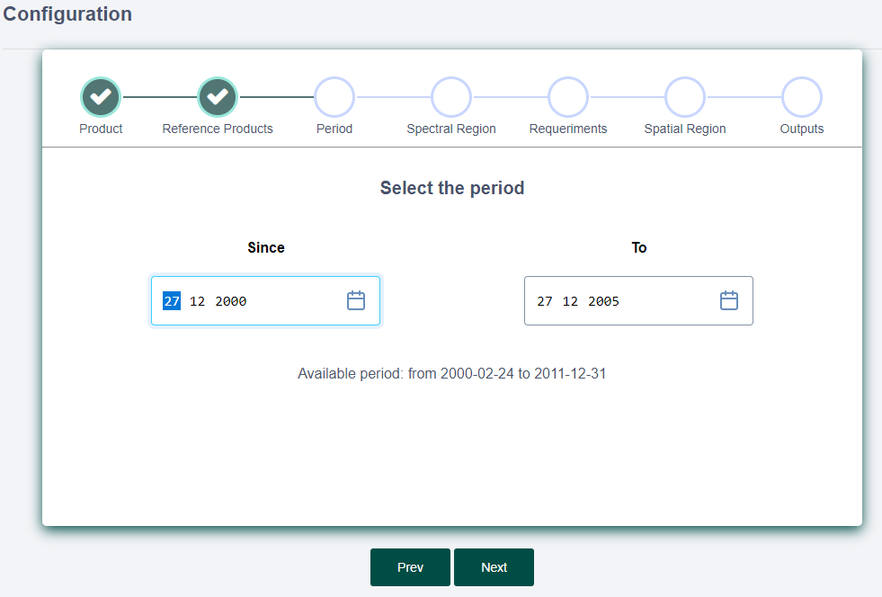
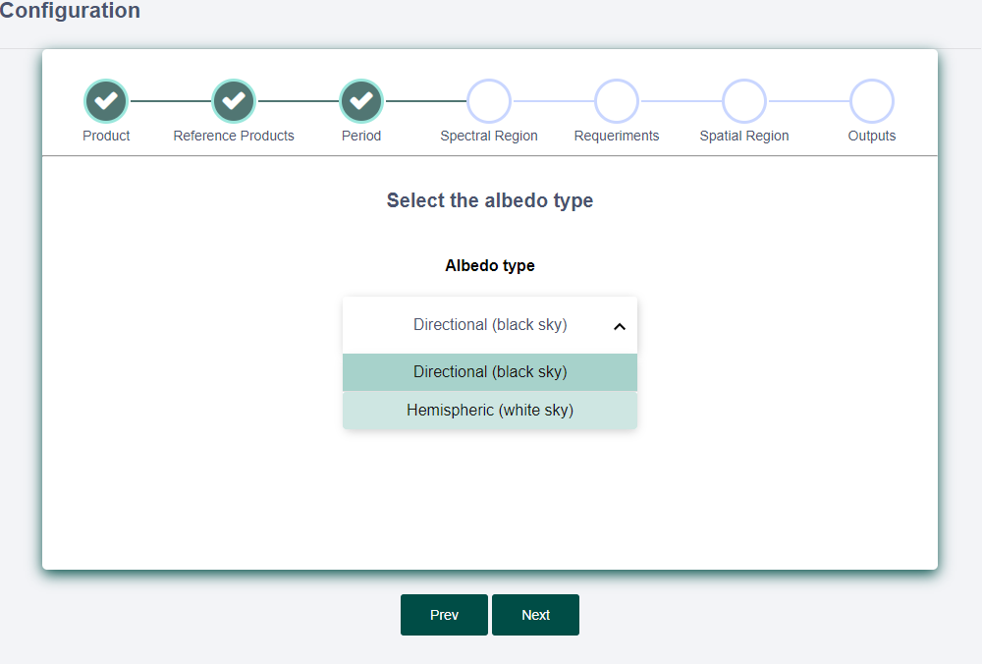
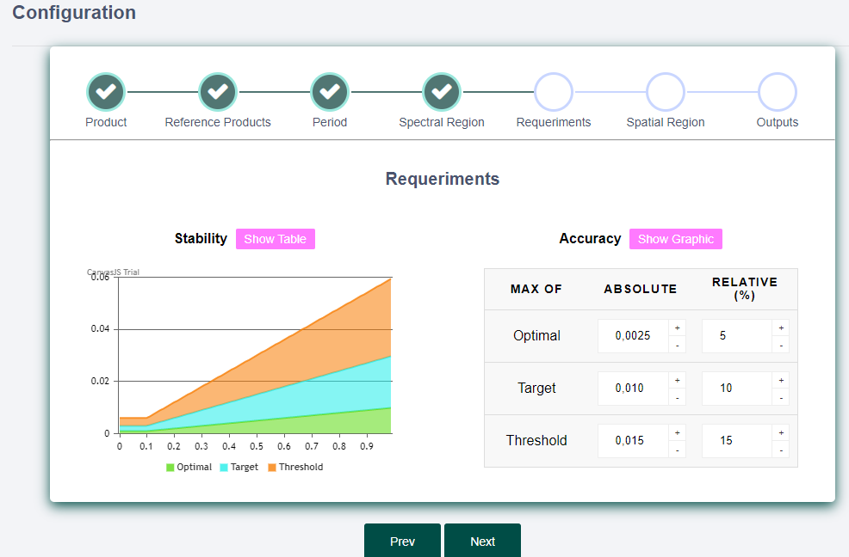
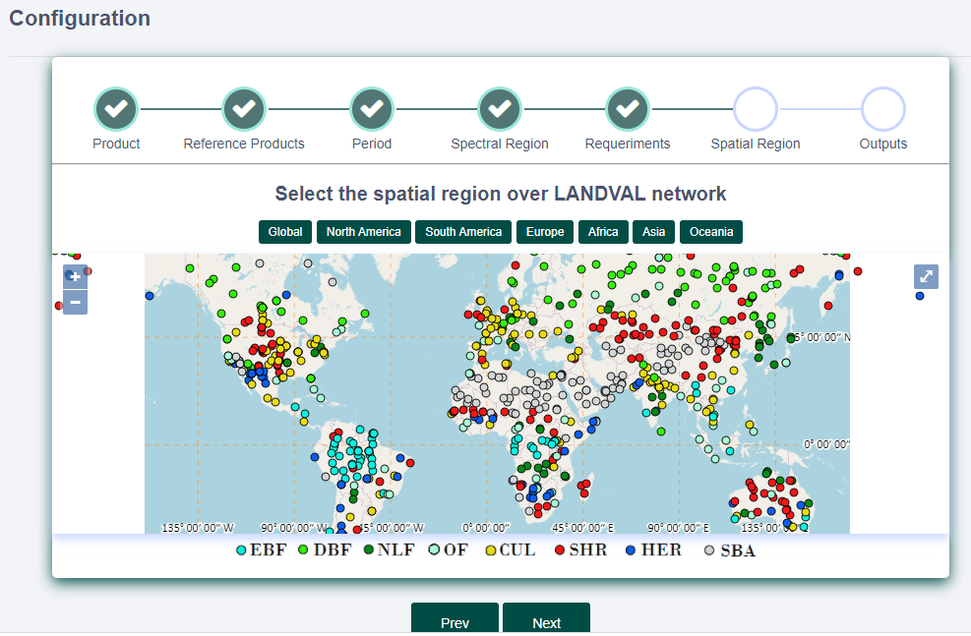
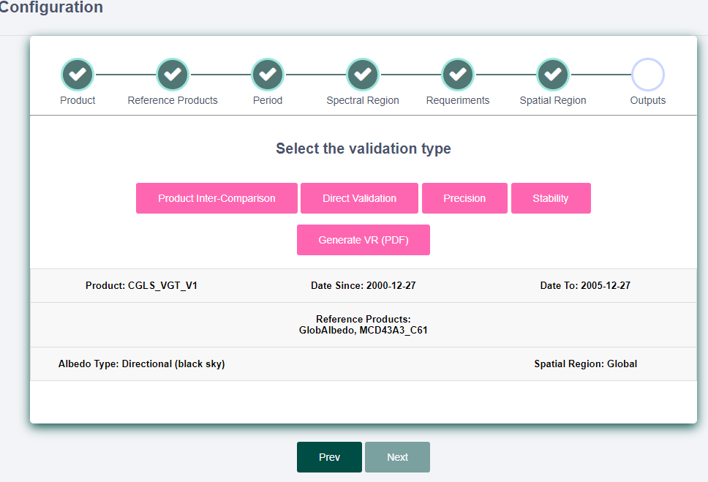
LPV Action Plan (2019-2022) Wrap Up
Validation and Intercomparison exercises
SALVAL online tool for validation of SA products

Slide 8
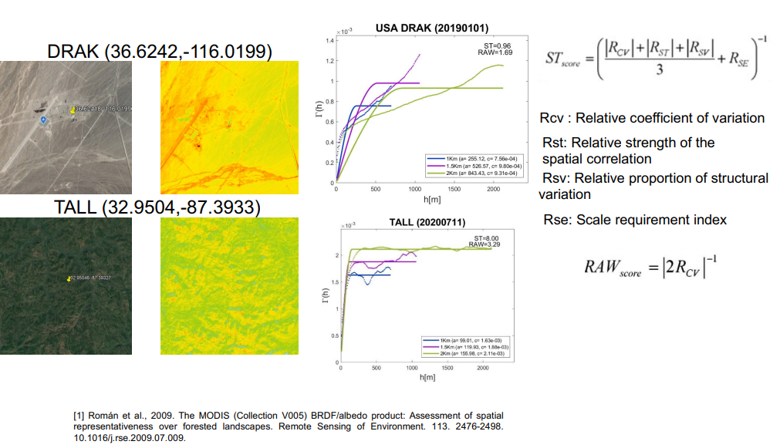
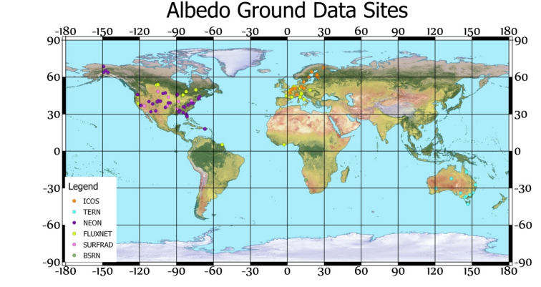
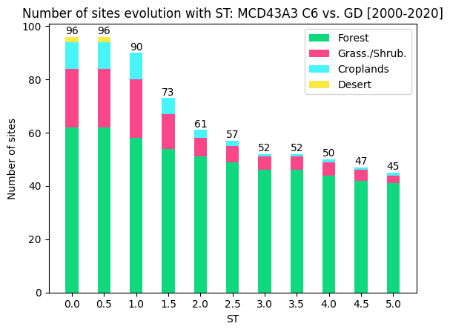
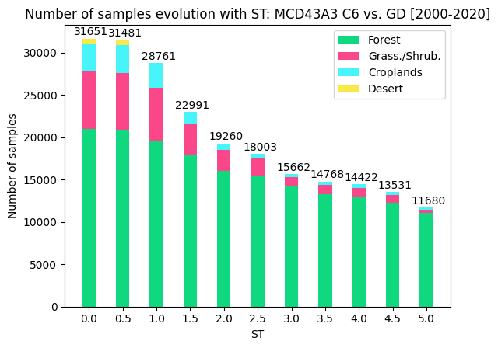
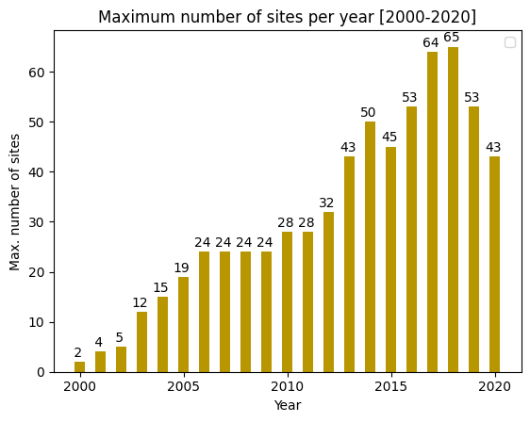
LPV Action Plan (2019-2022) Wrap Up
Validation and Intercomparison exercises
SALVAL online tool for validation of SA products
Direct Sites
99 sites analysed after visual screening
73 spatially representative sites > 22000 samples
Period: 2000-2020
ST score = 1.5 was found a good compromise for validation

Slide 9
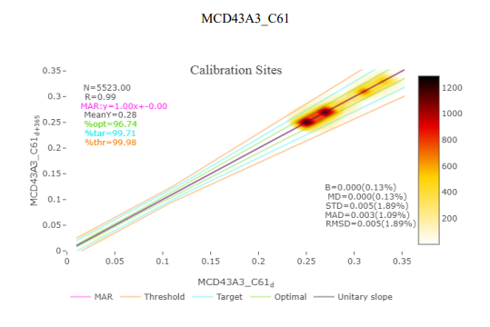
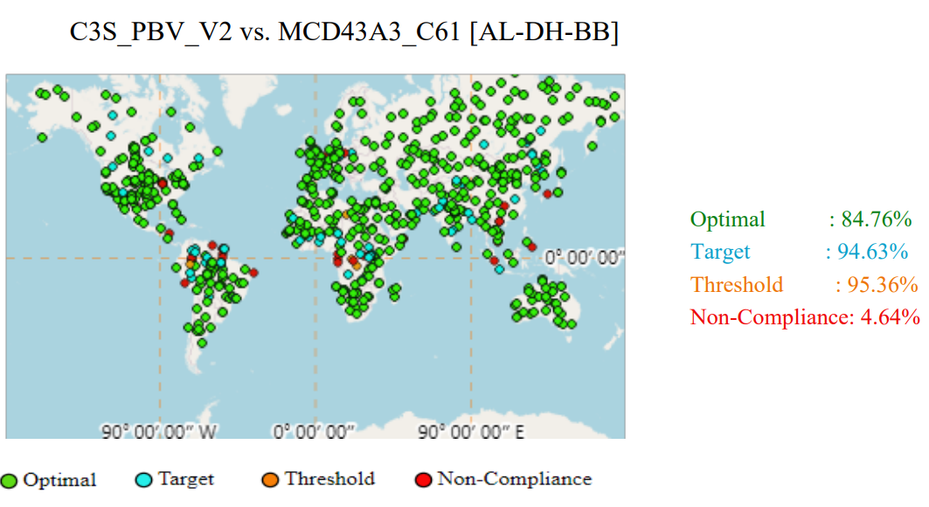
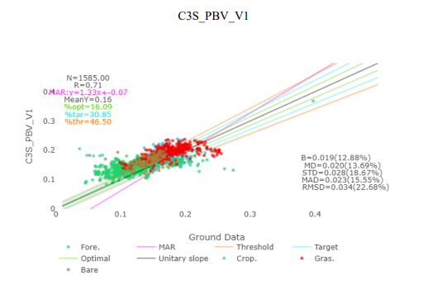
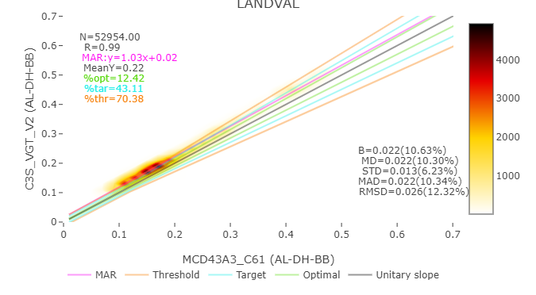
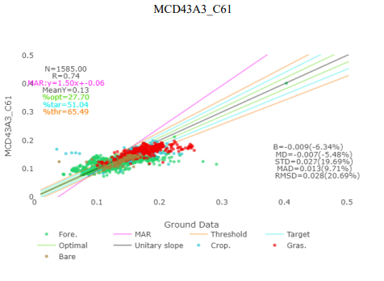
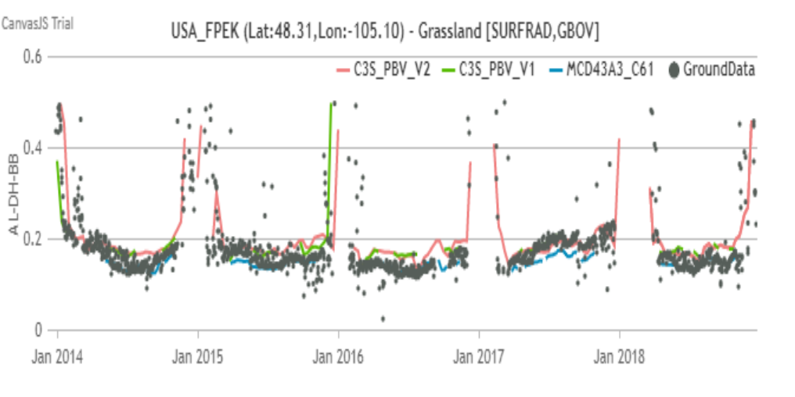
LPV Action Plan (2019-2022) Wrap Up
Validation and Intercomparison exercises
SALVAL online tool for validation of SA products
Standardized Outputs

Slide 10
SRIX4Veg (CEOS CV-20-01)
Surface Reflectance Intercomparison for Vegetation
Validation and Intercomparison exercises
On-going
Confirmed participants to the round robin in July 2022 (Barrax- Spain)
1ST Workshop 28th March 2022
NERC Field Spectroscopy Facility (FSF)
Luxembourg Institute of Science and Technolgoy
Rochester Inst. of Tech.
Wageningen University and Research
JB Hyperspectral Devices GmbH
GEO-K s.r.l.
Geoscience Australia
National Research Council of Canada
University of Milano Bicocca

Slide 11
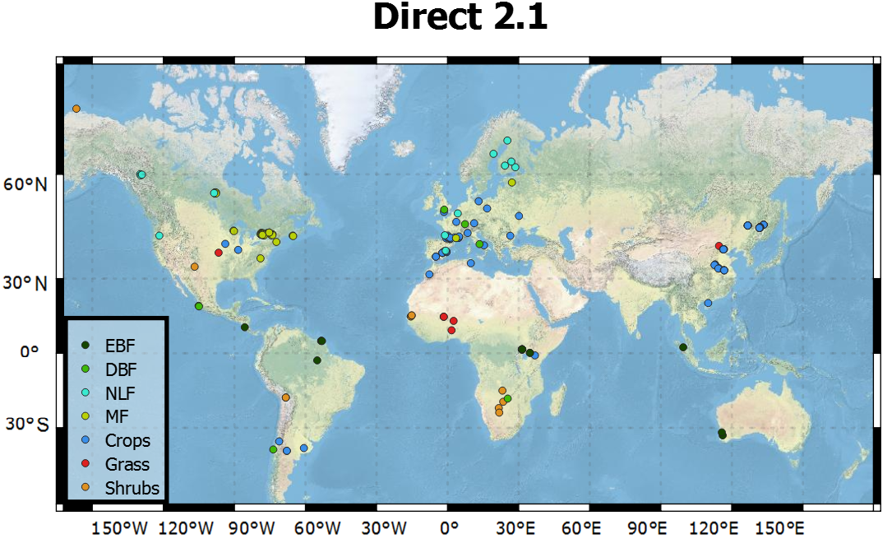
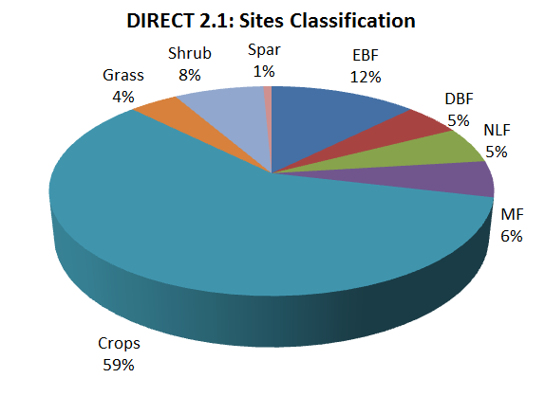
LPV DIRECT 2.1
LPV Action Plan (2019-2022) Wrap Up
Ground Reference Data
From 2000 to 2021
143 sites (7 main biome types)
286 LAI measurements
Database of LAI and FAPAR upscaled measurements (unique for the validation of CDR since 2000).
44 new sites multitemporal sampling in China ( valLAI_crop database, Chinese Academy of Science)
+ 2 ESA FRM4Veg sites (with uncertainties)
Propose to be hosted in CEOS WGCV portal -> Cal/Val Data

Slide 12
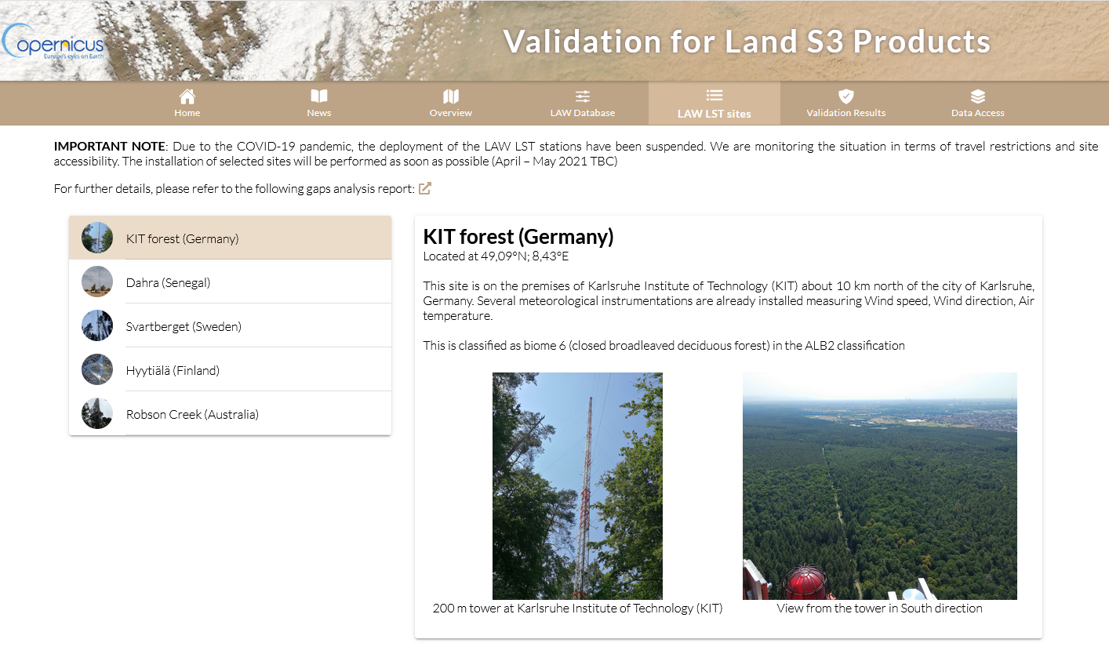
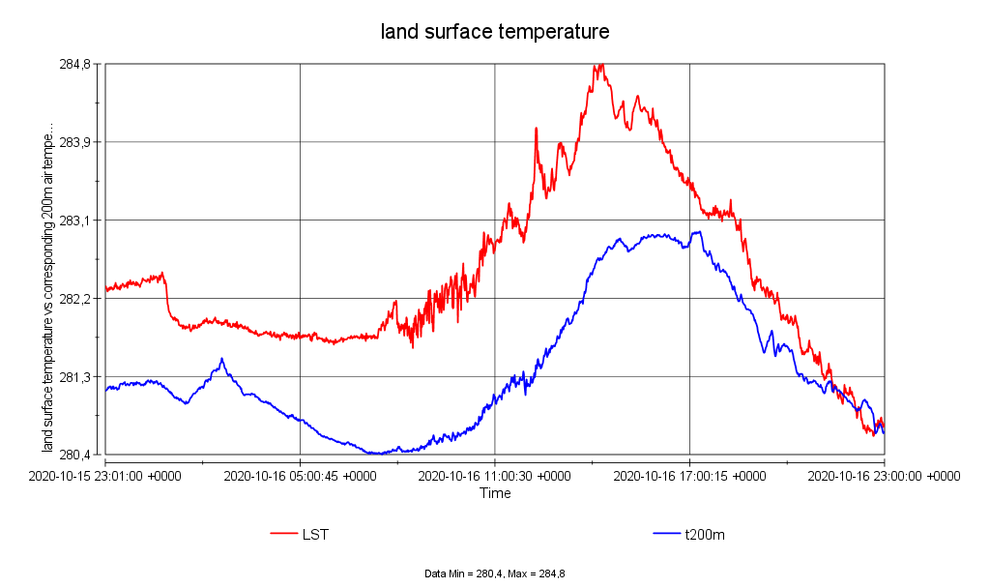
LPV Action Plan (2019-2022) Wrap Up
Ground Reference Data
Raw data logger files (csv) converted to netCDF (ESA GlobTemperature)
LPV Supersites
FRM LST measurements

Slide 13
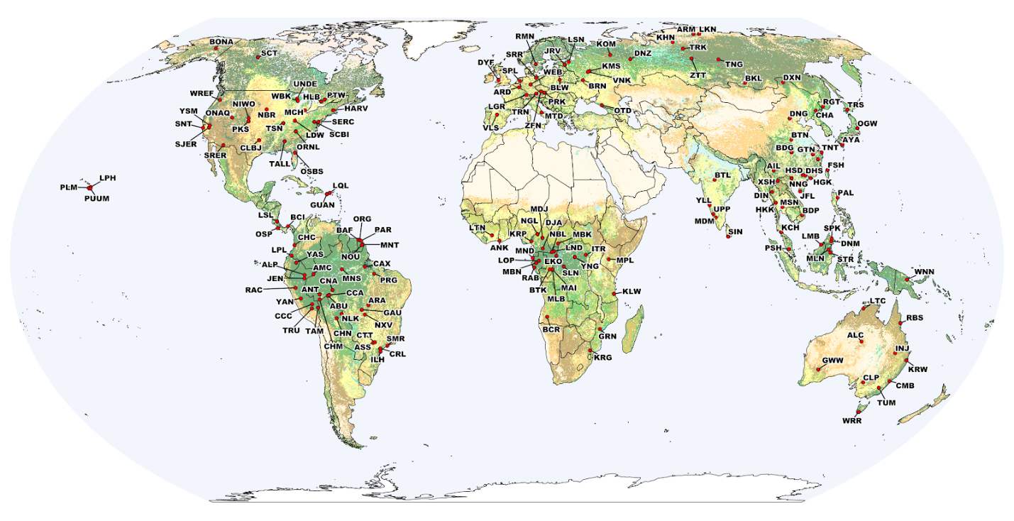
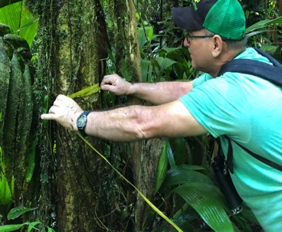
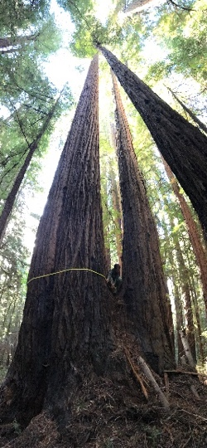
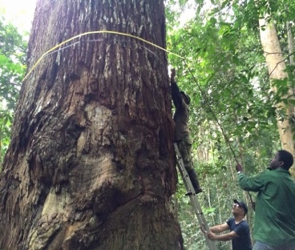
Forest Biomass Reference System for Tree-by-Tree Inventory Data (GEO-TREES). Supporting coordinated collection of new high-quality reference measurements for validation of biomass products.
LPV Action Plan (2019-2022) Wrap Up
GEO-TREES (CARB-21-03)
Ground Reference Data
On-going
WGCV LPV LSI-VC Forests
CEOS GFOI Lead
SIT Chair
We encourage CEOS agencies to coordinate on data collection for biomass validation following recommendations from the biomass protocol (open high-quality field, TLS, and airborne lidar).

Slide 14
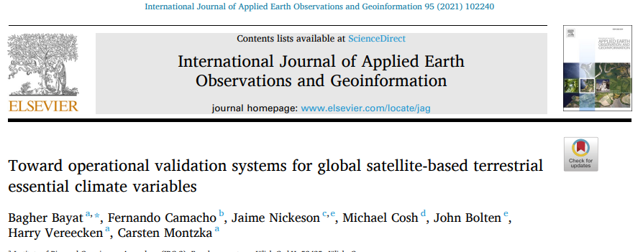
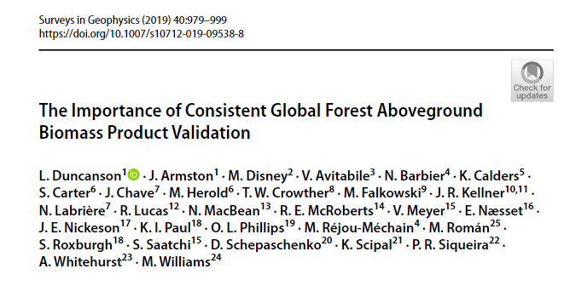
LPV Action Plan (2019-2022) Wrap Up
Communication
Others

Slide 15
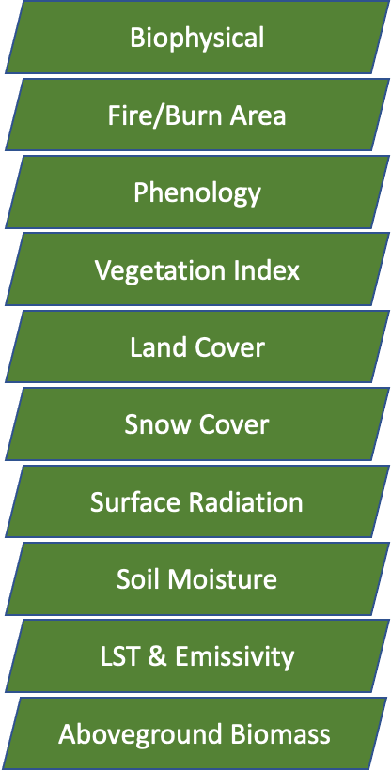
Biophysical (1/2)
•Beginning planning for Protocol update (discussed through telecons)
•Validation of the CGLS Sentinel-3, EUMETSAT EPS, NASA/NOAA VIIRS LAI and FAPAR products at GBOV-NEON sites is ongoing
•Updated CEOS DIRECT 2.1 database (new sites from Asia & FRM4VEG)
•Field campaigns
–FRM4VEG (LAI, FAPAR, CCC) in cropland (Barrax, Sp) and forest (Wytham Woods, UK), July 2021
–P2S2 for the validation of S2 LAI/fAPAR (France & Belgium)
–Vertical LAI measurement (DNF, 42.41°N, 117.31 ° E, China), Apr, Jun, & Sep, 2021

Slide 16
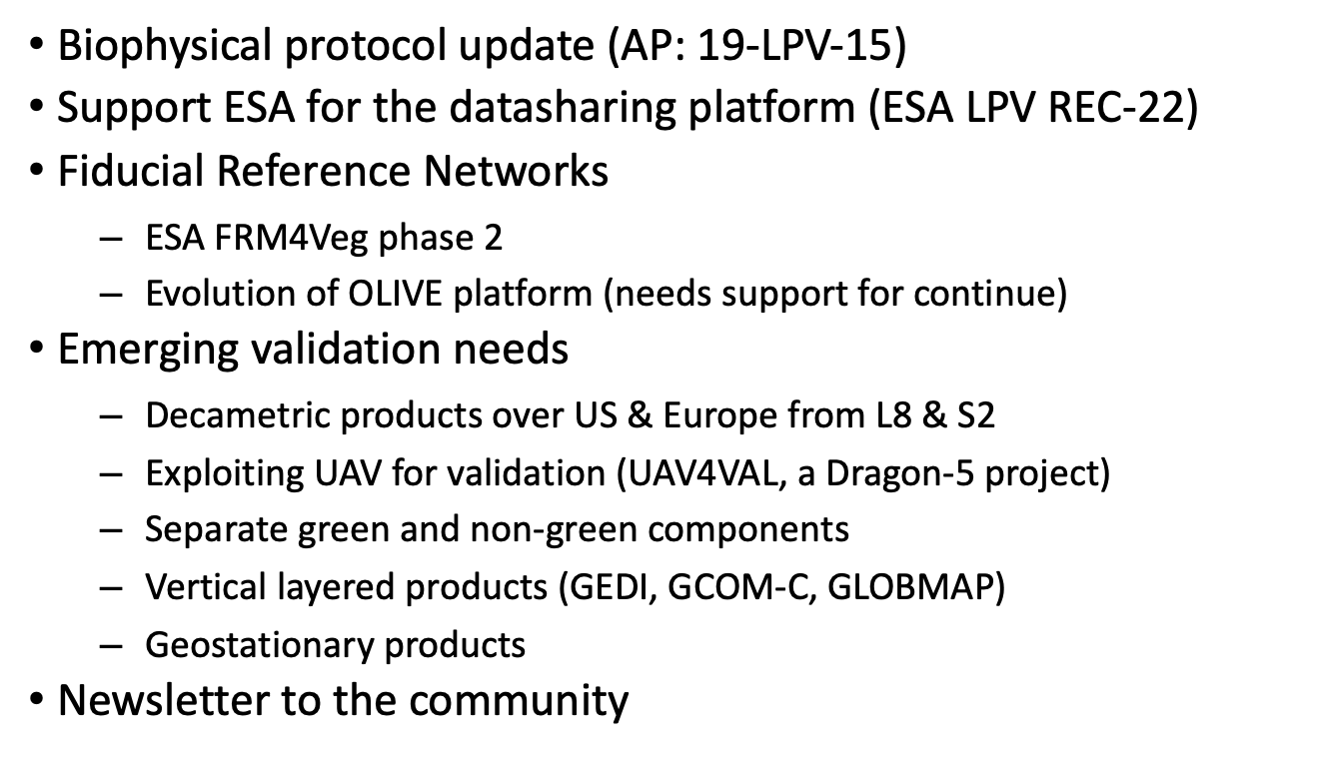
Biophysical (2/2)

Slide 17
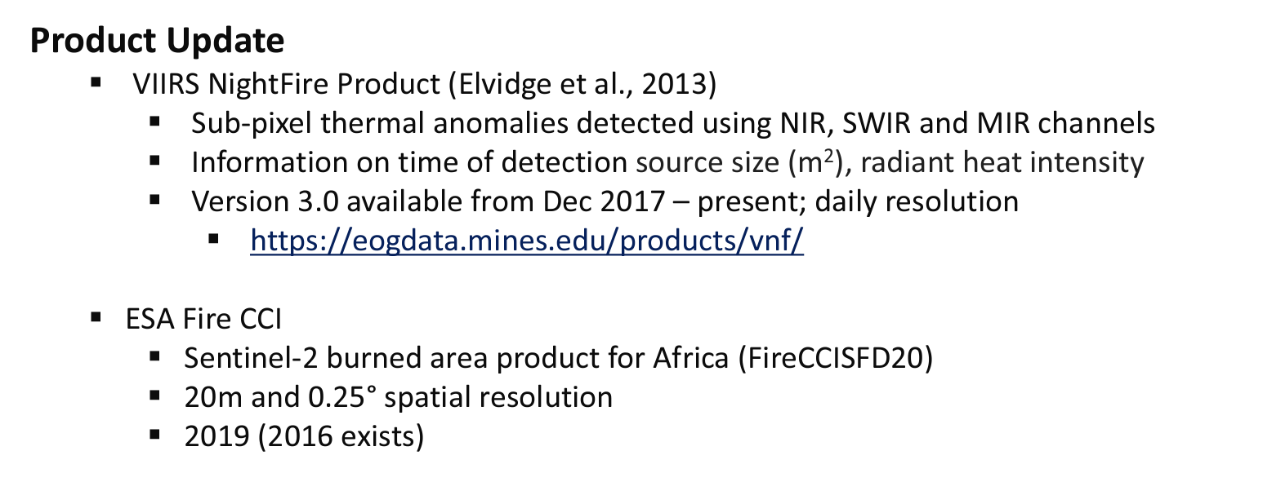
Fire / Burn Area

Slide 18
Phenology
Accomplishments
•Website updated with operational products and recent relevant literature
•Protocol document outlined, contributors and chapter organizers contacted
•Considerable scientific progress/findings reported out in the literature (e.g. your recent review paper, our flux paper, etc.)
•Caparros-Santiago, J.A. & Rodriguez-Galiano, V. Estimating LSP from MODIS: a sensitivity analysis to the choice of the vegetation index, smoothing and extraction techniques
Goals for Coming Year
•Final protocol developed and released
•Newsletter
•Community meeting (previous goal but not possible during pandemic)
•Journal Special issue
•Workshops and special sessions in conferences
•New Developments and Applications of Land Surface Phenology (LSP) (A3.2). 44th COSPAR Scientific Assembly 2022

Slide 19
Vegetation Index

Slide 20
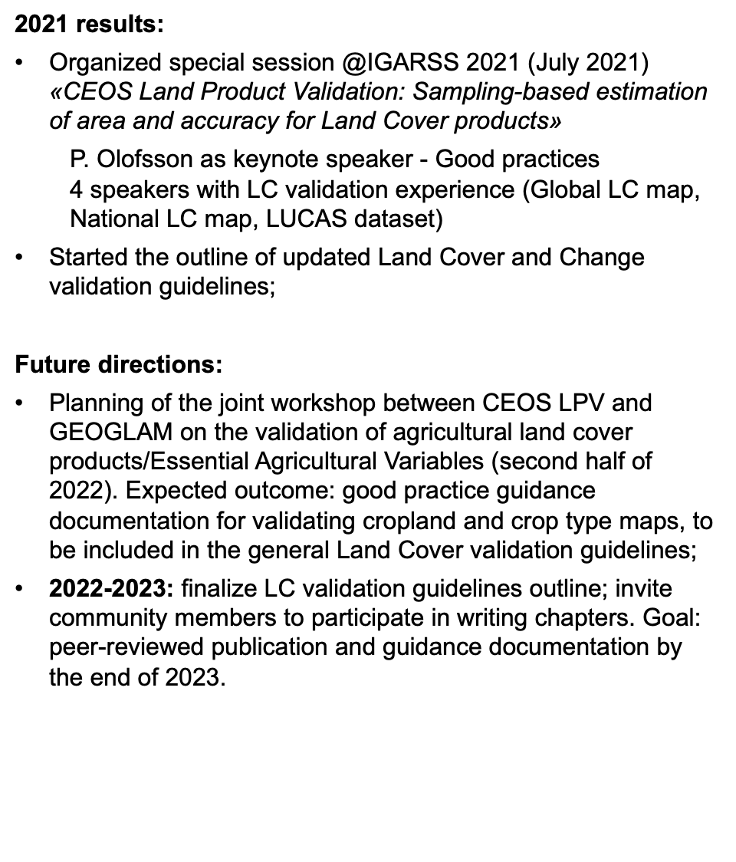
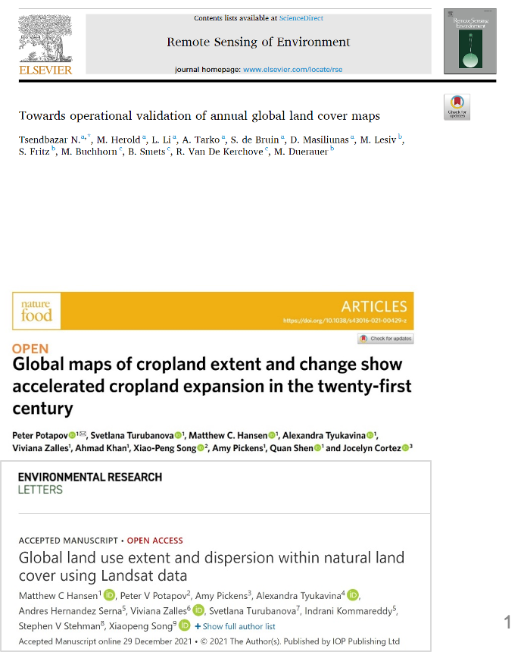
Land Cover

Slide 21
Snow Cover

Slide 22
Surface Radiation

Slide 23
Soil Moisture
Achievements:
Good Practices Document published: Montzka, C., M. Cosh, B. Bayat, A. Al Bitar, A. Berg, R. Bindlish, H. R. Bogena, J. D. Bolten, F. Cabot, T. Caldwell, S. Chan, A. Colliander, W. Crow, N. Das, G. De Lannoy, W. Dorigo, S. R. Evett, A. Gruber, S. Hahn, T. Jagdhuber, S. Jones, Y. Kerr, S. Kim, C. Koyama, M. Kurum, E. Lopez-Baeza, F. Mattia, K. McColl, S. Mecklenburg, B. Mohanty, P. O´Neill, D. Or, T. Pellarin, G. P. Petropoulos, M. Piles, R. H. Reichle, N. Rodriguez-Fernandez, C. Rüdiger, T. Scanlon, R. C. Schwartz, D. Spengler, P. Srivastava, S. Suman, R. van der Schalie, W. Wagner, U. Wegmüller, J.-P. Wigneron, F. Camacho, and J. Nickeson (2020): Soil Moisture Product Validation Good Practices Protocol Version 1.0. In: C. Montzka, M. Cosh, J. Nickeson, and F. Camacho (Eds.): Good Practices for Satellite Derived Land Product Validation (p. 123), Land Product Validation Subgroup (WGCV/CEOS), DOI:10.5067/doc/ceoswgcv/lpv/sm.001
QA4SM Online validation tool published by TU Vienna, https://qa4sm.eu
Goals:
Expand listserve and update LPV website product list and validation datasets
Support the soon established International Soil Moisture School (ISMS) to teach also validation good practices
Establish/improve cooperation with International Soil Moisture Monitoring Network (ISMN), now hosted by German Federal Institute of Hydrology (BfG)

Slide 24
LST & Emissivity

Slide 25
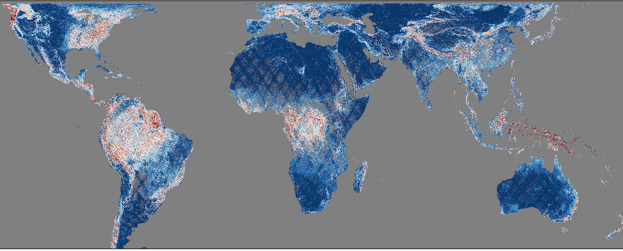
Aboveground Biomass
Products will be assessed following the WGCV LPV biomass protocol using available reference data in pilot USGS SilvaCarbon countries
Uncertainties are calculated differently between products and are scale-dependent. Harmonizing uncertainties will be challenging.
CCI Biomass
2017
Standard
Deviation (%)
0 20 40 60 80 100
JPL 2015
Uncertainty
Mg/ha
0 20 40 60 80 100
GEDI 2020
Standard Error
Mg/ha
GEDI Biomass
2020
The first goal is to have a pilot harmonization framework (and product) by COP-26 (Nov 2021)

