Slide 1
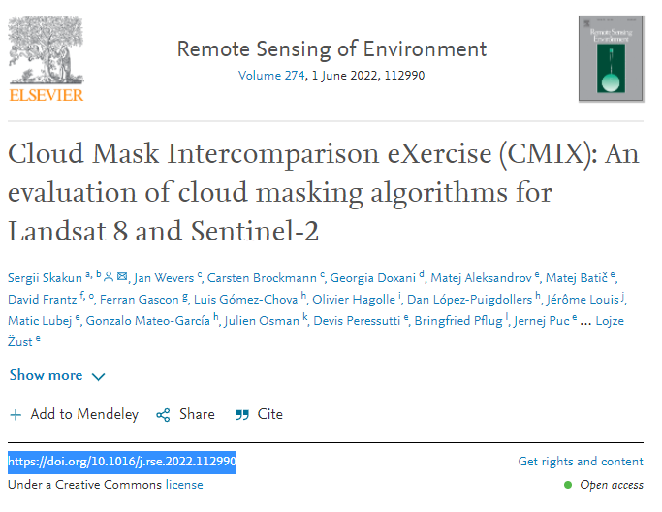
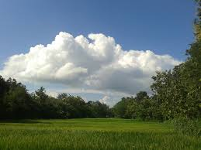
CMIX: status
CMIX
>> CMIX - Scientific publication
A research paper has been published in Remote Sensing of Environment link
Cloud Mask Intercomparison eXercise (CMIX): An evaluation of cloud masking algorithms for Landsat 8 and Sentinel-2 – ScienceDirect
https://doi.org/10.1016/j.rse.2022.112990t
>> CMIX page in CEOS Cal/Val portal
Information, participants [10 processors], validation datasets and report in https://calvalportal.ceos.org/cmix
CMIX: main conclusions
All 5 validation datasets (VD) have different strengths and weaknesses -> results vary depending on the validation dataset
  Subjectivity of detecting/photo-interpreting clouds, especially thin clouds, in VD should be minimized, e.g. use of a network of sky images
No clear superiority of any methodology (Spectral tests vs. AI, mono vs. multitemporal)
Buffer and its size have a strong influence on the validation results --> Bigger buffer = better results
Thin semi-transparent clouds and cloud boundaries are an issue for mostly all algorithms. -> How to define a transparent cloud? boundary of a cloud?
The validation dataset and methods do not allow for detecting systematic errors
Notes:
.

Slide 2
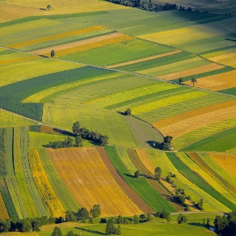
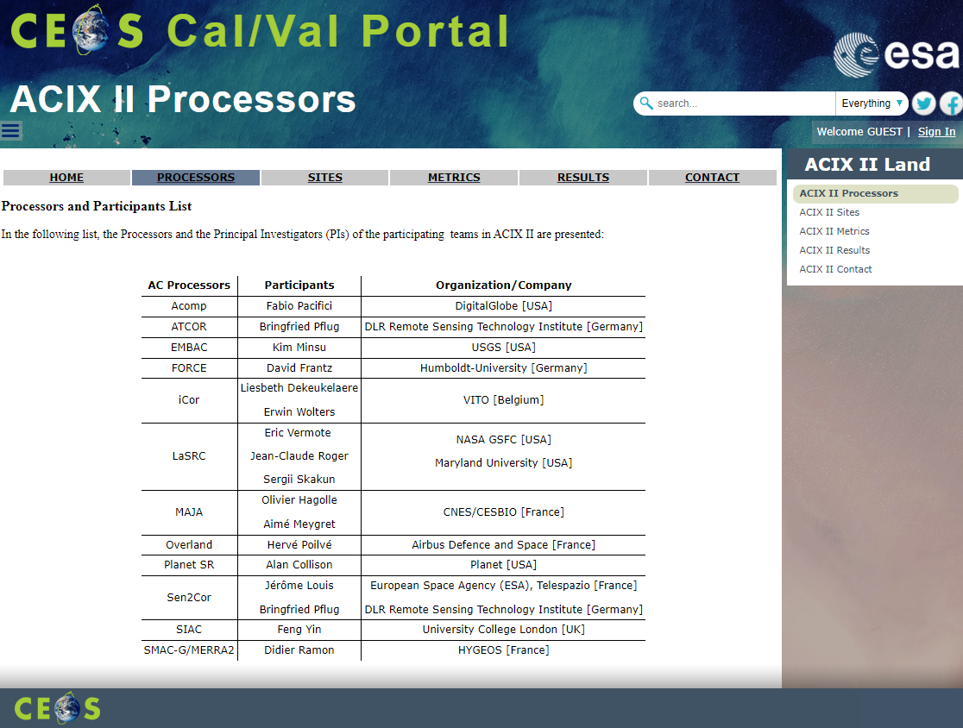
ACIX-II Land: status
ACIX-Land
>> ACIX-II Land - Report (Scientific publication)
The draft manuscript is being prepared together with the participants
>> ACIX-II Land page in CEOS Cal/Val portal
Information, participants [12 processors] and results in https://calvalportal.ceos.org/acix-ii-land
ACIX-II Land: main conclusions
AOD retrievals: mostly in moderate agreement with the AERONET reference values,
∼ 0.65 < R² < 0.775 and ∼ 0.115 < RMSE < 0.2
WV retrievals: strong correlations with the AERONET data, ﻿ R² > 0.9 and RMSE <0.25
SR retrievals: No clear superiority
-
Similar results for most processors in the SR comparison with RadCalNet measurements [La Crau, Gobabeb]
-
Simulation reference using 6SV and AERONET : Variation in the results amongst processors, but overall the results are improving from VNIR to SWIR
-
More in situ SR measurements are needed, i.e., CESBIO agricultural site, HyperNet, etc.
Notes:
.

Slide 3
ACIX-III Land, Aqua and CMIX-II: status
>> 20-21 June, ESA/ESRIN (Frascati, Italy)
Information and registration:
https://earth.esa.int/eogateway/events/1st-workshop-of-acix-iii-land-aqua-and-cmix-ii
Participation To ACIXs And CMIX Is Open To All The Developers Who:
1.
are the original developers of the atmospheric correction and/or cloud-masking processor to be inter-compared,
2.
are authorized by the original developer to run the AC/CM processor on their behalf,
3.
agree on submitting the AC/CM processing results within the required constraints (deadline, format, etc.).
Notes:
.

Slide 4

With the support of:
ACIX-III
CMIX-II
Atmospheric Correction
Inter-comparison
Cloud Masking
Inter-comparison
Processors over
LAND sites
Processors over
AQUATIC sites
Sentinel-2, Landsat-8 & PRISMA*
Sentinel-2, Landsat-8 & PRISMA*
PRISMA*
*PRISMA ad-hoc acquisitions over the selected set of sites for each of the exercises will be provided by ASI
Notes:
.

Slide 5

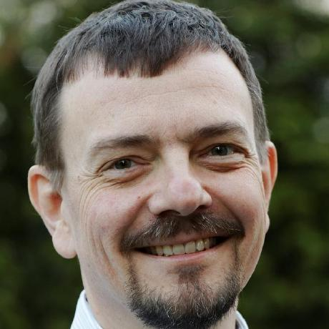

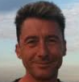
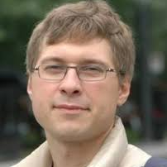
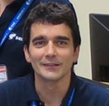
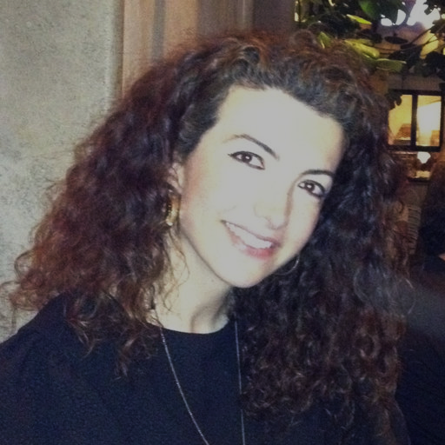
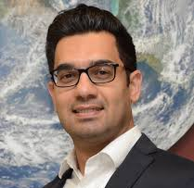
With the support of:
ACIX III
CMIX II
Atmospheric Correction
Inter-comparison
Cloud Masking
Inter-comparison
Task Coordinators
Processors over
LAND sites
Task Coordinators
Processors over
AQUATIC sites
Task Coordinators
Carsten
Brockmann
Jan Wevers
Eric Vermote
Sergii Skakun
Ferran Gascon
Georgia Doxani
Phil Townsend
Claudia Giardino
Nima Pahlevan
5
Notes:
.

