Slide 1
Radiometric calibration network for vicarious calibration of Earth observing imagers in the reflected solar
K. Thome
NASA/GSFC

Slide 2
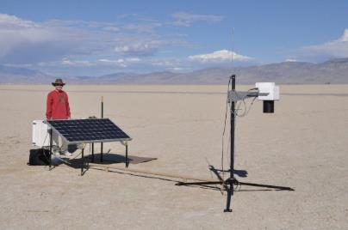
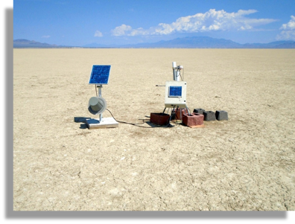
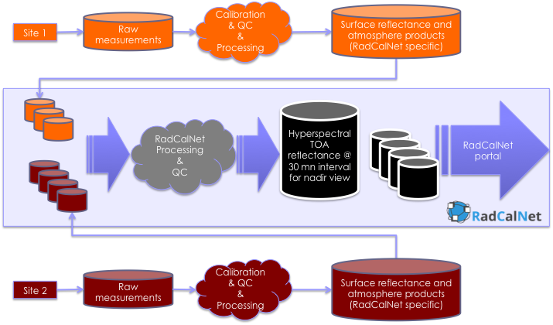
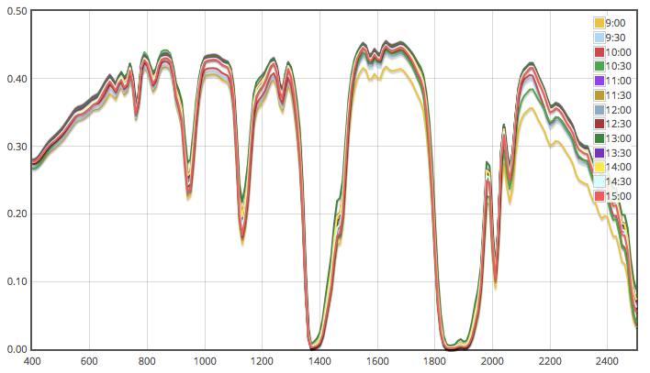
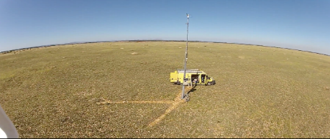
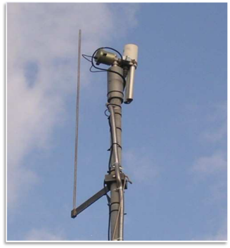
RadCalNet architecture overview
Architecture developed has three main parts
1) Test sites provide data to RadCalNet
2) Centralized processing of data
3) Distribution of top-of-atmosphere reflectance
RadCalNet - Radiometric Calibration Network

Slide 3
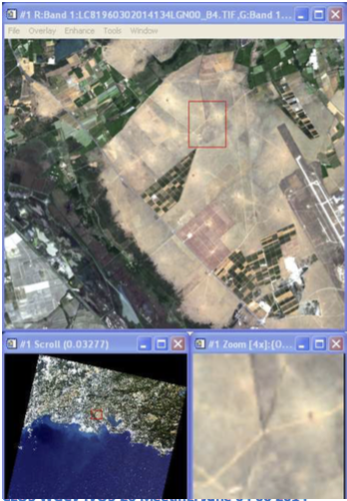
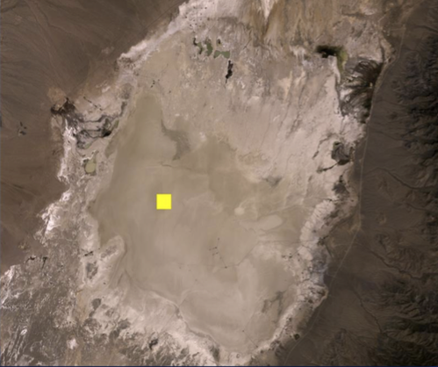
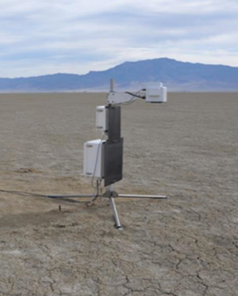
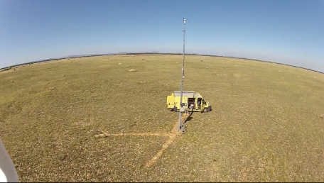
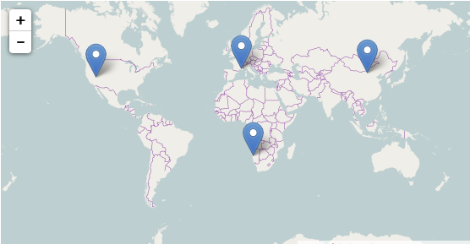
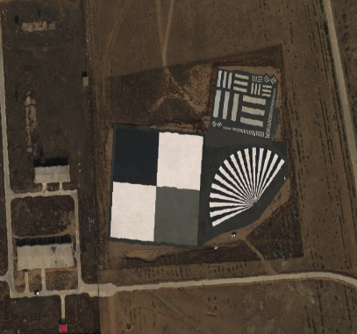
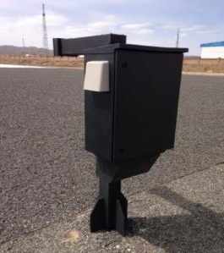
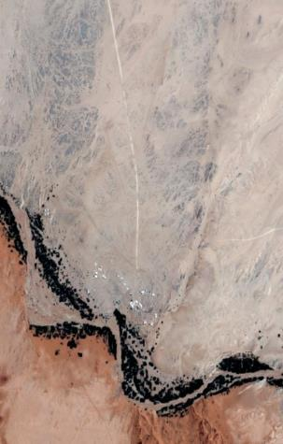
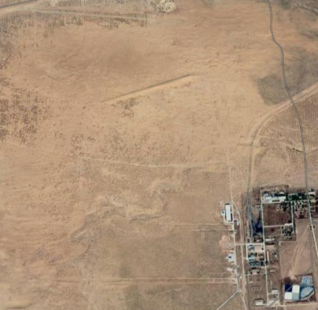
RadCalNet – New Candidate sites
Current RadCalNet Sites
La Crau, France
CIMEL photometer (12 bands)
Pebbles and low vegetation
Site used since 1987 for calibration and instrumented since 1997
Railroad Valley Playa, USA
>20 years working experience on site
6 radiometers, sun photometer, met station
Dry lakebed
Gobabeb, Namibia
Sun photometer similar to La Crau) and met station
Sparse dry grass and gravel/sand
Operational since 2017
Baotou, China (two sitest)
Three automated spectrometers + sun photometer
Artificial target (white, black, and gray)
Operational since 2015
Sandy desert site added in 2017
Baotou, China

Slide 4
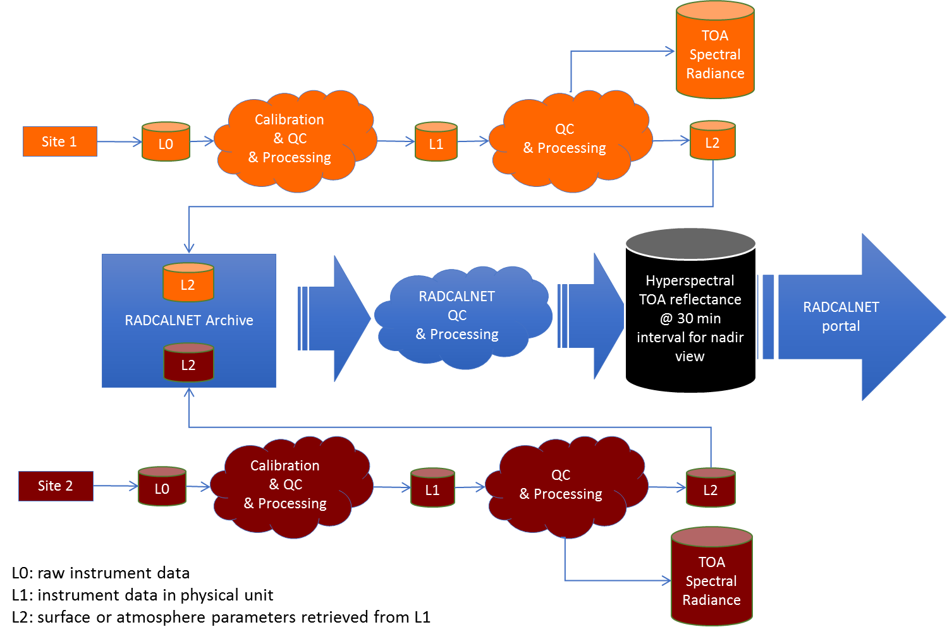
Test sites provide pre-processed input data to RadCalNet
RadCalNet does not standardize collection and processing schemes of sites
Site-specific output
Standardized output
Standardized input from RadCalNet sites
Standardized RadCalNet processing stream
Sites have developed additional RadCalNet dedicated processing
Sites perform QA on their data
Site-specific output

Slide 5
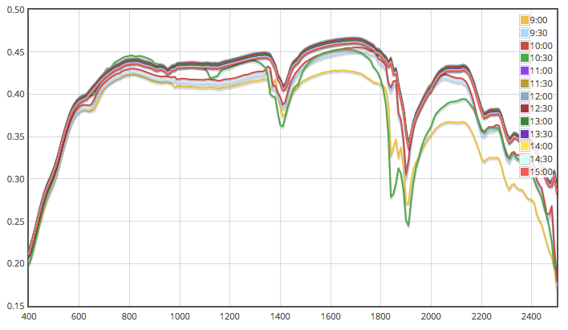
Predict nadir-viewing top-of-atmosphere reflectance and uncertainties
RadCalNet Inputs
RadCalNet Outputs
Calibration
& QC
& Processing
QC
& Processing
L1
L2
TOA Reflectance with Uncertainties
30 minute intervals
9 am to 3 pm local standard time
Nadir view
10 nm intervals from 400 nm to 1000 nm
Calibration
& QC
& Processing
QC
& Processing
L1
L2
Surface Reflectance
30 minute intervals
9 am to 3 pm local standard time
Nadir view
10 nm intervals from 400 nm to 1000 nm
Atmospheric Data
Pressure
Temperature
Aerosol
Water Vapor
Ozone
Uncertainty
Hyperspectral TOA reflectance @ 30 min interval for nadir view
RADCALNET portal
RADCALNET
QC
& Processing

Slide 6
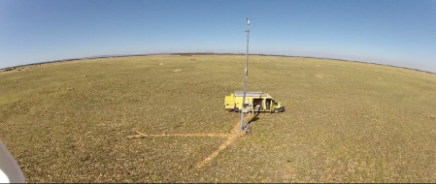
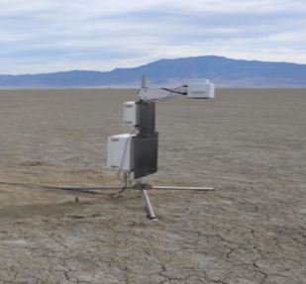
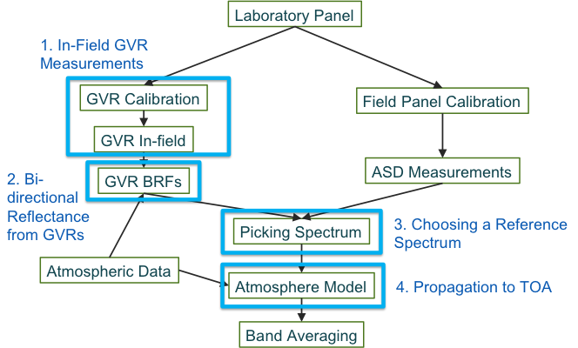
Teams work to evaluate SI-traceability and error budgets
Relying on process outlined in NPL Uncertainty Analysis for Earth Observation course (www.meteoc.org/training.html)
Sites have responsibility for their own quality assurance and providing uncertainties for inputs
Uncertainty budgets include:
Instrumentation effects
Data sources
Spatial homogeneity of site
Radiative transfer code
Sampling
Processing assumptions
Analysis performed using a combination of literature, laboratory results, Monte Carlo analysis, image analyses

Slide 7
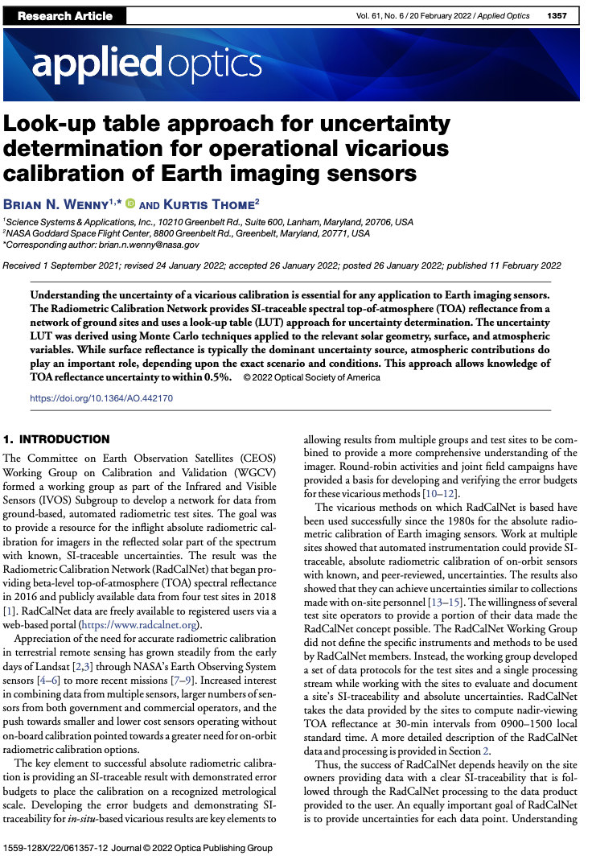
Per data point uncertainties
Monte Carlo results based on input uncertainties to radiative transfer code modeling of predicted top-of-atmosphere radiance
High aerosol loading with large sized aerosols for small solar zenith angle and six surface reflectance values
Applied Optics
Vol. 61, Issue 6, pp. 1357-1368 (2022)
https://doi.org/10.1364/AO.442170

Slide 8
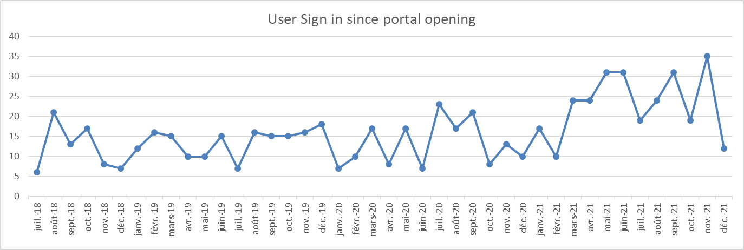
User statistics
Recent drop in number of users due to need for users to update their information

Slide 9
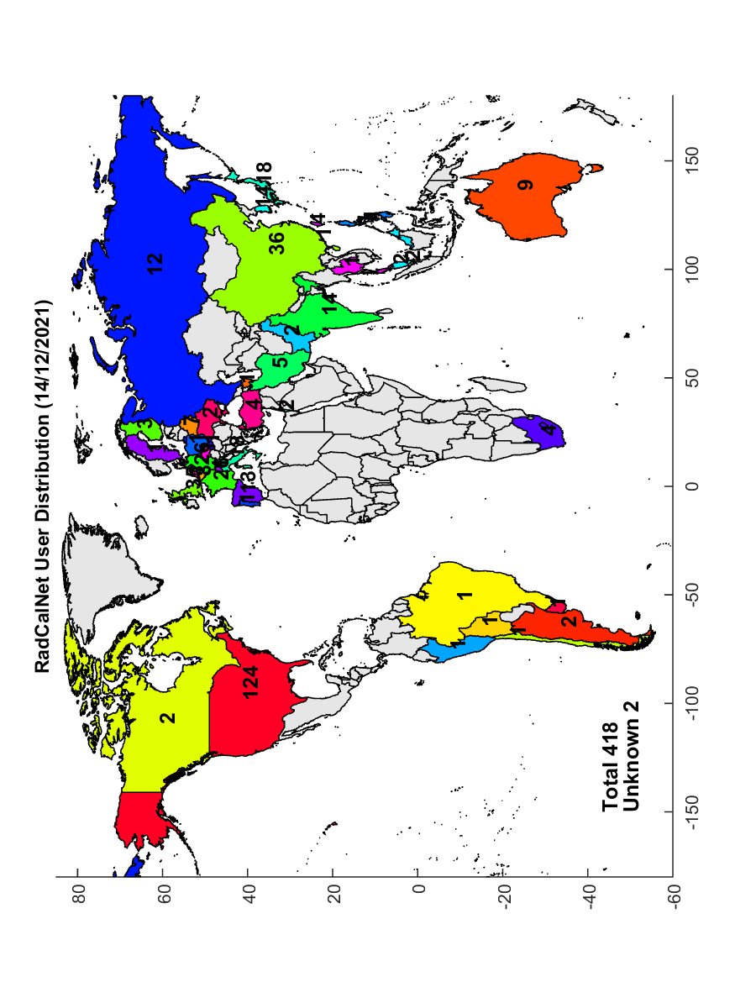
RadCalNet data has been openly available since Summer 2018
Currently 418 users with numbers continuing to increase
Global distribution

Slide 10
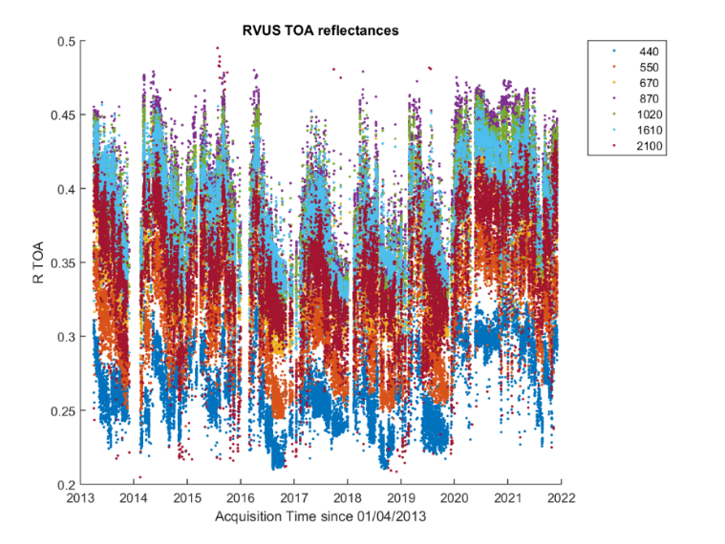
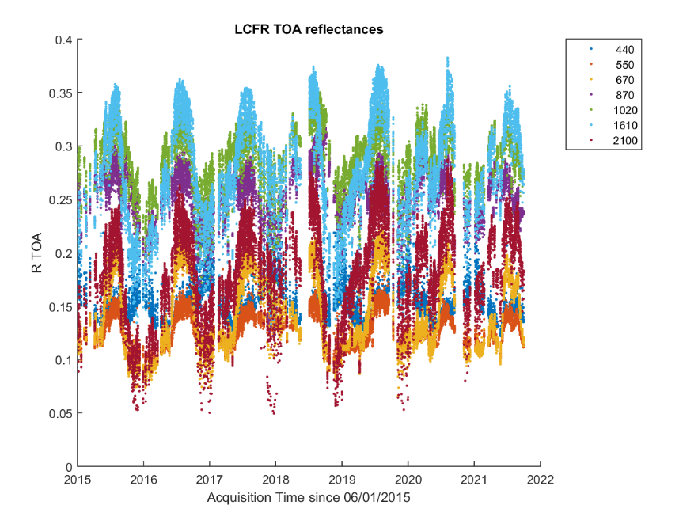
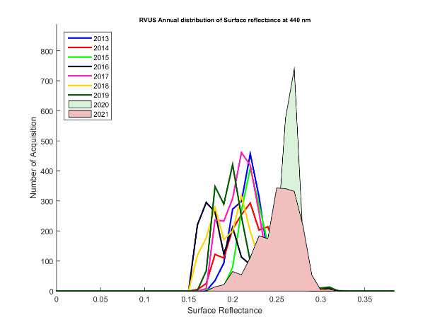
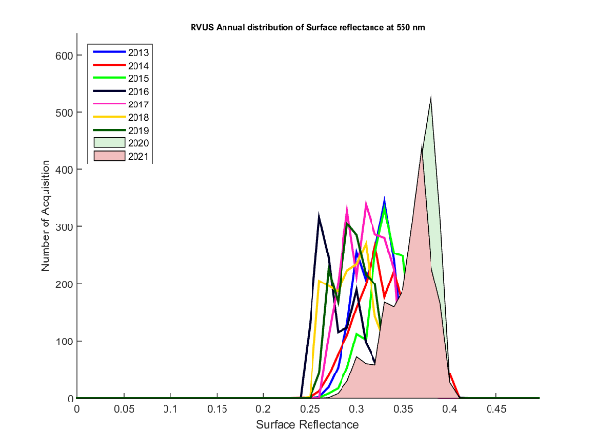
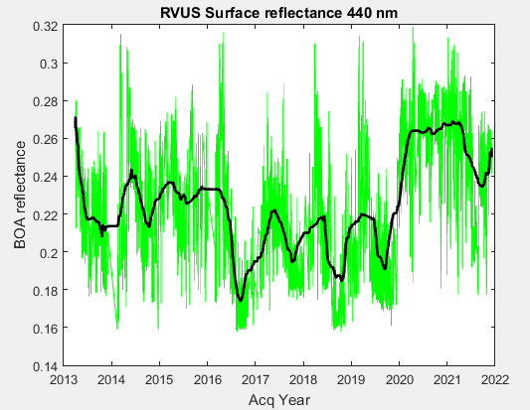
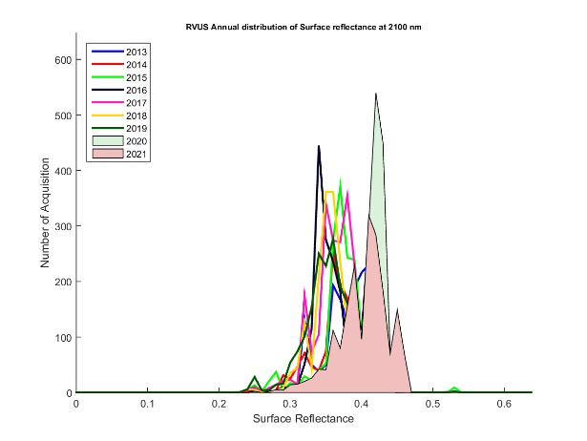
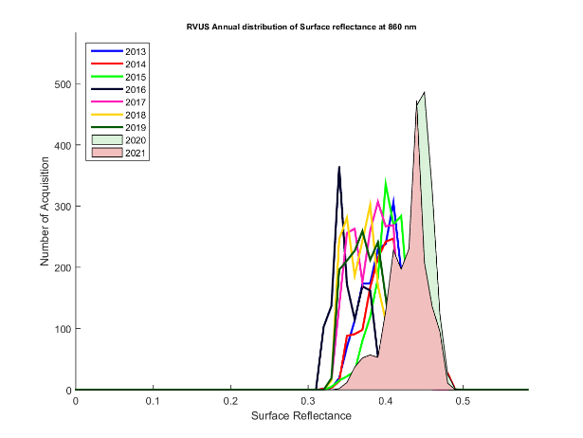
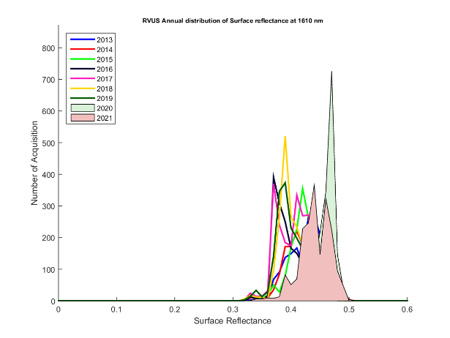
Data quality control
Temporal evolution of reflectances
RVUS site
LCFE site
Annual BOA reflectances histogram
440
550
2100
870
1600

Slide 11
Collection 2022 Preparation
Lessons learned from past three years led to decision to reprocess
Input files revised/updated at site owner’s discretion
BTCN, BSCN – instrument temperature correction applied ~2021-present
GONA, LCFR – new calibration applied ~2020-present
RVUS – now uses MODTRAN 6, reprocessed entire archive
Output files reprocessed to new version:
Radiative Transfer Code changed to MODTRAN 6.0.2r2
Atmospheric CO₂ amount no longer treated as constant
 | Input | Date Range | Output
BSCN | v00.03 v00.04 | 2017_177 – 2020_287 2020_290 – 2021_332 | v04.03 v04.04
BTCN | v00.03 v00.04 | 2016_096 – 2020_263 2021_097 – 2021_332 | v04.03 v04.04
GONA | v00.04 v00.06 | 2017_200 – 2020_064 2020_068 – 2022_056 | v04.04 v04.06
LCFR | v00.02 v00.04 | 2015_006 – 2019_260 2019_283 – 2021_300 | v04.02 v04.04
RVUS | v00.05 | 2013_091 – 2022_058 | v04.05

Slide 12
RadCalNet Data Re-Processing Status
Reprocessing to v04 output of entire data archive is complete and under review by the RadCalNet working group
RadCalNet Working Group meeting April 14 to evaluate progress of re-processing
Expected release to public in late April 2022
Current v04 processing totals (as of March 18, 2022)
Site | 2013 | 2014 | 2015 | 2016 | 2017 | 2018 | 2019 | 2020 | 2021 | 2022 | Total
RVUS | 193 | 237 | 225 | 222 | 264 | 246 | 246 | 263 | 250 | 48 | 2194
LCFR | - | - | 117 | 139 | 151 | 114 | 155 | 115 | 96 |  | 887
BTCN | - | - | - | 52 | 76 | 108 | 102 | 30 | 85 |  | 453
GONA | - | - | - | - | 136 | 160 | 286 | 215 | 222 | 20 | 1039
BSCN | - | - | - | - | 15 | 41 | 73 | 41 | 80 |  | 250

Slide 13
Documentation Updates
G5-RadCalNetGuidance-Peer-ReviewAndComparison_V2.pdf
Has been uploaded on the portal
https://www.radcalnet.org

Slide 14
Acceptance process for new sites
RadCalNet WG members contribute to the review
Process overseen by WGCV
Through an acceptance panel reporting to WGCV

Slide 15
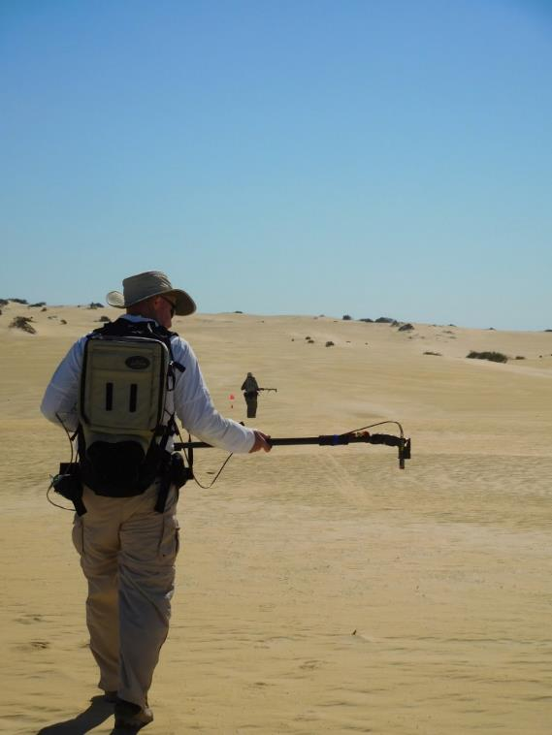
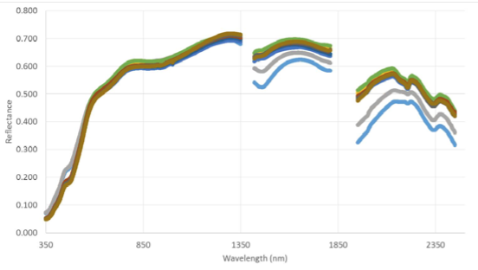
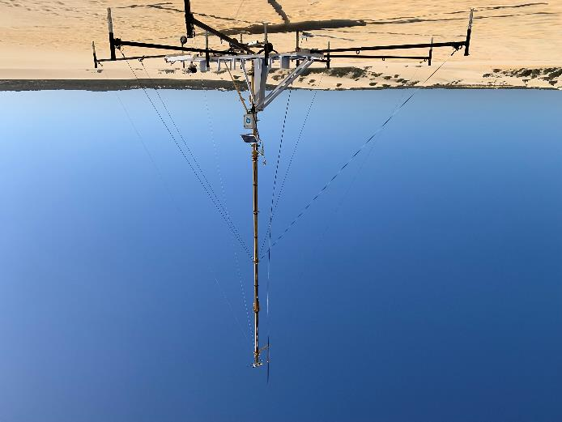
RadCalNet – New Candidate sites
Pinnacles, Australia (CSIRO)
Planned installation of sun photometer similar to La Crau) and met station
CSIRO team is in contact with NPL and CNES related to data processing and data quality assessment
Sand dunes in Nambung National Park, north of Perth, Australia
Baotou, China

Slide 16
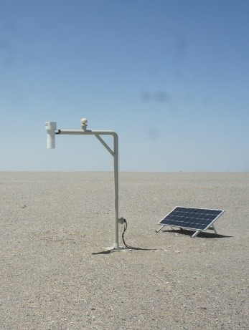
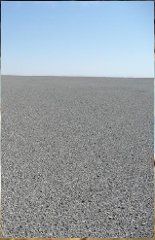
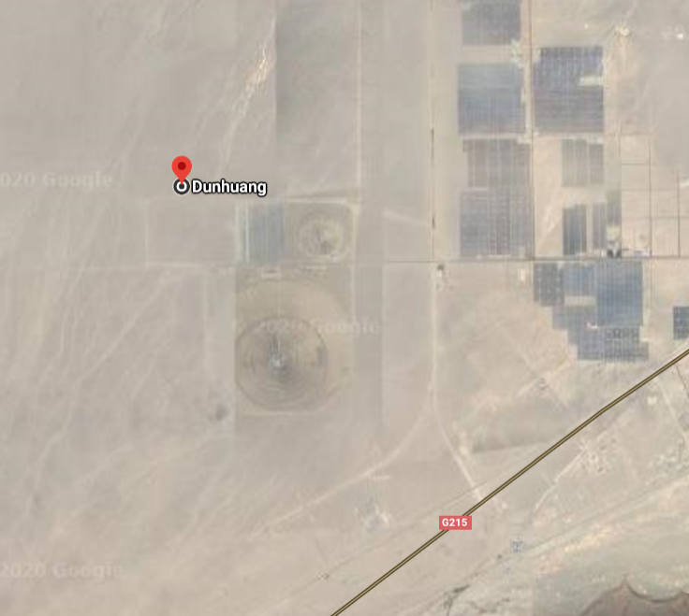
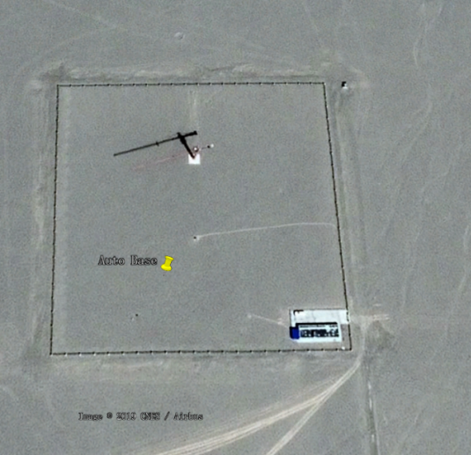
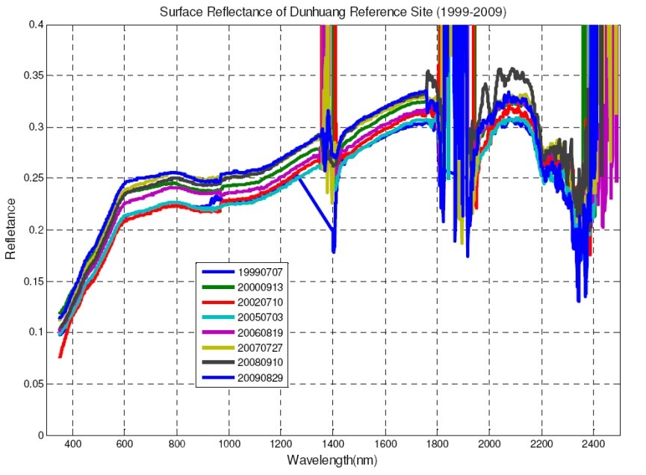
RadCalNet – New Candidate sites
Dunhuang, China (CMA)
Radiometers, sun photometer, met station
30x30 km area of Gobi Desert covered with sandy soil and gravel
Used for vicarious calibration since 2008
Baotou, China

Slide 17
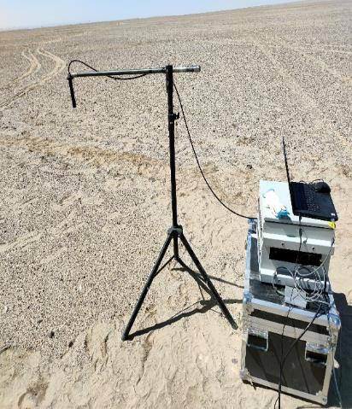
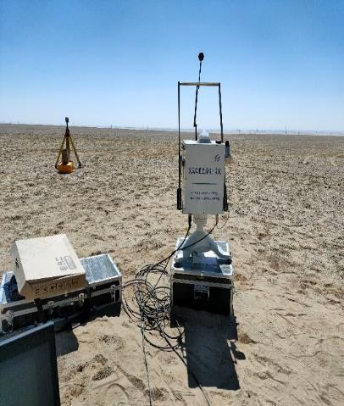
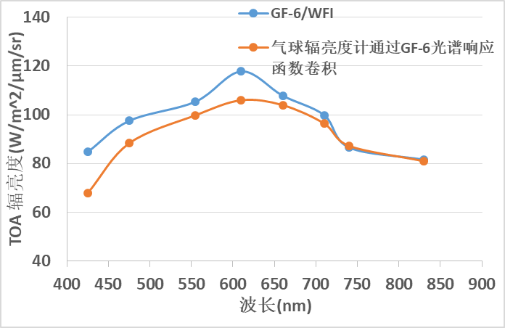
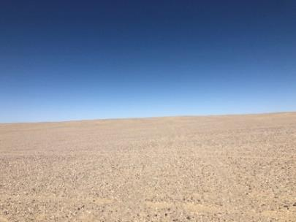
RadCalNet – New Candidate sites
Golmud, China (AIR/CAS)
Initial field campaigns completed. Automated instrumentation to be deployed.
5x5 km area of Gobi Desert covered with sandy soil and gravel
Radiance / W m-2 um-1 sr-1
Baotou, China
Wavelength / nm

Slide 18
Thank you to RadCalNet Team
Aime Meygret,
Patrice Henry,
Sebastien Marcq
Jeffrey Czapla-
Myers
Marc Bouvet (Chair), Philippe Goryl
Lingling Ma
Chuanrong Li
Baotou, China
Beatrice Berthelot
Nigel Fox, Emma Woolliams,
Agnieszka Bialek
Brian Wenny

