Slide 1
Working Group Calibration & Validation
TMSG & DEMIX progress
Peter Strobl, EC-JRC, WGCV
CEOS WGCV #50, Virtual Meeting
24 March 2022

Slide 2
TMSG status
Proceedings of the Terrain Mapping SubGroup (TMSG)
Re-activated early 2020
as of Feb 28th 2022:
62 subscriptions (+4)
14 countries
~50% with CEOS background
~30% Geomorphometry.org
~35 expressed interest in the intercomparison exercise DEMIX
plenary envisaged for Q3 2021 postponed (waiting for DEMIX results) on the agenda now for Q2 2022
Subscription page: https://ec.europa.eu/eusurvey/runner/WGCV-TMSG_membership

Slide 3
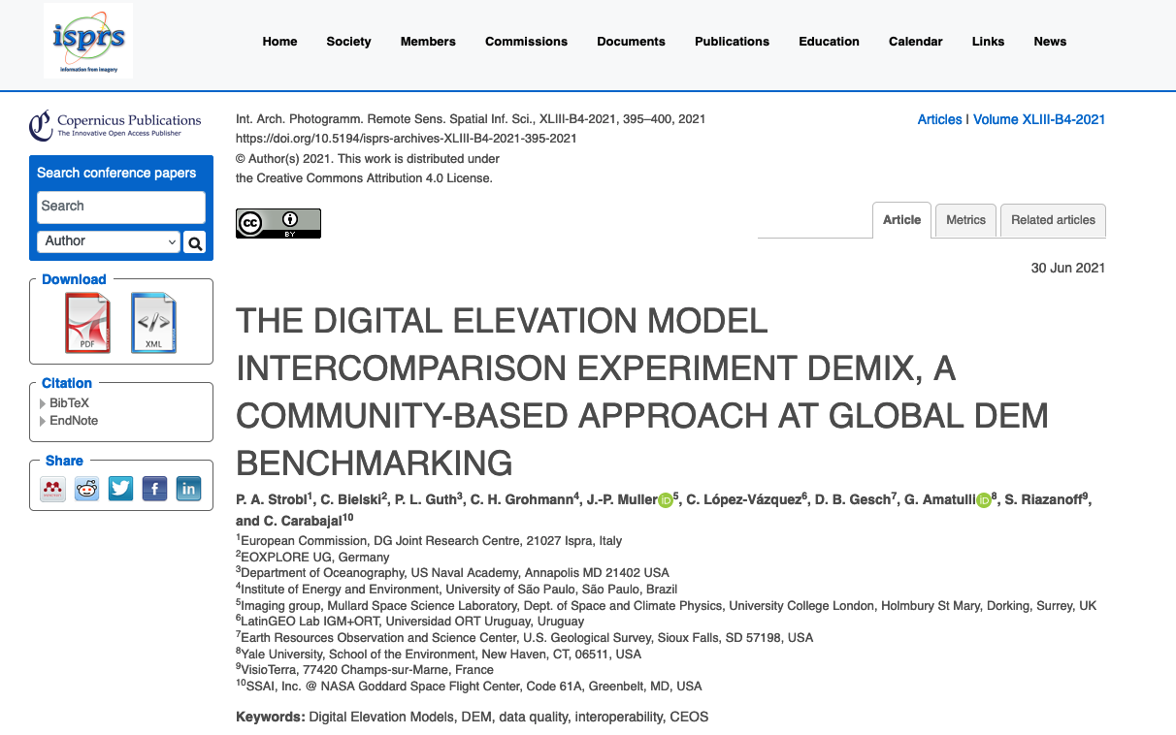
Digital Elevation Inter-Comparison (DEMIX)
Status:
DEMIX call for participation issued 5 May 2020
Kick-off meeting held with 26 participants on 26&30 June 2020
~25 participants active (CAS, DLR, EC, ESA, ISRO, JAXA, NASA, USGS) + domain experts & industry
Progress:
Sub-groups currently active:
terminology and analytical basis
algorithms and software – open source tool box
platforms and processing
TEAMS channel (thanks USGS!)
biweekly meetings of subgroups 2&3 on Teams
document sharing and via Teams cloud
ISPRS2021 conference paper and 10 minute introductory video

Slide 4
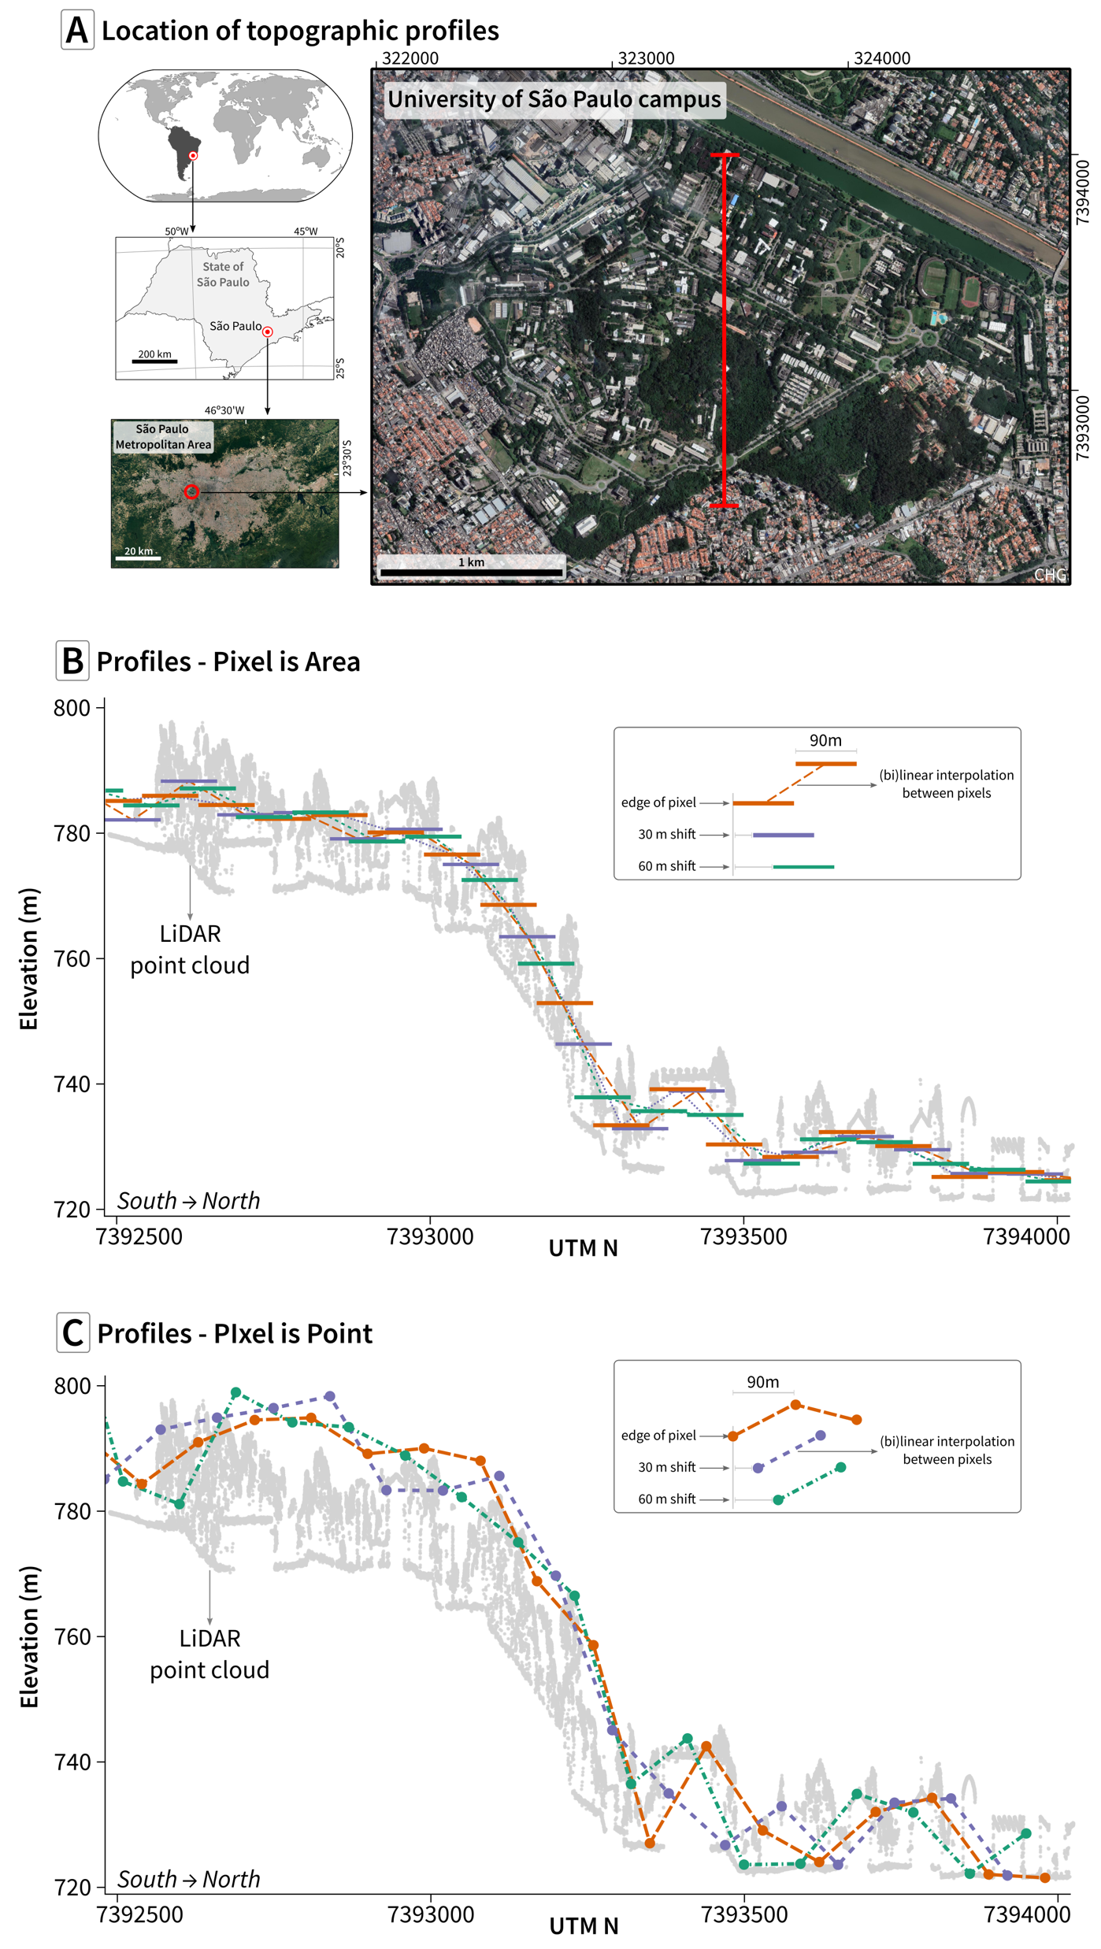
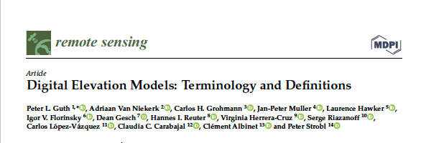
Subgroup 1
Progress:
Revised terminology and comprehensive definitions (glossary) finished
Peer reviewed paper published: Guth et. al. 2021

Slide 5
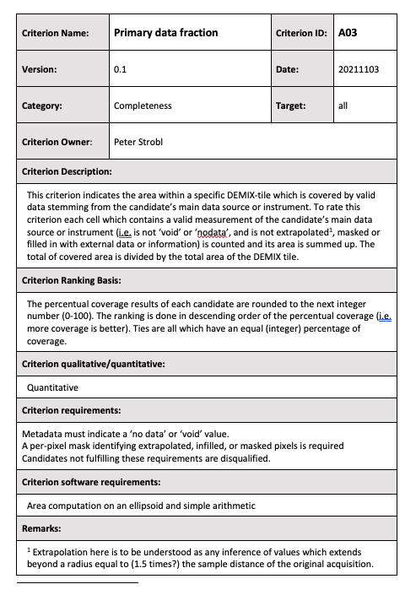
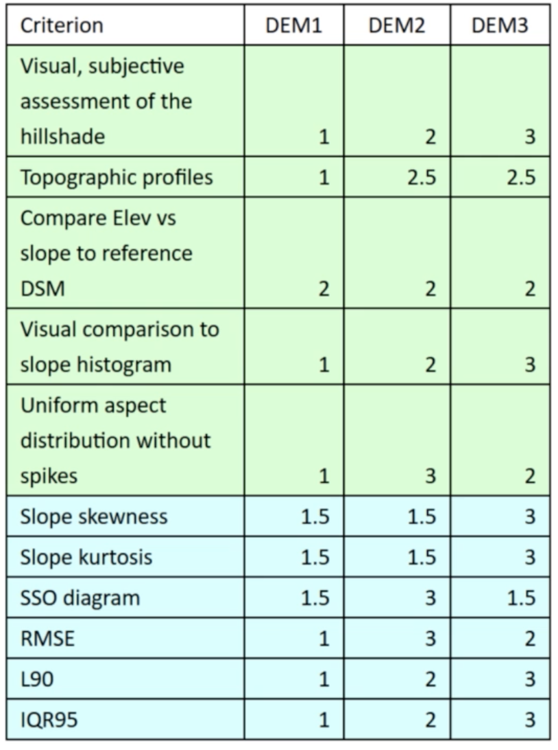
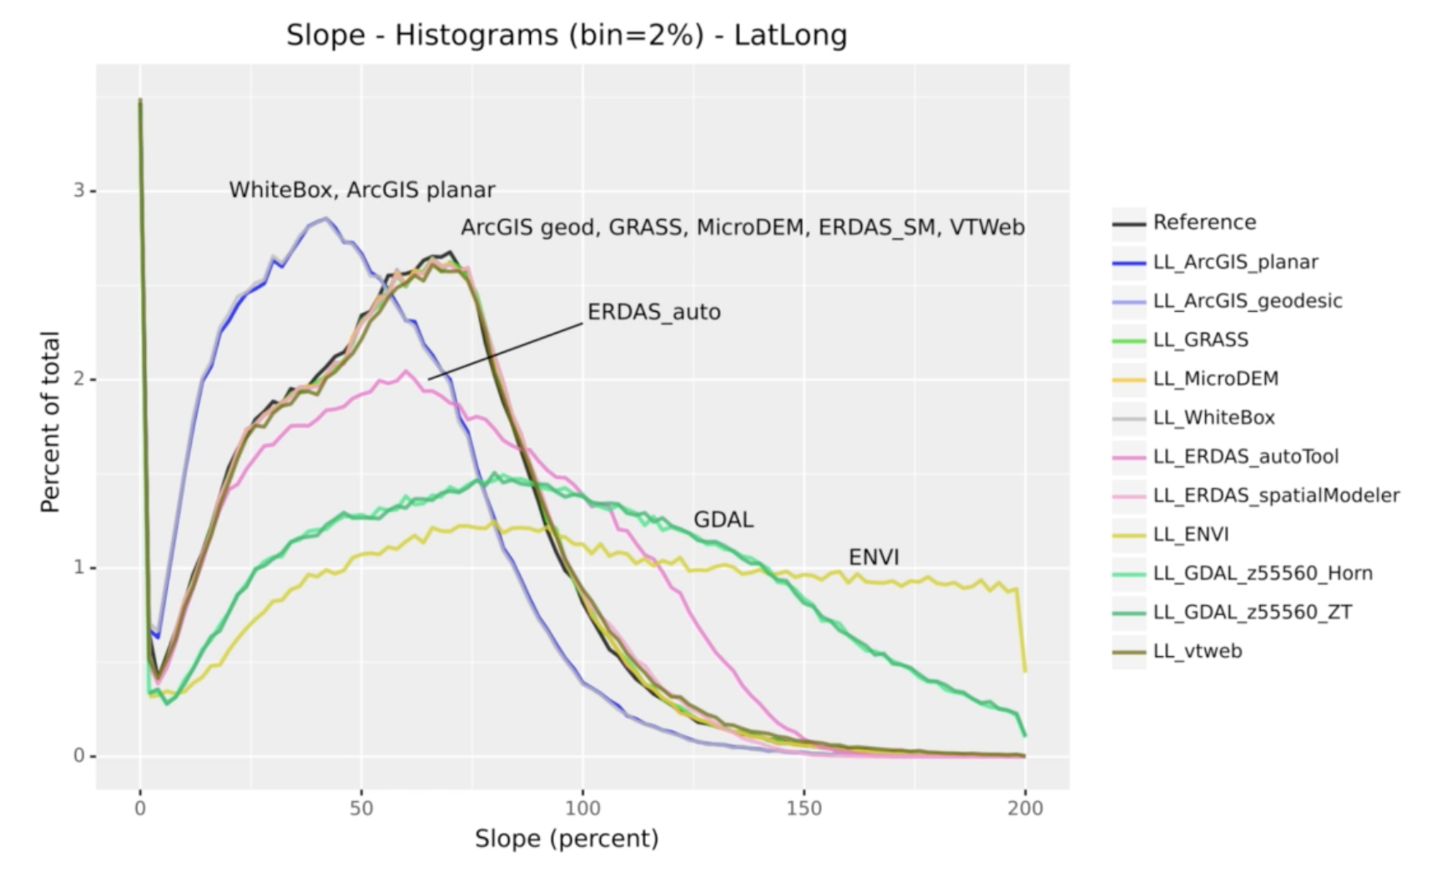
Subgroup 2
Progress:
Extensive test of algorithms and tools
Criteria categories and catalogue set-up
Criteria Consensus Documents agreed
Reference data preparation protocols developed
Implementation of ‘wine contest’ concept using Jupyter notebooks
Peer reviewed paper on methods and results in preparation

Slide 6
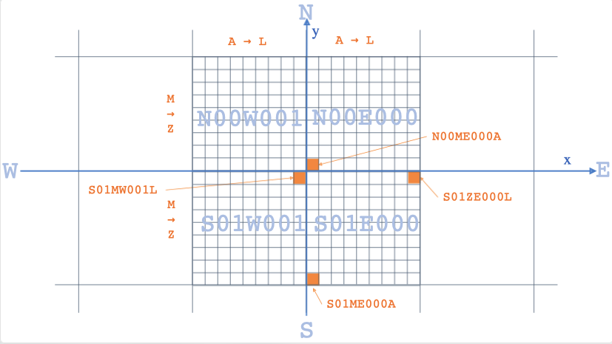
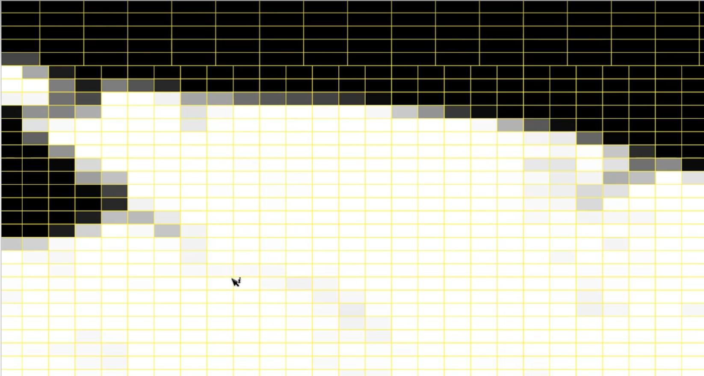
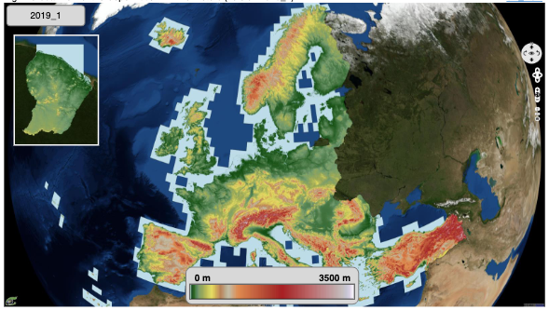
Subgroup 3
Progress:
Major support by ESA (through VtWeb) Much appreciated!
Contacts to CEOS Earth Analytics Interoperability Lab (EAIL)
Ensuring easy and consistent access to test data
Global master grid agreed
Preparations for roll out of tests to continental/global scale

Slide 7
Digital Elevation Inter-Comparison (DEMIX)
DEMIX to be performed in 4 phases
General agreement among main contributors (data owners) on approach & scope; Call for expression of interest to further partners (commercial tbd); circulation of JRC Workshop report (in preparation) & selection of base (△x, △y, △z) & extended (slope, aspect, morphology) testing methods and algorithms; Identification of suitable test areas (at least 1 per continent);
Cross-comparison of all participating data sets on test areas and, if feasible, identification of a reference dataset (at DGED L1). If available and where applicable cross-comparison to suitable orthorectified (reference?) imagery (Sentinel-2?); Workshop to exchange experiences from the test areas and agree on details of an eventual global roll-out;
Feasibility testing & potential global roll out of at least base tests & determination of suitable aggregation scale for reporting;
Calculation of agreed comparison metrics for all candidates and publication of results.
Timeline
Q3 2020 |  | Q1 2021 |  | Q3 2021 |  |  | Q4 2020 | Q4 2021 |  | Q2 2022
 | Phase I
 |  |  | Phase II
 |  |  |  |  | Phase III
 |  |  |  |  |  |  |  |  | Phase IV

Slide 8
Thank you for your attention!
Any questions?
Peter.Strobl@ec.europa.eu
Big thanks to all active volunteers!
In particular the sub-group leaders: Peter Guth, Carlos Grohman,
Conrad Bielski, Serge Riazanoff

