Slide 1
Common Online Dictionary Initiative
CEOS Common Terminology Group
CEOS WGISS #53 & WGCV #49
Virtual Meeting
23/24 March 2022

Slide 2
Executive summary
Background
Joint initiative of CEOS WGCV, CEOS WGISS, and CEOS LSI-VC
Mandate: CEOS WGCV Action Item 49-06 (June 2021) “[…] to advance the idea of a CEOS common online dictionary, with a view to eventually reaching out to launch a broader community effort”
Status of activities
CEOS Common Terminology group established August 2021
Workplan drafted
Integrated WGISS Data Stewardship Glossary (pdf) and NOAA NESDIS Data Management Lexicon (pdf) into existing WGCV ‘Terms and Definitions’ Wiki
Discussing categorization of terms (see next slide) - prototyping approach using base terms and high impact terms – ongoing
Discussing governance - ongoing
Reaching out to promote initiative – ongoing internally with focus on WGISS, WGCV, LSI-VC externally with ISO/OGC (see slide)
Discussing target infrastructure – upcoming – support needed!
http://calvalportal.ceos.org/ca/t-d_wiki

Slide 3
Terminology groups
In order to combine advance on fundamental terminology with raising awareness of the relevance of the topic and attracting more participation, two lists with terms are proposed:
BASE terms illustrate the fundamental concepts, they should use understandable, unambiguous language and be built only on other base terms.
Examples:
Phenomenon
Data
Observation
Sample
HIGH IMPACT terms refer to expressions used within a domain to define more complex concepts or make important distinctions.
Examples:
In-situ Observation
Remote Sensing
Land Cover
Processing Levels
For both categories we are starting to assemble candidate lists.
Proposals are highly welcome - with or without a definition! Send your input to: katrin.molch@dlr.de

Slide 4
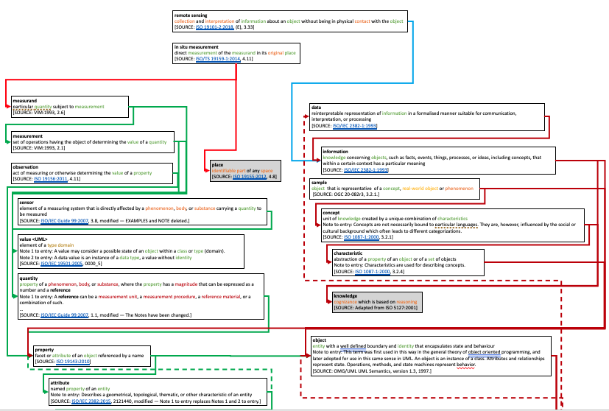
Relation to international standards
Reached out to ISO and OGC to align approach and learn about most recent standard developments (e.g. ISO 19156)
ISO maintains a comprehensive glossary called the 'Geolexika' (https://isotc211.geolexica.org/concepts/)
Several related ISO standards (e.g. 19124) are currently under review but close to being finalised, we are late in the game!
CEOS should make sure that ISO terminology is fit for own purposes, also in the foreseeable future, especially regarding 'high impact' terms which often even within CEOS suffer clear concepts see e.g. 'in-situ' vs. 'remote'
Feedback needed!
ISO/TC 211 Multi-Lingual Glossary of Terms (MLGT)

Slide 5
For questions please contact
WGCV – Peter.Strobl@ec.europa.eu
LSI-VC - labahn@usgs.gov
WGISS - Katrin.Molch@dlr.de

Slide 6
Additional Material
See also presentation CEOS WGISS #52

Slide 7
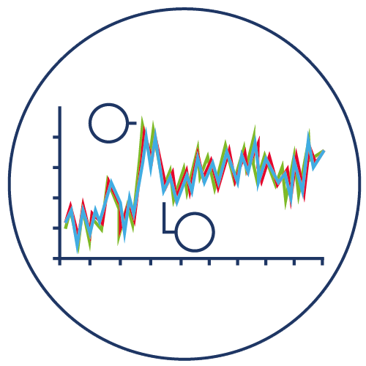
Points of discussion 1: Hierarchy of terms
Very early draft of ideas!
Measured values
Phenomenon
Has a
Property
Observation /
Measurement
Data
Which we can either
Phenomenon
Property
Information
Observe or Model.
Quantitative observation
Is a
$$T_{\text{Earth}}$$
Measurement
Giving us
Modelling
Data
Data
in the form of
Measured values
That we can combine with other data and interpret to give us
Modelled values
Information

Slide 8
Points of discussion 2: Classifications or scales?
Very early draft of ideas!
Data are:
Modelled or measured (or a bit of both)
Analogue or Digital (or perhaps a bit of both depending on the resolution of the digitisation)
Quantitative or Qualitative (can this also be a bit of both? E.g. some classifications)
SST from satellite
Modelled
Measured
Analogue
Digital
Quantitative
Qualitative
Measured
Qualitative
Modelled
Quantitative
Analogue
Digital

Slide 9
Points of discussion 3: Words that need to keep multiple meanings
Very early draft of ideas!
Terms that have different meanings in different communities, but we can make that clear with an additional adjective, e.g.
Traceability
Metrological Traceability = having an unbroken chain of calibrations to the SI (international system of units)
Documentary Traceability = have clear metadata describing where the dataset has come from
Interoperability
Metrological Interoperability = Comes with sufficient metrological traceability, comparison and uncertainty, analysis information to be able to understand the likely size of biases and expected differences
Data Interoperability = Data sets able to be used by others
ARD Interoperability = …
However, in these cases, is there an overarching definition that is able to encompass both?
E.g. Interoperability = the characteristic of a system that enables it to work with other systems

Slide 10
Processing Levels re-consideration
Processing Levels were so far defined as a more or less generic chain of refinement regarding the radiometry (or more general the 'measurand') and the geometry of the (satellite) observation data.
If one considers these two types of refinements separate, a matrix could be built in which classical Processing Levels would (roughly) appear as below:

Slide 11
Processing Levels re-consideration
For the discussion of 'Analysis Readiness' of data a clearer separation of these two 'dimensions' of processing yields a chance to obtain a transparent scheme in which also recommendations about best possible paths (processing sequences) are feasible. This would be advantageous for defining 'Analysis Ready Data' standards at different processing Levels.
Is there interest in WGISS to follow this up?

