Slide 1
A Network of Sites for Land Surface Temperature (LST) Measurements based on Thermal IR sensors
Aimé MEYGRET and
Patrice HENRY, CNES
WGCV 50 - Virtual Meeting
March 25, 2022

Slide 2

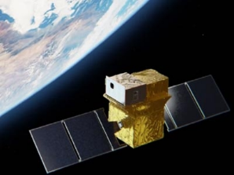
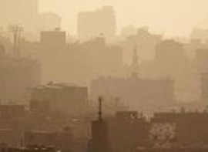

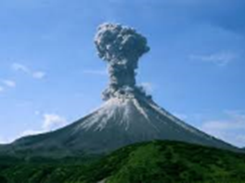
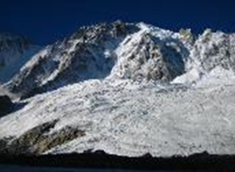


The TRISHNA mission
ISRO/CNES cooperation, launch in 2025, 5-year lifetime
Scientific & operational applications
Focus on ecosystem stress and water use + coastal & inland waters
Global coverage
4 TIR bands + 5 VNIR bands + 2 SWIR bands
Revisit : 3 acquisitions at equator per 8 day period
  761km-8 day orbit reducing hot spot constraints in intertropical zone
± 34° scan angle, 1030 km swath
Nadir spatial resolution (VIS-NIR-SWIR-TIR):
  57 m for continental and coastal areas, binned at 1 km over open ocean
Overpass time : 1 PM (LTDN)
NeDT 0.2K
Indo-French(*) Joint Science Team (*) with other contributors
  Free and open data policy for worldwide scientific community
Learn more about TRISHNA !
https://labo.obs-mip.fr/multitemp/trishna
https://trishna.cnes.fr/en
Slide 2

Slide 3
Context
Several TIR operational missions: ECOSTRESS, ASTER, LANDSAT-8&9, MODIS, VIIRS, SLSTR, SEVIRI…
TIR future missions with increased spatial resolution: TRISHNA, LSTM, SBG,…
More and more demanding LST accuracy requirements (better than 0.1K for climate studies)
Importance of vicarious calibration for the validation of on-board calibration systems (black bodies) or direct calibration
L2 products (temperature, emissivity) validation need
Slide 3

Slide 4
Objectives
Why a new network of instrumented sites dedicated to the radiometric calibration of Earth Observation Thermal IR optical sensors?
To collect surface temperature and emissivity, and atmospheric data necessary for the simulation of observations by TIR optical sensors and thus verify their radiometric calibration
To increase the number of matchups between in-situ measurements and space sensor observations and reduce the overall uncertainties, and reduce the efforts of individual agencies
To ensure traceability of the space sensor radiometry to the “Système International” (SI)
To support the establishment of the Global Earth Observation System of Systems by providing measurements to verify the radiometric consistency between EO space sensors
The success and experience return from RadCalNet network dedicated to VNIR-SWIR optical sensors cal/val
Slide 4

Slide 5
Existing “Networks”
Reference to the excellent work performed by WGCV/LPV subgroup and dedicated to Land Surface Temperature Product Validation Best Practice Protocol (jan. 2018) which identifies the existing networks and their limitations
SURFRAD: Surface Radiation, NOAA
GCU: Global Change Unit, University of Valencia
KIT (Karlsruhe Institute of Technology) stations
JPL network
USCRN: US Climate Reference network
Location of ground observational networks currently used to validate standard LST products derived from US and European spaceborne instruments.
Slide 5

Slide 6
Limitations
Limitations of existing ground based measurements
Spatial representativeness of the in situ reference measurements
Directional effects
Lack of emissivity measurements
Data access
Data harmonization
Do not provide TOA radiances
Data quality assurance (error budget traceable to SI)
In situ instruments calibration quality and traceability
Needs for the development of denser ground-based reference Network
Slide 6

Slide 7

Next Step?
What is proposed
A network to set up jointly between IVOS and LPV subgroups
A dedicated working group including sites owners
US CRN, Riley station
JPL, Russell Ranch
U. of Valencia, Barrax
KIT, Gobabeb
First discussions between CNES and ESA
Slide 7

Slide 8
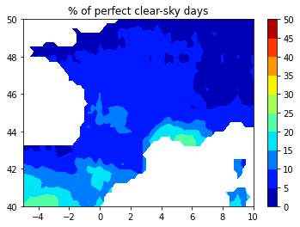
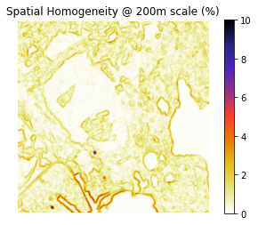
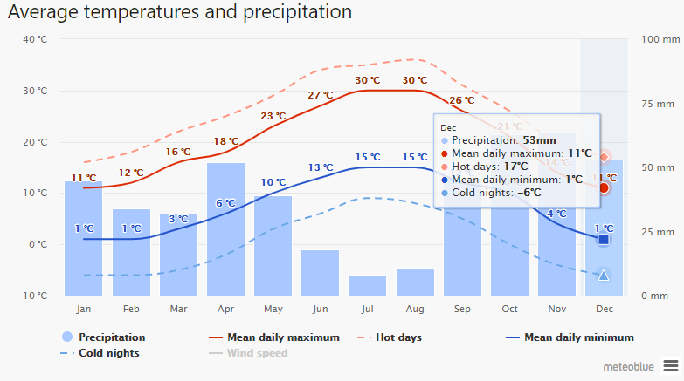
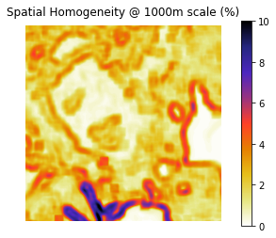
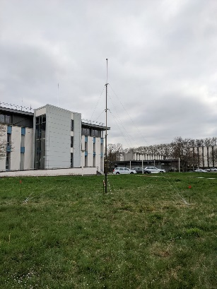
A CNES Site?
CNES first site dedicated to TIR cal/val → a beta tester on “how to join the Network”?
Cloud Cover
Estimation of Spatial Homogeneity
on a L8 TIRS image
La Crau (RadCalNet site) region is a good candidate
Telescopic mast test
Slide 8

Slide 9
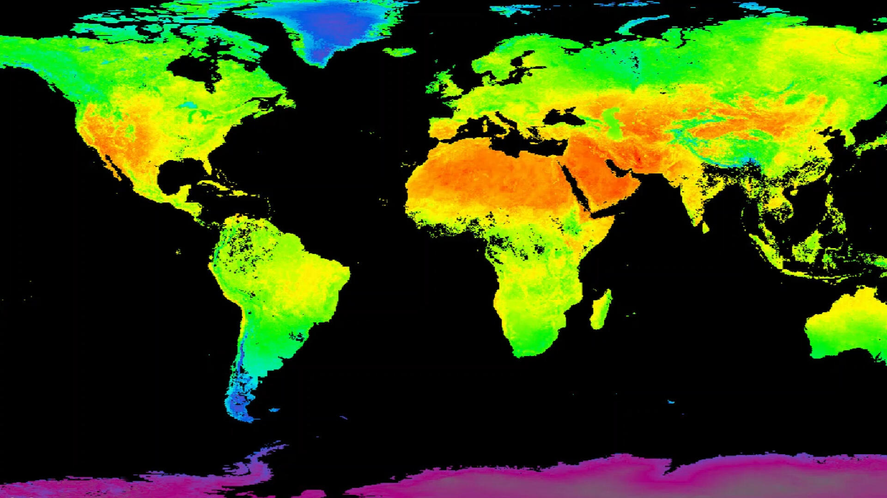
Thanks for your attention

