Slide 1
WGISS WG on Information Systems and Services Overview
Makoto NATSUISAKA (WGISS, JAXA)
Tom SOHRE (WGISS, USGS)
WGISS-54, 6th WGISS-WGCV joint meeting
5th Oct. 2022

Slide 2
WGISS (the Working Group on Information Systems and Services)
Working Group on Information Systems and Services.
WGISS promotes collaboration in the development of systems and services that manage and supply Earth observation data as a working group of CEOS.
The activities and expertise of WGISS span the information life cycle by enabling:
the sharing of CEOS agency learned relating investigations, developments, experiences and lessons o EO data stewardship.
the discovery, access, preservation and use of CEOS agency data.
the exchange of technical information and lessons-learned about current and trending software technologies and services.

Slide 3
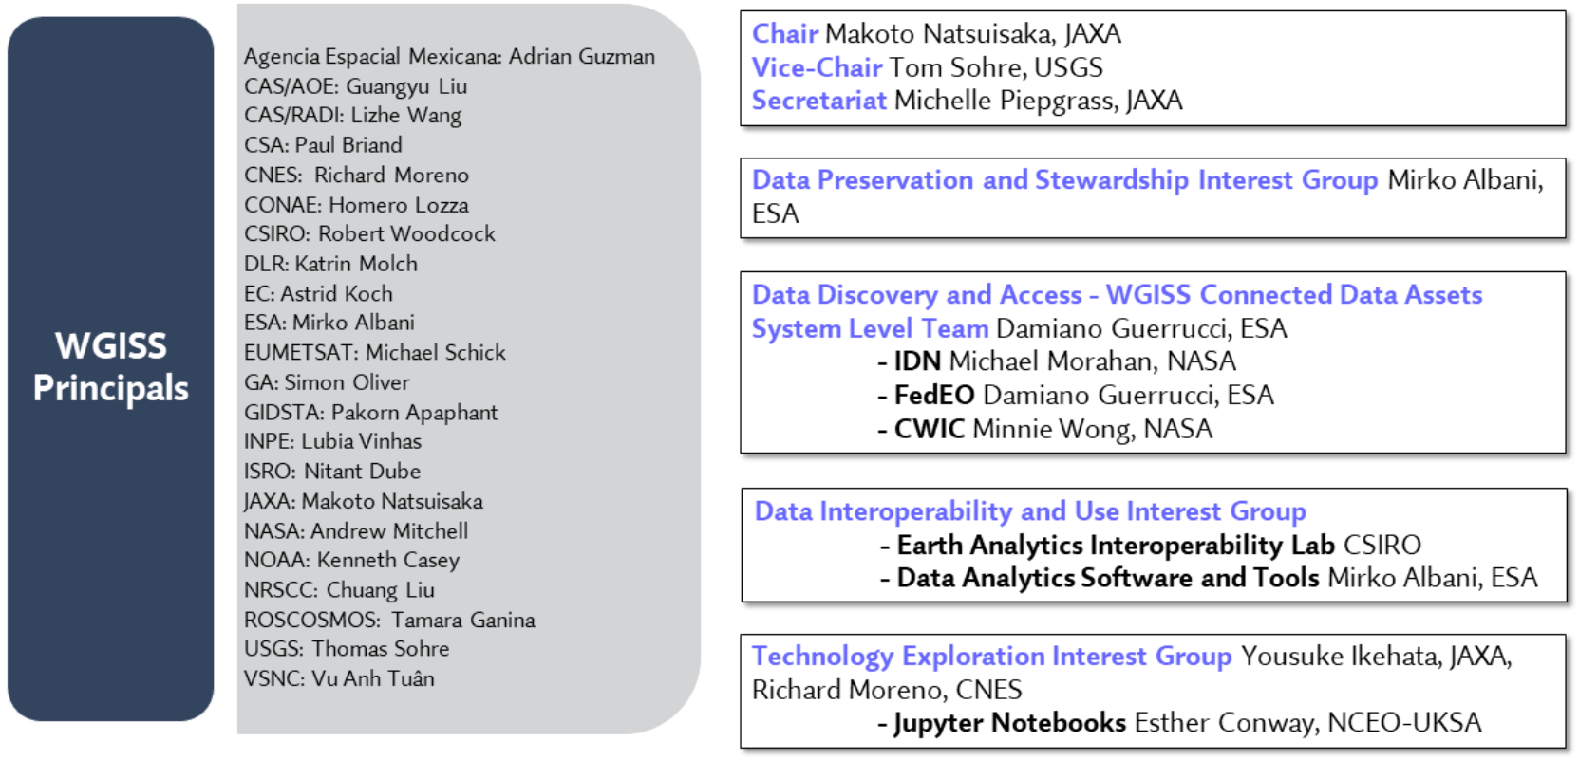
WGISS Interest Groups
https://ceos.org/ourwork/workinggroups/wgiss/

Slide 4
Recent Activities
WGISS Meetings … WGISS-54, Oct. 3-7, Tokyo JAPAN
WGISS Exec Meetings … Monthly
Interest Group Meetings … Monthly
WGISS Webinar … Jupyter Notebook Day Planned in Oct.

Slide 5
Recent Topics
Data Integrity and Authenticity on Cloud -> under discussions
Data Quality Assessment and Indicators, and DMSMM Maturity Matrix -> Best Practice
WGISS Connected Data Assets -> in operation
STAC -> Best Practice
Service Discovery -> Best Practice
CEOS Common Online Dictionary -> Online Dictionary
EAIL (Earth Analytics Interoperability Lab.) -> EAIL
Jupyter Notebooks Initiative -> Best Practice and Webinar
Machine Learning, Data Learning, Artificial Intelligence -> White Paper

Slide 6
Cooperation with Other Entities
CEOS ARD Oversight Group … CEOS SIT, VCs, WGs
CEOS Ocean Coordination Group … CEOS SIT, VCs, WGs
CEOS Interoperability Framework … LSI-VC
CEOS Engagement with Standard Organizations … LSI-VC
EAIL initiative … SEO, WGDisaster (Flood Pilot Project), WGCV (DEMIX), COAST, Rice Monitoring Community
Jupyter Notebook initiative … SEO, WGCapD
Common Maturity Metrics … WGCV, CGMS
Common On-line Dictionary … WGCV
AI/ML White Paper … WGDisaster
Service Discovery … WGDisaster

