Slide 1
WGISS-54 - Data Management and Stewardship Maturity Matrix: introduction, background and definitions
I.Maggio, Rhea GROUP for ESA
Agenda ID: 2022.10.05_15.20
WGISS-54
Tokyo, Japan (JAXA)
3-7 October 2022

Slide 2
Executive Summary
Main concepts of the WGISS Data Management & Stewardship Maturity Matrix
Step by Step in using the DMSMM
How to read the final result of DMSMM

Slide 3
Main Concepts

Slide 4
Data Management and Stewardship Maturity Matrix (DMSMM): Main concepts
DMSMM defines all activities needed to preserve and improve the information content, quality, accessibility, and usability of data and metadata.
Data stewardship “encompasses all activities that preserve and improve the information content, accessibility, and usability of data and metadata” (National Research Council 2007).
Data management includes all activities for “planning, execution and oversight of policies, practices and projects that acquire, control, protect, deliver and enhance the value of data and information assets.” (Mosely et al. 2009).

Slide 5
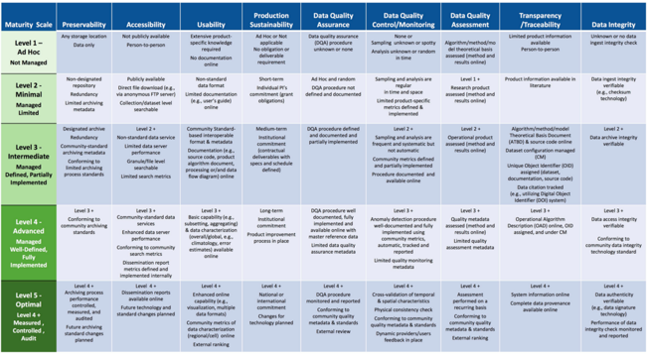

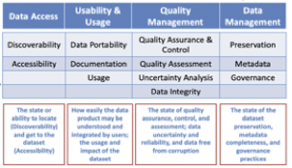
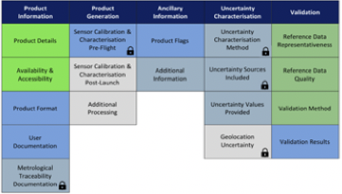
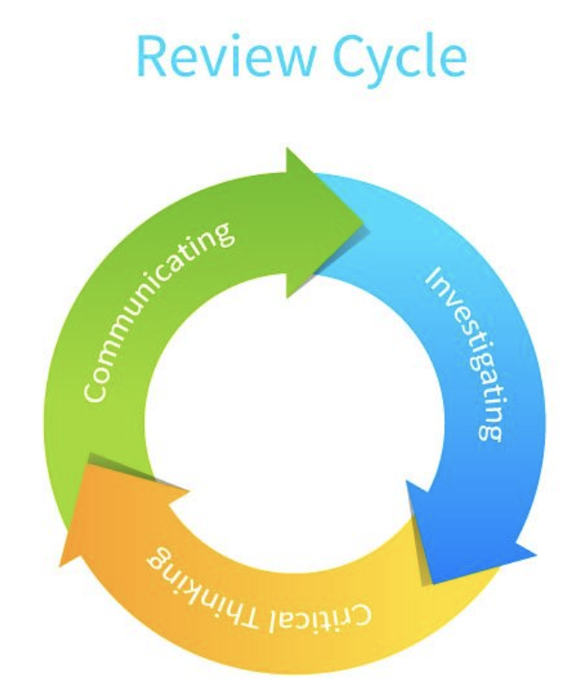
Starting Points
MM for Long-Term Scientific Data Stewardship
RDA FAIR Data Maturity Model
WMO Stewardship MM for Climate Data
ESA Earthnet Quality Data Assessment Pilot
GEOSS Data Management Principles
CEOS WGISS DMSMM: Generation process

Slide 6
CEOS WGISS Data Management & Stewardship Maturity Matrix
TO BE UPDATED AFTER JOINT DISCUSSION
http://ceos.org/document_management/Working_Groups/WGISS/Interest_Groups/Data_Stewardship/White_Papers/WGISS%20Data%20Management%20and%20Stewardship%20Maturity%20Matrix.pdf

Slide 7
WGISS DMSMM pillars
12 Components
Metadata for Discovery
Online Access
Data encoding
Data Documentation
Data Traceability
Data Validation
Data Metrology (e.g. Uncertainty)
Data Quality Control
Product Details
Data Preservation
Data Verification
Data Processing/Reprocessing
Persistent & Resolvable Identifier
5 Areas
  Discoverability
  Accessibility
  Usability
  Preservation
  Curation
4 Level of Maturity
L0 Not Managed
L1 Partially Managed
L2 Managed
L3 Fully Managed

Slide 8
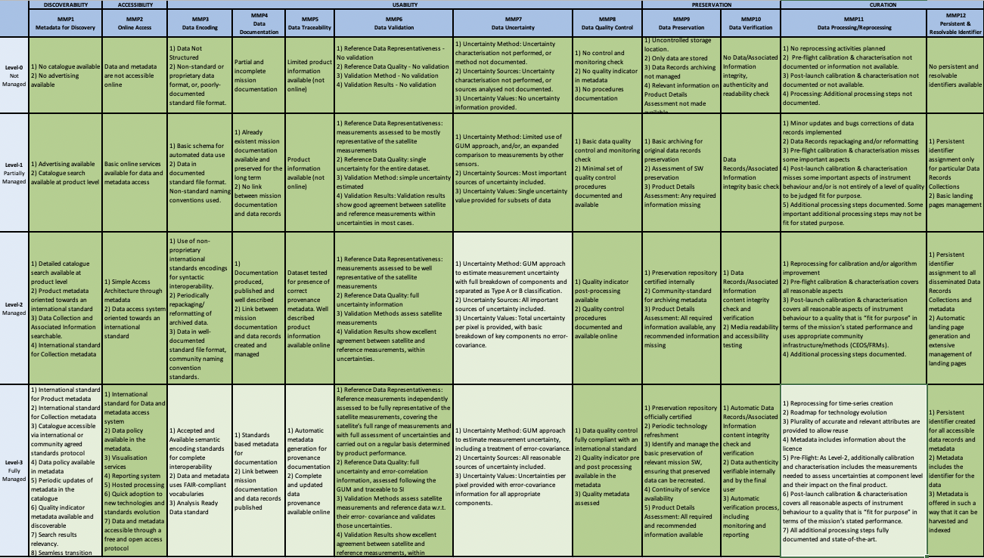

Data Management & Stewardship Maturity Matrix - Scope
A way to measure the status of the Agency Data Stewardship processes in place
A way to plan goals of Data Stewardship processes and projects

Slide 9
Step by step in DMSMM

Slide 10
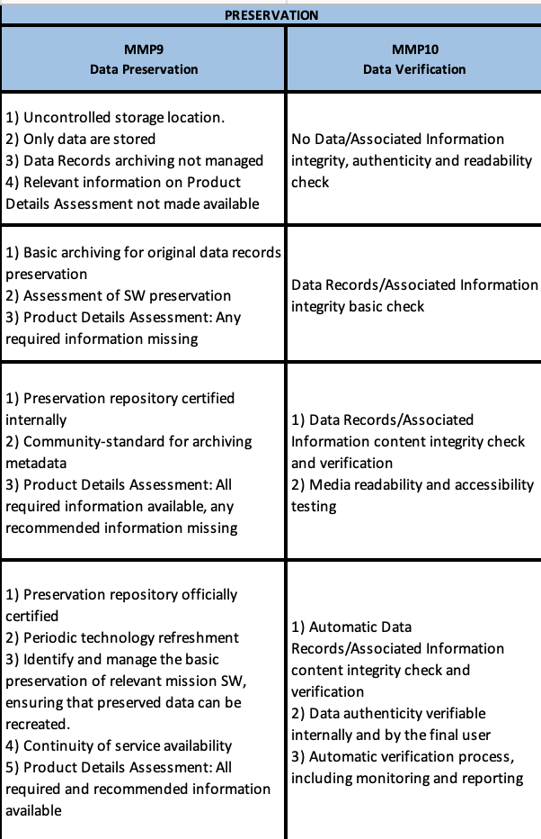
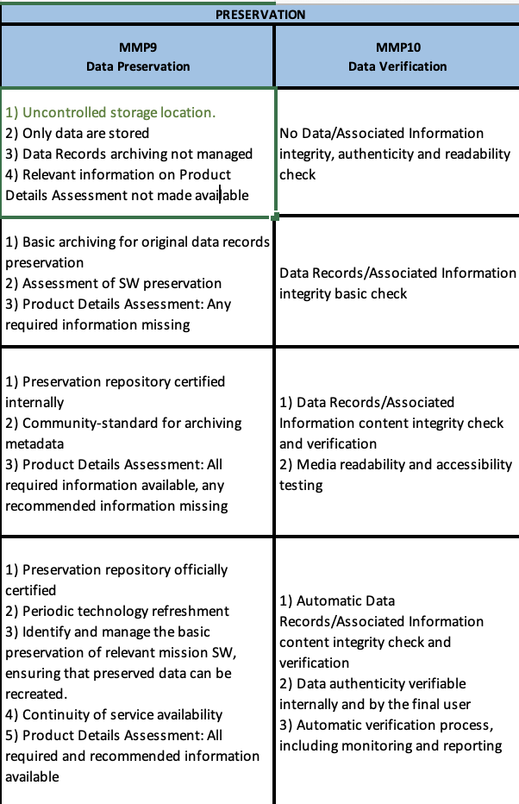
For each component go through the checklist
L0
L1
L2
L3
Perform a verification for
each task putting in green the
tasks already implemented.

Slide 11
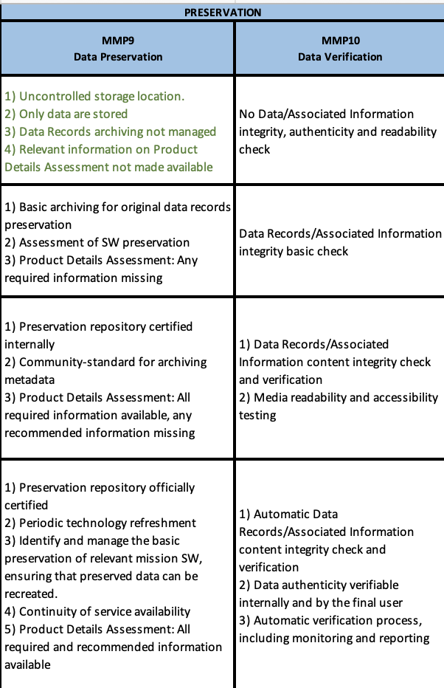
For each component go through the checklist
L0
L1
L2
L3
Perform this kind of verification
for each task in the maturity
level under analysis.

Slide 12
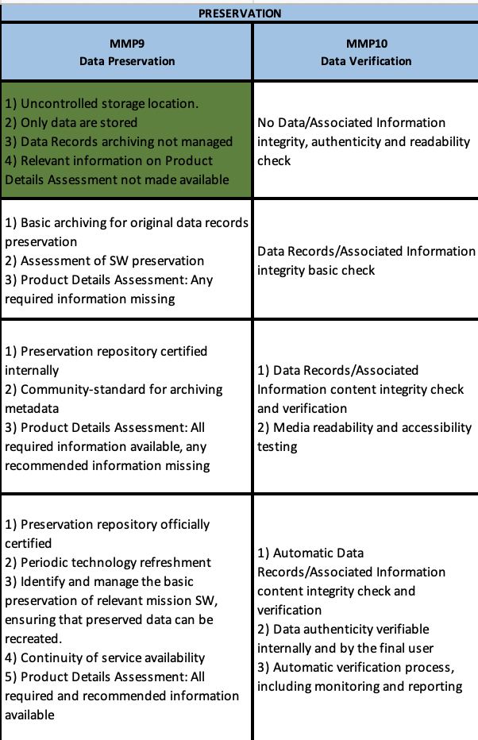
For each component go through the checklist
L0
L1
L2
L3
When all tasks in the analysed
maturity level are fully covered, fill with a colour the whole cell in green.

Slide 13
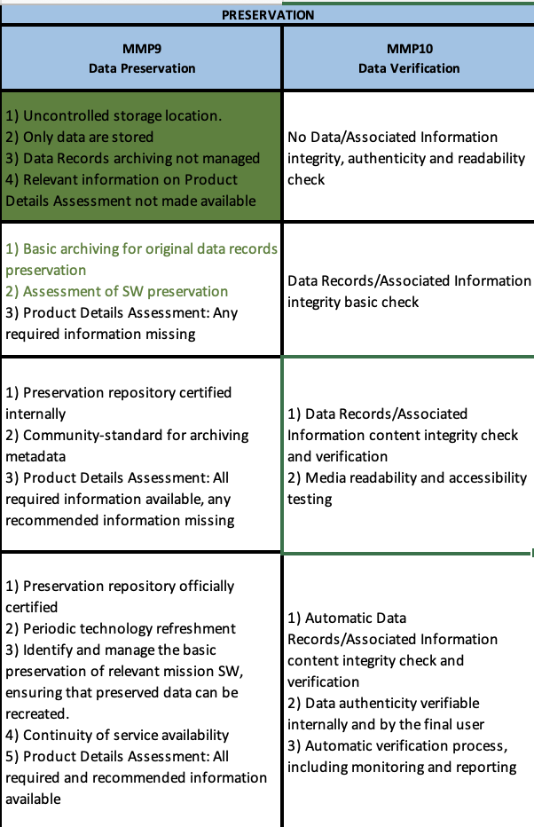
For each component go through the checklist
L0
L1
L2
L3
The analysis continues going on to
the next level of maturity.

Slide 14
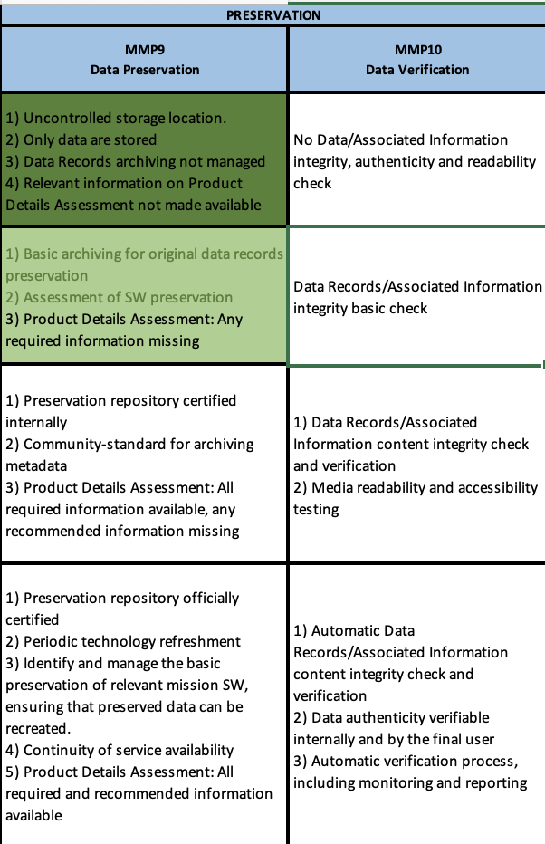
For each component go through the checklist
L0
L1
L2
L3
When a task is not already
implemented it remains in black
and at the end the cell, partially
covered, becomes in light colour.

Slide 15
Score compilation
L0
L1
L2
L3
L0
L1
L2
L3

Slide 16
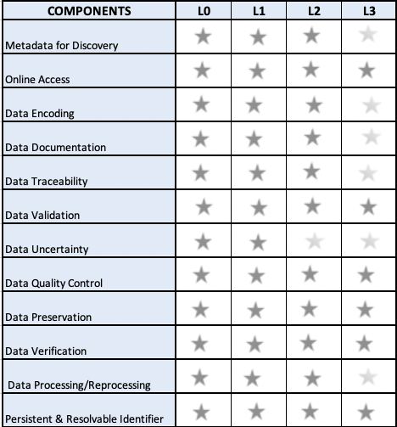
Example of final view of the DMSMM and Score

Slide 17
AVHRR DMSMM Use Cases and
DISCUSSION

Slide 18
DMSMM Assessment performed before starting AVHRR curation project (2017)

Slide 19
DMSMM objectives definition

Slide 20
DIFF(AS-IS and Objectives) - Tasks to be performed to reach the objectives

Slide 21
DMSMM assessment performed after the end of AVHRR curation project (2018)

Slide 22
DMSMM last verification using last version of Maturity Matrix (2022)

