Slide 1
WGCV-52
CEOS Work Plan Review
Marie-Claire Greening
CEOS Executive Officer
Agenda Item 1.4
WGCV-52, ESA/ESRIN, Italy
5th - 9th June 2023

Slide 2
Executive Summary
CEOS Mission & Objectives
CEOS Long-term Priorities
GISTDA CEOS Chair Priorities 2023
WGCV Mission & Objectives
CEOS Governance & Work Planning
2023 – 2025 CEOS Work Plan
WGCV Deliverables

Slide 3
CEOS Mission & Objectives
Primary Objectives:
To optimise the benefits of space-based Earth observation
To serve as the focal point for international coordination of space-based Earth observation activities
To encourage complementarity and compatibility

Slide 4
CEOS Long-term Priorities
Ensure that climate observation requirements identified by the Global Climate Observing System (GCOS) – and implications of the Paris Climate Agreement – are addressed.
Ensure, in the context of the Sendai Framework for Disaster Risk Reduction 2015-2030, that CEOS Agency data are made available in support of disaster risk reduction and that CEOS continues engagement with UN agencies and authorities.
Ensure that space-based Earth observations support the success of the next decade of the Group on Earth Observations (GEO), and that CEOS engagement in GEO governance and leadership is enhanced.
Proactively engage in global discussions on the critical challenges that face society, in support of the UN 2030 Agenda for Sustainable Development.

Slide 5
GISTDA CEOS Chair Priorities 2023 Space Technology for Better Environments, Economies, and Humanity
1
Supporting CEOS Preparations and Inputs to the Global Stocktake of the UNFCCC Paris Agreement
2
Supporting Exploration of New Geometries for Space Agencies and CEOS with New Space

Slide 6
WGCV Mission & Objectives
Mission: To ensure long-term confidence in the accuracy and quality of satellite-based Earth observation data and products and provide a forum for the exchange of information about calibration and validation and associated coordination, and cooperative activities.
Objectives:
To enhance coordination and complementarity, to promote international cooperation and to focus activities in the calibration and validation of Earth observations for the benefit of the CEOS membership, the Group on Earth Observation (GEO), and the international user community.
Specific objectives include:
Sensor-specific calibration and validation to document and establish forums for the assessment, recommendation and implementation of current techniques and standards for pre- and post-launch characterisation, calibration and validation.
Bio-geophysical validation to document and establish forums for the assessment, recommendation and implementation of techniques for validation of bio-geophysical parameters derived from EO satellite systems.

Slide 7
Governance & Work Planning
Four key governing documents primarily guide the work of CEOS:
CEOS Terms of Reference defines the mission and scope of CEOS activities
CEOS Strategic Guidance document articulates the overarching long-term (7-10 years) purpose and goals of CEOS
CEOS Governance and Processes document provides
guidelines on the structure, operations, and processes
CEOS employs to achieve its goals
4. CEOS Work Plan (3-year rolling) sets forth near-term
actions to achieve the goals outlined in the CEOS
Strategic Guidance document. Detailed work defined
as deliverables: outlined in the WP, reconciled and
tracked in CEOS deliverable tracking tool

Slide 8
2023 – 2025 CEOS Work Plan
 | Chapter in Work Plan | Responsible
1 | Climate Monitoring, Research, and Services | WGClimate
2 | Carbon Observations in Support of Climate Science and Policy | GHG Task Team, GFOI, AFOLU
3 | Observations in Support of the Global Stocktake of the UNFCCC | UNFCCC
4 | Observations for Agriculture | GEOGLAM, AFOLU
5 | Observations for Disasters | WGDisasters
6 | Observations for Water | GEO AquaWatch
7 | Data Quality | WGCV
8 | Capacity Building and Data Democracy | WGCapD
9 | Data Discovery, Access, Preservation, Usability and Exploitation: approaches, systems, tools and technologies | WGISS
10 | Advancement of the CEOS Virtual Constellations | VCs, ARD Oversight Group
11 | Support to Other Key Stakeholder Initiatives | SDG Coordination Group, NSTT, EETT, COVERAGE, COAST AHT, UN SDGs, GEOBON, GEO Blue Planet, MBON
12 | CEOS Services

Slide 9
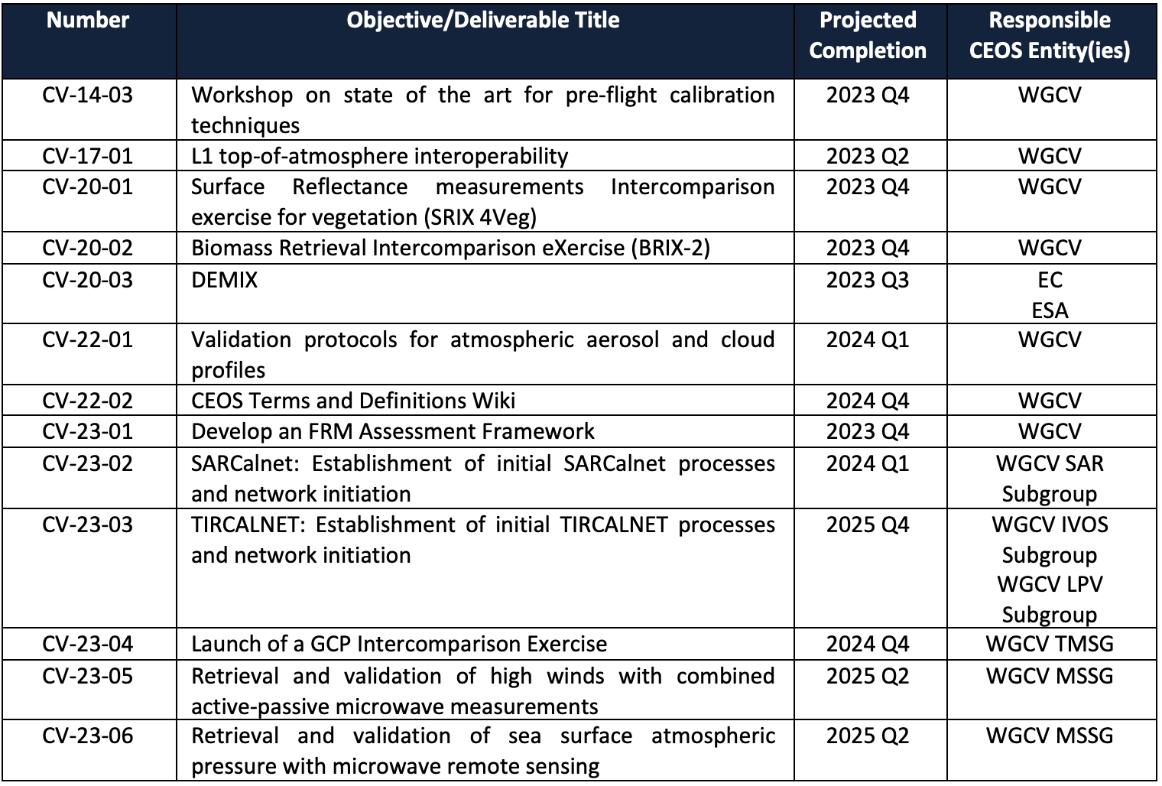
WGCV Deliverables

Slide 10
Thank you!

