Slide 1
AC-VC
Status of WP Actions and Coordination with WGCV
Presenter, Organisation
Agenda Item #
WGCV-52, ESA/ESRIN, Italy
5th - 9th June 2023

Slide 2
Air Quality Constellation
Cal/Val coordination (VC-20-02) plans (-03) Announcements of Opportunities (-04)
GEMS AO (issued in 2018) → Cal/Val activities with international participation, comparisons with Sentinel-5P, testing of Sentinel-4 L2 algorithms
Sentinel-4/-5 AO preparation started, Call to be issued end 2023
Growing Pandora Asian Network complements coverage of Pandora Global Network for operational acquisition of reference data for validation
TEMPO (launched on 7 April 2023), joint NASA/NOAA summer 2023 science field campaigns will contribute to validation, Mission Validation Plan (next slide)

Slide 3
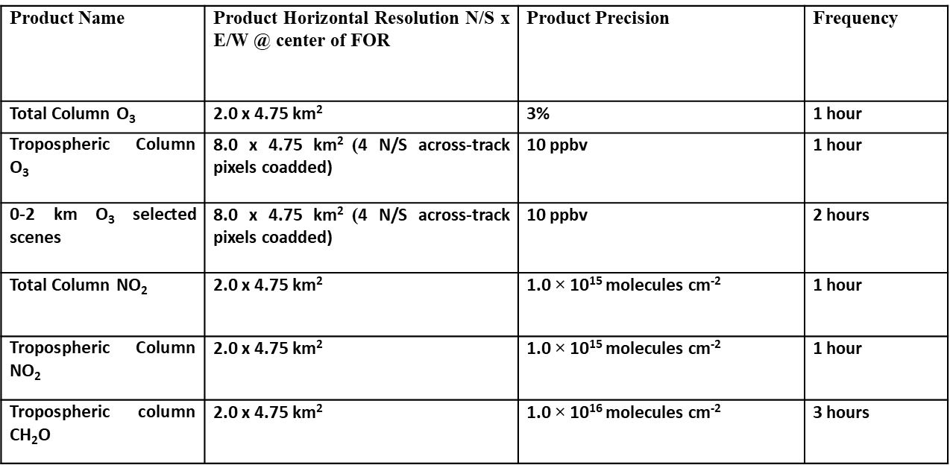
Air Quality Constellation: TEMPO Mission Validation Plan
Outlines a best-efforts validation approach for the ozone, nitrogen dioxide, and formaldehyde data products.
Leverages a comprehensive set of existing measurements (ground-based and satellite) for routine validation enhanced by episodic field mission and modeling efforts.
Describes a structure for the geophysical data product maturity progression and discusses specific metrics to be generated to provide a ‘fit for purpose’ applications framework. Three stages of validation: beta, provisional, and full maturity of products

Slide 4
Air Quality Particulate Matter
Whitepaper “Monitoring Surface PM2.5” (VC-20-05) endorsed at plenary 2022
Next step: roadmap → contribution welcome!
Cal/Val related recommendations:
Rec 4: Continue efforts to enhance the consistency of satellite aerosol products
Rec 6: Continue efforts to enhance the radiometric consistency of satellite sensors
Rec 14: Use co-located in-situ PM sensors, radiometers, and ceilometers, to enhance the understanding of the link between satellite observables and PM
Rec 15: Validate satellite-informed PM products

Slide 5
Joint Meeting AC-VC#19 + ACSG
October 24-27, 2023, Brussels, Belgium, Hosted by BIRA
Monday: WGCV ACSG only (at BIRA-IASB)
Tuesday-Thursday: joint AC-VC & WGCV ACSG
Friday: recap of joint sessions + AC-VC only

