Slide 1
WGCV-52
Presentation Template and Guidance
Xiaolong DONG, NRSCC/NSSC
Agenda Item 2.5
WGCV-52, ESA/ESRIN, Italy
5th - 9th June 2023

Slide 2
Recent Focuses of MSSG
MSSG covers EO sensors operated in microwave spectrum, except SAR
MWR, SCAT, ALT, GNSS-RO/R
  Microwave Radiometers (sounders, imagers) (MWR)
  Radar Scatterometers (surface and volume) (SCAT)
  Radar Altimeters (ALT)
  GNSS-Radio occultation and reflectrometry (GNSS-RO/GNSS-R)
With current focuses on
  Radar Scatterometers (Active Microwave)
  Microwave Radiometers (Passive Microwave)

Slide 3
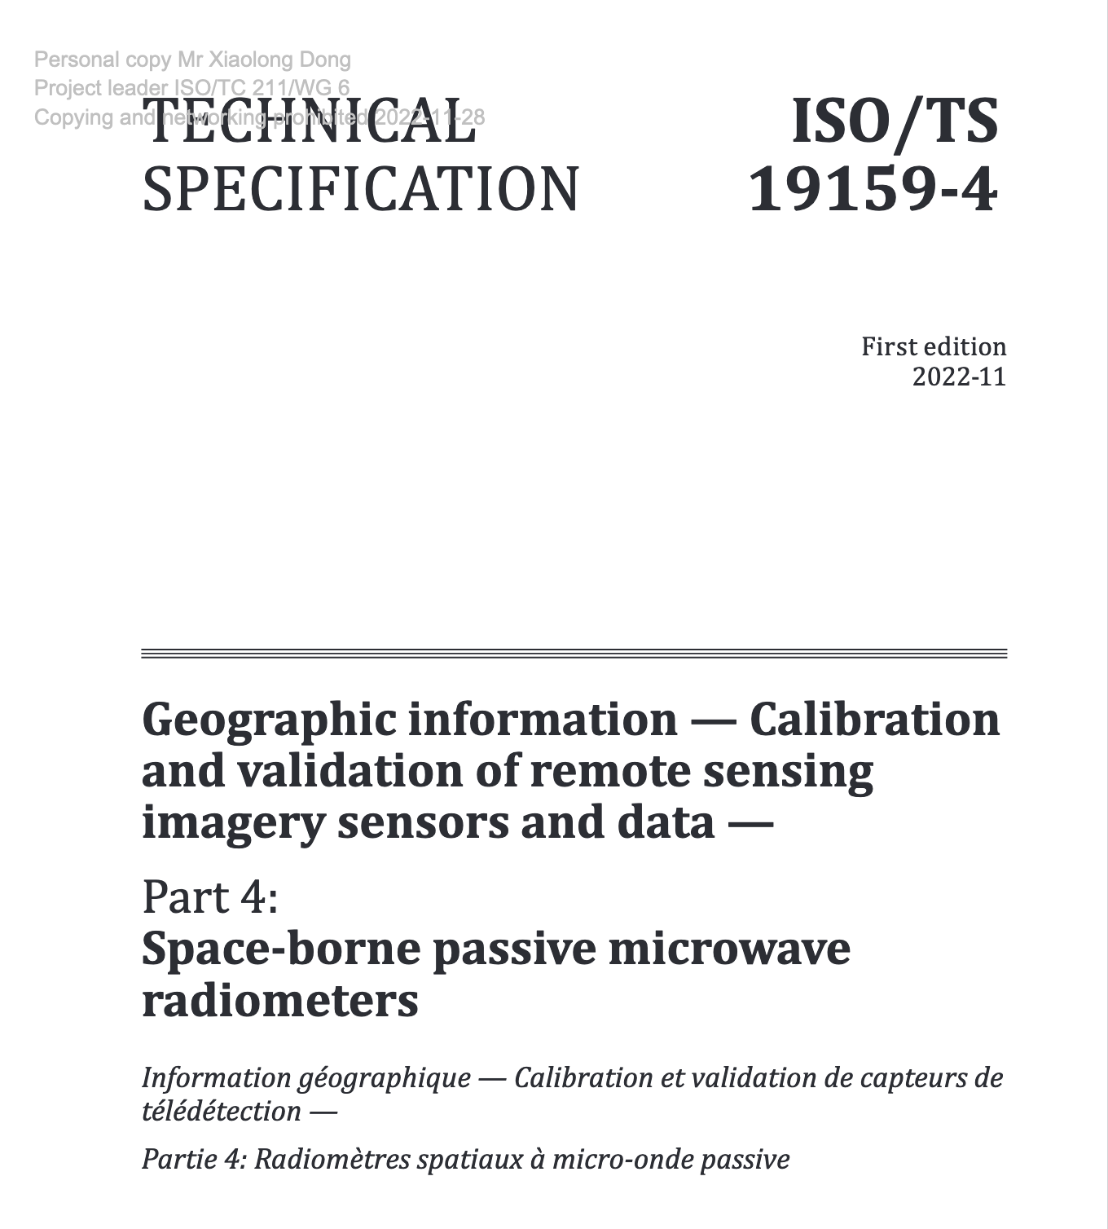
Recent Tasks of MSSG
Completed tasks:
  Radar Scatterometers (Active Microwave)
CEOS task CV-20-05: Standards and Metrics for Scatterometers and Wind Retrievals
(ISO-TS initiated in TC-211 plenary in May, 2023)
  Microwave Radiometers (Passive Microwave)
ISO/TS 19159-4:2022 (published in November 2022)
Geographic information — Calibration and validation of remote sensing imagery sensors and data — Part 4: Space-borne passive microwave radiometers (ISO TC-211 19159-series)
On-going tasks:
  CV-23-05 Retrieval and validation with high winds with combined active-passive microwave measurements (2025 Q2)
  CV-23-06 Retrieval and validation of sea surface atmospheric pressure with microwave remote sensing (2025 Q2)

Slide 4
Progress of task CV-23-05
CV-23-05: Retrieval and validation with high winds with combined active-passive microwave measurements
Task lead:
Prof. Wenming Lin
Nanjing University of Information Science and Technology (NUIST)

Slide 5
Progress of task CV-23-05
Introduction
An extreme wind warning is issued when sustained winds of 32.7 m/s or greater are expected.
Extreme sea surface winds may lead to storm surge, transportation disruptions, injury or death, damage to ships and coastal buildings, and etc.
Monitoring of sea surface extreme winds using satellite-based microwave sensors is of great significance to the Disaster Risk Management authorities in protecting lives and safeguarding property, also to support understanding the turbulent air-sea fluxes, the biogeochemistry and gas fluxes under extreme wind conditions.
The current satellite scatterometer or radiometer-derived extreme winds are far from the “truth”, requiring a re-calibration or re-process task in order to achieve a consistent multi-mission extreme winds.

Slide 6
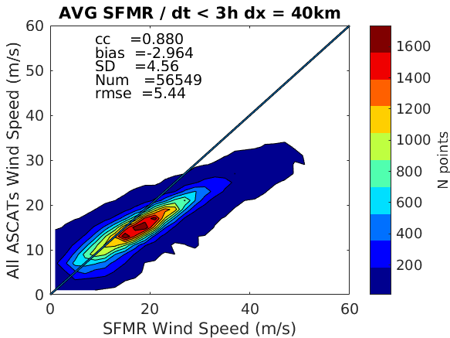
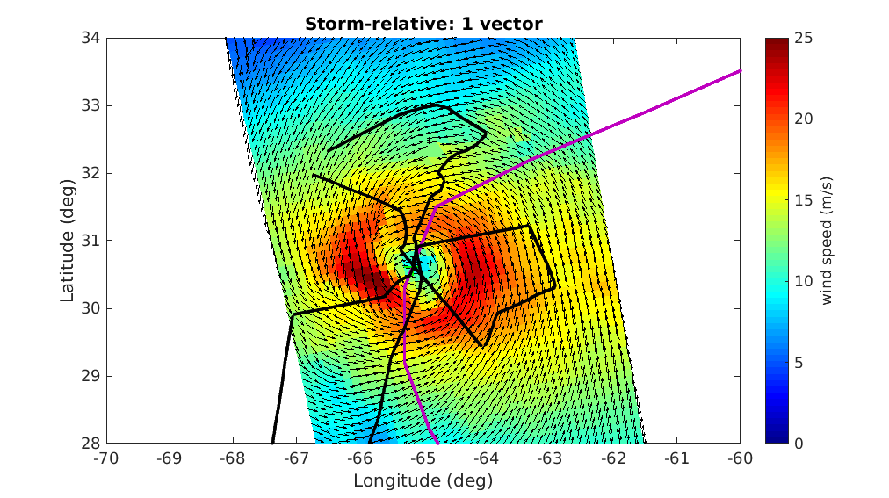
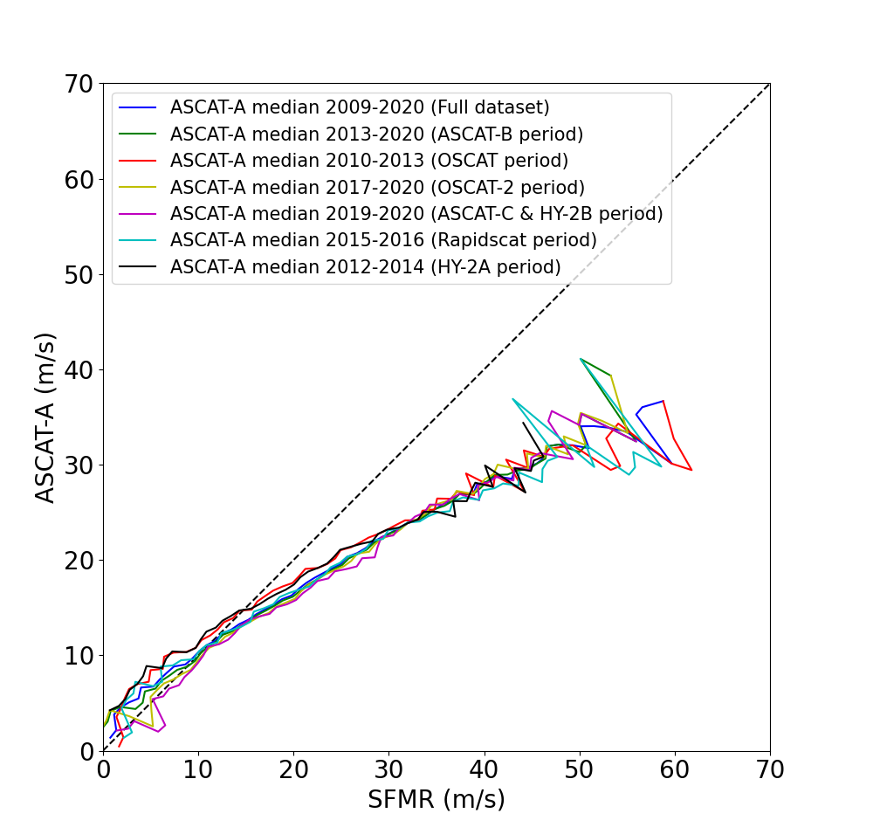
Progress of task CV-23-05
ASCAT high and extreme winds are much lower than the SFMR reference wind speed (other SCATs’ winds are with similar results, see lower right panel)
Best track
NOAA flight trajectory

Slide 7
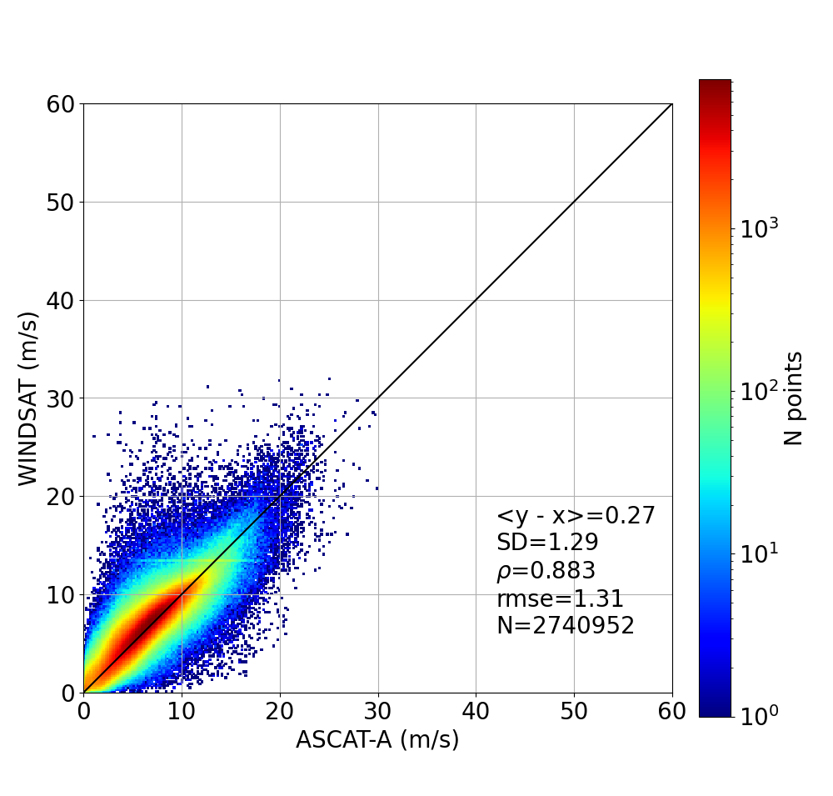
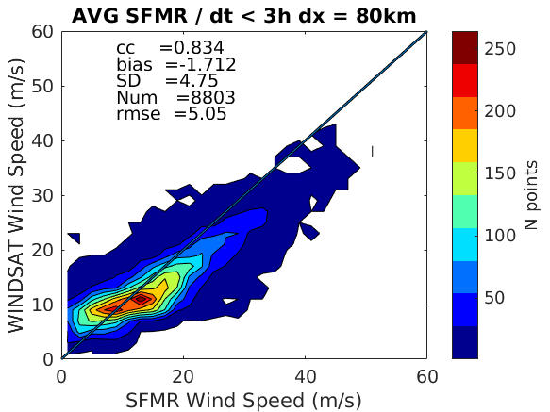
Progress of task CV-23-05
Windsat wind retrieval issues under TC conditions?
ASCAT-A & Windsat winds inconsistent in the range 10-15 m/s when collocated with SFMR

Slide 8
Progress of task CV-23-05
Objective
  To re-calibrate microwave radiometer brightness temperature, radar scatterometer and synthetic aperture radar (SAR) normalized radar cross section (NRCS, σ⁰) product, and to derive a good inter-calibrated high and extreme sea surface wind product from all the mentioned satellite wind sensors.
  To validate the high and extreme winds using collocated NOAA hurricane hunter Stepped Frequency Microwave Radiomater (SFMR) winds as reference.
  To better understand the intrinsic characteristics (e.g., the true spatial scale of each wind source) of the satellite-derived high and extreme winds.
Towards a consistent multi-mission extreme sea surface wind product

Slide 9
Progress of task CV-23-05
Task content
  Reference aspect:
  Collocations in storm-centric coordinates: improve storm centre location.
  Spatial representativeness: Look for suitable SFMR upscaling for each SAR, scatterometer & radiometer.
  Satellite aspect:
  Analyze the sensitivity of each sensor measurement under high and extreme wind conditions, improve the radiation and scattering models.
  Re-calibration of radiometer brightness temperature, and radar NRCS.
  Re-calibration and/or re-process the extreme winds from the mentioned sensors.
  High and extreme wind validation using the reference data.

Slide 10
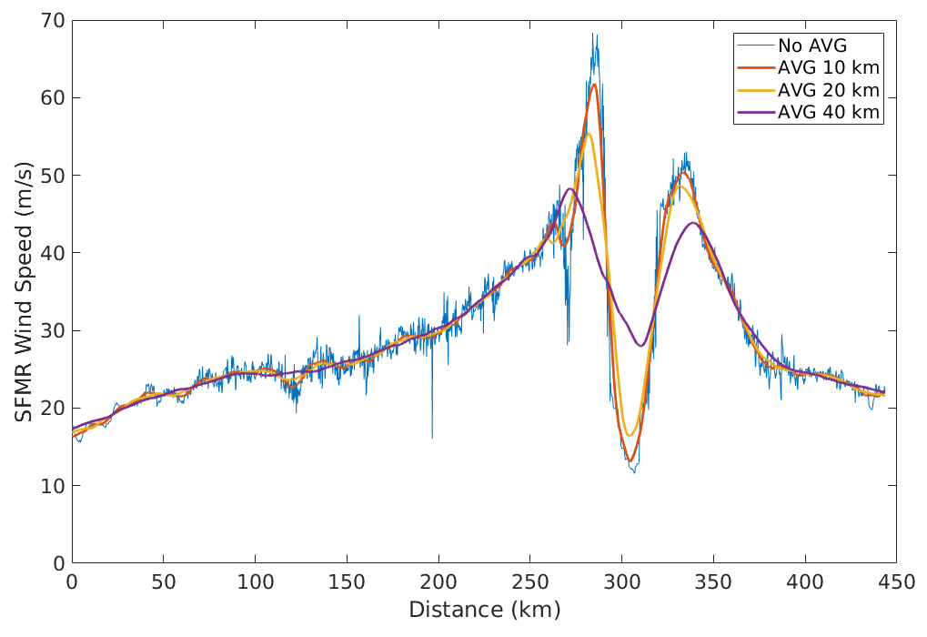
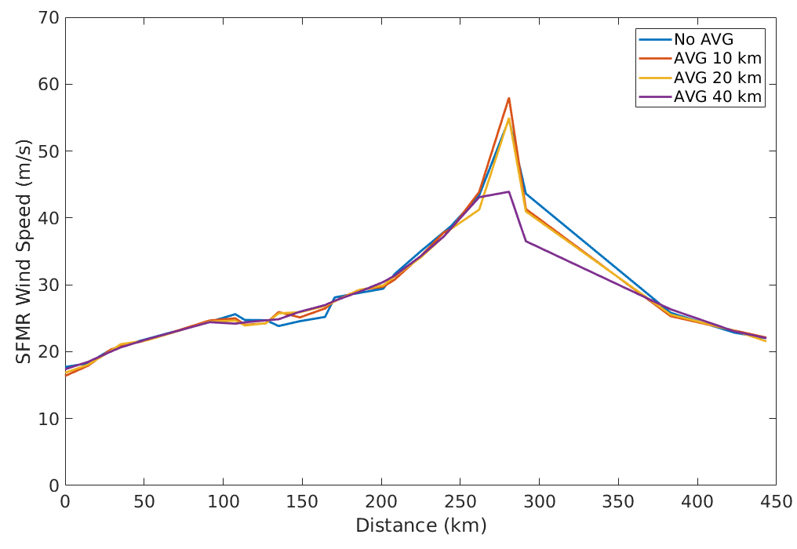
Progress of task CV-23-05
  Reference aspect:
SFMR upscaling effects at SFMR 1-sec sampling
SFMR upscaling effects at 12.5 km sampling
Spatial scale is a relevant aspect in the verification of satellite-derived winds.

Slide 11
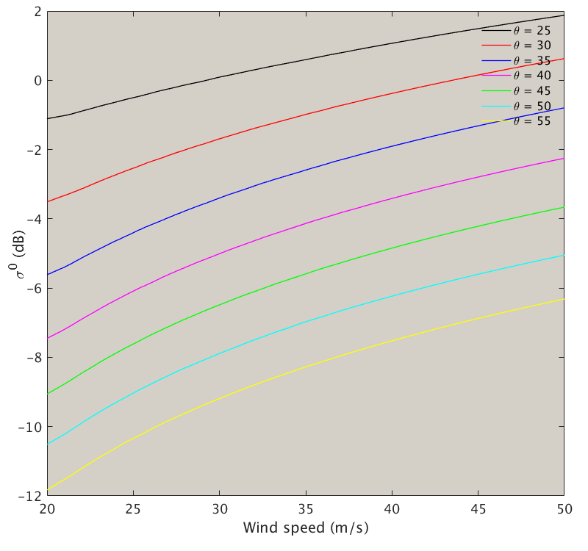
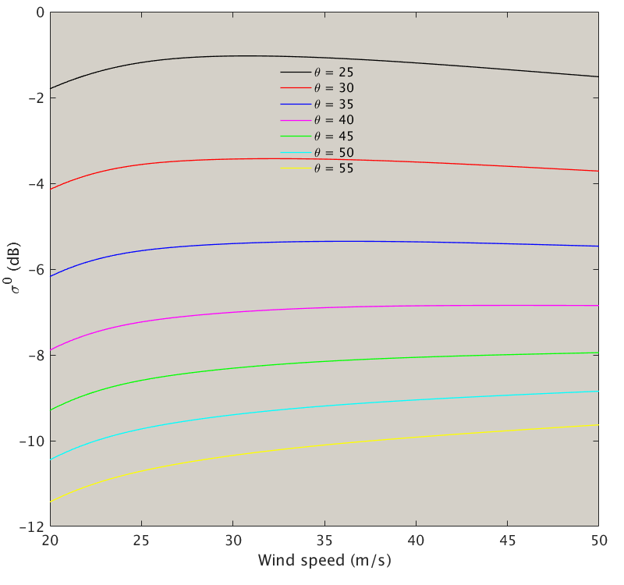
Progress of task CV-23-05
  Satellite aspect:
  sensitivity of σ⁰ to high and extreme winds
Ku-VV up-wind
0.1 dB sigma-0 change corresponds to 3.6 m/s wind speed change
C-VV up-wind

Slide 12
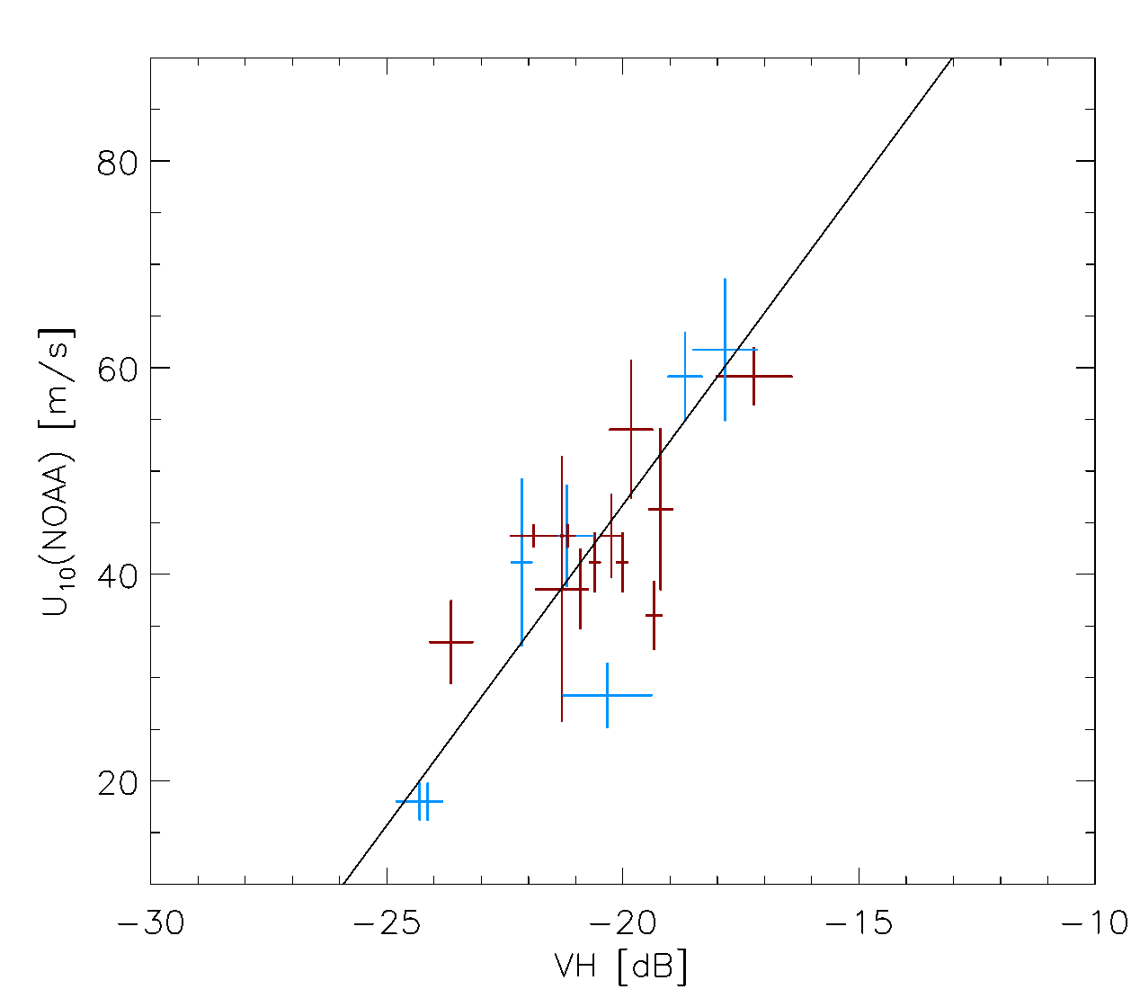
Progress of task CV-23-05
C-band cross-polarization backscatter is sensitive to the extreme winds

Slide 13
Progress of task CV-23-05
Task team
  Nanjing University of Information Science and Technology (NUIST); (Task lead & SAR extreme winds);
  National Space Science Center (NSSC); (Rain effect for extreme winds)
  Royal Netherlands Meteorological Institute (KNMI); (SCAT extreme winds)
  National Ocean Satellite Application Center (NSOAS); (SCAT and RAD extreme winds);
  National Satellite Meteorological Center (NSMC/CMA); (C- and Ku- combined wind)
  National Oceanic and Atmospheric Administration (NOAA); (SFMR reference winds)
  Other potential contributers

Slide 14
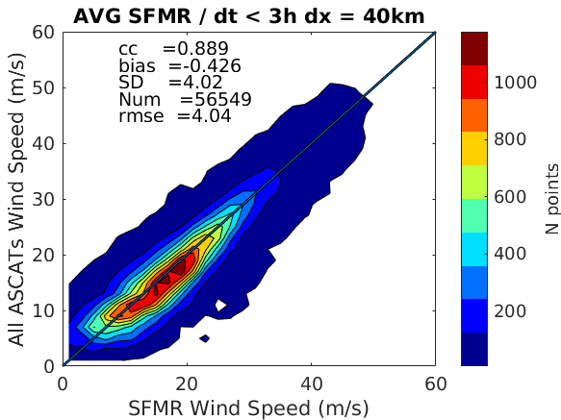
Progress of task CV-23-05
Progress
Original ASCAT winds
Adjusted ASCAT winds
Adjusted ASCAT winds (fitting) consistent with SFMR (as expected)
Portabella, et al., 2022

Slide 15
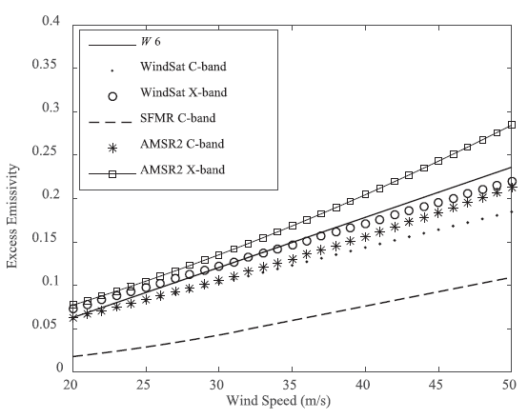

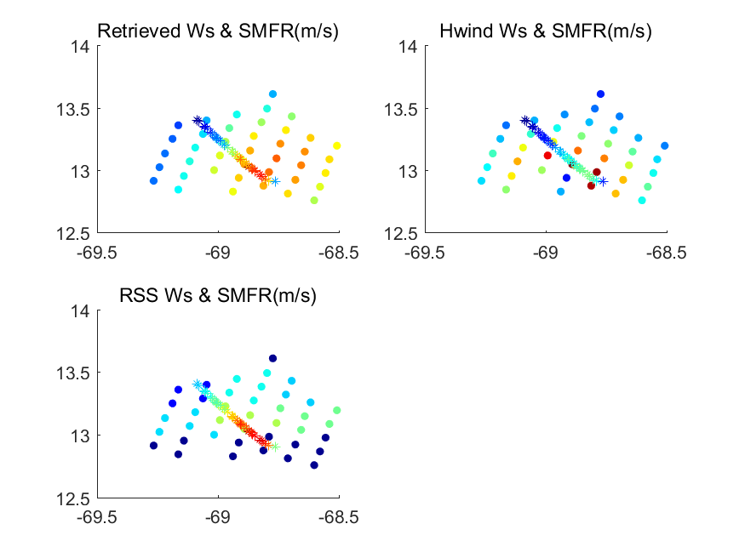
Progress of task CV-23-05
Progress
Improved emissivity model + retrieval using low frequency channels, leading to improved estimation of extreme winds (compared to SFMR) (Yin, et al., 2023)
Improved emissivity model

Slide 16
Progress of task CV-23-05
Main development issues
Error analysis (triple collocation) of multi-mission winds & reference data
Improve the radiation and/or scattering models
Joint SFMR/SAR/SCAT & RAD (statistical & spatial) analysis bring added value
Spatial analysis (RMW, wind radii, etc.) is needed to further validate the satellite-derived winds
Seek for user feedback
Next step
Team meeting for detailed workplan and deliverables

Slide 17
Progress of task CV-23-06
CV-23-05: Retrieval and validation of sea surface atmospheric pressure with microwave remote sensing
Task lead:
Dr. Zijin ZHANG
National Space Science Center, CAS

Slide 18
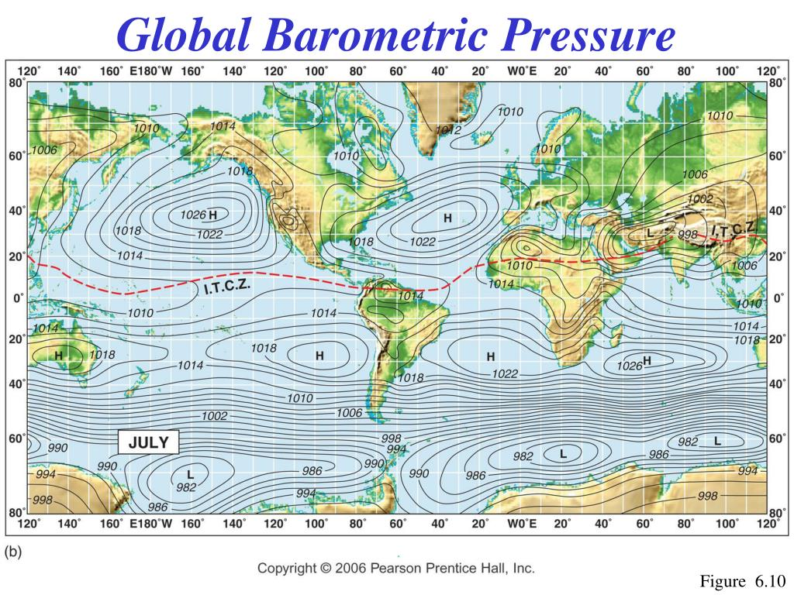
Progress of task CV-23-06
Introduction
Surface pressure data have important applications in numerical weather prediction (NWP), tropical cyclone forecasting and analysis, global climate change studies.
Currently, ocean surface atmospheric pressure data are mainly provided by buoys and ship measurements. The spatial coverage of in situ data for use by weather forecasters is very poor.
Only remote sensing techniques can obtain surface pressure data with large spatial coverage and high density sampling over oceans. However, no on-orbit sensor is designed for ocean surface pressure observation, and there are no operational surface pressure retrieval products.
Stations reporting surface pressure

Slide 19
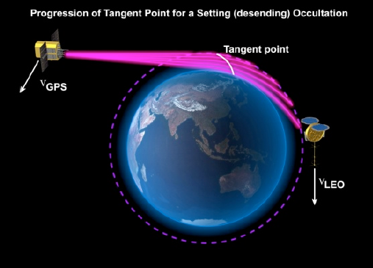
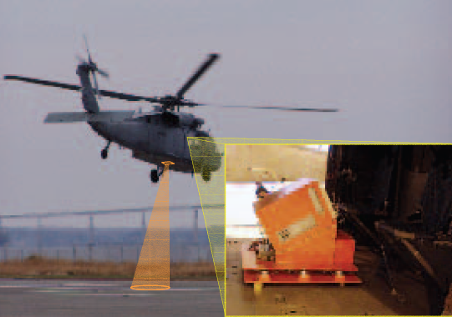
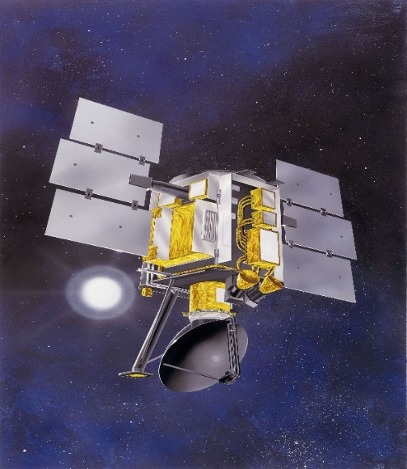
Overview of Existing Techniques
Progress of task CV-23-06
Instrument | Frequency Band | Accuracy | Disadvantages
Grating spectrometer (Mitchell and O’Brien, 1987) | O₂ A band (759-771 nm) | 1~2 hPa (Clear Sky) | Only available in daytime and clear-sky
Global Positioning System radio occultation （Healy, 2013） | L-band L1:1.57542 GHz L2: 1.227 GHz | 1~2 hPa | Horizontal resolution is several hundred kilometers
Airborne differential absorption radar (L. Millan 2014; Lin and Hu 2005) | 50-56 GHz O₂ bands | 4~7 hPa | Continuous, large-scale and wide swath observations are not available
Microwave Scatterometer (Patoux et al., 2008; Zhang et al., 2011) | 14.6 GHz (SASS) 13.4 GHz (QuikSCAT) | 1~3 hPa (clear-sky、cloudy and rainy conditions) ~ 20 hpa (hurricanes and typhoons) | Performance during extremely high wind conditions (wind speed >28 m/s) are not satisfactory Data cannot be obtained in real-time
19

Slide 20
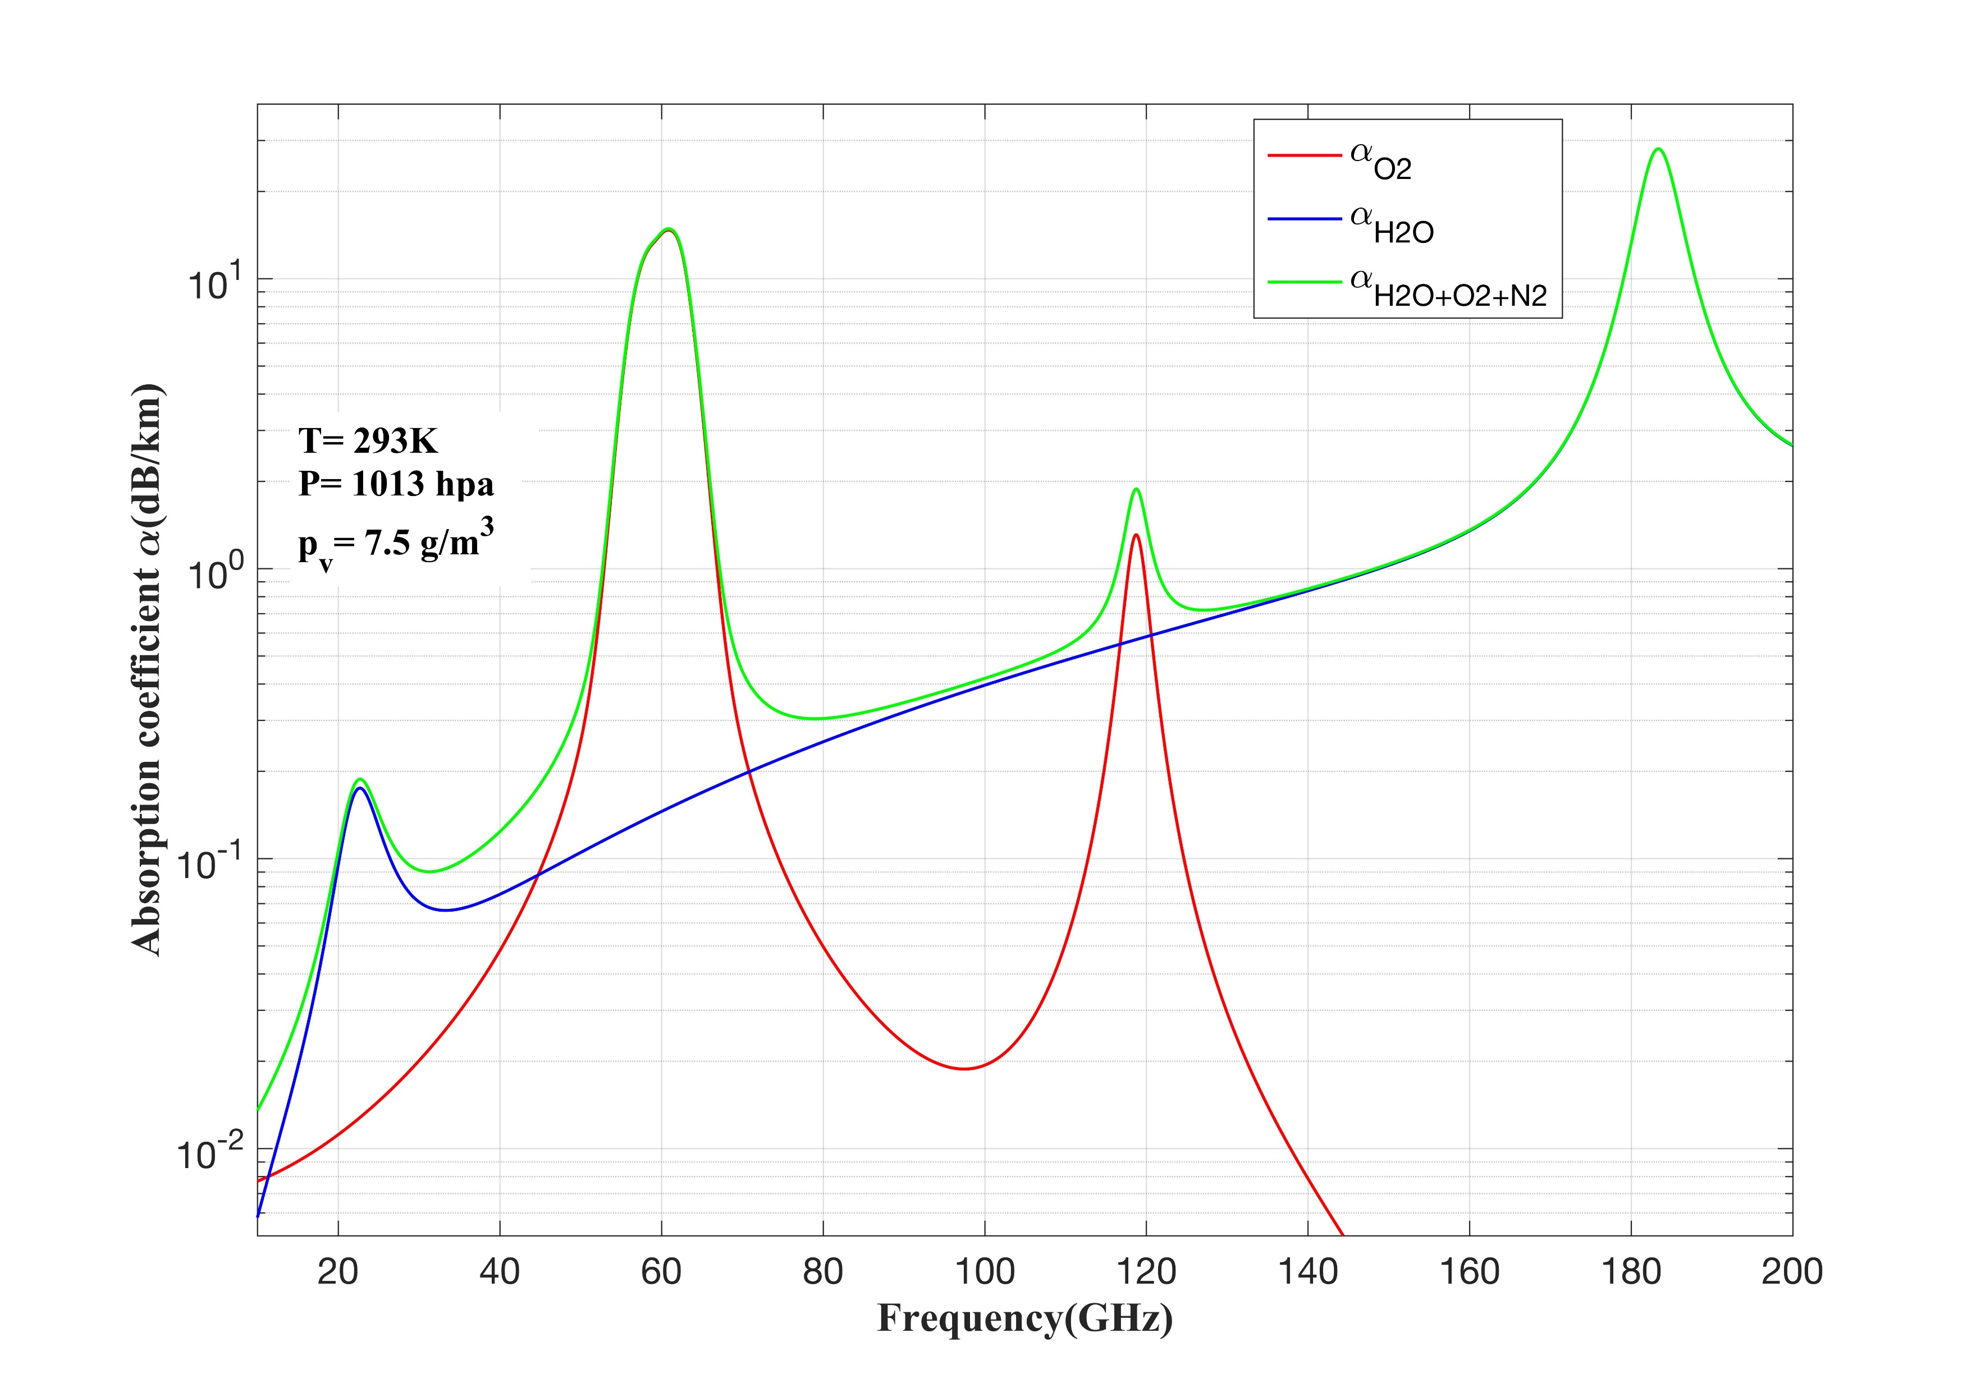
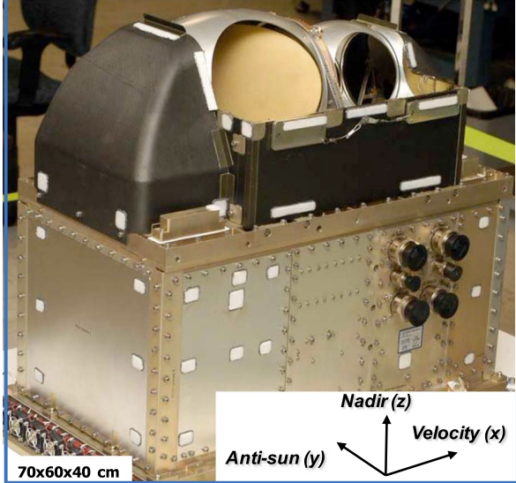
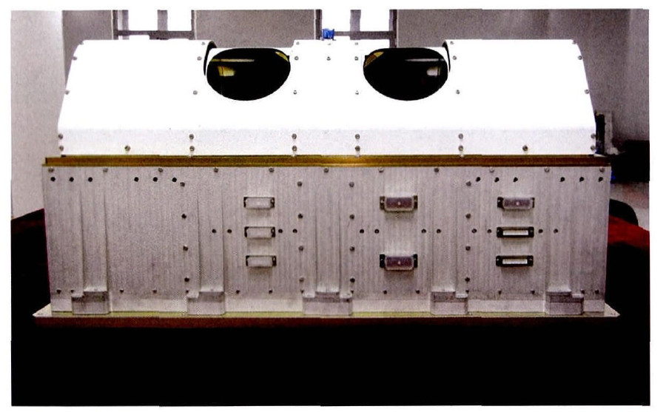
Progress of task CV-23-06
Retrieving surface atmospheric pressure from spaceborne passive microwave observations
Surface pressure sounding is achieved by microwave radiometers due to their ability to measure the total columnar oxygen absorption.
In the oxygen absorption band (50-70 GHz, 118 GHz) , the total columnar atmospheric absorption is strongly related to column oxygen mass. Oxygen is uniformly mixed in the atmosphere; therefore, the column oxygen mass is directly proportional to the surface pressure.
SNPP/ATMS (50-60 GHz )
FY-3C/MWHTS(118 GHz)

Slide 21
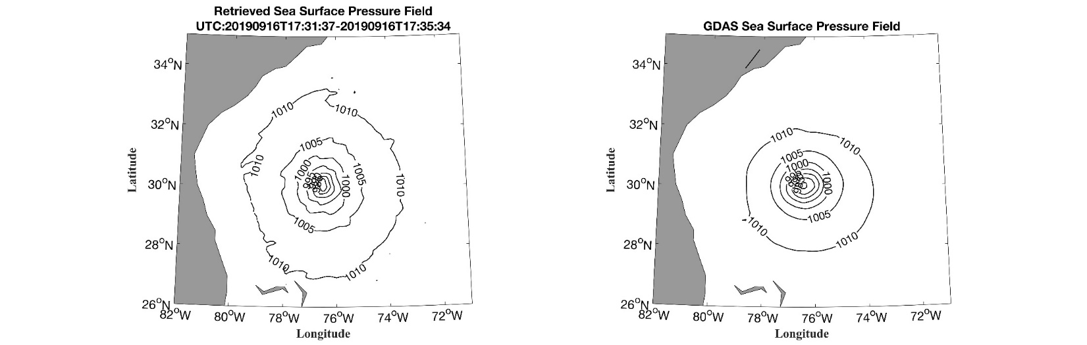
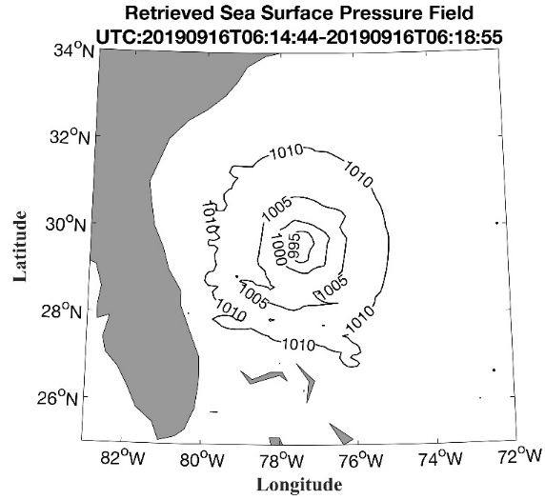
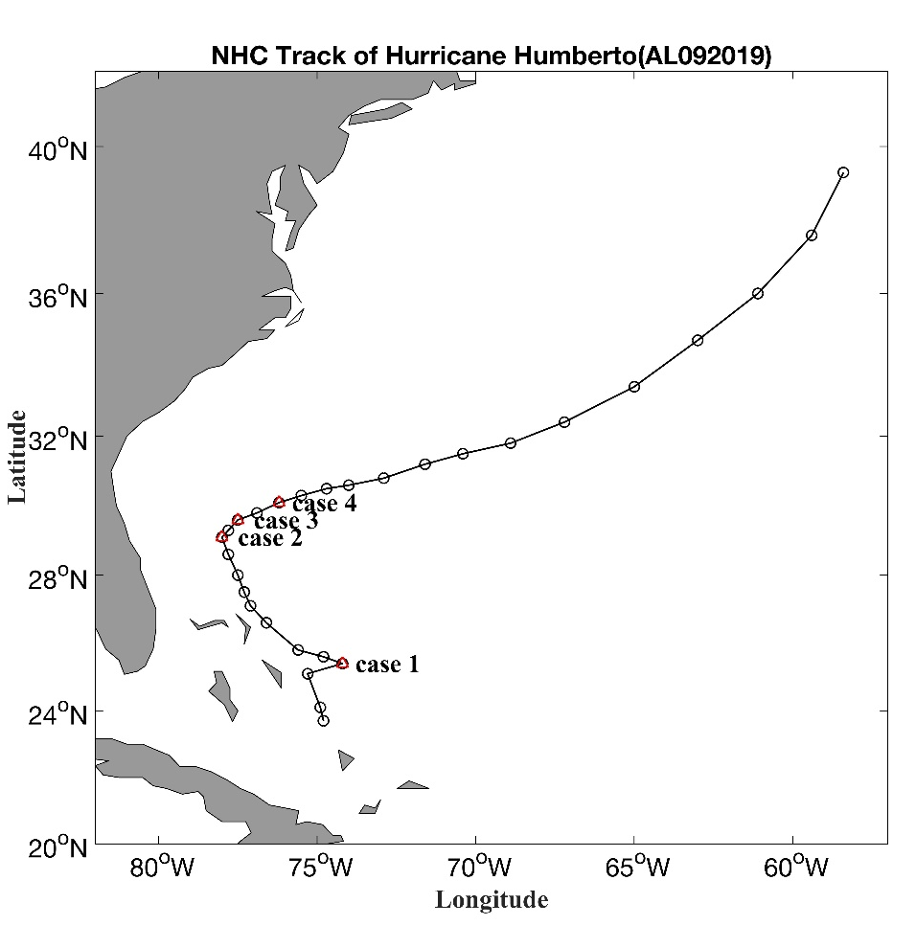
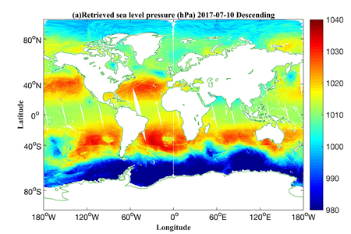
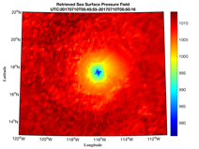
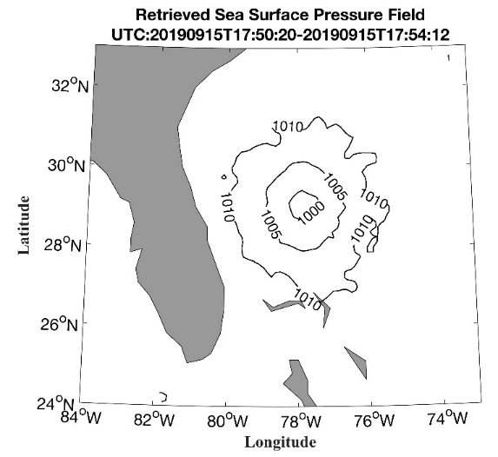
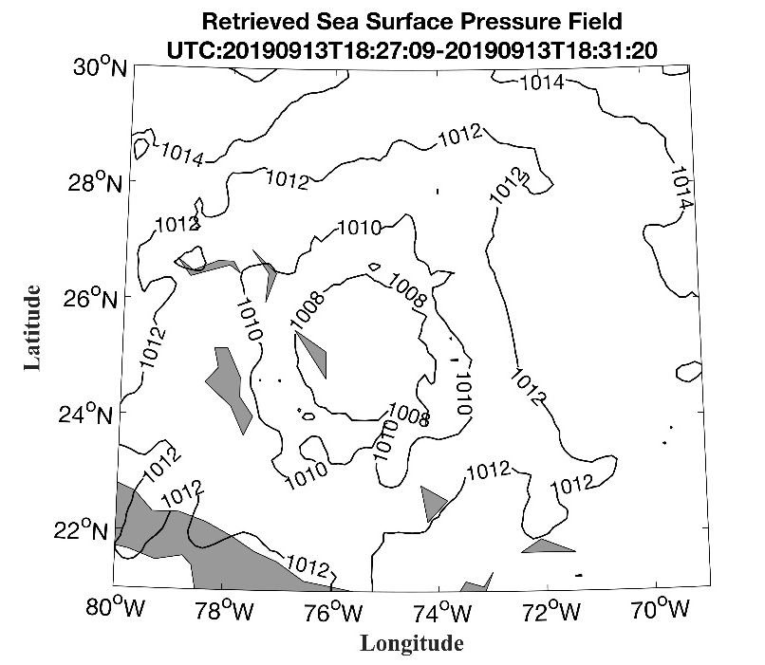
Advantages of the new technique
Progress of task CV-23-06
Applications:
Prediction and forecasting for disasters and extreme weather;
Numerical weather prediction (NWP);
Global climate change studies;
Advantages:
All weather capability
Day and night capability
High spatiotemporal resolution (<3h, ~16km by multi-satellite joint observation)
Wide swath observations (several thousand km): fast, continuous and stable global observations capability
21

Slide 22
Progress of task CV-23-06
Objective
  To develop and optimize the retrieval models and algorithms for sea surface pressure by passive microwave observations.
  To validate and assess the sea surface pressure data products using collocated in situ measurement data.
  To deliver the all-weather sea surface pressure data product from passive microwave observations.
Towards all-weather quality ocean surface atmospheric pressure product

Slide 23
Progress of task CV-23-06
Task team (TBC)
  National Space Science Center (NSSC); (Task lead & retrieval algorithm)
  Shanghai Typhoon Institute (TC data analysis);
  National Satellite Meteorological Center (NSMC/CMA); (MWHT/MWHT data)
  National Ocean Satellite Application Center (NSOAS); (SCAT wind data);
  Hong Kong Observatory (in situ data)
  Other potential contributors

Slide 24
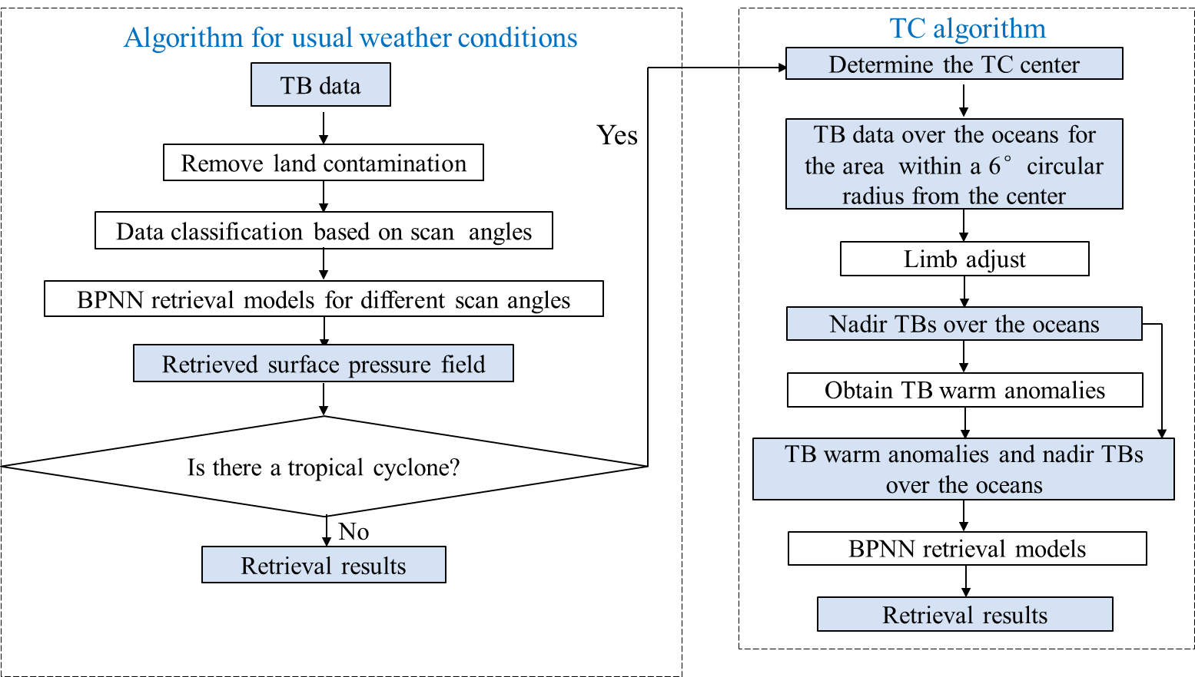
Development of retrieval algorithms
Progress of task CV-23-06
Progress
A backpropagation neural network (BPNN) based retrieval algorithm was established and used to retrieve surface pressure from the input TB data.
The priori information is not required as input of the algorithm. Ocean surface atmospheric pressure data can be rapidly and directly retrieved from radiometric observations.

Slide 25
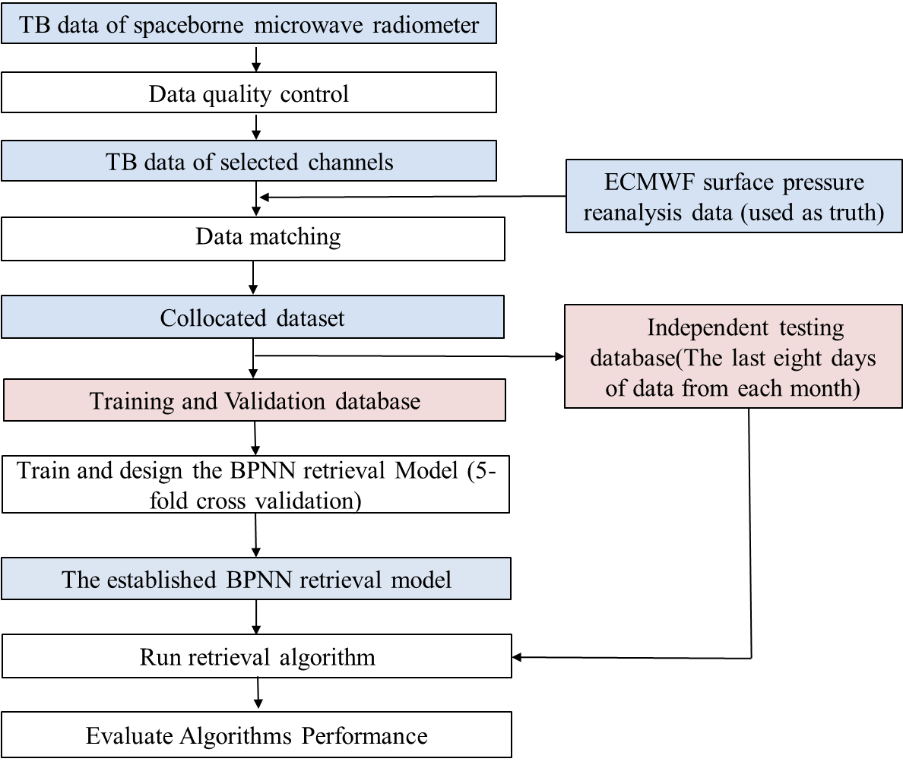
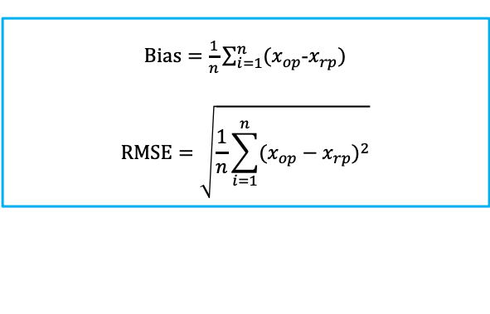
Assessment of the retrieval accuracy
Progress of task CV-23-06
Brightness temperature data of spaceborne microwave radiometer - input of the algorithm
- Spatial resolution (nadir): 32 km (SNPP/ATMS and FY-3D/MWTS-II), 16 km (FY-3D/MWHTS, FY-3D/MWHTS)
- Temporal resolution: 2 times/day
ECMWF reanalysis surface pressure data or NCEP GDAS/FNL surface pressure analysis fields– to develop and test the algorithm
- Spatial resolution: 0.25º☓ 0.25º
- Temporal resolution: 6 hours
- The last eight days data of each month are used for independent testing.
In situ surface pressure data (buoys, ships and dropsondes) – to test the algorithm
$Bias=\frac{1}{n}\sum_{i=1}^{n}{(x_{op}}$-$x_{rp})$
$$RMSE=\sqrt{\frac{1}{n}\sum_{i=1}^{n}{(x_{op}}−x_{rp})^{2}}$$

Slide 26
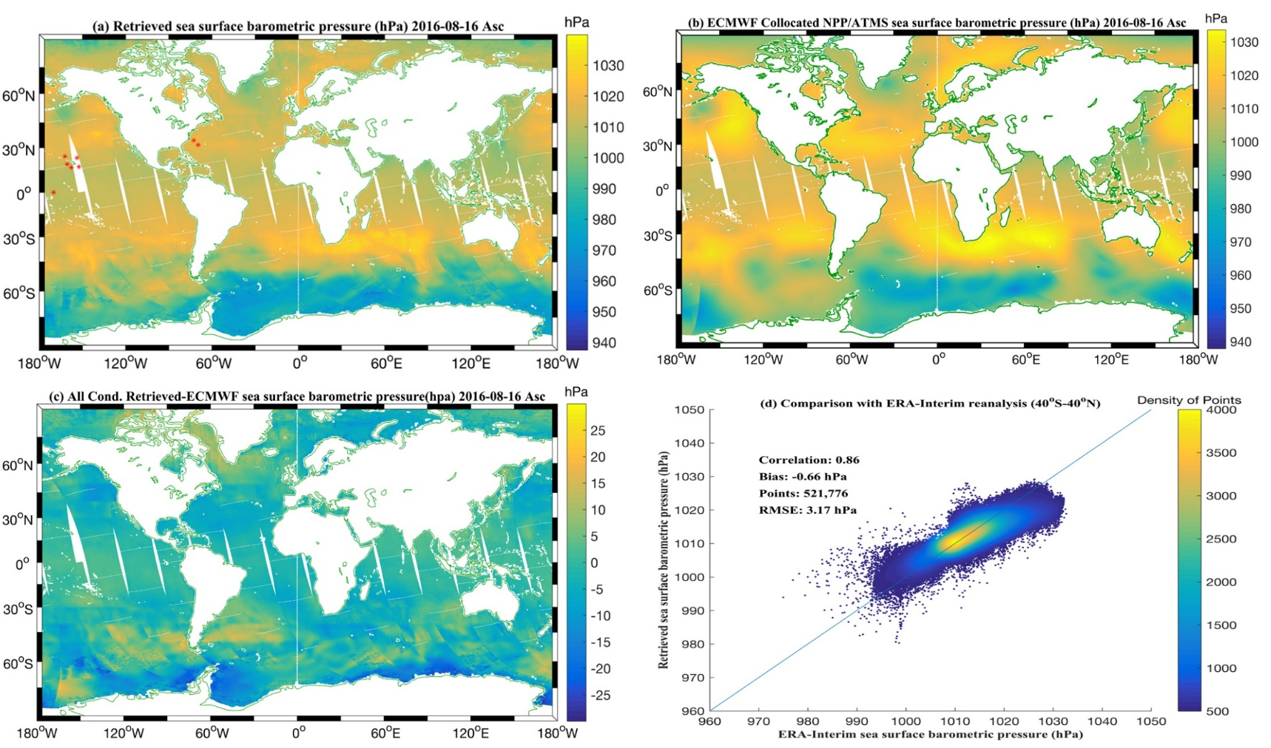
Preliminary assessment of by comparing the retrievals from SNPP/ATMS data with ERA-Interim reanalysis
Progress of task CV-23-06
Progress
Retrievals correlate well with the ERA-Interim reanalysis surface pressure data.
Retrieval results using the SNPP/ATMS ascending data in August 16, 2016.

Slide 27
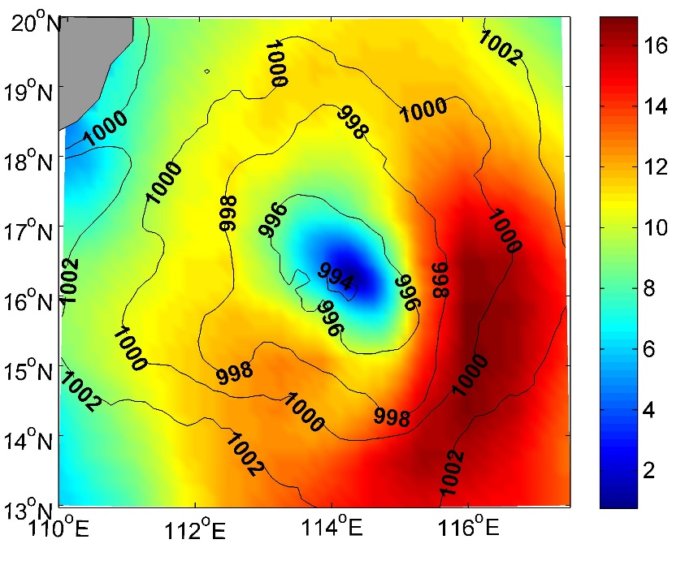
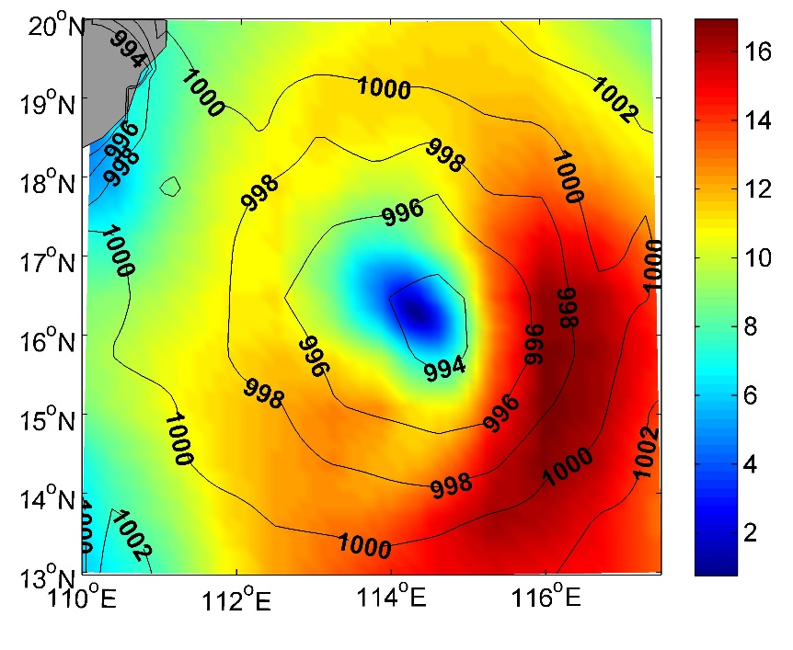
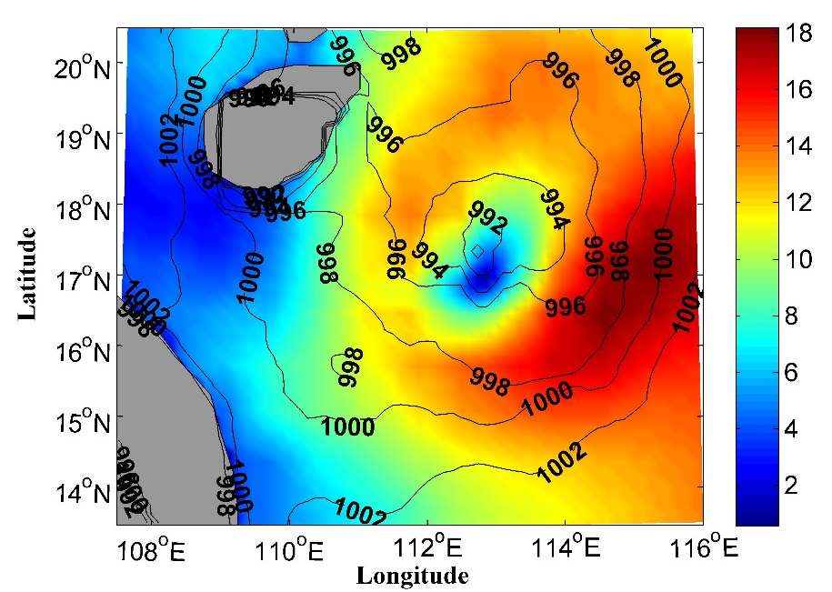
Preliminary assessment by comparing the retrievals from SNPP/ATMS data with NCEP GDAS/FNL analysis data
Progress of task CV-23-06
Retrievals
NCEP analysis
Retrievals correlate well with the NCEP GDAS/FNL surface pressure analysis data.
The TC structure described by the retrieved surface pressure fields agree well with that described by the NCEP GDAS/FNL 10m wind speeds.
Retrievals
NCEP analysis
Retrieved surface pressure shown using contour, and NCEP GDAS/FNL 10m wind speeds shown using shade for tropical storm Jebi at 0604 UTC (top) and 1835 UTC (bottom)1 August 2013.
27

Slide 28
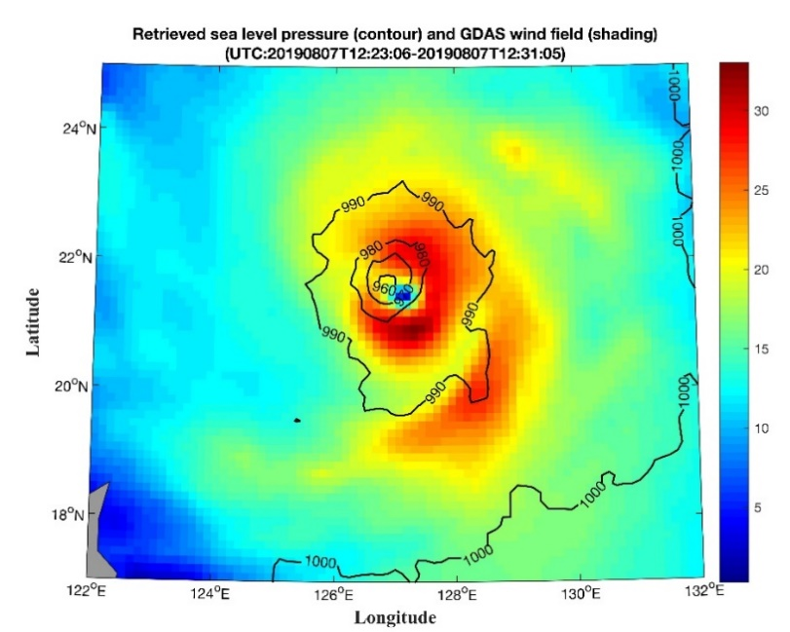
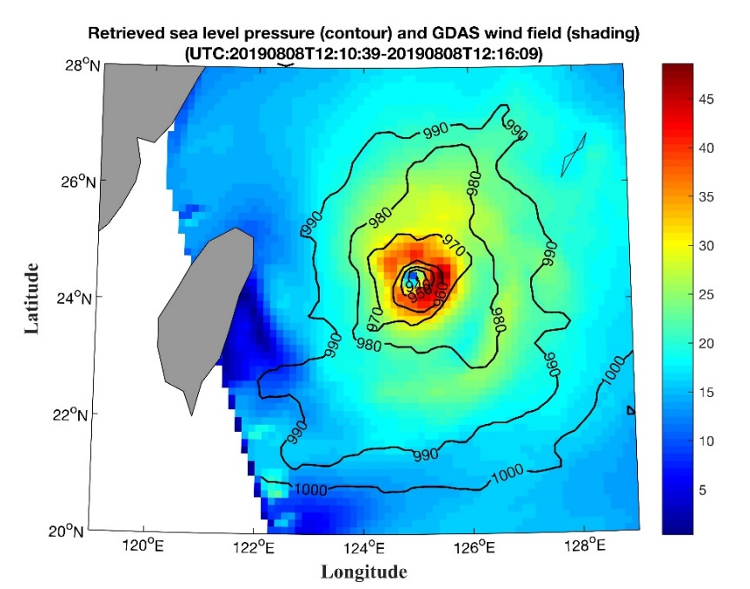
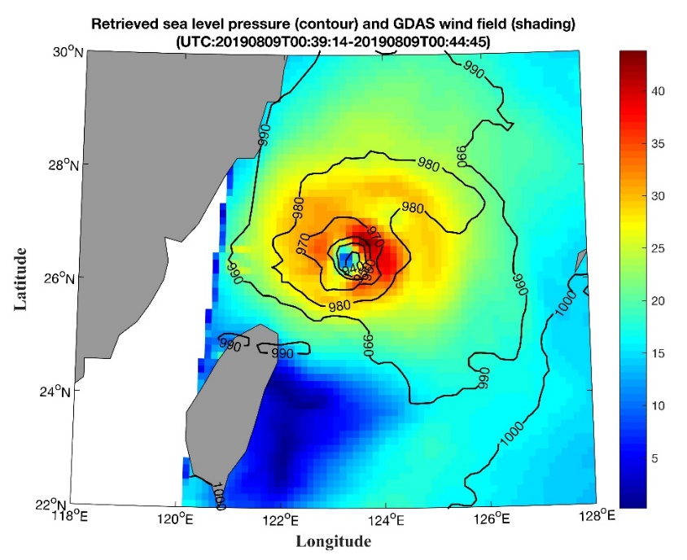
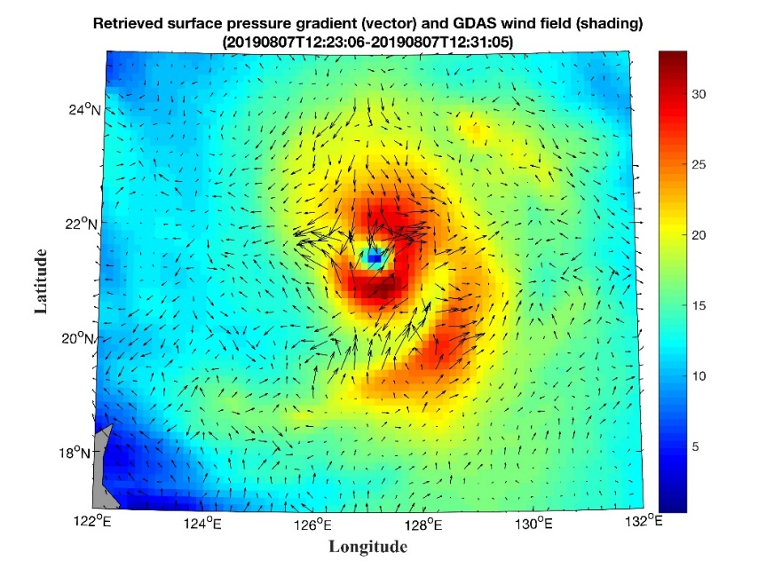
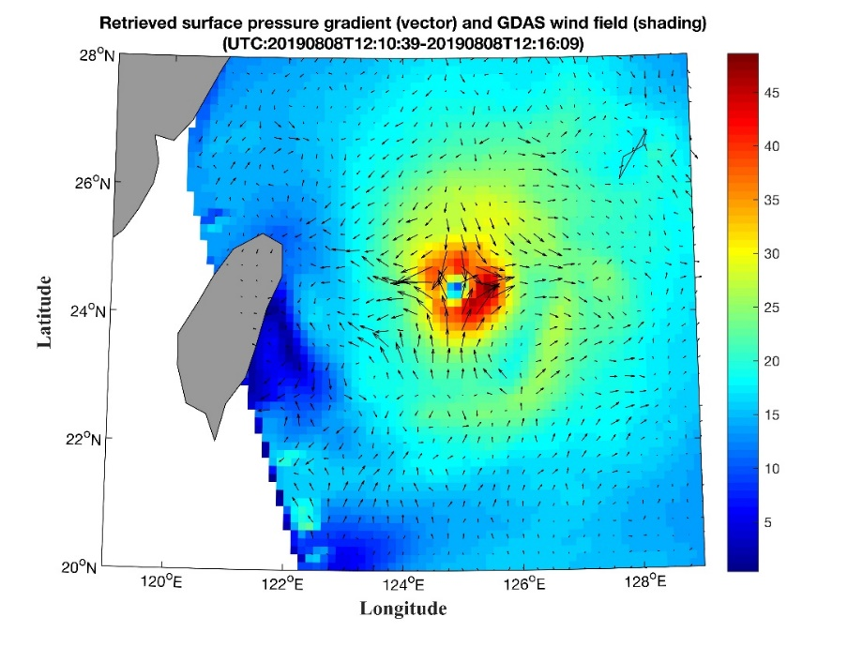
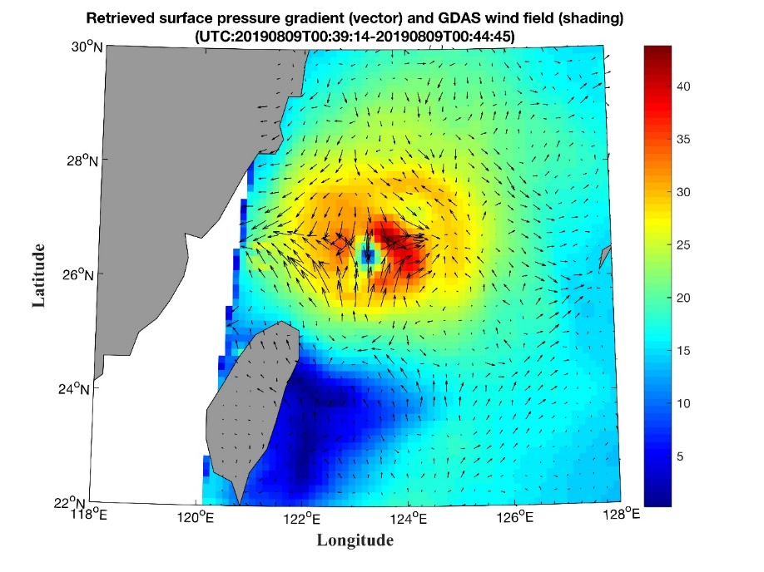
Preliminary assessment by comparing the retrieved surface pressure and pressure gradients from FY-3C/MWHTS data with NCEP 10m wind analysis data
Progress of task CV-23-06
The TC structural features described by the retrieved surface pressure fields agree well with that described by the NCEP 10m wind speeds.
The retrieved surface pressure gradients correlate well with surface winds.
Retrieved surface pressure (top) shown using contour, surface pressure gradients (bottom) shown using vector and NCEP GDAS/FNL 10m wind speeds shown using shade for typhoon lekima (1909).
28

Slide 29
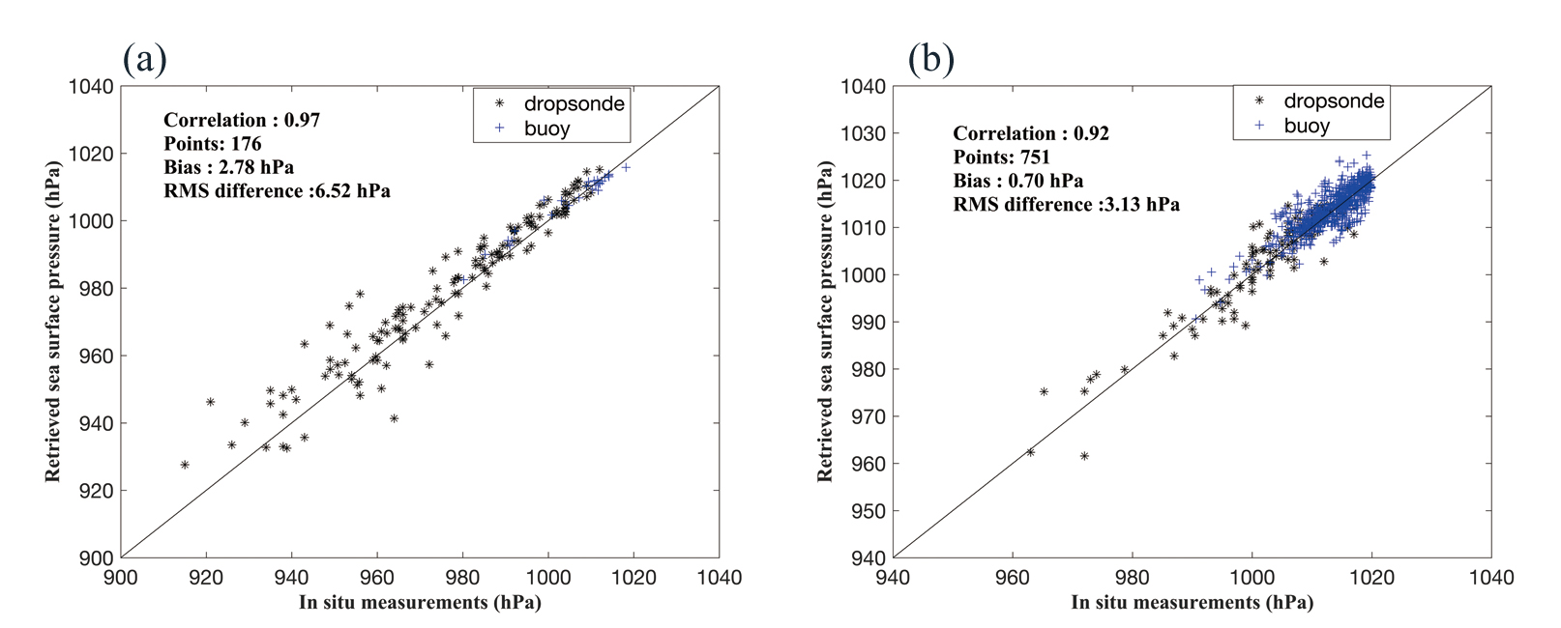
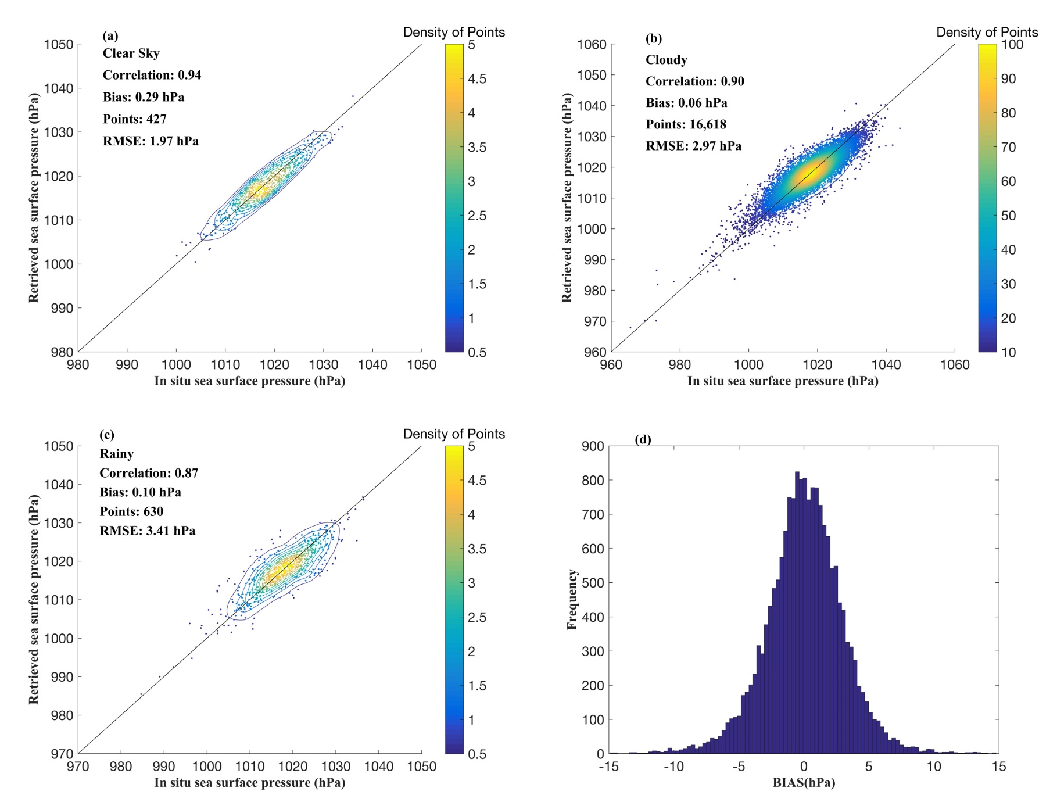
Preliminary assessment by comparing the retrievals from SNPP/ATMS data with in situ data
Progress of task CV-23-06
TC centers
TC core area
(<2º radius from center)

Slide 30
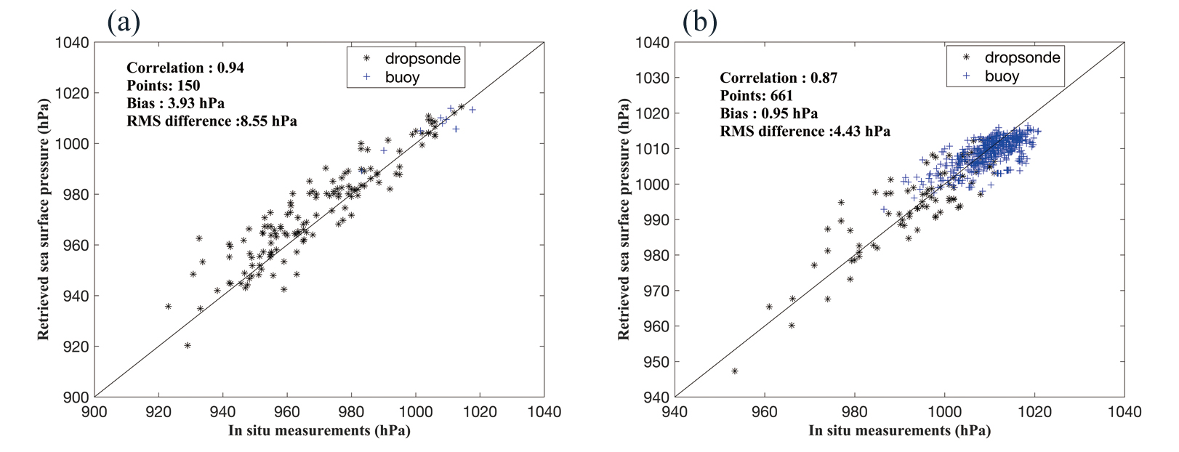
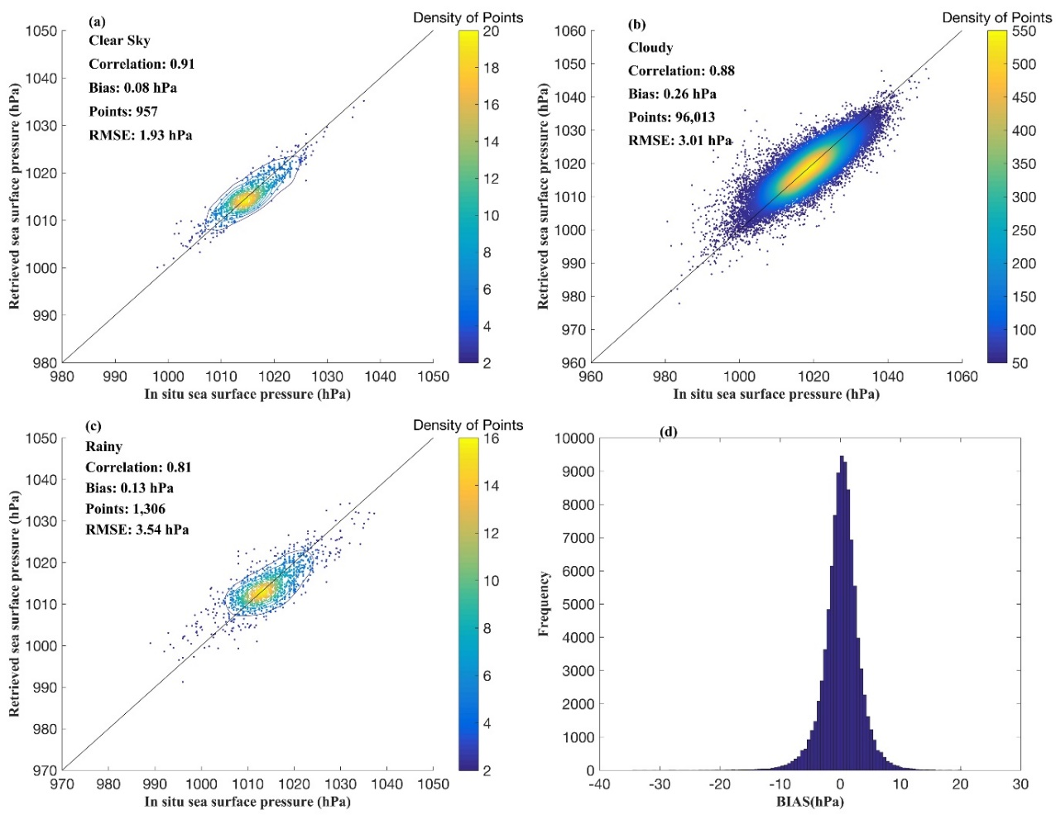
Preliminary assessment by comparing the retrievals from FY-3C/MWHTS data with in situ data
Progress of task CV-23-06
TC centers
TC core area
(<2º radius from center)

Slide 31
Summary of the preliminary assessment comparison results between retrievals and In situ data
Progress of task CV-23-06
Data source | RMSE (hPa)
 | Clear sky | Cloudy | Rainy | TC centers |  |  | TC core area
 |  |  |  | TD and TS | TY and HU | STY and Major HU
SNPP/ATMS | 1.97 | 2.97 | 3.41 | 4.26 | 6.38 | 9.61 | 3.13
FY-3C/MWHTS | 1.93 | 3.01 | 3.54 | 3.62 | 7.98 | 9.68 | 4.43
50-60 and 118 GHz microwave radiometer has a similar surface pressure sounding ability？
(Requires further validation because the FOVs of SNPP/ATMS and FY-3C/MWHTS are not overlap)

Slide 32
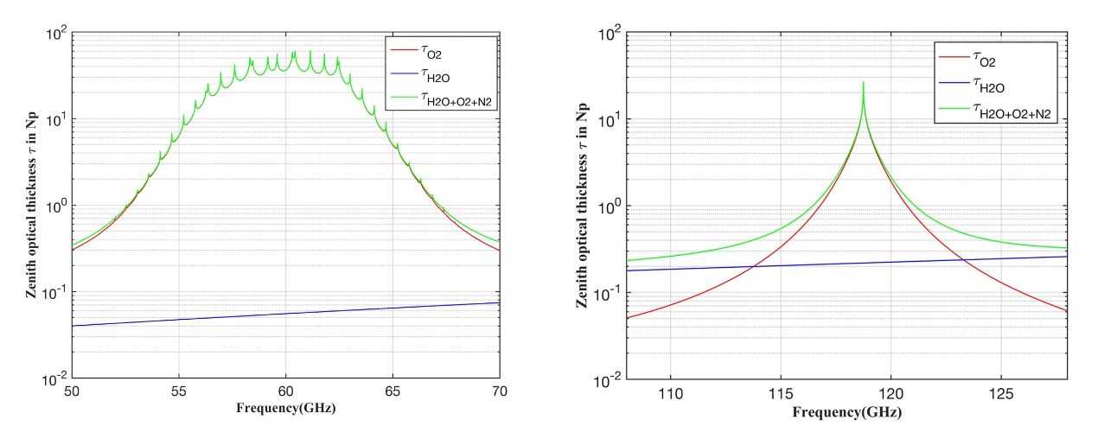
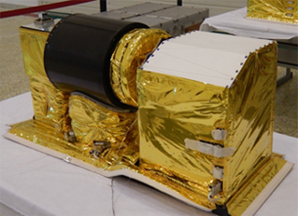
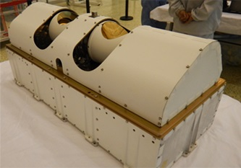
Progress of task CV-23-06
Comparison of retrievals using FY-3D/MWTS-II and FY-3D/MWHTS data
FY-3D/MWTS-II (50-60 GHz )
FY-3D/MWHTS(118 GHz)
The oxygen absorption characteristics are different
Their FOVs are partially overlap
50-60 and 118 GHz microwave radiometer, which has a better surface pressure sounding ability？
Using the joint passive microwave observations of 50-60 and 118 GHz for surface pressure retrieval, can retrieval accuracy be improved?

Slide 33
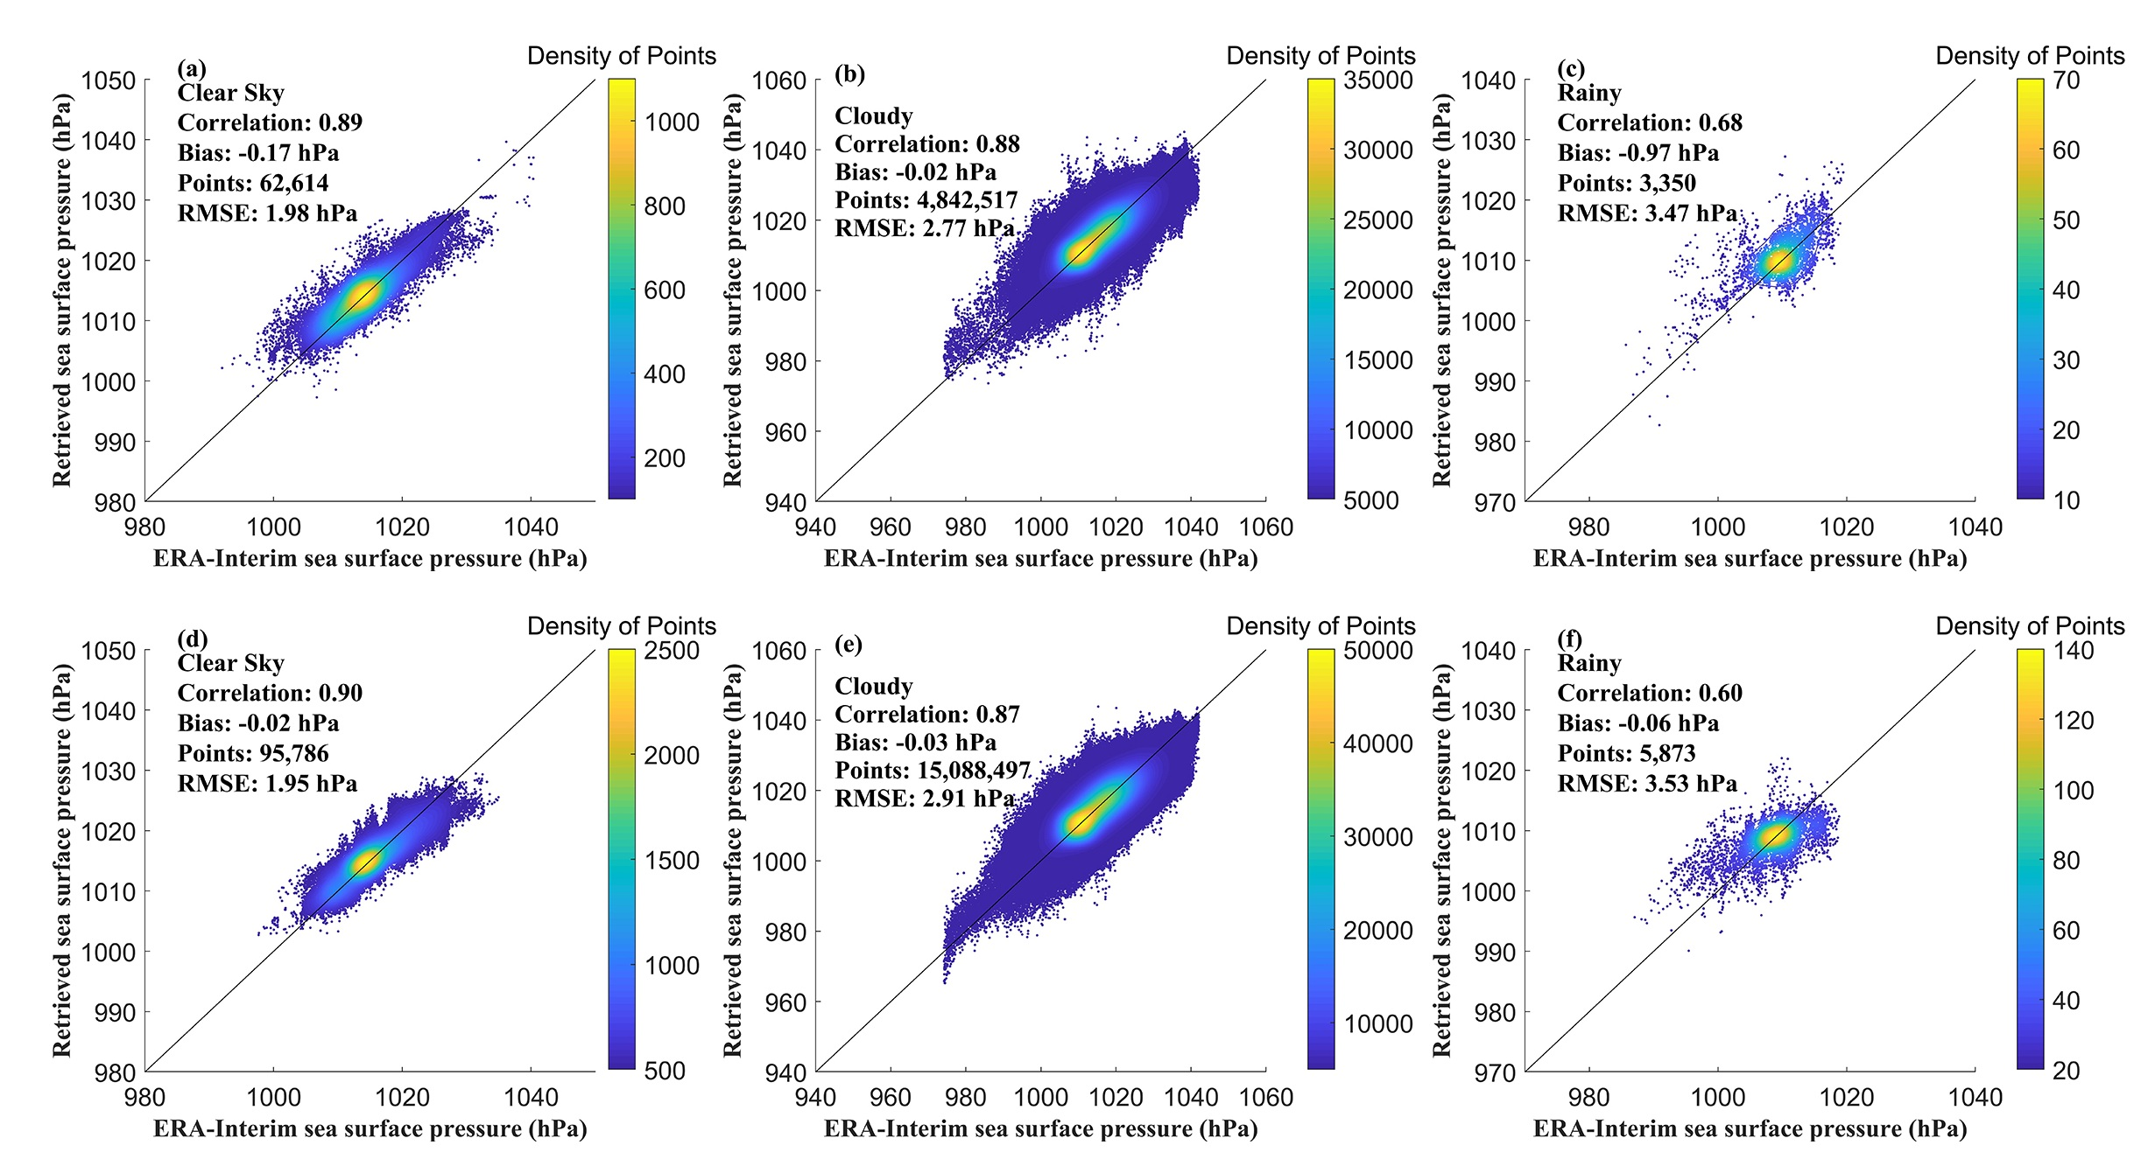
Comparison the retrievals from FY-3D/MWTS-II and FY-3D/MWHTS data with ERA-Interim reanalysis
Progress of task CV-23-06
MWTS-II
MWTS-II
MWTS-II
MWHTS
MWHTS
MWHTS
33

Slide 34
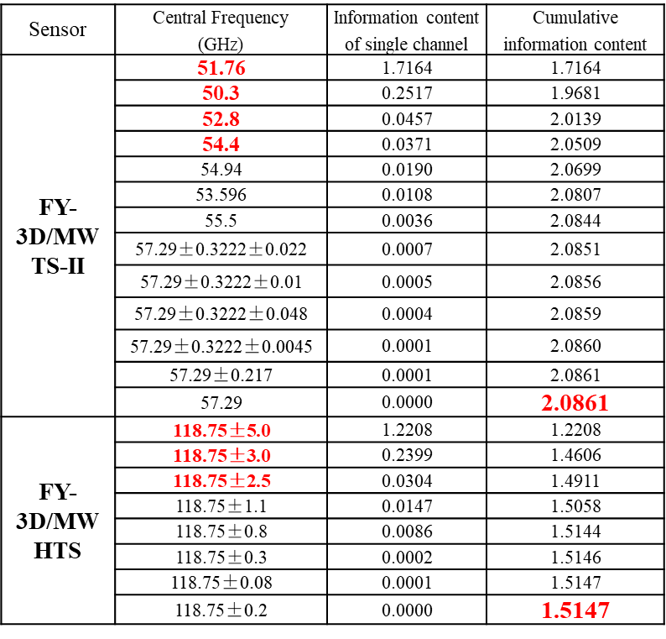
Compare the retrievals from FY-3D/MWTS-II and FY-3D/MWHTS data with ERA-Interim reanalysis
Progress of task CV-23-06
For clear-sky condition, the retrieval performance are similar;
For cloudy and rainy conditions, the retrieval performance of MWTS-II is better than MWHTS
MWTS-II
higher information content
less sensitive to cloud and rain
34

Slide 35




Comparison of the retrievals from FY-3D/MWTS-II and FY-3D/MWHTS data with NCEP analysis data
Progress of task CV-23-06
Retrievals using MWTS-II data for hurricane Humberto (AL092019).
For tropical depressions, the performance are similar.
For tropical storms, typhoons and hurricanes, the retrieval performance of MWTS-II is slightly better than MWHTS.
Retrievals using MWHTS data
MWTS-II
Higher surface pressure information content
Less sensitive to cloud and rain
Lower spatial resolution
NCEP GDAS analysis
1750 UTC, 15 Sep 2019
0614 UTC, 16 Sep 2019
1731 UTC, 16 Sep 2019
35

Slide 36
Combined retrieval with the 50-60 and 118 GHz observations for surface pressure retrieval
Progress of task CV-23-06
Sensor | Central Frequency (GHz) | BW (MHz) | Sensitivity (K) | Information content of single channel | Cumulative information content
MWTS-II +MWHTS | 51.76 | 400 | 0.28 | 1.7164 | 1.7164
 | 50.3 | 180 | 0.37 | 0.2517 | 1.9681
 | 118.75±5.0 | 2000 | 0.27 | 0.0932 | 2.0613
 | 118.75±3.0 | 1000 | 0.27 | 0.0543 | 2.1155
 | 52.8 | 400 | 0.21 | 0.0344 | 2.1500
 | 54.4 | 400 | 0.19 | 0.0285 | 2.1785
 | 54.94 | 400 | 0.19 | 0.0148 | 2.1932
 | 53.596 | 400 | 0.18 | 0.0085 | 2.2017
 | 118.75±2.5 | 200 | 0.49 | 0.0071 | 2.2088
 | 118.75±1.1 | 200 | 0.52 | 0.0035 | 2.2123
 | 55.5 | 330 | 0.23 | 0.0028 | 2.2152
 | 118.75±0.8 | 200 | 0.65 | 0.0021 | 2.2172
Channels used for joint retrieval were selected based on the information content;
The weighted average method was used to match the FY-3D/MWHTS observations (~16km) to the FY-3D/MWTS-II (~32 km) resolution level;
Using the 60 and 118.75 GHz oxygen absorption bands together for surface pressure retrieval, more surface pressure information can be obtained;
The selected channel set is mainly composed of channels centered at the wing of the oxygen absorption band；

Slide 37

Comparison of the retrievals from FY-3D/MWTS-II + FY-3D/MWHTS data with ERA-Interim reanalysis
Progress of task CV-23-06
MWTS-II+MWHTS achieves better retrieval accuracy.
Using the 50-60 and 118 GHz passive microwave observations together for surface pressure retrieval, more surface pressure information can be obtained, and better retrieval accuracy can be achieved.
Data source | RMSE (hPa)
 | Clear sky | Cloudy | Rainy
MWTS-II | 1.95 | 2.77 | 3.47
MWHTS | 1.98 | 2.91 | 3.53
MWTS-II+MWHTS | 1.86 | 2.34 | 3.20

Slide 38
Progress of task CV-23-06
Main development issues
Ocean surface atmospheric pressure data with high spatiotemporal resolution can be retrieved from satellite passive microwave observations for both low and high wind conditions. In situ comparison demonstrates that the retrieval accuracy is better than 2.0 hPa for clear-sky, 3.0 hPa for cloudy, and 3.5 hPa for rainy, 6.0 hPa for TD and TS centers, 8.0 hPa for TY and HU centers, and 10.0 hPa for STY and Major HU centers, respectively; a joint retrieval algorithm is proposed to retrieve surface pressure over oceans using the observations of FY-3D/MWTS-II and FY-3D/ MWHTS together, which shows better retrieval accuracy;
Further optimization of the retrieval model and algorithm still needed;
Validation methodology and data sets need to be developed.
Next step
Team organizing meeting for detailed workplan and deliverables

Slide 39
Other work in preparation
Promote the ISO TS on calibration and retrievals of sea surface wind by radar scatterometry, which is the further deliverable of task CV-20-05.
CAL/VAL for GNSS-R.

Slide 40
Thanks!
dongxiaolong@mirslab.cn

