Slide 1
WGCV-52
Greenhouse Gases Cal/Val Network Updates and Future Requirements: NDACC, TCCON, COCCON
M.K. Sha, B. Langerock, M. De Mazière,
and J.-C. Lambert, BIRA-IASB
Agenda Item 2.8
WGCV-52, ESA/ESRIN, Italy, 5-9 June 2023

Slide 2
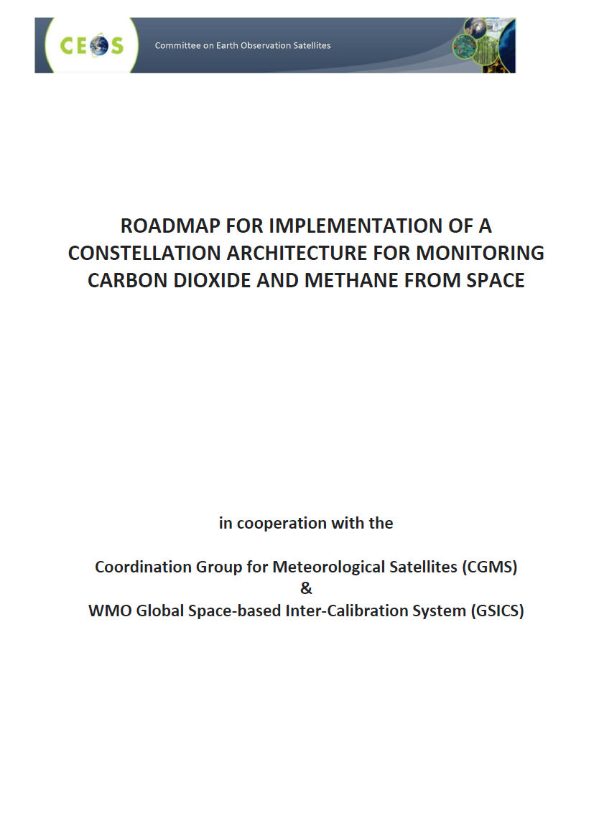
GHG Cal/Val Networks in CEOS Pubs
NDACC implicitly,
as a contributor to WMO GAW
2013
TCCON primarily,
EM27/SUN as extension
2018
TCCON primarily,
EM27/SUN as extension
2020
TCCON only
2014

Slide 3
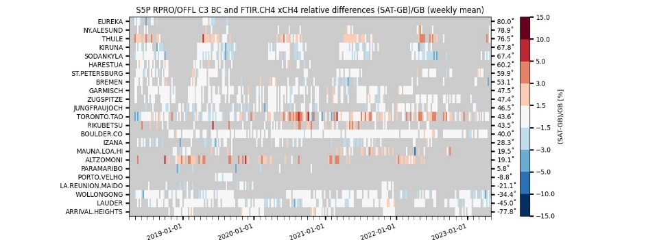
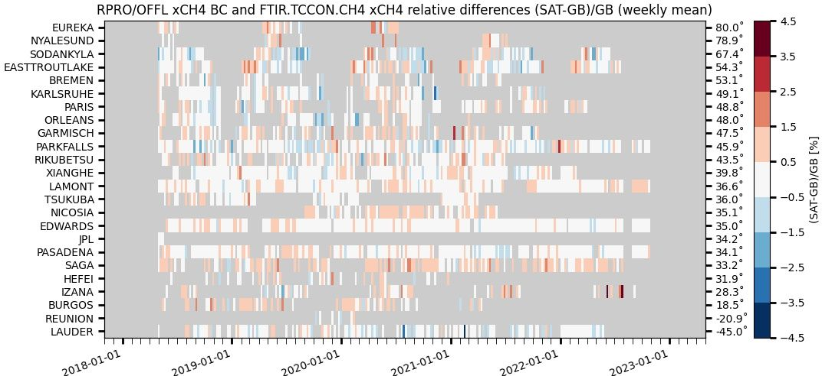
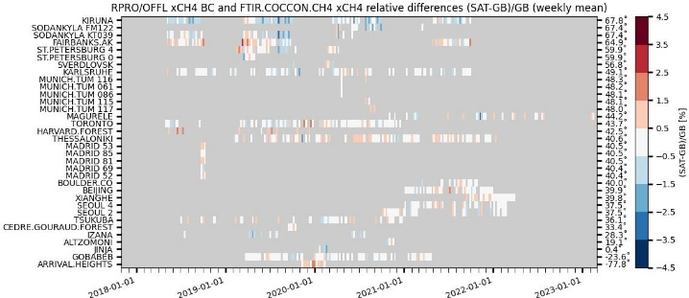
Sentinel-5p GHG Operational Validation
Sentinel-5p TROPOMI CH₄ and CO validation relies on three GHG monitoring networks:
NDACC FTIR : automated validation channel in ATM-MPC Automated Validation Server (https://mpc-vdaf-server.tropomi.eu).
Validation protocols based on published experience with HALOE, MOPITT, SCIAMACHY, MIPAS, ACE-FTS, IASI, GOSAT…
TCCON FTIR : manual validation channel in ATM-MPC, ESA contract for operations support to be placed in 2023
COCCON FTIR : manual validation channel in ATM-MPC, automation in progress (ESA contract 2023-2027)
S5P TROPOMI CH4 & CO validation updated permanently vs. NDACC FTIRs
and monthly vs. TCCON & COCCON FTIRs.
Quarterly validation reports available on http://mpc-vdaf.tropomi.eu
Images courtesy M.K. Sha
ATM-MPC update April 2023
Automated collection of observations from 17
NDACC FTIR stations
through EVDC =>
automated production of S5P Quality Indicators
TCCON GGG2020 data
released 26 April 2022
No/limited data submitted
since early 2021 until the
release of new data version
GGG2020
Collection of permanent
and campaign based
observations
More COCCON stations
to contribute in the
coming months

Slide 4
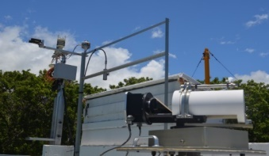
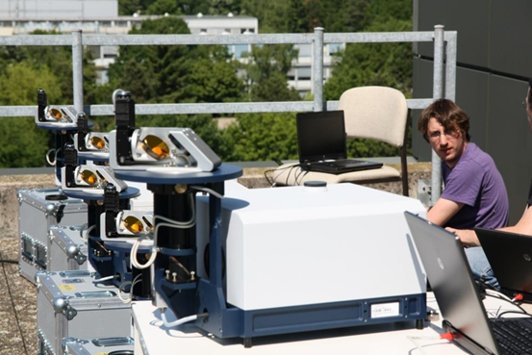
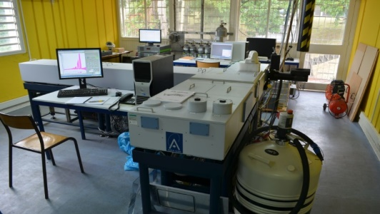
GHG Cal/Val Networks
NDACC FTIR
http://ndacc.org
Bruker 120HR/125HR
Resolution 0.0036 cm⁻¹
Profile retrievals (low vertical resolution, at least tropo/strato separation)
TCCON
http://tccon.org
Bruker 125HR
Resolution 0.02 cm⁻¹
Profile scaling retrievals
COCCON
http://www.imk-asf.kit.edu/english/COCCON.php
Bruker EM27/SUN
Resolution 0.5 cm ⁻¹
Profile scaling retrievals

Slide 5
GHG Cal/Val Networks
NDACC FTIR
http://ndacc.org
Bruker 120HR/125HR
Resolution 0.0036 cm⁻¹
Spectral range: SWIR, MIR and TIR
Measurements every ±10’
21 stations worldwide
Targets: O₃, CH4, N₂O, (CO₂, HCHO, SF₆, CFC, HCFC, H₂O, HDO not official), CO, HNO₃, HCl, HF, HCN, C₂H₆, ClONO₂, (C₂H₂, PAN, OCS, CH₃OH, NH₃, HCOOH, NO₂ not official)
Profile retrievals (low vertical resolution, typically tropo/strato separation)
Retrieval software: SFIT or PROFFIT
Measurement protocol (SOP), no central processing, QA/QC for selected targets in CAMS operational validation
TCCON
http://tccon.org
Bruker 125HR
Resolution 0.02 cm⁻¹
Spectral range: SWIR
Measurements every ~ 3’
28 stations worldwide
Targets: CO₂, CH₄, N₂O, H₂O, HDO, CO, HF
Profile scaling retrievals (profile retrievals in development)
Retrieval software GGG
Central QA/QC
COCCON
http://www.imk-asf.kit.edu/english/COCCON.php
Bruker EM27/SUN
Resolution 0.5 cm ⁻¹
Spectral range: SWIR
Measurements every ~ 1’
> 60 instruments worldwide (some fixed sites but mostly for campaigns)
Targets: CO₂, CH₄, CO
Profile scaling retrievals
Retrieval software PROFFAST
Central calibration & processing facility at KIT

Slide 6
GHG Cal/Val Networks
NDACC FTIR
http://ndacc.org
Operational use in: ESA/Copernicus ATM-MPC TROPOMI validation and CAMS validation (RD delivery supported by CAMS)
Recent and ongoing harmonisation efforts in QA4ECV, GAIA-CLIM, CAMS27, C3S-311a-Lot3 (BARON) Latest SFIT/PROFFIT to improve harmonization of uncertainties evaluation, better spectroscopy
Selected NDACC stations to join EU research infrastructure ACTRIS: with central processing facility, QA/QC, training…
CO2 retrieval strategy under development (IUP/UB & BIRA-IASB)
TCCON
http://tccon.org
Operational use in: OCO-2/3 & GOSAT-2 Cal/Val, CAMS validation, ESA TROPOMI validation (but limited RD delivery)
GGG2020 show improved prior profiles (shape and possible bias), no CO calibration factor, improve spectroscopy, reduce remaining airmass and H₂O dependences, reduce scatter in CO product, improve diagnostics for instrumental issues.
Negotiations ongoing for selected TCCON stations to join EU research infrastructure ICOS, with central processing facility
Profile retrievals under development. Tropospheric partial columns derived indirectly
COCCON
http://www.imk-asf.kit.edu/english/COCCON.php
Operational use in: OCO-2/3, GOSAT-2, S5P TROPOMI validation (started in 2020)
Updated PROFFAST release in May 2023, updated spectroscopic line lists (line mixing, speed dependent Voigt, …), refined modeling of airmass dependency, re-evaluation of gas-specific calibration factors based on reference meas. at different TCCON stations, …
EM27/SUN as travelling standard for TCCON, COCCON complements TCCON, support by ESA for COCCON-PROCEEDS, follow-up crucial for current capabilities
Towards extension of COCCON with VERTEX70 / INVENIO and IRcube (other low resolution FTIR instruments – with higher spectral resolution and additional species) – ESA FRM4GHG project https://frm4ghg.aeronomie.be

Slide 7
Recent developments
Retrieval of CH₄ vertical profile information from TCCON NIR spectra with 2.4 DOFs (https://doi.org/10.5194/amt-12-6125-2019) – EU H2020 – RINGO
Retrieval of CH₄ and N₂O total columns from low-resolution (0.2 cm⁻¹) Bruker Vertex70 in the mid-infrared region (https://doi.org/10.5194/amt-2022-17); first comparison of HCHO retrievals with high-resolution show promising results, further improvements under testing for measurements at Uccle (Belgium) and Kolkata (India) (ideal to support validation of multiple-satellites (LEO GHG satellites and GEO GEMS)
Traveling standard instrument operating autonomously for NIR using EM27/SUN developed and already deployed at TCCON stations in Japan, Canada, Australia. Inter-hemispherical consistency to better tie the instruments within the network, use the data for (re-)evaluation of gas-specific calibration factors for COCCON – traceability to the WMO scale
Development of autonomous mobile set-up for field deployment of low-resolution spectrometers – compact solar tracker and thermally isolated waterproof enclosure, Stirling-cooled InSb detector for measurements in MIR region.
Fiber optics feed for coupling solar radiation to low-resolution spectrometers (IRCube, EM27/SUN, …).
Develop AirCore observation of additional species (N₂O, OCS) – ESA FRM4GHG project https://frm4ghg.aeronomie.be

Slide 8
Future challenges and requirements
Availability of good reference in-situ profiles covering different measurement scenarios. Consistency of AirCore in-situ profiles for target species, reduction of in-situ uncertainty (e.g., due to error in altitude registration), observation of additional species, observation in the PBL using AirCore on drones or low-flying aircrafts.
Reduction of uncertainty of the remote sensing products: improve existing retrieval methodology (software and strategies) and ancillary data (e.g., IR spectroscopic parameters).
Enhance consistency within and between the three networks NDACC/TCCON/COCCON: traveling standard, scale target gases (e.g., methane) to the WMO reference scale, cancel systematic biases in the total column products delivered by the networks.
Extend network observational capabilities to fill data gaps in the critical regions covering the different atmospheric states and ranges of influencing parameters (network design & evolution studies with focus on satellite validation), e.g., extend to urban, coastal and marine areas.
Discuss the need for, and accordingly deploy co-located observations of GHG and AQ species (CO2M and GOSAT-GW will measure simultaneously aerosols, NIR GHG and VIS NO₂ and SIF).

Slide 9
Future challenges and requirements
Improve the operational performance of the networks: avoid long instrument outages, tailor stable measurement frequency to satellite validation needs.
Develop funding scenarios for sustained operation in the mid/long term. Ground-based networks used as a satellite validation reference lack structural funding. Some projects by ECMWF, ESA, NASA… fund product improvement, faster data delivery and/or QA/QC but no measurement. Most of the stations run on short-term funding sources for operation, maintenance and data acquisition. This poses question as to the long-term operation of the station and the availability of reference data.
Improve responsivity of the networks: reprocessing of the network long time-series is a multi-year effort (e.g., GGG2020 -> 2023, upgrade to latest GEOMS data template for NDACC +4y). Central processing facilities (ACTRIS, COCCON) for dedicated products used for operational validation of satellites could improve the current situation in various aspects: e.g., rapid data delivery at more sites, update of spectroscopic database, efficient upgrading of retrieval software, implementation of improved prior profile data (NCEP/ECMWF/…)

