Slide 1
WGCV-52
JAXA Agency report
Akihiko KUZE
Kazuhisa TANADA, JAXA
Agenda Item #2.8
WGCV-52, ESA/ESRIN, Italy
5th - 9th June 2023

Slide 2

New WGCV member from JAXA
Kazuhisa TANADA
Has been involved in CAL/VAL for SGLI on GCOM-C
Slide 2

Slide 3
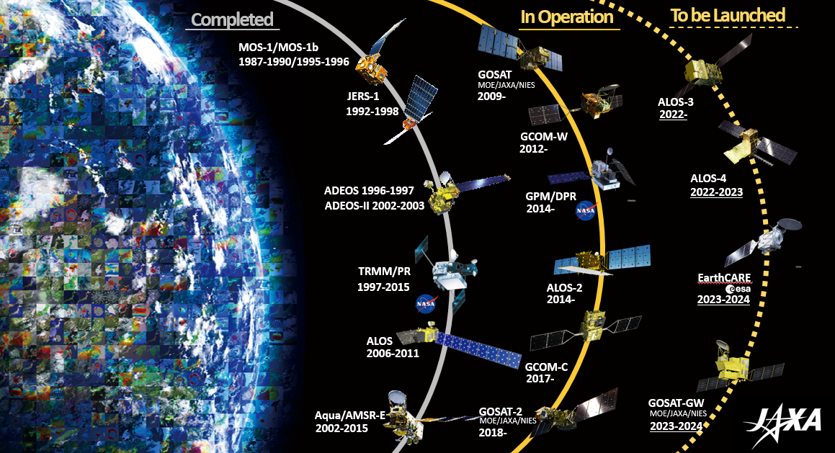
JAXA EO Satellites and Sensors

Slide 4
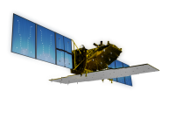
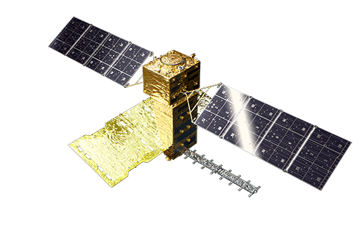
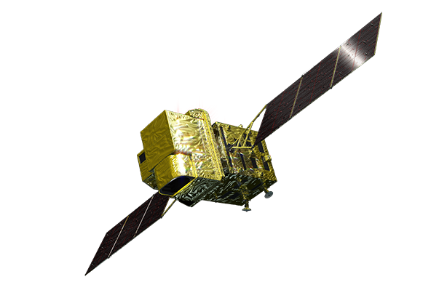

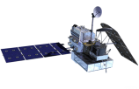
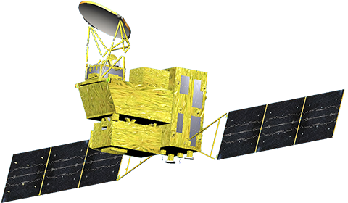


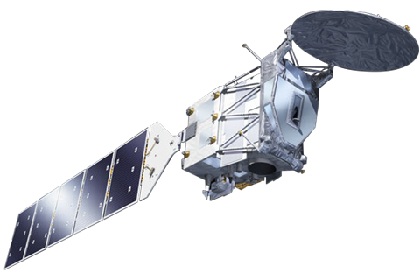

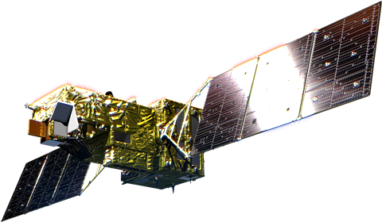
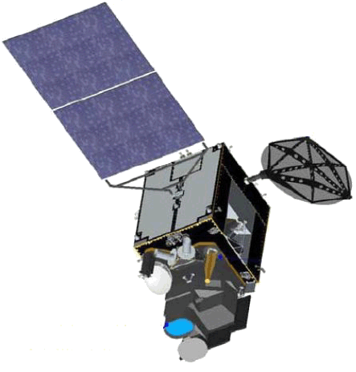
Schedules
JFY: Apr-Mar |  | 2016 | 2017 | 2018 | 2019 | 2020 | 2021 | 2022 | 2023 | 2024 | 2025 | 2026
Disasters & Resources
Climate System Water Cycle
Climate change
Greenhouse gases
2014~
[Land and disaster monitoring]
ALOS-2 / PALSAR-2
ALOS-4
ALOS-2/CIRC
[thermal camera]
ISS/CIRC
ALOS-3
TRMM / PR 1997~
2014~
[Precipitation 3D structure]
GPM / DPR
【AOS】 PMM/KuDPR 2028~
with NASA
with CNES
2012~
[Wind, SST , water vapor, precipitation]
GCOM-W / AMSR2
GOSAT-GW/AMSR3
[Vegetation, aerosol, cloud, SST, ocean color..]
GCOM-C / SGLI
[Cloud and aerosol 3D structure]
EarthCARE/CPR 2023~
with ESA
2009~
GOSAT / FTS, CAI
GOSAT-GW/TANSO-3
[CO_{2,} Methane]
GOSAT-2 / FTS2, CAI2
with MOE
[CO_{2,} Methane, CO, aerosol]
(ref.) JMA meteorological satellites
[Cloud, SST, aerosol, ..]
Himawari-8/AHI
Himawari-9 (stand by)
Mission status
On orbit
Development
Study
Pre-phase-A

Slide 5
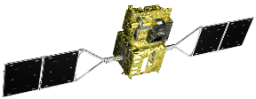
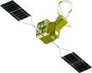


JAXA programs for Climate
GCOM-C
Cloud & Aerosols
spatial distribution
GCOM-W
Water vapor & Precipitation
spatial distribution
Himawari-8/9
Climate change
(change of redistribution of the solar energy)
GOSAT-2
EarthCARE
Cloud & Aerosols
3D structure
cloud growth /precipitation process
Cloud
GPM/DPR
Precipitation
3D structure
cloud droplets
Latent heat
raincloud
cloud condensation nuclei
Water vapor
Aerosol
Precipitation
Vegetation,
surface temperature
Soil moisture
For the Earth system prediction and supporting the policy making through
Precise diagnosis of the current state which is changing with the global warming
Understanding of the aerosol-cloud-precipitation system

Slide 6
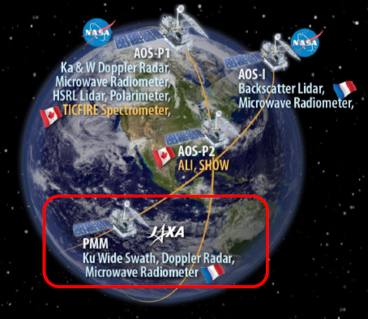
Topics: AOS Collaboration
“Aerosol” and “Clouds, Convection and Precipitation” (A-CCP) were selected as the Designated Observables by the US Decadal Survey issued in 2017
NASA established “AOS” (Atmosphere Observing System) project which is an international scheme to observe A-CCP with a constellation.
  AOS constellation has two projects: AOS-I (Inclined orbit) and AOS-P (polar orbit)
JAXA GPM + EarthCARE community has agreed to join the AOS project with PMM (Precipitation Measurement Mission) / KuDPR (Ku-band Doppler Precipitation Radar) as AOS-I with following new/advanced functions improved from GPM/DPR
KuDPR targets | KuDPR function (requirement)
To detect shallow & light rain/drizzle, snow For more accurate global precipitation map | Higher Sensitivity than DPR
To improve the model representation World first observation of vertical motion of the precipitation | Doppler Velocity Observation

Slide 7
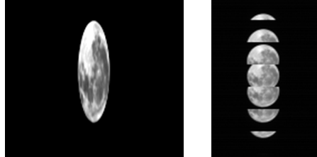
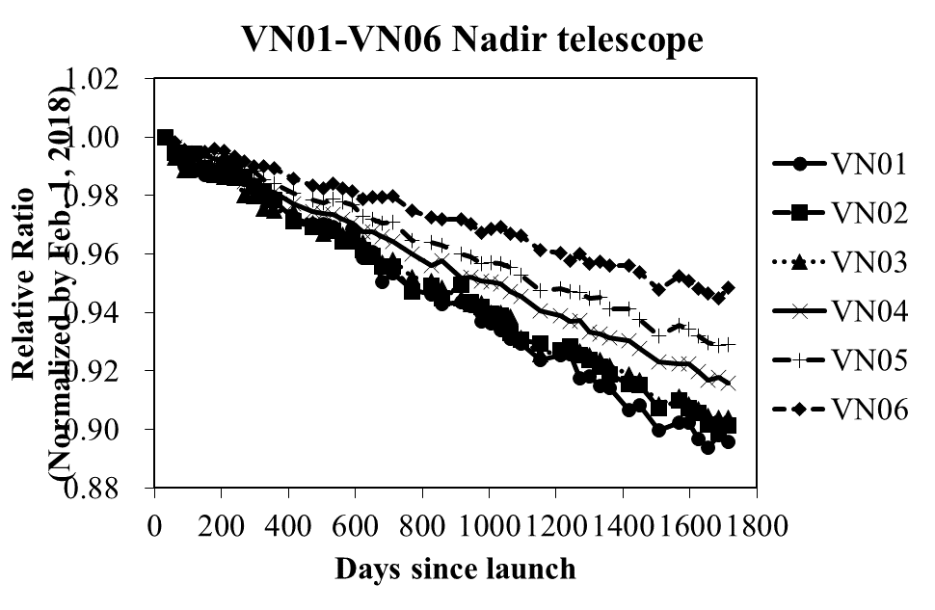
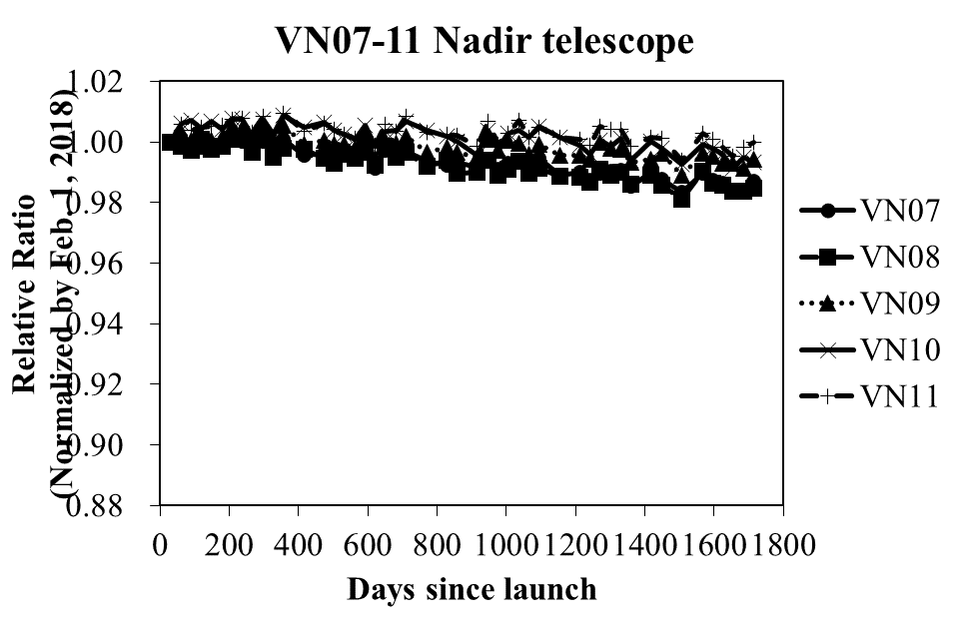
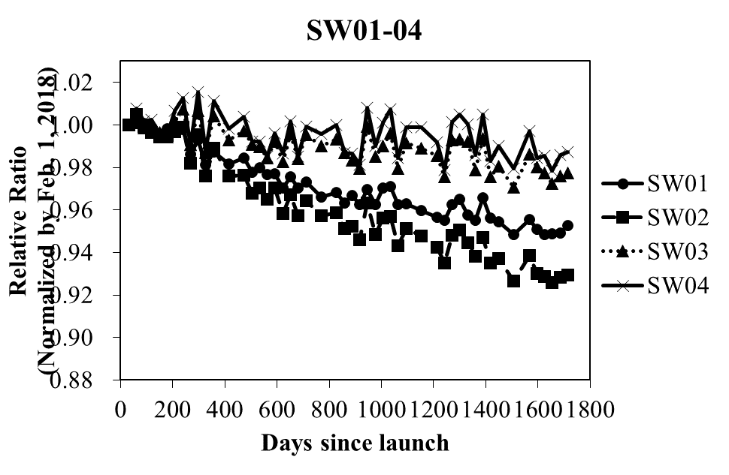
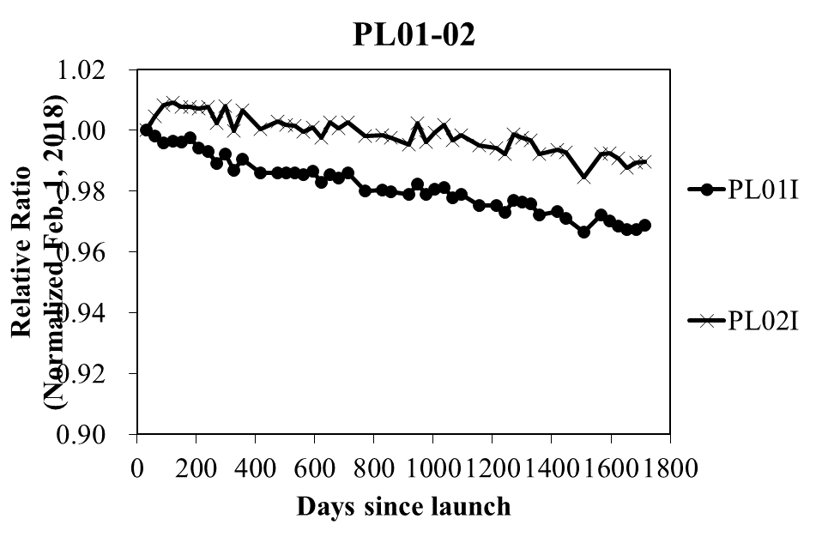
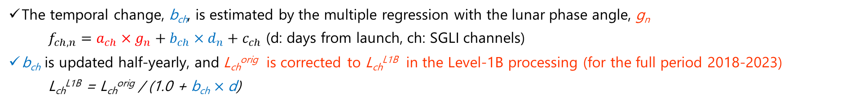
TOPICS: Agency's Calibration Major Updates
SGLI Lunar CAL by GIRO
GCOM-C SGLI lunar calibration is regularly updated by the monthly (phase angle ~7°) lunar observation operations (by the pitch maneuver; 67 times in 2018-2022) with GIRO
All SGLI lunar observation data (GIRO input/output files) have been submitted to GLOD
VNR
IRS
The temporal change, b_{ch}, is estimated by the multiple regression with the lunar phase angle, g_{n}
    $f_{ch,n}=a_{ch}×g_{n}+b_{ch}×d_{n}+c_{ch}$ (d: days from launch, ch: SGLI channels)
b_{ch} is updated half-yearly, and L_{ch}^{orig} is corrected to L_{ch}^{L1B} in the Level-1B processing (for the full period 2018-2023)
  L_{ch}^{L1B} = L_{ch}^{orig} / (1.0 + b_{ch} $×$d)
VIS 380~565nm
VIS-NIR 670~865nm
SWIR 1050~2210nm
PL670 865nm
Time series of SGLI/GIRO trend (Normalized by 2018/2/1)
Urabe et al. (2020). DOI: 10.3390/rs12010069;
Urabe et al. (2019) DOI: 10.1109/IGARSS.2019.8897892

Slide 8
Summary
(JFY: Japanese fiscal year, April-March)
Summary of current and future instruments
  GOSAT, GCOM-W, GPM Core/DPR, ALOS-2, GCOM-C, GOSAT-2: Operating
  ALOS-3 (advanced Optical): The H3 new rocket failed.
  ALOS-4 (advanced SAR, successor of ALOS-2
  EarthCARE/CPR (joint mission with ESA): to be launched
  GOSAT-GW (successor of GOSAT-2 & GCOM-W): Planned to be launched in JFY2024

Slide 9
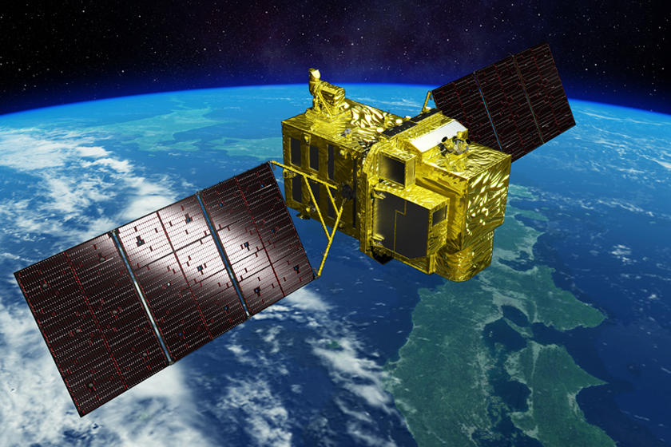
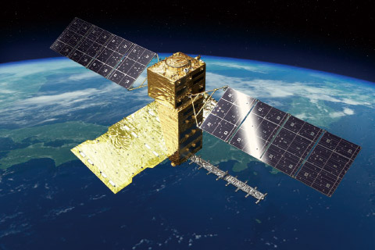
Appendix: ALOS-3 and -4 summary
ALOS-3
Wide-swath and high-resolution optical imager
Panchromatic band (black and white)
Ground resolution: 0.8 m / Swath width: 70 km at nadir
Wavelength: 0.52 - 0.76 μm
Multi-band (color)
Ground resolution: 3.2 m / Swath width: 70 km at nadir
Band 1 0.40 - 0.45 μm (Coastal)
Band 2 0.45 - 0.50 μm (Blue)
Band 3 0.52 - 0.60 μm (Green)
Band 4 0.61 - 0.69 μm (Red)
Band 5 0.69 - 0.74 μm (Red Edge)
Band 6 0.76 - 0.89 μm (Near-Infrared)
ALOS-4
L-band synthetic aperture radar (PALSAR-3)
- Stripmap mode (Resolution 3 m, 6 m, 10 m) 100km-200km
- ScanSAR mode (Resolution 25 m) 700km
- Spotlight mode (Resolution 1 m x 3 m) 35km X 35km
Space-based Automatic Identification System Experiment (SPAISE3)
Slide 9

