Slide 1
USGS - Space Agency Report WGCV-52
2023/06/06
Cody Anderson, ECCOE PM
USGS
chanderson@usgs.gov
Earth Resources Observation and Science (EROS) Center, Sioux Falls, SD 57198, USA.

Slide 2
Landsat 9 Reprocessing

Slide 3
Landsat 9 Reprocessing
https://www.usgs.gov/landsat-missions/news/upcoming-reprocessing-all-landsat-9-data
Landsat 9 Collection 2 Operational Land Imager (OLI) and Thermal Infrared Sensor (TIRS) data from the first year of operations ~ November 2021
Reprocessing started March 1, 2023
Reprocessing takes advantage of calibration updates identified by the USGS/NASA Calibration and Validation team

Slide 4
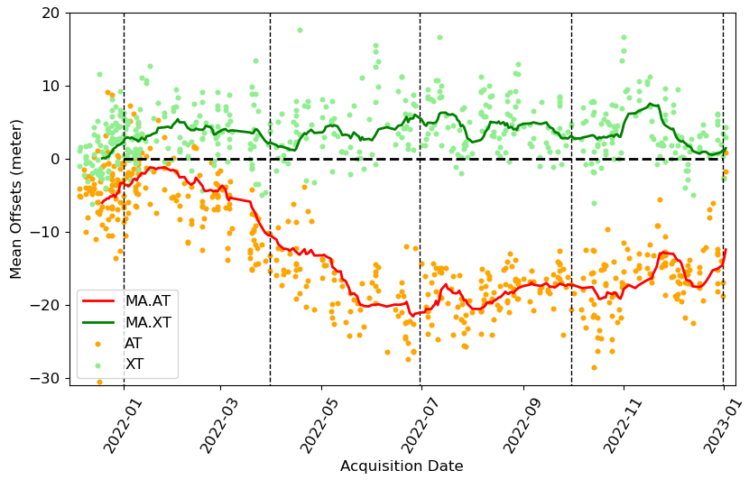
L9 Geodetic Accuracy – Pre-Calibration
Geodetic Accuracy pre-fit measurements indicate the accuracy of L1GTs and are an indication of OLI pointing accuracy
Sensor alignment updates remove biases in the L1GTs
Plot on right are geodetic accuracy mean results in along track (AT) and across track (XT) for the Geometric Supersites
Moving average of means is shown to better demonstrate trends
Mean offsets in along track direction for 2022 Q2, Q3, and Q4 would be reduced with calibration parameter updates
Update applied to data acquired after January 2023
Update needed for continuity with L8 and previously acquired L9 data
Around 20m bias in AT direction in 2022 Q2,Q3,Q4

Slide 5
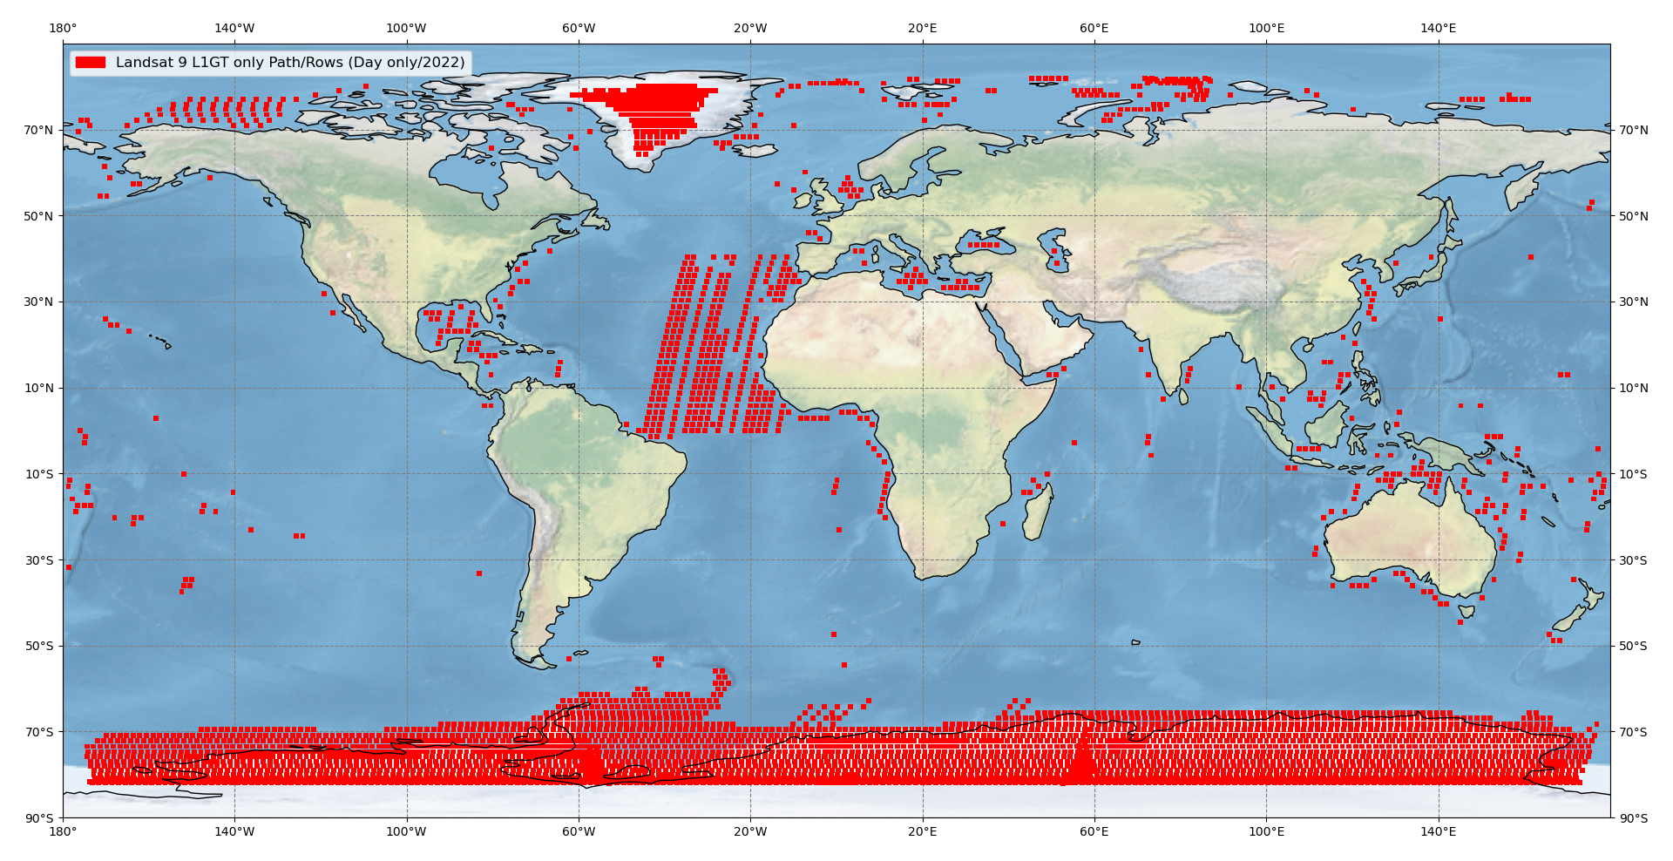
L1GT Only – Path/Rows ​
Geographic locations where only L1GTs are generated.

Slide 6
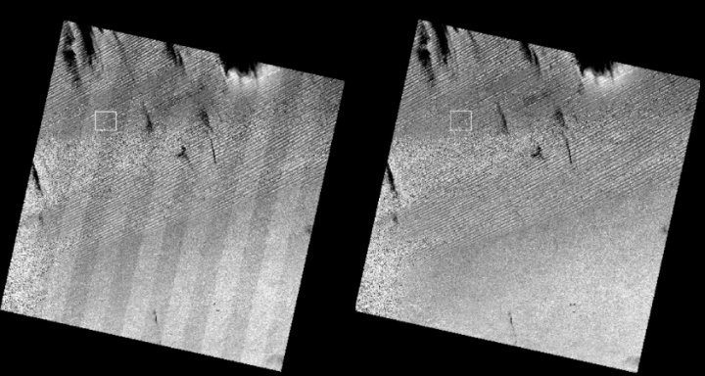
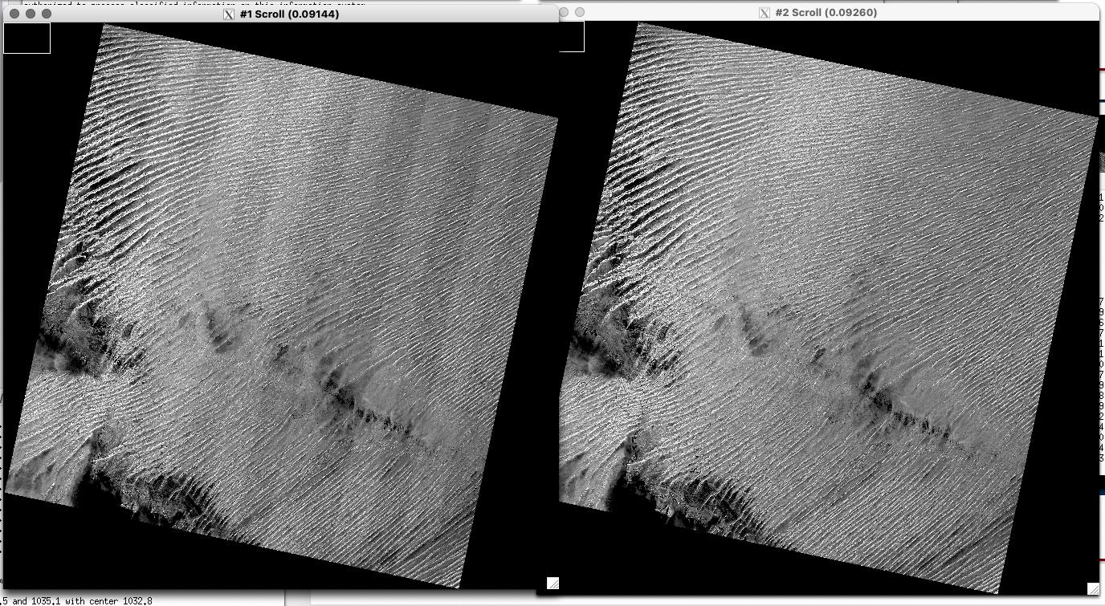
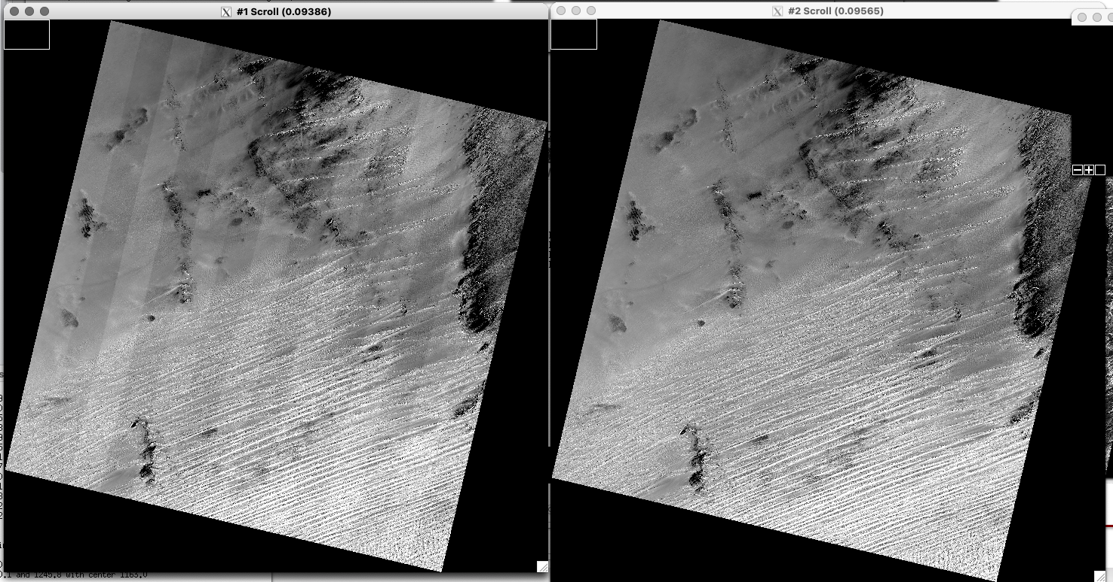
OLI SCA Relative Gains (Banding)
Current
Reprocessed
SWIR-2 SCA Relative Gains
~ ±0.6% variations
Banding over bright targets
Update only applied to data acquired after March 2022
Data acquired Nov. 2021 – March 2022 still contain banding
201/46 from 1-23-2022
Current
Reprocessed
165/47 from 2-28-2022
Current
Reprocessed
187/47 from 2-08-2022

Slide 7
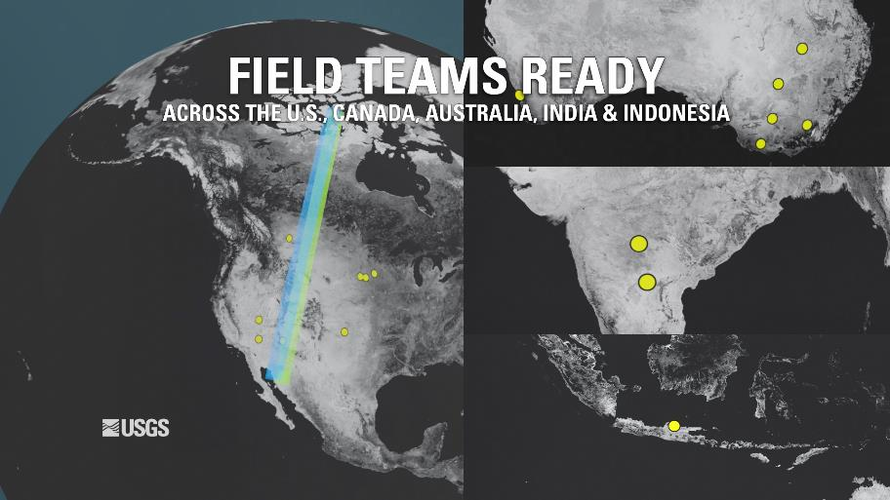
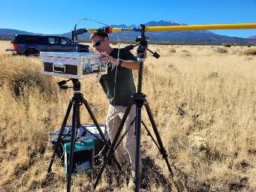
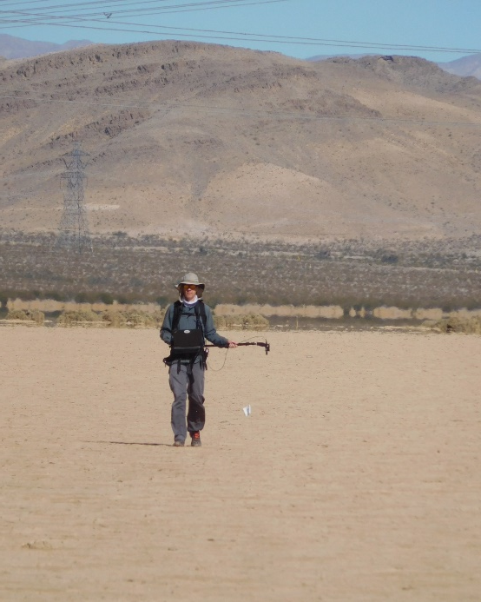
Landsat 8 and 9 Underfly

Slide 8
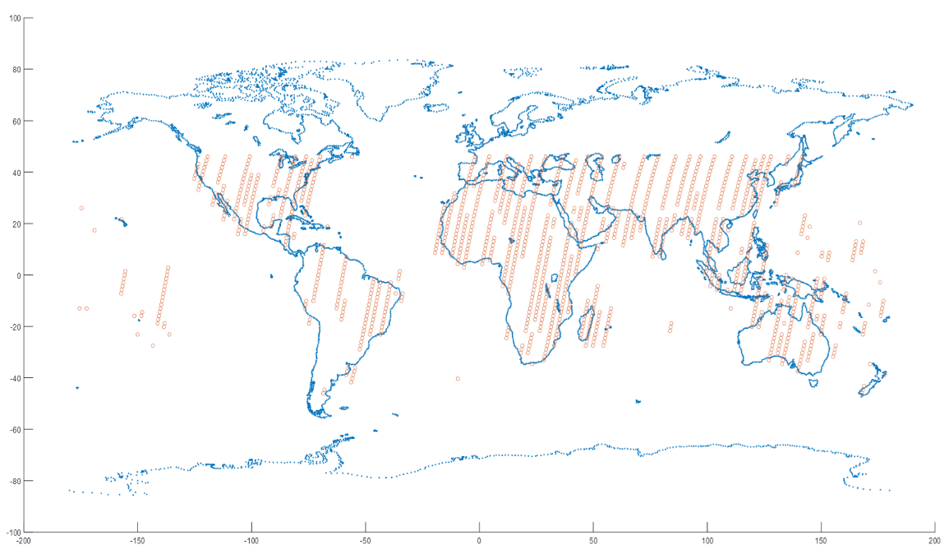
Underfly Scene Pairs
L9 Acquisitions during underfly period
Analysis involves 1464 L8/L9 OLI scene pairs

Slide 9
OLI Cross-Calibration (Reflectance and Radiance)
Underfly Cross-Calibration revisited and validated against PICS
Cirrus Band calibrated with solar and lunar collects
No adjustments prior to reprocessing
Improved consistency between Landsat 8 and Landsat 9
Update not applied to any previously acquired data
Phase 2​ | Reflectance​ | Radiance ​
Band​ | Mean​ | Mean​
Band 1​ | 1.001​ | 0.999
Band 2​ | 1.002​ | 1.000
Band 3​ | 0.996​ | 0.9978
Band 4​ | 1.000​ | 0.996​
Band 5​ | 1.001​ | 0.996​
Band 6​ | 1.003​ | 0.9923
Band 7​ | 1.002​ | 0.990​
Band 8​ | 0.999​ | 0.9962
Band 9 | 1.0077 | 0.945

Slide 10
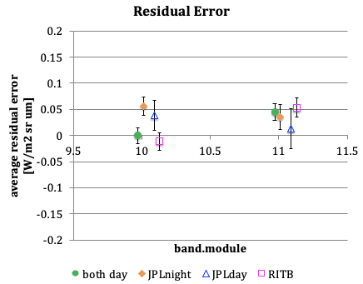
TIRS Absolute Update
L9 TIRS absolute radiance is currently tied to prelaunch calibration
L8 TIRS, L7 ETM+, and L4/L5 TMs are tied to NASA JPL and NOAA buoys
L9 TIRS vicarious calibration detected small difference between prelaunch and buoys
Improve consistency between Landsat 8 and Landsat 9
Update not applied to any previously acquired data
-0.0004
0.0447

Slide 11
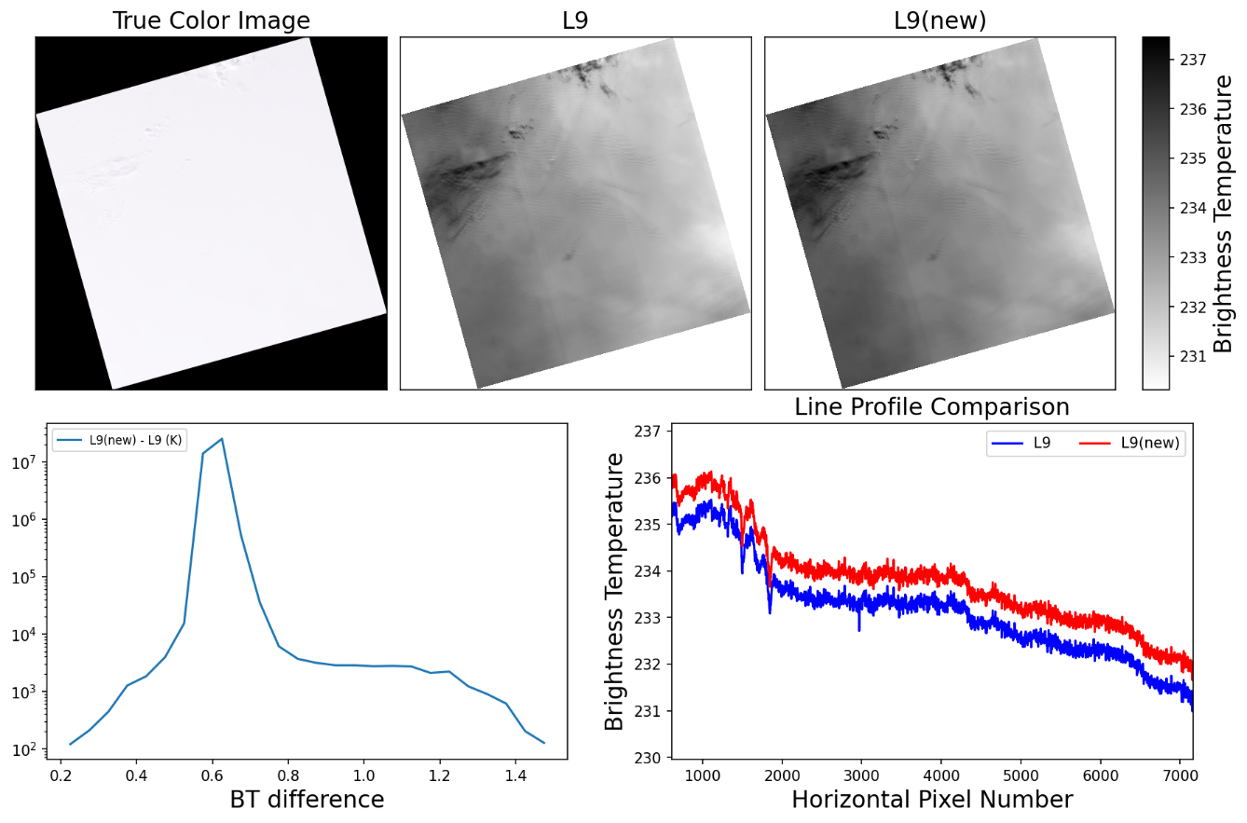
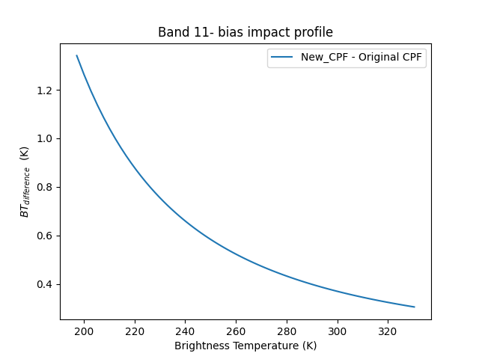
Band 11 TOA Brightness Temperature
Updated TOA BT varies from ~0.65K to ~0.37K depending on signal level
Impact is larger for colder scenes
Antarctica example on right
0.65 K
0.37 K

Slide 12
"Landsat 9 Pre-launch, Commissioning, and Early On-Orbit Imaging Performance“
Remote Sensing –Special Issue
https://www.mdpi.com/journal/remotesensing/special_issues/15B4V2K92K#info

Slide 13
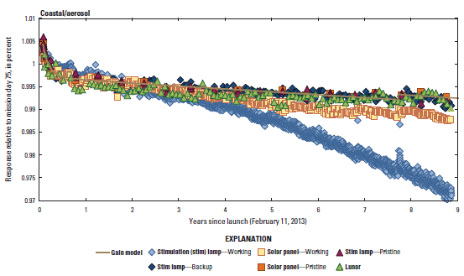
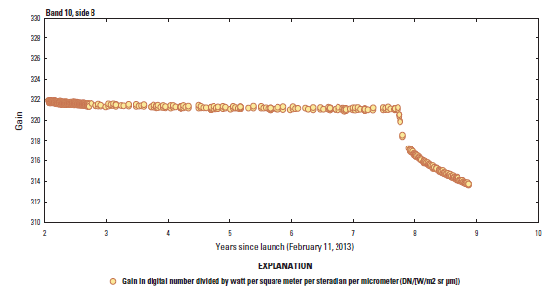
L8 Radiometric Performance
Quarterly Reports: https://www.usgs.gov/calval/landsat-calibration-and-validation
OLI
TIRS

Slide 14
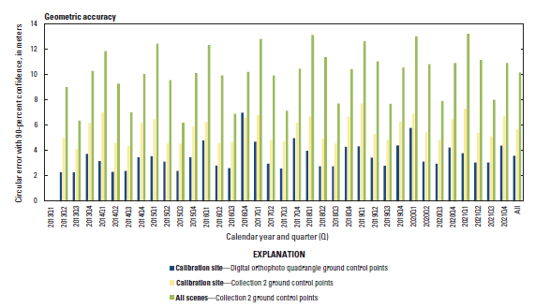
L9 Geometric Performance
Quarterly Reports: https://www.usgs.gov/calval/landsat-calibration-and-validation

Slide 15
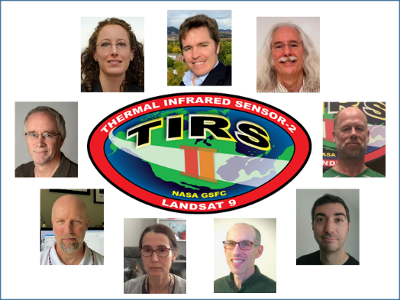
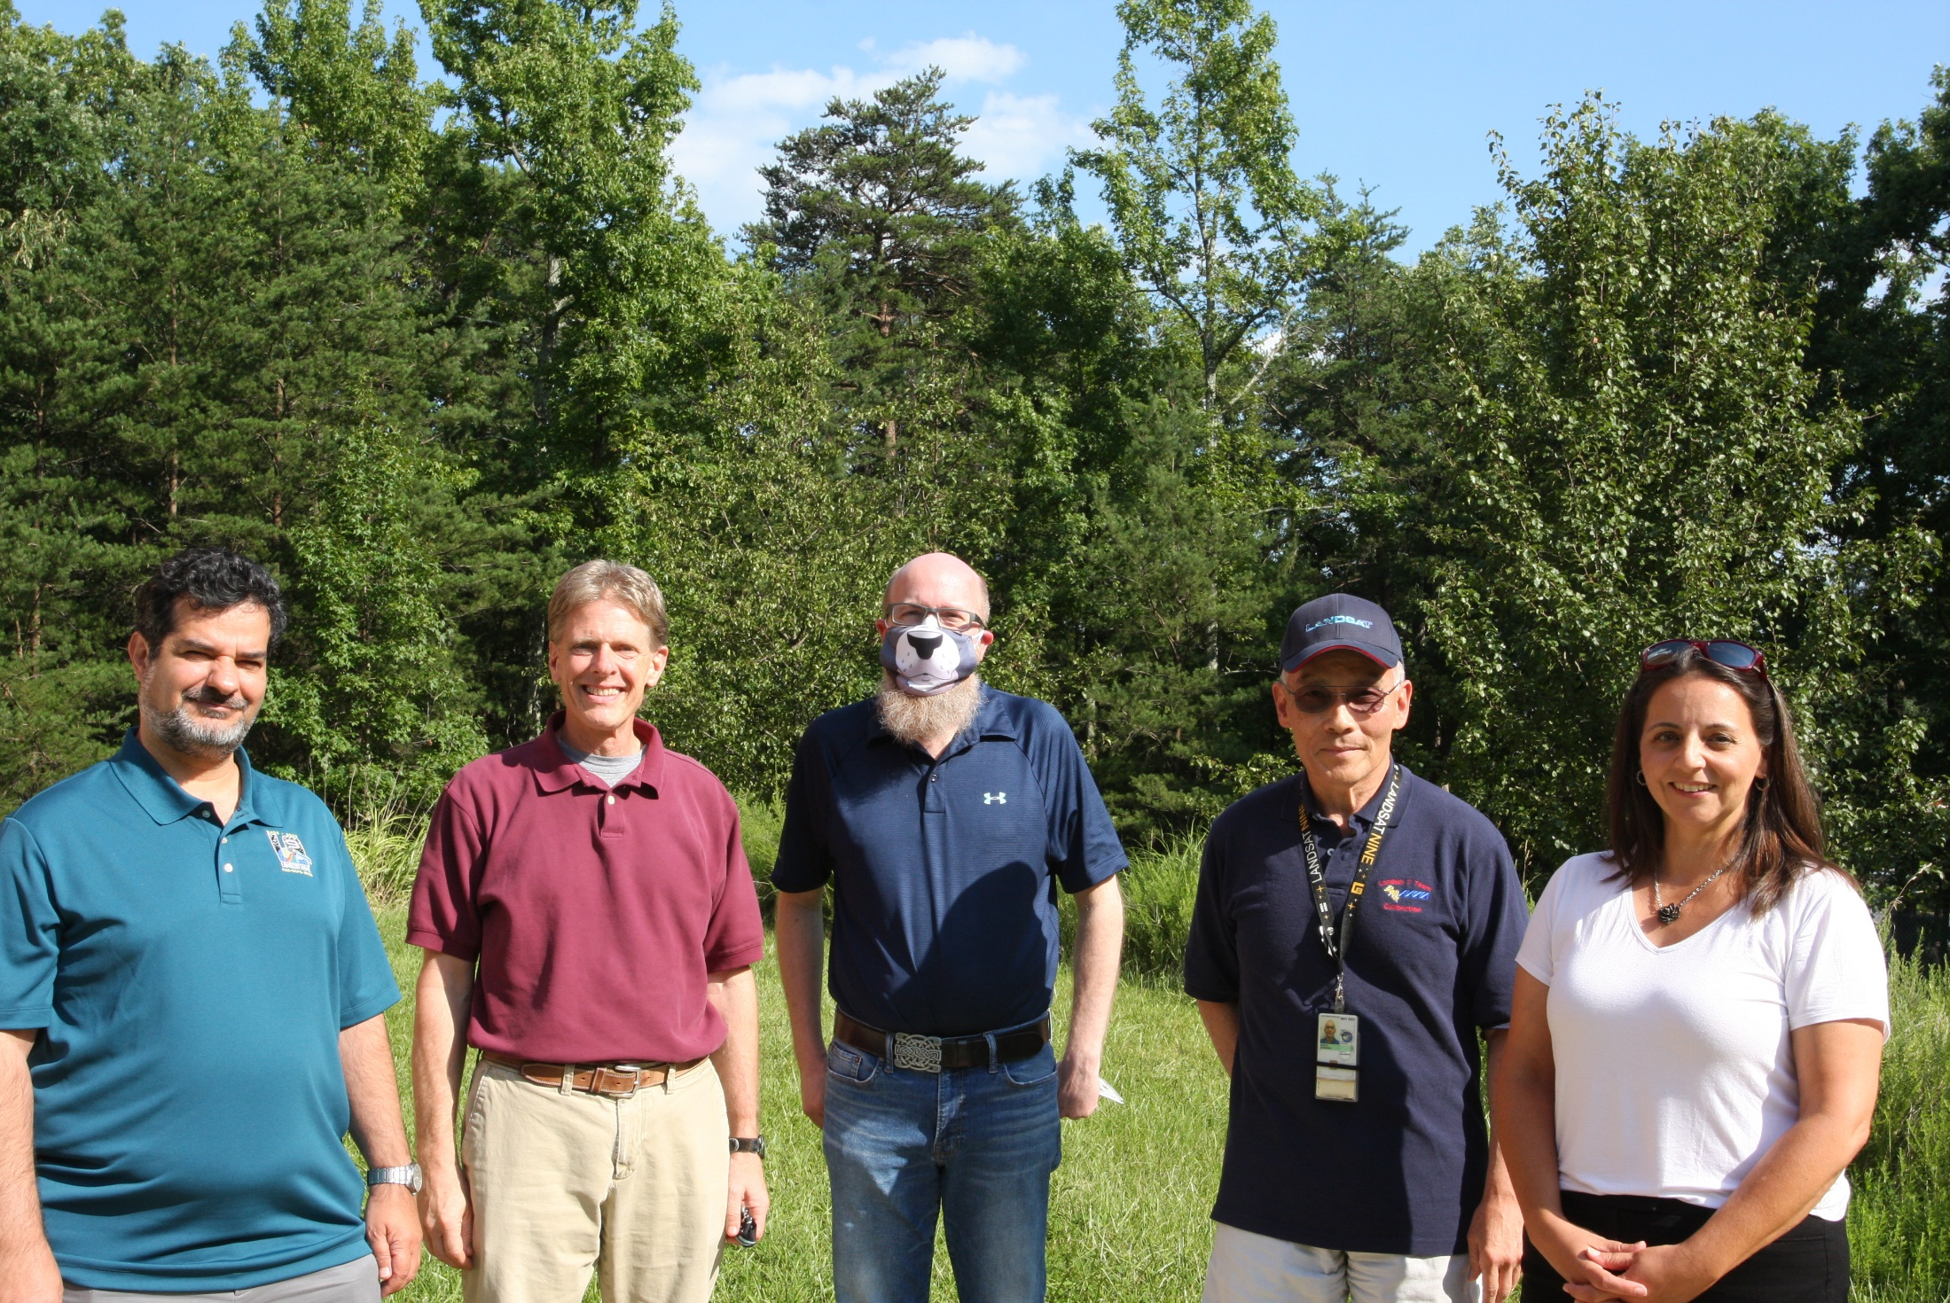
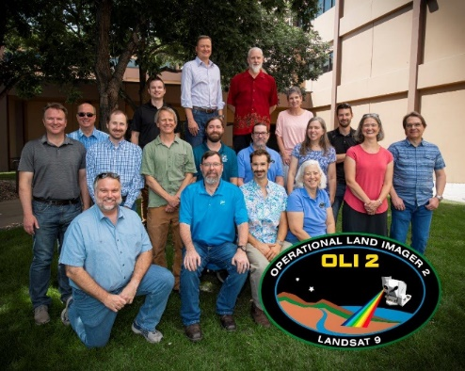
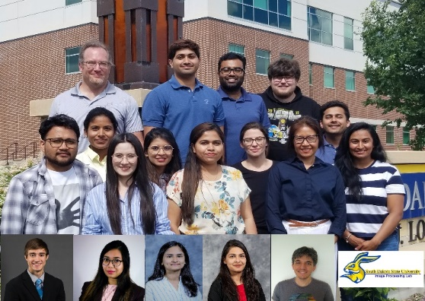
NASA Robert H. Goddard Award for Science
NASA GSFC Landsat Calibration and Validation Team

Slide 16
USGS Landsat Collection 3

Slide 17
Collection 3 Potential Scope
Precision Correction Enhancements
Increase the Bounding Box for Scenes with Few GCPs
MSS Temporal GCP Library Updates
Seasonal GCP Library Updates
Replace GCTP with PROJ
Enhanced Uncertainty Reporting
Per-Pixel Radiometric Uncertainty
Per-Pixel Geometric Uncertainty
Surface Reflectance Measurement Uncertainty
Improved Per-Pixel Metadata
New Cloud Mask Version
Add Per-Pixel Flagging of IC Shutter Intrusions in QA Band
Angle Band Improvements
Quality Band Improvements
USGS Landsat Global ARD
Continental Equal-Area Projection Specification
Develop and Document Global ARD Tiling Scheme
Miscellaneous Enhancements
Add Data Corners to Level-1 and Level-2 Product Metadata
Currently Non-Processed Data Types
Package Elevation Data with Level-1 (and Higher) Products
Update GDAL Version
Landsat Next
Landsat Next Considerations for Collection 3
Terrain Enhancements
Updated DEM for Collection 3
Terrain Shadow Mask
Terrain Illumination Correction
Surface Reflectance Improvements
Nadir-Adjusted BRDF Correction
Landsat 8/9 Surface Reflectance (LaSRC) Improvements
Develop Level-2 Surface Reflectance Product for MSS
Surface Temperature Improvements
Native Resolution Thermal / Split Window
Investigate Alternative Radiative Transfer Model
Gaps in ASTER GED for Surface Temperature Processing
Temporal Emissivity Grid Capability
Incorporate CAMEL / ECOSTRESS for ST Emissivity
Update Interpolation Method for Landsat Emissivity Data
Surface Temperature-Only Product for Polar Regions
Single-Channel Surface Temperature Improvements

Slide 18
Summary
Landsat 8, 9, and 7 are performing nominally
Landsat 9 cross-calibration with Landsat 8 within sub percent
USGS Collection 3 scope definition underway

