Slide 1
WGCV-52
Hyperspectral Cal/Val Resources
Philippe Goryl (ESA/ESRIN),
Cindy Ong (CSIRO AU)
Paolo Castracane (Rhea System for ESA/ESRIN)
Agenda Item 3.4
WGCV-52, ESA/ESRIN, Italy
5th - 9th June 2023

Slide 2
Table of Contents
Hyperspectral Cal/Val Resources
https://docs.google.com/document/d/1coQkACGLg2aLSfyC2dZL_I9VUlzn2ruoFEcRP1kOHCM/edit#heading=h.scgocn7m8pb7
Introduction
Networks
Guidelines and Protocols
Campaigns and Inter-comparison Excercise
Instrumentation and Hardware
Mission-Specific Resources
Comments/Inputs are welcome!
Slide ‹#›

Slide 3
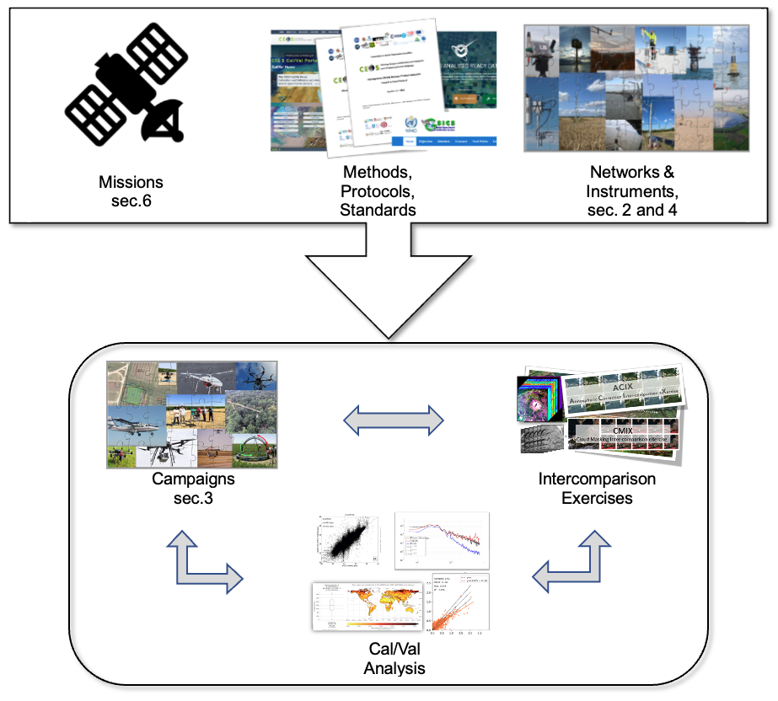
Introduction
The document was created following the request made to the CEOS for guidance on hyperspectral Cal/Val reference instrumentation for land, coast and open ocean measurements; relevant for all satellite missions to have a coordinated global network
A spaceborne hyperspectral imaging sensor is an advanced spaceborne optical sensor that captures high spectral resolution images of the Earth's surface in many contiguous bands across the electromagnetic spectrum, typically between the visible to shortwave infrared ranges
The data collected by spaceborne hyperspectral imaging sensors are used in a wide range of applications, including environmental monitoring, agriculture, forestry, and non-renewable resources exploration and extraction
The list of hyperspectral missions is growing rapidly with new missions being launched by countries around the world.
In general Cal/Val activities for Hyperspectral Mission will include the elements sketched in the figure above
Slide ‹#›

Slide 4
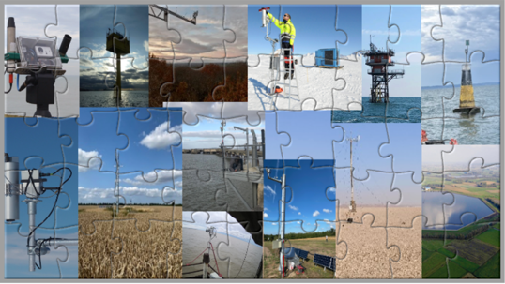
Networks
Among all the Cal/Val activities, the ones based on permanent and automated instruments working in Network are probably the most efficient as it gives a large number of points well characterised against which the satellite measurements can compare. Among the existing Networks, the following provide useful information for Hyperspectral imaging validation:
HYPERNETS a new hyperspectral radiometer integrated in automated networks of water and land bidirectional reflectance measurements for satellite validation.
RadCalNet the Radiometric Calibration Network portal.
PICS Pseudo Invariant Calibration Sites. Two projects related to the usage of PICS are PICSCAR and PICSAND.
CEOS-LPV supersites Supersites defined by the Land Product Validation Subgroup.
GBOV (Ground-Based Observations for Validation).
TERN the Australia's land ecosystem observatory.
NEON National Ecological Observatory Network.
ICOS The Integrated Carbon Observation System.
EUFAR the European Facility for Airborne Reasearch.

Slide 5
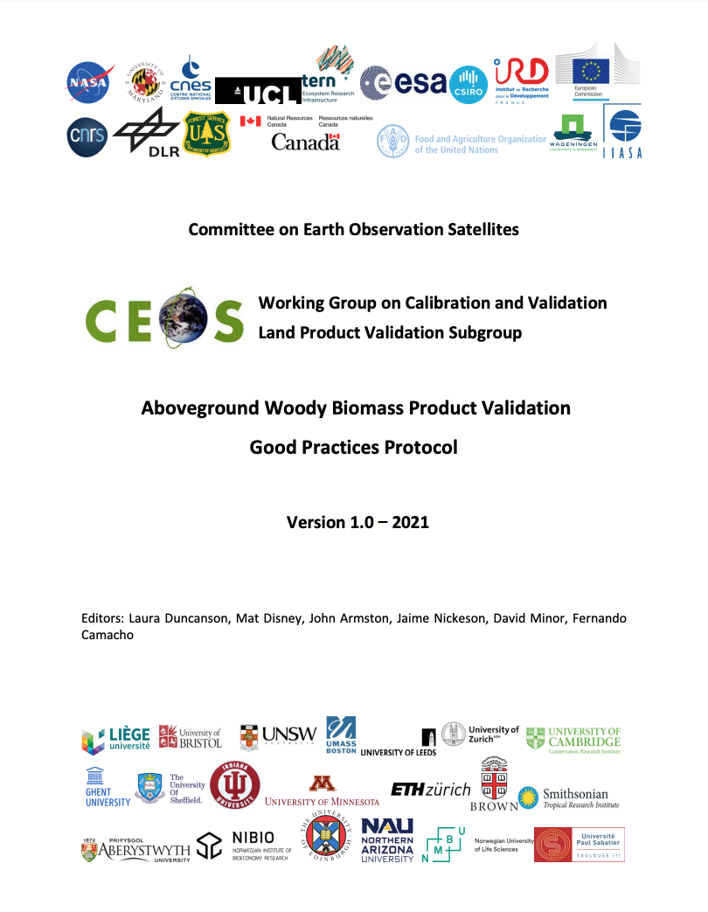
Guidelines and Protocols
The following relevant Guidelines and Protocols have been identified:
CEOS-LPV Protocols
The definition of CEOS-LPV best practices started in 2014 with the first protocol, and it now includes endorsed protocols for the following variables: LAI, Albedo, Above Ground Woody Biomass, Soil Moisture and Land Surface Temperature. The definition of CEOS-LPV protocols for other land products, in particular land cover, fire/burned areas, vegetation indices is currently on-going and a first version of these documents is expected to be finalized during 2023.
FRM4Veg Protocols
The Fiducial Reference Measurements for Vegetation (FRM4Veg) project was initiated by ESA in 2018 with the objective of establishing the protocols required for traceable in-situ measurements of satellite-derived surface reflectance and vegetation products.
CEOS WGCV SR Validation Protocol
Details on the Surface Reflectance Validation protocol is available on a technical handbook named “A community approach to the standardised validation of surface reflectance data”.

Slide 6
Campaigns and Inter-comparison Excercise
CEOS-LPV DIRECT Database
The DIRECT V2.1 database includes LAI, fAPAR and FCover averaged values over a 3 km x 3 km area, useful for the validation of satellite-derived coarse resolution land products.
SRIX4Veg
SRIX4VEG (Surface Reflectance Intercomparison Exercise for Vegetation) is contributing towards global community-agreed guidelines for UAV-based surface reflectance product validation.
HyperSense Campaign
To best prepare CHIME/SBG for its tasks ahead, and as part of a cooperation between ESA and NASA’s Jet Propulsion Laboratory (JPL), the Hypersense campaign, managed by the University of Zurich, made use of the Next Generation Airborne Visible Infrared Imaging Spectrometer, AVIRIS , an instrument which resembles the capabilities that CHIME will have once in orbit

Slide 7
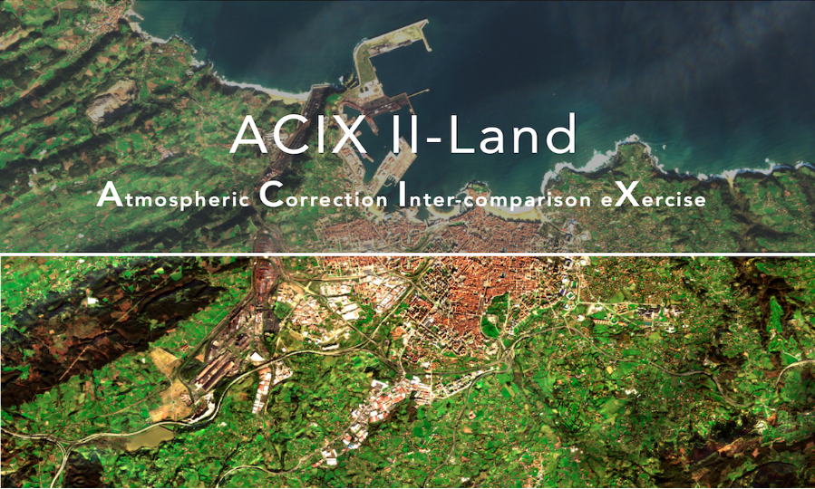
Campaigns and Inter-comparison Excercise
ACIX
ACIX is an initiative that brings together the developers of Atmospheric Correction (AC) processors, who are invited to generate Bottom-Of-Atmosphere (BOA) products from Top-Of-Atmosphere (TOA) optical satellite data. It is a collaborative activity of ESA and NASA initiated in 2016 in the frame of CEOS WGCV. ACIX has been implemented twice on multispectral Copernicus Sentinel-2 and Landsat 8 imagery. More information on the latest analysis and the results can be found on the dedicated web pages for the Land and Aqua focused part of the exercise.
In parallel with ACIXs, a Cloud-Masking Inter-comparison exercise (CMIX) runs over specific areas with reference data available. Similar to ACIXs, the focus of the first CMIX was on open and free imagery acquired by the Copernicus Sentinel-2 (EC/ESA) and Landsat 8 (NASA/USGS) missions. More information on the first CMIX implementation can be found here.

Slide 8
Instrumentation and Hardware
ASD FieldSpec Range
field-portable UV/Vis/NIR/SWIR spectroradiometers covering the full solar reflected spectrum. The latest version of this spectroradiometer family is the ASD FieldSpec 4
Spectral Evolution
Spectral Evolution designs, manufactures, and services high resolution, high sensitivity, full range UV-VIS-NIR spectrometers and spectroradiometers.
SVC
Spectra Vista Corporation (SVC) is a company that specialises in building good quality spectroradiometers. These devices feature array detectors that capture spectral data accurately.
Hypstar
HYPSTAR® (HYperspectral Pointable System for Terrestrial and Aquatic Radiometry) is an autonomous hyperspectral radiometer system dedicated to surface reflectance validation of all optical Copernicus satellite data products. HYPSTAR takes radiance and irradiance measurements.
PANTHYR
The pan-and-tilt hyperspectral radiometer system, PANTHYR is designed for autonomous measurement of hyperspectral water reflectance.
HySpex VNIR-1800
The HySpex VNIR-1800 hyperspectral camera is developed for field, laboratory, and airborne applications. It utilises an actively cooled and stabilised scientific CMOS detector. The dynamic range of 20000 ensures high SNR levels even in darker areas of an image of highly dynamic scenes.

Slide 9
Instrumentation and Hardware
HySpex VNIR-3000N
HySpex VNIR-3000N utilises the same spectrograph as the other HySpex VNIR models. It has a pixel size of 3.45 μm, compared to 6.5 μm for VNIR-1800, HySpex VNIR-3000 N has less than 1.6 pixels per FWHM of the PSF spatially and less than 1.8 bands spectrally, ensuring that narrow band features will be resolved equally for all cameras. With 3000 spatial pixels, 300 bands and a noise floor of 2.4e-.
HySpex SWIR-384
The HySpex SWIR-384 hyperspectral camera is developed for field, laboratory, and airborne applications. The state of the art MCT sensor is cooled down to 150K yielding low background noise, high dynamic range, and high SNR levels.
HySpex SWIR-640
The HySpex SWIR-640 hyperspectral camera is developed for field, laboratory, and airborne applications. The state of the art MCT sensor is cooled down to 150K using a sterling cooler, yielding low background noise, high dynamic range, and high SNR levels.
HySpex Mjolnir VS-62
The HySpex Mjolnir VS-62 hyperspectral camera is developed for ground and UAV applications. The VNIR and SWIR optical axis are coaligned in the along track direction, assuring perfect coregistration in the flight direction. The hyperspectral datacube covers the spectral range from 400 - 2500 nm, with 490 bands.
Hyper-Cam
The Hyper-Cam cameras from Telops are advanced passive infrared hyperspectral imaging systems that combine high spatial and spectral resolution. It provides real-time radiometrically calibrated data for gas and mineral detection and identification. It is offered in ground-based format and compact airborne hyperspectral imaging system.

Slide 10
Instrumentation and Hardware
HyMAP
HyMap is an airborne hyperspectral sensor manufactured and operated by HyVista Corporation. It is mainly used for spectral mapping and offers 128 bands across the reflective solar wavelength region, ranging from 0.45 to 2.5um, with contiguous spectral coverage (except in water vapor bands) and an average bandwidth of 15nm.
AVIRIS/AVIRIS Next-gen
Airborne Visible / Infrared Imaging Spectrometer (AVIRIS) is a optical sensor instrument used in Earth remote sensing. It captures calibrated images of upwelling spectral radiance in 224 spectral bands ranging from 400 to 2500nm. This instrument has been successfully deployed on NASA's ER-2 jet, Twin Otter International's turboprop, Scaled Composites' Proteus, and NASA's WB-57 aircraft platforms.

Slide 11
Mission-Specific Resources
EnMAP
The Environmental Mapping and Analysis Program (EnMAP) is a German hyperspectral satellite mission that monitors and characterises Earth’s environment on a global scale. EnMAP measures geochemical, biochemical and biophysical variables providing information on the status and evolution of terrestrial and aquatic ecosystems. More information about the main objectives and the status can be found on the mission page
PRISMA
PRISMA, owned by the Italian Space Agency, started its journey in space on 22 March 2019, aboard a VEGA carrier. It is an innovative hyperspectral optical sensor, able to provide a unique informative contribution for different applications.
DESIS
DLR Earth Sensing Imaging Spectrometer (DESIS) was launched to the International Space Station (ISS) in June 2017. The instrument was developed by DLR and delivered to Teledyne Brown Engineering (TBE) which operates, commands and monitors the instrument. DESIS is realised as a pushbroom imaging spectrometer spectrally sensitive over the visible and near-infrared wavelength range from 400 to 1000 nm. DESIS is a predominantly commercial mission but DLR has the right to task DESIS or request archived data for scientific and humanitarian purposes
EMIT
EMIT was developed at NASA’s Jet Propulsion Laboratory and launched on 14 July 2022. The instrument observes Earth from outside the International Space Station. EMIT data is delivered to NASA Land Processes Distributed Active Archive Center (DAAC) for use by other researchers and public. EMIT uses an advanced two mirror telescope and high throughput F/1.8 Dyson imaging spectrometer
HISUI
Hyperspectral Imager Suite (HISUI) was launched to the International Space Station (ISS) in December 2019. It is a hyperspectral earth imaging system developed by the Japanese Ministry of Economy, Trade, and Industry (METI), consisting of a reflective telescope and two spectrometers which cover the visible and near infrared region (VNIR) and the shortwave infrared region (SWIR). Each spectrometer consists of a grating and a two-dimensional detector. Currently, data access is restricted but possible through research proposals.

