Slide 1
“COSMO-SkyMed Second Generation (CSG): characterization for calibrators out of Italy”
ASI Cal-Val Updates
Antonio Montuori, ASI
Francesco Longo, ASI
Cristina Lidó de la Muela, TAS-I
Valerio Grimani, TAS-I
Agenda Item #3.9
WGCV-52, ESA/ESRIN, Italy, 5th - 9th June 2023
E-mail contacts:
ASI: antonio.montuori@asi.it
TAS-I: Valerio.Grimani@thalesaleniaspace.com

Slide 2
Table of contents
Background
Introduction
Premises of the study
Methodology of the study
  IRF parameters
  Radiometry
  Geolocation
Conclusions
Slide 2

Slide 3
Background
COSMO-SkyMed:
  CSK-3 deorbiting procedure started on May 2022
  CSG-2 is operational: After successfully passing the test and in-flight qualification stage, the data acquired by the CSG2 satellite are made available to users by the Italian Space Agency and Ministry of Defence).
  Now, on the same orbit, 3 CSK + 2 CSG
  CSG mission will be upgraded with third and fourth satellites CSG-3/4 (work in progress)
A new “Open Call for Science” on the use of CSK and CSG data is available on the ASI website: https://www.asi.it/bandi_e_concorsi/open-call-for-science-data-utilization-of-the-cosmo-skymed-mission-first-and-second-generation-english-version/
PRISMA is operating nominally (https://prisma.asi.it/) and PRISMA SG Phase A activity is on-going.
Since 20 July 2021, ASI has been started the provision of SAOCOM data within the ASI ZoE: https://www.asi.it/en/2021/07/asi-starts-the-exploitation-phase-of-data-acquired-in-europe-by-the-l-band-sar-sensors-of-the-argentinean-saocom-constellation/
Slide 3

Slide 4
Introduction
The acquisition over the Italian calibrators is becoming more difficult every day due to the high number of requests from end users and institutional organizations; however the monitoring and the calibration tasks must be done.
So the research for new stable targets over the world is opened.
The main risk is that these objects are not perfectly categorised by us because they are out of our control and maintenance service; the orientation, size, position, … all this variables are unknown.
This presentation shows the results obtained from the study of alternative calibrators all over the world with features similar to the Italian ones.
The characterization campaign has lasted six months (from October 2022 to March 2023) and has been based on the analysis of the following performance parameters:
  IRF parameters
  Radiometry
  Geolocation
Slide 4

Slide 5
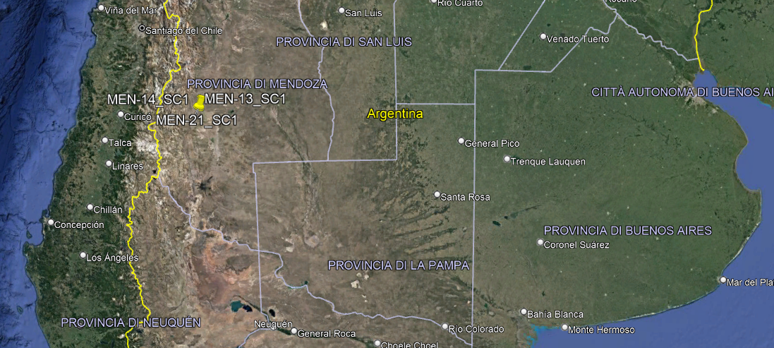
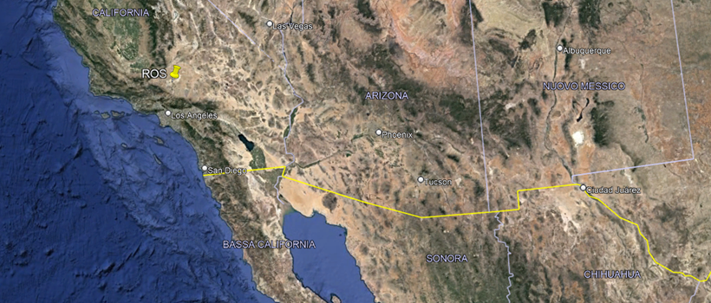
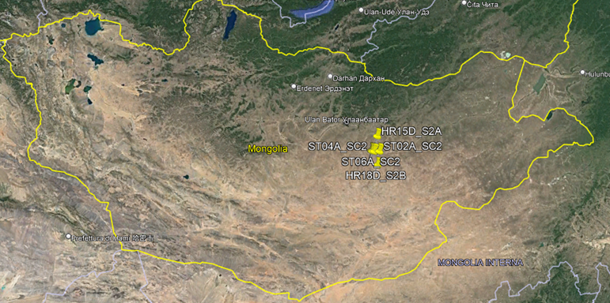
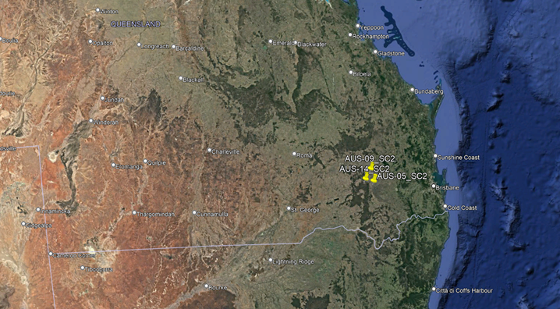
Premises of the study (I)
The following locations and targets under study have been selected:
  Mendoza
  Rosamond
  Mongolia
  Australia

Slide 6
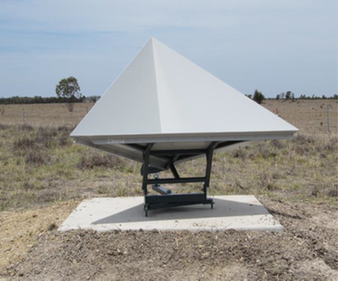
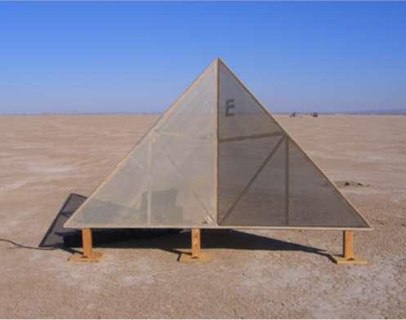
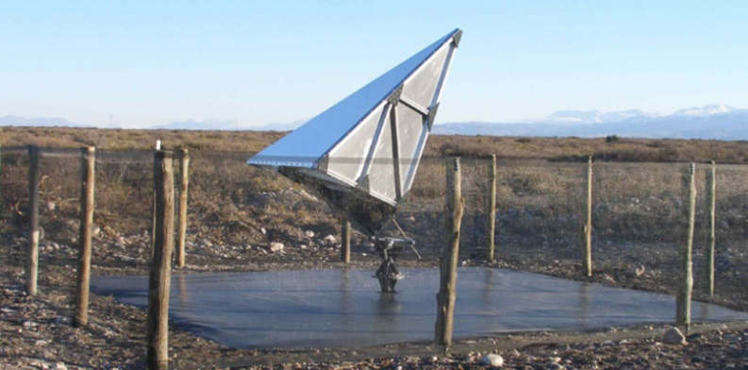
Premises of the study (II)
All the targets under study are supposed to be trihedral corner reflectors but we have not got the accurate information of all of them:
Australia
Rosamond
Mendoza

Slide 7
Premises of the study
All modes has been analysed for both COSMO SG SSAR1 and SSAR2 satellites:
  Spotlight: S2A, S2B, S2C
  Stripmap
  PingPong
  Quadpol
  Scansar: 1, 2
All products have been acquired according to COSMO SG orbital cycle period (i.e. 16 days) to obtain a better statistic.
  The total number of products under study has been 348.
  The total number of targets under study has been 2.902.
  The total number of measures under study has been 60.942.

Slide 8
Methodology of the study: IRF parameters
The first step was focused on studying all IRF parameters for both COSMO SG satellites. For each mode and each target all IRF parameters have been evaluated. The candidate targets have been selected according to the required performance thresholds.
There are modes where it is easy to follow the behavior of the targets because the number of targets under study is small (e.g. Spotlight S2A image). However there are other modes where it is necessary to apply a filter according to the size/RCS of the target (e.g. Scansar 2 image).
Filtering for
RCS > 48dBm²

Slide 9
Methodology of the study: Radiometry (I)
The second step was considered the RCS of the targets. For each calibrator the mean of the RCS and its standard deviation were calculated to test how stable it was.
This is an example of one of this statistical tables. It is possible to observe how the mean is close/far, to/from the RCS initial reference but this is not an issue because it could be due to unknown geometric information (e.g. object size and orientation).
STR-15 | RCS Initial Reference | MEAN | STANDARD DEVIATION
MEN-15 | 54,5 | 53,4071 | 0,2120
MEN-16 | 54 | 53,2764 | 0,1269
MEN-17 | 54,5 | 53,6517 | 0,1270
MEN-18 | 54 | 53,3997 | 0,1551
ROS-23 | 63,58 | 47,9427 | 0,6984
ROS-24 | 63,58 | 45,8840 | 0,5890
ROS-25 | 63,58 | 45,6848 | 0,6411
ROS-26 | 63,58 | 45,8685 | 0,7926
ROS-27 | 63,58 | 44,9499 | 0,7368

Slide 10
Methodology of the study: Radiometry (II)
Even studying the RCS parameter, it was possible to notice a “supposed seasonal factor” from December to February maybe caused by the bad weather conditions, for the calibrators sited in Mongolia.
And even other uncertain phenomenon was observed related to the target, maybe it was moved, covered, changed the orientation, …
Seasonal factor
Uncertain phenomenon

Slide 11
Methodology of the study: Radiometry (III)
The third step was concentrated on the study of the radiometry. The radiometric accuracy can be calculated for any target. The radiometric linearity and stability instead require two or more targets in scene.
For the most of the targets and modes, the first results were out of the thresholds:
It is due to the difference between the RCS initial reference and its mean. The size and the orientation of the targets are unknown and this initial value of the RCS initial reference was assigned in a rough way.

Slide 12
Methodology of the study: Radiometry (IV)
So it was necessary to recalculate the value of the RCS to get a “RCS estimated” more accurate, in order to use this RCS estimated for the rest of the study like a RCS nominal. This is what we called «radiometric characterization» of the target.
To calculate the “RCS estimated”, the outlier measures were removed. Then, considering only the right values for both satellites, the mean of the RCS was calculated.
When the new accurate estimation of the RCS is applied, the radiometry parameters are within the thresholds.

Slide 13
Methodology of the study: Radiometry (V)
The following tables show the statistical results for the targets under study:
SPOTLIGHT 2A_014 | RCS Initial Reference | Mean | Standard deviation RCS ref. | RCS estimated | Standard deviation RCS est.
HR15D | 35,95 | 34,2486 | 1,9774 | 35,4457 | 0,2105
HR07D | 36,15 | 30,5988 | 6,9359 | 34,7663 | 0,3553
SPOTLIGHT 2B_037 | RCS Initial Reference | Mean | Standard deviation RCS ref. | RCS estimated | Standard deviation RCS est.
HR19A | 36,15 | 36,0420 | 0,4765 | 36,2045 | 0,1890
HR18D | 36,15 | 35,6795 | 1,4282 | 36,1276 | 0,2756
HR23D | 36,15 | 34,6788 | 1,9972 | 35,5937 | 0,3703
SPOTLIGHT 2C_023 | RCS Initial Reference | Mean | Standard deviation RCS ref. | RCS estimated | Standard deviation RCS est.
AUS-20 | 43,59 | 41,2129 | 0,8314 | 41,1753 | 0,8314
HR07D | 36,15 | 27,9023 | 7,9004 | 33,4095 | 0,9311
STRIPMAP STR_15 | RCS Initial Reference | Mean | Standard deviation RCS ref. | RCS estimated | Standard deviation RCS est.
MEN-15 | 54,5 | 53,4071 | 0,2120 | 53,4051 | 0,2120
MEN-16 | 54 | 53,2764 | 0,1269 | 53,2771 | 0,1269
MEN-17 | 54,5 | 53,6517 | 0,1270 | 53,6508 | 0,1322
MEN-18 | 54 | 53,3997 | 0,1551 | 53,3942 | 0,1614
ROS-23 | 63,58 | 47,9427 | 0,6984 | 48,2972 | 0,3899
ROS-24 | 63,58 | 45,8840 | 0,5890 | 46,0168 | 0,4119
ROS-25 | 63,58 | 45,6848 | 0,6411 | 45,8262 | 0,5551
ROS-26 | 63,58 | 45,8685 | 0,7926 | 45,8901 | 0,7926
ROS-27 | 63,58 | 44,9499 | 0,7368 | 45,1929 | 0,4396
PINGPONG PPS_19 | RCS Initial Reference | Mean | Standard deviation RCS ref. | RCS estimated | Standard deviation RCS est.
AUS-19 | 43,90 | 41,3297 | 0,5132 | 41,6017 | 0,5331
AUS-27 | 43,40 | 41,2840 | 0,5826 | 41,4919 | 0,5869
AUS-30 | 43,40 | 41,0262 | 0,5360 | 41,3141 | 0,5570
ST17A | 45,94 | 44,8785 | 1,8373 | 45,8125 | 0,5504
QUADPOL QPS_015 | RCS Initial Reference | Mean | Standard deviation RCS ref. | RCS estimated | Standard deviation RCS est.
MEN-15 | 54,50 | 53,9701 | 0,2405 | 53,9460 | 0,2400
MEN-16 | 54 | 54,0202 | 0,2498 | 53,9999 | 0,2517
MEN-17 | 54,50 | 54,9535 | 0,2190 | 54,9212 | 0,2385
MEN-19 | 52 | 54,2030 | 0,2369 | 54,1812 | 0,2378
MEN-20 | 52 | 45,3643 | 2,2418 | 45,6456 | 0,2932
SCANSAR 2 SC2_001 | RCS Initial Reference | Mean | Standard deviation RCS ref. | RCS estimated | Standard deviation RCS est.
ST-02 | 45,94 | 42,9484 | 2,4771 | 44,3598 | 0,6345
ST-04 | 45,94 | 42,3017 | 2,9040 | 44,2153 | 0,4626
ST-06 | 45,94 | 43,3035 | 2,0601 | 44,4259 | 0,5518
ST-08 | 45,94 | 42,1500 | 1,3980 | 42,9287 | 0,3649
AUS-05 | 52,30 | 50,9613 | 0,5702 | 50,9713 | 0,5593
AUS-09 | 48,40 | 46,3723 | 0,5372 | 46,3668 | 0,5403
AUS-14 | 52,30 | 49,7331 | 0,3011 | 49,7248 | 0,2935
SCANSAR 1 SC1_003 | RCS Initial Reference | Mean | Standard deviation RCS ref. | RCS estimated | Standard deviation RCS est.
MEN-13 | 51 | 47,4455 | 0,4930 | 47,5396 | 0,4085
MEN-14 | 51 | 46,4222 | 0,7737 | 46,5572 | 0,7185
MEN-21 | 53 | 52,8321 | 0,5167 | 52,9169 | 0,4907
Reference values, before the characterisation
Estimated values, after the characterisation

Slide 14
Methodology of the study: Geolocation (I)
The geolocation is closely related to the correct position of the targets.
The main problem is that the accurate coordinates of the targets are often unknown.
When the coordinates are right and accurate, the geolocation is within the thresholds.
---- Threshold: 3,75 m
---- SSAR1
---- SSAR2

Slide 15
Methodology of the study: Geolocation (II)
However, when the coordinates are far from the real coordinates, the geolocation performance is stable but out of the thresholds.
---- Threshold: 3,75 m
---- SSAR1
---- SSAR2

Slide 16
Summary
Finally, after considering the previous requirements, the following targets have been selected.
OP Mode | Location | Target | Incident angle | RCS after characterization | Standard deviation
S2A | Mongolia | HR15D | 35,1211 | 35,4457 | 0,2105
S2B | Mongolia | HR18D | 53,5744 | 36,2045 | 0,1890
S2C | Australia | AUS20 | 43,5239 | 41,1753 | 0,8314
STRIPMAP | Mendoza (Argentina) | MEN-15 MEN-16 MEN-17 MEN-18 | 46,4759 46,4576 46,3026 46,2330 | 53,4051 53,2771 53,6508 53,3942 | 0,2120 0,1269 0,1322 0,1614
PINGPONG | Australia | AUS-19 AUS-27 AUS-30 | 51,7336 51,7221 50,4857 | 41,6017 41,4919 41,3141 | 0,5331 0,5869 0,5570
QUADPOL | Mendoza (Argentina) | MEN-15 MEN-16 MEN-17 MEN-19 MEN-20 | 38,5745 38,5506 38,3549 38,5635 38,5372 | 53,9460 53,9999 54,9212 54,1812 45,6456 | 0,2400 0,2517 0,2385 0,2378 0,2932
SCANSAR-1 | Mendoza (Argentina) | MEN-13 MEN-14 MEN-21 | 41,7104 41,8214 41,7234 | 47,5396 46,5572 52,9169 | 0,4085 0,7185 0,4907
SCANSAR-2 | Australia | AUS-05 AUS-09 AUS-14 | 26,3537 26,4188 24,5023 | 50,9713 46,3668 49,7248 | 0,5593 0,5403 0,2935

Slide 17
Conclusions
The outcomes of the study have shown the possibility to select some stable targets both in radiometry and geolocation out of Italian borders.
A radiometric characterization has been needed in any case due to the unknown information about size, pointing and maintenance status of targets.
All these targets will be included in the monthly monitoring campaign of COSMO SG together with the Italian ones.
Our suggestion would be to share, as much as possible, both calibration site information (depending on national security rules/policies) and results of monitoring campaigns, also over other mission calibration sites to provide feedbacks on their behavior.

