Slide 1
Calibration & Validation Research in CSIRO
Cindy Ong on behalf of CSIRO | 7 June 2023

Slide 2
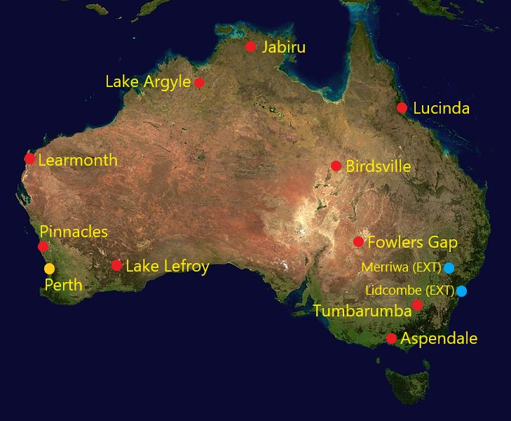
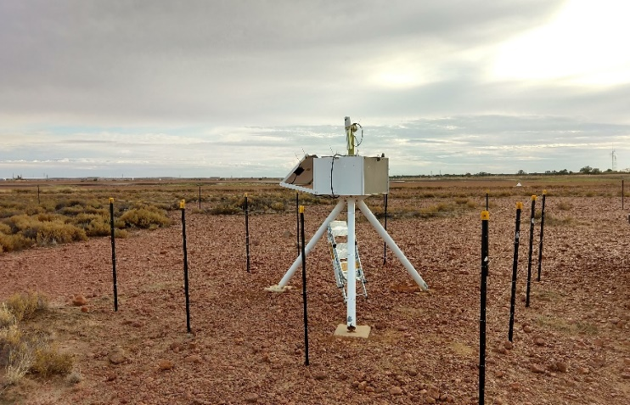
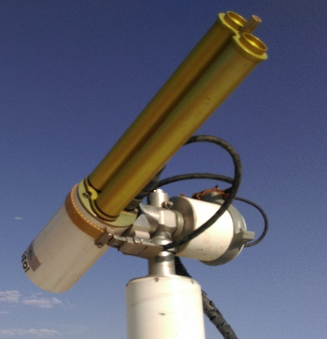
AeroSPAN (CSIRO) - Sun Photometry over a Land Area of 7.8 million km²
AeroSPAN (CSIRO): Aerosols via Sun Photometry Australia Network
Network of 10 current sun photometer sites
Located in New South Wales, Northern Territory, Queensland, Victoria, Western Australia
Team: Ian Lau, David Barker

Slide 3
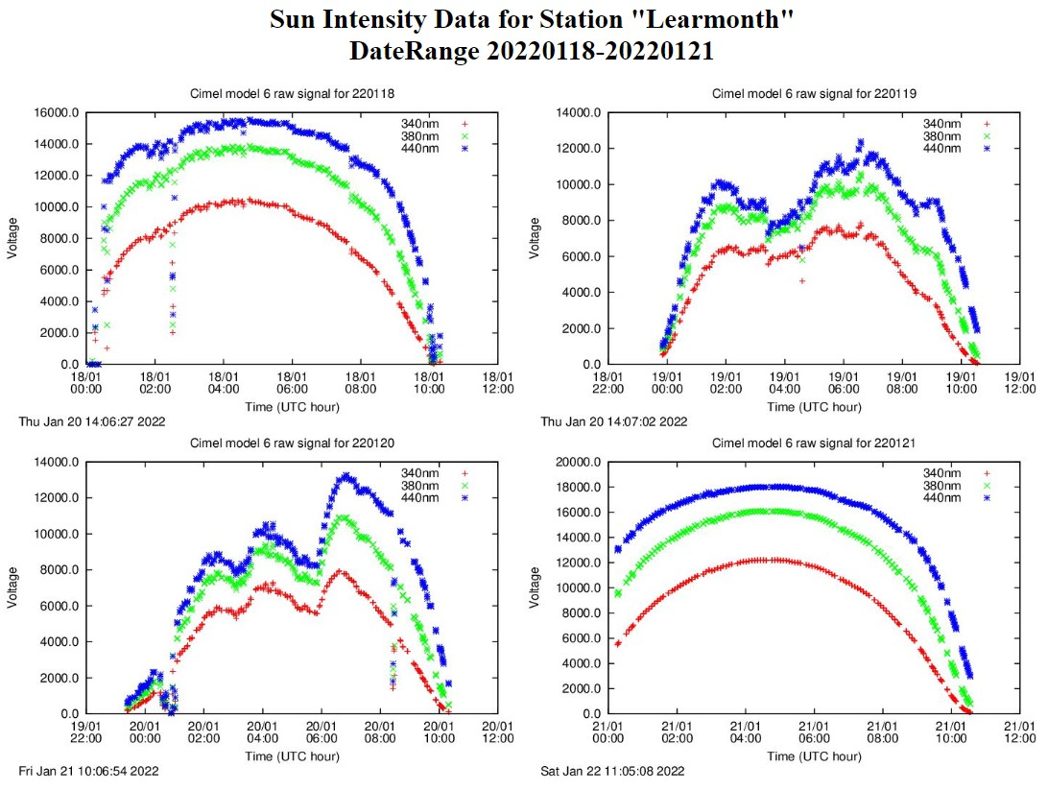
Observations – Hunga-Tonga Volcano Plume
Volcanic plume travel seen by most sites
Changes in intensity
Variations by wavelength
Comparison with AERONET Aerosol Optical Depth (AOD) Trends

Slide 4
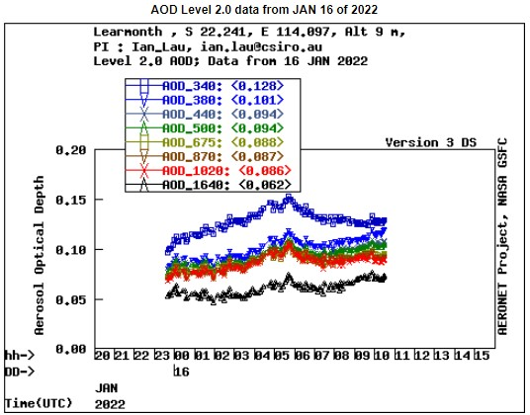
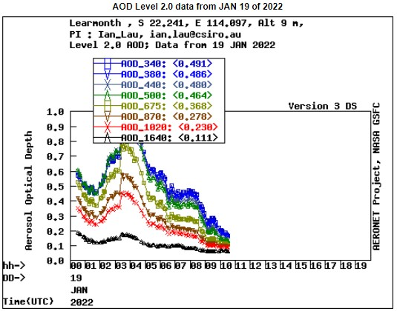
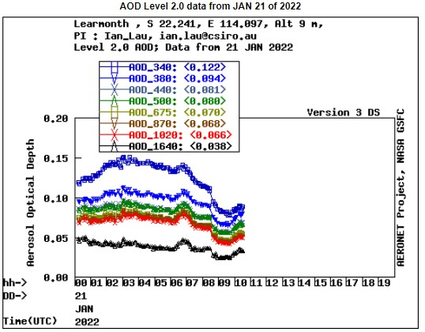
Observations - Hunga-Tonga Volcano Plume
AOD from AERONET (Level 2 – calibration and time drift adjusted)
Changes in AOD peak values - Volcanic plume changes over time

Slide 5
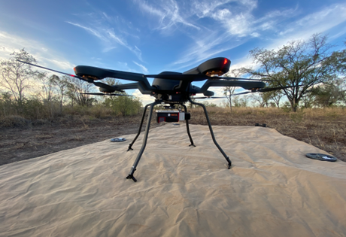
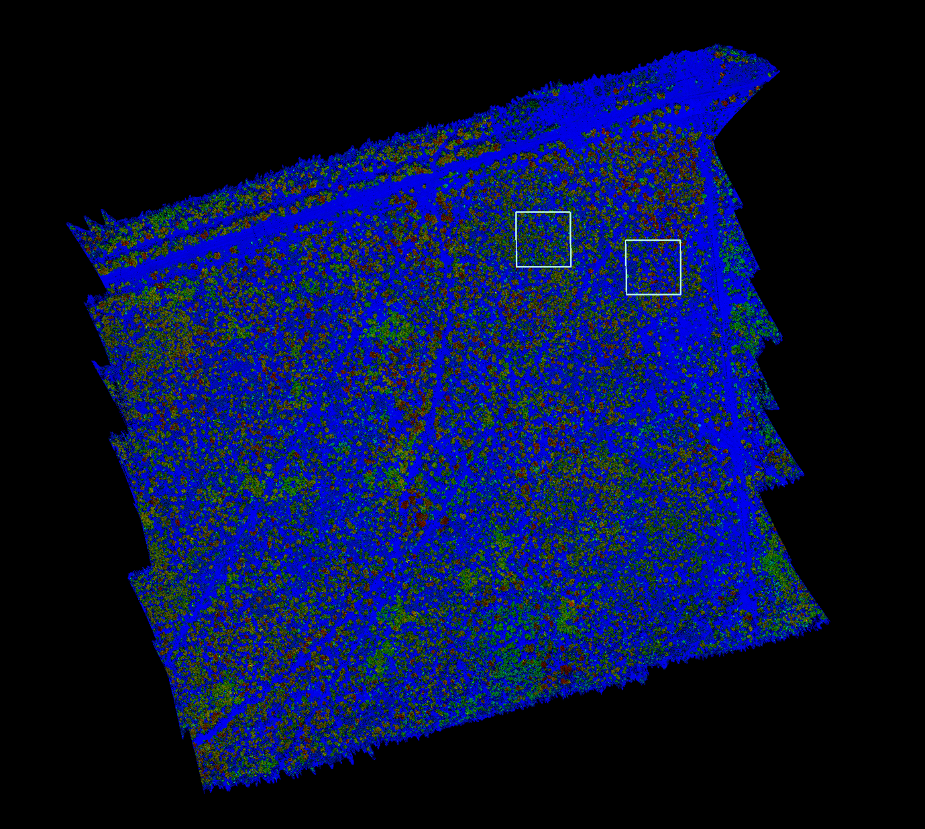
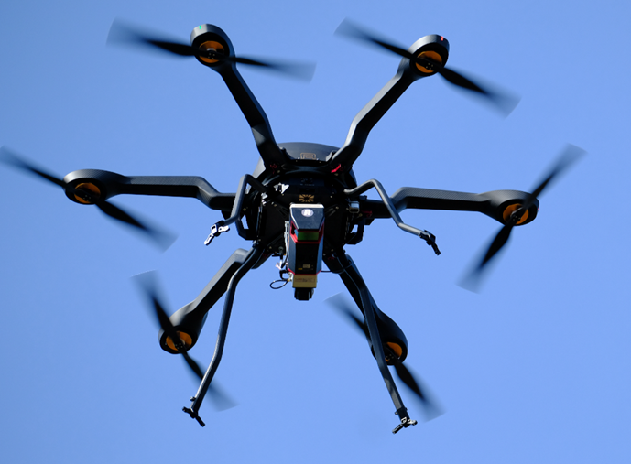
UAV-LiDAR collection for GEDI and NISAR calval
UAV-LiDAR acquisitions (100- 1000 ha scale)
Canopy height
(blue to red)
Coincident field plots and UAV-LiDAR acquisitions
Lead: Shaun Levick

Slide 6
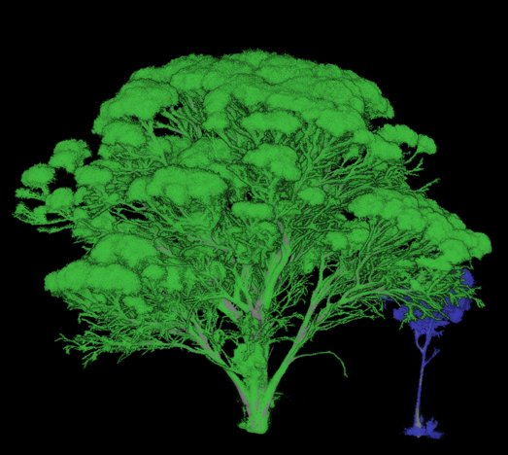
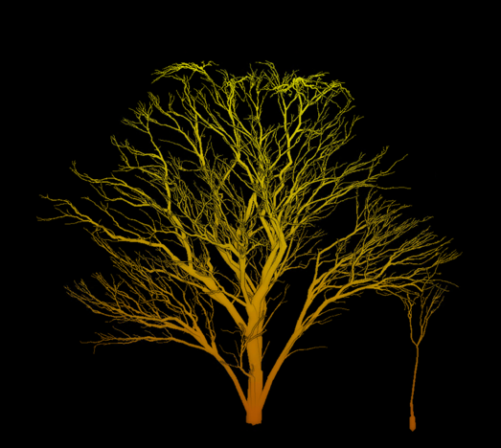
Quantitative structure modeling
No longer solely in the domain of TLS
UAV-LiDAR can dramatically increase the scalability of QSM approach (with the right sensor)
Terrestrial LiDAR (TLS), Riegl VZ-2000i
UAV-LiDAR (ULS), Riegl VUX-120

Slide 7
Dark water Inland Observatory Network (DION)Vision
To contribute quality assurance observations to global calibration and validation efforts, leading to increased fidelity of satellite-derived water quality products in Australia.
DION aims to achieve Fiducial Reference Measurements (FRM) quality requirements for radiometers using standard protocols and processing eg instrument calibrations and uncertainty budgets,
High temporal database of paired laboratory, in situ and satellite observations for modelling and forecasting,
Open access portal for data and products,
Operational facility, future-proofed with capacity for additional instrumentation.
Funded by CSIRO & AusCalVal
PI: Janet Anstee

Slide 8
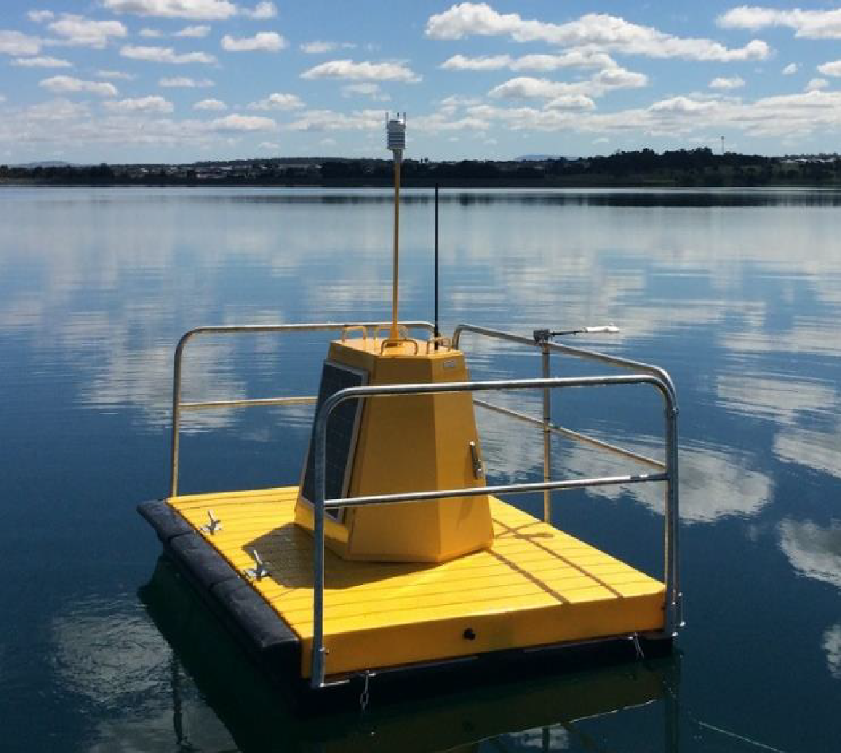
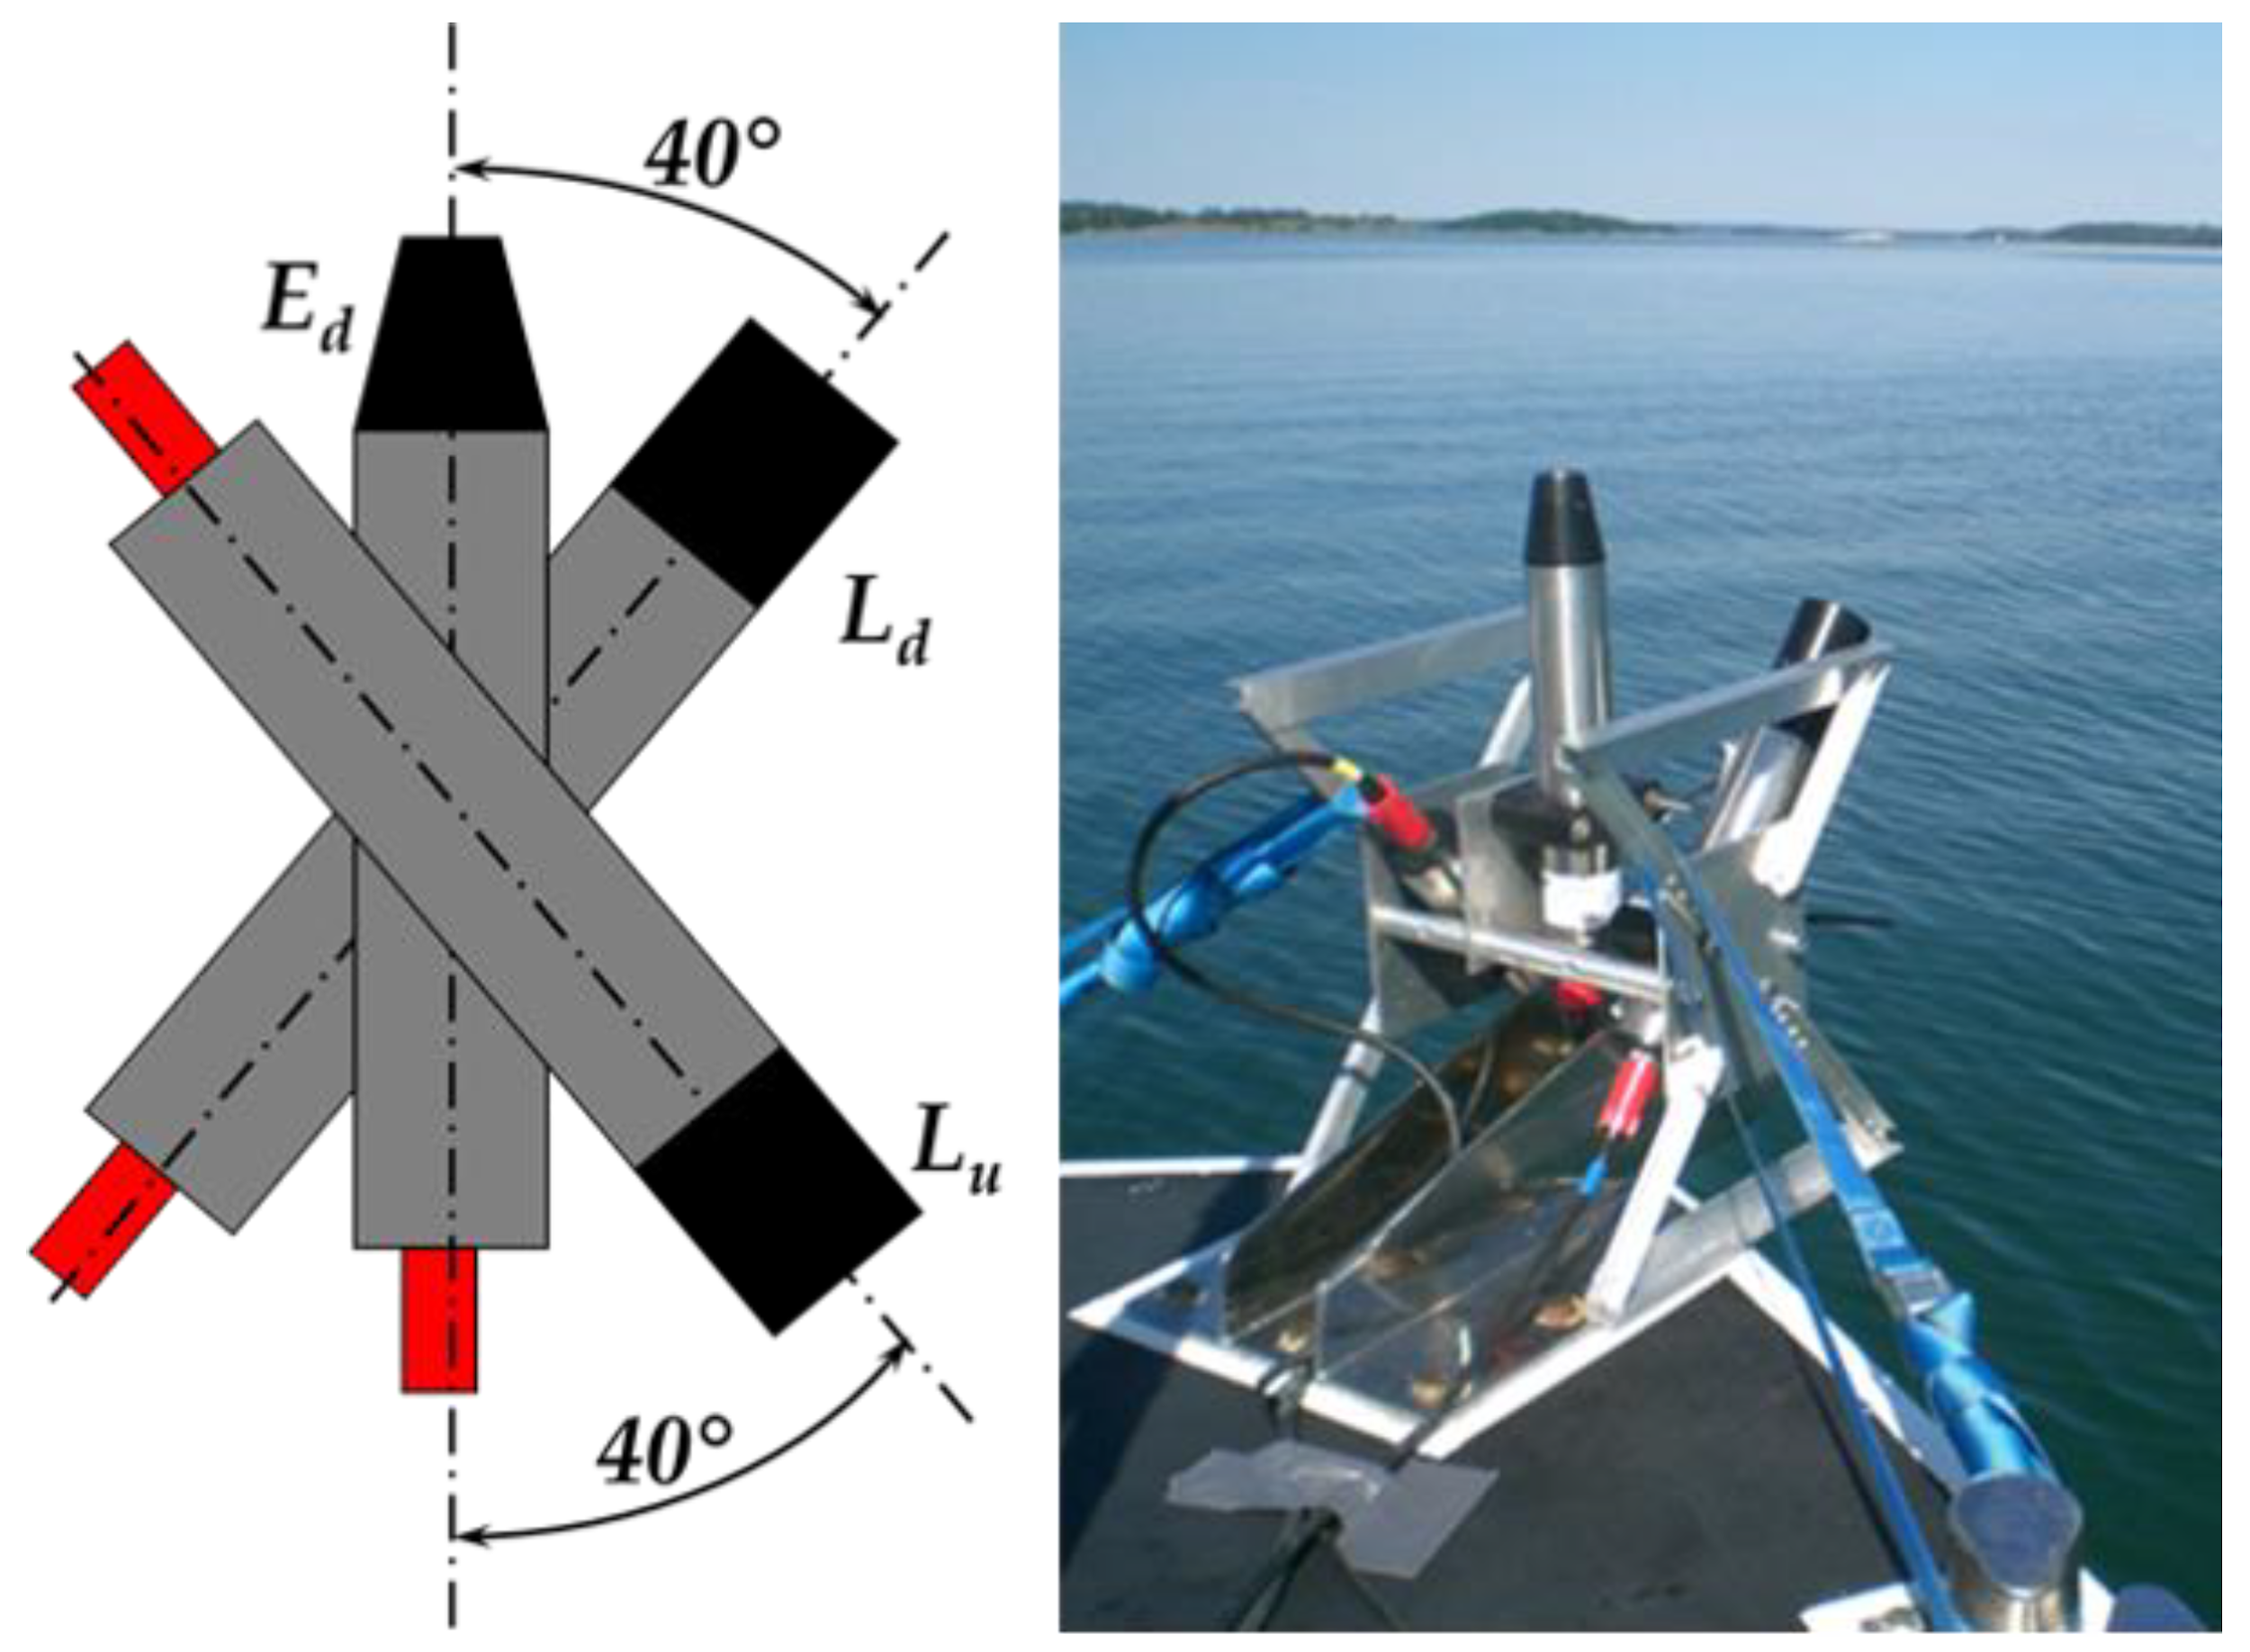
DION Phase 1
Planned deployment for Googong Dam, a dark water drinking-water reservoir 30km SE of Canberra in mid-2023.
Autonomous water surface measurements (every 15 minutes) with fortnightly in-water observations will build a comprehensive database for water quality modelling and forecasting.
Funded by AusCalVal & CSIRO.
Current instruments include:
TriOS Ramses E_{d}, L_{sky} and L_{w}
Pan/tilt unit
Weather station
Cameras horizontal and forward-looking
Water temperature (below surface & 2 depths (4/8m)
Autonomous power and communications
CSIRO Environment | DION Project Team
Janet Anstee (PI), Gemma Kerrisk, Nathan Drayson, Darius Culvenor*, Hannelie Botha, Lesley Clementson
*Environmental Sensing Systems
Notes:
The Googong Dam catchment is located in New South Wales, to the south-east of Canberra and is part of the larger Queanbeyan River catchment. Googong Dam was completed in 1978 and upon closure formed the Googong Reservoir. The inflows of water to the dam have low concentrations of sediment and nutrients, and do not require additional water treatment.

Slide 9
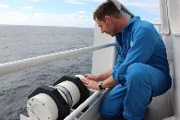
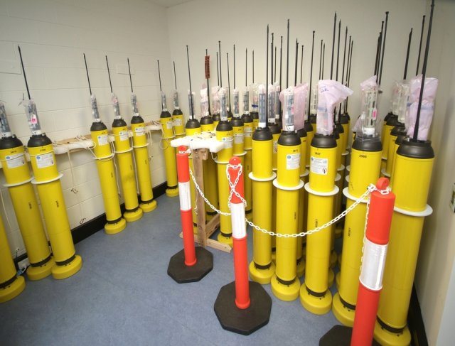
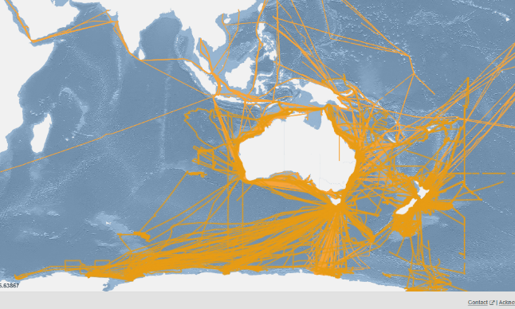
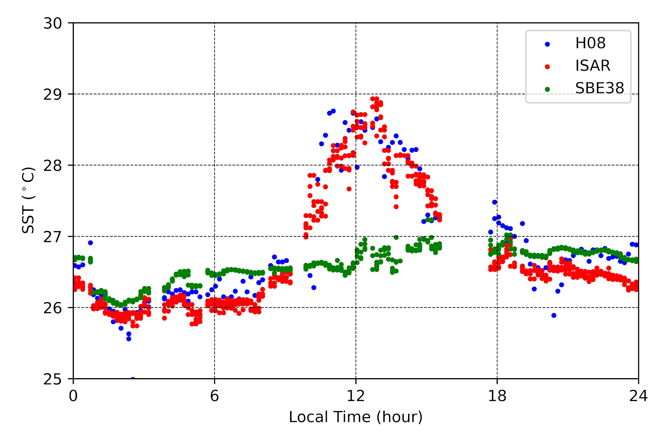
IMOS ship and Argo SST for satellite validation http://imos.org.au/sstsensors.html
ISAR
Argo
Image: Bruce Miller
IMOS Project provides real-time, QC’d, ship sea surface temperature (SST) data valuable for satellite SST validation, particularly in regions lacking other in situ SST (coastal Australia, Indonesian seas, Southern Ocean).
IMOS bulk SST at several meters depth from commercial and research vessels have been used by the Bureau and Uni of S. Carolina to validate IR SST data from NOAA POES and EnviSat AATSR radiometers, IMOS Multi-sensor L3S and the International Space Station's ECOSTRESS radiometer. Data are provided to the GTS and NOAA's iQUAM portal (https://www.star.nesdis.noaa.gov/socd/sst/iquam/) for satellite validation.
Infrared Autonomous SST Radiometer (ISAR) skin SST data from RV Investigator, provides delayed mode, QA'd SST data at the depth sampled by IR satellite sensors and referenced to international temperature standards, and have been used by the Bureau, OUC, EUMETSAT and JAXA to validate Himawari-8, Sentinel-3 and GCOM-C skin SST. Data are provided to www.ships4sst.org for satellite validation.
IMOS also provides real-time, QC'd, 5 m depth SST from Argo profiling floats, routinely used by Space and Meteorological Agencies to validate satellite SST products and analyses, due to their accuracy and homogeneous global distribution. Data are provided to the GTS (see https://imos.org.au/facilities/argofloats)
All data are publicly available from the AODN (https://portal.aodn.org.au).
IMOS ship tracks
since 2008
IMOS Himawari-8 skin SST, ISAR skin SST, SBE 38 SST(7m)
Great Barrier Reef, 12 Oct 2016
Helen Beggs (Bureau of Meteorology) – Leader IMOS Ship SST Sensors Sub-facility

Slide 10
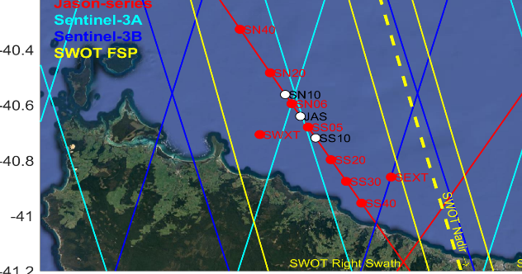
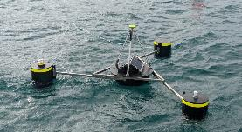
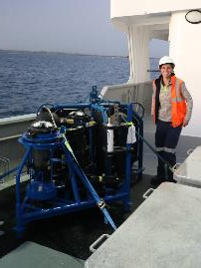
Satellite Altimetry Calibration and Validation
https://imos.org.au/facilities/srs/srscalval
The Bass Strait satellite altimeter validation facility has been used for validation of the sea level observations since the launch of TOPEX/Poseidon in 1992.
Bass Strait is the sole facility of its kind in the Southern Hemisphere. Recognised as one of four key in situ validation facilities internationally.
The facility contributes directly at the mission level across multiple missions (Jason-series, Sentinel-series, SWOT…) and across multiple agencies (NASA, CNES, ESA…). It forms a part of the iterative cycle of validation/understand/improve associated with the production of altimeter data used scientifically and operationally around the world.
IMOS have provided sustained support for infrastructure (sub-surface moorings, surface GNSS equipped buoys) and multi-disciplinary capability (geodesy and oceanography) required to address stringent cal/val requirements in this marine remote sensing space. Requirements:
Geometric observations of sea level in an absolute reference frame in a highly dynamic and challenging environment.
Observations of ocean properties (bottom pressure, temperature, salinity, current and waves) over a sustained period.
Increasingly stringent accuracy requirements requiring evolution in the in situ measurement approaches.
Integration of knowledge across disciplines of geodesy, oceanography and remote sensing.
The oceanographic observations also feed into AODN for the benefits of various marine applications beyond cal/val.
IMOS seems the right stakeholder for the marine infrastructure operations and leveraging satellites for marine applications. AUSCALVAL might be the right pathway to expand the applications (e.g. value adding activities, a postdoc, specific new tech development…), integration in connection with space agencies, integration across disciplines in Australia.
GNSS
GNSS Buoy
CWPIES
GNSS
PORT
GNSS
TG
GNSS
GNSS
20 km
GNSS/INS equipped buoys in Bass Strait.
Sub-surface moored oceanographic sensors being deployed
Christopher Watson (UTas), Benoit Legresy (CSIRO)

Slide 11
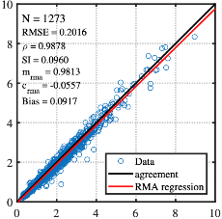
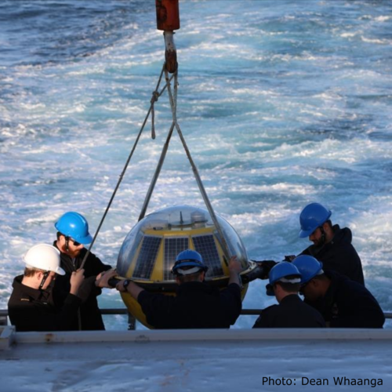
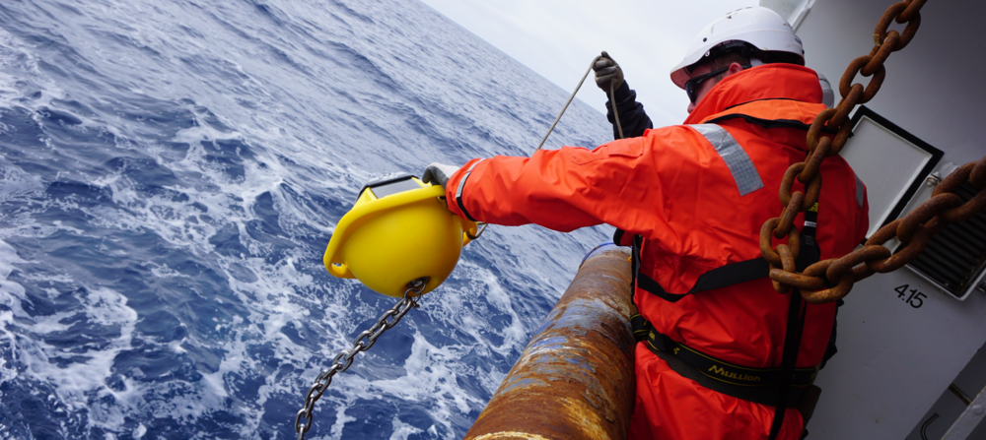
Cal/Val of satellite ocean surface waves and wind
Waves
Australian coastal wave buoys (mostly operated by State and Commonwealth agencies) record wave conditions at several coastal locations
Large gaps exist in the Southern coast, Northern WA and the top end
Low-cost wave buoys (~4 kg; Sofar spotter) can fill these gaps and IMOS recently executed a pilot project which confirmed their accuracy
Wave buoy measurements are crucial for:
monitoring wave conditions
tuning regional and coastal wave models
cal/val of SRS wave measurements
Wind
Australian offshore wind measurements are scarce
Australia’s emerging offshore wind industry requires accurate wind measurements
Existing measurements are on coastal infrastructure and confounded by land effects
Satellites also provide wind observations (Scatterometers, SARs, Radiometers), which critically need in-situ measurements for cal/val
Typical satellite altimeter wave height calibration
Buoy wave height (m)
Australian wave conditions are captured by:
(i) coastal wave buoy network with several gaps
(ii) Radar Altimeter and SAR satellites
(iii) Numerical wave models
Altimeter wave height (m)
TriAXYS ~230 kg
Datawell waverider
~100 kg
SOFAR Spotter
~4kg
https://imos.org.au/facilities/srs/surface-waves
Traditional buoys to low-cost drifting wave buoys
Salman Khan (CSIRO) Ian Young (UMelb)

Slide 12
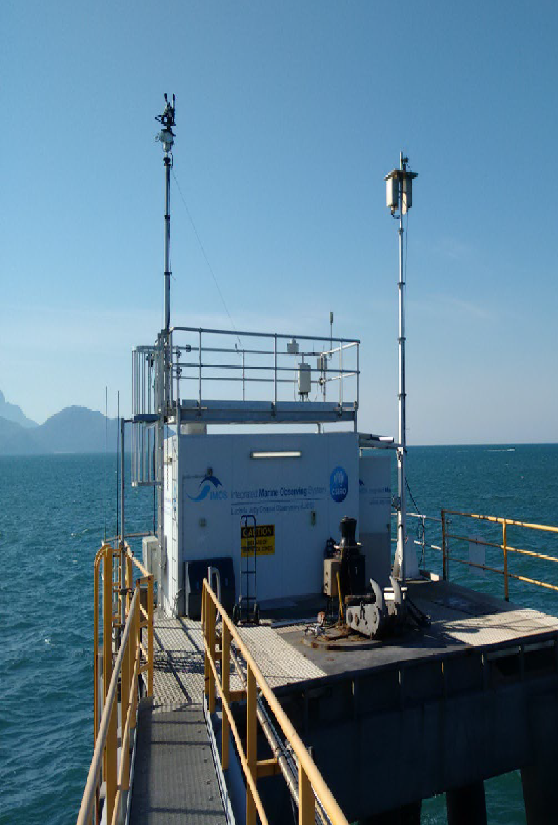
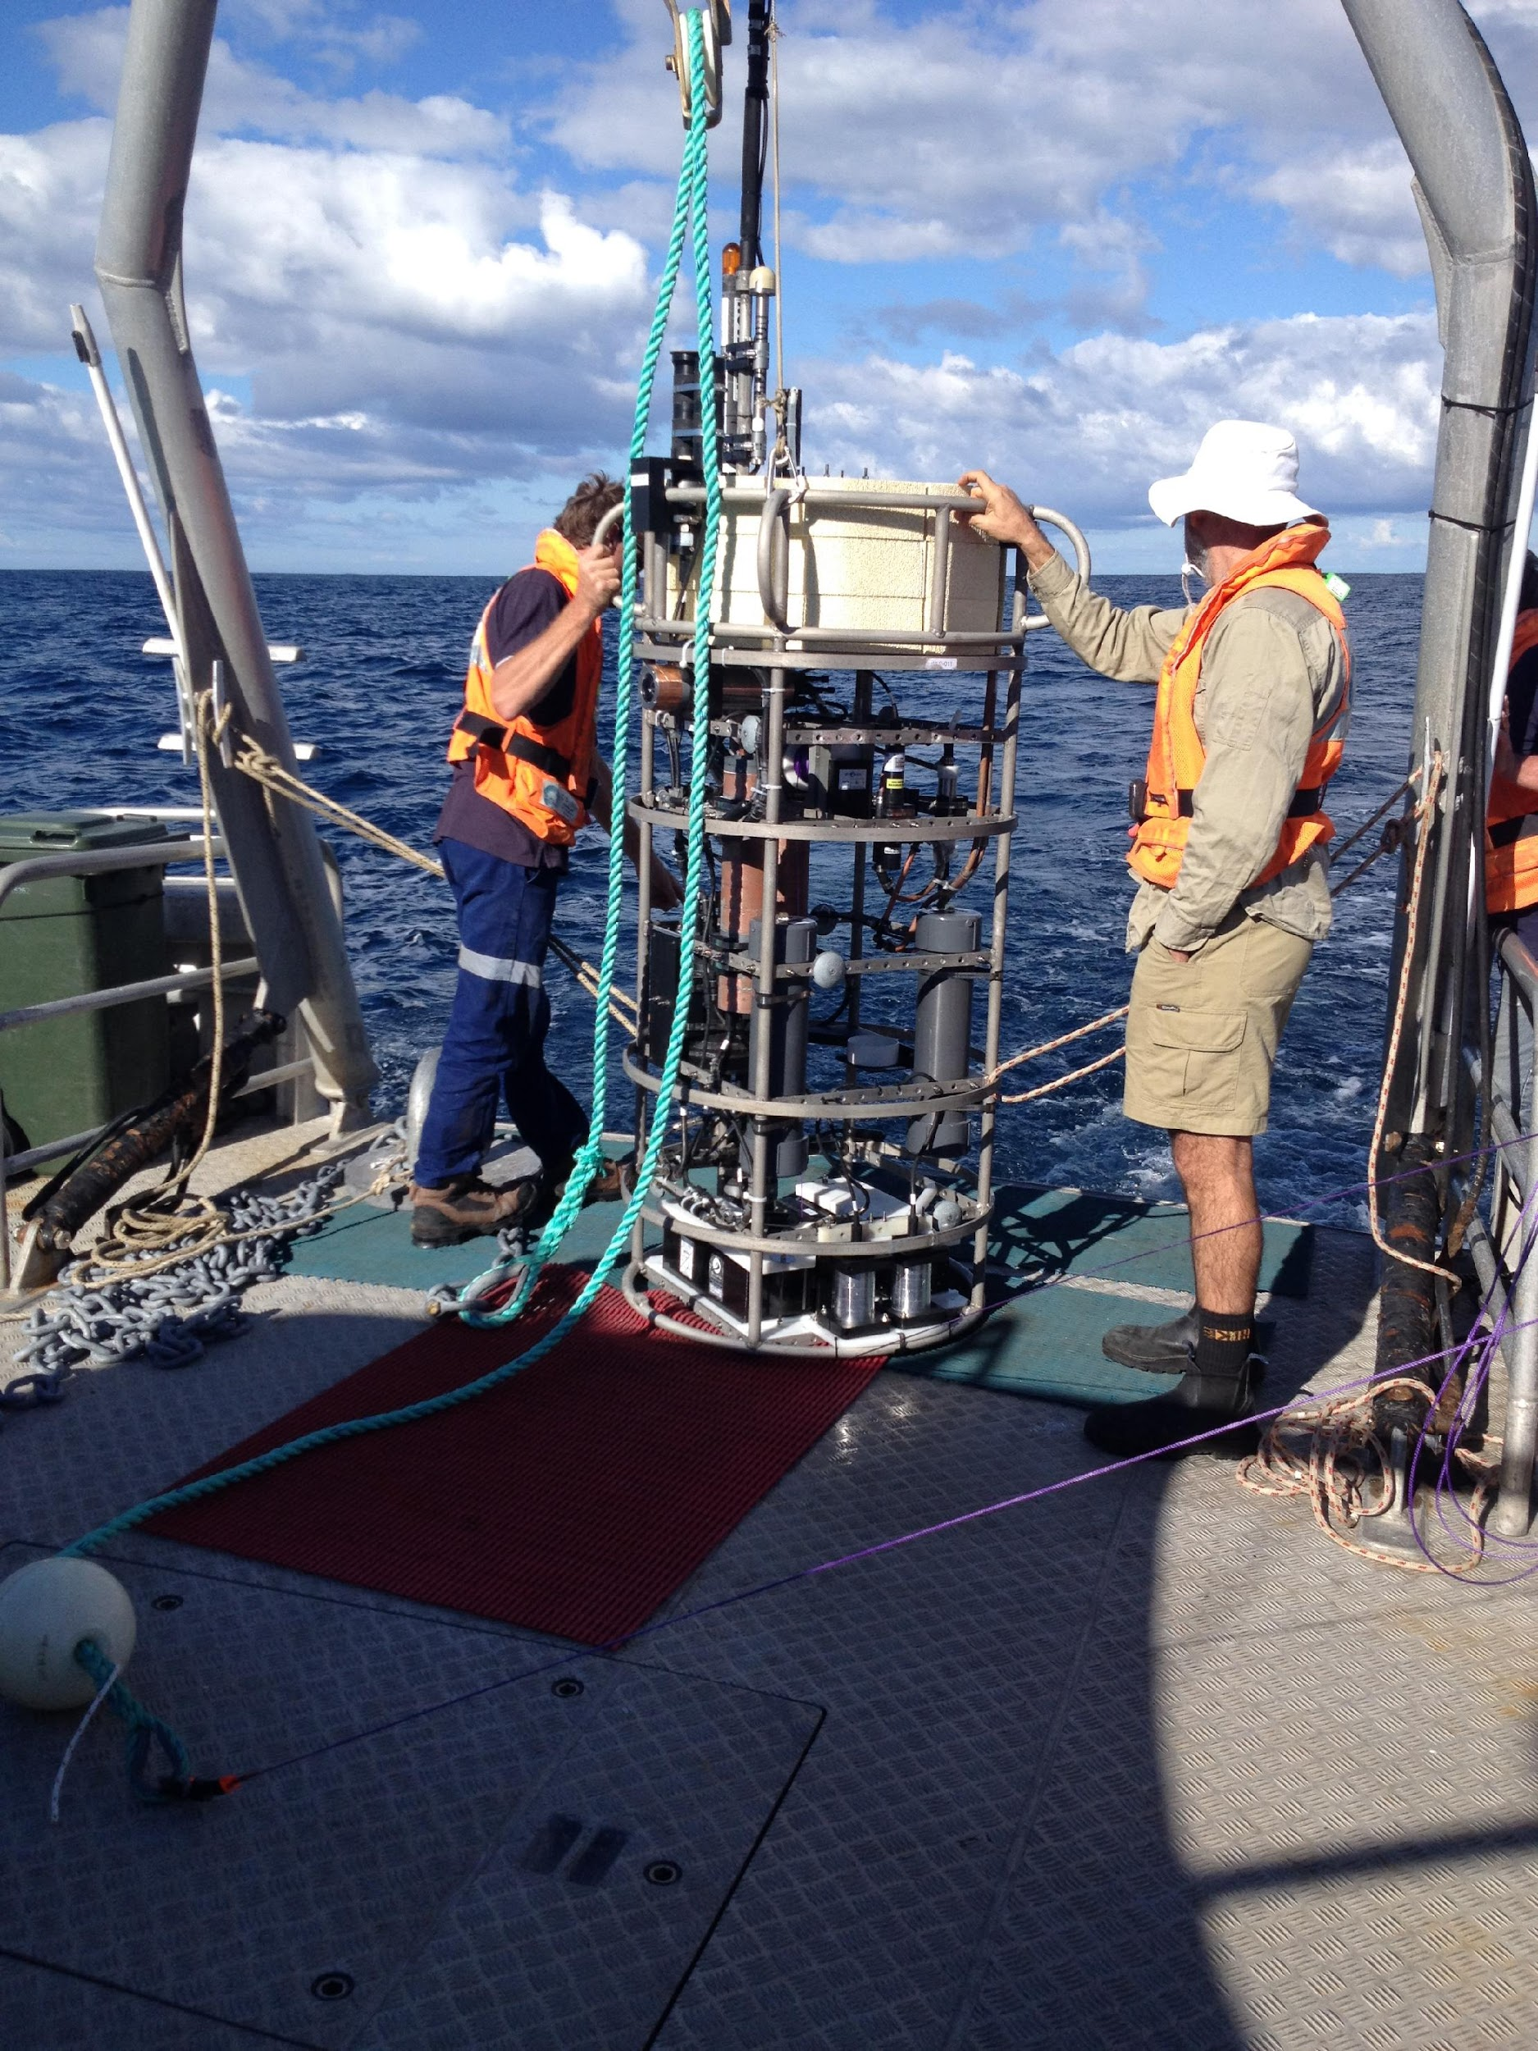
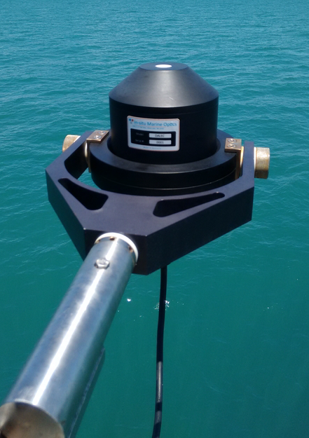
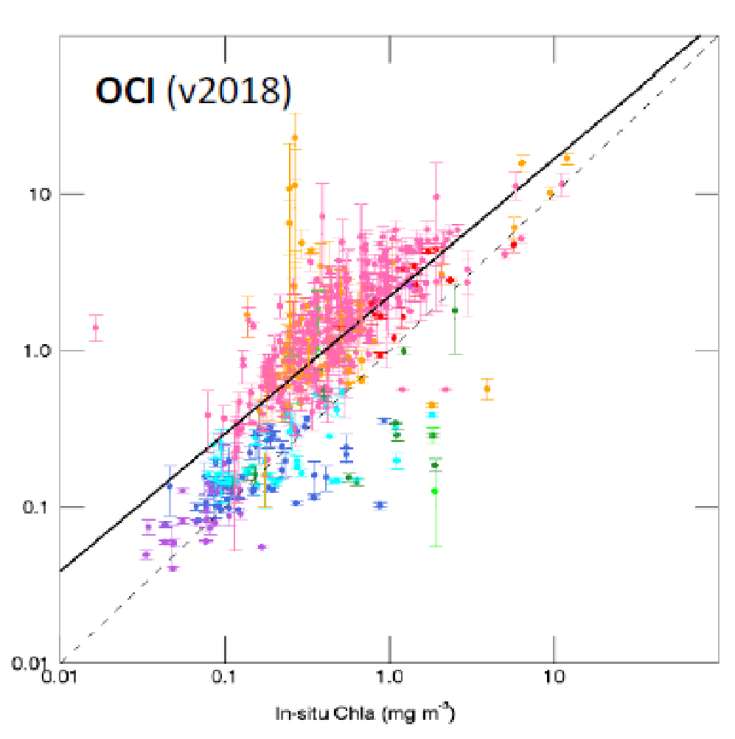
IMOS Satellite Ocean Colour Sub-facility Cal/Val
Co-leads: Thomas Schroeder (CSIRO), David Antoine (Curtin) University)
Validation and production of satellite Ocean Colour products for the wider Austral-Asian region
Lucinda Jetty Coastal Observatory (LJCO)
Fixed Platform, QLD
Rottnest Island Thetis
(RITS)
Profiler Mooring, WA
DALEC on AIMS RV Solander
En-route Radiometry, AU
Bio-optical database (BODB)
Data Collection, AU
Production & validation of OCR data
Data Repositories, AU
Operator CSIRO
Operator Curtin
Operator CSIRO
Operator CSIRO
Operator CSIRO/Curtin
Observations
Above-water radiometry
In-water optics
Biogeochemical samples
Observations
In-water radiometry
In-water optics
Observations
Above-water radiometry
Observations
Biogeochemical samples
(Pigments, TSS, CDOM)
In-water optics
Observations
Level 2, 3 products Sentinel-3 OLCI, VIIRS SNPP NOAA20, MODIS-A
National & International Engagement & Collaborations
eReefs, Digital Earth Australia, BoM, GBRMPA, AIMS, AquaWatch Australia, QLD Government, IMOS Community of Practice & RTT
NASA AERONET-OC, NASA SeaBASS, Sentinel-3 Validation Team OC, EnMAP, FRM4SOC, Copernicus CVS, IOCCG, wider research community

Slide 13
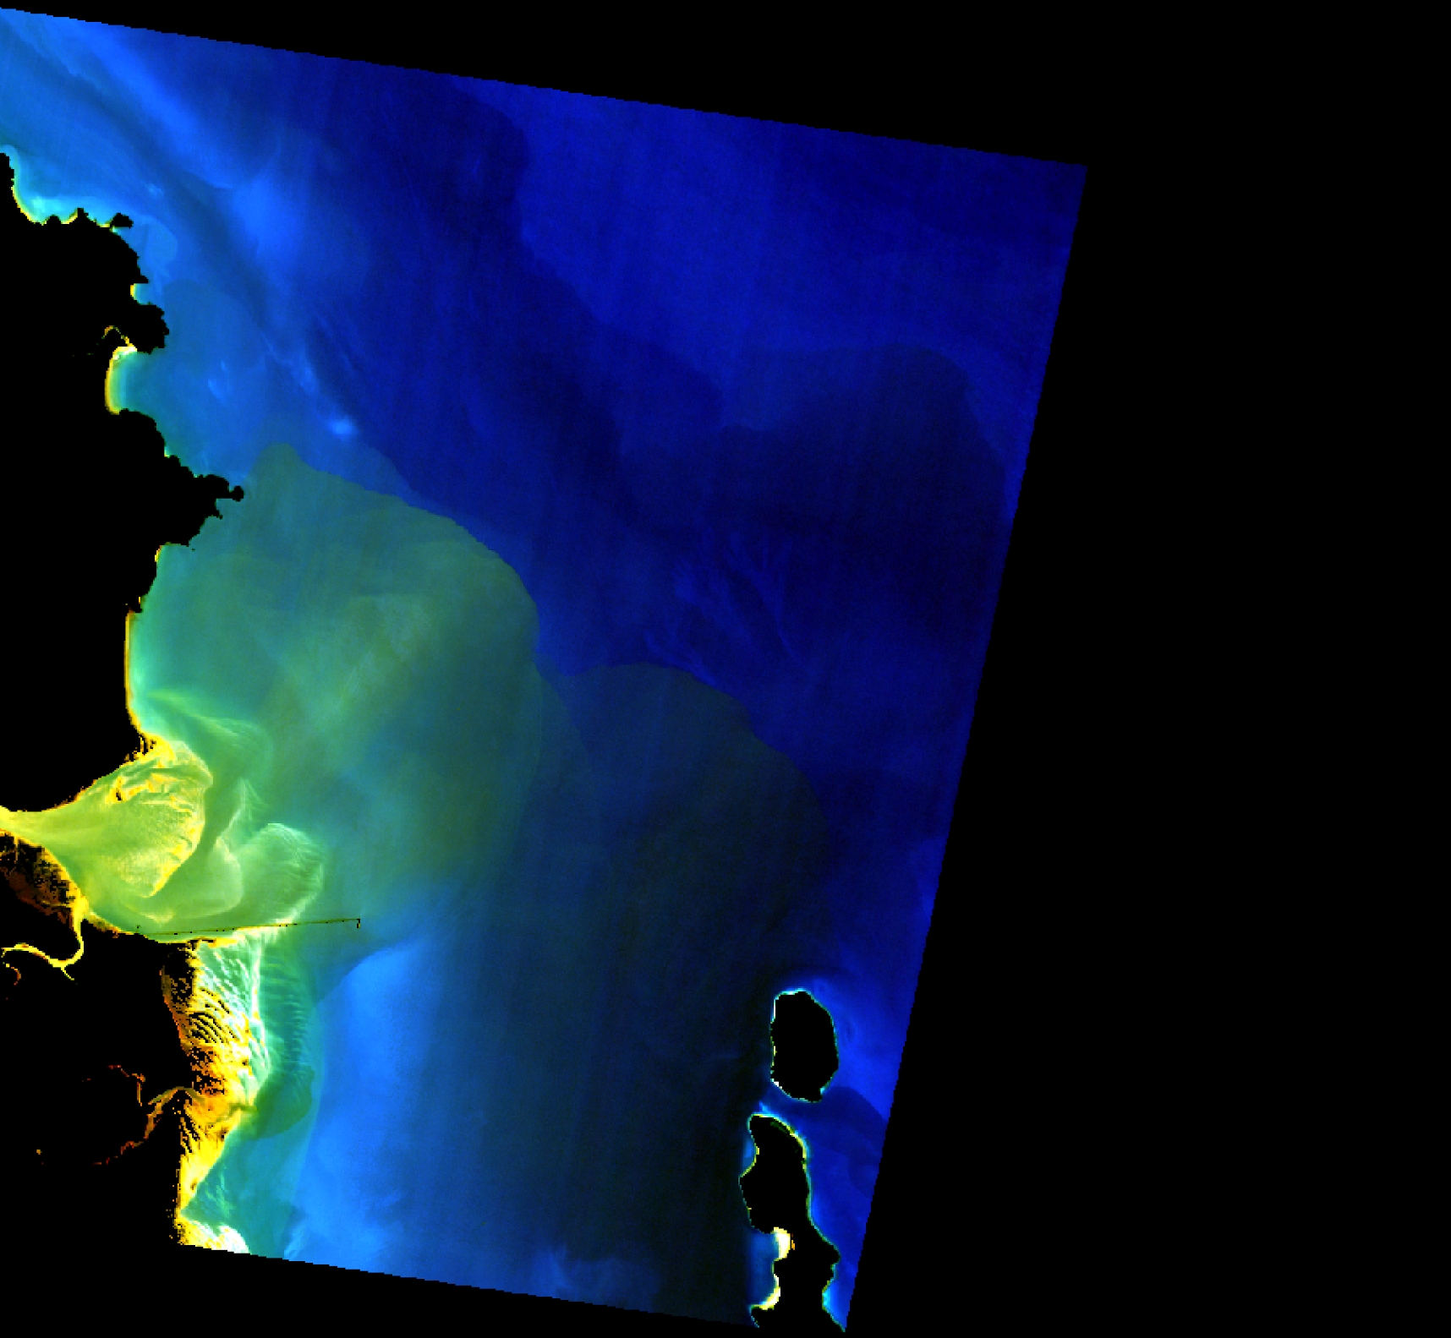
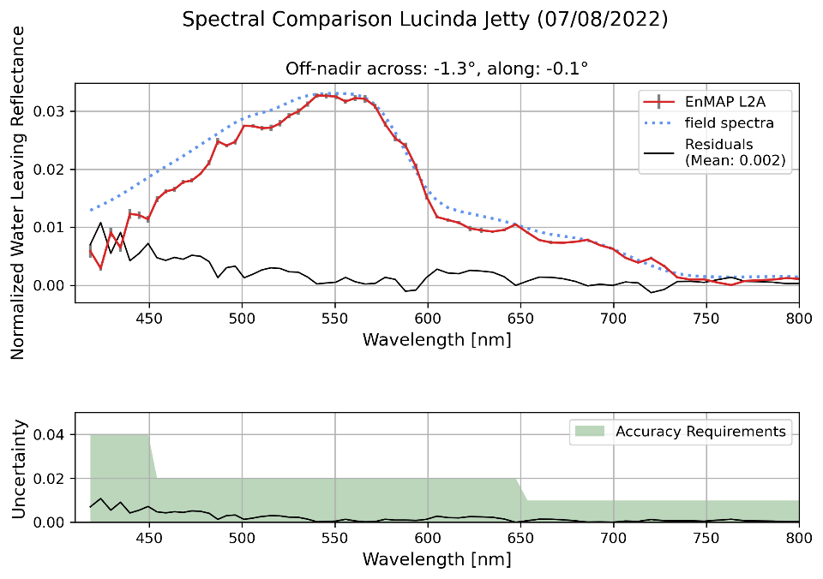
EnMAP validation – Lucinda Spectral comparison with Satlantic HyperOCR, 8 July 2022 First results with the MIP atmospheric correction provided by AWI (Analysis: Mariana Altenburg Soppa, AWI)

Slide 14
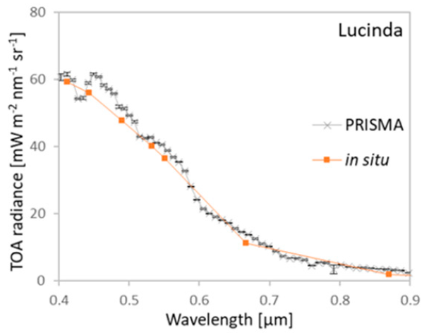
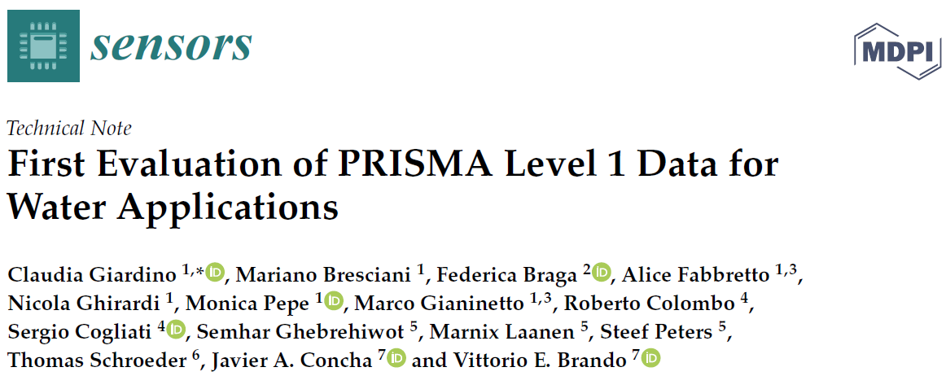
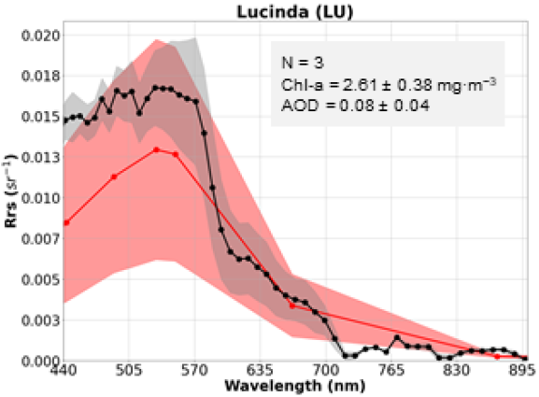
PRISMA validation - Lucinda
TOA radiances measured by PRISMA and simulated with 6SV (labelled as in-situ).
https://doi.org/10.3390/s20164553
Comparison of mean PRISMA L2d (grey) and Lucinda AERONET-OC Rrs data (red).
https://doi.org/10.3390/rs15082163

Slide 15
Continental-Scale Spatiotemporal Analysis
Driven by the aim to find a coarse resolution site;
Update analysis using recent 10 year archive of Landsat 8 USGS ARD;
Transfer workflow to modern (Earth Analytics Science and Innovation, EASI) data analytics platform;
Streamlined to work more efficiently. Test results: 1/2 continent of 10 years of USGS LS8 processed <45 minutes using 70 x 64c 256Gig workers;
Workflow potential
applicable to other regions or locations;
Can be adapted for
aquatic sites characterisation;
other datasets, including TIR for locating potential targets & site characterisation;
Team: Mike Caccetta, Yiqing Guo, Cindy Ong, Ian Lau
Support from EASI team: Rob Woodcock, Geoffrey Squire.
Funding from AusCalVal

Slide 16
Pinnacles Progress
Passed one full year of continuous collections;
CIMEL approved for incorporation into AeroNet network;
First pass processing completed with strong support from CNES;
Promising results, ironing out challenges identified;
Contribution to EnMAP
Commissioning phase dedicated campaign & match up data after CNES processing;
Continue to contribute to operational monitoring & campaign cross calibration exercise;
Image credit: https://www.nicepng.com/downpng/u2e6r5r5o0u2a9i1_handprint-tree-tree-with-hand-prints/
Team: Cindy Ong, Ian Lau

Slide 17
: 09/03/2022 - 22/08/2022
Processing completed by CNES, thanks to Aimé Meygret, Guilleminot Nicolas, Stéphanie Bourdeau, Pelou Sophie

Slide 18
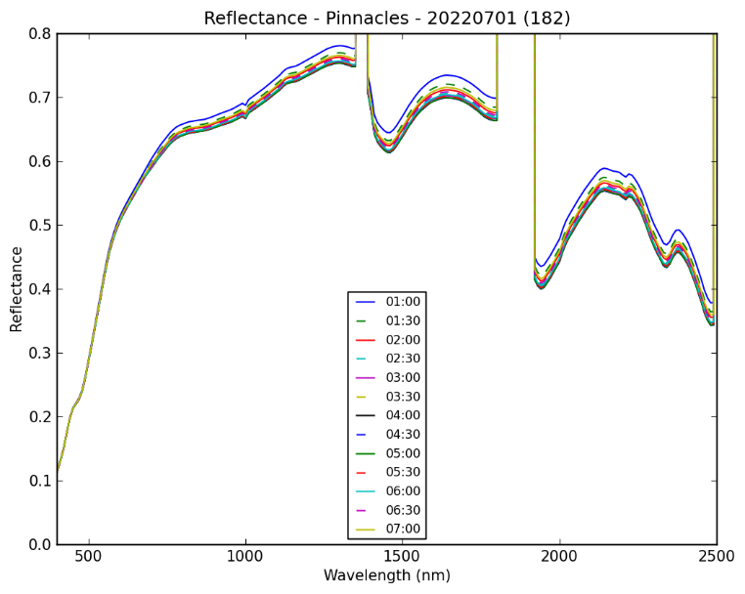

Slide 22
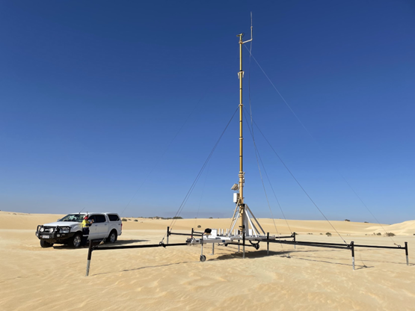
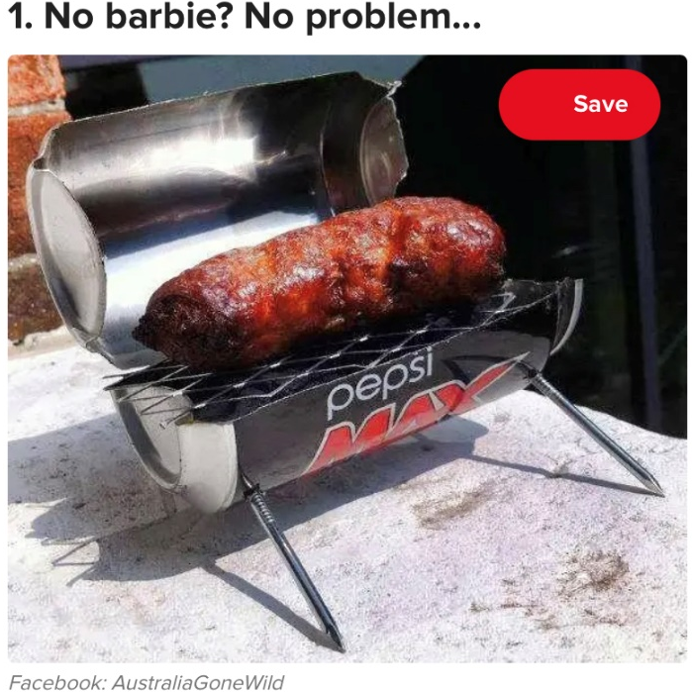
Where we’re at & future plans
RadCalNet submission
Complete processing for year;
Comparison of some Sentinel-2 data for validation;
Completion of paperwork;
Infrastructure improvement & addition
Transfer of platform to more permanent infrastructure;
Testing NASA SkyCam to be deployed to Pinnacles;
Waiting on HyperNets for testing & trial;
Plan for TIR trial;

Slide 23
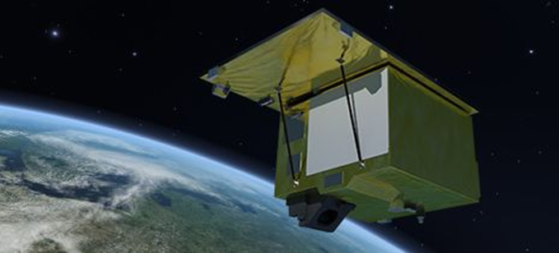
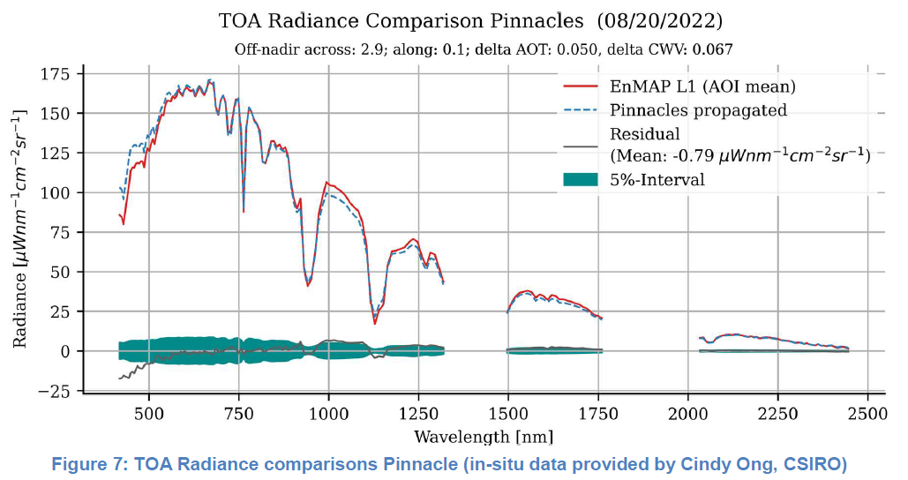
EnMAP commissioning phase
Image from https://www.enmap.org/mission/
Storch, T., Honold, H.-P., Chabrillat, S., Habermeyer, M., Tucker, P., Brell, M., . . . Fischer, S. (2023). The EnMAP imaging spectroscopy mission towards operations. Remote Sensing of Environment, 294, 113632. doi:https://doi.org/10.1016/j.rse.2023.113632

Slide 24
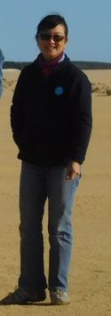
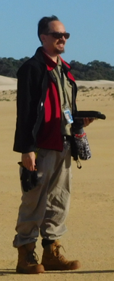
CSIRO Energy
Cindy Ong Principal Research Scientist
t +61 8 6436 8677
e cindy.ong@csiro.au
w www.csiro.au
CSIRO Environment
Janet Anstee Group Leader
t +61 2 6246 5714
e janet.anstee@csiro.au
w www.csiro.au
CSIRO Mineral Resources
Ian C Lau Senior Experimental Scientist
t +61 8 6436 8646
e ian.lau@csiro.au
w www.csiro.au
CSIRO Environment
Shaun Levick
Team Leader
t +61 8 8944 8429
e shaun.Levick@csiro.au
w www.csiro.au
CSIRO Environment
Thomas Schroeder
Senior Research Scientist
t +61 7 3833 5581
e Thomas.Schroeder@csiro.au
w www.csiro.au

