Slide 1
WGCV-52
NASA Agency Report
X. Xiong, K. Thome, NASA GSFC
Agenda Item #: 3.9
WGCV-52, ESA/ESRIN, Italy
5th - 9th June 2023

Slide 2
Cal/Val Activities
NOAA-21 VIIRS
  Early On-orbit Calibration Activities and Performance
Terra and Aqua MODIS
  Impact of Terra and Aqua Drifting Orbits and MODIS Calibration Strategies
PACE and SBG Mission Status
Slide 2

Slide 3
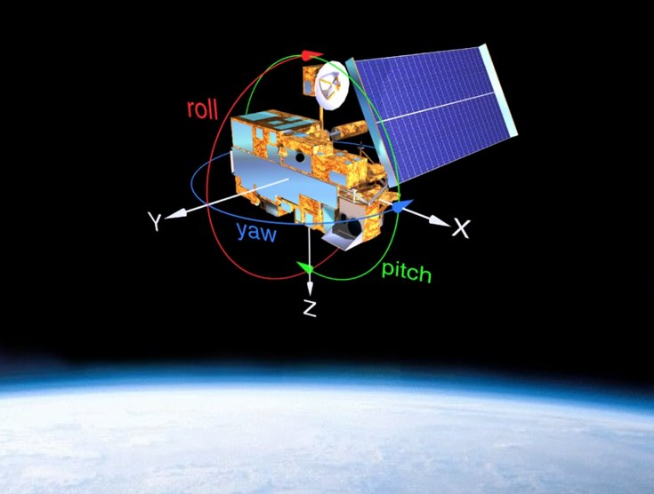
NOAA-21 VIIRS
Early On-orbit Calibration Activities
  Calibration Maneuvers
    Yaw: to characterize SD/SDSM BRDF and screen transmission
    Pitch: to characterize response versus scan-angle (RVS) for the thermal emissive bands (TEB)
    Roll: to view the Moon at the same phase angles (also on a regular basis)
  On-board Calibrators
    BB: nominally controlled at 292.5 K, an early mission warn-up and cool-down (WUCD)
    SD: views the sun each orbit
    SDSM: regularly scheduled (each orbit -> daily -> weekly)
Slide 3

Slide 4
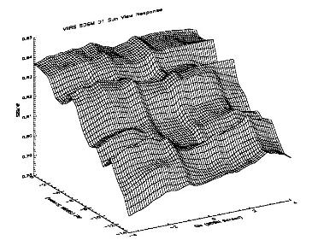

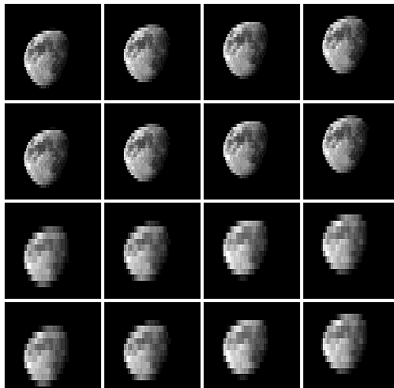
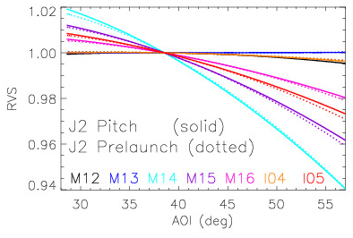
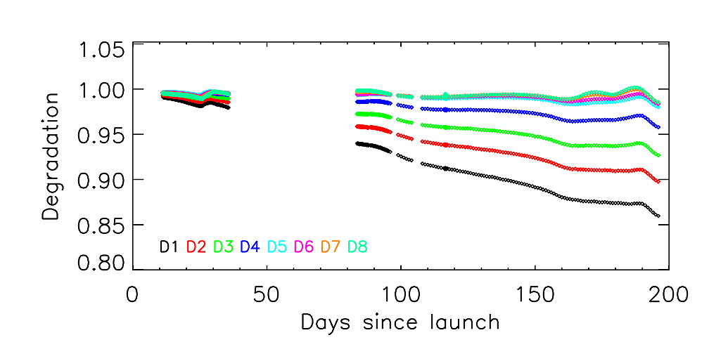
NOAA-21 VIIRS
Yaw
Pitch
Roll
SDSM
D1
I1
Images of M15
I2
M1
SD Degradation
M2
N-21 VIIRS lunar images (05/31/23)
Lunar observations are scheduled on a regular basis
Slide 4

Slide 5
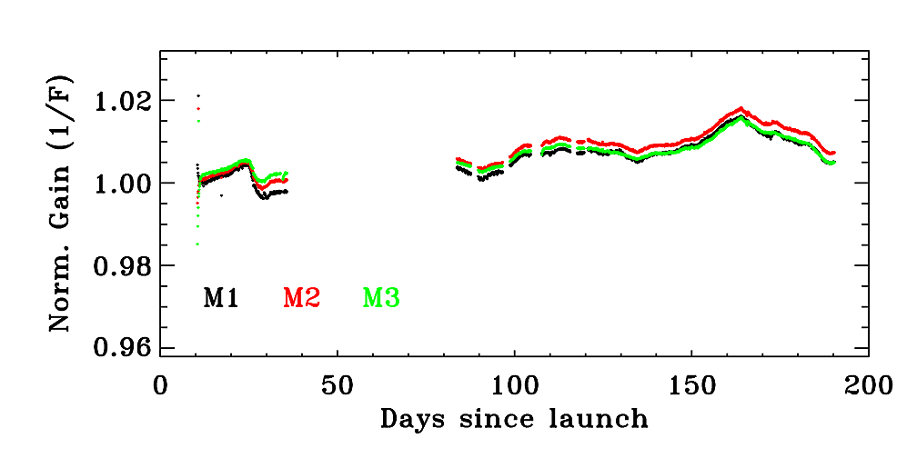
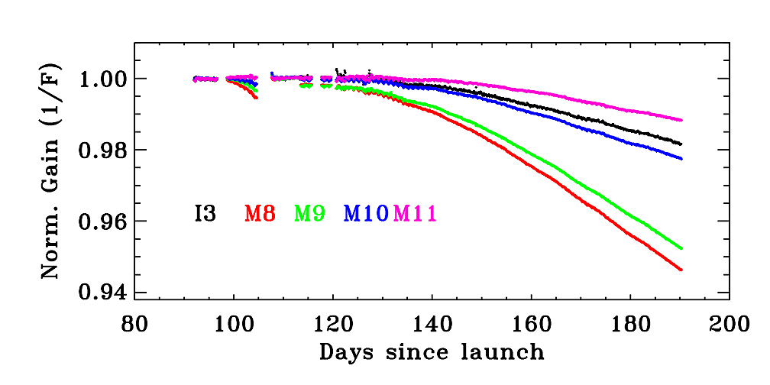
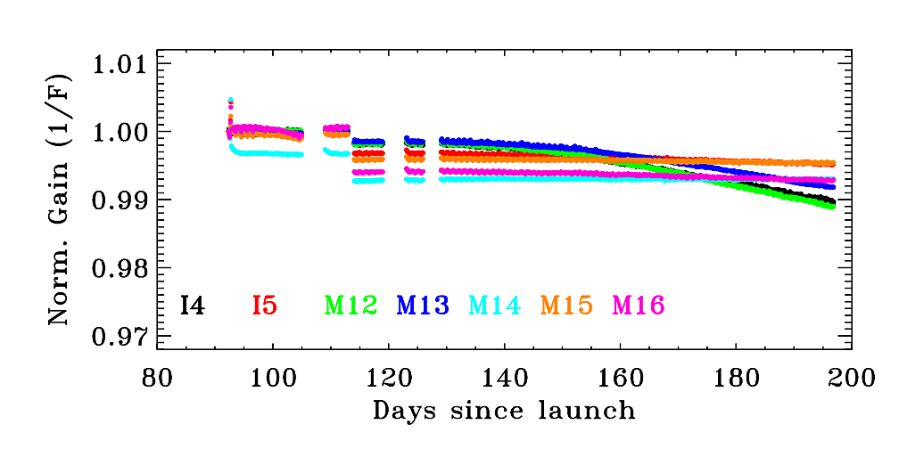
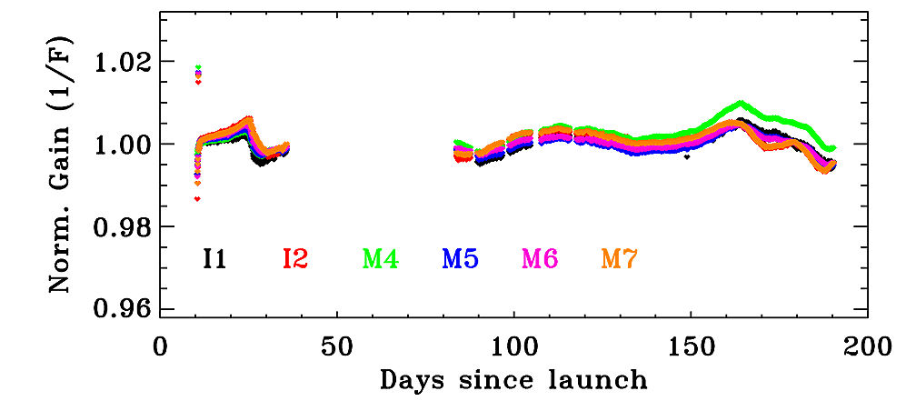
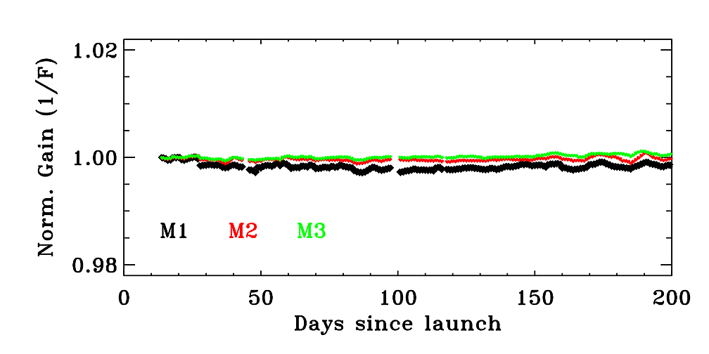
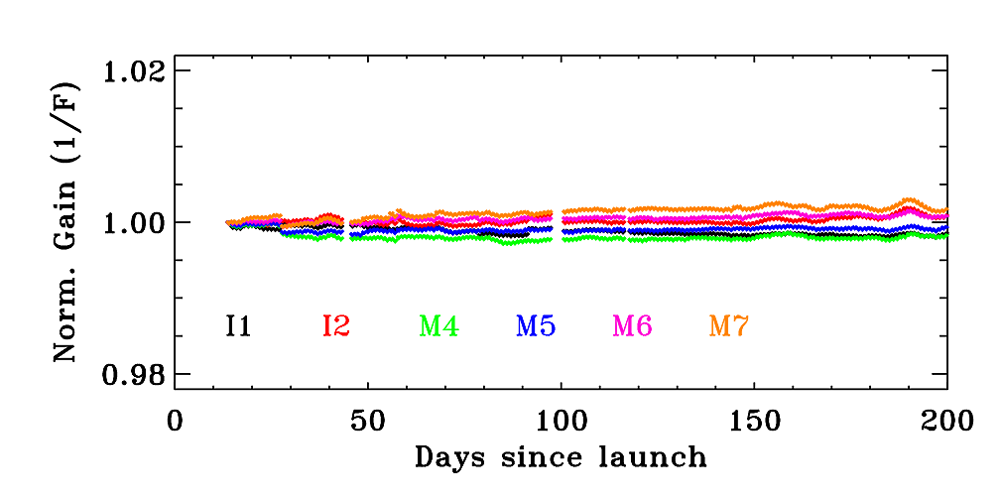
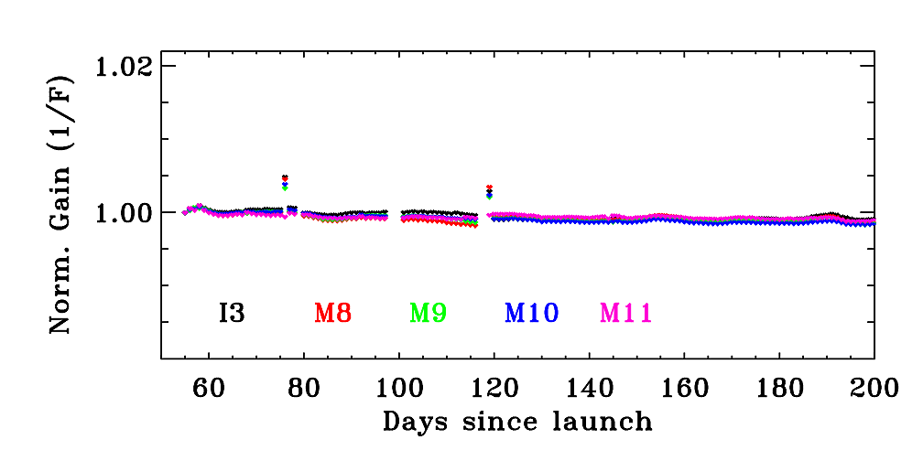
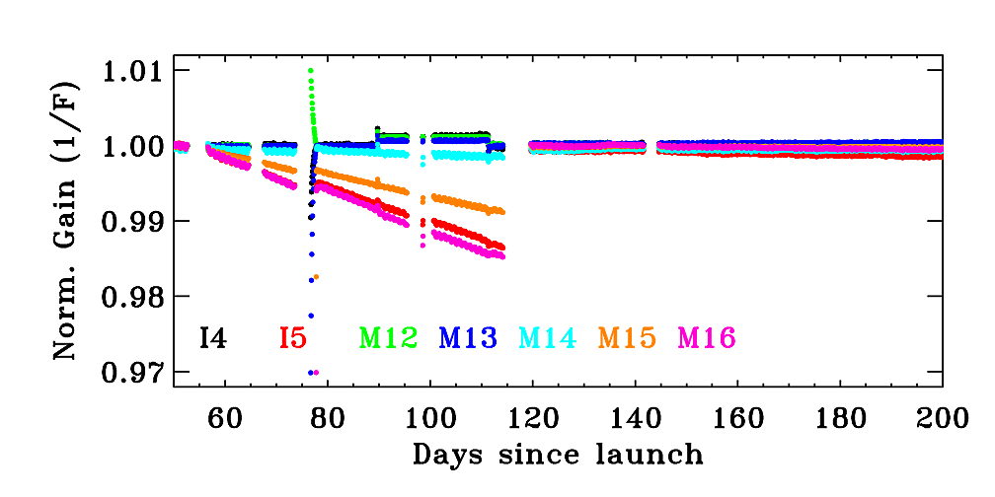
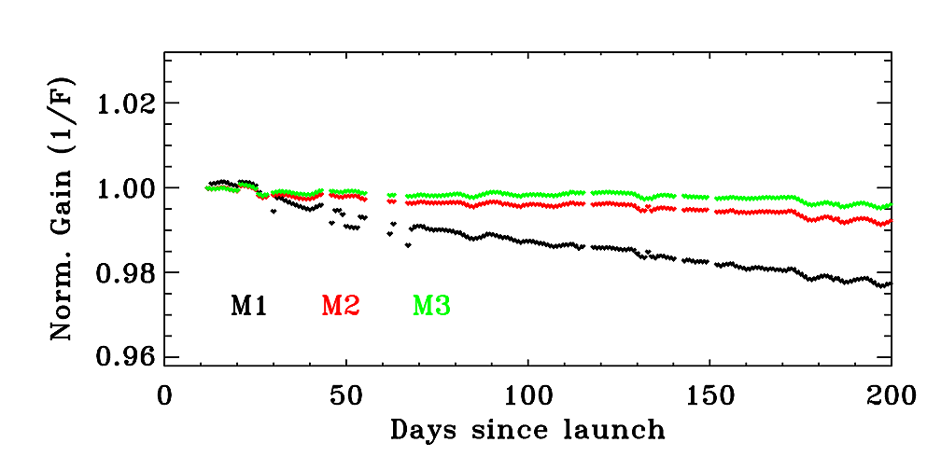
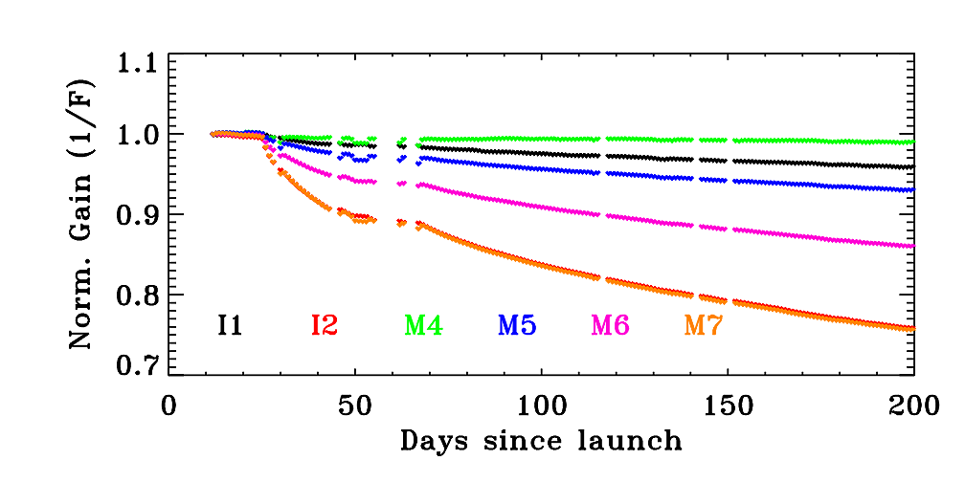
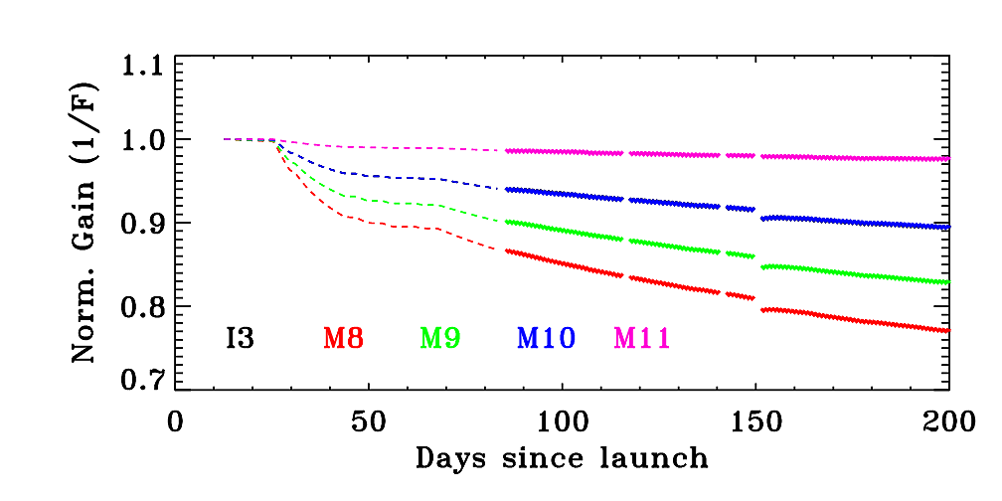
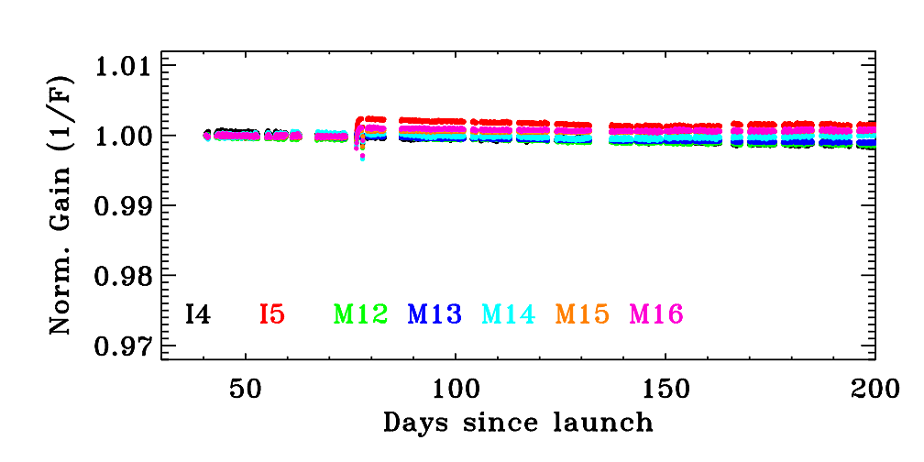
NOAA-21 VIIRS
Initial Spectral Band Responses (Gains): N-21, N-20, and S-NPP
λ < 0.5 μm
0.5 μm < λ < 1.0 μm
1.0 μm < λ < 2.3 μm
3.5 μm < λ < 12.2 μm
N-21
N-20
S-NPP
Slide 5

Slide 6
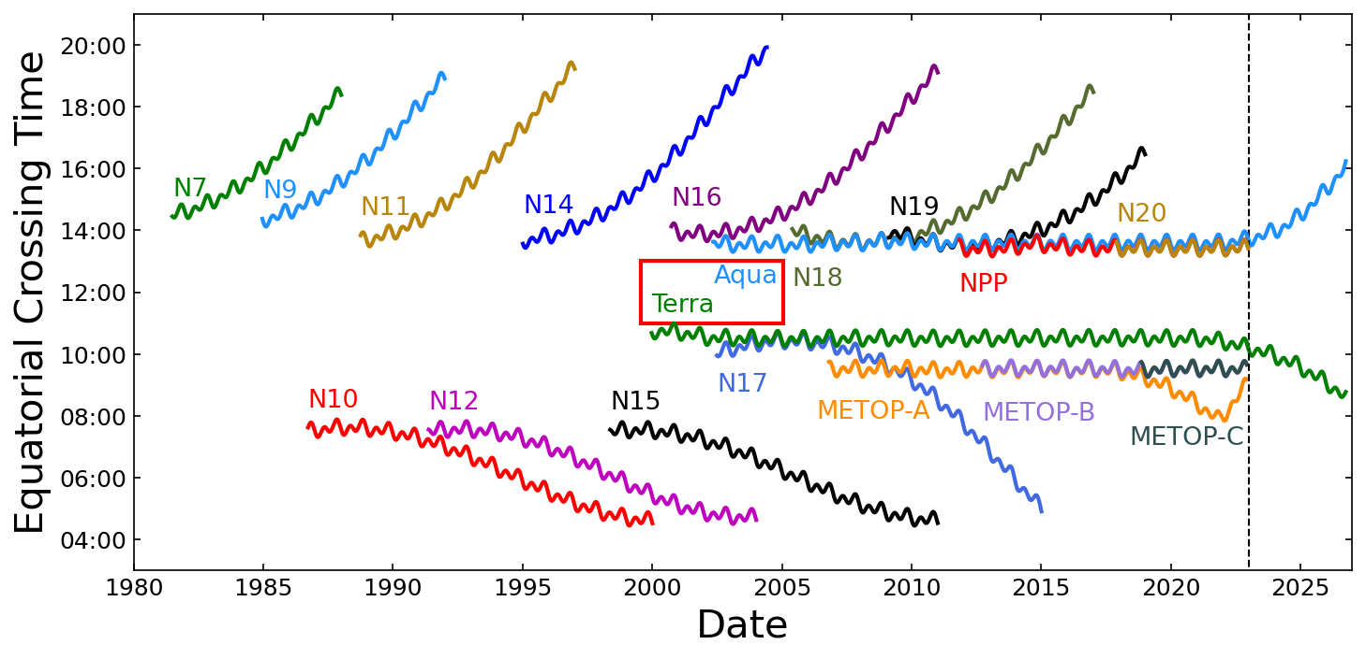
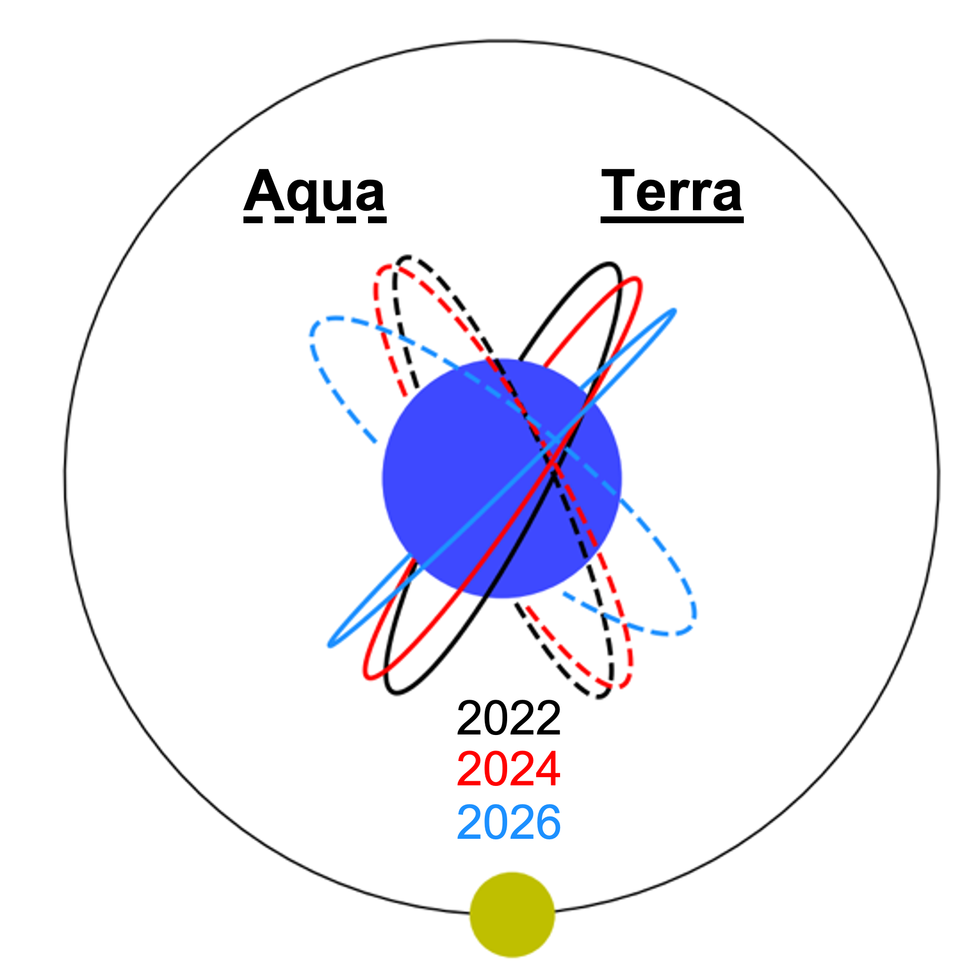
Terra and Aqua MODIS
Terra and Aqua Orbits
  Terra and Aqua have been kept at stable equatorial crossing times (10:30 and 13:30, respectively) for most of their mission lifetimes.
    Terra: Feb 2020 – End of regular IAMs; Oct 2022 – Constellation exit maneuvers (CEM), end of regular DMUs, and start of free orbit drift
    Aqua: March 2021 – End of regular IAMs; Dec 2021 – End of regular DMUs and start of free orbit drift
  Going forward, orbit maintenance will stop, and the orbits will drift to earlier (Terra) and later (Aqua) equatorial crossing times.
Aqua
Terra
Jan. 1, 2023 when we are projecting the orbit forward
Slide 6

Slide 7
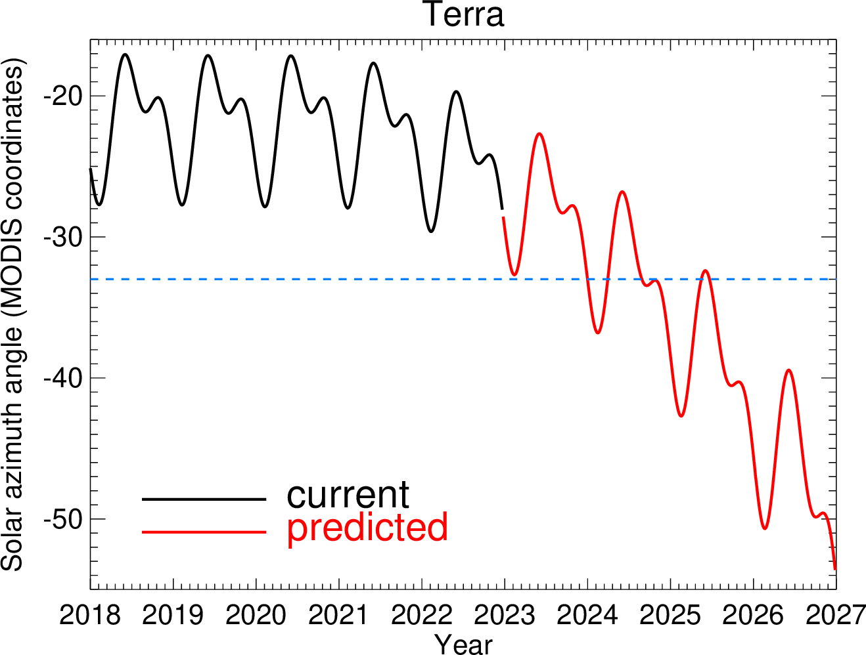
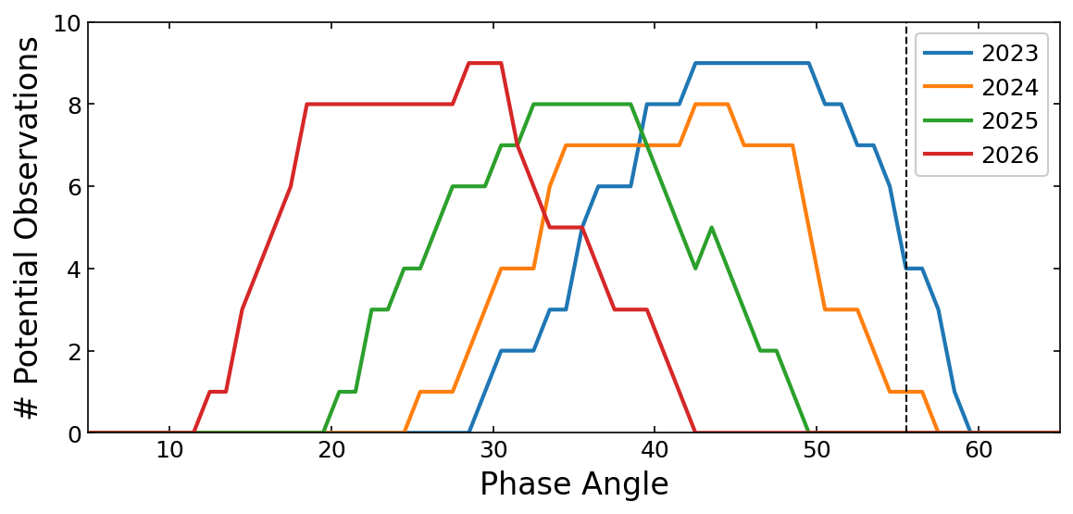
Terra and Aqua MODIS
Impact of Drifting Orbits on Calibration
  SD/SDSM Calibration
    Solar azimuth angles used for SD calibration have been gradually shifting and will exceed (in ~2024) the limits of the known SD BRF and SD screen vignetting function (VF).
  Lunar Calibration
    With drifting orbits, the select nominal lunar phase angles (55° to 56° for Terra and -55° to -56° for Aqua) cannot be maintained in order to keep similar number of lunar viewing opportunities; potential impact (small) on lunar calibration due to use of different lunar PA
  Use of Ground Targets
    Changes in solar and viewing angles at select EV targets
Limit of pre-launch and yaw measurements
Slide 7

Slide 8
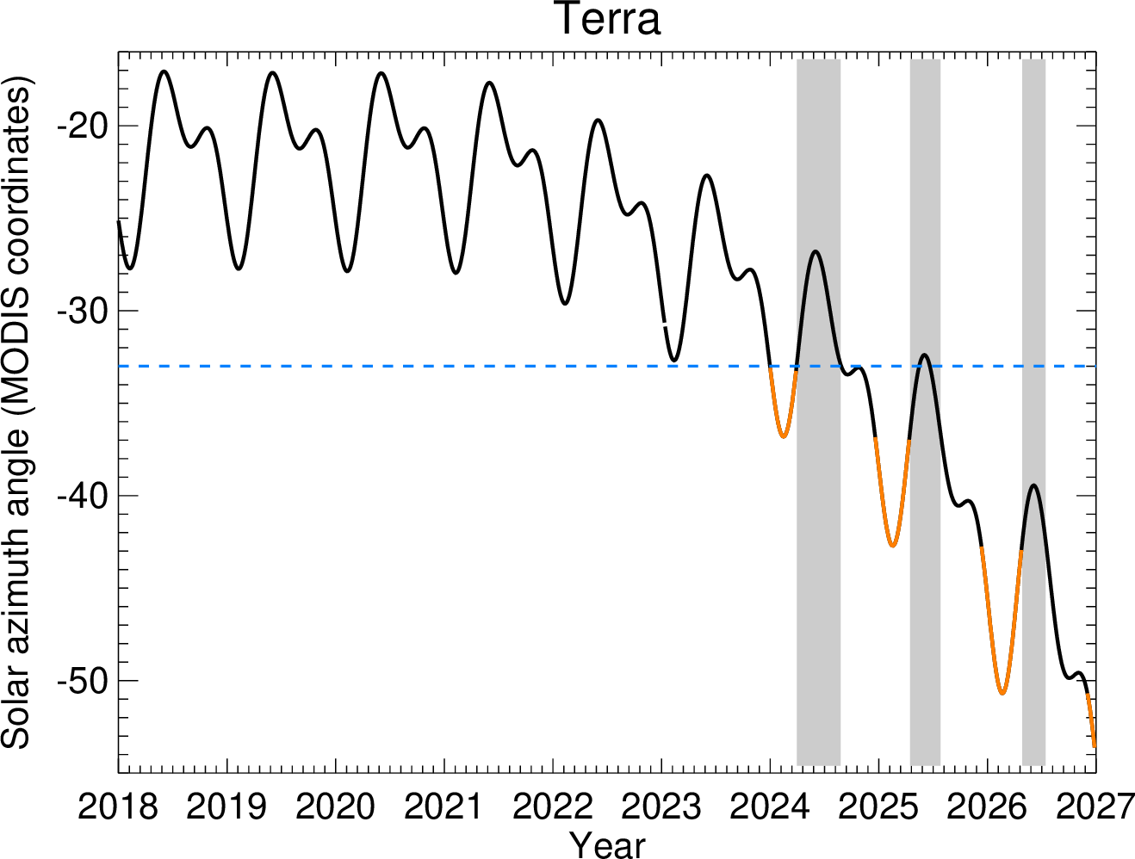
Terra and Aqua MODIS
Strategies
  SD/SDSM Calibration
    Additional yaw maneuvers to extend the solar angle range of known SD BRF*VF (work better for Aqua)
    For Aqua, VF can be characterized for each SD calibration pair (screen open + screen closed) directly
    Use of year-to-year overlap to build out BRF*VF with some added uncertainty (work better or Terra)
  Lunar Calibration
    Nominal lunar PA: Terra at 55.5° and Aqua at -55.5°
    Include a few lunar observations each year at the PA range to be applied in the coming year, providing residual phase corrections among different PA ranges.
    Limited use of unscheduled lunar observations
Previously mapped solar angles
Unmapped solar angles each year
Year | Terra | Aqua
2023 | [49, 50] | [-51, -50]
2024 | [44, 45] | [-45, -44]
2025 | [38, 39] | [-45, -44]
2026 | [30, 31] | [-32, -31]
Slide 8

Slide 9
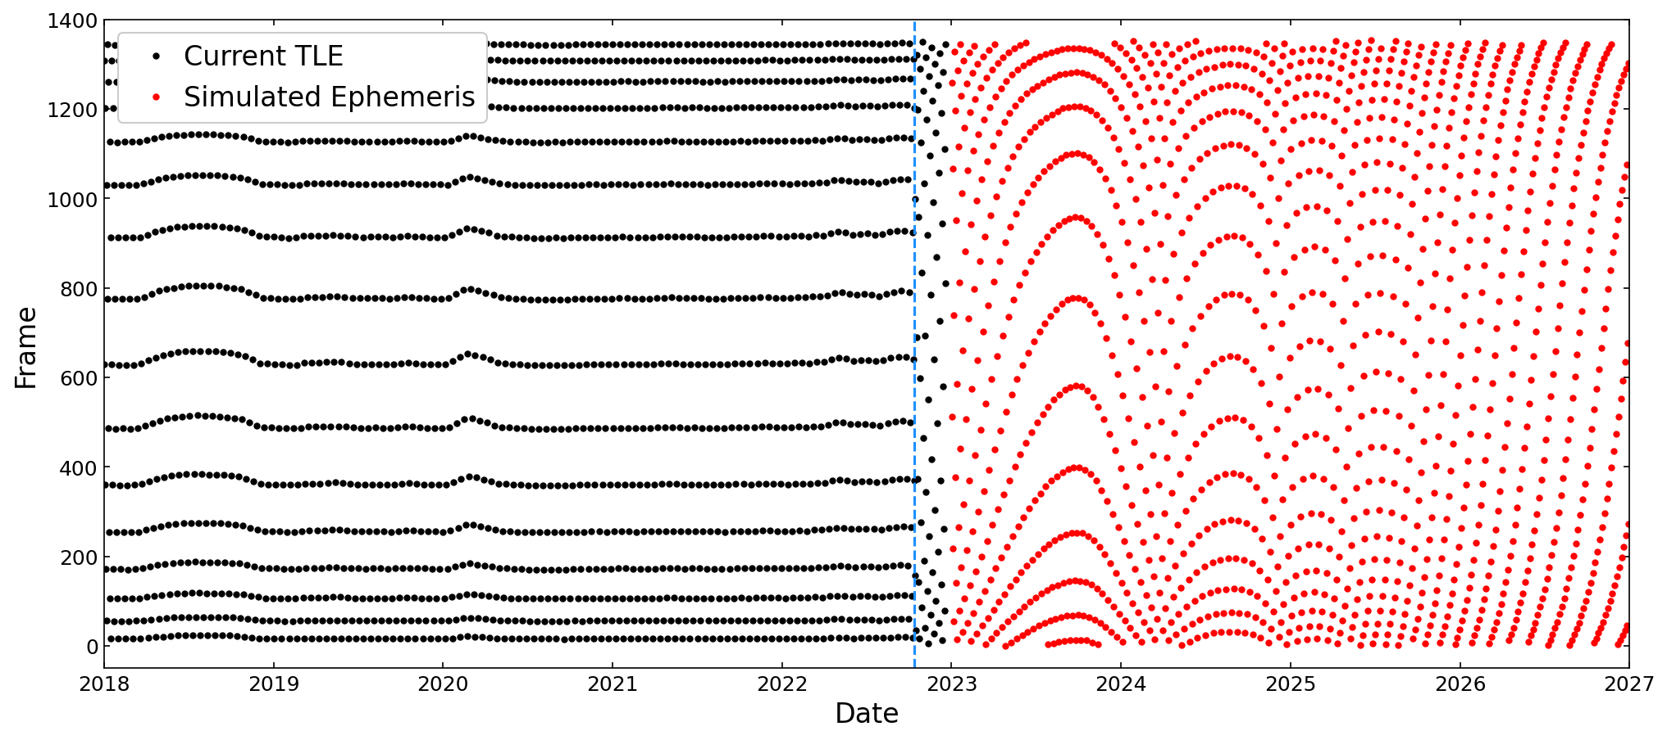
Terra and Aqua MODIS
Strategies
  Use of Ground Targets
    New RVS approach that aggregates all observations for a single desert site within 1-month intervals to fit the view-angle dependence of signal first, then trend over time; an interpolation of the current semi-empirical BRDF is used to extend the BRDF correction to any arbitrary frame (to be validated)
    DCC reflectance data already tracked at multiple AOI and used to apply RVS corrections for Terra SWIR bands 5, 6, 7, and 26; could be extended for bands 1, 3, 4, and 18 (other bands are saturated)
    Dome C with more frequent overpasses
Frames (view angles) of Libya-4 observations by Terra MODIS (historical and predicted)
The blue dash line is the time of the Terra CEM in October 2022
Slide 9

Slide 10
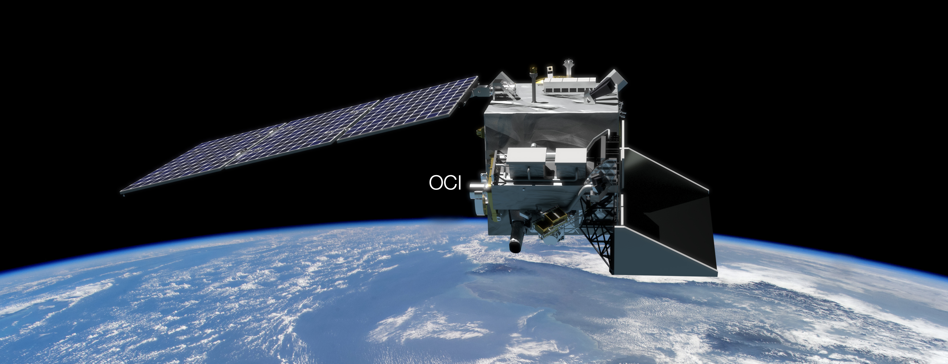
Plankton, Aerosol, Cloud, ocean Ecosystem
PACE will extend key systematic ocean color, aerosol, & cloud climate data records.
PACE will reveal the diversity of organisms fueling marine food webs & how ecosystems respond to change.
Looking at the ocean, clouds, and aerosols together will improve knowledge of the roles each plays in our planet.
Mission update:
Observatory fully assembled & integrated
Mechanical (acoustics, vibration) testing complete
Thermal vacuum testing underway in Summer 2023
Orbit(s)-in-the-life data flow testing in progress
Delivery to Kennedy Space Center in November 2023
Launch in January 2024
2 contributed multi-angle polarimeters:
HARP-2 (UMBC)
  4 visible-NIR bands
  Wide swath; 2.5 km @ nadir
  Hyper-angular
  Cloud capabilities beyond OCI
SPEXone (SRON/Airbus)
    Hyperspectral UV-NIR
    Narrow swath; 3 km @ nadir
    5 angles
    Aerosol capabilities beyond OCI
The PACE Ocean Color Instrument (OCI):
340-890 nm @ 5 nm resolution in 2.5 nm spectral steps
Plus 940, 1038, 1250, 1378, 1615, 2130, & 2250 nm
2-day global coverage; 1-km² @ nadir; ±20º fore/aft tilt
Performance driven by ocean color science requirements
https://pace.gsfc.nasa.gov
@NASAOcean
Slide 10

Slide 11




Surface Biology and Geology
SBG is key to understanding in five science and applications focus areas
  Functional traits, diversity and health of terrestrial vegetation and inland and near-coastal aquatic ecosystems
  Physiology of primary producers, productivity and stress
  Effects of changing land use on surface energy, water, momentum, and carbon fluxes
  Snow and ice accumulation and melt, surface water availability and management
  Active geological surface changes, natural hazards
Decadal Survey defines the implementation as two sensors: hyperspectral imagery in the VSWIR; multi- or hyperspectral imagery in the thermal IR
SBG started Phase A on Feb. 27, 2023
  Successful Mission Concept Review (MCR) held in June 2022
  Key Decision Point-A (KDP-A) meeting took place Nov. 8, 2022
Mission System Requirements Review (SRR) scheduled for Late September 2023
KDP-B meeting planned for late November 2023
Goal is to begin Phase C in October 2024
Launch dates: September 2028 (TIR) and June 2029 (VSWIR)
Slide 11

Slide 12
Acknowledgements
Contributions and Support:
MODIS Characterization Support Team (MCST)
VIIRS Characterization Support Team (VCST)
MODIS and VIIRS Science Team
PACE Science Team
Terra, Aqua, S-NPP, and JPSS Mission/Flight Operation Teams (MOT/FOT)
Slide 12

