Slide 1
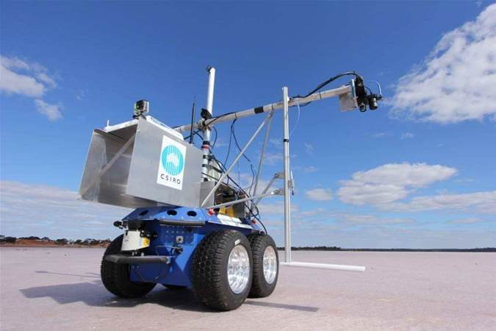
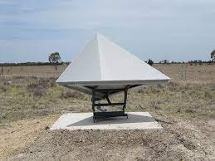
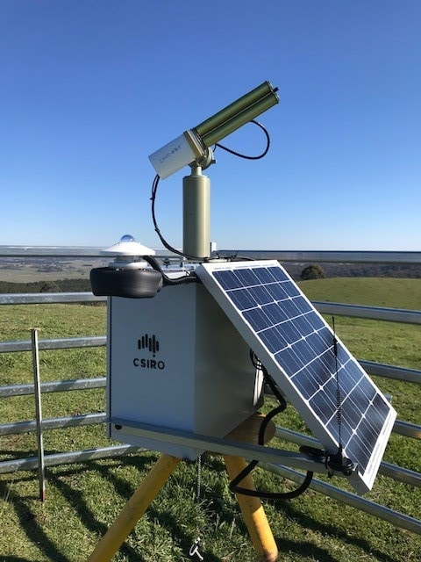
AusCalVal
AusCalVal Facility & status
Update to CEOS WGCV-52
8 June 2023
Matt Garthwaite
CSIRO Space and Astronomy
Matt.Garthwaite@csiro.au

Slide 2
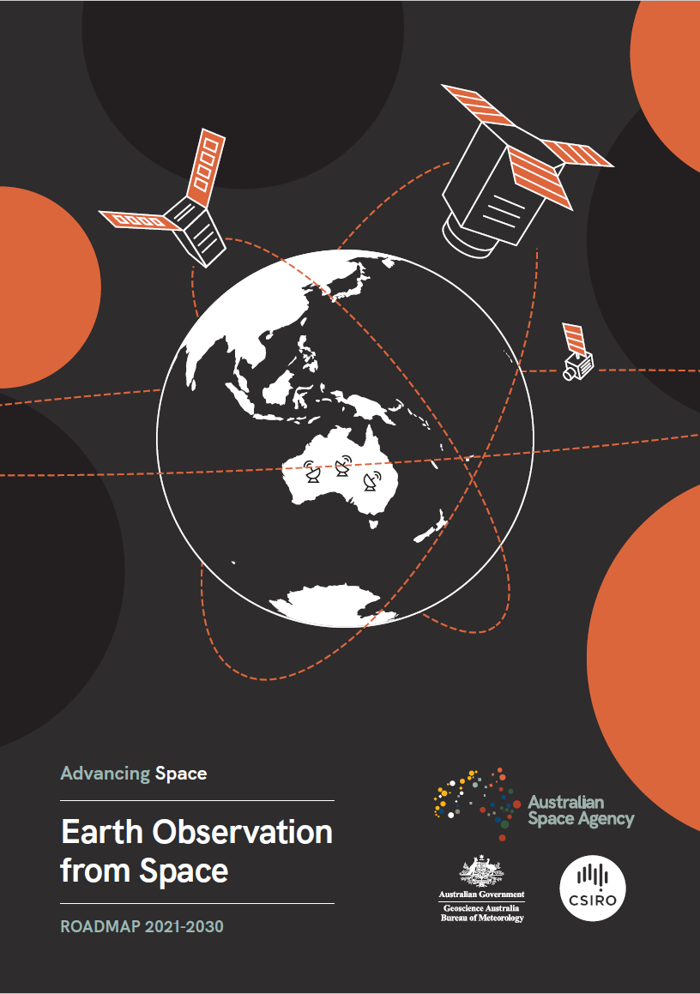
AusCalVal
2021 Earth Observation from Space Roadmap
5 focus areas, including Data quality and integrity monitoring
coordinated network of quality assurance sites for operational and research purposes (AusCalVal)
tools and support to satellite operators to utilise the infrastructure (EO-AIM)
support various Australian and international remote sensing missions (both)
National Space Program for EO – Australian Space Agency’s programmatic response to the roadmap.
Currently under consideration by the federal government
CSIRO has started to implement AusCalVal as a National Facility in 2022.

Slide 3
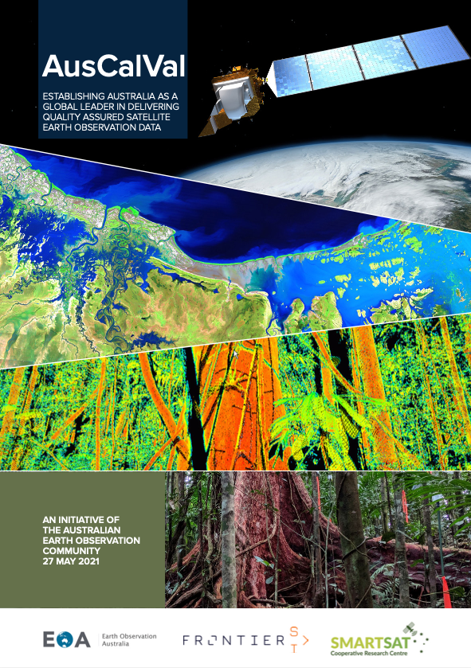
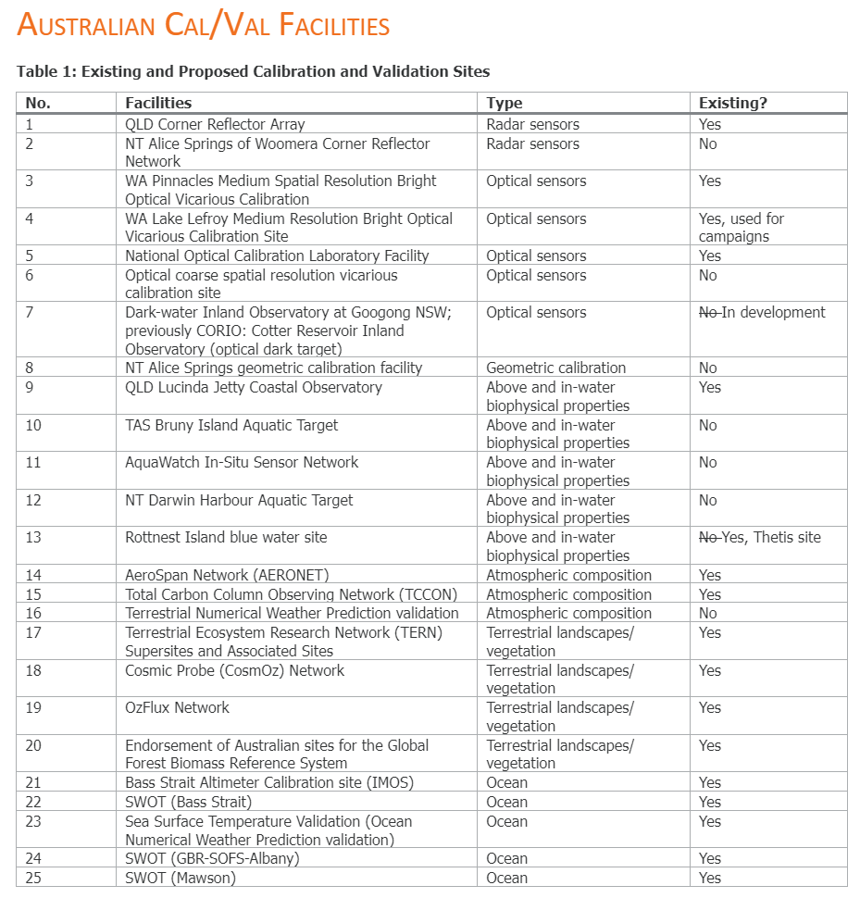
AusCalVal
2021 AusCalVal report provides the blueprint for CSIRO facility implementation
25 “sites” (capabilities) were identified:
https://frontiersi.com.au/auscalval/

Slide 4
AusCalVal
AusCalVal national facility will:
support a sustained network of sites across Australia for calibration of Earth observation sensor data and validation of derived products.
provide free and open access through a single interface to routinely acquired, quality assured and consistent cal/val data.
Customers:
Federal and State Governments,
International partners (e.g. space agencies),
Industry (e.g. New Space and product development)
Research (e.g. new applications)

Slide 5
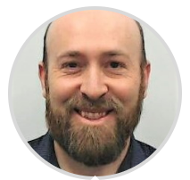
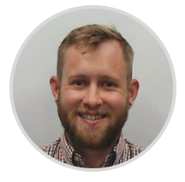
AusCalVal
AusCalVal team:
Matt Garthwaite, AusCalVal Manager, CSIRO. Started August 2022.
Andy Allen, Facility Implementation Lead, CSIRO. Started March 2023.
Claire Fisk, Jia-Urnn Lee
George Dyke, Jasmine Muir, Libby Rose, Matt Steventon, Stephen Ward,

Slide 6
AusCalVal
AusCalVal Technical Advisory Group (ATAG)
Bringing together Australian expertise in cross-domain EO cal/val to provide recommendations to CSIRO on the development of AusCalVal
Met for the first time in April 2023
Secretariat support from Symbios
Currently 7 members and a capped membership of 12
Possibility to invite an international member
Initial Membership:
Cindy Ong, Chair (CSIRO)
Matt Garthwaite, co-chair (CSIRO)
Janet Anstee (CSIRO)
David Antoine (Curtin)
Helen Beggs (BoM)
Tim Malthus (CSIRO)
Medhavy Thankappan (GA)

Slide 7
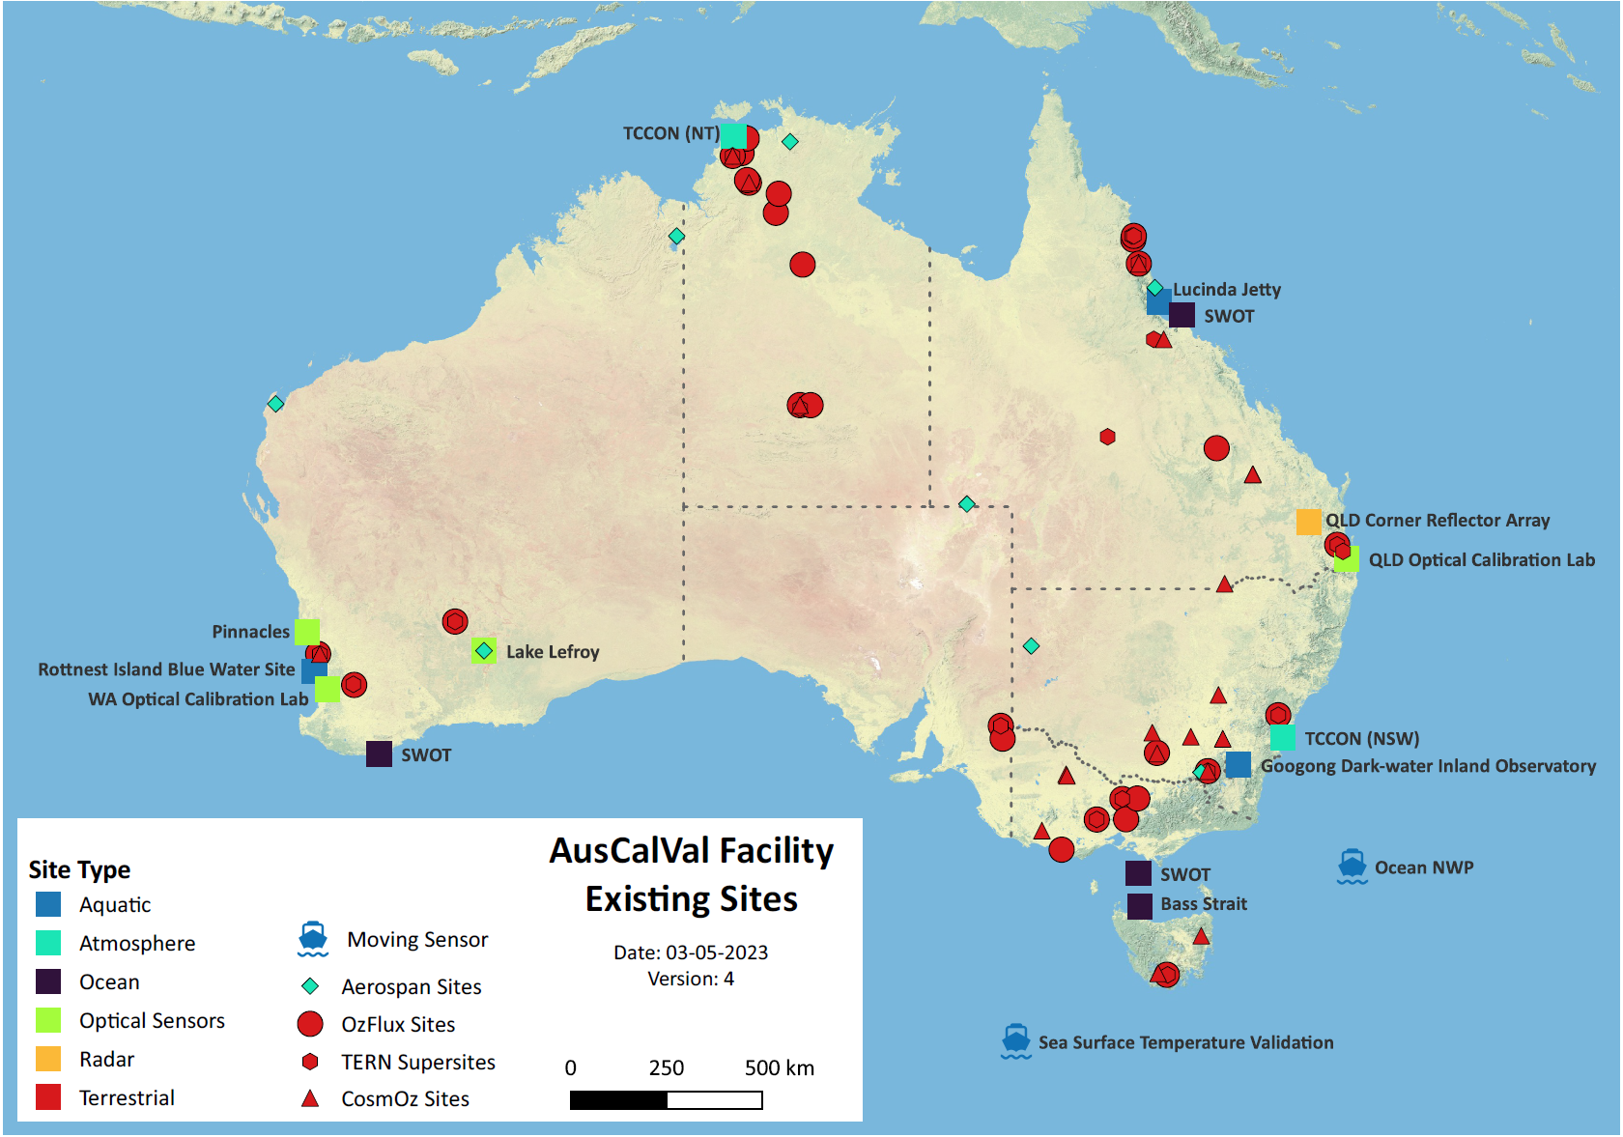
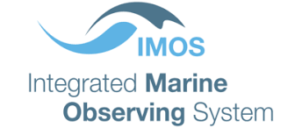
AusCalVal
Existing Australian capabilities

Slide 8
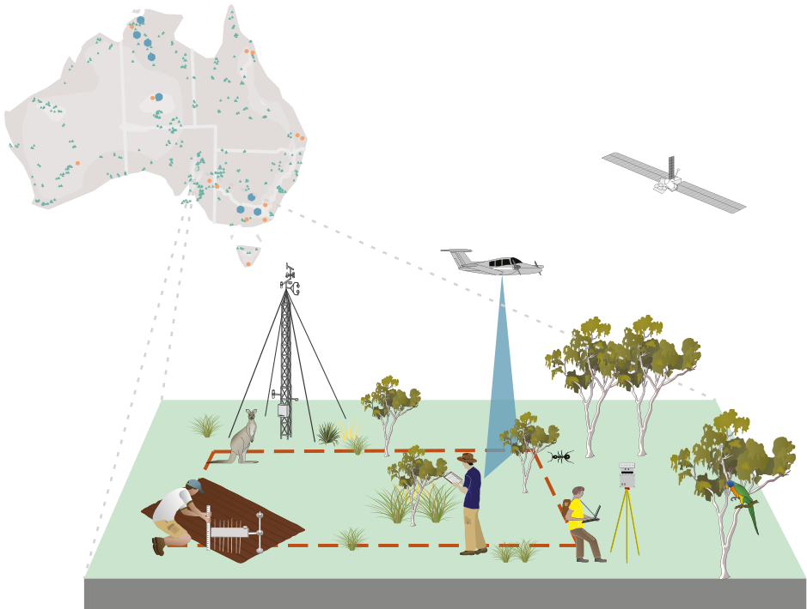
TERN: a multi-scale continental ecosystem observatory
TERN monitors ecosystems from site to continental scale
TERN’s data repository is open access
Researchers can co-locate research at TERN monitoring sites
TERN’s national collection of over 100,000 vegetation & soil samples are available for research

Slide 9
TERN provides
Open Data
Data Infrastructure
Standard, Protocols & Collections
Site-Based Instruments & Monitoring
Open access ecosystem data via the TERN Data portal
Continental-scale gridded remote sensing, soil and landscape products
Plot-based soil and vegetation surveillance monitoring data
Aggregated state government survey data
Calibration and validation data for remote sensing
Time series flux tower, phenocam and acoustic monitoring sensor data
Tools that support the discovery, analysis and re-use of data
Cloud-based virtual desktop to run and share experiments (CoESRA)
Data submission, harmonisation and retrieval of ecological data (SHaRED)
Discovery, mapping and analysis of landscape-scale ecosystem datasets (Data Visualiser)
Cloud-based analysis, synthesis and training platform
Services that facilitate research, education and management
Catalogued plant and soil sample collection
Nationally consistent field methods
Guidelines for calibration and validation of remotely-sensed data
Field data collection apps
A network of ecosystem monitoring sites and sensor data streams available to long term researchers
Eddy covariance flux towers; Heat flux plates; Radiometers; Anemometers; Infrared Gas Analysers; Spectrometers; CosmOz soil moisture meters; Groundwater bores; Ecoacoustic sensors; Phenocams; Terrestrial laser scanners; UAV/drones; Camera traps; Photopoints; & more…

Slide 10
TERN helps verify the accuracy of globally important space-based imagery
Example Cal/val initiatives:
Supporting NASA since 2015 with data for SMAP, GEDI, ECOSTRESS. Future NISAR?
Partnering with the Copernicus Global Land Service’s Ground Based Observations for Validation (GBOV)
Establishing Forest Biomass reference sites in support of GEO-TREES

Slide 11
Investment in Cal/Val for Marine Satellite Sensors
Domains
Sea Surface Temperature (BoM)
Ocean Colour Radiometry (UCurtin+CSIRO)
Sea Surface Height/Altimetry (UTas+CSIRO)
Surface Waves and Winds (UMelb+CSIRO)
Satellite Remote Sensing Investment*
~$1.7M p.a., with ~$1.8M co-investment p.a.
Long-term, 16 years since 2007
Support includes
Salaries
Equipment (instruments and platforms)
Operations (deployment, QA/QC)
International travel for Science/mission team participation; eg GHRSST, S3VT, OSTST
https://imos.org.au/facilities/srs
* Not including Argo (used for SST)
Outcomes and Benefits
International missions/agencies recognise Australian contributions arising from
Characterisation of unique environments
Unique geographic location (eg S.Hemisphere, Indo-Pacific)
Innovation in techniques and instrumentation
Commitment to long-term consistency
Commitment to open data
Australian participation in mission science teams benchmarks and maintains expertise in quantitative Earth Observation at global best practice level
Global satellite data products are developed with Australian relevance and well-understood performance/quality
Early/privileged access to data from new missions
Underpins capability to deliver tailored products for Australian applications
Australian applications scientists have local points of contact for mission/product-specific advice and support.

Slide 12
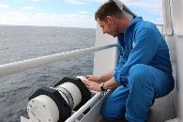
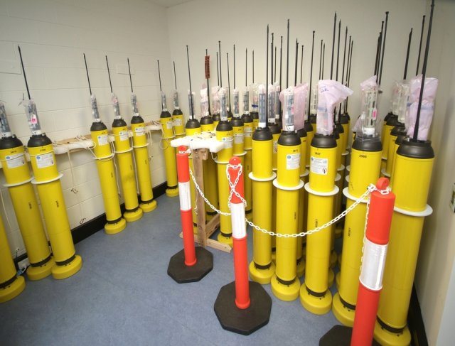
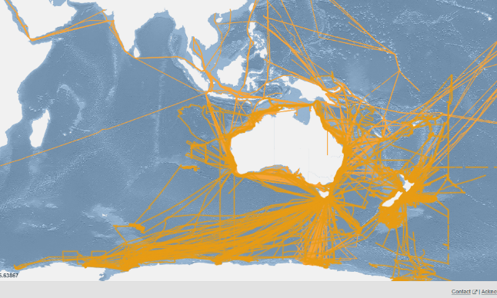
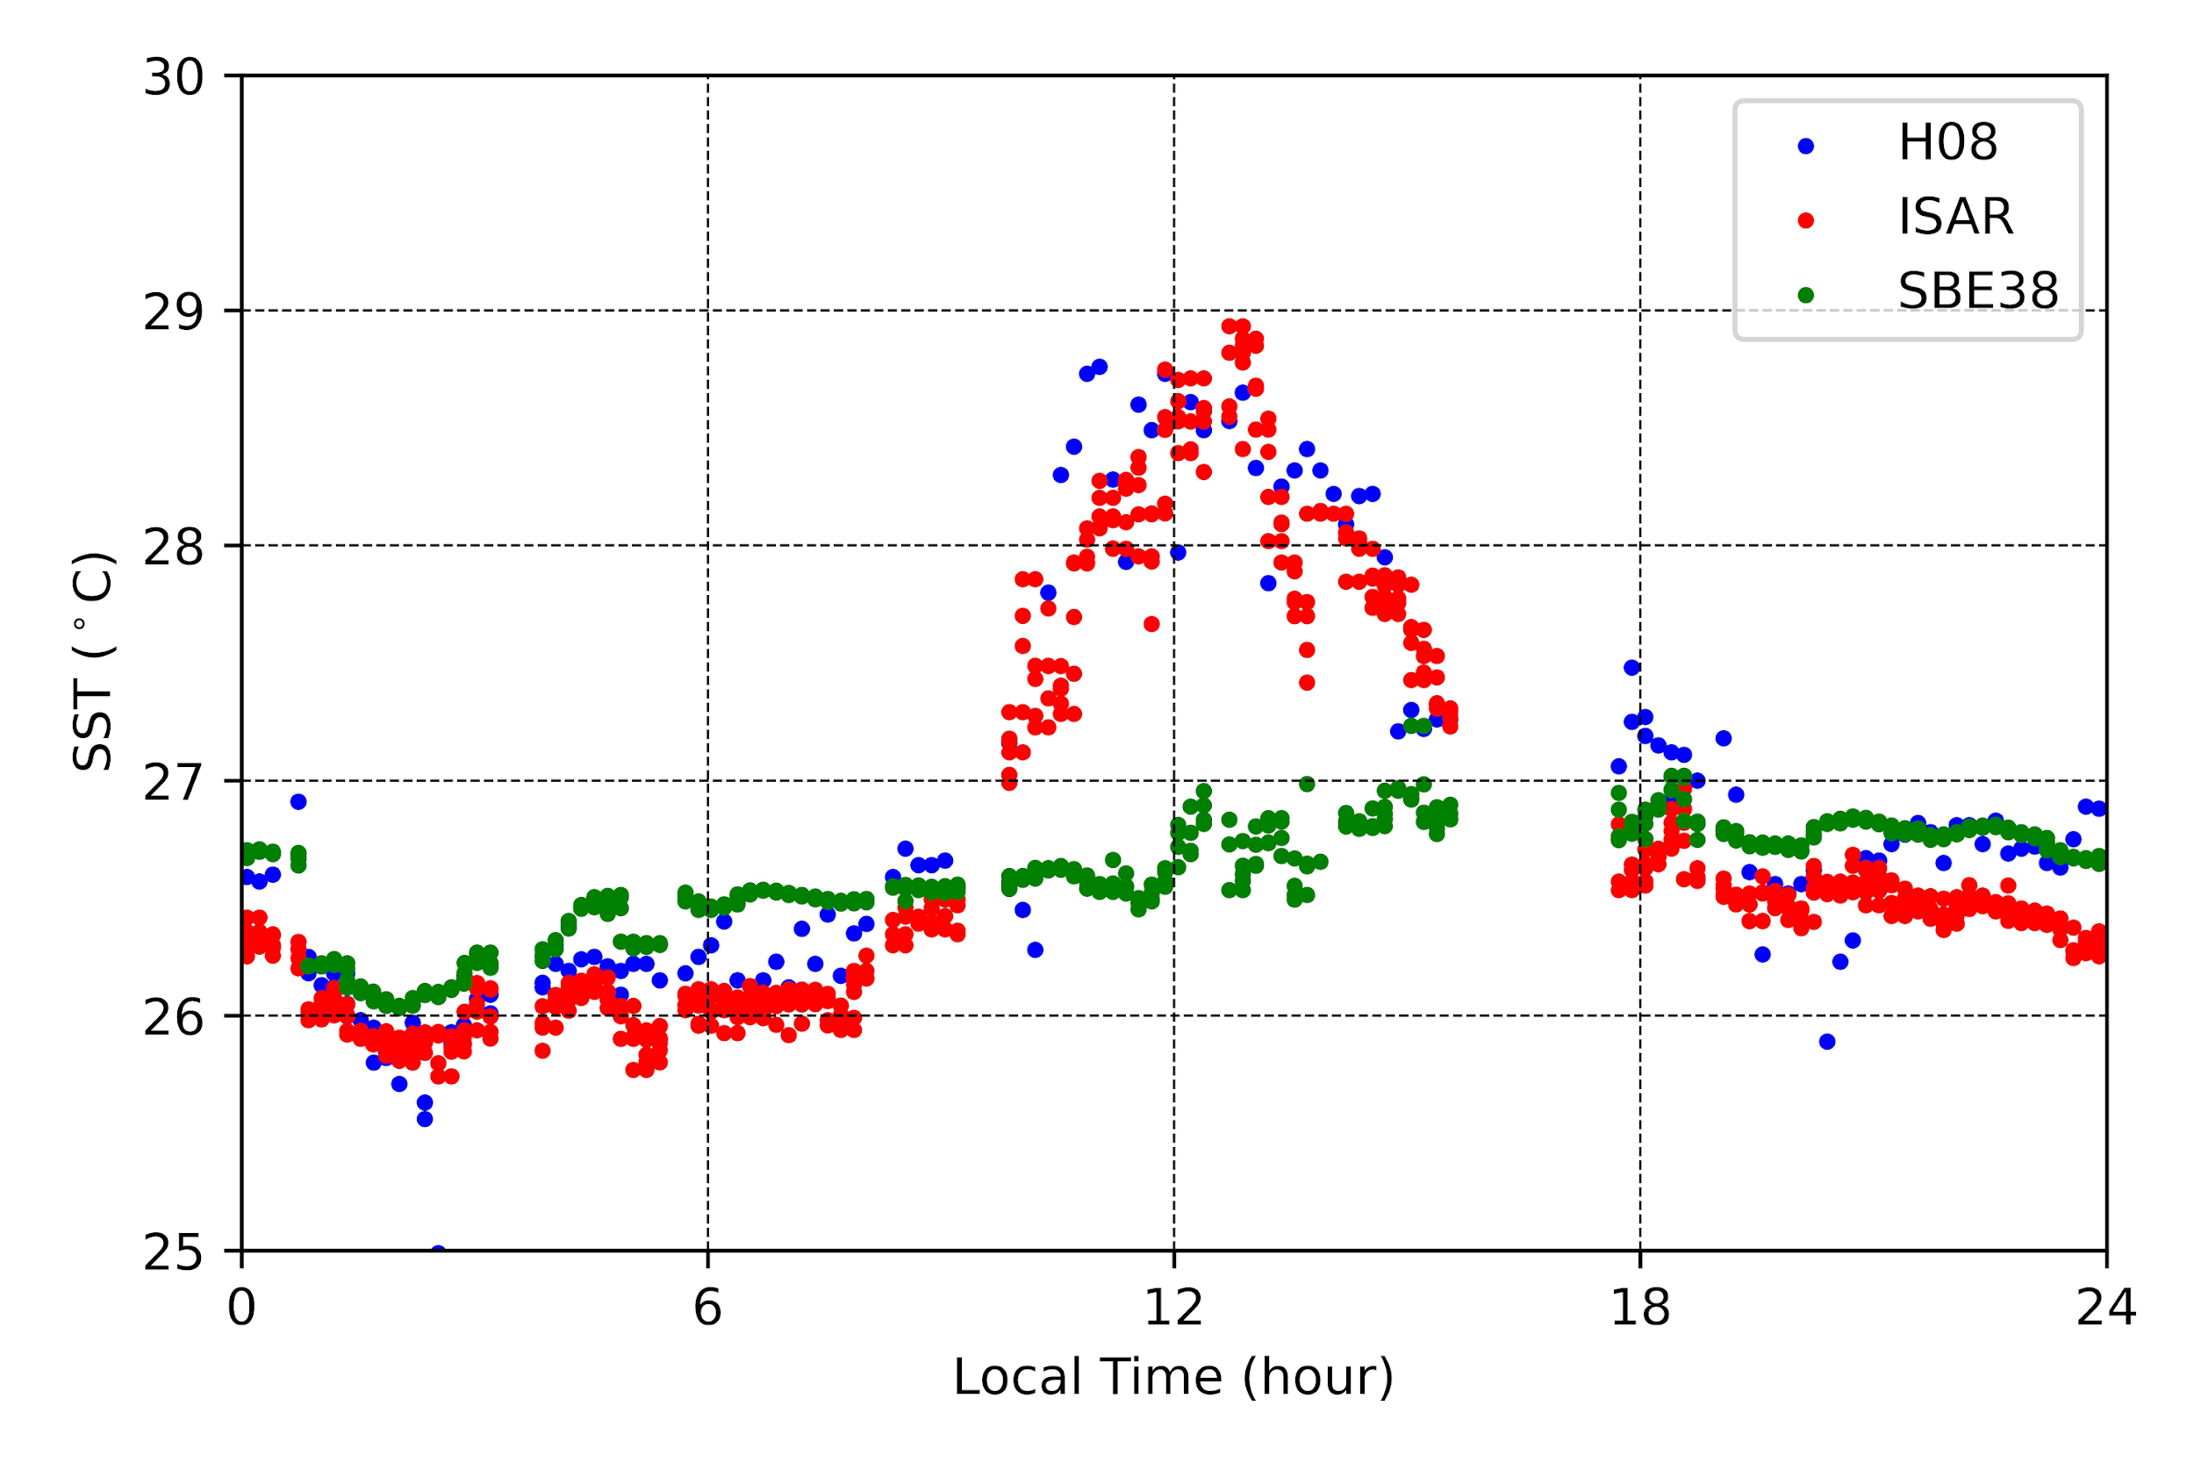
Ship and Argo SST for satellite validation http://imos.org.au/sstsensors.html
ISAR
Argo
Image: Bruce Miller
IMOS Project provides real-time, QC’d, ship sea surface temperature (SST) data valuable for satellite SST validation, particularly in regions lacking other in situ SST (coastal Australia, Indonesian seas, Southern Ocean).
IMOS bulk SST at several meters depth from commercial and research vessels have been used by the Bureau and Uni of S. Carolina to validate IR SST data from NOAA POES and EnviSat AATSR radiometers, IMOS Multi-sensor L3S and the International Space Station's ECOSTRESS radiometer. Data are provided to the GTS and NOAA's iQUAM portal (https://www.star.nesdis.noaa.gov/socd/sst/iquam/) for satellite validation.
Infrared Autonomous SST Radiometer (ISAR) skin SST data from RV Investigator, provides delayed mode, QA'd SST data at the depth sampled by IR satellite sensors and referenced to international temperature standards, and have been used by the Bureau, OUC, EUMETSAT and JAXA to validate Himawari-8, Sentinel-3 and GCOM-C skin SST. Data are provided to www.ships4sst.org for satellite validation.
IMOS also provides real-time, QC'd, 5 m depth SST from Argo profiling floats, routinely used by Space and Meteorological Agencies to validate satellite SST products and analyses, due to their accuracy and homogeneous global distribution. Data are provided to the GTS (see https://imos.org.au/facilities/argofloats)
All data are publicly available from the AODN (https://portal.aodn.org.au).
IMOS ship tracks
since 2008
IMOS Himawari-8 skin SST, ISAR skin SST, SBE 38 SST(7m)
Great Barrier Reef, 12 Oct 2016
Helen Beggs (Bureau of Meteorology) – Leader IMOS Ship SST Sensors Sub-facility

Slide 13
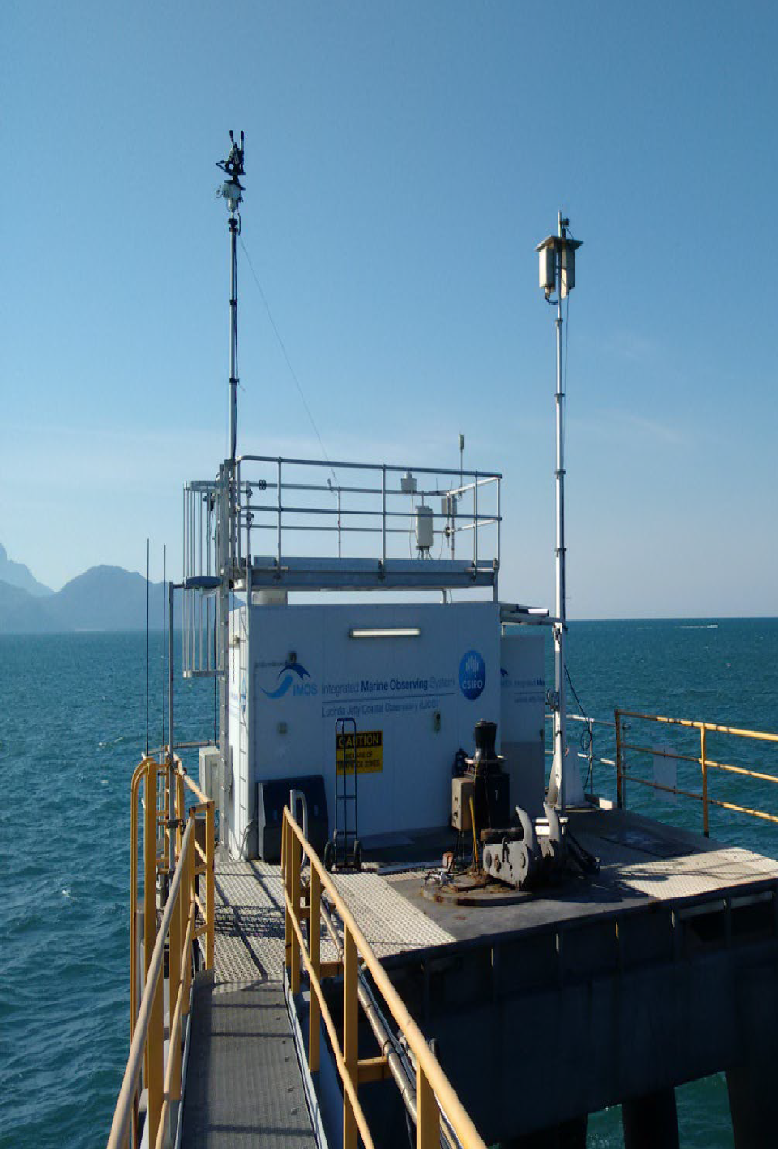
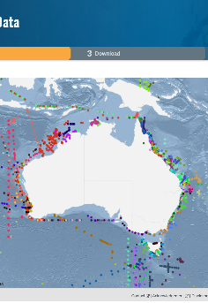
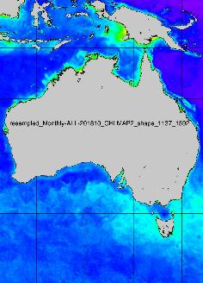
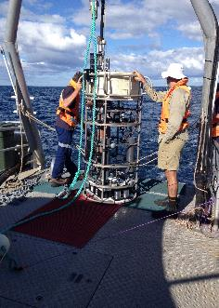
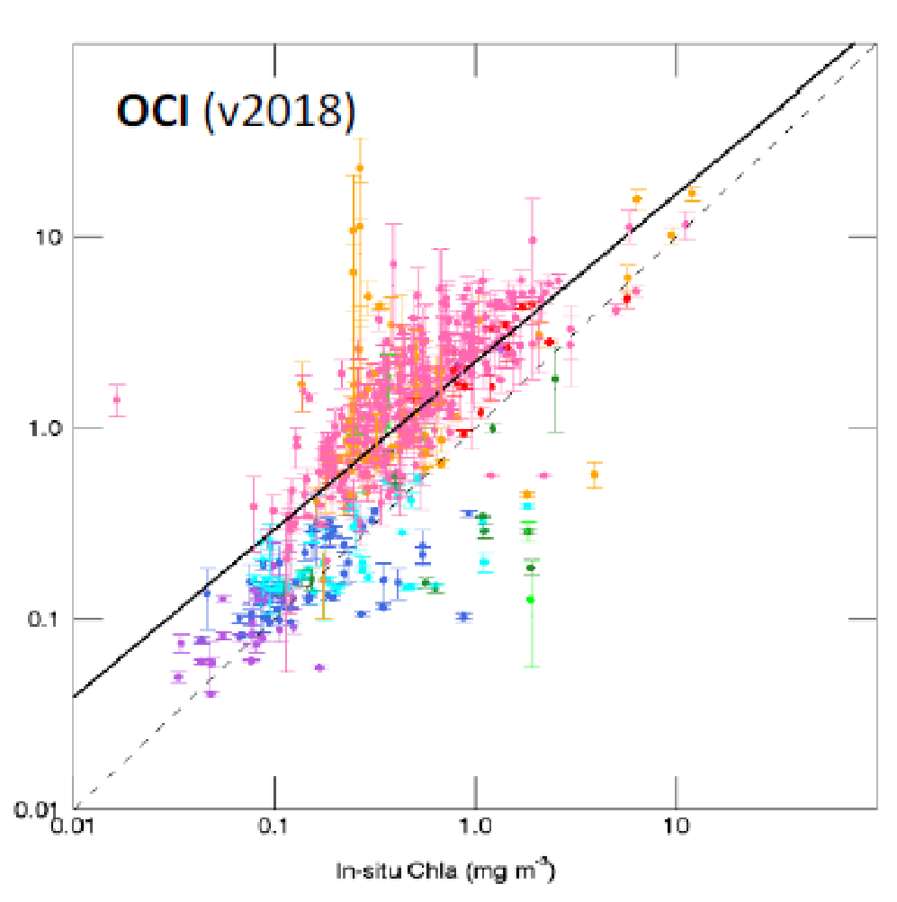
IMOS Satellite Ocean Colour Sub-facility Cal/Val
Co-leads: Thomas Schroeder (CSIRO), David Antoine (Curtin University)
Validation and production of satellite Ocean Colour products for the wider Austral-Asian region https://imos.org.au/facilities/srs/oceancolour
Lucinda Jetty Coastal Observatory (LJCO)
Fixed Platform, QLD
Rottnest Island Thetis
(RITS)
Profiler Mooring, WA
DALEC on AIMS RV Solander
En-route Radiometry, AU
Bio-optical database (BODB)
Data Collection, AU
Production & validation of OCR data
Data Repositories, AU
Operator CSIRO
Operator Curtin
Operator CSIRO
Operator CSIRO
Operator CSIRO/Curtin
Observations
Above-water radiometry
In-water optics
Biogeochemical samples
Observations
In-water radiometry
In-water optics
Observations
Above-water radiometry
Observations
Biogeochemical samples
(Pigments, TSS, CDOM)
In-water optics
Observations
Level 2, 3 products Sentinel-3 OLCI, VIIRS SNPP NOAA20, MODIS-A
National & International Engagement & Collaborations
eReefs, Digital Earth Australia, BoM, GBRMPA, AIMS, AquaWatch Australia, QLD Government, IMOS Community of Practice & RTT
NASA AERONET-OC, NASA SeaBASS, Sentinel-3 Validation Team OC, EnMAP, FRM4SOC, Copernicus CVS, IOCCG, wider research community

Slide 14
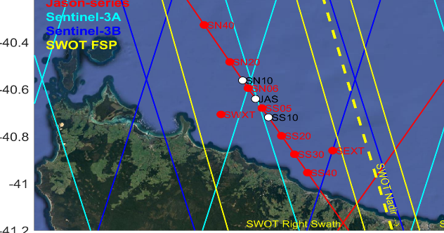
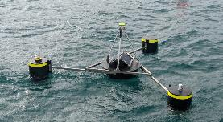
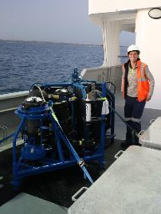
Satellite Altimetry Calibration and Validation
https://imos.org.au/facilities/srs/srscalval
The Bass Strait satellite altimeter validation facility has been used for validation of the sea level observations since the launch of TOPEX/Poseidon in 1992.
Bass Strait is the sole facility of its kind in the Southern Hemisphere. Recognised as one of four key in situ validation facilities internationally.
The facility contributes directly at the mission level across multiple missions (Jason-series, Sentinel-series, SWOT…) and across multiple agencies (NASA, CNES, ESA…). It forms a part of the iterative cycle of validation/understand/improve associated with the production of altimeter data used scientifically and operationally around the world.
IMOS have provided sustained support for infrastructure (sub-surface moorings, surface GNSS equipped buoys) and multi-disciplinary capability (geodesy and oceanography) required to address stringent cal/val requirements in this marine remote sensing space. Requirements:
Geometric observations of sea level in an absolute reference frame in a highly dynamic and challenging environment.
Observations of ocean properties (bottom pressure, temperature, salinity, current and waves) over a sustained period.
Increasingly stringent accuracy requirements requiring evolution in the in situ measurement approaches.
Integration of knowledge across disciplines of geodesy, oceanography and remote sensing.
The oceanographic observations also feed into AODN for the benefits of various marine applications beyond cal/val.
IMOS seems the right stakeholder for the marine infrastructure operations and leveraging satellites for marine applications. AUSCALVAL might be the right pathway to expand the applications (e.g. value adding activities, a postdoc, specific new tech development…), integration in connection with space agencies, integration across disciplines in Australia.
GNSS
GNSS Buoy
CWPIES
GNSS
PORT
GNSS
TG
GNSS
GNSS
20 km
GNSS/INS equipped buoys in Bass Strait.
Sub-surface moored oceanographic sensors being deployed
Christopher Watson (UTas), Benoit Legresy (CSIRO)

Slide 15
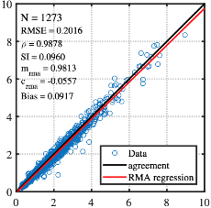
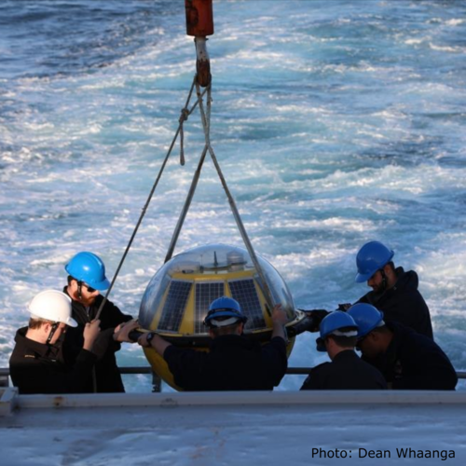
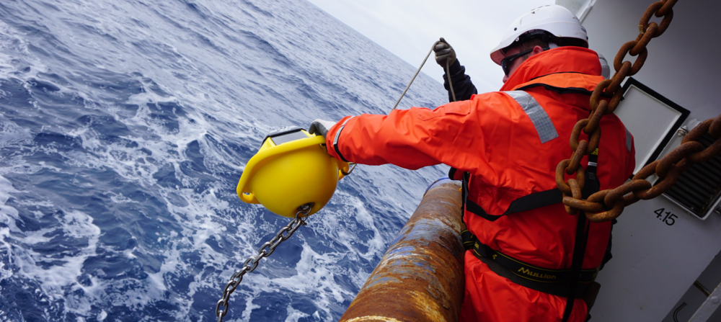
Cal/Val of satellite ocean surface waves and wind
Waves
Australian coastal wave buoys (mostly operated by State and Commonwealth agencies) record wave conditions at several coastal locations
Large gaps exist in the Southern coast, Northern WA and the top end
Low-cost wave buoys (~4 kg; Sofar spotter) can fill these gaps and IMOS recently executed a pilot project which confirmed their accuracy
Wave buoy measurements are crucial for:
monitoring wave conditions
tuning regional and coastal wave models
cal/val of SRS wave measurements
Wind
Australian offshore wind measurements are scarce
Australia’s emerging offshore wind industry requires accurate wind measurements
Existing measurements are on coastal infrastructure and confounded by land effects
Satellites also provide wind observations (Scatterometers, SARs, Radiometers), which critically need in-situ measurements for cal/val
Typical satellite altimeter wave height calibration
Buoy wave height (m)
Australian wave conditions are captured by:
(i) coastal wave buoy network with several gaps
(ii) Radar Altimeter and SAR satellites
(iii) Numerical wave models
Altimeter wave height (m)
TriAXYS ~230 kg
Datawell waverider
~100 kg
SOFAR Spotter
~4kg
https://imos.org.au/facilities/srs/surface-waves
Traditional buoys to low-cost drifting wave buoys
Salman Khan (CSIRO) Ian Young (UMelb)

Slide 16
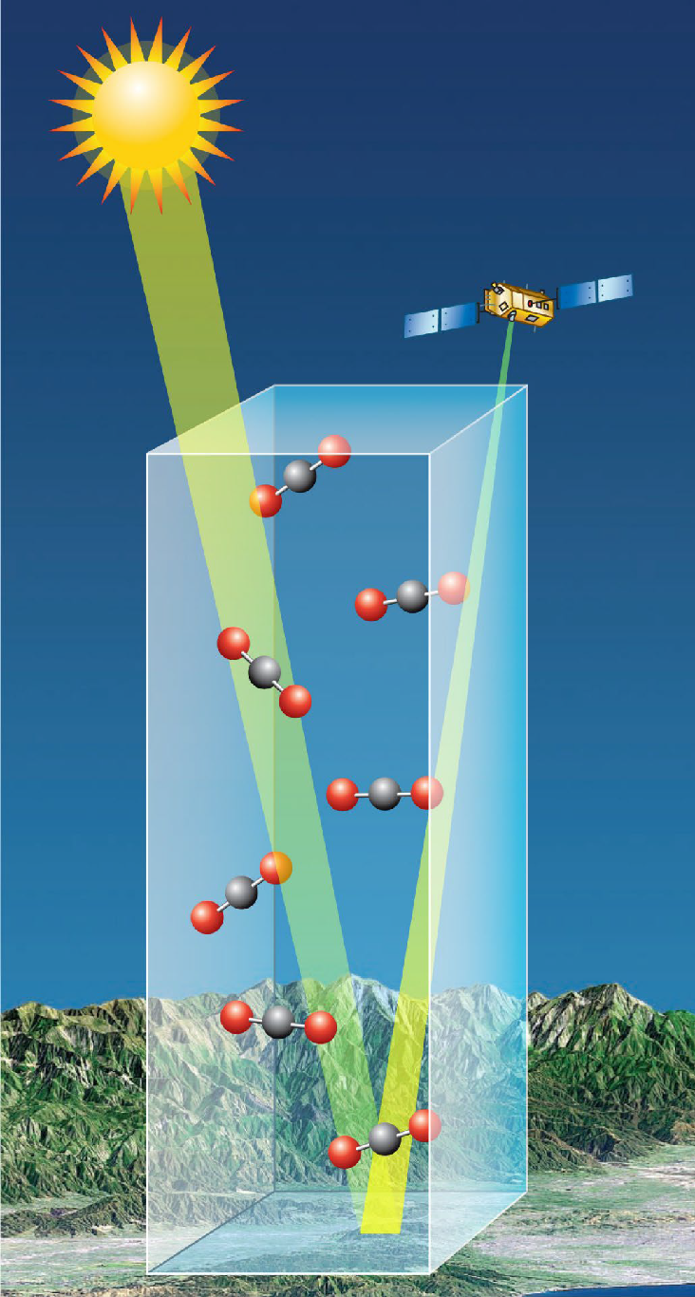
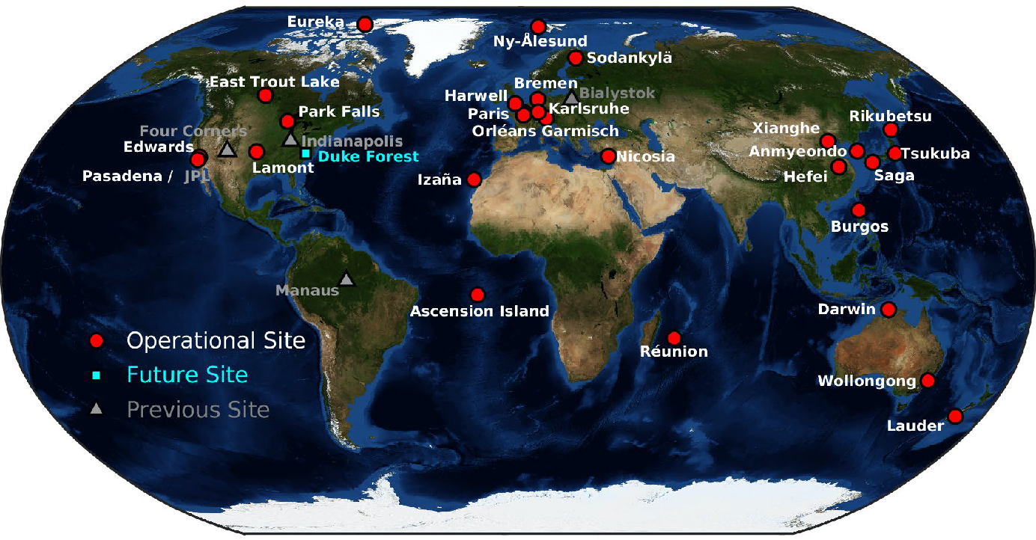
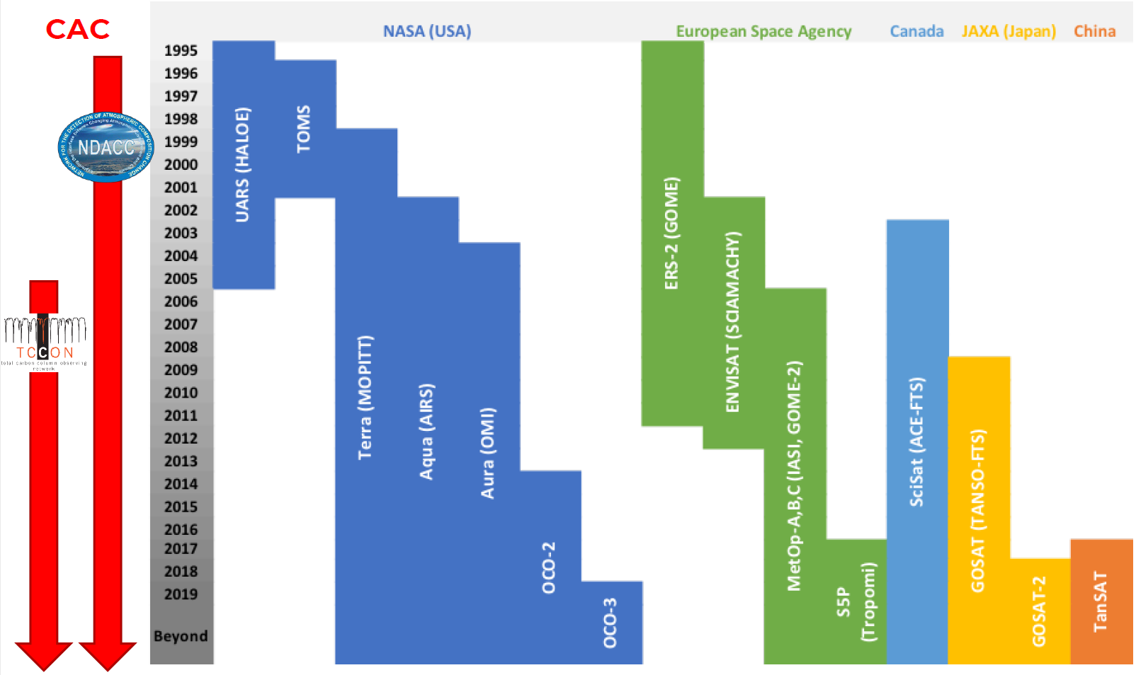
University of Wollongong Centre for Atmospheric Chemistry operates two TCCON stations – Wollongong (since 2008) and Darwin (since 2005)
Seeking funding to make operations more sustainable
Nicholas Deutscher, TCCON Co-chair Asia/Oceania

Slide 17
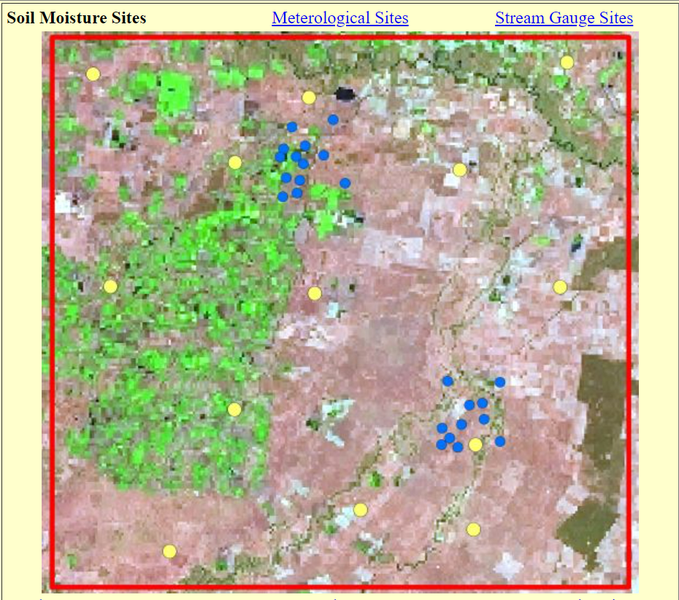
Data is made available through oznet.org.au and GBOV

Slide 18
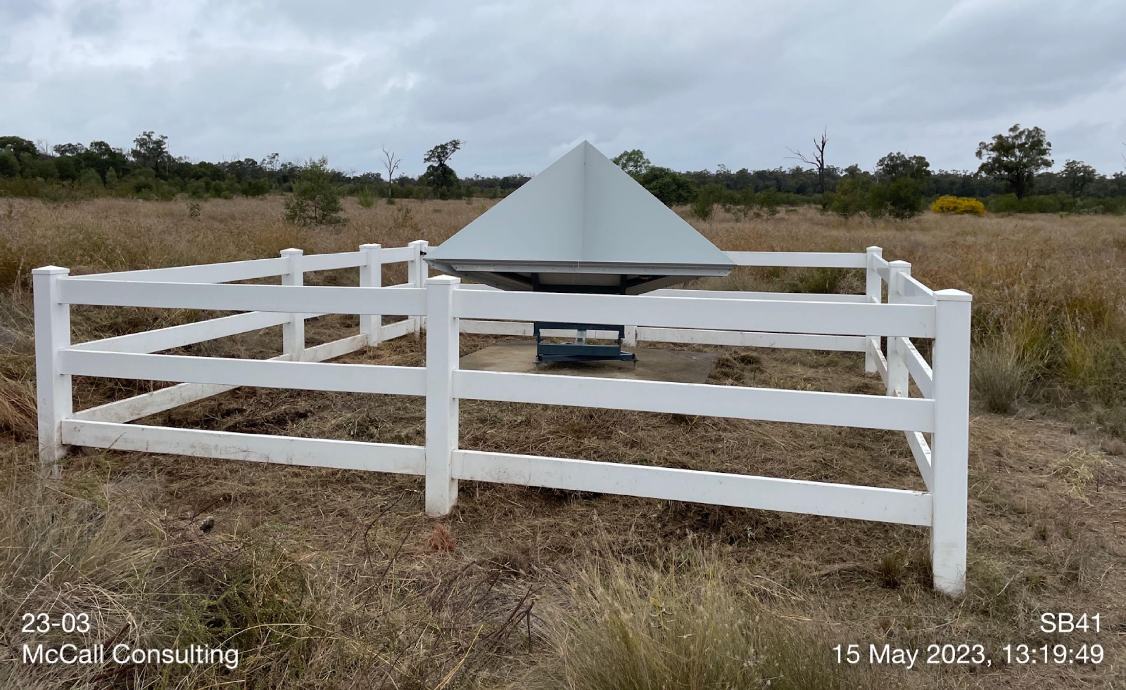
Queensland Corner Reflector Array
Geoscience Australia established the QCRA in 2014
AusCalVal recently funded a maintenance of all 40 sites, completed May 2023
Before
After

Slide 19
Darkwater Inland Observatory Network (DION)
To contribute quality assurance observations to global calibration and validation efforts, leading to increased fidelity of satellite-derived water quality products in Australia.
DION aims to achieve Fiducial Reference Measurements (FRM) quality requirements for radiometers using standard protocols and processing eg instrument calibrations and uncertainty budgets,
High temporal database of paired laboratory, in situ and satellite observations for modelling and forecasting,
Open access portal for data and products,
Operational facility, future-proofed with capacity for additional instrumentation.

Slide 20
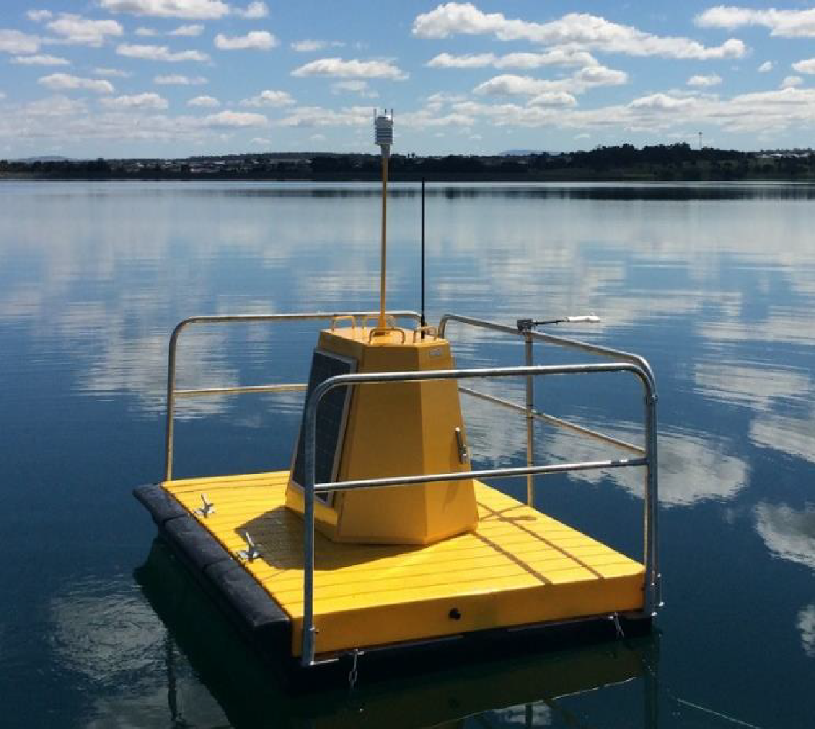
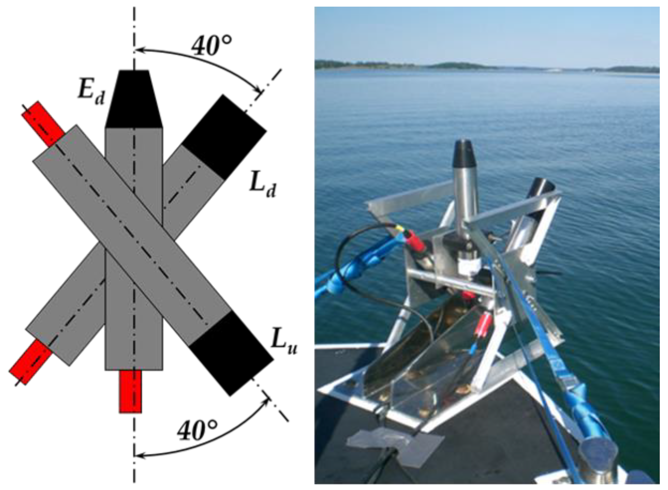
DION Phase 1
Planned deployment for Googong drinking- water reservoir 30km SE of Canberra in June 2023.
Instruments include:
TriOS Ramses E_{d}, L_{sky} and L_{w}
Pan/tilt unit
Weather station
Cameras horizontal and forward-looking
Water temperature (below surface & 2 depths (4/8m)

Slide 21
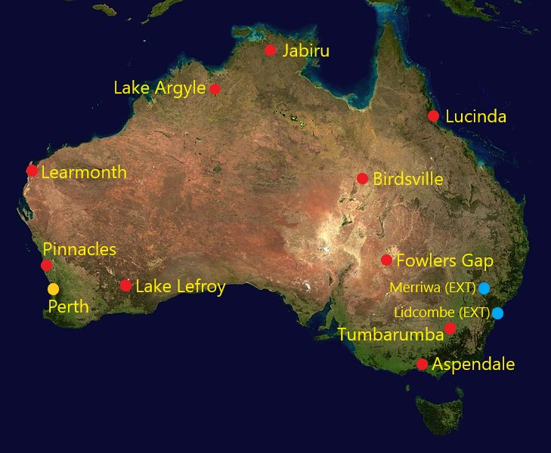
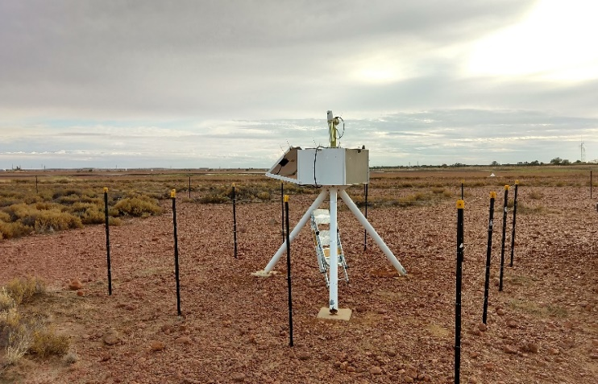
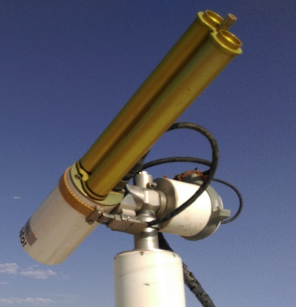
AeroSPAN - CSIRO contribution to AERONET
AeroSPAN (CSIRO): Aerosols via Sun Photometry Australia Network
Network of 10 current sun photometer sites
Located in New South Wales, Northern Territory, Queensland, Victoria, Western Australia

Slide 22
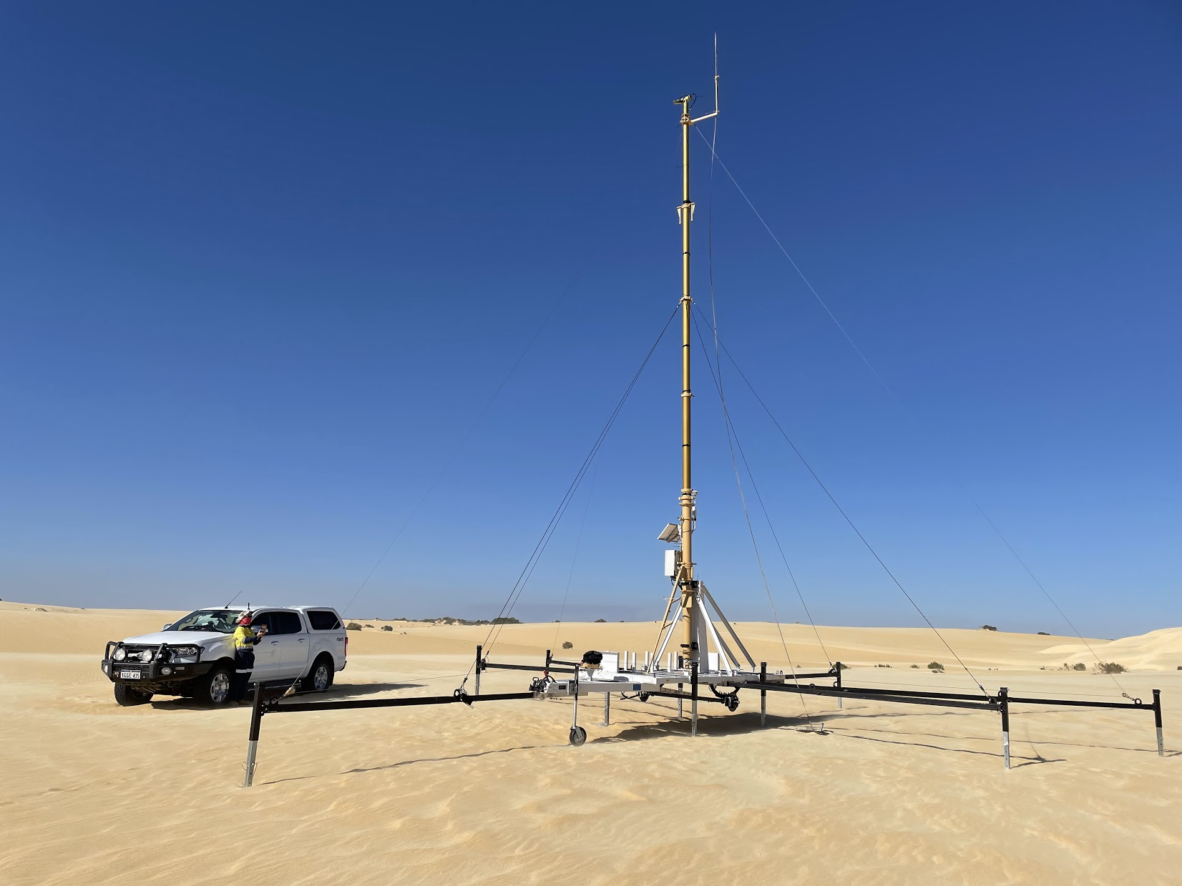
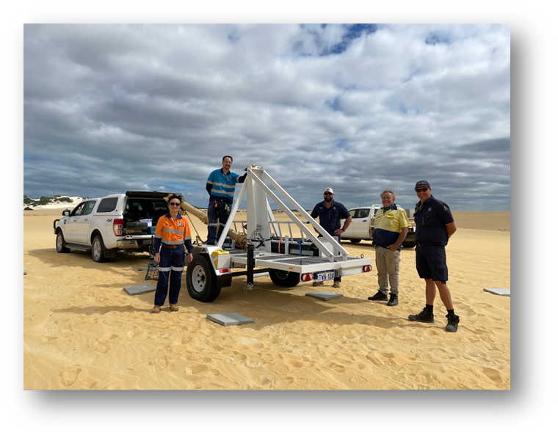
Pinnacles Autonomous Vicarious Calibration Site
Instrumentation
CIMEL CE318-TU12 12 band BRDF photometer on 9 m mast on a mobile trailer platform;
Weather station;
Sky view camera (in collaboration with AIST)
Deployment
21 March 2022 with the assistance of local
rangers and traditional owners.

Slide 23
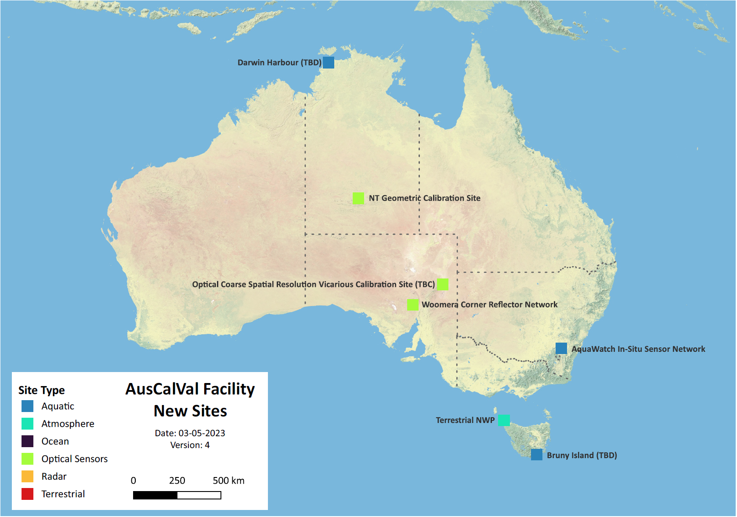
AusCalVal
Future capabilities?
Further optical vicarious calibration sites to support SCR
Geometric calibration
SAR calibration and validation
TIR calibration
Atmosphere / GHG
Aquatic calibration sites – Aquawatch…

Slide 24
AquaWatch Australia: a weather service for water quality
World’s first integrated ground-to-space water quality monitoring system, with forecasting capability.
National goals
Improve availability and accuracy of information
Harmonise water quality monitoring
Global goals
Be the world’s best water quality monitoring system
Provide information to people at risk everywhere

Slide 25
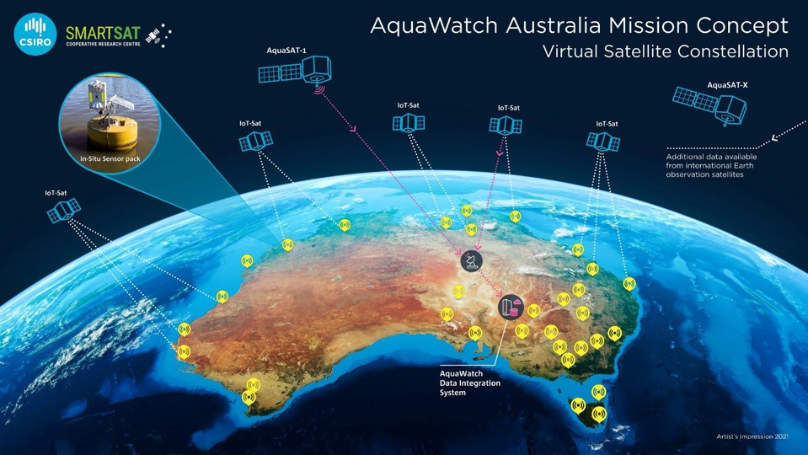
HydraSpectra
AquaSat
ADIAS

Slide 26
AusCalVal
Initial AusCalVal activities (next 12 months):
Establish a “shop-front” and start to provide access to cal/val data streams and capability information. Add more progressively through time
Define an AusCalVal framework that outlines expectations on data quality with reference to existing standards/protocols, both for site operators and customers.
Welcome any feedback or suggestions!
Matt.Garthwaite@csiro.au

