Slide 1
WGCV-52
Cal/Val Park and BAQUNIN supersite
F. Niro, S. Casadio
Serco for ESA/ESRIN
WGCV-52, ESA/ESRIN, Italy
5th - 9th June 2023

Slide 2
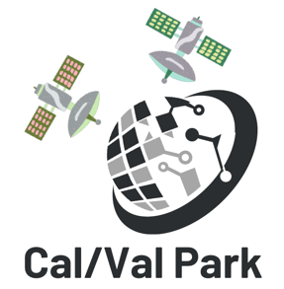
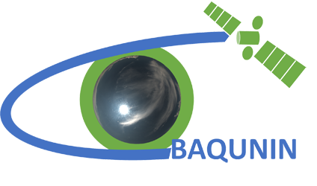
Outline
Cal/Val Park
Background and Motivations
Principles and Approach
Project Status and Outlook
BAQUNIN
Background and Motivations
Principles and Approach
Project Status and Highlights

Slide 3
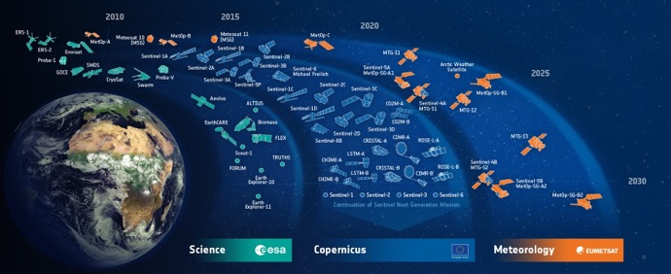
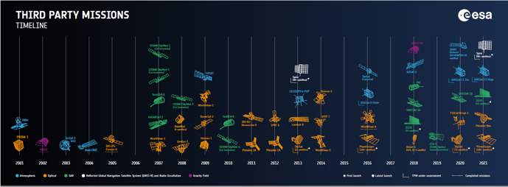
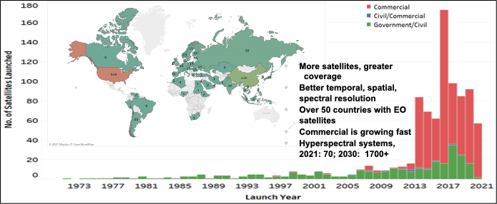
Cal/Val Park – Background
In recent years the EO domain is undergoing dramatic changes in all respects:
The amount of space borne EO systems is growing at an unprecedented pace, owing to sensors/platform miniaturization allowing quick and inexpensive access to Space
Advanced remote sensing systems provide ever improving spatial, temporal, and spectral resolution, notably, hyperspectral sensors are expected to grow significantly
The availability of EO data from commercial providers represents an opportunity to complement/expand ESA EO capacity, notably with HR/VHR imagery
How to synergistically exploit such a wealth of EO data? 🡪 Data need to be interoperable 🡪 Provided with rigorous uncertainty analysis and all necessary metadata allowing to fully characterise, and eventually correct for, the differences between sensors

Slide 4
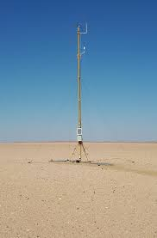
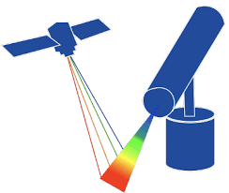
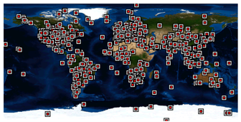
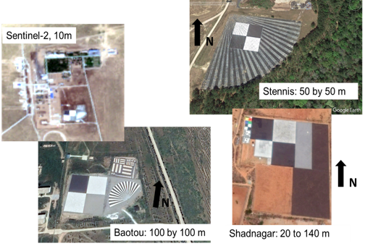
Cal/Val Park – Status and gaps
Space agencies should promote Cal/Val best practices and ensure that an adequate ground-based infrastructure is available to facilitate interoperability
This mandate has been succesfully fulfilled within CEOS-WGCV (protocols, networks, tools), yet limitations remain:
Existing Cal/Val networks or sites are dedicated to specific task or focus on some geophysical variables, with little flexibility / scalability
Existing Cal/Val sites do not strictly follow FRM metrological guidelines
Lack of dedicated targets for assessing geometric accuracy and image quality of HR/VHR sensors, historical targets often outdated
Scarcity of reference data for validating SR products, notably of hyperspectral and multi-angular measurements, HYPERNETS will fill the gap
Synergies across networks and sites are seldom exploited
Operational networks are based on mature devices and do not allow testing innovative technological solutions

Slide 5
Cal/Val Park – Concept
The Cal/Val Park is meant to address these limitations, it is a multi-agency ESA-ASI joint effort aiming at:
Supporting Cal/Val need of any optical mission in the VNIR/SWIR range, both multi- and hyper-spectral having GSD ≤ 30 m, with strong focus on HR/VHR sensors
Openly providing Cal/Val data for Institutional and Commercial EO data providers
Promoting the adoption of metrological best practices (FRM) in Cal/Val
Promote research and innovation in Cal/Val methods and sensors by providing a common “Playground” to test and validate new solutions
Exploiting synergies with current and planned networks and super-sites
Ensuring flexibility and scalability, to accommodate the needs of future sensors and of other instrument-type, e.g., Atmospheric, SAR or HR TIR
Facilitating collaborations among Space Agencies and commercial EO data providers, encouraging dialogues and information exchanges

Slide 6
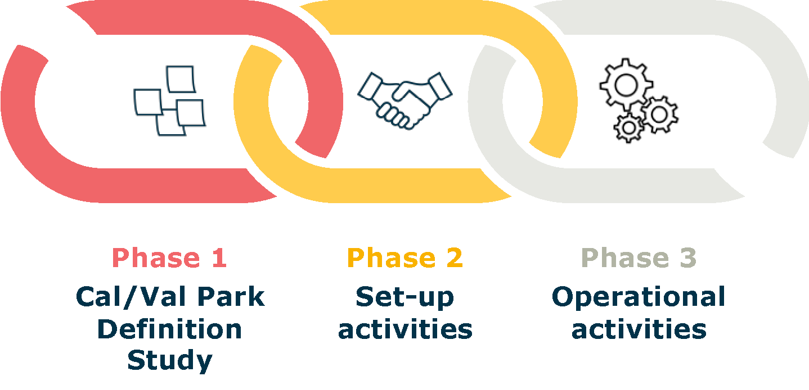
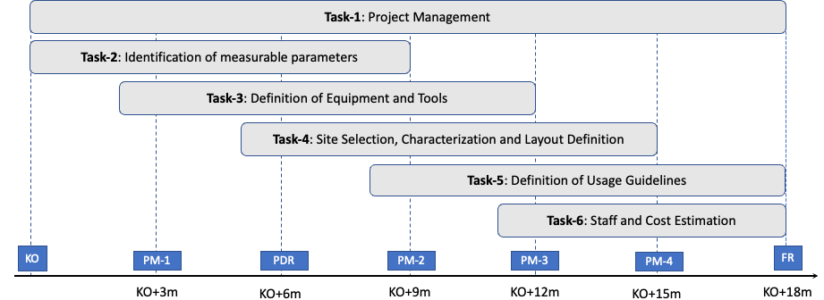
Cal/Val Park – Timeline and Consortium
The Cal/Val Park will be implemented in 3 consecutive Phases
Phase 1 (Design) kicked-off on March 2023 for 18 months
Joint ESA-ASI effort for Phase 2-3
Phase 1 consortium

Slide 7
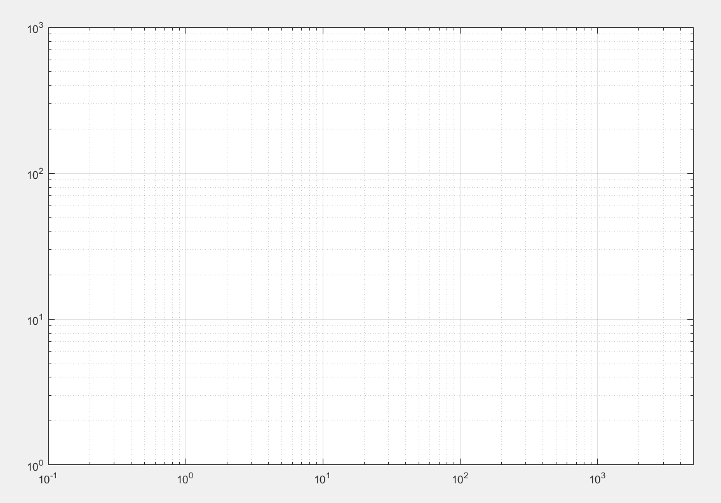
Cal/Val Park – Targeted missions
30 m
In development:
Shalom
GHOSt, Orbital Siddekick , 2023
Wyvern, 2023
Earthdaily, 2023
Pixxel, 2023
Hypersat, 2023
…
Hypersat
Pixxel
Shalom
GHOSt
Enmap
Hyperion
Prisma
SBG
Chime
Number of spectral bands
hyperscout
Wyvern
MODIS
Objective
Provide Cal/Val data for all these missions using a single set of ground-based sensors and targets
EarthDaily
Worldview3
S3 OLCI
MERIS-RR
MERIS FR
Worldview3
S2/MSI
PROBAV
VGT 1/2
Pleiades
GSD (m)

Slide 8
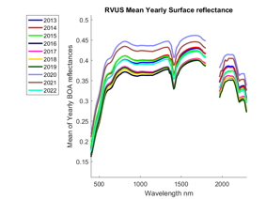
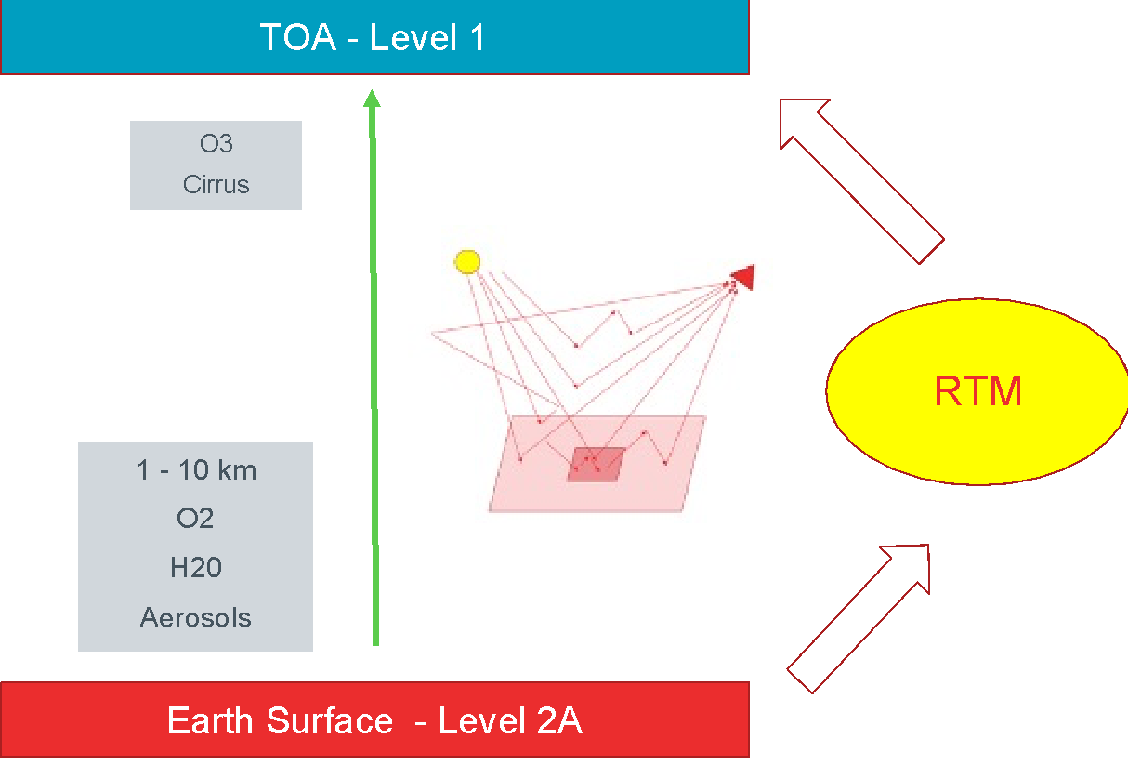
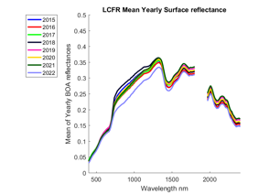
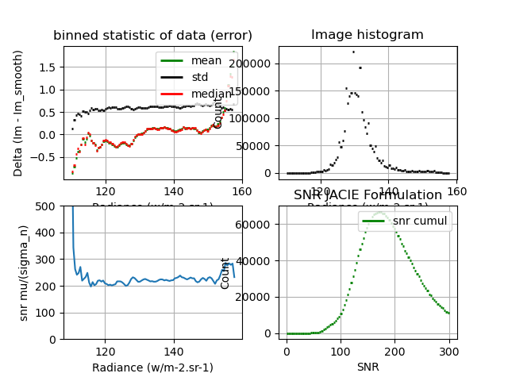
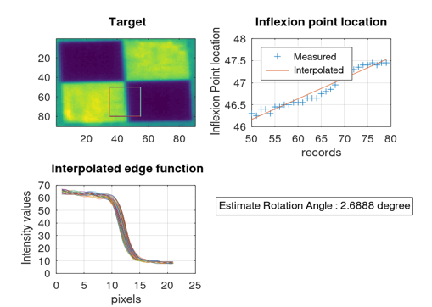
Cal/Val Park design Phase Task 2 – Definition of Measurable parameters
Liaising with EO data providers (Institutional and Commercial) to collect their Cal/Val needs
Complement with consortium’s knowledge + experience from existing networks (RadCalNet, Hypernets…)
Identifying the main Cal/Val parameters/metrics and the associated methods, focus on:
Radiometry at TOA and BOA: field spectroscopy for BOA direct validation; propagation to TOA for L1 validation
Geometry: geolocation error, co-registration with artificial GCPs complemented with natural or man-made targets
Image quality: MTF, PSF, SNR assessment using a combination of artificial targets (chessboard, fan-shape, …)
Spectral: spectral shift and FWHM potentially using selective absorbing/emitting dyes, to be further investigated
Others: validation of higher level products and extension to other EO missions, e.g., thermal, radar, atmosphere

Slide 9
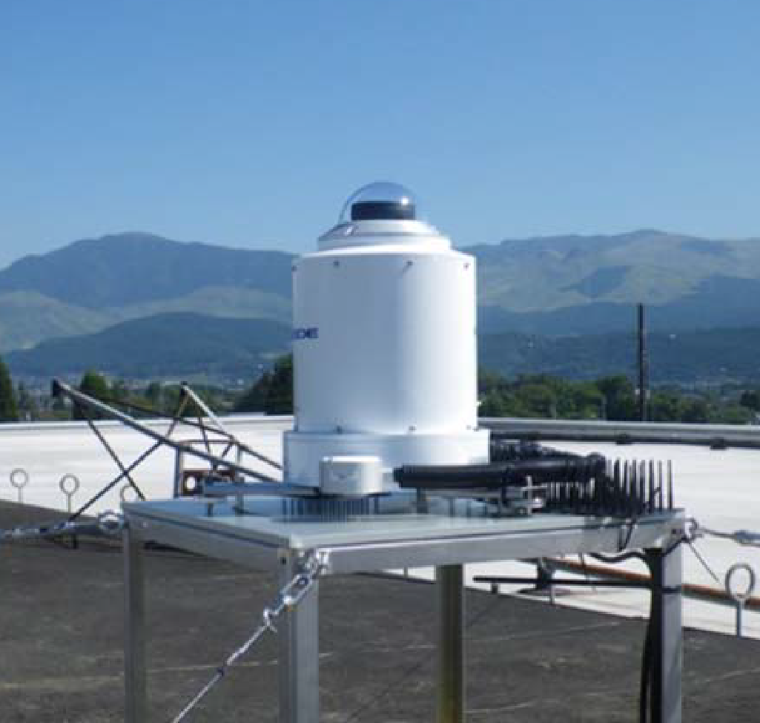
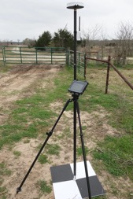
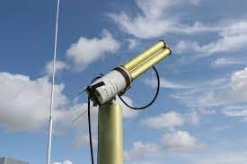
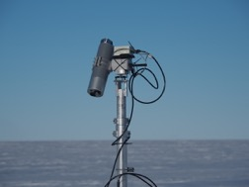
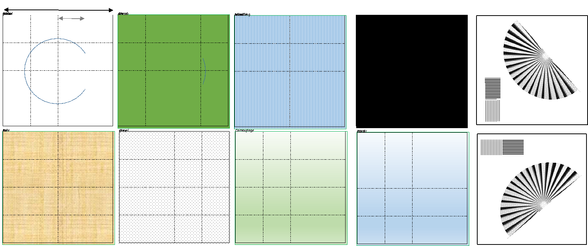
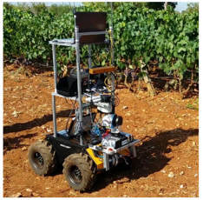
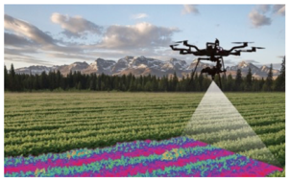
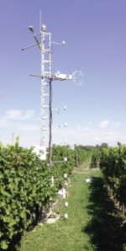
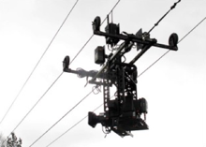
Cal/Val Park design Phase Task 3 – Definition of Equipment and Tools
Different complementary elements
Operational: suite of sensors, targets, platforms for automated/systematic acquisition of Cal/Val data
Playground: to test innovative sensors and platforms (robotics, UAV, zip lines) and for field campaigns
Supporting infrastructure: laboratory for instrument maintenance, space for meetings,…
Adopted approach
Ensure adherence to metrological guidelines (FRM)
Build on mature robust technology, while exploiting advanced solutions in the Playground
Exploit synergies across sensors, e.g., CIMEL for propagation to TOA, all sky camera for cloud
Ensure adaptability to different sensors, e.g., moveable targets, adjustable sampling design

Slide 10
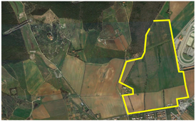
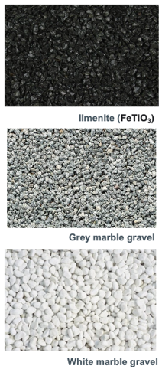
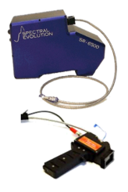
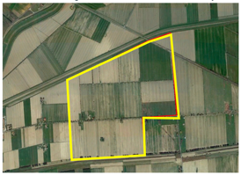
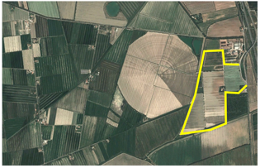
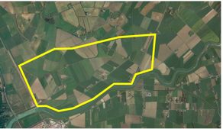
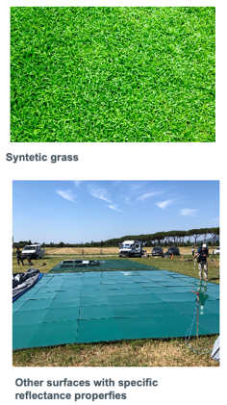
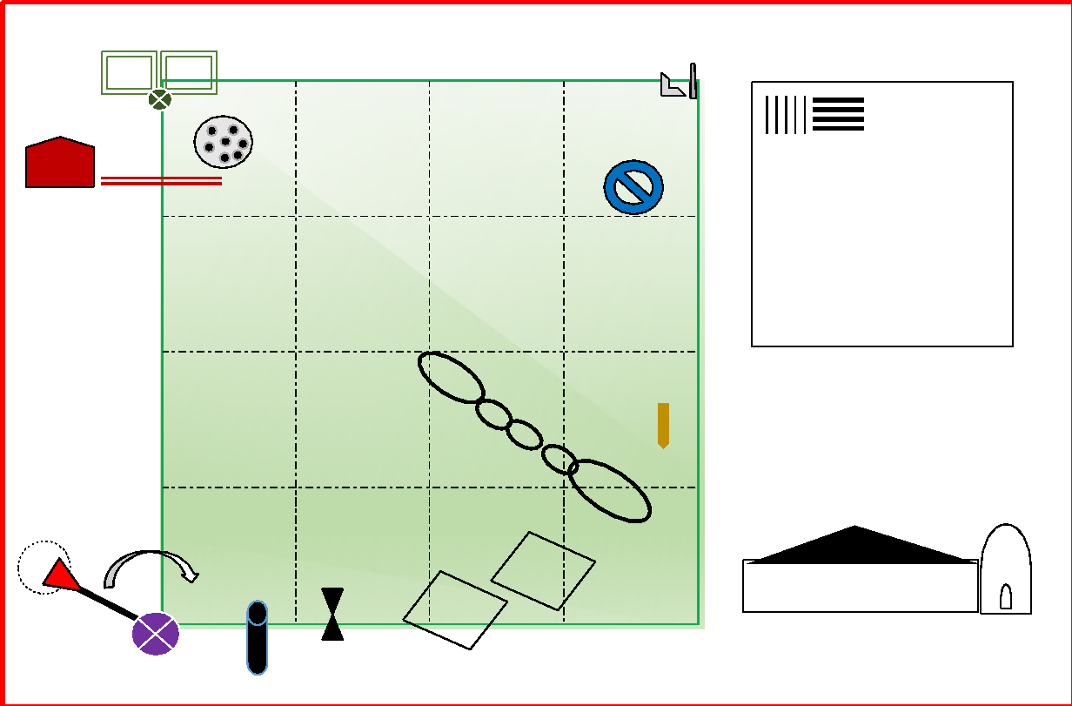
Cal/Val Park Design Phase Task 4 – Site Selection, Layout and Characterisation
Approach to site selection
Suitability criteria: size, atmosphere, clouds, topography, land-use, adjacency effects
Practical matters: availability, accessibility long-term (>10 years), logistics
Initial list of sites identified in Central Italy that tentatively match those requirements
List to be expanded, Pros/Cons of each site will be investigated in details
Site layout and characterisation
Identification of site layout and target materials
Field characterisation over selected sites: field and UAV survey with spectroradiometers
Assess uncertainty budget with model-based (RTM) approach, including adjacency effects

Slide 11
Cal/Val Park – Status and Outlook
Current Status
Dialogue with commercial and Institutional EO data providers on-going to ensure comprehensive gathering of Cal/Val needs
High interest and willingness to collaborate: Planet, MAXAR, Satellogic, Airbus, SSTL, Orbital Sidekick, Albedo Space, ConstelIr, Kuva Space, Aistech Space, Satellite Vu, BlackSky
Questionnaire provided, answers being reviewed/discussed in ad-hoc meetings
Already 10 questionnaires filled in, and counting; one-to-one meetings organised with Cal/Val teams of the various companies; very interesting and insightful feedback !
Upcoming tasks
Start definition of “Equipment and Tools” to be deployed at the site
Continue investigation of potential candidate sites
Visit to potential sites planned for Sep-Oct 2023
Promote the Cal/Val Park within EO community, e.g., VHR-RODA, JACIE WS
End of Phase 1 in Summer 2024 followed by Phase 2 (set-up and implementation)

Slide 12
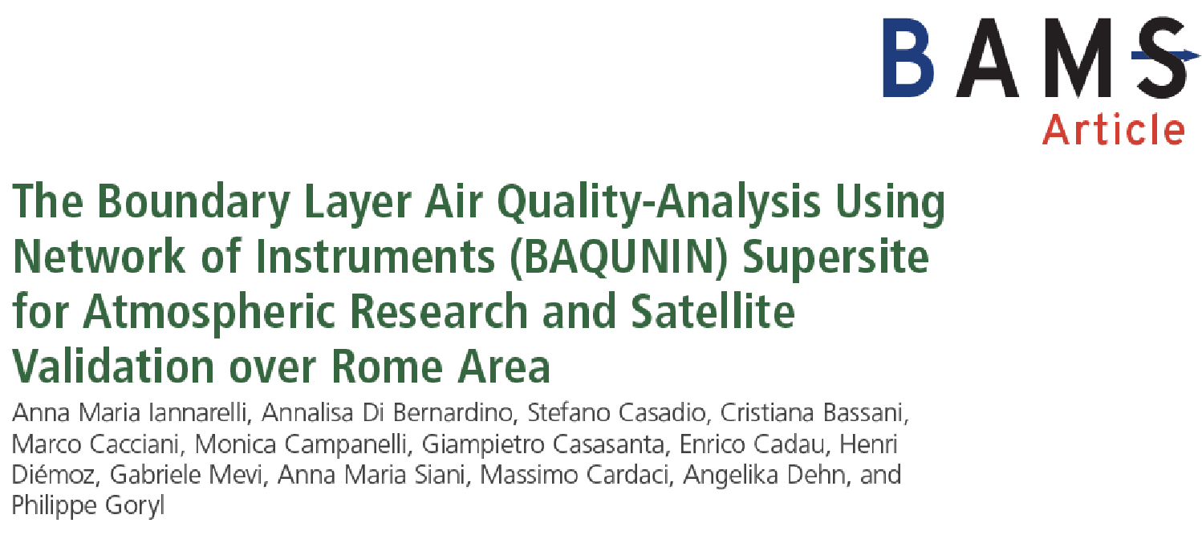
BAQUNIN Supersite
The Boundary-layer Air Quality-analysis Using Network of INstruments Supersite for Atmospheric Research and Satellite Validation
S. Casadio^{1,6}, A.M. Iannarelli¹, A. Di Bernardino², M. Campanelli³, G. Casasanta³, E. Cadau¹, H. Diémoz⁴, C. Bassani⁵, G. Mevi¹, A.M. Siani², N. Ferrante¹, F. Marcozzi¹, M. Cardaci¹, S. Falasca², A. Dehn⁶, P. Goryl⁶
SERCO Italy, Frascati (RM), Italy
Sapienza University of Rome, Italy
CNR-ISAC Tor Vergata, Rome, Italy
ARPA Valle d’Aosta, Aosta, Italy
CNR-IIA, Monterotondo (RM), Italy
EOP-GMQ ESA/ESRIN, Frascati (RM), Italy

Slide 13
BAQUNIN - Background
Boundary-layer Air Quality-analysis Using Network of INstruments
2015 – 2019 => IDEAS/QA4EO Work Package
2019 – 2022 => BAQUNIN
2022 – 2024 => BAQUNIN-2
Sustain the maintenance and operation of ground based remote sensing and in situ instruments for Satellite Cal/Val and Atmospheric Monitoring/Research purposes, operating in the Rome area
Acquire, homogenise and distribute high quality data
Perform inter-calibration and validation campaigns
Attract/engage Space/Research/Health Agencies
Stimulate research in Urban Atmospheric Boundary Layer physics and chemistry by facilitating inter-connections between national and international research institutes

Slide 14
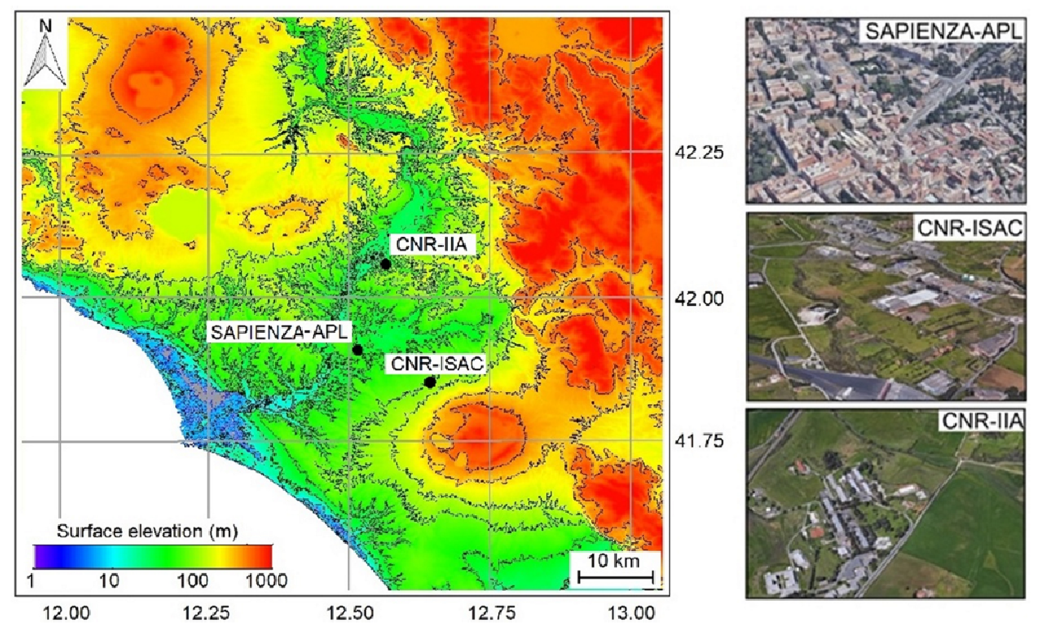
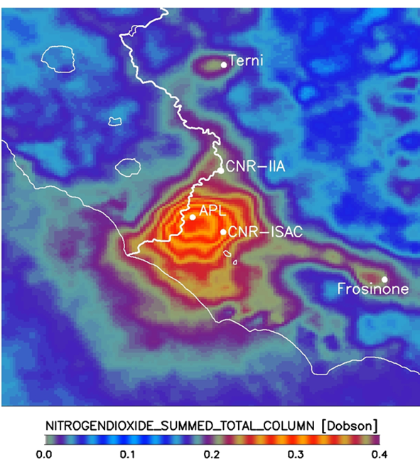
BAQUNIN - Concept
URBAN
SEMI-RURAL
RURAL

Slide 15
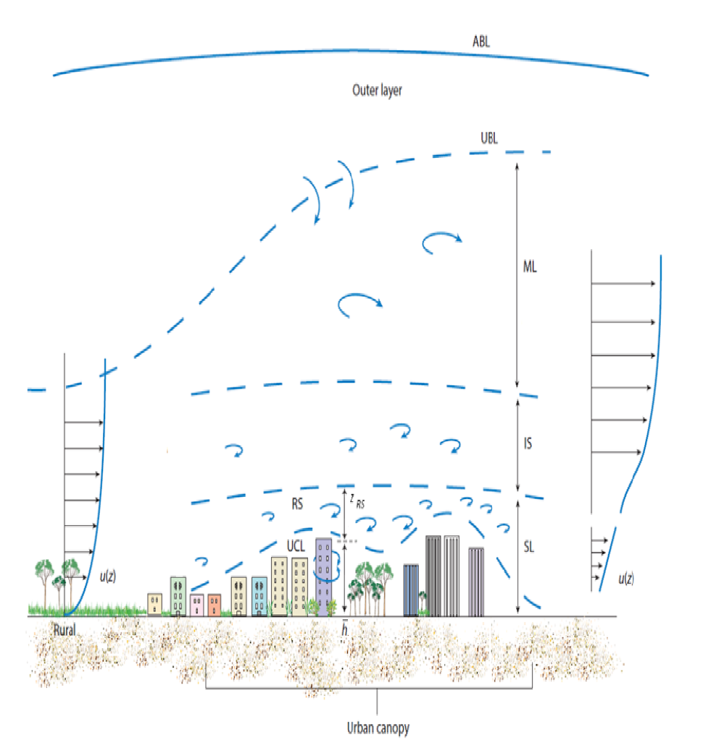
BAQUNIN - Concept
a) Ground based remote sensing instruments “see” upper SL and above. Good time resolution, large air volumes. However the pollution production layer (UCL) is not probed. Clouds can be a limiting factor, some instruments need sunlight.
b) In situ instruments are embedded in the UCL but can only probe the atmosphere in their proximity. Low time resolution, insufficient coverage, and no uncertainties are limiting factors.
c) Atmospheric Composition Satellite instruments provide a good 2D description, but are almost insensitive to what happens below the SL (physical limitations). Clouds are a limiting factor, need sunlight.
d) Modelling provides a good 4D description, knowledge of emission sources is a limitation, UBL physics/chemistry too complex, no unpredictable events (e.g. industrial/wild fires)
₸ ₸ ₸ ₸ ₸ ₸ ₸ ₸ ₸ ₸
Urban Pollution (traffic, heating)
These techniques are fully complementary
Accurate information on (urban) atmosphere
is obtained from their physically consistent combination
Urban Boundary Layer (UBL)
Mixed Layer (ML)
Inertial Sublayer (IS)
Surface Layer (SL)
Roughness Sublayer (RS)
Urban Canopy Layer (UCL)

Slide 16
BAQUNIN – Instrumental suite
Instrument | Network | Site
POM-PREDE #11 | SKYNET | APL
POM-PREDE #22 | SKYNET | CNR-ISAC
POM-PREDE Lunar | SKYNET | APL
Air Quality Low Cost |  | APL
PANDORA #115 | PGN | CNR-ISAC
PANDORA #117 | PGN | APL
PANDORA #138 | PGN | CNR-IIA
Pyranometer |  | APL
EM27-Sun FTIR | COCCON | APL
All Sky Camera |  | APL
MWL-LIDAR |  | APL
SODAR |  | APL
MFRSR |  | APL
BREWER | EUBREWNET | APL
WRF model |  | ALL
CIMEL | AERONET | APL
Microbarometer |  | APL
Meteo Station |  | APL
All Sky Camera “stereo view” | NASA CM | APL
Ceilometer RAP |  | APL
Ceilometer IIA |  | CNR-IIA
CNR-ISAC “CIRAS”
MaxDOAS
CIMEL
SODAR
CNR-IIA “Liberti”
MaxDOAS
Meteo Station
Air Quality in situ
APL => URBAN
CNR-ISAC => Semi-rural
CNR-IIA => Rural
Radiation
Next to come
Wind-lidar
MW Profiler
Air quality
Trace/GHG
Aerosol
Clouds
Meteorology

Slide 17
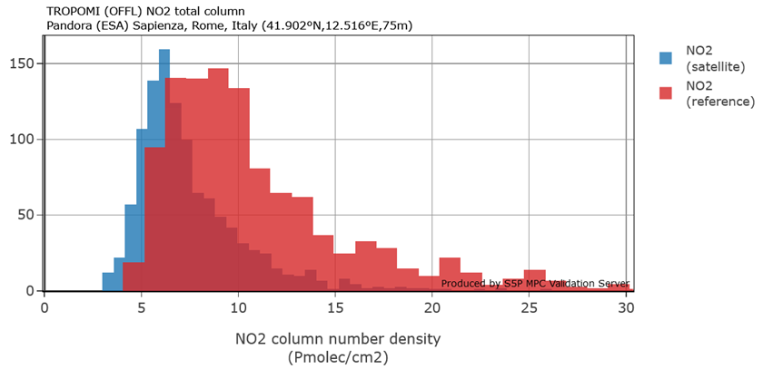
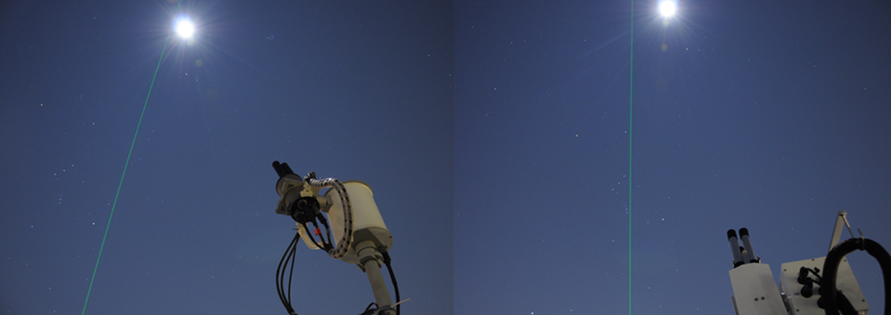
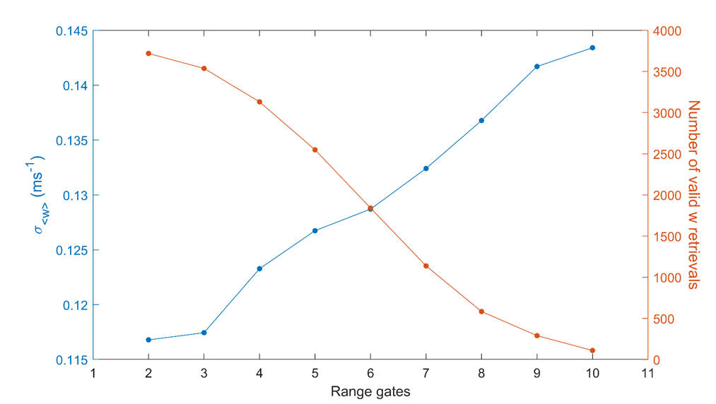
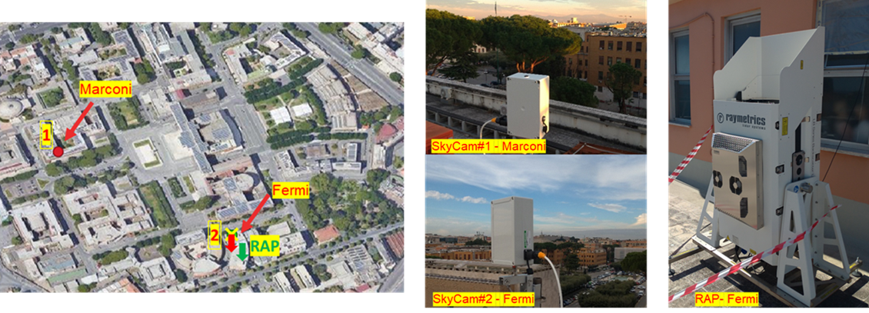
BAQUNIN – Cal/Val + R&D activities

Slide 18
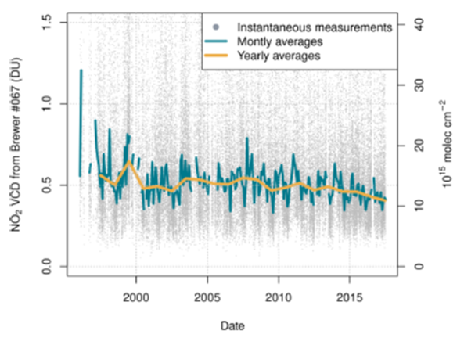
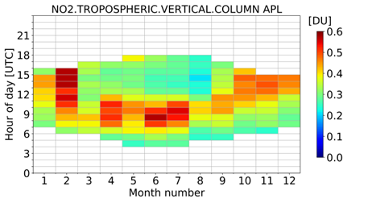
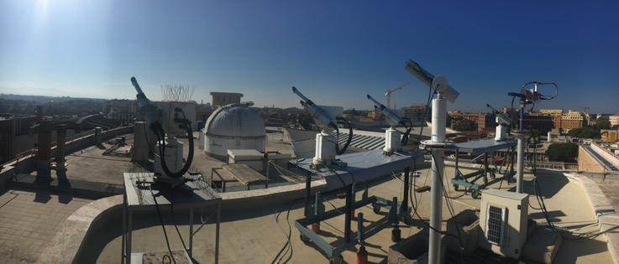
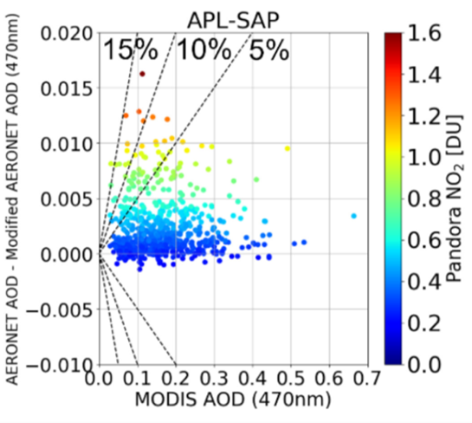
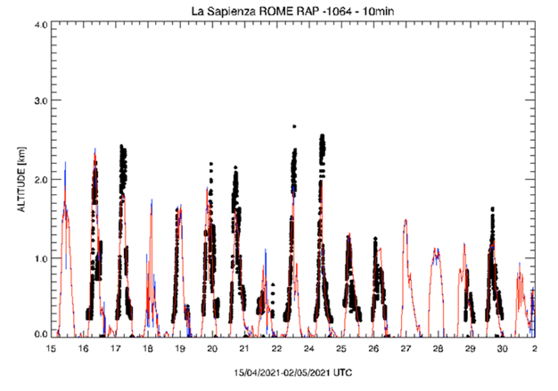
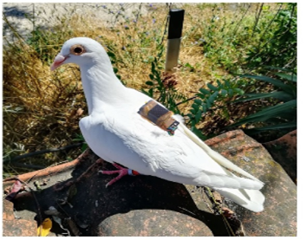
BAQUNIN – Cal/Val + R&D activities

Slide 19
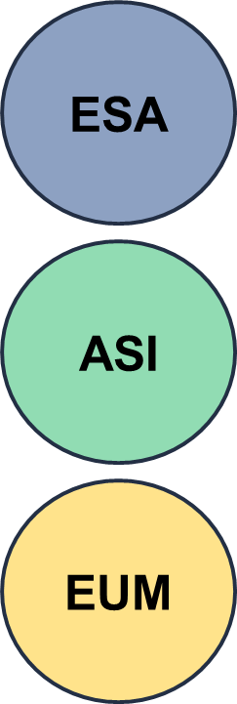
BAQUNIN – Status
EC-VT
COCCON
EDAP
Data harmonisation:
GEOMS / NecCDF
Data distribution:
EVDC
PGN
AERONET
SKYNET
EUBREWNET
BAQUNIN website
https://www.baqunin.eu/
POp
QA4EO
BAQUNIN
DIVA
S5p-VT
FRM4AQ
CV Park
FRM4AER
IRIDE
PRIMARY

Slide 20
BAQUNIN collaborations
Institute/Company | Country
CNR-ISAC | ITA
CNR-IIA | ITA
INAIL | ITA
SAPIENZA | ITA
SERCO | ITA
ENEA | ITA
ISPRA | ITA
LuftBlick | AUT
UoCagliari | ITA
ESA | ITA
NOAA | USA
Raymetrics | GRE
Brockmann | GER
CNR-ISMAR | ITA
EUM-ESA | GER
INFN | ITA
Institute/Company | Country
UoLAquila | ITA
UoLeicester | UK
ARIANET | ITA
ARPA VdA | ITA
CNR-ISAFOM | ITA
DWD | GER
Int. Ozone Serv. | CAN
NASA-GSFC | USA
SCO | ITA
UNIBAS | ITA
UoAthens | GRE
UoMaryland | USA
UoReading | UK
UoTohoku | JPN
UoValencia | SPA
VirgPolInst | USA
Outreach 2016 - 2022
16 Scientific Papers
20 Oral Presentations
24 Poster Presentations
10 Technical Notes

Slide 21
BAQUNIN - Outlook
Urban (APL), Semi-Rural (CNR-ISAC), Rural (CNR-IIA) components
Continuous operation of active/passive remote sensing and in situ instrumentation
Free data dissemination to citizen, scientific and Cal/Val communities
Testing new instruments and operation modes
Hosting short/medium/long-term inter-calibration/comparison campaigns
Education initiatives (e.g. summer schools): hands on instruments!
BAQUNIN for Cal/Val Park
Share experience in super-site and lab 24/7 operation/maintenance
Atmospheric component definition, operation and exploitation
BAQUNIN (https://www.baqunin.eu/) contacts:
Massimo Cardaci (Contract Manager) Massimo.Cardaci@serco.com
Anna Maria Iannarelli (Scientific Coordinator) Annamaria.Iannarelli@serco.com
Stefano Casadio (Senior Scientist) Stefano.Casadio@serco.com, Stefano.Casadio@ext.esa.int

Slide 22
BAQUNIN Supersite
Thank you!

