Slide 1
WGCV-52
CEOS Cal/Val Portal status and updates
Paolo Castracane,
Rhea System for ESA/ESRIN
Agenda Item 5.3
WGCV-52, ESA/ESRIN, Italy
5th - 9th June 2023

Slide 2
Table of Contents
Actions
Numbers
Software Update
Content Updates
Outreach: Newsletter, New Video
Slide 2

Slide 3
Actions
IID | Description | Current status
WGCV-51-ACT-09 | Nigel Fox and Paolo Castracane to update the wording on the Cal/Val Portal regarding solar irradiance spectrum references. | Input provided by Nigel – Updates on CEOS Cal/Val portal (June)
WGCV-51-ACT-10 | Nigel Fox and Paolo Castracane to investigate the creation of a private IVOS section of the Cal/Val Portal that would allow for peer review by IVOS members of proposed radiometric calibration methodologies and associated documentation/uncertainties before publishing to a wider audience. | To be discussed – easy from technical point of view
WGCV-51-ACT-21 | Paolo to work with the GISTDA team to include THEOS-1 calibration site data on the Cal/Val Portal. | GISTDA Cal/Val web portal is still under construction. preliminary version at the URL: https://sites.google.com/gistda.or.th/calval
WGCV-51-ACT-22 | Philippe Goryl, Jean-Christopher Lambert and Paolo Castracane to discuss additional atmospheric composition guidance for the Cal/Val Portal. | To be discussed: same approach used for other documents (e.g. Hyperspectral Cal/Val resources and FRM assessment framework could be applied) ???

Slide 4
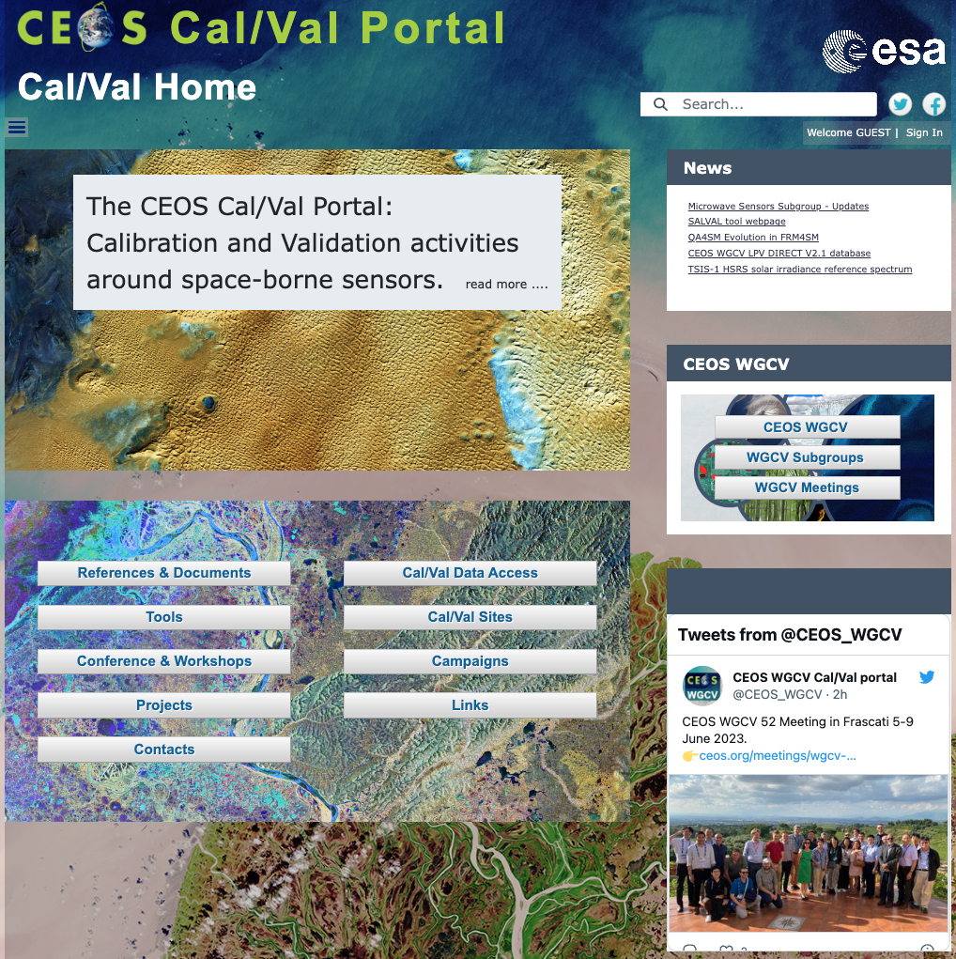
Numbers/CCN
https://calvalportal.ceos.org
Some numbers: 2th June 2023:
Users
1148 Registered Users
154 CEOS WGCV SAR Subgroup and 3 super-users
32 MTF Members
6 Cal/Val Doc Repository (rights for editing)
21 Terms and Definitions (rights for editing)
System availability
BC uses Nagios (http://www.nagios.org/) for monitoring the IT services.
The availability of the Cal/Val Portal is close to 100%.
The CCN1 for “CEOS Cal/Val Portal and MySPPA maintenance and support” extension until 31 December 2024
Slide 4

Slide 5
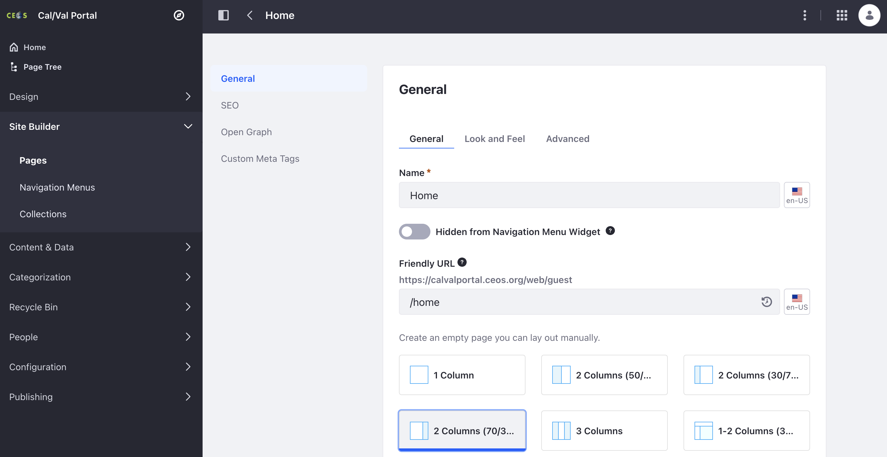
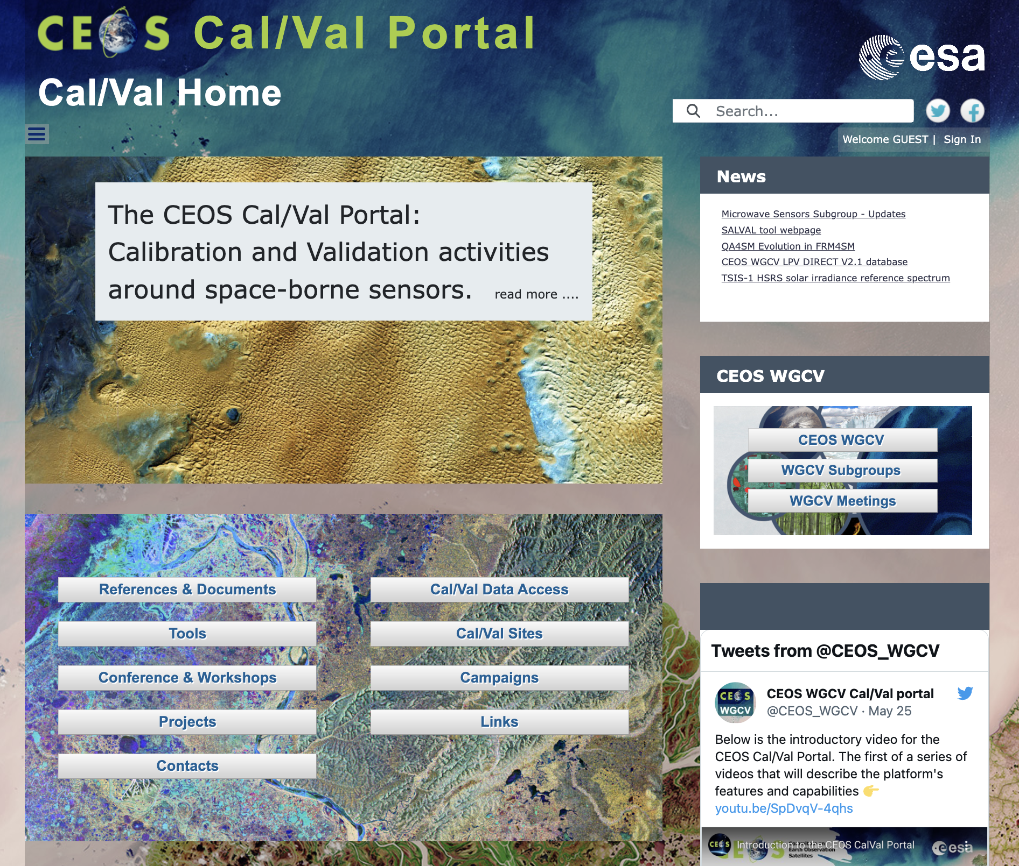
Software update
Liferay® Updates
Info: Liferay Community Edition Portal 7.4.3.14 CE GA14 (Cavanaugh / Build 7403 / March 4, 2022)
Migration of all documentation.
Migration of all accounts, passwords, access definitions for all groups.
Security patches applied
More and updated development features
Improved Performances

Slide 6
Content Update
SAR Subgroup Workshop.
CEOS SAR Cal/Val 2023 Workshop Announcement and website - New dedicated website for SARCalNet is in development phase.
ACSG provided input for Cal/Val sites. Plan for new website.
SALVAL (Surface Albedo VALidation) tool.
LPV DIRECT 2.1 database
New MSSG website pages – hosted in the Cal/Val Portal: Space-borne scatterometers and wind retrieval, more to come
Plan for a new Website, including DEMIX material
Dedicated page for TSIS-1 HSRS Updates on IVOS Workshop
6

Slide 7
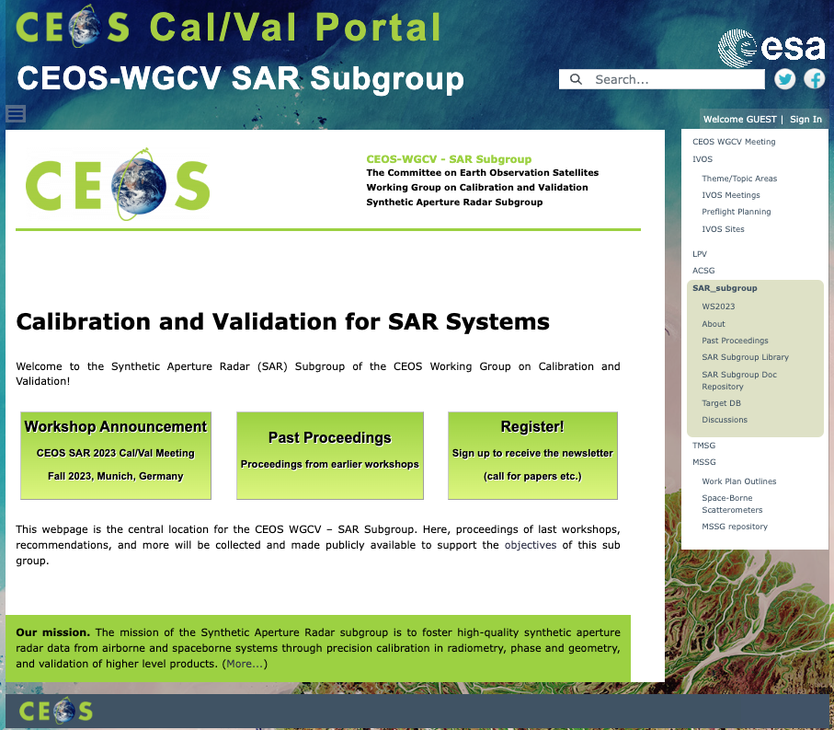
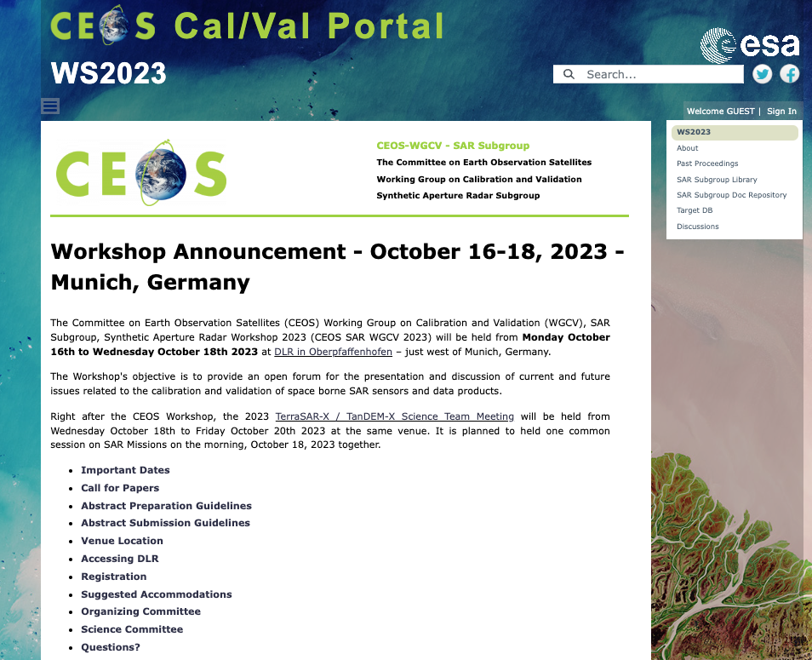
CEOS SAR Subgroup

Slide 8
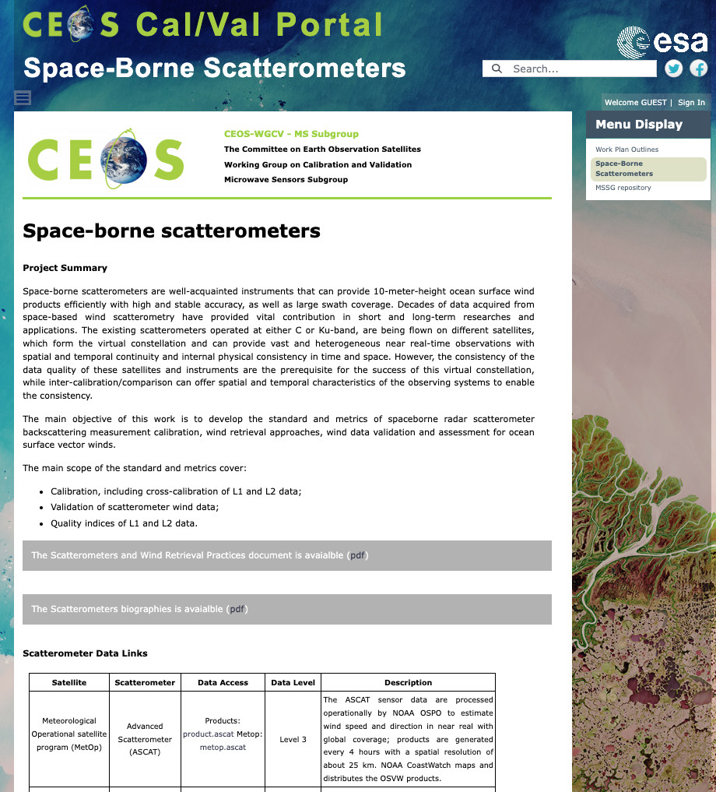
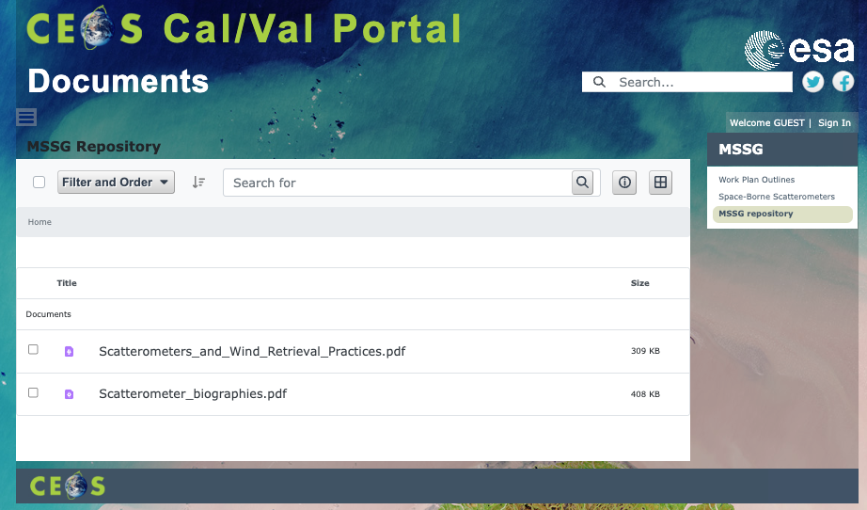
Microwave Subgroup MSSG
MSSG Gruop page is now available – thanks to the input from
Xiaolong Dong and his team
https://calvalportal.ceos.org/web/guest/mssg1
Project Summary
Work Plan Outlines
Scatterometers and Wind Retieval Practices
Scatterometer Biographies

Slide 9
Atmospheric Composition Subgroup ACSG
Input received from Jean-Christopher Lambert – implemented on Cal/Val Portal
"Use of PICS for calibration evaluation for atmospheric sounders".
Relevant links
Updates on Cal/Val Sites; Projects
ACSG webpage:
New Action for Paolo – to provide Jean-Christopher Lambert rights to edit the webpage – including info and support

Slide 10
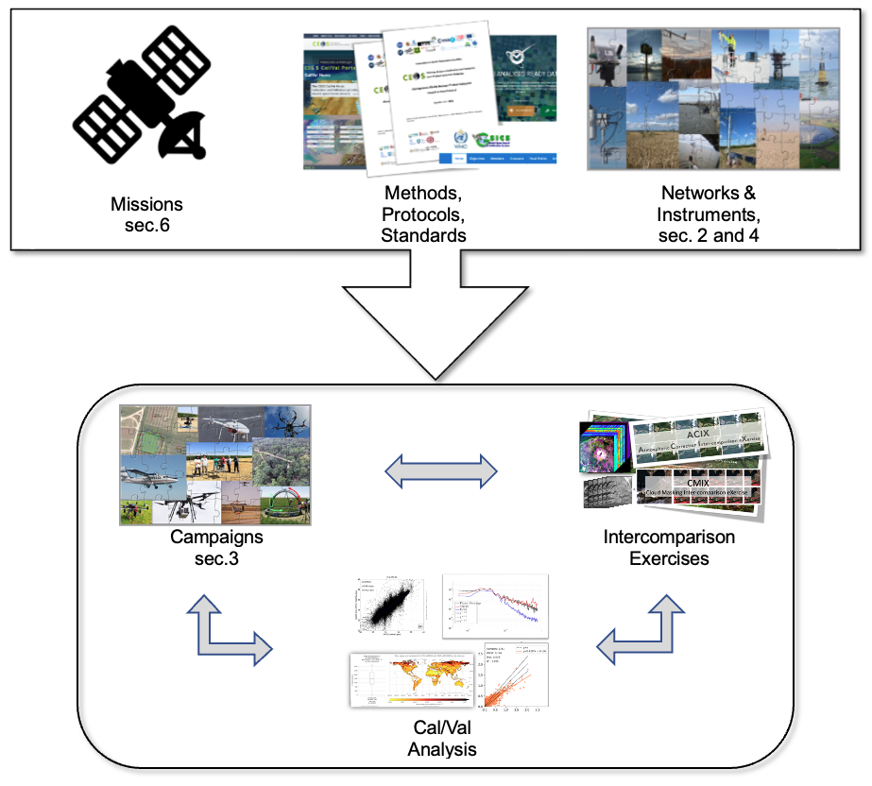
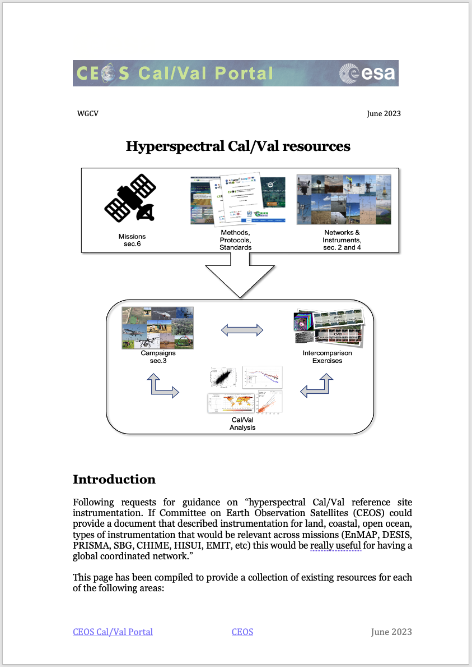
Hyperspectral Cal/Val Resouces
Hyperspectral Cal/Val Resources
https://docs.google.com/document/d/1coQkACGLg2aLSfyC2dZL_I9VUlzn2ruoFEcRP1kOHCM/edit#heading=h.scgocn7m8pb7
Introduction
Networks
Guidelines and Protocols
Campaigns and Inter-comparison Excercise
Instrumentation and Hardware
Mission-Specific Resources
In general Cal/Val activities for Hyperspectral Mission will include the elements sketched in the figure above

Slide 11
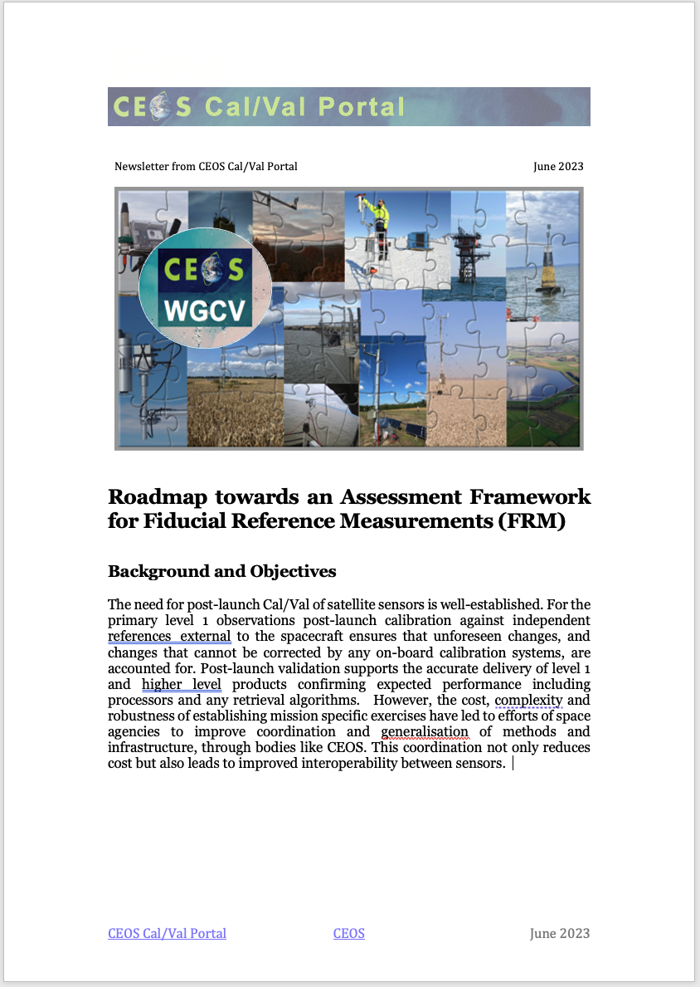
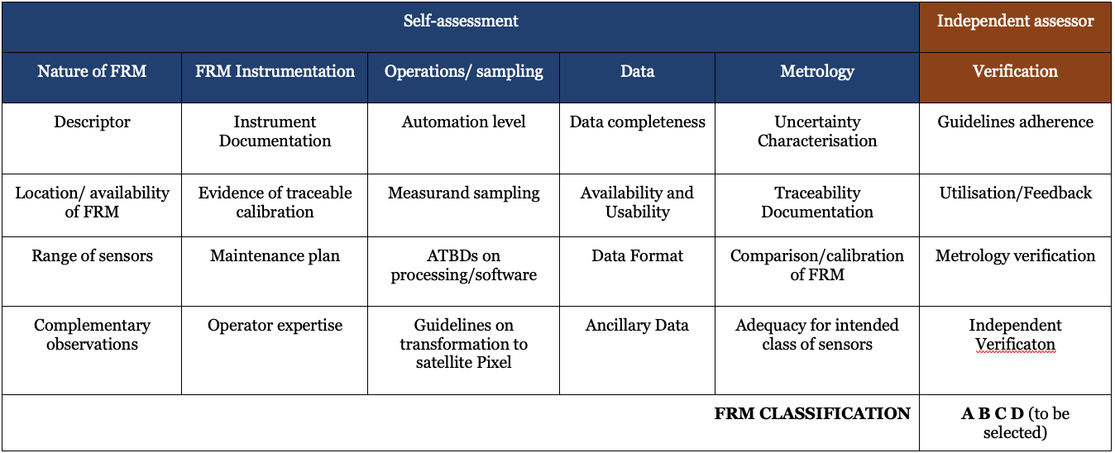
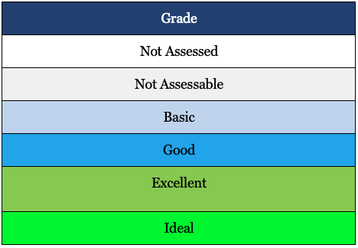
FRM Assessment Framework
Roadmap towards an Assessment Framework for Fiducial Reference Measurements (FRM)
https://docs.google.com/document/d/1OLJGUgErsFpNFGuqhlGrBBEpYF7q2mWi/edit#heading=h.2bn6wsx
The purpose of the document is to propose a roadmap towards an assessment framework to endorse a specific class of measurements as a Fiducial Reference Measurement (FRM).
Background and Objectives
FRM Definition and Principles
FRM Endorsement Process
FRM Maturity Matrix
FRM Overall Classification

Slide 12
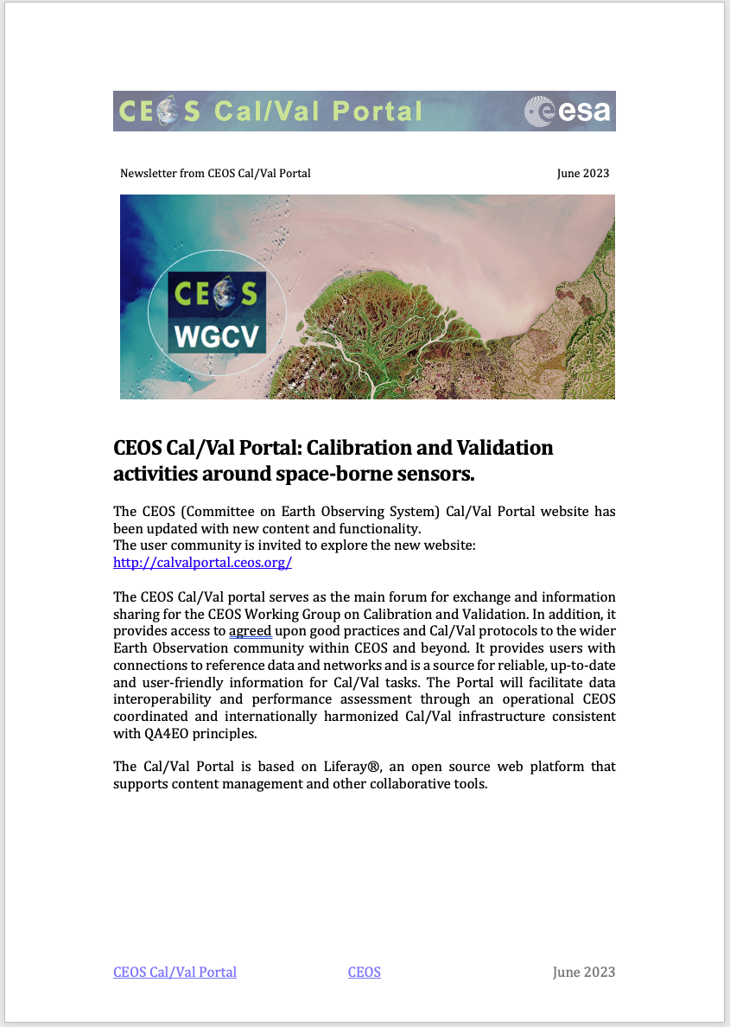
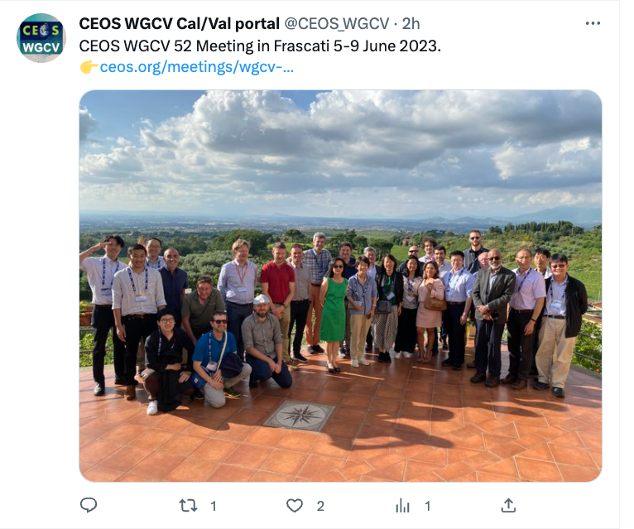
Outreach/Newsletter
Newsletter June 2023
Software Platform Update
Content Updates for each subgroups
Hyperspectral Cal/Val resouces
FRM Assessmente framwork
Outreach, video tutorials, twitter, contact and support

Slide 13
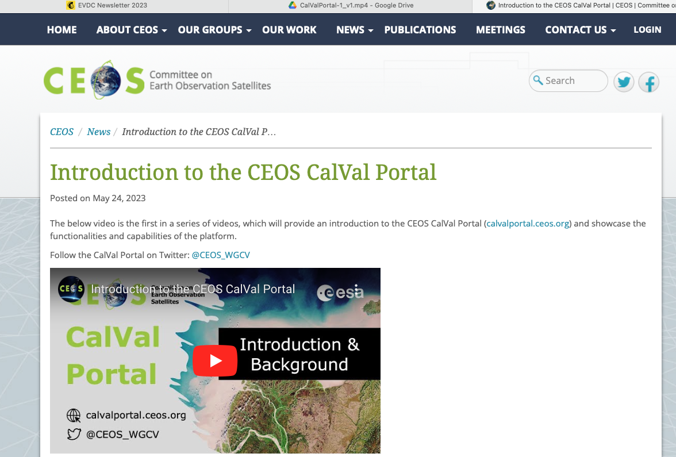
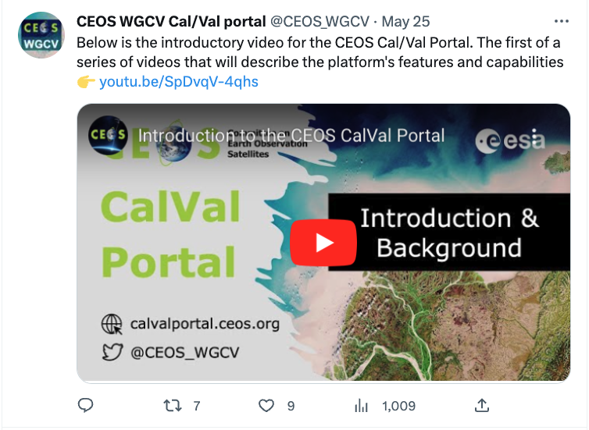
Overview Video
Introductory video for the CEOS Cal/Val portal. The first of a series of videos that will describe the platform's features and capabilities.
https://ceos.org/news/cvp-video-1/
https://youtu.be/SpDvqV-4qhs
thanks to Libby Rose (Symbios)!
The list of videos will include:
Introduction to the WGCV and the CalVal Portal
WGCV Subgroups
Terms and Definitions Wiki
Registered Users
Document repository
CalVal Sites
PICS sites
Projects
Tools
CalVal data
Campaigns
Conferences and Workshops
Keeping up-to-date with the WGCV CalVal Portal

