Slide 1
WGCV-52
GSICS Collaboration
Paolo Castracane
Rhea System for ESA/ESRIN
Manik Bali
NOAA/UMD-CICS
With Contribution from
Dave Doelling, Likun Wang,
Larry Flynn, Jack Xiong and Tom Stone
Agenda Item 5.4
WGCV-52, ESA/ESRIN, Italy
5th - 9th June 2023

Slide 2
Table Of Contents
GSICS Overview
GSICS Annual Meeting 2023
GSICS Actions and Recommendations
WGCV and GSICS area of cooperation
Slide 2

Slide 3
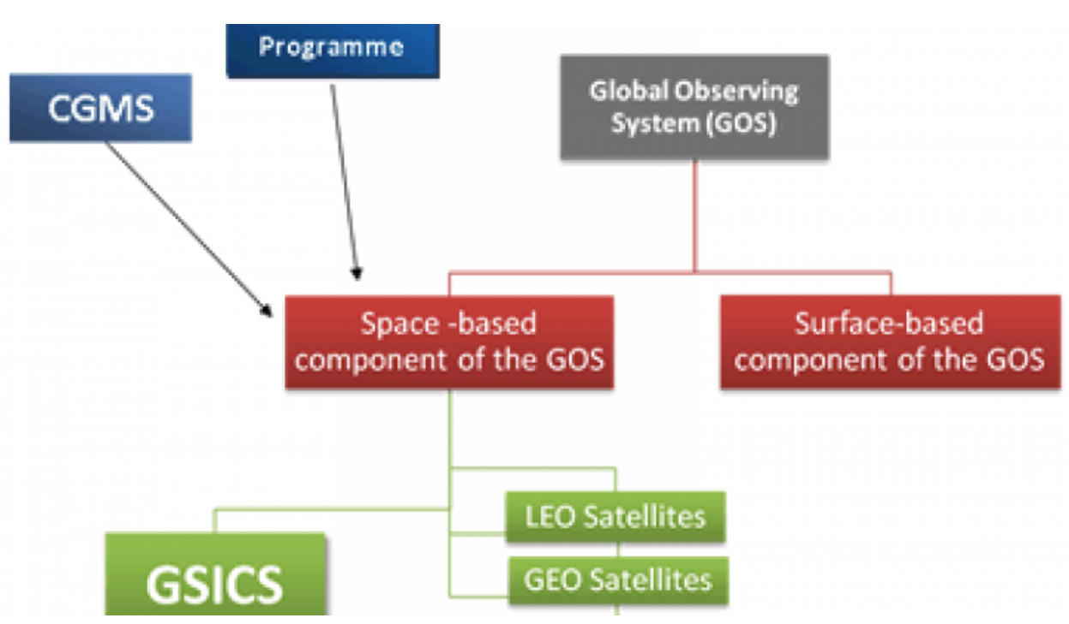
GSICS Overview
Global Space-based Inter-Calibration Sytem (GSICS) is an international collaborative effort initiated in 2005 by the World Meteorological Organization (WMO) and the Coordination Group for Meteorological Satellites (CGMS) to 1-monitor, 2-improve and 3-harmonize the quality of observations from operational weather and environmental satellites of the Global Observing System (GOS).
GSICS aims at ensuring consistent accuracy among space-based observations worldwide for climate monitoring, weather forecasting, and environmental applications.
This is achieved through a comprehensive calibration strategy which involves:
monitoring instrument performances,
operational inter-calibration of satellite instruments,
tying the measurements to absolute references and standards, and
recalibration of archived data.
GSICS delivers calibration corrections needed for accurately integrating data from multiple observing systems into products, applications and services. GSICS contributes to the integration of satellite data within the WMO Integrated Global Observing Systems (WIGOS) and within the Global Earth Observation System of Systems (GEOSS) of the Group on Earth Observations (GEO).
GSICS https://gsics.wmo.int/
GSICS Wiki: http://gsics.atmos.umd.edu/wiki/Home
GSICS Meetings and conferences: http://gsics.atmos.umd.edu/bin/view/Development/MeetingsAndConferences

Slide 4
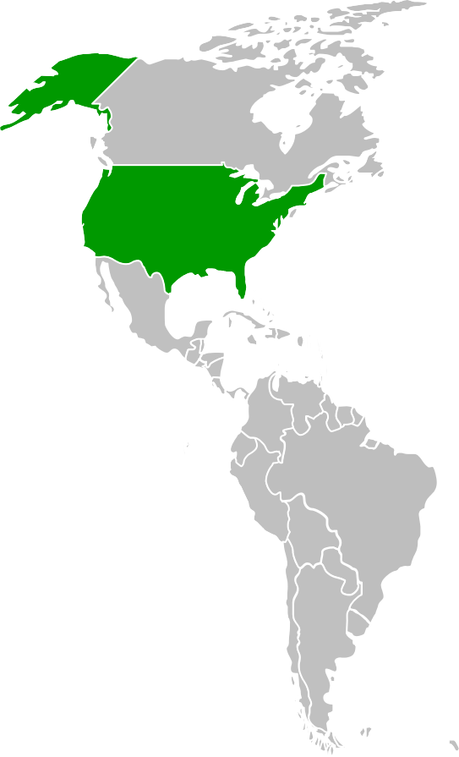
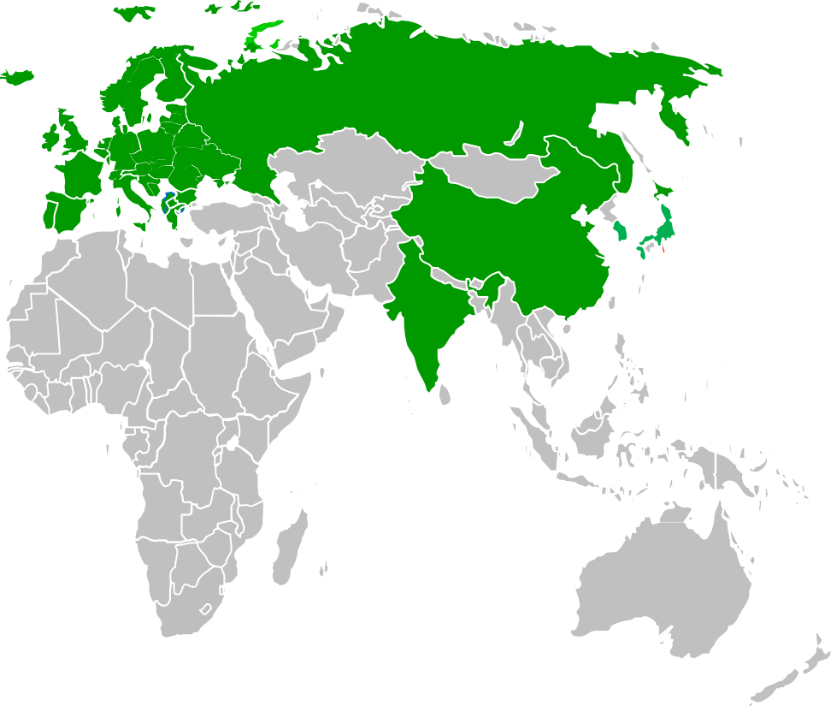
GSICS Members
ROSHYDROMET
WMO/EUMETSATESA/CNES
USGS/NOAA
NASA/NIST
WMO
KMA
CMA/SITP
JMA/JAXA
IMD/ISRO
Observer.
Associate member.
CEOS/WGCV
GPM X-Cal
15 Members Worldwide
7
dohy

Slide 5
GSICS Structure
CGMS satellite operators
CGMS satellite operators
CGMS satellite operators
CGMS satellite operators
WMO
GSICS Exec Panel
Notebooks
Inter-Operability Platforms
GSICS
Coordination Center
GSICS
Research Working Group
GSICS Data Working Group
QA4EO
CEOS WGISS
UV
Sub-Group
VIS/NIR
Sub-Group
IR
Sub-Group
Microwave Sub-Group
GPM X-CAL
WGCV ACSG
WGCV IVOS
WGCV LPV
WGCV MWSG
WGCV SAR

Slide 6
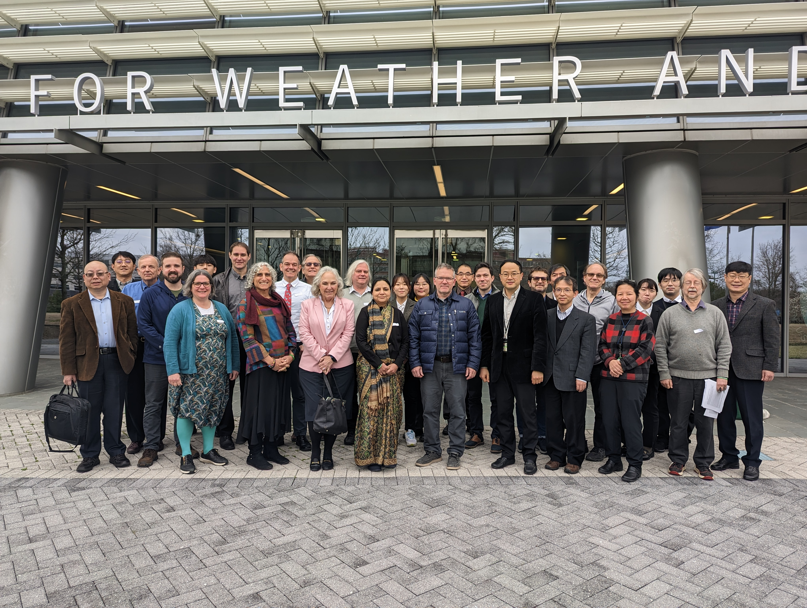
GSICS Annual Meeting 2023
The GSICS Annual Meeting 27 feb. – 03 Mar. 2023, College Park, MD, USA
At NCWCP (NOAA Centre for Weather and Climate Prediction) - in person and online.
The Meeting had the following sessions:
Mini Conference
Plenary: Agency Report
UVN and Space Weather - parallel sessions
IR and GDWG - parallel sessions
VIS/NIR (including Lunar Calib.) and MW – parallel session
Cross Cutting Session
Info, presentations and minutes can be found at: http://gsics.atmos.umd.edu/bin/view/Development/Gsicsannualmeeting2023
Slide 6

Slide 7
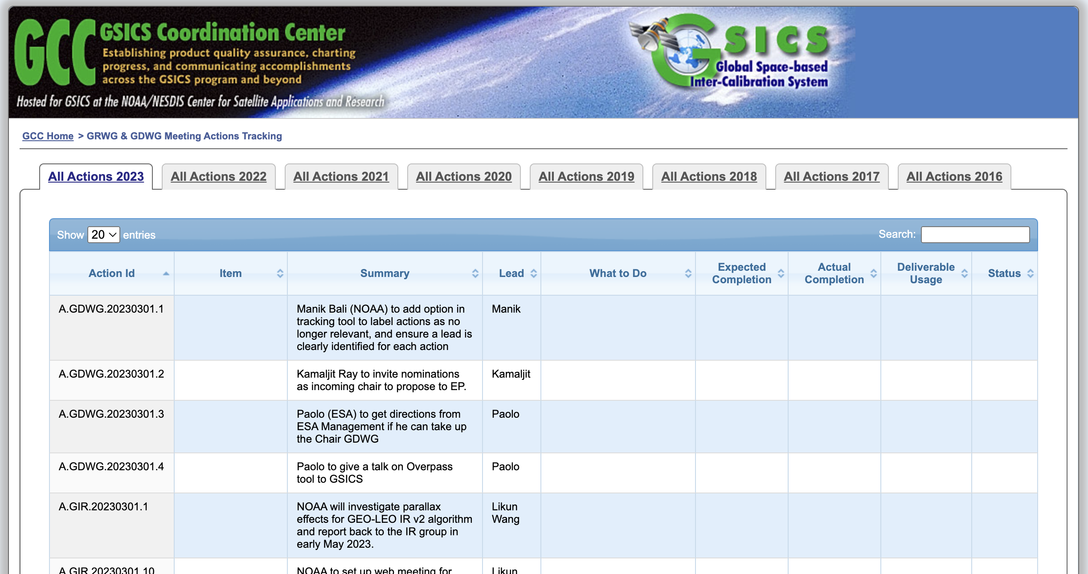
GSICS Actions
https://www.star.nesdis.noaa.gov/smcd/GCC/MeetingActions.php
Slide 7

Slide 8
Discussion points, conclusions, Actions, Recommendations, Decisions
Importance of traceability, harmonization and terminology
Recommendations: movement from use of single reference instruments to consensus blend of reference instruments. Unless one reference Is clearly superior, it may be better scientifically and politically to define a consensus reference (to generate a synthetic hybrid reference instrument requires the propagation of all the uncertainties associated with converting and combining the reference instruments )
Mini Conference
Agencies report about their Cal/Val activities, current, latest and future missions and instruments, activities related to GSICS Products.
WMO reports on the renewed Unified Data Policy, OSCAR Database. NASA : increased importance of small sats
NOAA: Promoted GSICS as a stakeholder in BIPM workshop on Metrology for Climate Action, Importance of Lunar Calibration, Used TSIS-1 HRSR as spectral solar irradiance, Other innovations of interest to GSICS: AI-based RTM development, …
Proposal for revisions of GSICS products addressing the evolving needs: Combining the IR and VIS-NIR in a single product, include validity date/time/dynamic range Appending additional metadata Accommodating several algorithm improvements
Agency Reports

Slide 9
Discussion points, conclusions, Actions, Recommendations, Decisions
UVN Spectrometer Break Out Session
A good mix of updates ranging from CDRs for past instruments (GOME/SCIAMACHY), to End-of-Life (Metop-A GOME-2), to “operational” sensors (EPIC, NPP OMPS), to newer sensors (GEMS / TropoMI), to recently launched (NOAA-21 OMPS), to soon to be launched (TEMPO, OMS) with excursions to solar irradiance studies (OMI / TropoMI) and product comparisons (OCO-3 and GEMS).
UVN-S Subgroup members are making use of a range of GSICS methods including: DCC Methods Ray tracing SNOs with/without Double Differencing Radiative Transfer modeling Rayleigh scattering Comparisons to TSIS HSRS reference and OMI time series for solar PICS and other ground sites (e.g., Open Ocean, Ice fields)
There is good communication across the community. OCO, TropoMI and CO2M gave four NIR-related talks in various sessions. The OCO/GOSAT/TropoMI Calibration Team have productive quarterly meetings and have invited participation by GSICS and CO2M in those meetings.
There is significant overlap with the Vis/NIR group and we will continue to hold topical meetings with participation by both subgroups.

Slide 10
Discussion points, conclusions, Actions, Recommendations, Decisions
Space Weather Breakout Session
As experts in space environment measurement, its application, and understanding user’s requirements, members of the SW sub-group will carry out the following activities:
Discussion and coordination on research, development and implementation of inter-calibration for space environment sensors, initially focusing on high-energy electron sensor in geostationary orbit
Analysis of the characterization (sensitivity, secular variation, etc.) of individual sensor and publication of the outcomes (product), and consideration of its implementation in the framework of GSICS
Examination and documentation of standardization (data format, data exchange, inter-calibration, etc.)
Examination of developing a standard products (near-real time bases, and post-data analysis bases) that integrates multiple satellite data
NWP O-B method helps for calibration Infrared observations from instruments are compared with the simulations using NWP+RTM method. NWP O-B method can benefit the IR instrument calibration because NWP and RTM improvements: Characterizing instrument features (e.g., stripes) Spectral response error Monitor instrument calibration change Bias diagnosis Limitation should be clearly acknowledged.
Straylight Characterization Stray light rejection around local midnight during eclipse season is a unique challenge for satellite instrument on geostationary orbit for the SW IR bands. A method has been developed to characterize ABI-type straylight Time-difference processing Coordinate transformation Straylight magnitude estimation It evaluate the capability of straylight rejection for different ABI-type instruments.
Inter-Calibration using Moon Moon potentially serve as a stable target to inter-calibrate IR sensors when the Moon was within their FOVs. A model of the IR irradiance of the disk-integrated Moon is available. Disk-integrated infrared observations of the Moon was compared with the model and the results agree each other.
IR Breakout Session

Slide 11
Discussion points, conclusions, Actions, Recommendations, Decisions
GDWG

Slide 12
Discussion points, conclusions, Actions, Recommendations, Decisions
Microwave (MW) subgroup meetings Validation of new MW instrument constellation assets CMA FY-3E MWTS, MWHS, and WindRad NOAA-21 ATMS Calibration maintenance and sustainment of current MW instruments Each operational and space agency continuously monitors their on-orbit MW sounder and/or imager calibration performance ESA SMOS Mission SMOS – SMAP Brightness Temperature (Tb) inter-comparison continues to show good agreement between the two sensors DOMEX experiment (L-band radiometer in Antarctica) has continued with nominal operations.
Future MW instrument cal/val preparation EUMETSAT SNO method planned to validate MWS radiances by inter-comparison with AMSU, MHS and ATMS and FY-3/MWTS/MWHS (dependent on LECT). NWP / Radiosonde / Radio Occultation + RTM methods will be key in MWI/ICI and MWS Cal/Val Plans during commissioning and operations. The methods will be extended to validate potential frequency shifts for MWS, and possibly to inter-calibration by double-differencing. Sterna draft EURD requires inter-calibration monitoring through mission life against a reference – such as another mission (e.g. EPS-SG MWS), vicarious targets or RO. Tandem flights could be beneficial. ESA TriHex mission concept developed (flight formation L-band interferometer) CIMR mission (https://cimr.eu/) algorithm prototyping and product definitions have progressed well. CMA New MWRI (MWRI-II and MWRI-RM) were developed and will be launched soon onboard FY-3F (FY-3G). PMR (Precipitation Measurement Radar) has been completed and will be launched soon. Follow-on MWTS and MWHS will be launched onboard FY-3F. NOAA QuickSounder; Using TROPICS Pathfinder to explore the utility of small sats in their MW portfolio
Innovations AI-based radiative transfer calculations proved to be 100 times faster for clear-sky, and 400-1,000 time faster than the CRTM, and achieved high accuracy Developing methods to quantify simulated MW Tb uncertainties JAXA AMSR-2 Product Updates - Sea Ice Motion Vector V1 in Mar. 2022; SST V4.1 in Jul. 2022; Improved Snow depth V3 & Soil Moisture Content as research product in Sep. 2022; Precipitation V3 in Oct. 2022 ESA SMOS - New version of L4 sea-ice product, L3 Freeze and Thaw soil state product delivered In Dec. 2021, JAXA and NASA started to release the DPR V07, corresponding to the Ka-band PR scan pattern change. ESA RFI monitoring and reporting has continued (https://rfi.smos.eo.esa.int/) MW Subgroup Wiki updated and expanded to include all meetings
MW Breakout Session

Slide 13
Discussion points, conclusions, Actions, Recommendations, Decisions
VIS/NIR and Lunar Calibration
VIS/NIR highlights We have had 6 monthly web meetings during the last year Presented visible imager and visible calibration strategies VIS/NIR reference status update CLARREO sensor has been postponed and is now scheduled to operate in 2025 TRUTHS sensor to launch in 2030 NOAA21 – VIIRS RSB channel calibration is very good (Might use as the future reference) The sensor / retrieval continuity session VGT 1/2/Proba surface reflectance continuity – Marta Luffarelli Historical GOES recalibration and archiving – Jessica Matthews MODIS and VIIRS cloud retrieval continuity – Kerry Meyer MODIS and VIIRS aerosol continuity – Rob Levy | Inter-calibration OCO-2/3 ray-matching - Thomas Kuroso Himawari 8/9 and VIIRS ray-matching – Kazuki KODERA Discussion of DCC algorithm and product promotion Seb Wagner – migrating DCC algorithm from MODIS to VIIRS and in MICMICS Kazuki KODERA – implementing DCC calibration for Him-8/9 GSICS DCC algorithm uncertainties discussion GSICS VIS/NIR ray-matching calibration strategy
Lunar Session Seb Wagner (EUMETSAT) presented updates on lunar calibrations for Sentinel-2 and Meteosat-8 end-of-life tests S2 work on stray light assessments and determining Moon image oversampling MSG1 (Meteosat-8) was given 8 hours to run test acquisitions of the Moon series of images acquired in rapid succession; analysis ongoing Jack Xiong (NASA) reported on inter-calibration of MODIS and SNPP and N20 VIIRS Calibration differences were reduced with using TSIS-1 HSRS solar spectrum First Moon images taken by NOAA-21 VIIRS this week! Emma Woolliams (NPL) gave presentation on the Lunar Irradiance Model of ESA (LIME) Rigorous uncertainty analysis applied to lunar Langley acquisitions CoMet toolkit used for spectral interpolation/processing LIME toolkit: in development for operating lunar calibration using LIME expected to be available for community use by the end of 2023 | Bikash Basnet (NOAA) reported on using H. Kieffer’s SLIMED lunar model at NOAA Comparisons of using SLIMED and GIRO on the same GOES-16 and 17 datasets results show clearly some limitations of GIRO this work transitioned well to the next talk: Discussion on implementing a new GSICS lunar model — led by Tom Stone (USGS) and Hugh Kieffer (Celestial Reasonings) Tom presented a proposed framework for software system development Hugh has distributed a document describing SLIMED implementation Potential multi-agency effort, under GSICS Emma Woolliams stressed the importance of tracking uncertainties Suggestion to potentially use the LIME toolkit as a starting point Fred Wu indicated possible NOAA support for this Tentative Action: NOAA to study using the LIME toolkit for implementing a new GSICS lunar calibration model

Slide 14
CEOS in GSICS Annual Meeting 2023
QA4EO: Applying metrological principles : Emma Woolliams, NPL. Emma reviewed the steps in establishing traceability – the first is to define the measurand, then establish an uncertainty tree.
Developing QA4EO: Comparisons as a system and steps towards metrological approaches
Emma is establishing a group to consider various aspects of comparisons and seeking further participation from GSICS members. If you’re interested in participating in such a group, then fill in this: https://forms.office.com/e/vDt5JchCWR
Philippe highlighted some WGCV activities of interest to GSICS
GSICS CEOS: Philippe Goryl and Paolo Castracane
SITSats common interest
Fiducial Reference Measurements (FRMs) - as part of a generic approach to satellite cal/cal, as outlined in agenda item 1m. Possible role of CEOS in endorsing FRMs, following the approach for Analysis Ready Data, and following a non-binary maturity matrix
Newspace – developed a cal/val maturity matrix following EDAP Best Practice Guidelines / see also 6-minute YouTube talk by Sam Hunt (NPL): https://www.youtube.com/watch?v=IRjR_611-ao
Workshop on preflight calibration and characterisation – need to revise membership of organisation committee – probably 2023Q4/2024Q1
GSICS Data Working Group
Paolo presented the QA websites, has been invited to appraise GSICS community on tool developed to detect overpasses

Slide 15
GSICS-CEOS Discussion Points

Slide 16
Discussion points/Area of cooperation
WGCV and GSICS share methods and protocols
WGCV and GSICS look for REFERENCES
Fiducial Reference Measurement (FRM) Assessment Framework
SITSats common interest
Newspace Context
Workshop Pre-flight Calibration and Characterisation (organization in progress)
Notes:
@Philippe please add/modify steps, plan and conclusion here.

Slide 17
Discussion Points
We may investigate some potential topics, i.e.
The Fiducial Reference Measurements (FRM) for atmospheric microwave sounding, which are important for long-term historical record and also for the applications of small satellite data;
The Fiducial Reference Measurements for sea ice with microwave imagers;
Calibration/Validation for new products with microwave sensors, such as the ocean surface wind, ocean surface atmospheric pressure, as proposed in my presentation.
Xiaolong Dong

Slide 18
CEOS and GSICS Data Working Group
GSICS Data Working Group is a GSICS group dedicated to building algorithms, Data, Meta data/code and sharing platforms. Works very closely with CEOS ( Paolo Castracane ) and recently CEOS has hosted GSICS Notebooks.
Bash script to download GSICS Data http://gsics.atmos.umd.edu/bin/view/Development/DownloadGSICSProducts
Series of notebooks to read, view and process GSICS Data and Deliverables from the browser in a collaborative ecosystem
DCC Product notebook
This notebook reads DCC products and plots and lists them
GIRO SRF notebook
GSICS Product RAC notebook and NRT notebook
3. Plotting Tool http://gsics.tools.eumetsat.int/plotter
4. GSICS Product Catalog: https://www.star.nesdis.noaa.gov/smcd/GCC/ProductCatalog.php
5. GSICS Product Status registration: Register here
6. GSICS Inter-Operability Platform. Platform allows to inter-compare any two observing systems using Python libraries and ARTS Radiative Transfer Model
Q. Should CEOS have a Data Working Group?
Suggestions and Actions are welcome

Slide 19
VIS/NIR group WGCV-52 talking points
4th Joint GSICS/IVOS Lunar Calibration hybrid Workshop at EUMETSAT in Darmstadt Germany 4-8 December 2023
SLIM lunar model software framework in progress designed for future lunar model plug ins
NOAA will convert the algorithm to Python for general use.
The SLIM model created incentive to review the GSICS approach to lunar models.
GSICS recommends NOAA-20 as the VIS/NIR calibration reference
NOAA21 – VIIRS RSB channel calibration is consistent with NOAA-20 calibration
CLARREO CPF to launch on the ISS no earlier than 2025
GSICS recommends the TSIS-1 HSRS V3 solar spectra to convert VIS/NIR imager observed (solar diffuser based) reflectances into radiance on L1B datasets
GSICS VIS/NIR group to establish/optimize a ray-matching inter-calibration methodology along with the GSICS IR group
GSICS VIS/NIR group is trying to promote calibration for continuity of environmental retrievals
Calibration includes spectral response function, pixel size, response vs scan angle, response differences. Every retrieval team has their own optimized calibration coefficients, that do not necessarily agree with other retrieval teams.
Promote future hyperspectral sensors with high resolution pixels to convolve historical spectral response functions and aggregation of pixels (MODIS to VIIRS to future sensors or other sensor chains) to facilitate multi-sensor retrieval records
Dave Doelling

Slide 20
GSICS IR subgroup
Scope of the IR Sub-Group
Focus on any IR instruments or IR channels on satellite instruments
To establish user requirements for inter-calibration
Cooperate with instrument calibration groups
To communicate relevant information to the users
To help them understand the root cause of observed biases and develop fixes
Review existing, or develop new inter-calibration algorithms, procedures, corrections, collocation, spectral-gap filling etc.
Including NWP, ground-based, near-space measurements, etc.
To define and promote calibration standards, tools and datasets, and best practices
Including selection of inter-calibration reference
GSICS IR inter-calibration products
Using CrIS/IASI as a standard to inter-calibrate geostationary imagers
Example: Meteorological Satellite Center (MSC) | GSICS Calibration Monitoring (jma.go.jp)
Bi-monthly web meeting
Plan on Thursday for the first week of each Month
Focus on all the inter-calibration activities related to IR sensors
MeetingsAndConferences < Development < GSICS Wiki (umd.edu)
Chair: Likun Wang (wlikun@umd.edu )
Support more cross-community efforts,
Dialogue between GSICS with ISSCP-NG, NWP community, CEOS WGVS
Encourage more experts involved in the IR group
Updates on new instrument, methods, and datasets for the IR group

Slide 21
Backup slides

Slide 22
Discussion points, conclusions, Actions, Recommendations, Decisions
Summaries from subgroups, Action review. More details on discussion on Maturity Matrix. Recalling the GSICS Procedure for Product Acceptance is built on the QA4EO maturity matrix. Reviewing alignment to a common framework through CEOS WGCV including potential application for small sats from new space Glossary of terminology – generic to GSICS – and beyond Emma Woolliams in WGCV on glossary task force – this has gathered material from different existing terminologies onto the CalVal Portal (https://calvalportal.ceos.org/t-d_wiki), but needs doing properly as a hierarchical, consistent terminology – will feed back to CEOS WG in April, requesting someone to take this on, including use of software package to generate hierarchical glossary. She offered to act as a point of contact
UVN:Q: Use of RTM? Most of community use VLIDORT as a reference RTM - in Feedback from IR sub-group on use of TSIS1/2 HSRS reference solar spectra Changes in v2 is mostly in IR Operational users need stability Lunar Workshop in EUMETSAT Dates proposed: 4-7 December 2023 (preferred)
Cross Cutting and Final Discussion
Philippe highlighted some WGCV activities of interest to GSICS: SITSAT Coordination Group – to be proposed to WGCV in 23 June 2023 - As a joint task team with GSICS. He outlined provisional objectives of this group Fiducial Reference Measurements (FRMs) - as part of a generic approach to satellite cal/cal, as outlined in agenda item 1m. Possible role of CEOS in endorsing FRMs, following the approach for Analysis Ready Data, and following a non-binary maturity matrix Newspace – developed a cal/val maturity matrix following EDAP Best Practice Guidelines / see also Youtube talk by Sam Hunt Workshop on preflight calibration and characterisation – need to revise membership of organisation committee – probably 2023Q4/2024Q1 WGCV provisionally endorsed TSIS-2 as an update to TSIS-1 as a reference solar spectrum – will update Cal/Val Portal to reflect this – but still need to assess impact – Nigel Fox is planning a small online workshop
Manik introduced the OSCAR portal, which links to Instrument landing pages, which can include GSICS products and other information relating to calibration

Slide 23
Area of cooperation
WGCV and GSICS share methods and protocols
WGCV and GSICS look for REFERENCES
SITSats Coordination Group
Fiducial Reference Measurement (FRM) Assessement Framework
Newspace Context
Workshop Pre-flight Calibration and Characterisation (organization in progress)
Notes:
@Philippe please add/modify steps, plan and conclusion here.

