Slide 1
WGCV-53
GHG task team (joint campaign and match-up dataset)
Akihiko KUZE, GHG task team
Agenda Item # 3.7
WGCV-53, Córdoba, Argentina
5th - 8th March 2024

Slide 2
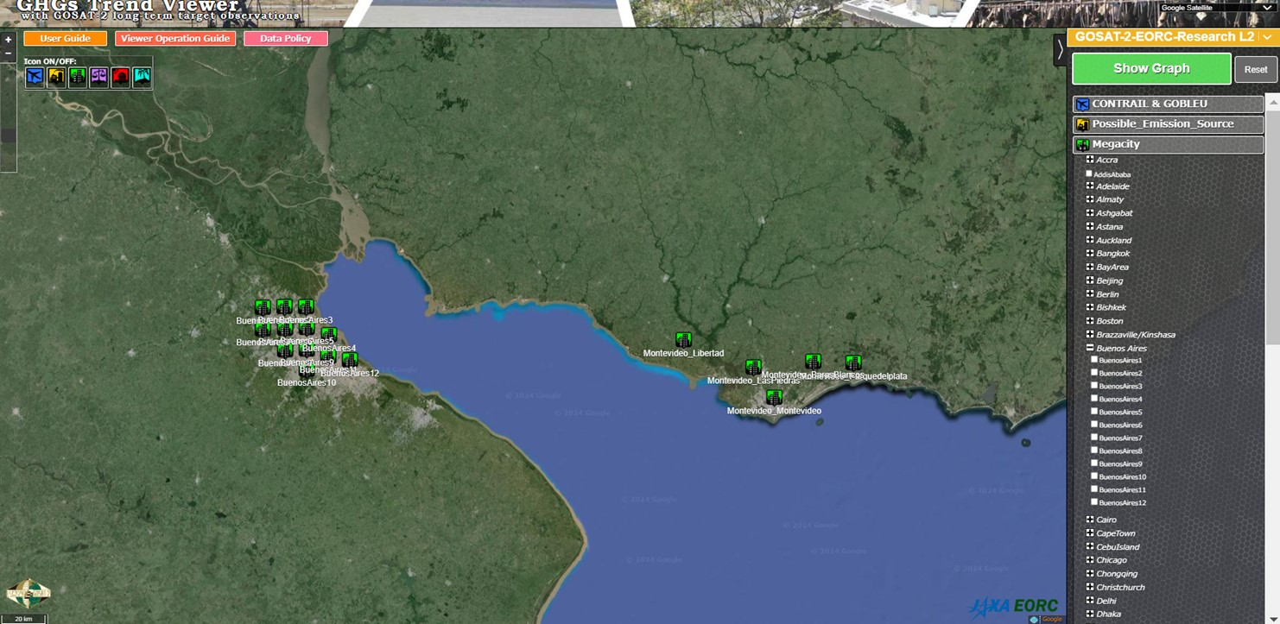
Buenos Aires GHG by GOSAT-2
https://www.eorc.jaxa.jp/GOSAT/CO2_monitor/index_Ver.K.G2.html

Slide 3
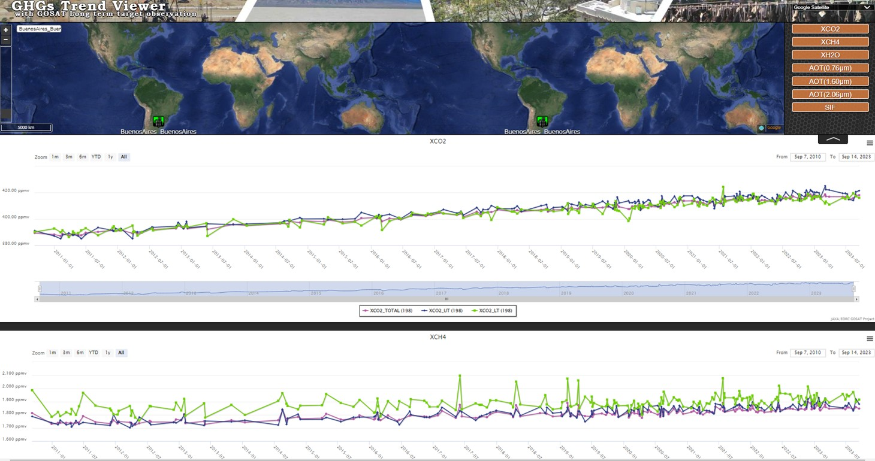
Downtown Buenos Aires CO2 and CH4 Long term by GOSAT
Light Green
Lower troposphere
Dark Blue
Upper troposphere
Light Red
Total column
Upper: CO2
Lower: CH4

Slide 4
Topics
Joint Cal/Val Campaign meeting for OCO-TROPOMI-TEMPO-GOSAT (Jan. 19, 2024）
2023 campaign results
Uncertainty in vicarious calibration
Solar and lunar calibration high spectral resolution data set
B. GHG match-up database – GOSAT, GOSAT-2 AIRS, IASI, CrIS Match ups
Math up dataset with SNO (nadir) and 2O- SONO (off nadir)
Simultaneous nadir overpasses (SNOs)
2-orthogonal simultaneous off-nadir overpass (2O-SONO)
(2) Double Difference Method using the common target

Slide 5
A. RRV Vicarious calibration
Summary of TROPOMI-OCO-GOSAT calibration meeting (Jan. 19)
Long term L1B using prelaunch vs forward calculation with a common RT model with RRV campaign data using 5 different footprints of GOSAT, GOSAT-2,OCO-2, OCO-3 and TROPOMI with viewing geometry and IFOV correction
Uncertainties Estimation toward seamless multi-sensor and long-term data set
Investigate the difference of 5% in OCO-2 between JPL and GOSAT team analysis
BRDF correction error
Long term stability (RRV2023 shows large change in forward viewing geometry)
Geometry correction error (forward and backward reflection)
Large off-nadir angle correction (especially for OCO-3, TROPOMI)
Polarization (sensitivity 2—5% estimated from RRV2023, should be updated in RRV2024 campaign)
3. Recommendation of geometry and data selection for vicarious calibration

Slide 6
A. Solar and Lunar Calibration products
1. Request by the TSIS team
The TSIS team is interested in long term and high spectral resolution data from solar calibration by GHG spectrometers
2. Lunar Calibration WS at EUMETSAT in Dec. 2023
GOSAT-2 lunar calibration presentation
Deviation of the absolute radiometric calibration from the lunar model it too large.
Request for Hight spectral resolution data and TIR data by GOSAT and GOSAT-2 (no TIR data were acquired yet to avoid operation risk)
3. Long term and analysis ready GOSAT solar calibration data

Slide 7
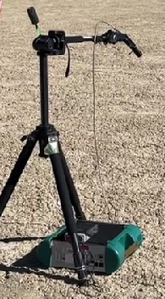
A. Plan for 2024 joint
Vicarious Calibration Campaign
16th Joint Vicarious Calibration Campaign June 12-17, 2024
June 14 (TROPOMI nadir (8.1 deg) , OCO-2, GOSAT)
June 16 (TROPOMI off nadir (46.3 deg), OCO-2, GOSAT, GOSAT-2)
2. OCO-3 becomes ready from the storage and after initial check
3. Estimate uncertainties
Update polarization sensitivity of the playa surface
4. Add TEMPO near O₂-A (POC: Xiong Liu, Harvard Smithsonian)
Spectral range: 290–740 nm (UV, VIS); spectral sampling: 0.2 nm; spectral resolution: 0.6 nm

Slide 8
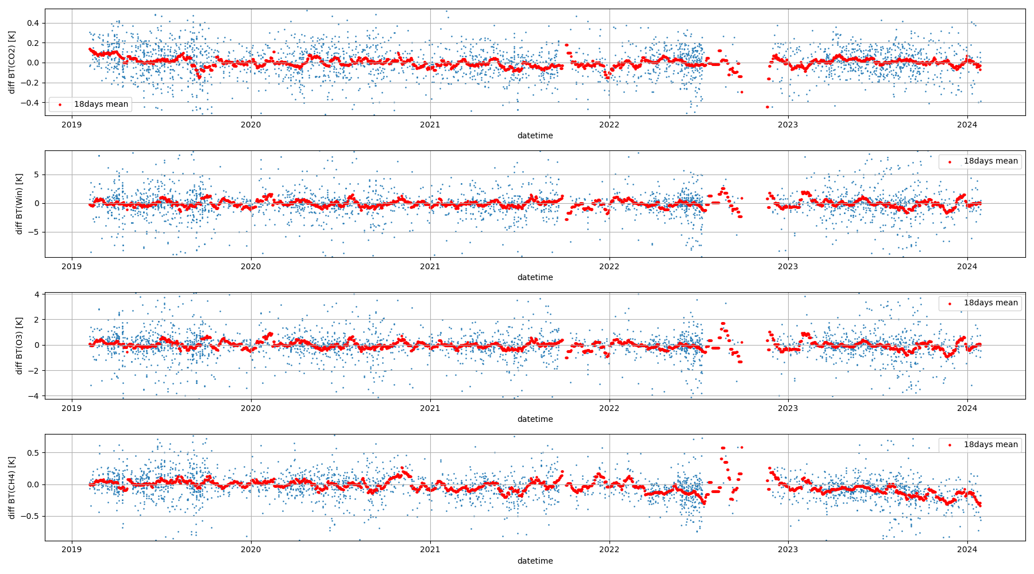
B. GHG match-up database (nadir)
SNO match up data set
SNO match ups dataset collaborating with SSEC, U of Wisconsin
GOSAT GOSAT-2
AIRS
(to be replaced by NOAA-20, 21 CrIS)
IASI
Long term (5 year)
GOSAT-2 IASI SNO
CO₂: 681.99-691.66 cm⁻¹
Window: 900.31-903.78 cm⁻¹
O₃ : 1030.08-1039.69 cm⁻¹
CH₄: 1304-1306 cm⁻¹
GOSAT2 - IASI (2019～2023) distance <100km, |lat| < 2deg, |SAT zenith| < 2deg, |GOSAT-2 AT| < 2deg

Slide 9
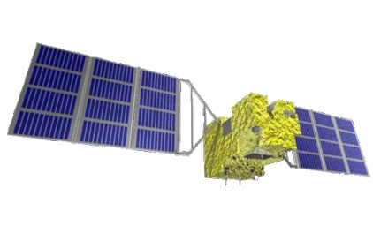
B. GHG match-up database (off-nadir)
Needs for 2O-SONOs
2-orthogonal simultaneous off-nadir overpass (2O-SONO)
GOSAT and GOSAT-2 have 2-axis pointing capability improve targeting GHG emission points such as mega cities.
TIR needs frequent calibration but only 1-axis rotation for calibration
Demonstrates AT vs CT Cross-Calibration
GOSAT
AT angle
Ascending
AIRS
Scan angle (+)
Descending
Suto et al., Atmos. Meas. Tech 2022

Slide 10
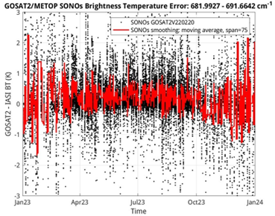
B. GHG match-up database (off-nadir)
SONO match up data set
Long term (5 year) GOSAT-2 IASI SONO
CO₂ 682-692 cm⁻¹
+Y(pitch)
North
G2 swath
IASI swath
G2 AT>0
SNO
IASI=0deg
G2=0deg
NH
Lat=81deg
G2 AT<0
Lat=74deg
SONO
IASI= -38degCT
G2= -38degAT
09:30
13:00

Slide 11
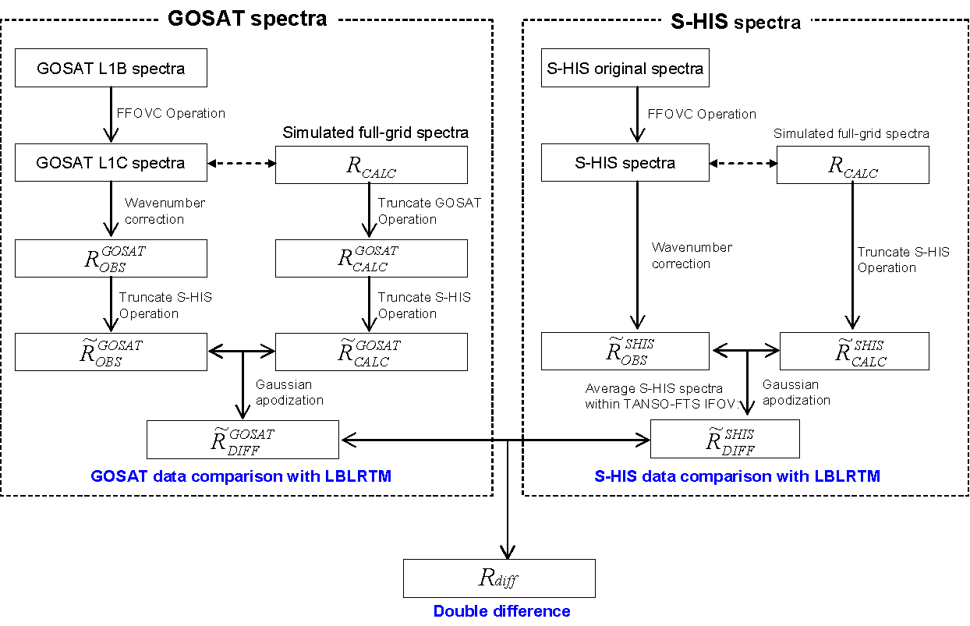
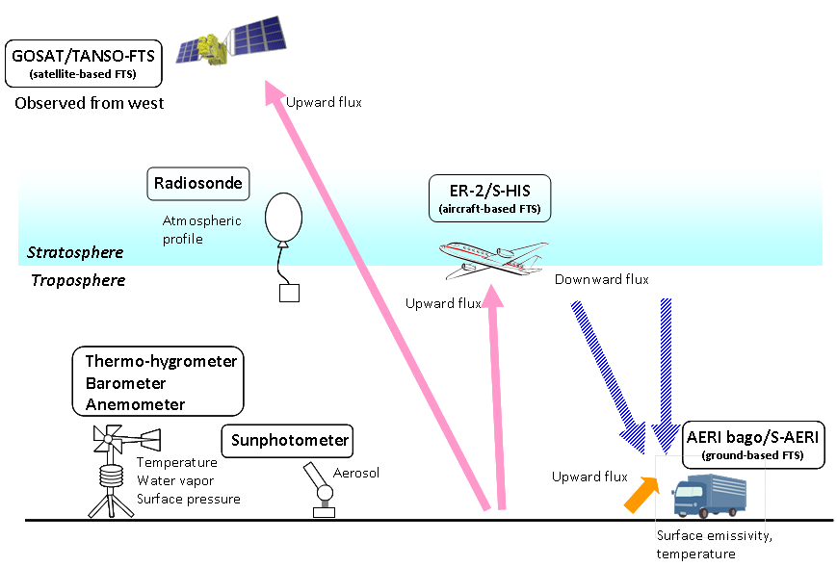
B. GHG match-up database (off-nadir)
Double Difference X-CAL
Double Difference =
((Measured by A) – (Simulation for A)) - ((Measured by B) – (Simulation for B)) -
To minimize the caused by due to geometry difference, radiative Double
Ground data can reduce uncertainties
Kataoka et al., TGRS 2014

Slide 12
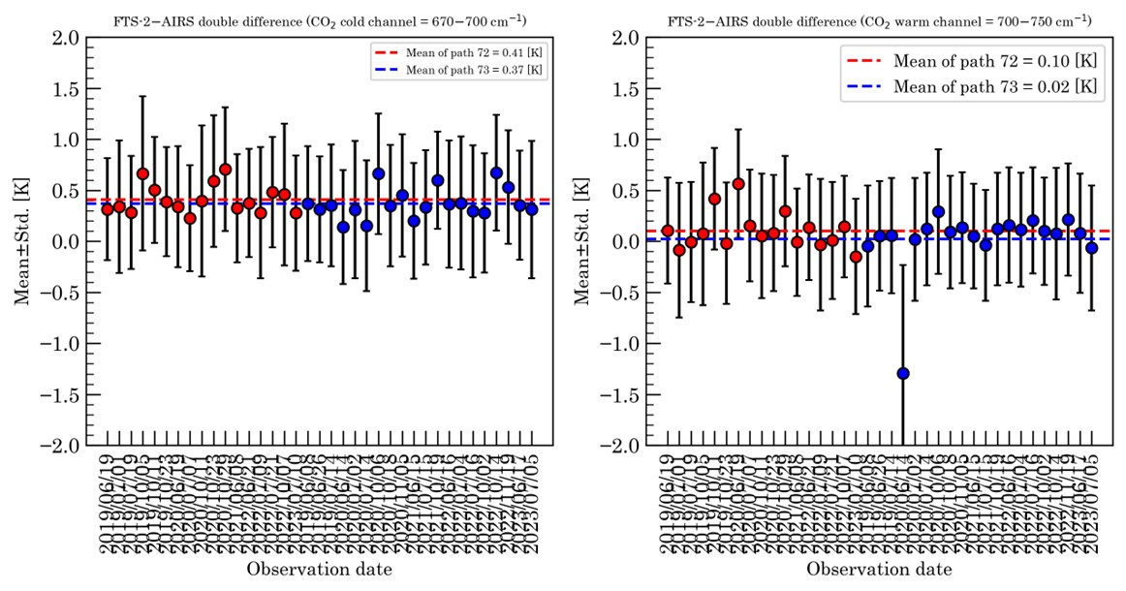
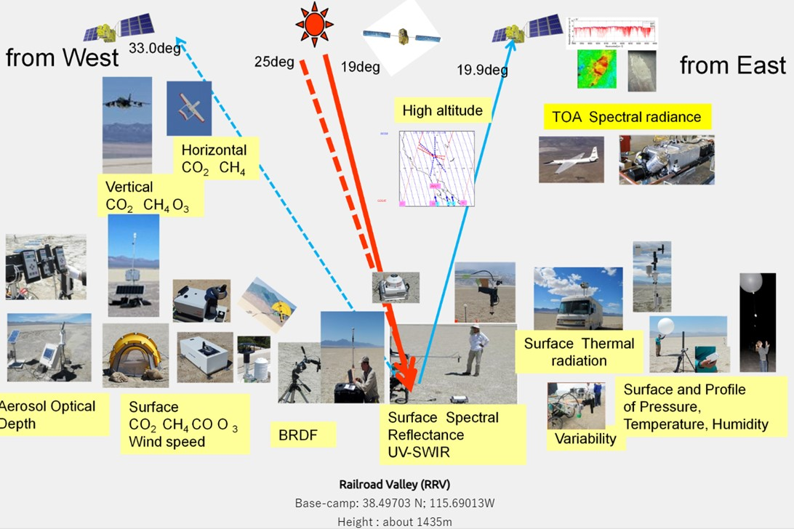
B. GHG match-up database (off-nadir)
Double Difference X-CAL over RRV site
Multiple sensors observe RRV calibration site from different geometries.
Surface reflectance, BRDF, Emissivity are available.
Double difference approach will minimize the bias due to different geometry

Slide 13
B. GHG match-up database Double
Long term & high spectral resolution data will be available from GHG Cal site

Slide 14
Presenter Guidelines 1
Presenters should name their file using the following convention:
AgendaItemNumber_LastName_Subject_Version (e.g., 1.1_Goryl_WGCV-53_Welcome_v1)
Documents and presentations should be uploaded to the shared folder to allow for streamlined self service
Shared Presentation Folder (default view only, ask for upload/edit permission as required)
For support contact riza@symbioscomms.com or matthew@symbioscomms.com
Documents for endorsement should be submitted by 20 Feb
Documents (for information only) and Presentations should be submitted by 27 Feb
Reporting to engage discussion or decision is encouraged, but detailed reporting should be provided as pre-meeting reading material or in background slides.
Meeting website: https://ceos.org/meetings/wgcv-53/
Slide ‹#›

