Slide 1
WGCV-53
Atmospheric Composition
Sub Group (ACSG)
Jean-Christopher Lambert
BIRA-IASB
Agenda Item 1.7
WGCV-53, Córdoba, Argentina
5th - 8th March 2024

Slide 2
Atmospheric Composition Updates
Aerosols and clouds profile validation protocol CV-22-01
Ongoing ACSG & AC-VC coordination
  AC-VC-19/ACSG Joint Meeting 2023
  Update on GHG Cal/Val
  Tropospheric ozone harmonization and validation VC-20-01
  Air Quality Constellation validation VC-20-02/03/04
Ground-based Network Design and Evolution
Initial maturity assessments
  CEOS-FRM maturity CV-23-01
  EDAP product maturity
New activity: CINDI-3 CV-24-01

Slide 3
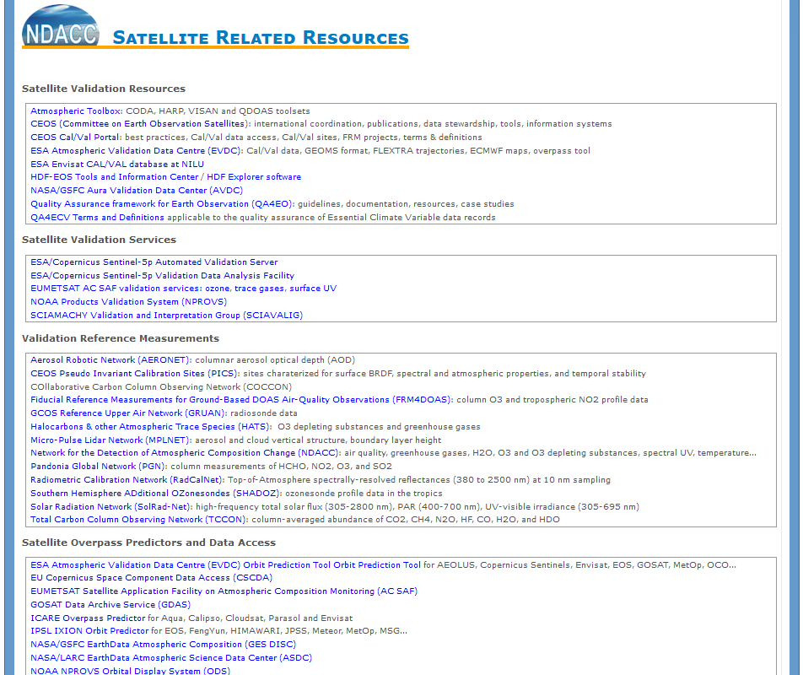
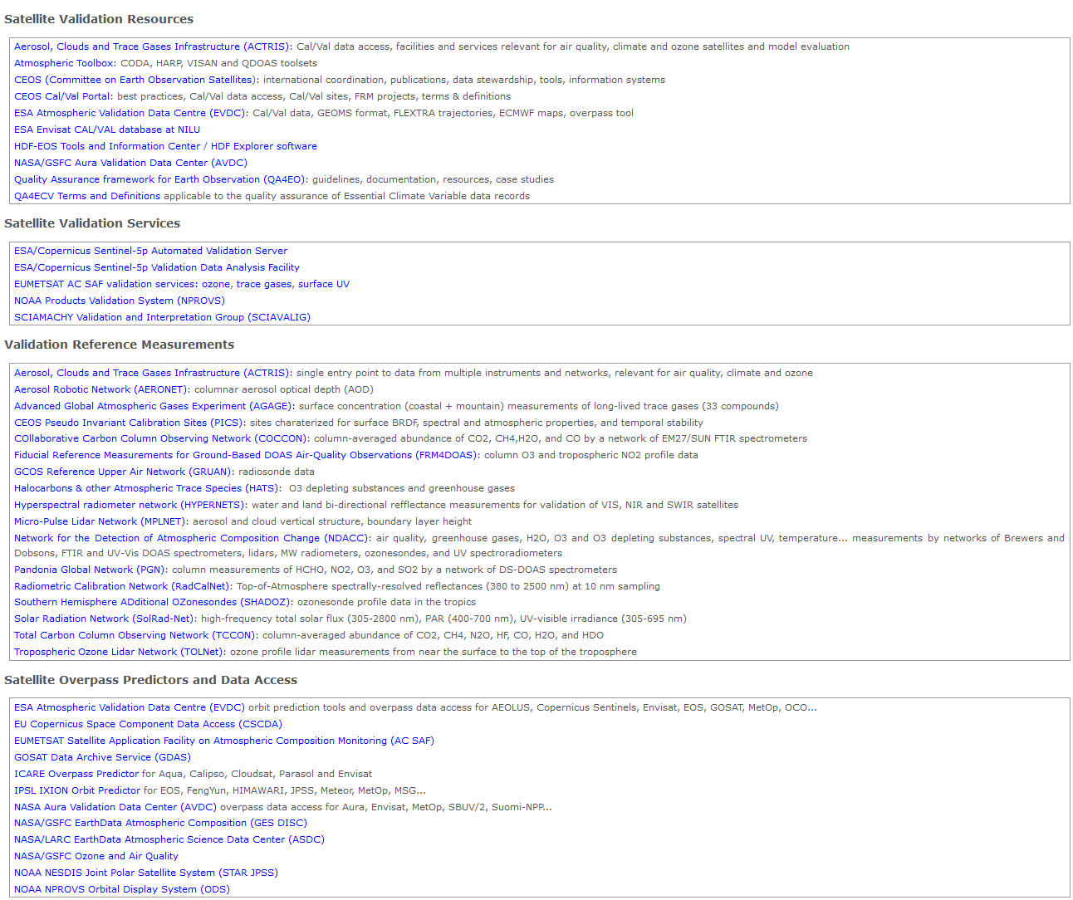
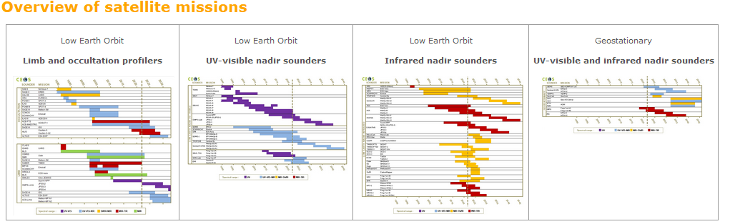
Synergies Cal/Val Portal and NDACC Satellite Website
NDACC Satellite WG website
  Overview of atmospheric trace gases satellite missions
  Satellite validation resources and services, reference data, overpass predictors…
  News on AOs, Campaigns (e.g., CINDI-3)…
Exchanges with CEOS Cal/Val Portal
access via main website https://ndacc.org
and https://accsatellites.aeronomie.be

Slide 4
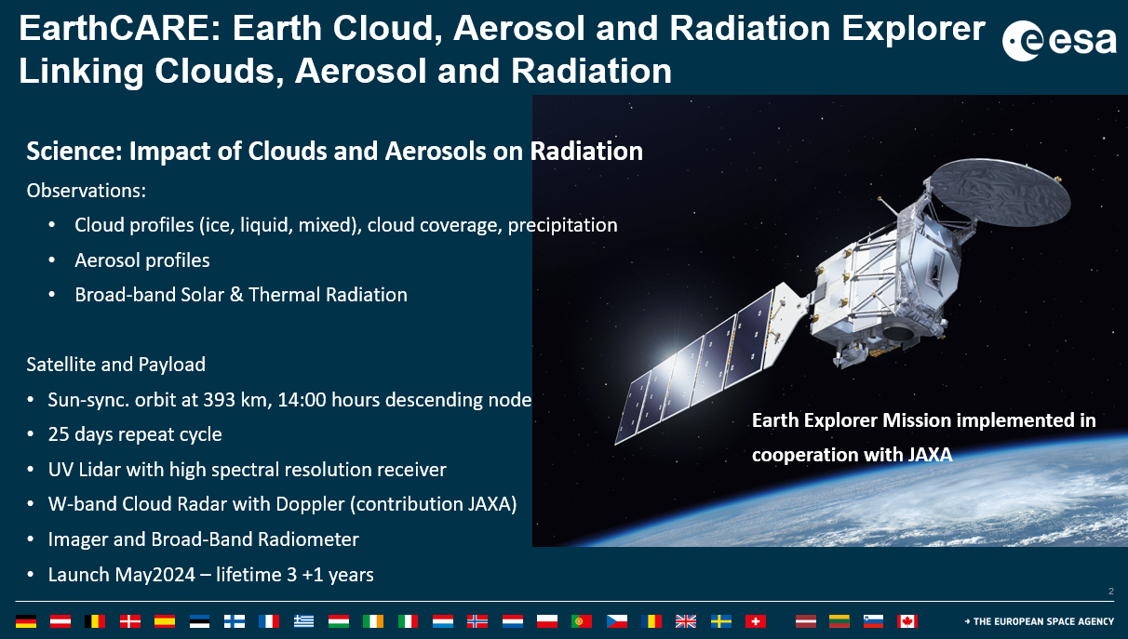
Cloud/Aerosol Profile Validation Protocol
CV-22-01

Slide 5
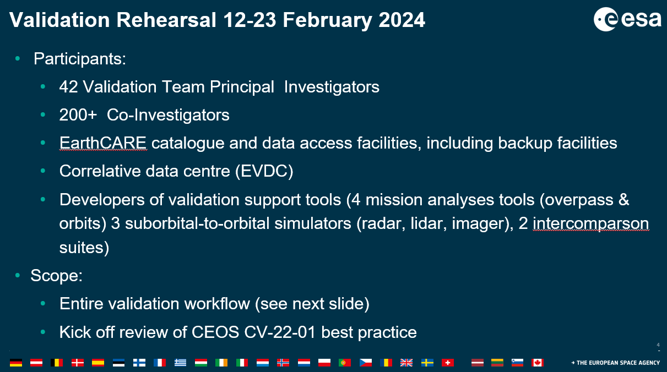
Cloud/Aerosol Profile Validation Protocol
CV-22-01

Slide 6
EarthCARE rehearsal: First results
Feedback from R. Koopman (ESA), CV-22-01 activity lead
Just before the rehearsal: last-minute changes to facilities:
  migration of collaboration portal, long process completed just in time for rehearsal
  workaround using test instance of registration interface
  Validation data centre user interface recovering from international cloud provider anomaly
All facilities functional (some with workaround) by start of rehearsal
Full repeat cycle of similated EarthCARE data made available
Principal and Co-Investigator takeup initially slow but ramping up progressively – large range in extent of rehearsal participation: from zero response to succesful actual collocated correlative observations converted to GEOMS format and uploaded to EVDC validation centre
Online Archive reports 10,000 downloads of EarthCARE simulated data by 74 unique users
Validation data centre full report (correlative data statistics) not yet available, but strong progression noted, especially with data conversion to GEOMS.
Discussion forum visited by 100 users
User questionaires due 7 March but initial feedback is generally positive on support services and helpdesks, some difficulties with registration and bulk download.

Slide 7
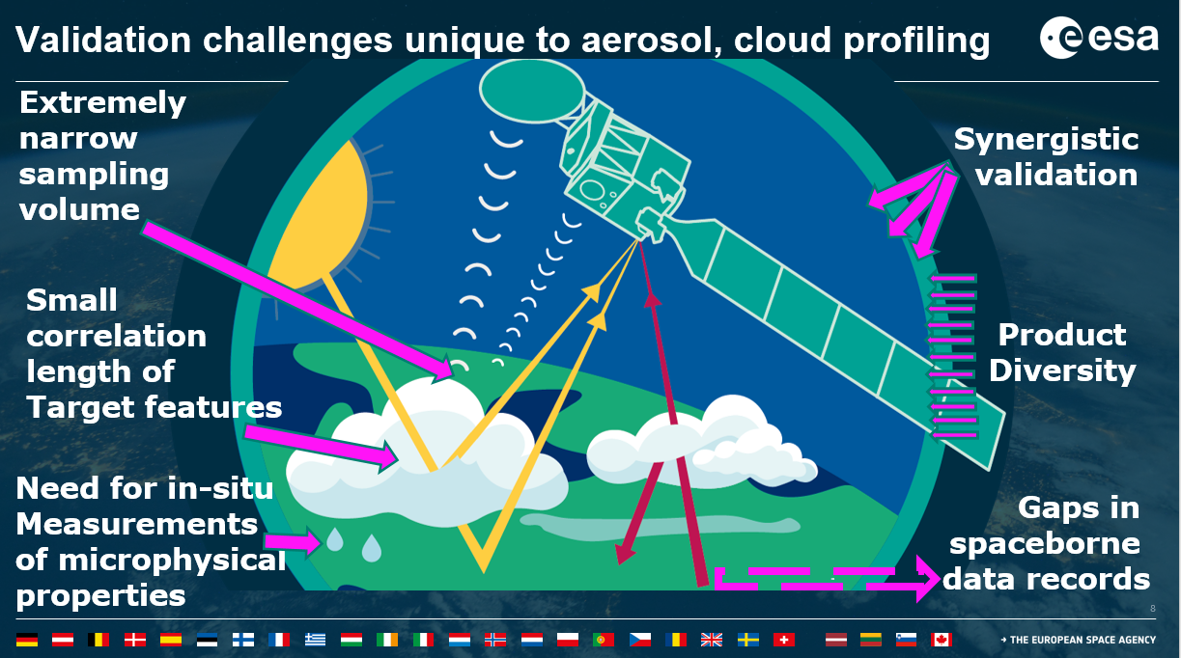
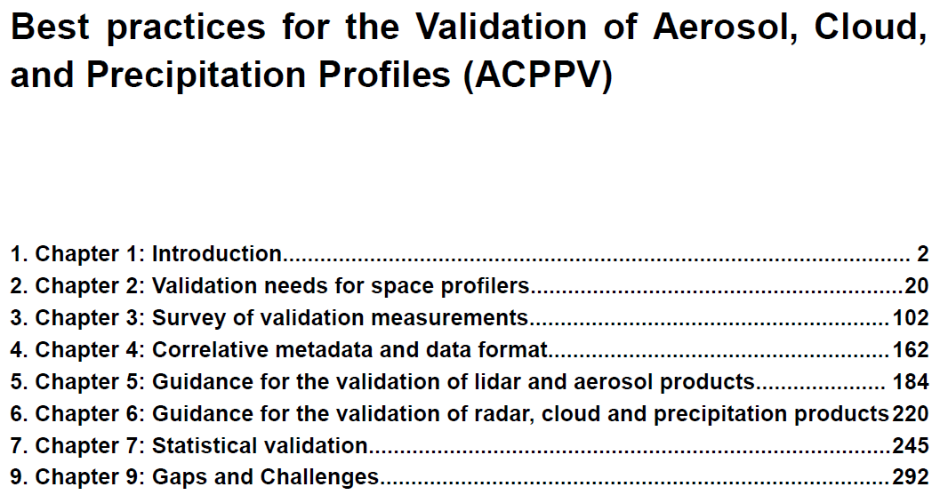
CV-22-01 – Cloud/aerosol validation protocol

Slide 8
Cloud/Aerosol Profile Validation Protocol
Broad community-led effort: participation of scientists from AOS Sub-Orbital Working Group and past and present missions, Aeolus and EarthCARE Validation Teams, and further scientists through JAXA and EUMETSAT
Involvement of space agencies: ESA, NASA, JAXA, EUMETSAT
CV-22-01
First draft for broad review delivered Feb. 14 to EarthCARE Validation Team (300+). Includes preliminary versions of the supporting tools, for suborbital-to-orbital level-1 simulation (lidar, radar, imager).
Studies on open issues ongoing in parallel to review (in particular spatiotemporal variabilities)
CEOS-ready version on track for delivery by April 2024.

Slide 9
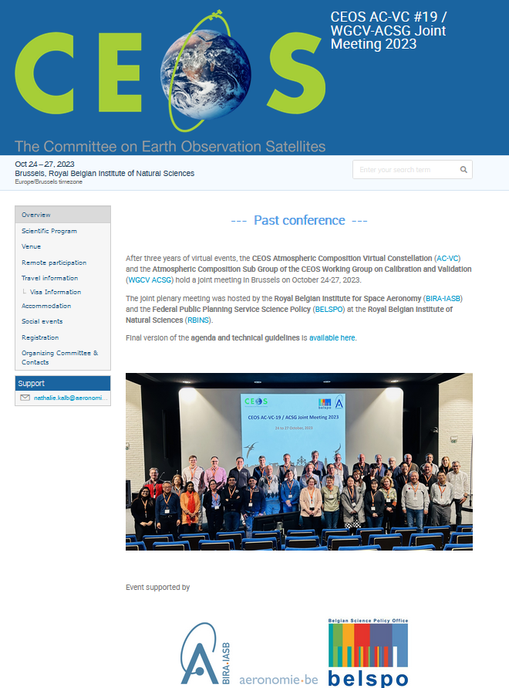
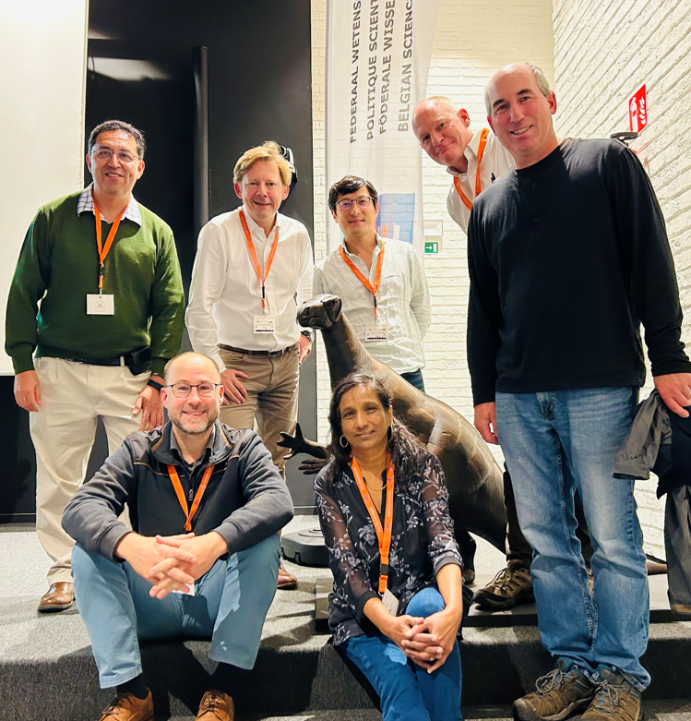
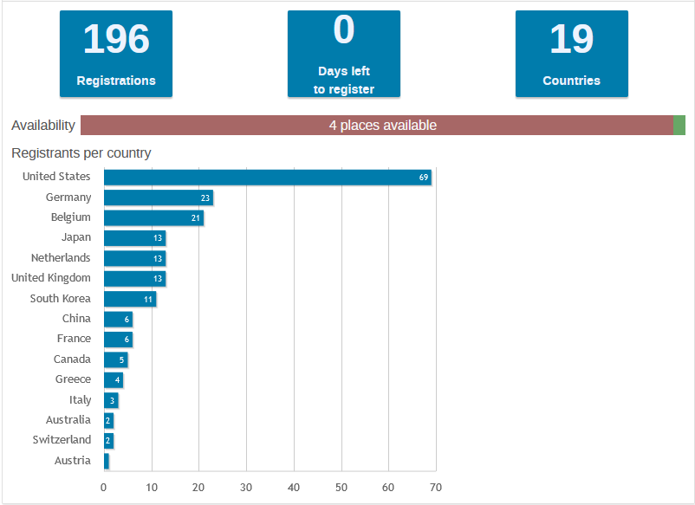
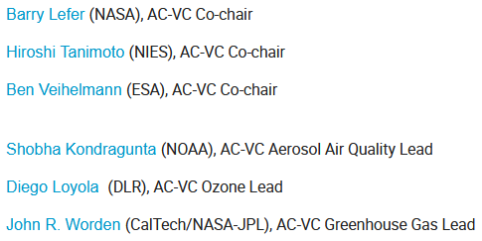
ACSG & AC-VC Collaboration
AC-VC-19 and ACSG Joint Meeting 2023, Brussels, Belgium, October 24-27
Event website
https://events.spacepole.be/event/126/
CEOS archive with presentations
https://ceos.org/meetings/ac-vc-19-acsg-joint-meeting-2023/
Overview of International Participation (Hybrid Set-up)

Slide 10
ACSG & AC-VC Collaboration
AC-VC-19 and ACSG Joint Meeting 2023
Themes
Greenhouse Gases
Trace Gases and Aerosols - Air Quality
Cal/Val for the Constellations
  Generic, CEOS activities, point-source (New Space), L1 calibration, panel
Ozone
Data Assimilation, Link with Policy
Emerging AC-VC Topics, Reflections on Activities
Cal/Val related discussions in every session

Slide 11
Joint meeting: Generic recommendations
To pursue FRM maturity assessment of the ground-based network data; accordingly, to improve FRM maturity and fitness-for-purpose for the relevant classes of sounders and products, in particular by harmonizing measurement procedures and implementing (central) processing, building on coordination by space agencies with ground-based instrument operators and network managers.
To elaborate strategies to optimize locations of FRM measurements and to characterise and handle their differences in spatio-temporal scales and smoothing w.r.t. satellite data.
To add and maintain FRM stations in under-sampled regions of the globe such as tropics, oceans, desert, and large parts of the Southern hemisphere.
To develop concepts and strategies for Cal/Val supersites having measurement capabilities not only for the target data product but also for the influence quantities and ancillary parameters needed to improve the retrieval (vertical profile of the target species and of temperature, aerosols, albedo, BRDF, 2D variability…)
To pursue the selection and processing of constellation data products and to plan accordingly their validation (Geo-AQ whitepaper Recommendation 5).
To compile a catalogue of Cal/Val resources for the atmospheric constellations inspired by the model recently developed for the Hyperspectral Cal/Val Resources document.

Slide 12
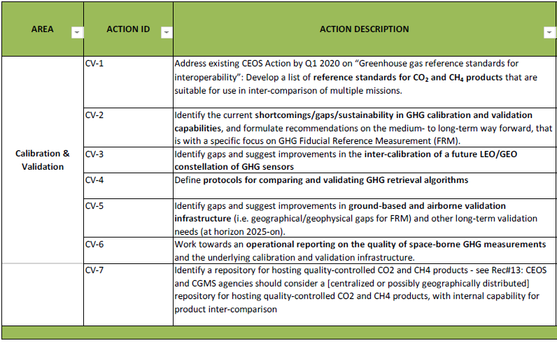
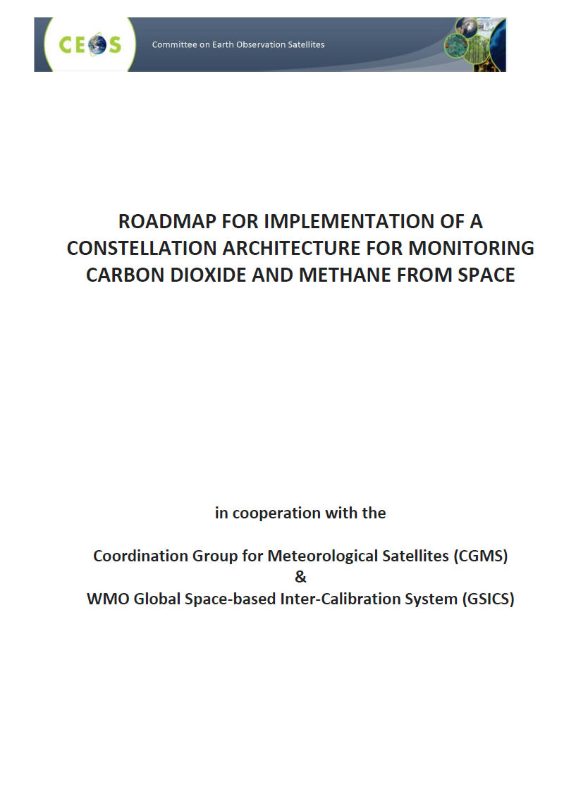
Joint meeting: GHG Constellation
GHG constellation roadmap – Annex C: Implementations actions – Calibration & Validation
Next step:
Update of Annex C
v2.3, March 2020
Update in progress

Slide 13
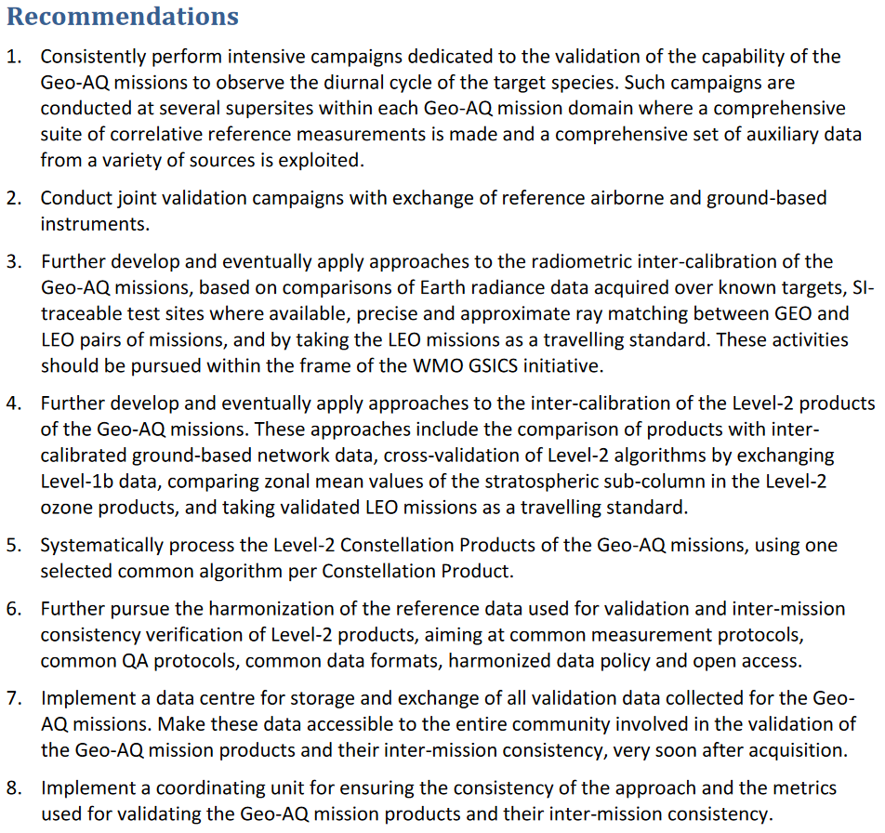
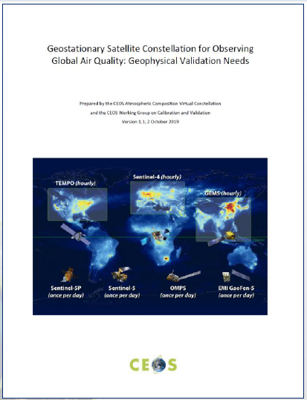
Joint meeting: Air Quality Constellation
Next step:
gap analysis & roadmap

Slide 14

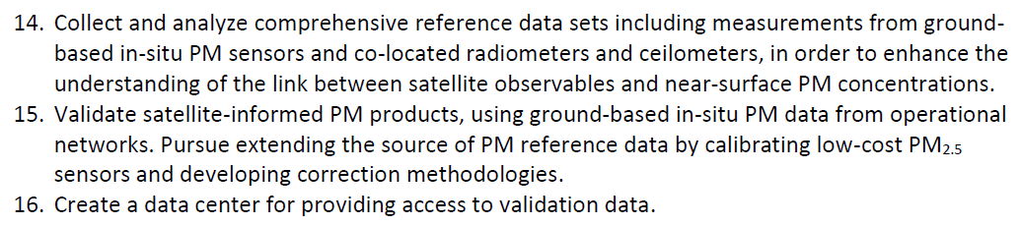
Joint meeting: AQ PM 2.5 Constellation
Whitepaper “Monitoring Surface PM2.5” (VC-20-05) endorsed at plenary 2022
Cal/Val related recommendations:
Next steps: Cal/Val needs → roadmap

Slide 15
Update on GHG Cal/Val
GHG-TT, ESRIN/Hybrid (2023/10) / Cal/Val Session
  Presentations by A. Kuze, J.-C. Lambert & T. Marbach + discussions
  WGCV-52 action resulted in eight actionable recommendations for GHG Cal/Val networks fitness-for-purpose and sustainability
  Need for Cal/Val over oceans
  Need to identify concrete criteria for deploying new sites
  Need for super-sites to advance accuracy of products and Cal/Val
  Airborne support highly valuable. Include in RRV campaigns?
GHG Cal/Val discussions at AC-VC-19/ACSG joint meeting (2023/10)
IMEO Cal/Val Testing WG: meetings and TN
Next GHG-TT meeting: March 11, 2024
Details in WGCV-53/3.6 GHG Cal/Val session on Thursday

Slide 16
Update on Air Quality Constellation
Cal/Val coordination (VC-20-02), plans (VC-20-03), Announcements of Opportunities (VC-20-04)
  GEMS AO (issued 2018) → Cal/Val activities with international participation; KORUS-AQ campaigns, cross-validations, PEGASOS validation service, Sentinel-4 L2 prototype testing
  TEMPO (launched 7 April 2023), Mission Validation Plan, joint NASA/NOAA science field campaigns contribute to validation
  Joint ESA/EUMETSAT Sentinel-4/-5 AO Call to be issued spring 2024
  Cross-validation with other satellites
Collaboration on ground-based networks, Pandora Asian Network complements Pandonia Global Network, CINDI-3 MAX-DOAS community campaign with participation of other networks
VC-20-02/03/04

Slide 17
Cal/Val Network Design and Evolution
ESA FRM4xxx Programme, EUMETSAT FRM Roadmap & CO2M Cal/Val studies, EUBREWNET, PGN, CO2M/MicroCarb workshop…
ACTRIS Expert Group on Satellite Cal/Val (EG-Sat), ICOS
NDACC Measurement Strategies and Emphases
  Ongoing update of network strategy in view of NDACC Symposium 2025 celebrating 35th anniversary of the network (formerly NDSC, incepted in 1990)
  Peer-reviewed paper in preparation, including satellite validation strategies for NDACC sub-networks and viewpoint of stakeholders (incl. ACSG)
WMO RRR / Statements of Guidance (SoG)
  Statement of Guidance for atmospheric composition Monitoring and Forecasting applications: final version delivered Oct. 2023, under review
  Includes consideration of satellite validation needs (ACSG & AC-VC input)
New initiatives: GGGW, IMEO (see WGCV-53 Th 3.6)

Slide 18
UNEP/IMEO Cal/Val Testing WG
IMEO TN ‘Validation of point-source methane emissions observed from space’
  (1) Need to identify specific needs for Cal/Val of detection, localization and emission quantification from point-source methane imagers.
  (2) Data conventions
    - Need to define critical validation components. Not only validation of CH₄ emissions, but also validation of column-mixing ratio (XCH4), localization, Probability of Detection (POD) and all associated uncertainties under various conditions.
    - Need to define conventions and definitions for understanding the applicability of a given validation method: e.g., Location-blind Detection Limit, Controlled Detection Limit, Uncertainty.
  (3) Validation methodologies specific for point-source methane emissions
    - Controlled release experiments.
    - Other methods: cross-comparisons, non-satellite observations, modeling support.
  (4) Conclusions and recommendations
    - To establish common definitions for key quantities needed to define how point-source methane emissions are validated.
    - To define common standard conditions under which satellite data providers agree to assess their satellite’s performance.
    - Multiple approaches should be taken for validation to cover as many conditions as possible.
⇨ Many links with GHG Roadmap Annex C: Prod-9, Inv-1/2/6/8/9, CV-7…

Slide 19

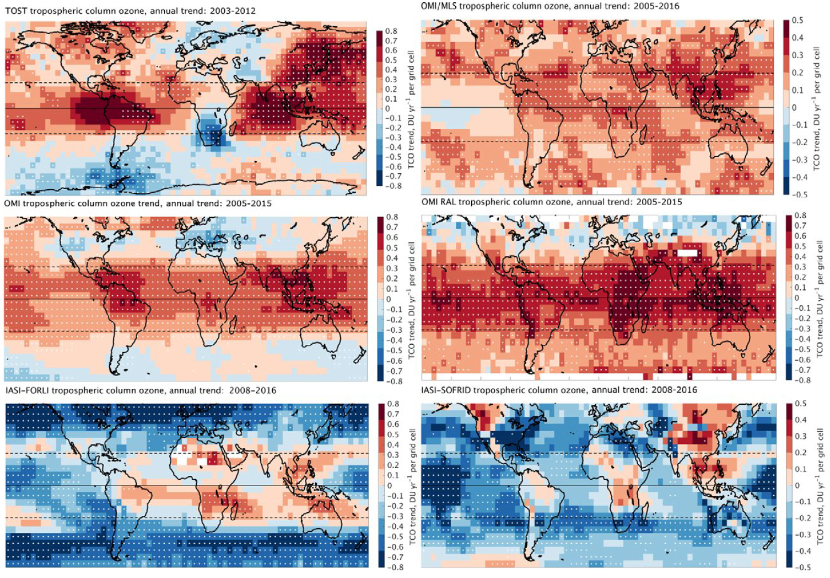
Tropospheric Ozone: Rationale
VC-20-01
IGAC Tropospheric Ozone Assessment Report
Questions from TOAR-I (Gaudel et al., 2018)
Why do measured distributions and trends differ (i) among satellites, and (ii) w.r.t. monitoring networks ?
Differences in vertical sensitivity and sampling, in TP definiition ?
(In)consistencies with TOST (ozonesonde based trajectories) ?
→ TOAR-II Satellite Ozone Working Group
Address above issues
Reconcile satellite-, ground- and aircraft-based data
Global chemistry transport models as transfer standard
Provide common methodology for validation of trends
Tropospheric Ozone Burden
Tropospheric Ozone Annual Trend
→ CEOS VC-20-01 response to IGAC TOAR-II needs
DLR, BIRA-IASB, NASA, ESA, FMI, JPL, KNMI, LISA, RAL, NOAA, U.Busan, ULB…

Slide 20
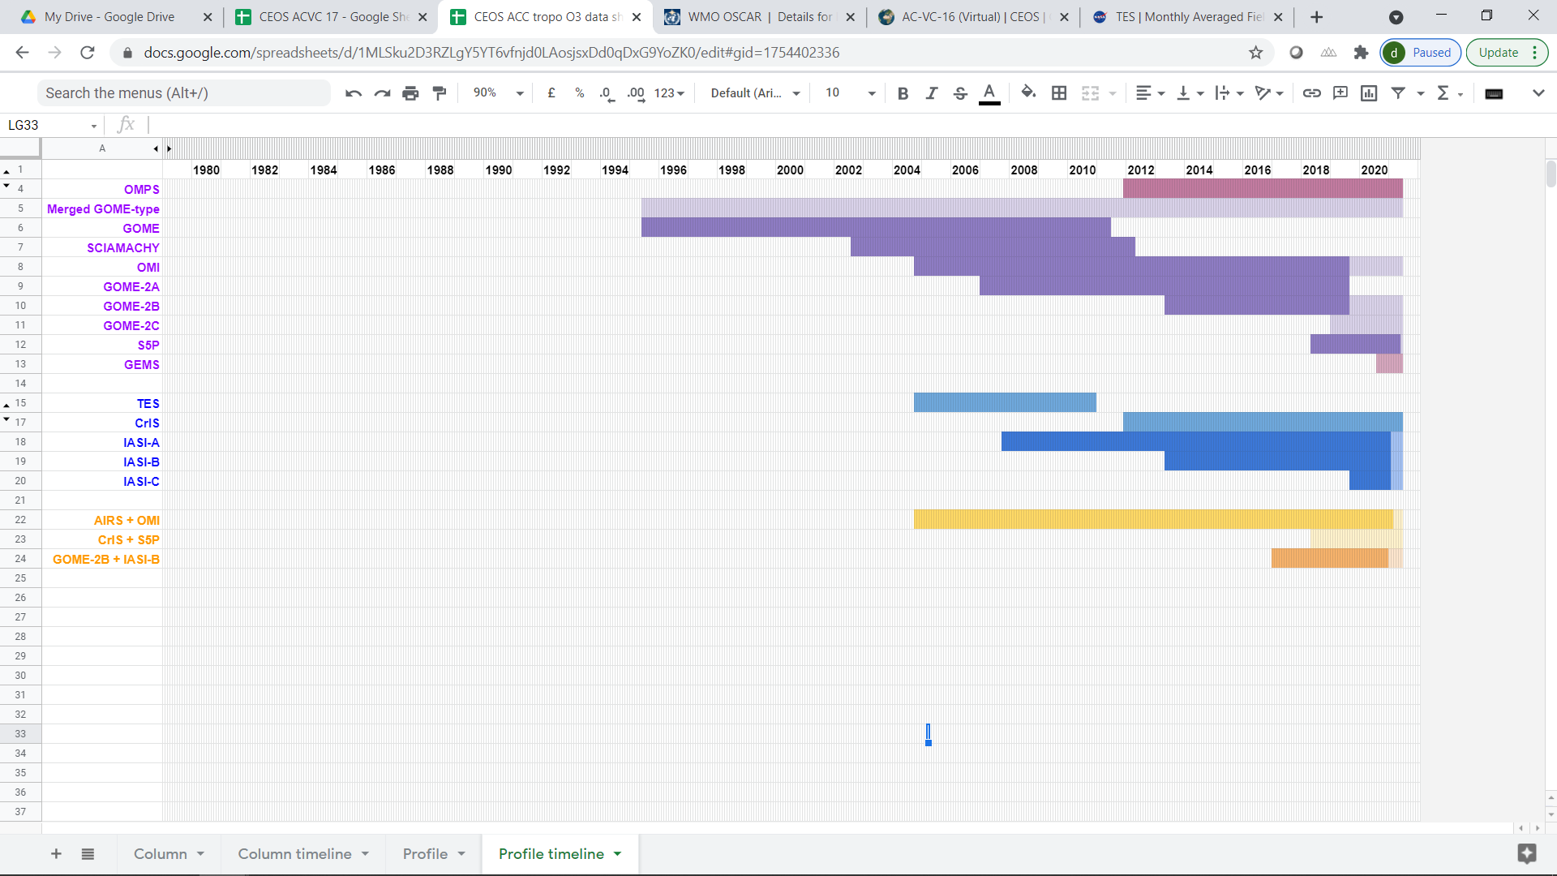
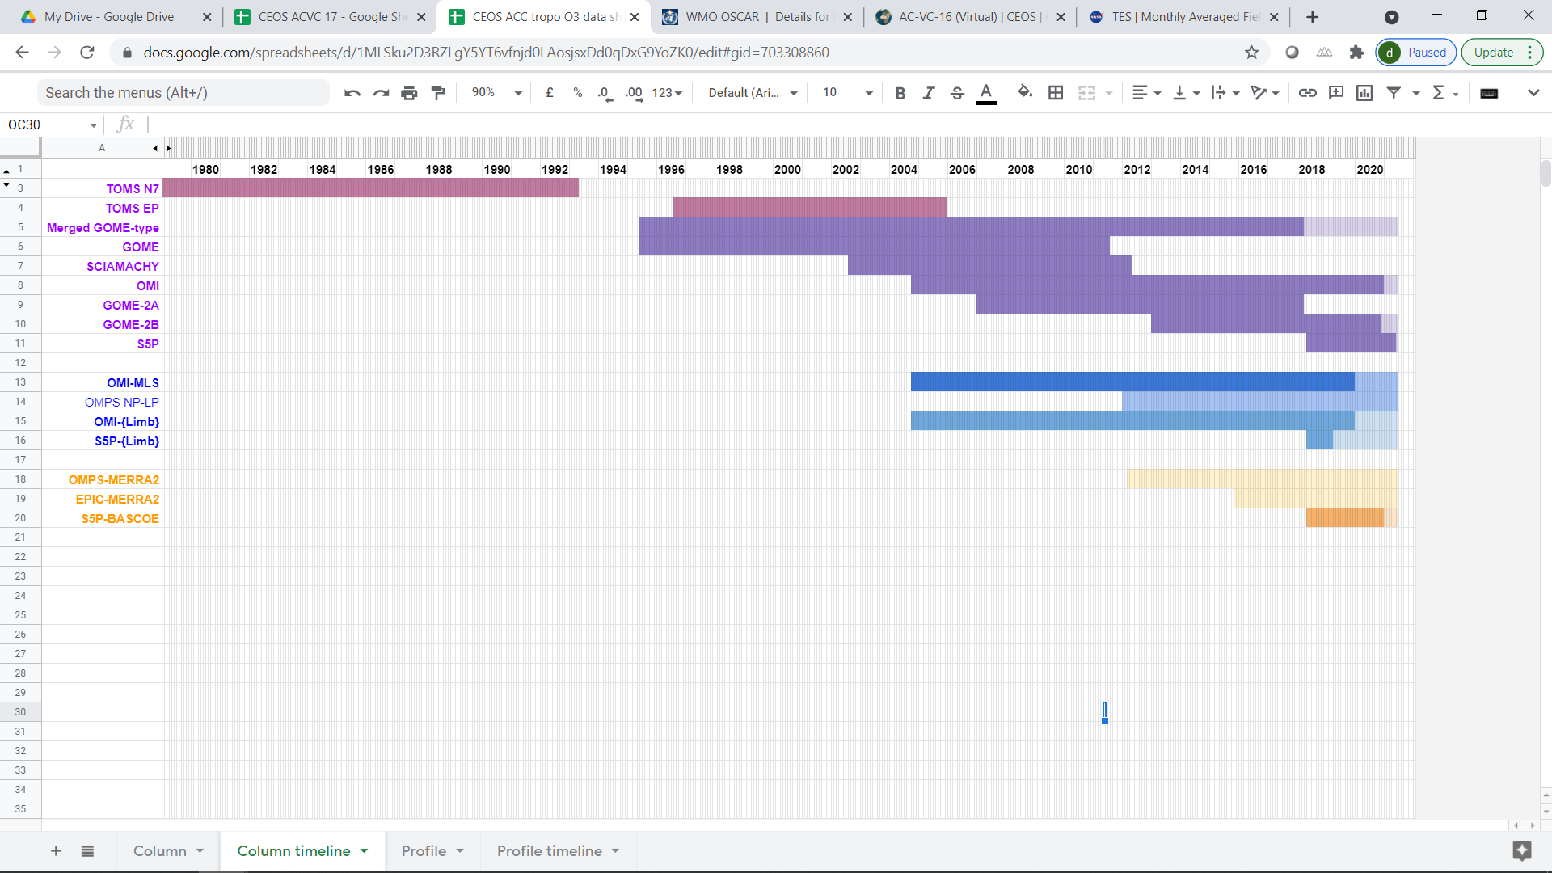
Tropospheric Ozone: Data sets
VC-20-01
Optimal Estimation retrieval
→ vertical profile at pixel level or at pixel-cluster level
UV-VIS
TIR
Synergy UV-VIS+TIR
Residual techniques
→ partial column calculated as difference between total and pseudo-stratospheric columns,
often gridded in time & space
Cloud-free TC minus
above Convective Cloud TC
Nadir TC minus Limb PROF
Nadir TC minus Reanalysis PROF

Slide 21
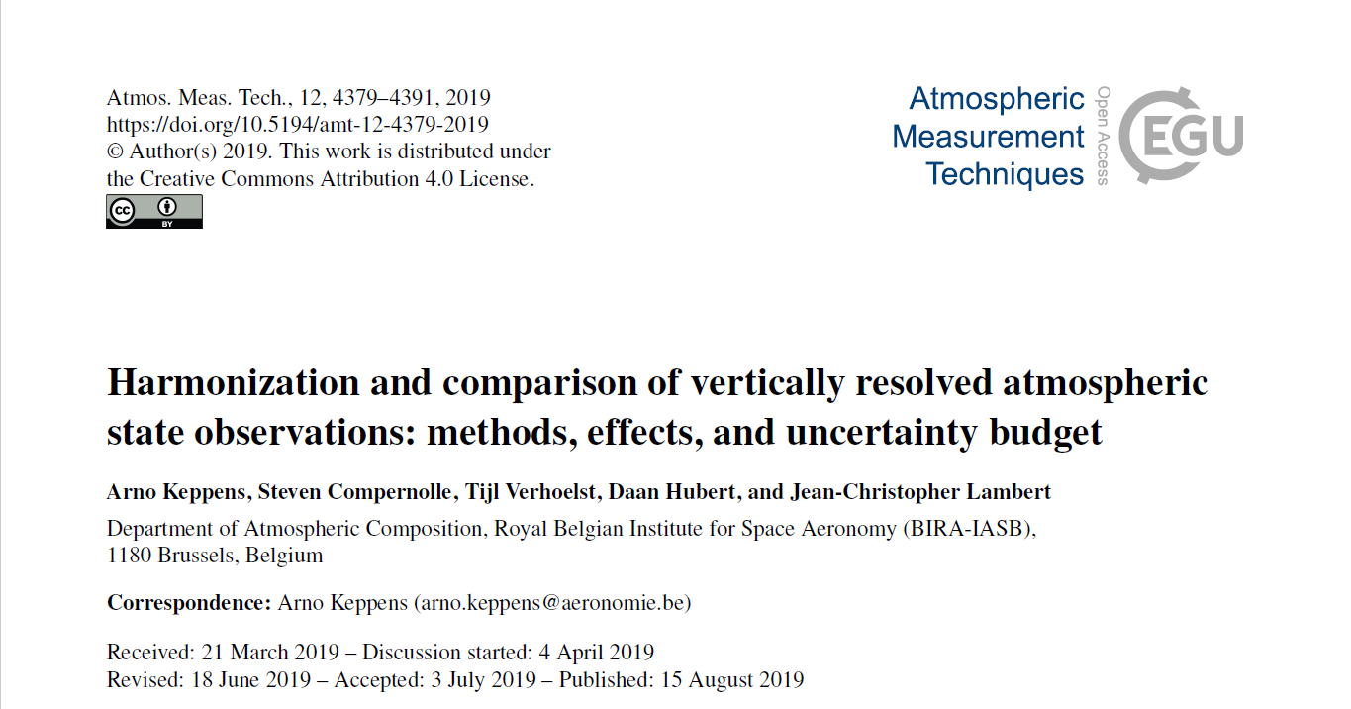
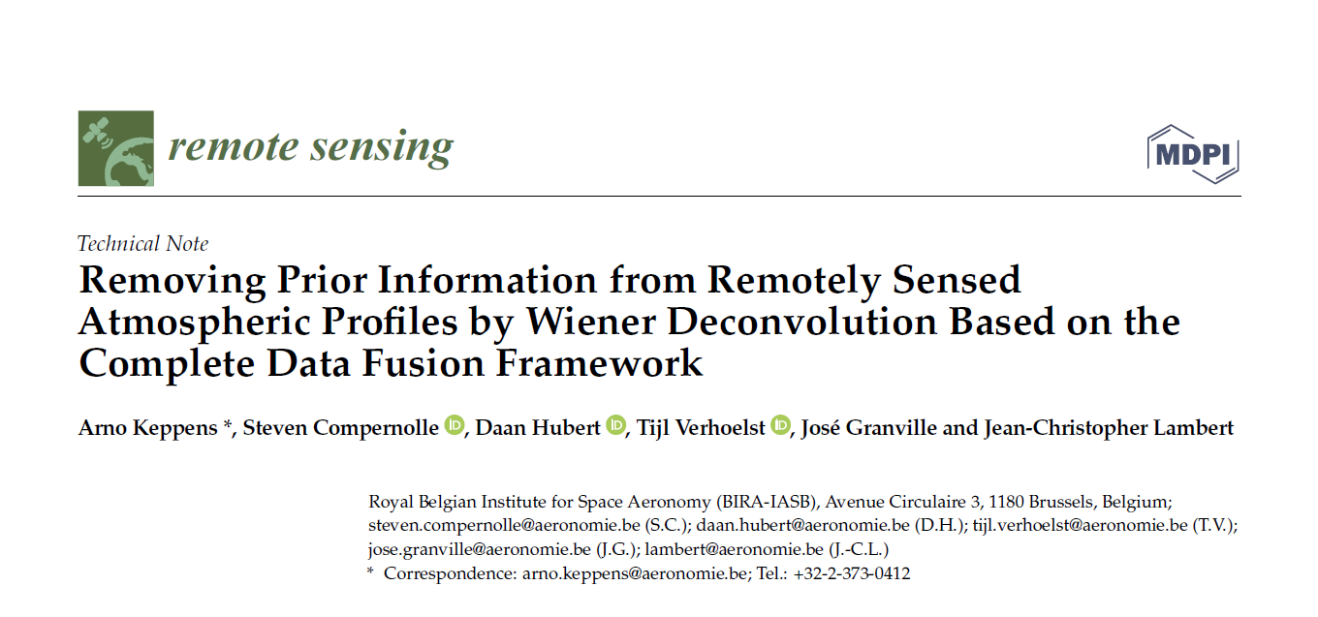
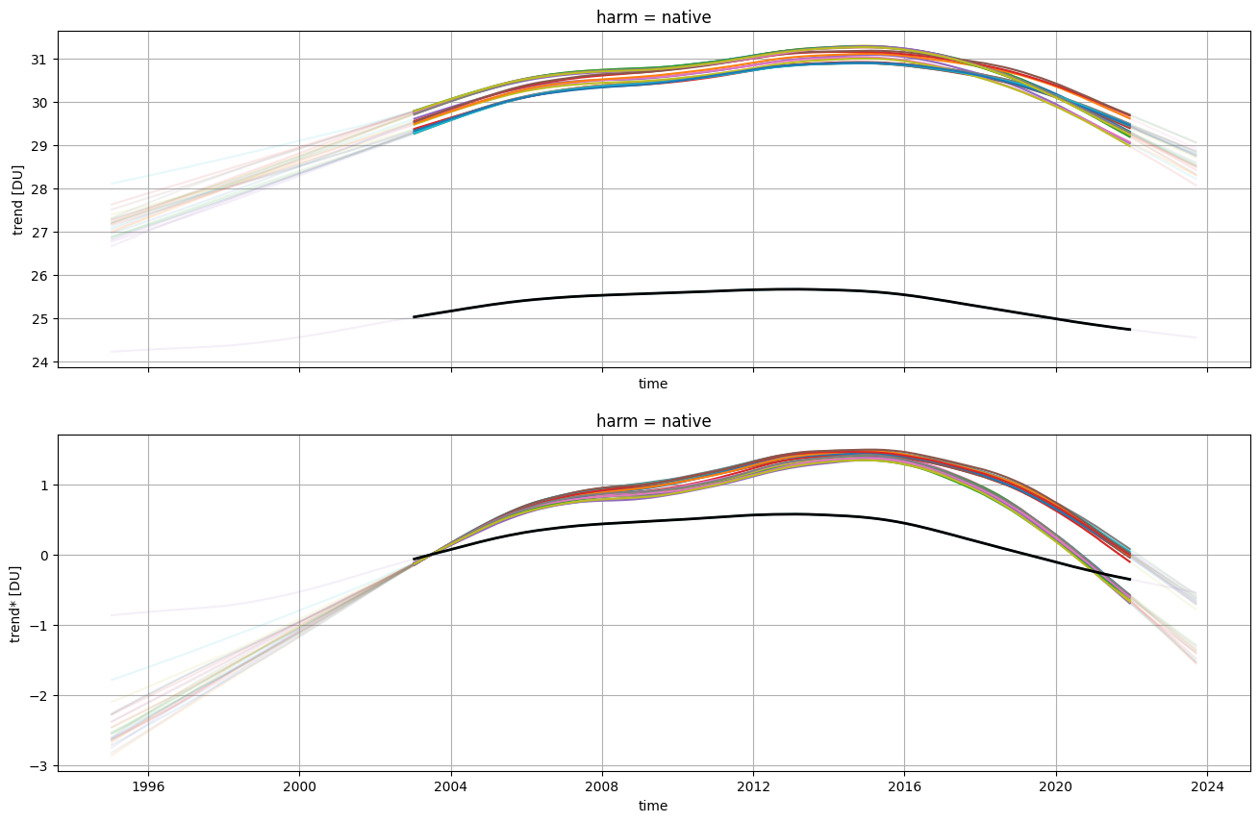
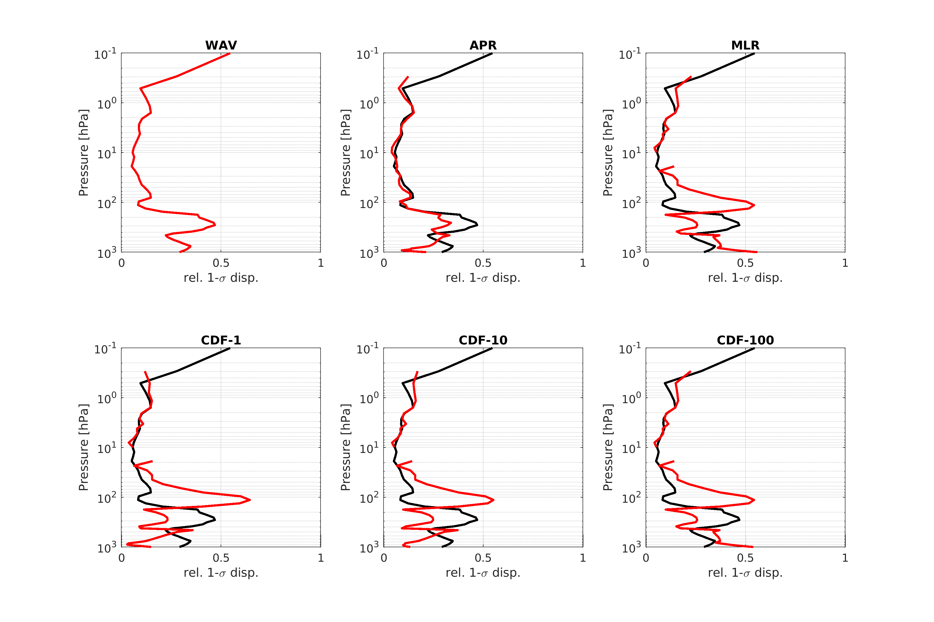
Tropospheric Ozone: Uncertainty
Methods based on previously published results
CAMSRA as transfer standard
Tropospheric top level definition for ~10 residual column products
Prior information for ~10 profile products (based on Complete Data Fusion)
Focus on sensitivity testing for different methods
DLM trend, 1 satellite CDR, 20S-20N mean TrOC [DU]
Colour :
Non-native top level, harmonised in different ways
In this particular example: harmonization changes time structure by <1 DU
(3-4%) and end point by <0.5 DU (1-2%)
↓
TODO : how about other SAT and top levels? Is there spatial structure?
Missing column added from adjusted CAMSRA
Black:
Native top level
DLM trend offset to 2003 mean, 1 satellite CDR, 20S-20N mean
Reduced
dispersion after
prior matching

Slide 22
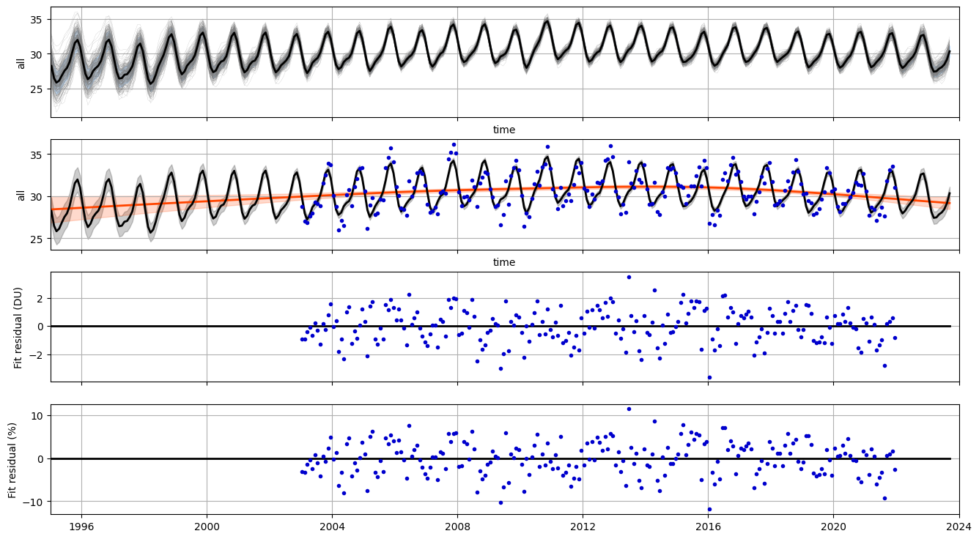
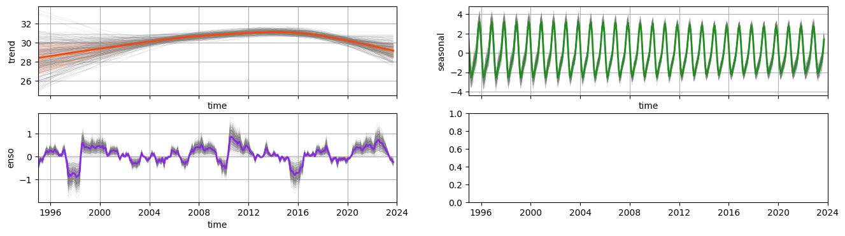
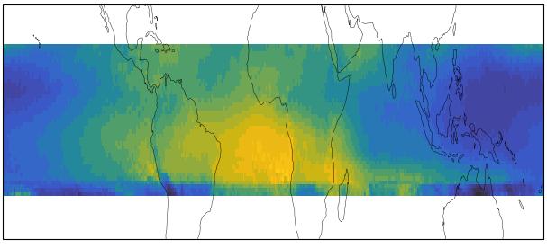
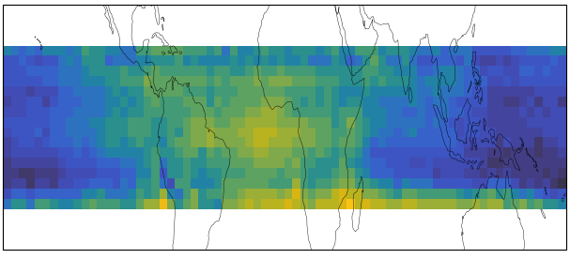
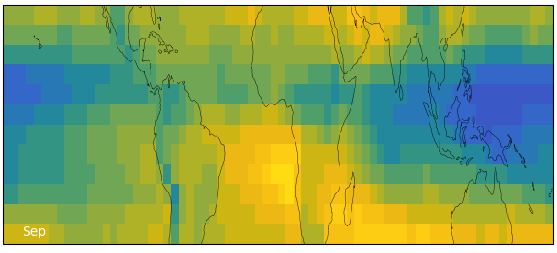
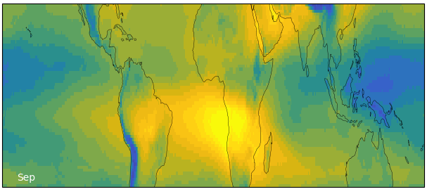
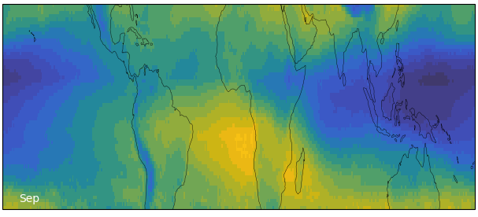
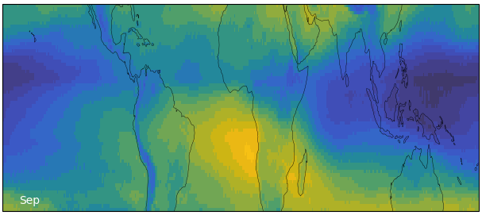
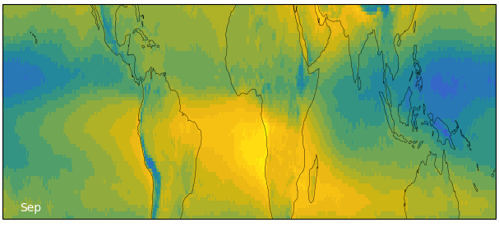
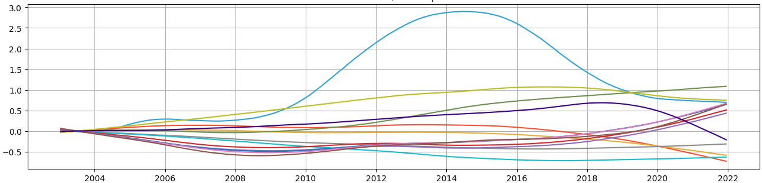
Tropospheric Ozone: Cycles and Trends
Example time series analysis: DLM trend + seasonal + ENSO + …?
TOAR-II status: work ongoing, papers in preparation
Community papers summer 2024, summary papers later 2024/2025
Several satellite-based papers,
one constellation-based assessment paper
Prelim result seasonal cycle for 7 SAT records: September over tropics, 2014-2018 mean
Prelim result trend for ~10 SAT records (20S-20N): harmonised to 450 hPa top level, offset to 2003 mean

Slide 23
FRM maturity assessment framework
2022/09 (NDACC SC 2022): Development of FRM-MAP and Validation Method (MET-MAP) Maturity Assessment Procedures undertaken by NDACC in response to CCVS recommendations.
2023/05 (WGCV-52): Initial evaluation of draft WGCV FRM Assessment Framework Roadmap. Fair convergence with NDACC FRM-MAP although applicability to atmospheric composition products not always obvious and key specificities not considered.
2023/09: Substantial feedback on CEOS-FRM document collected from ACSG and NDACC SC and implemented in GoogleDoc.
2024/02: FRM4DOAS and PGN test cases for CEOS-FRM tool
Reminder: NDACC Satellite WG & Instrument WGs willing to cooperate with WGCV on further developments, convergence, feedback, test cases…

Slide 24


CEOS-FRM test cases
CV-23-01
FRM4DOAS (exercise by M. Van Roozendael)
  ESA project tailoring MAX-DOAS measurements to satellite validation needs
  Scattered UV-visible sunlight, central processing, archival NDACC DHF
  Tropospheric and stratospheric columns and vertical profiling
  NO₂, O₃, HCHO, BrO, OClO, SO₂…
PGN (exercise by S. Casadio)
  Pandonia Global Network, sponsored by ESA, NASA, PGN-Asia…
  Pandora development and analysis LuftBlick
  Direct Sun, total columns, central processing, archival PGN
  Started with NO₂, expanding to HCHO, O₃ and SO₂, later lunar NO₃

Slide 25
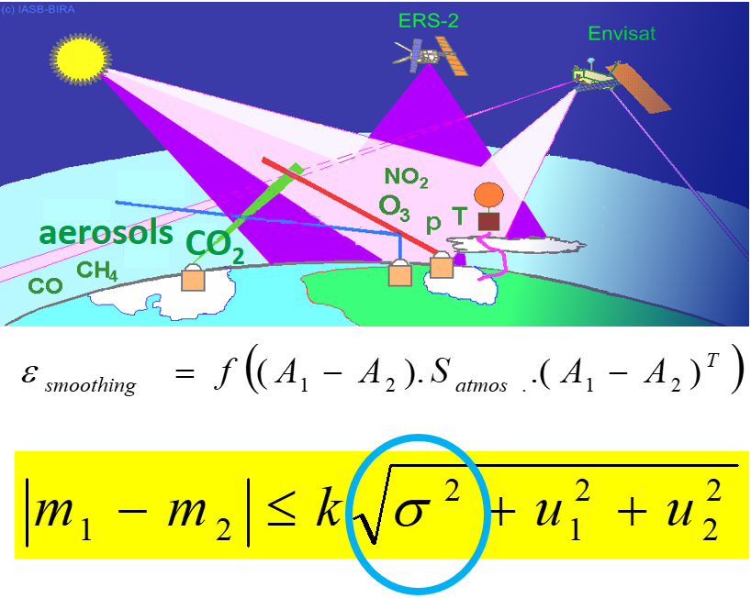
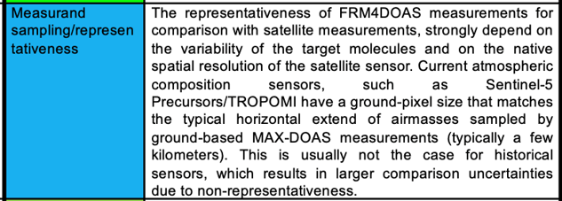
CEOS-FRM: Sampling/representativeness
PGN test: sampling of
measurand quantity value and of influence quantity values
test: horizontal
representativeness (smoothing)

Slide 26

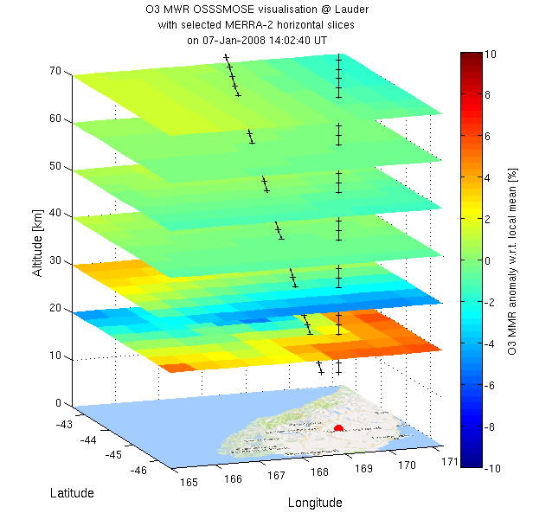
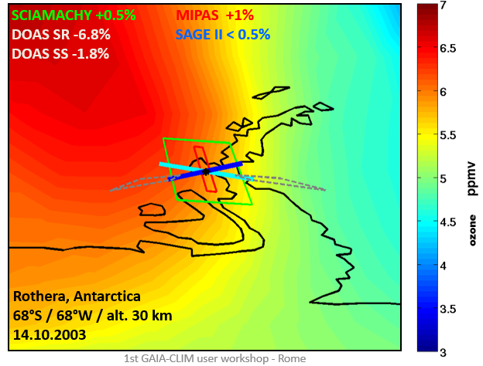
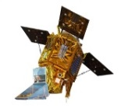
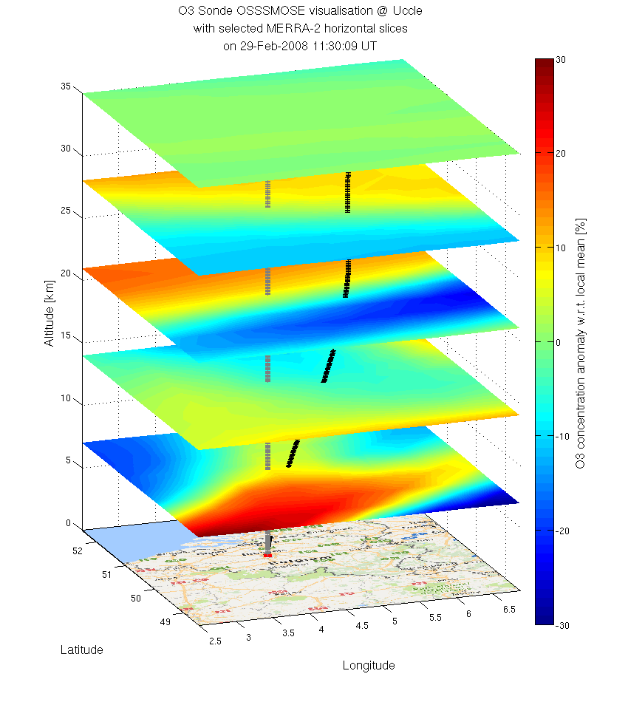
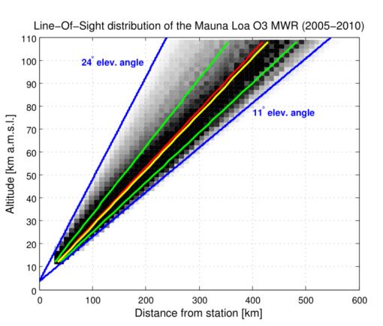
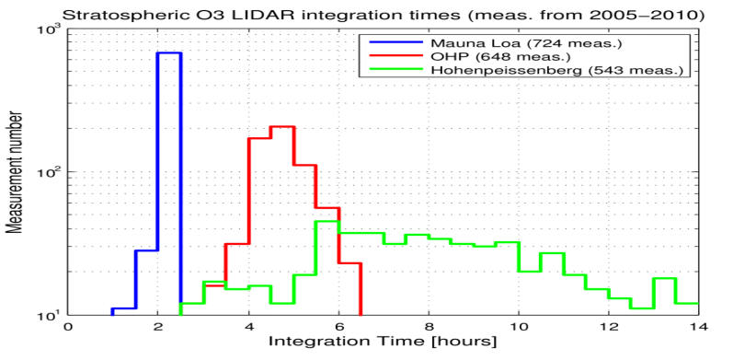
CEOS-FRM: Sampling/representativeness
OSSSMOSE simulations of co-location and resolution mismatches: Satellites vs. NDACC ozone data
Representativeness is a 4D issue !
MWR angles
Polar areas – Large SZA
Sentinel-5P vs. ozonesonde
S5p TROPOMI
13h45
Ozonesonde
12h30-14h00
DIAL temporal resolution (nighttime)
Courtesy Verhoelst et al., 2015

Slide 27
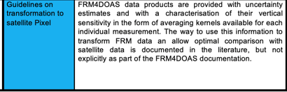
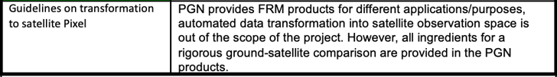
CEOS-FRM: Transformation to pixel
test: vertical sensitivity (averaging kernel) for every measurement. Transformation guidelines in the literature.
test: transformation is out of scope. PGN products contain
what is needed to do the transformation to pixel.

Slide 28
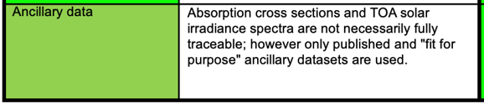
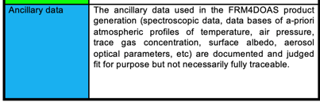

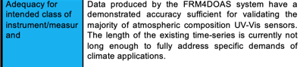
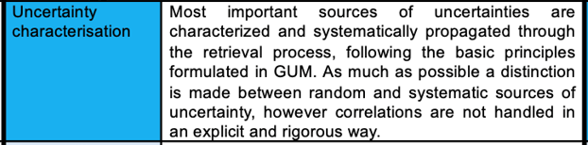
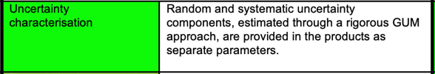
CEOS-FRM test cases
CV-23-01

Slide 29
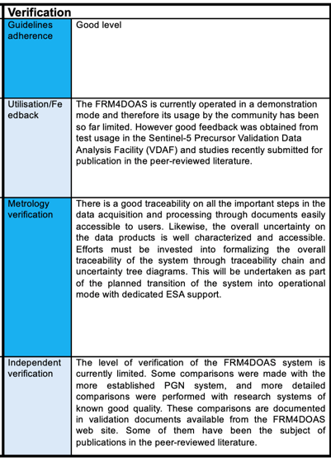
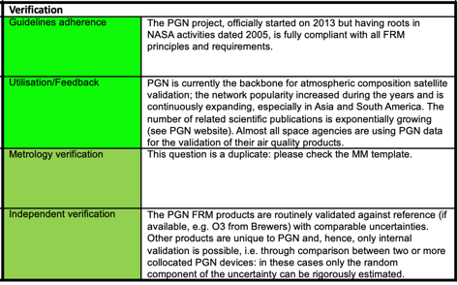
CEOS-FRM: Verification
Ranking based on Verification category

Slide 30
CEOS-FRM test cases: Conclusions
Two independent assessments of atmospheric FRM projects lead to interesting results – and different conclusions.
Understanding of terminology (traceability, reference, representativeness etc.) depends on the SMM user => guidance needed, references and illustrations recommended.
Cf. WGCV-52 discussion and feedback implemented in GoogleDoc: missing several concepts essential for atmospheric remote sensing.
Statements need to be evidenced.
Similar statements can lead to (very) different classification. The assessment exercise is valuable and appreciated, but questions about the meaning of the classification.

Slide 31
A few maturity assessments in progress
CEOS-FRM
Pilot phase: FRM4DOAS, PGN
ESA Precursors_cci+: FRMs for NO₂, HCHO, SO₂, CO, NH₃
Next version: NDACC DOAS, FTIR, lidars, sondes and MWR
EDAP SMM for satellite data products
Iteration (ESA/JPL/BIRA-IASB) on EDAP+ with NPL
Published: SWIR missions GOSAT-2, TanSat, GHGSat-C1 & -D
In progress: UV-Vis missions GEMS, Sentinel-5P TROPOMI

Slide 32







CINDI-3 (May 21 – June 21, 2024)
CV-24-01
The Third Cabauw INtercomparison of DOAS-like Instruments (CINDI-3)
Semi-blind intercalibration and intercomparison campaign with external referee
to intercalibrate instruments and assess mutual consistency of measurements,
to get NDACC/ACTRIS-CREGARS certification for new instruments,
to assess and improve FRM maturity for validation of CEOS Air Quality and Ozone satellite constellations.
Observation protocol
Additional species: CHOCHO and HONO

Slide 33

CINDI-3: Airborne component
CV-24-01
Airborne component part of ESA SVANTE+ project (Sentinel-5P TROPOMI validation)
Coordination: Frederik Tack (BIRA-IASB)
Operator: RBINS (Belgian Natural Science Institute), SURV unit (Ward van Roy)
Aircraft: BN-2 from Belgian Coast Guards, used for national North Sea aerial surveillance program and equipped with NOx, SO₂ and CO₂ sensors for ship plume monitoring
Planned payload for CINDI-3: SWING NO₂ whiskbroom imager + NO₂ ICAD

Slide 34






CINDI-3 (May 21 – June 21, 2024)
CV-24-01
31 groups confirmed
27 MAX-DOAS on double-layer containers infrastructure => all DOAS systems (1D and 2D) operated side-by-side with common viewing
2 SAOZ (zenith-sky DOAS), 1 Brewer UV Spectrophotometer
5 to 7 mobile DOAS systems
6 Pandora (PGN + U. Lille’s mobile lab)
2 Iterative CAvity enhanced DOAS (ICAD) for NO₂ and HONO
Lidars: JPL SMOL, KNMI aerosols and wind lidars, ESA lidar
BIRA-IASB AOTF NO₂ camera (ALTIUS related)
AERONET in Cabauw, mobile AERONET (U. Amsterdam)
Interested in measurement campaign? => CINDI-3 website
Coordinators: M. Van Roozendael (BIRA-IASB), A. Apituley (KNMI), K. Kreher (BKS)

