Slide 1
WGCV-53
Microwave Sensors Subgroup
Update Report
Xiaolong DONG, NRSCC/NSSC
Agenda Item 2.2
WGCV-53, Córdoba, Argentina
5-8 March, 2024

Slide 2
Recent Focuses of MSSG
MSSG covers EO sensors operated in microwave spectrum, except SAR
MWR, SCAT, ALT, GNSS-RO/R
  Microwave Radiometers (sounders, imagers) (MWR)
  Radar Scatterometers (surface and volume) (SCAT)
  Radar Altimeters (ALT)
  GNSS-Radio occultation and reflectrometry (GNSS-RO/GNSS-R)
With current focuses on
  Radar Scatterometers (Active Microwave)
  Microwave Radiometers (Passive Microwave)

Slide 3
Recent Tasks of MSSG
On-going tasks:
  CV-23-05 Retrieval and validation with high winds with combined active-passive microwave measurements (2025 Q2)
  CV-23-06 Retrieval and validation of sea surface atmospheric pressure with microwave remote sensing (2025 Q2)

Slide 4
Progress of task CV-23-05
CV-23-05: Retrieval and validation of high winds with combined active-passive microwave measurements
Task lead:
Prof. Wenming Lin
Nanjing University of Information Science and Technology (NUIST)

Slide 5
Progress of task CV-23-05
Overview
Extreme sea surface winds (speed ≥ 32.7 m/s) may lead to storm surge, transportation disruptions, injury or death, damage to ships and coastal buildings, and etc.
Monitoring of sea surface extreme winds using satellite-based microwave sensors is of great significance not only to the Risk Management authorities, but also the oceanic and atmospheric communities.
The current satellite scatterometer or radiometer-derived extreme winds are far from the “truth”, requiring a re-calibration or re-process task in order to achieve a consistent multi-mission extreme winds.

Slide 6
Progress of task CV-23-05
Task team
  Nanjing University of Information Science and Technology (NUIST); (Task lead & SAR extreme winds);
  National Space Science Center (NSSC); (Rain effect for extreme winds)
  Royal Netherlands Meteorological Institute (KNMI); (SCAT extreme winds)
  National Ocean Satellite Application Center (NSOAS); (SCAT and RAD extreme winds);
  National Satellite Meteorological Center (NSMC/CMA); (C- and Ku- combined wind)
  National Oceanic and Atmospheric Administration (NOAA); (SFMR reference winds)
  Other potential contributers

Slide 7
Progress of task CV-23-05
Deliverable: Provide a comparison of respective wind results from both type of sensors and examples of joint application methods for high wind retrievals.
Main contents:
  To re-calibrate microwave radiometer brightness temperature, radar scatterometer and synthetic aperture radar (SAR) normalized radar cross section (NRCS, σ⁰), and to derive well inter-calibrated high and extreme sea surface wind products.
  To validate the high and extreme winds using collocated NOAA hurricane hunter Stepped Frequency Microwave Radiomater (SFMR) winds as reference.
  To better understand the intrinsic characteristics (e.g., the true spatial scale of each wind source) of the satellite-derived high and extreme winds.

Slide 8
Progress of task CV-23-05
  Validation reference aspect:
  Collocations in storm-centric coordinates: improve storm centre location. (Done)
  Spatial representativeness: Look for suitable SFMR upscaling for each SAR, scatterometer & radiometer. (Done)
  Satellite data aspect:
  Analyze the sensitivity of each sensor measurement under high and extreme wind conditions, improve the radiation and scattering models. (Done)
  Re-calibration of radiometer brightness temperature, and radar NRCS. (Ongoing)
  Re-calibration and/or re-process the extreme winds from the mentioned sensors. (Ongoing)
  High and extreme wind validation using the reference data. (Ongoing)

Slide 9
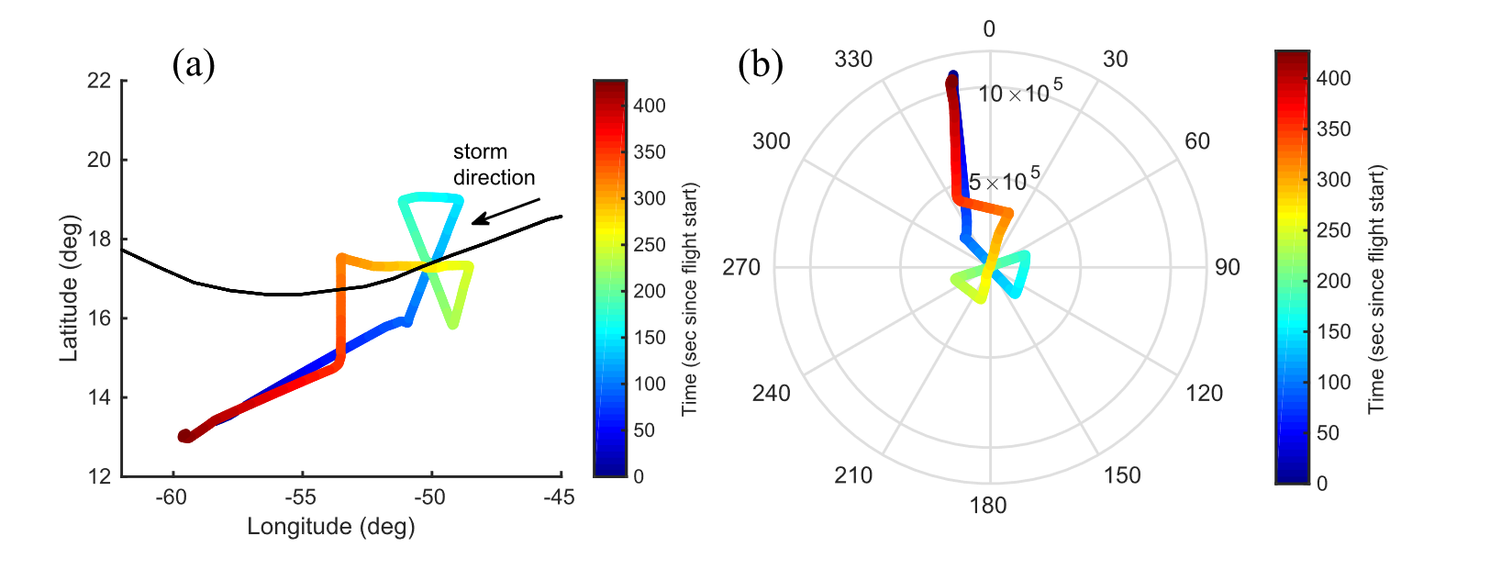
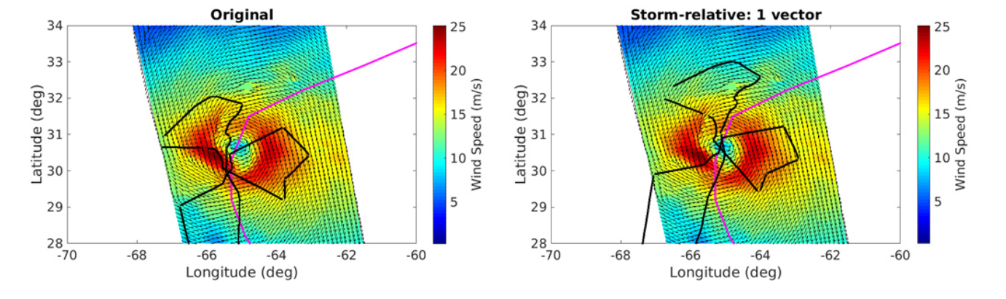
Progress of task CV-23-05
  (1) Validation reference:
a) Collocations in storm-centric coordinates:
SFMR spatially and temporally varying observations are projected into a “frozen” hurricane structure during such temporal window.
(a) Aircraft trajectory in original coordinates with respect to time (see colorbar), along with the BT data (black line). (b) Corresponding flight in storm-motion relative coordinates.
(Polverari, 2022)
The black line corresponds to (a) NOAA I2 SFMR flight trajectory in original coordinates and (b) storm-motion relative coordinates derived using a single vector.

Slide 10
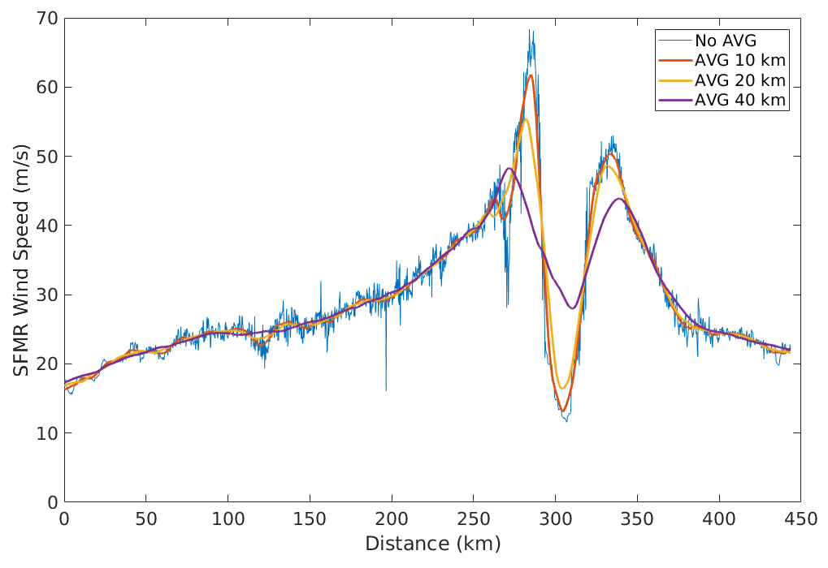
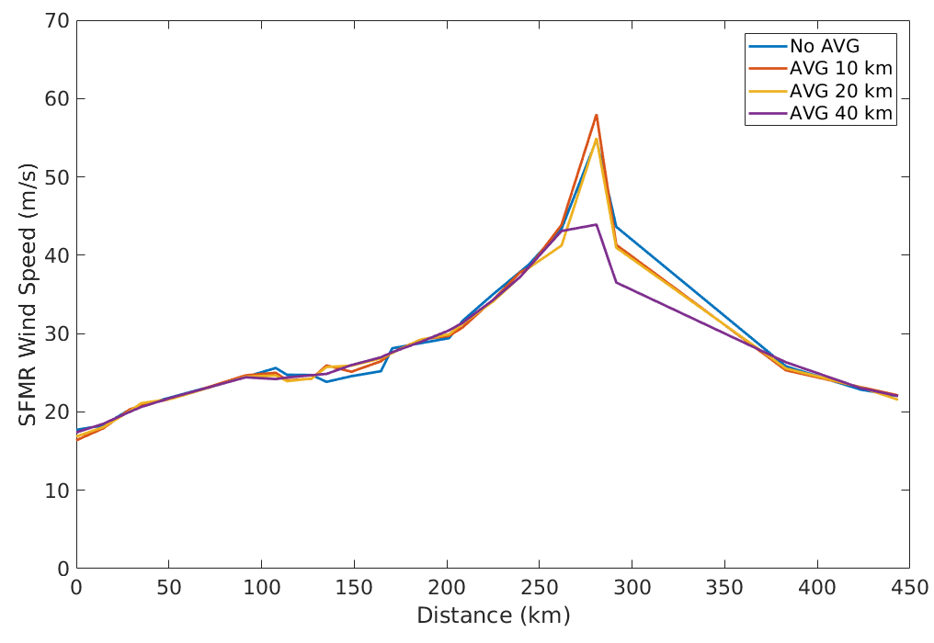
Progress of task CV-23-05
  (1) Validation reference:
b) Spatial representativeness
SFMR upscaling effects at SFMR 1-sec sampling
SFMR upscaling effects at 12.5 km sampling
Spatial scale is a relevant aspect in the verification of satellite-derived winds.

Slide 11
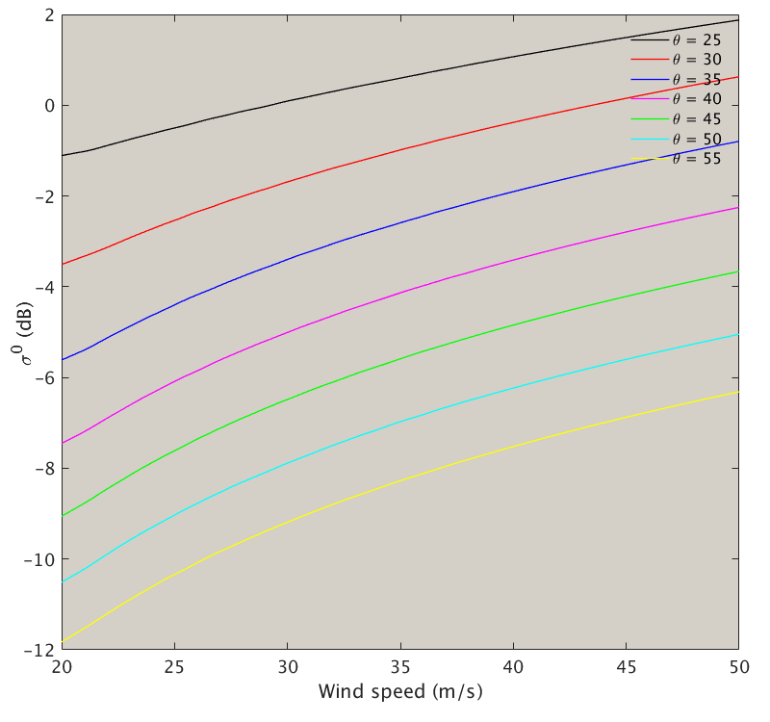
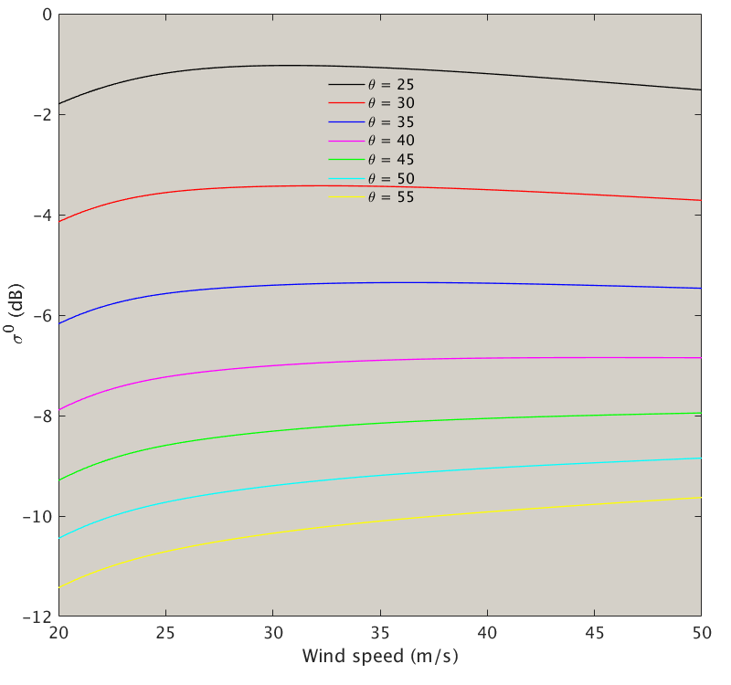
Progress of task CV-23-05
  (2) Satellite data:
  a) sensitivity of radar σ⁰ to high and extreme winds
Co-pol
Ku-VV up-wind
0.1 dB sigma-0 change corresponds to 3.6 m/s wind speed change
C-VV up-wind

Slide 12
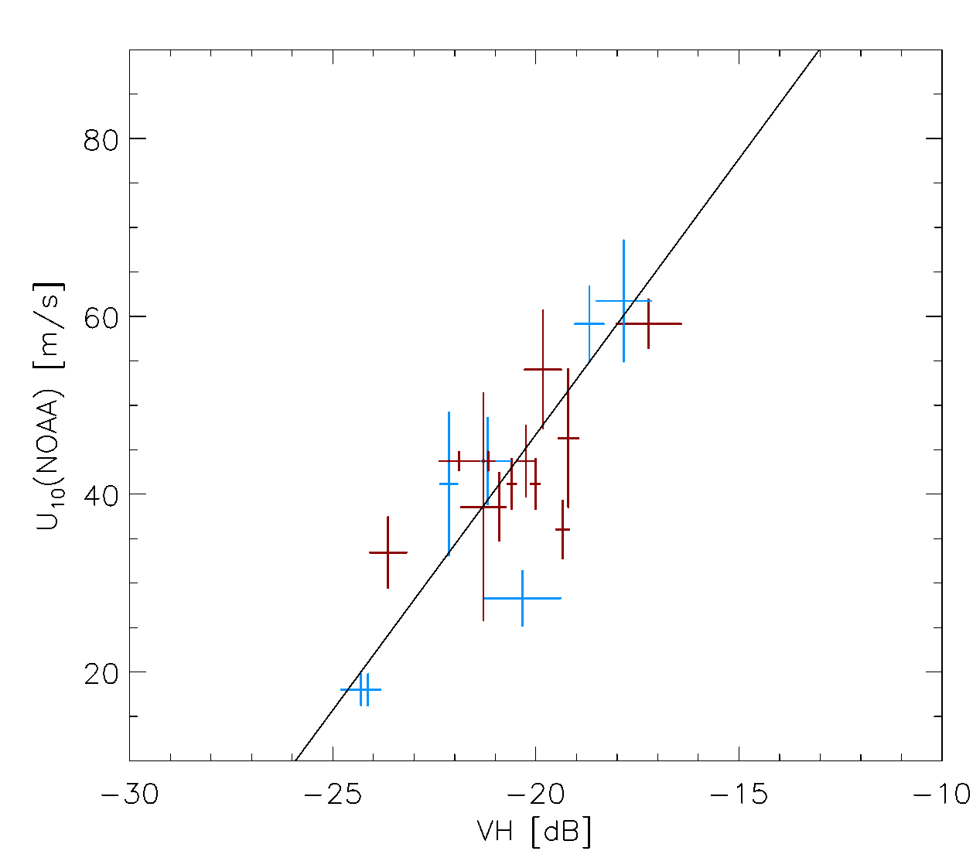
Progress of task CV-23-05
  (2) Satellite data:
  a) sensitivity of radar σ⁰ to high and extreme winds
C-band cross-polarization backscatter is sensitive to the extreme winds

Slide 13
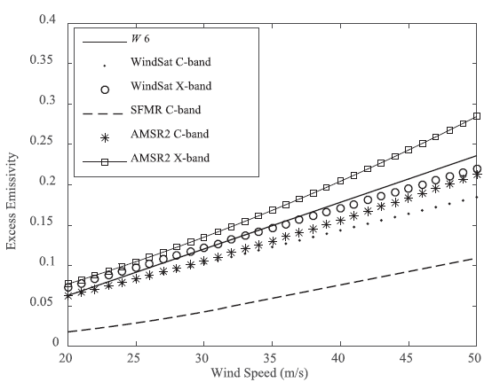
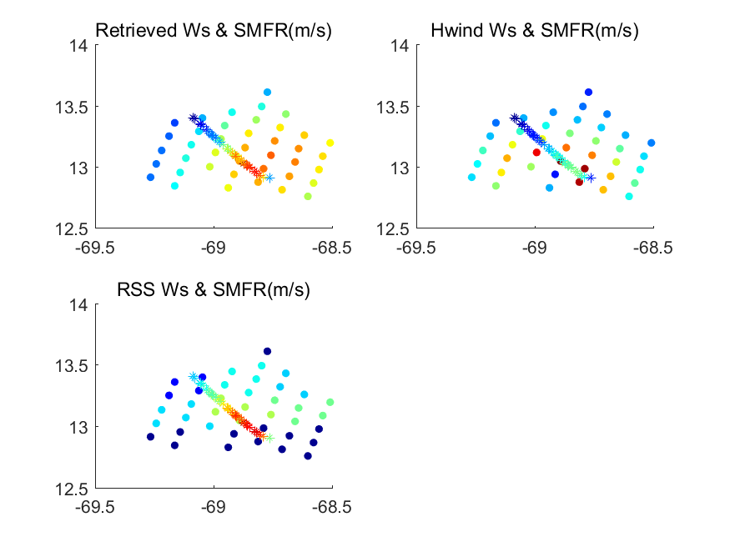
Progress of task CV-23-05
  (2) Satellite data:
  a) sensitivity of radiometer BT to high and extreme winds
Improved emissivity model (Yin et al., 2023)
Better agreement with SFMR

Slide 14
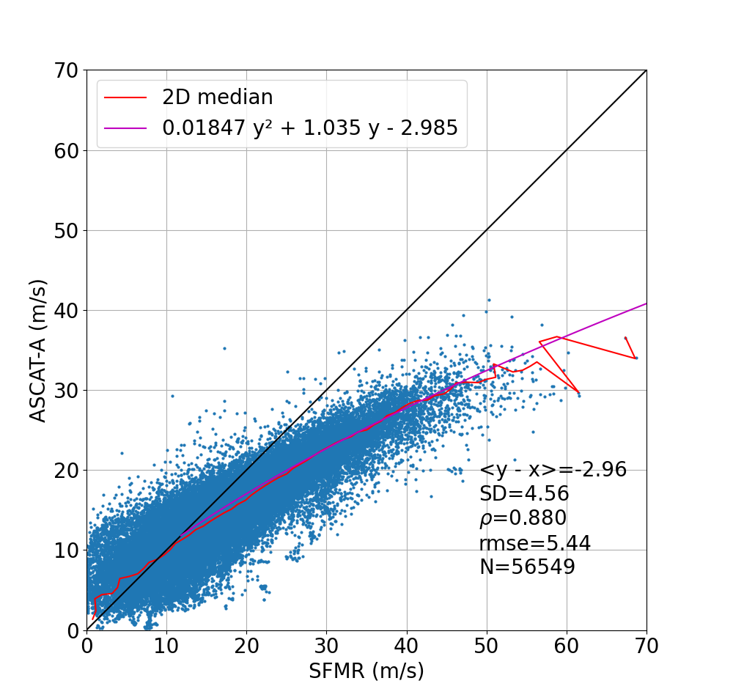
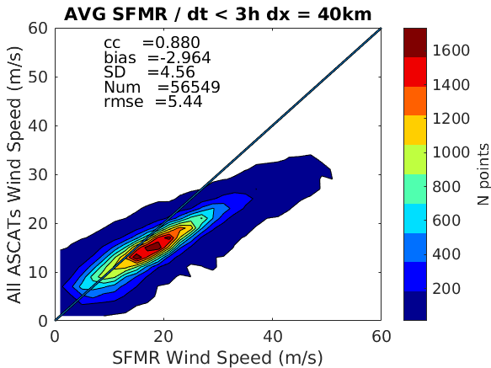
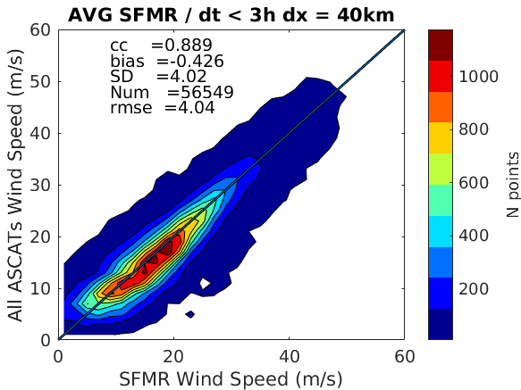
Progress of task CV-23-05
  (2) Satellite data:
  b) re-calibrate the satellite winds using an empirical adjustment
Original ASCAT winds
Adjusted ASCAT winds
C-band ASCAT (original) versus SFMR winds
(Portabella, 2023)

Slide 15
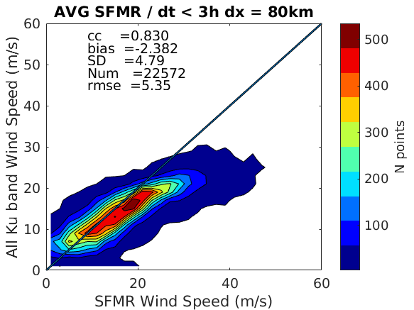
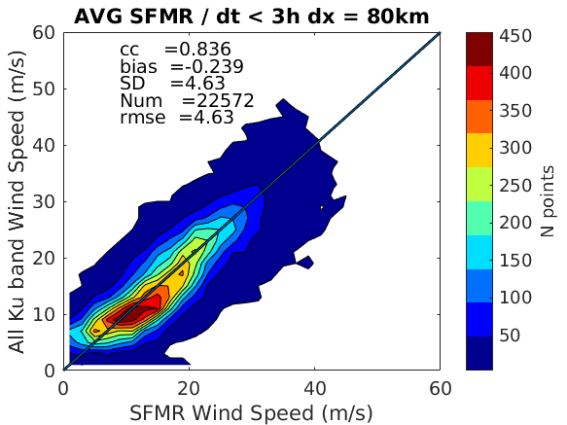
Progress of task CV-23-05
  (2) Satellite data:
  b) re-calibrate the satellite winds using an empirical adjustment
Original Ku-band winds
Recalibrated Ku-band winds
Adjusted Ku-band winds consistent with SFMR winds (as expected)
(Portabella, 2023)

Slide 16
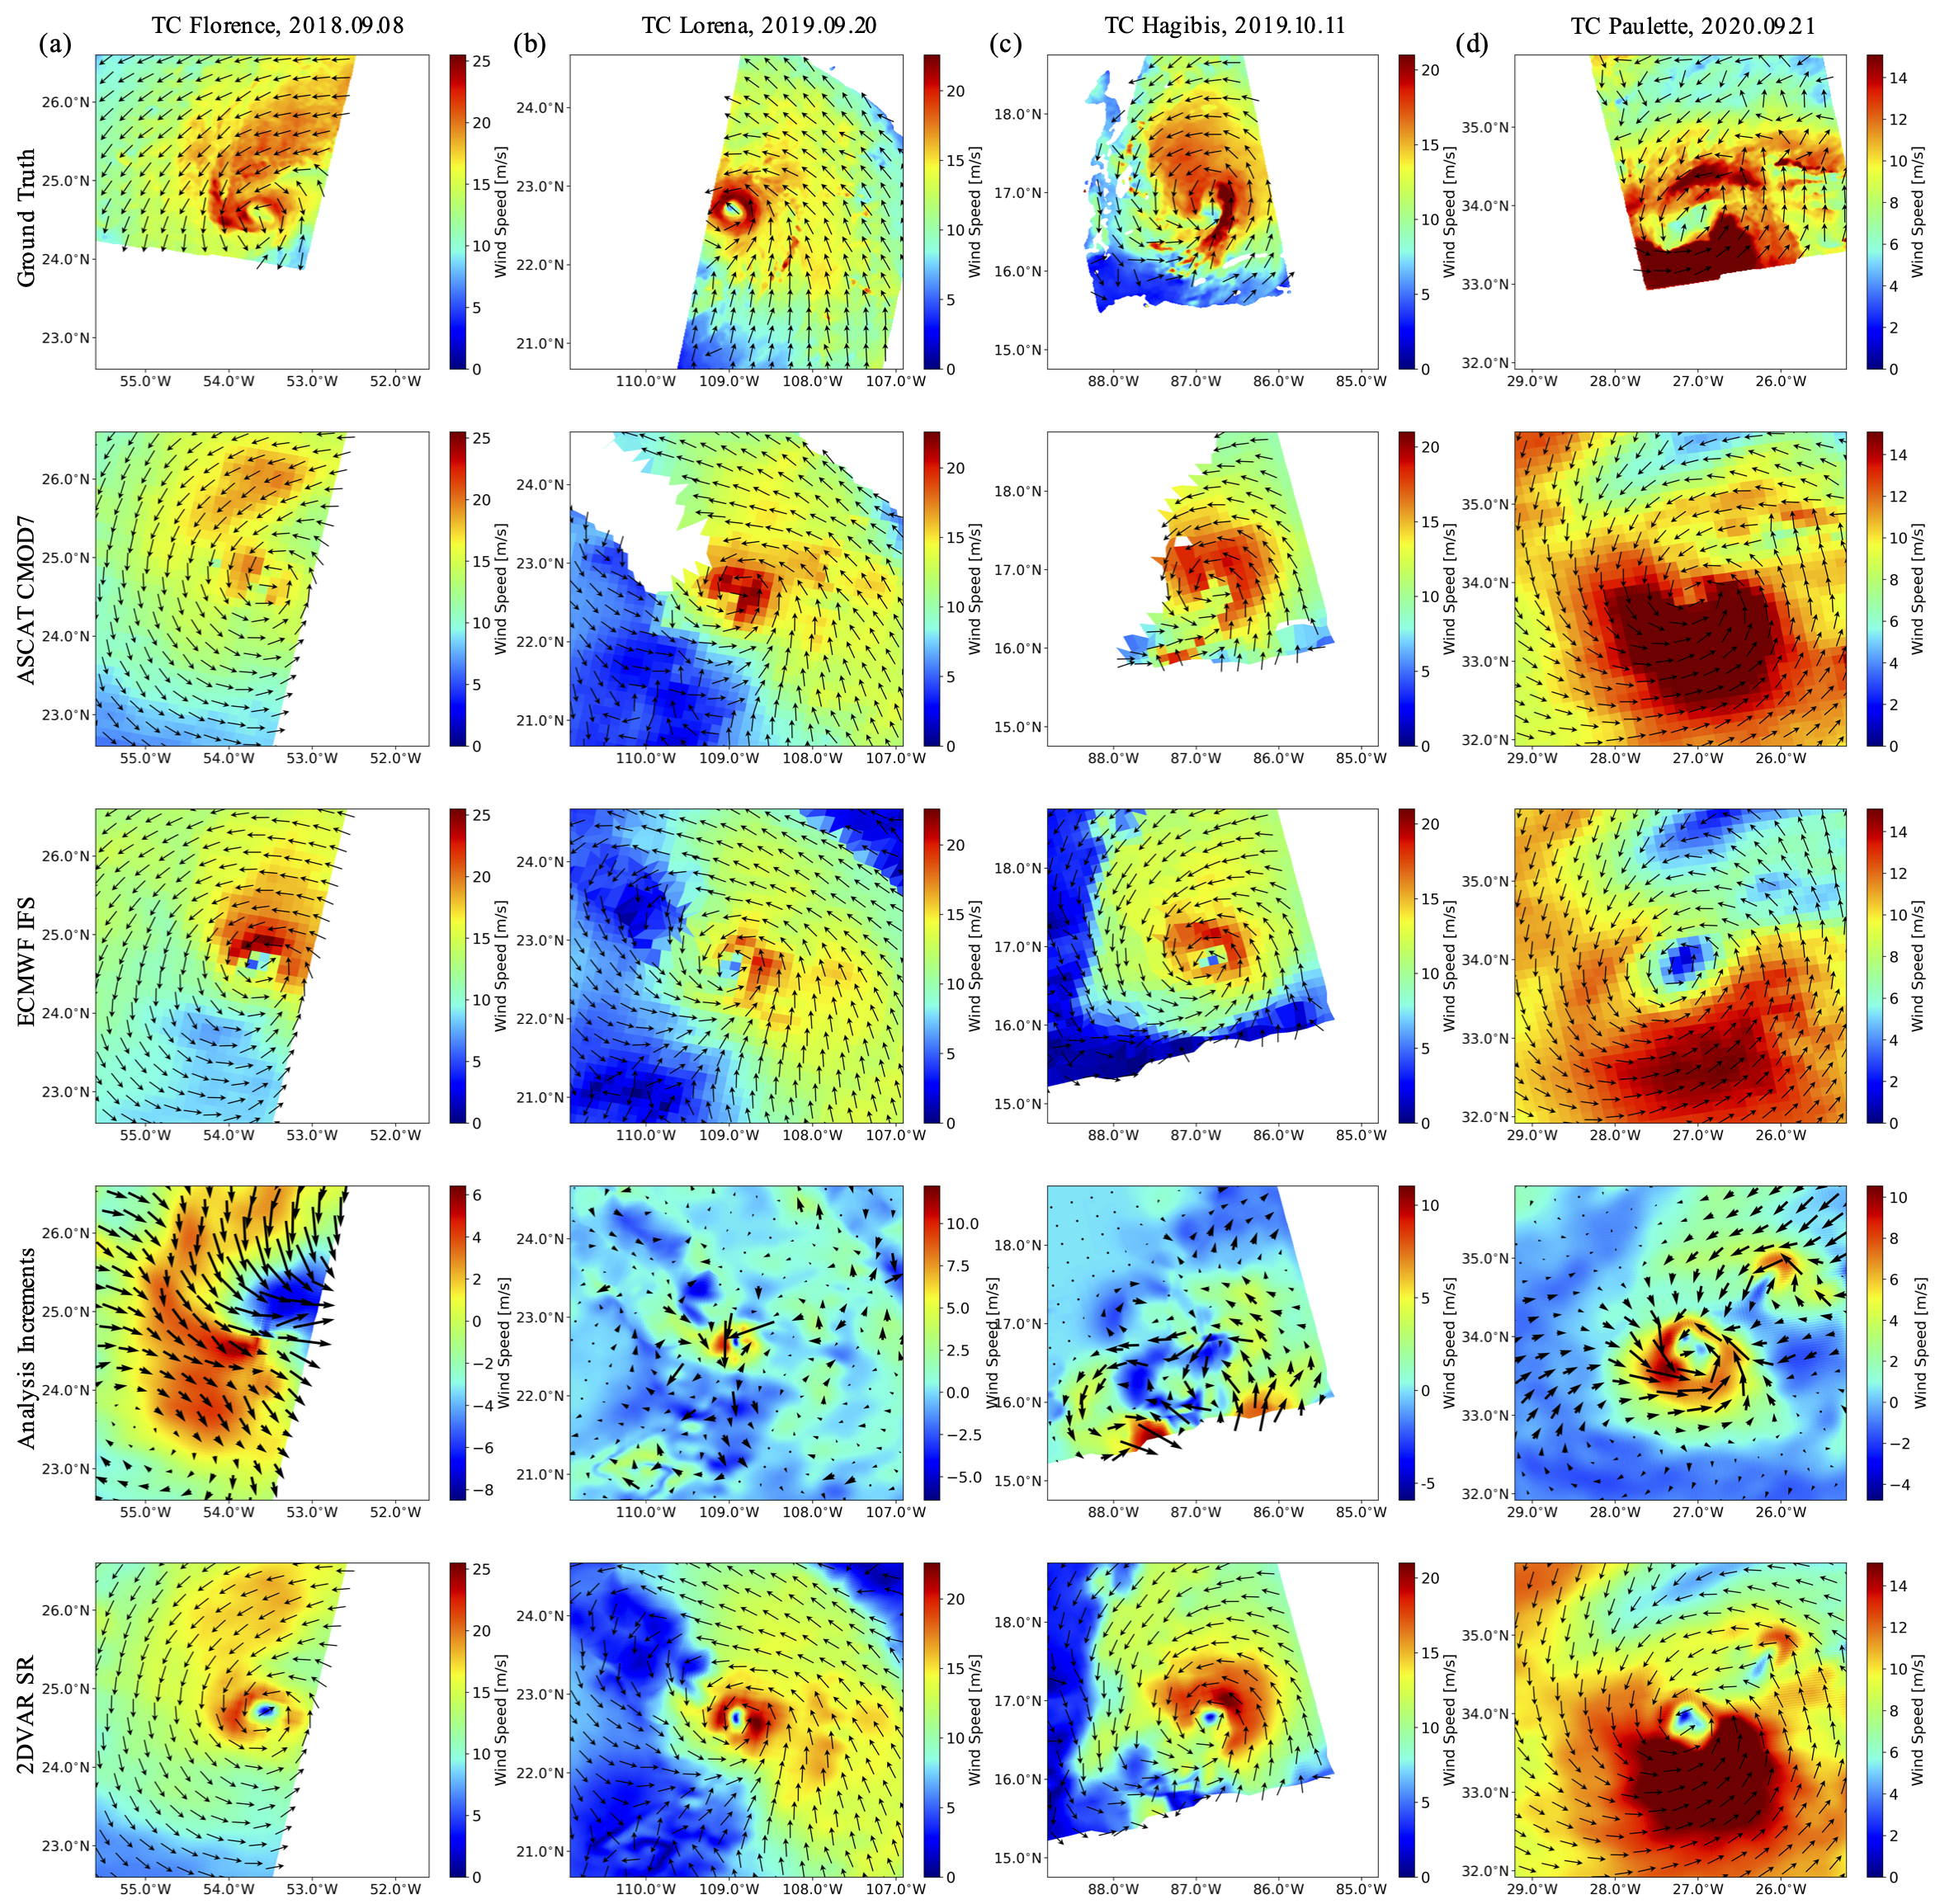
Progress of task CV-23-05
  (2) Satellite data:
  c) Improve the scatterometer high winds using a data fusion method
A method for generating super-resolution (SR) winds from low-resolution wind scatterometers using 2DVAR analysis method, wherein SR structure functions are empirically trained on SAR data. (Ni, 2023)
ASCAT
SR Winds
SAR Winds

Slide 17
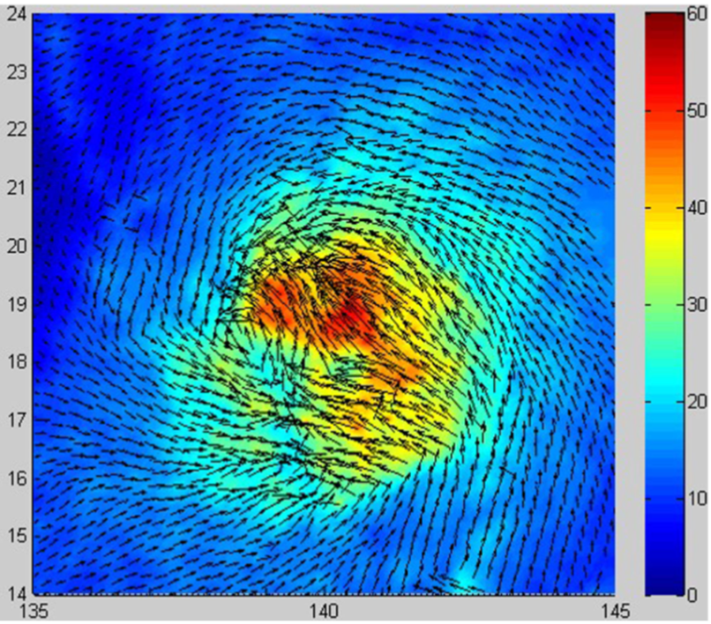
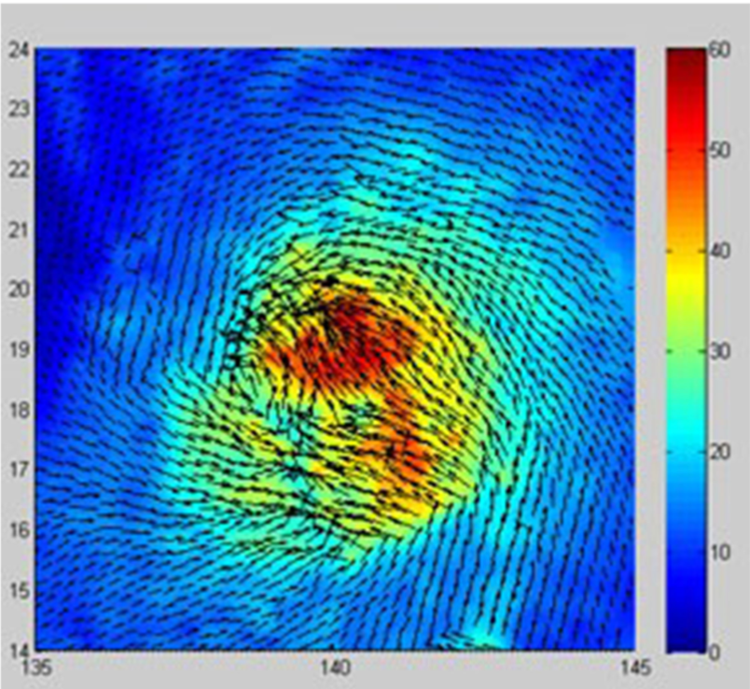
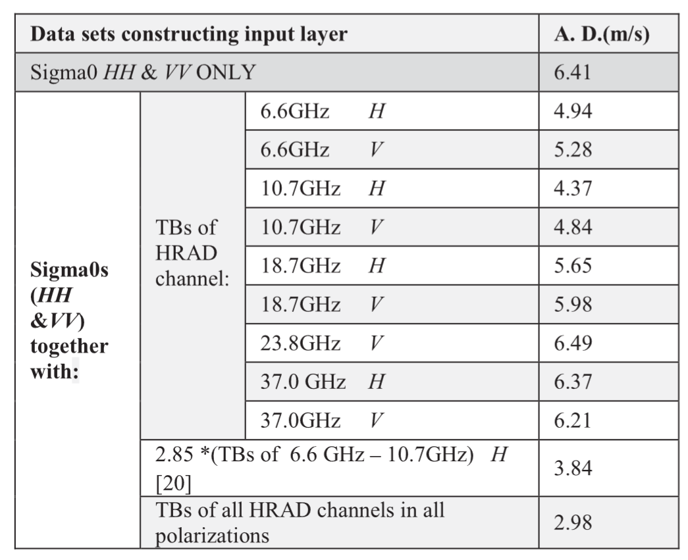
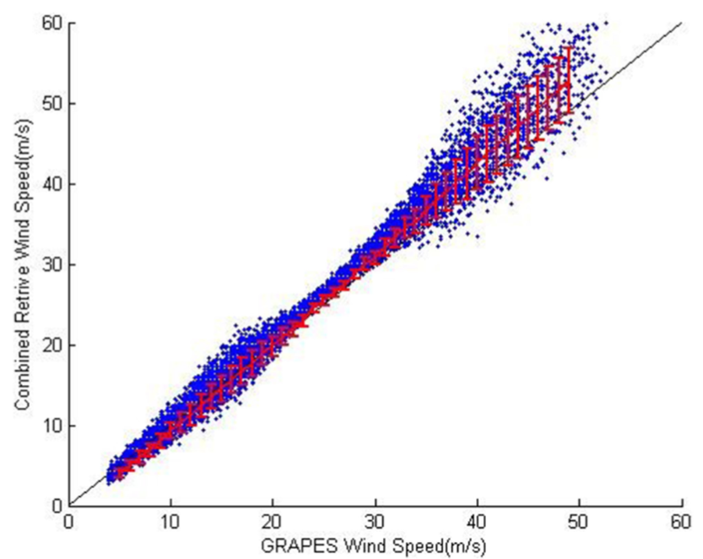
Progress of task CV-23-05
  (2) Satellite data:
  c) Improve the high winds using combined active/passive wind inversion
Combined inversion (HY-2 SCAR and RAD)
using BP neural network
HY-2A
CMA-GFS
(Xu, 2018)

Slide 18
Progress of task CV-23-05
  (2) Satellite data:
  c) Improve the high winds using SAR observations
The thermal noise exisinting in Sentinel-1 SAR images acquired in TOPSAR mode should be eliminated, prior to wind speed retrieval.
(Zhang, 2023)

Slide 19
Progress of task CV-23-05
Future works:
Combined active/passive inversion for extreme winds
Comprehensive validation of different wind products
Team meeting for refining and release review of deliverables
Scatterometer systems | FORMAT | PERIOD | SOURCE | FREQUENCY
ASCAT-A | BUFR/NetCDF | Full period | OSI SAF | C-band
ASCAT-B | BUFR/NetCDF | 11/2012 – 12/2020 | OSI SAF | C-band
ASCAT-C | BUFR/NetCDF | 01/2019 – 12/2020 | OSI SAF | C-band
OceanSat-2 | BUFR/NetCDF | 01/2010 - 02/2014 | OSI SAF | Ku-band
RapidScat | BUFR/NetCDF | 11/2014 - 08/2016 | OSI SAF | Ku-band
Scatsat-1 | BUFR/NetCDF | 01/2017 – 12/2020 | OSI SAF | Ku-band
HY-2A | BUFR/NetCDF | 06/2012 - 04/2015 | OSI SAF | Ku-band
HY-2B | BUFR/NetCDF | 01/2019 – 12/2020 | OSI SAF | Ku-band
HY-2C | BUFR/NetCDF | 11/2020 – 12/2020 | OSI SAF | Ku-band
CFOSAT | BUFR/NetCDF | 01/2019 – 12/2020 | OSI SAF | Ku-band
Radiometers | FORMAT | PERIOD | SOURCE | FREQUENCY
SMOS | NetCDF-4 | Full period | IFREMER | L-band
SMAP | Bytemap | 04/2015 – 12/2020 | REMSS | L-band
WindSat | Bytemap | 01/2010 – 10/2020 | REMSS | Channels (GHz): 6.8; 10.7; 18.7; 23.8; 37.0
AMSR2 | Bytemap | 07/2012 – 12/2020 | REMSS | Channels (GHz): 6.93; 7.3; 10.65; 18.7; 23.8; 36.5; 89.0
SSMI / SSMIS | Bytemap | Full period | REMSS | Channels (GHz): 19.35; 23.235; 37.0; 85.5
GMI | Bytemap | 03/2014 – 12/2020 | REMSS | Channels (GHz): 10.65; 18.7; 23.8; 36.5; 89.0; 165.5; 183.31
TMI | Bytemap | 01/2010 – 12/2014 | REMSS | Channels (GHz): 10.65; 19.35; 21.3; 37.0; 85.5
AMSRE | Bytemap | 01/2010 - 10/2011 | REMSS | Channels (GHz): 6.93; 10.65; 18.7; 23.8; 36.5; 89.0

Slide 20
Progress of task CV-23-05
Zhang et al. 2022, IEEE TGRS

Slide 21
Progress of task CV-23-06
CV-23-06: Retrieval and validation of sea surface atmospheric pressure with microwave remote sensing
Task lead:
Dr. Zijin ZHANG
National Space Science Center, CAS

Slide 22
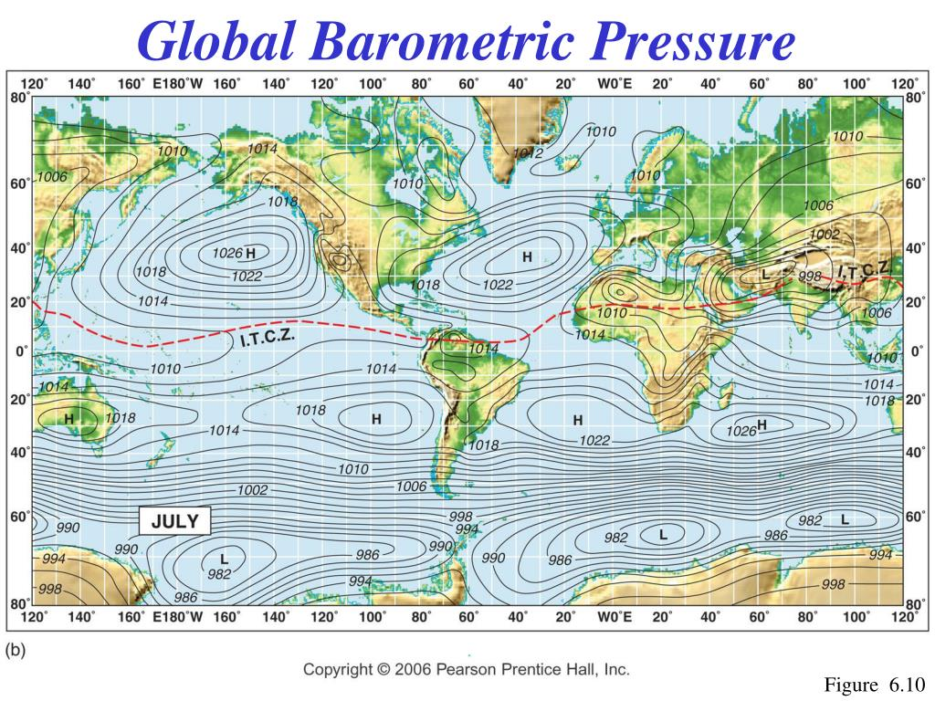
Progress of task CV-23-06
Introduction
Surface pressure data have important applications in numerical weather prediction (NWP), tropical cyclone forecasting and analysis, global climate change studies.
Currently, ocean surface atmospheric pressure data are mainly provided by buoys and ship measurements. The spatial coverage of in situ data for use by weather forecasters is very poor.
Only remote sensing techniques can obtain surface pressure data with large spatial coverage and high density sampling over oceans. However, no on-orbit sensor is designed for ocean surface pressure observation, and there are no operational surface pressure retrieval products.
Stations reporting surface pressure

Slide 23
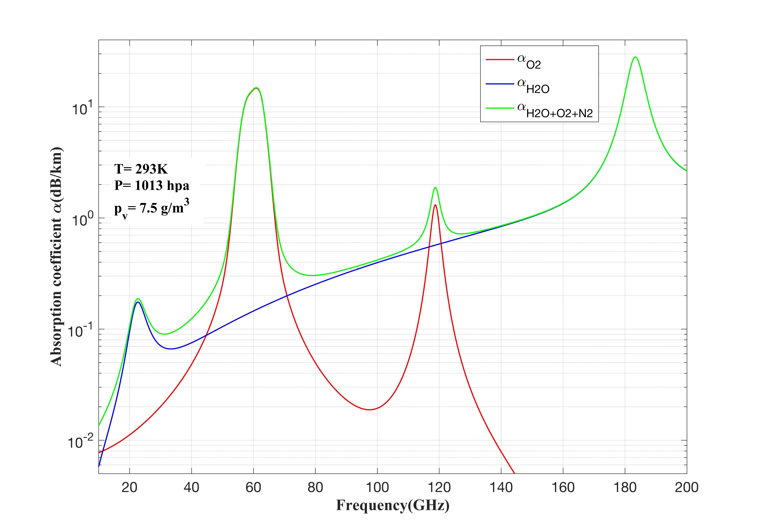
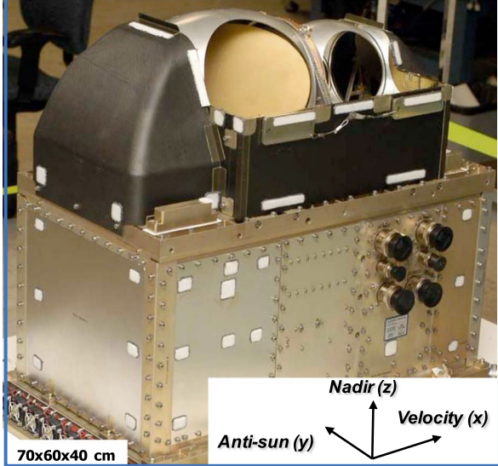
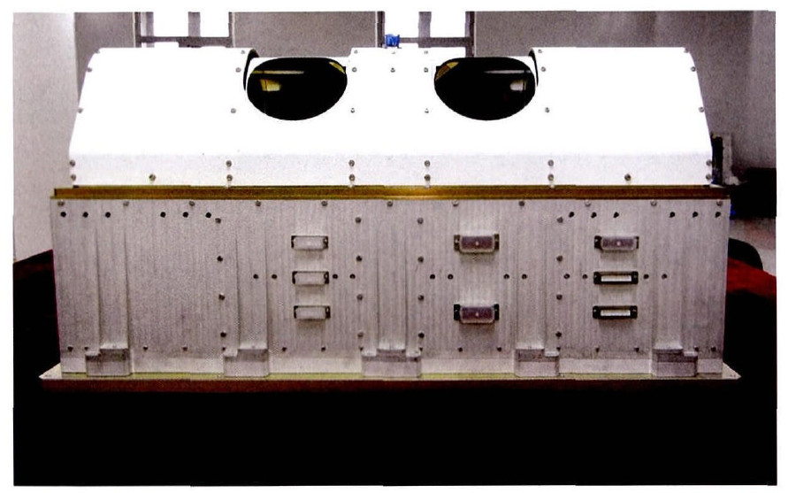
Progress of task CV-23-06
Sea surface atmospheric pressure from spaceborne passive microwave observations
Surface pressure sounding is achieved by microwave radiometers due to their ability to measure the total columnar oxygen absorption.
In the oxygen absorption band (50-70 GHz, 118 GHz) , the total columnar atmospheric absorption is strongly related to column oxygen mass. Oxygen is uniformly mixed in the atmosphere; therefore, the column oxygen mass is directly proportional to the surface pressure.
SNPP/ATMS (50-60 GHz )
FY-3C/MWHTS(118 GHz)

Slide 24
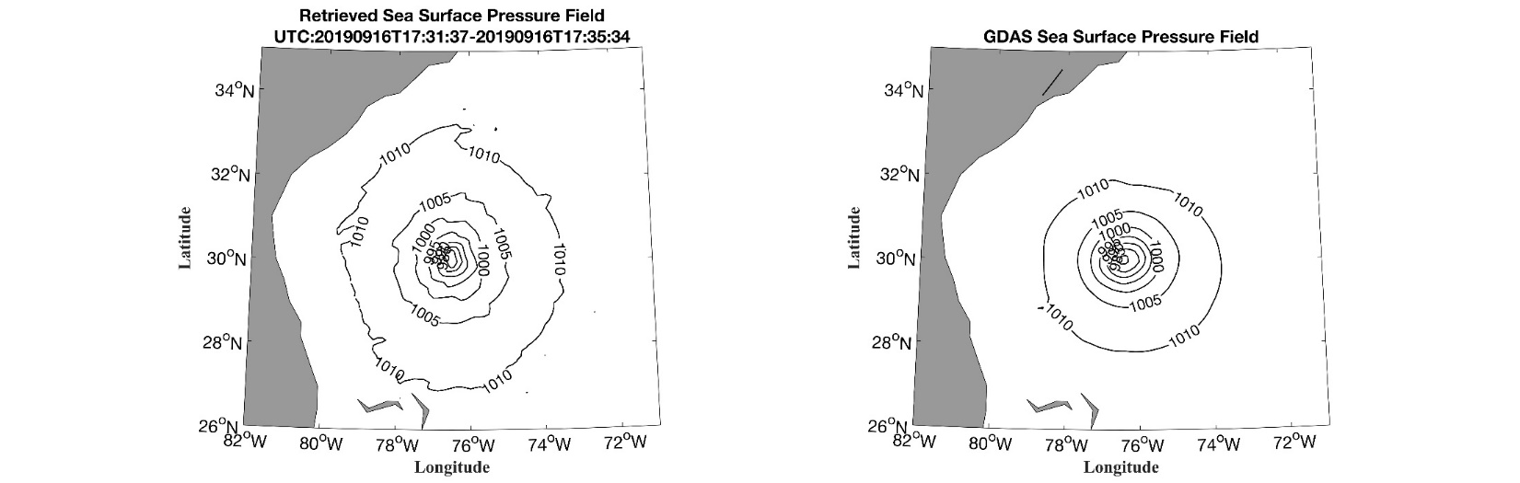
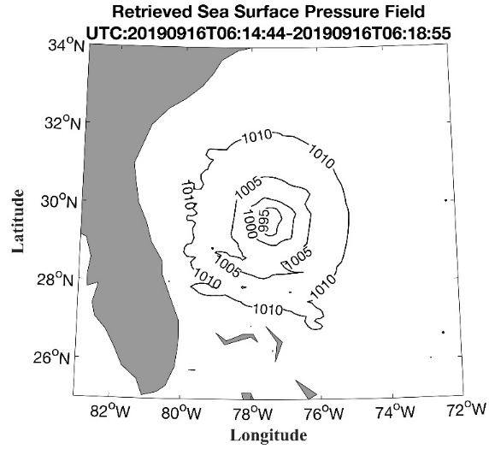
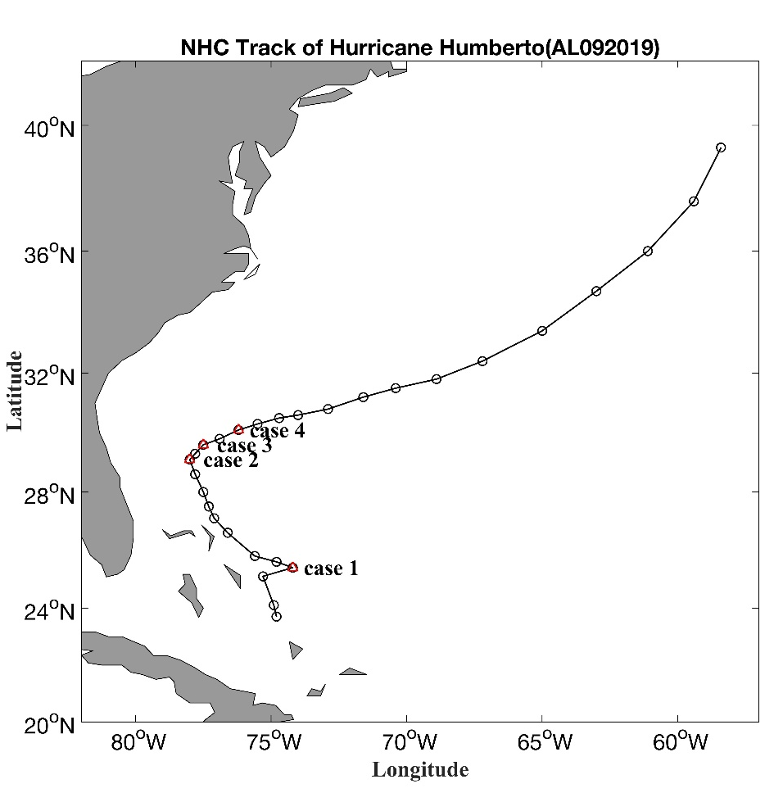
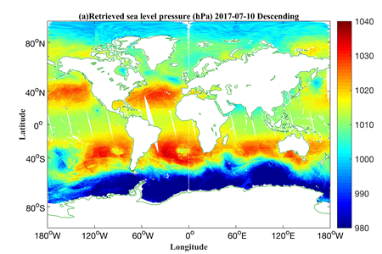
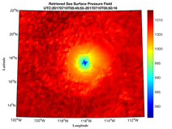
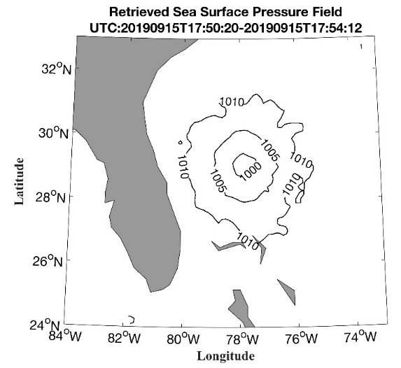
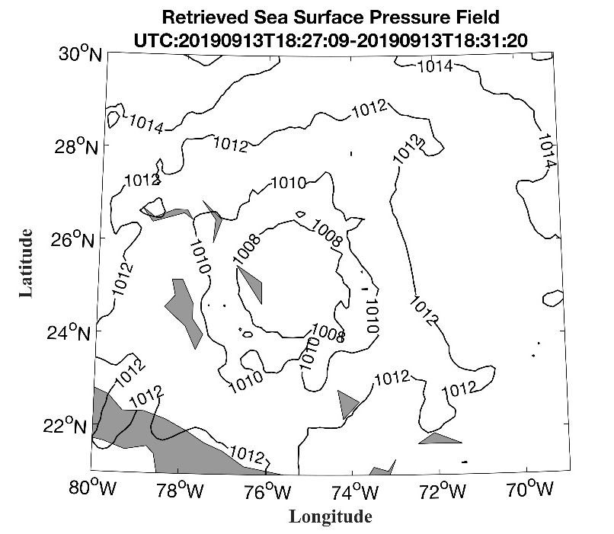
Significance of the Deliverables
Progress of task CV-23-06
Applications:
Prediction and forecasting for disasters and extreme weather;
Numerical weather prediction (NWP);
Global climate change studies;
Advantages:
All weather capability
Day and night capability
High spatiotemporal resolution (<3h, ~16km by multi-satellite joint observation)
Wide swath observations (several thousand km): fast, continuous and stable global observations capability
24

Slide 25
Progress of task CV-23-06
Task team
  National Space Science Center (NSSC); (Task lead & retrieval algorithm)
  Shanghai Typhoon Institute (TC data analysis);
  National Satellite Meteorological Center (NSMC/CMA); (MWHT/MWHT data)
  National Ocean Satellite Application Center (NSOAS); (SCAT wind data);
  Hong Kong Observatory (in situ data)

Slide 26
Progress of task CV-23-06
Objective
  To develop and optimize the retrieval models and algorithms for sea surface pressure by passive microwave observations.
  To validate and assess the sea surface pressure data products using collocated in situ measurement data.
  To deliver the all-weather sea surface pressure data product from passive microwave observations.
Towards all-weather quality ocean surface atmospheric pressure product

Slide 27
Progress of task CV-23-05
Deliverables: Sea surface pressure retrieval algorithms; validation of all-weather retrievals with collocated in situ measurement; demo dataset
  Algorithm aspect:
  Develop the retrieval algorithms for sea surface pressure by passive microwave observations. (Done)
  Analyze the relationship between TB warm anomalies (TB minus environmental TB) and surface pressure fields of tropical cyclone, improve the retrieval algorithms under strong wind conditions. (Done)
  Analyze the surface pressure information content obtained by 50-60 GHz and 118 GHz radiometers, develop the joint retrieval methods. (Done)
  Validation aspect:
  Validate the respective and joint retrieval results from 50-60 GHz and 118 GHz radiometers using collocated reanalysis and analysis data (ERA-interim, ERA5, and NCEP GDAS/FNL analysis). (Done)
  In situ validation data sets using the collocated buoy, ship and dropsonde data. (Ongoing)

Slide 28
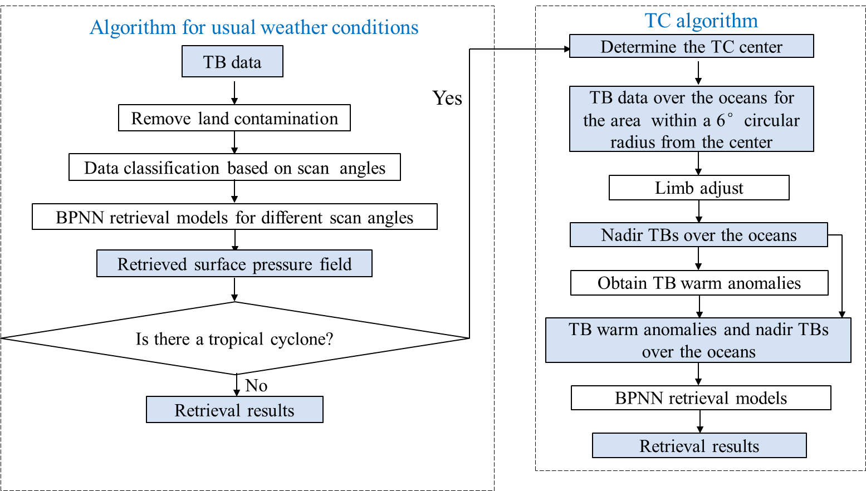
Development of retrieval algorithms
Progress of task CV-23-06
Progress
Three-step retrieval
Step 1: Preliminary retrieval of pressure
Step 2: Detection of TC
Step 3: Retrieval of TC pressure

Slide 29
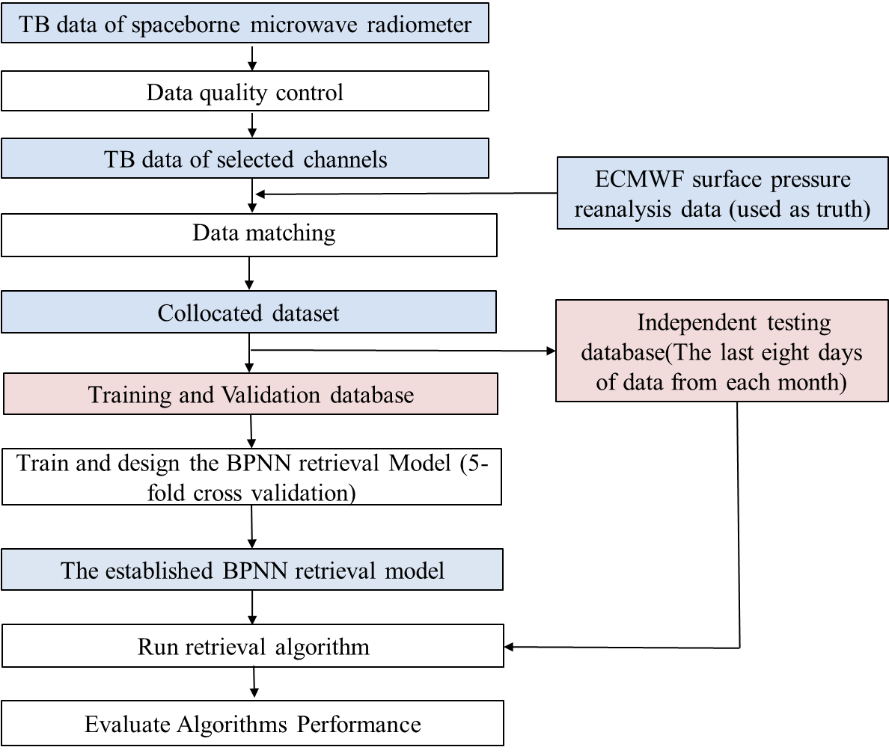
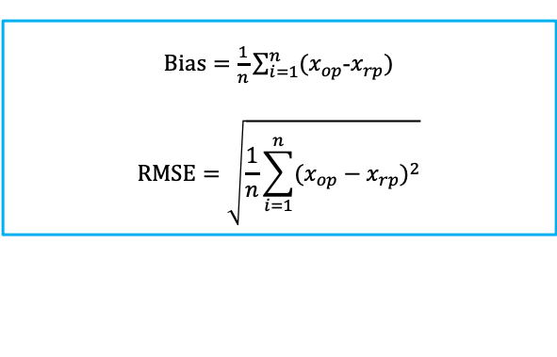
Assessment of the retrieval accuracy
Progress of task CV-23-06
Brightness temperature data of spaceborne microwave radiometer - input of the algorithm
- Spatial resolution (nadir): 32 km (SNPP/ATMS and FY-3D/MWTS-II), 16 km (FY-3D/MWHTS, FY-3D/MWHTS)
- Temporal resolution: 2 times/day
ECMWF reanalysis surface pressure data or NCEP GDAS/FNL surface pressure analysis fields– to develop and test the algorithm
- Spatial resolution: 0.25º☓ 0.25º
- Temporal resolution: 6 hours
- The last eight days data of each month are used for independent testing.
In situ surface pressure data (buoys, ships and dropsondes) – to test the algorithm
$Bias=\frac{1}{n}\sum_{i=1}^{n}{(x_{op}}$-$x_{rp})$
$$RMSE=\sqrt{\frac{1}{n}\sum_{i=1}^{n}{(x_{op}}−x_{rp})^{2}}$$

Slide 30
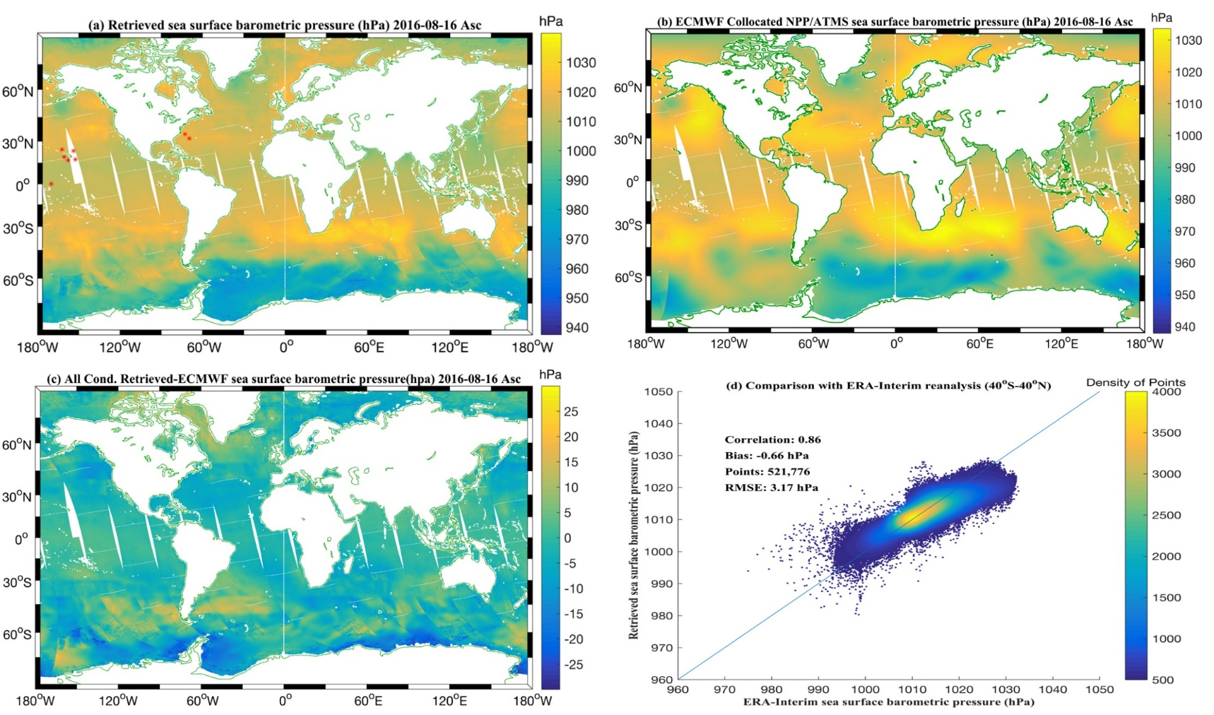
Preliminary assessment of by comparing the retrievals from SNPP/ATMS data with ERA-Interim reanalysis
Progress of task CV-23-06
Progress
Retrievals correlate well with the ERA-Interim reanalysis surface pressure data.
Retrieval results using the SNPP/ATMS ascending data in August 16, 2016.

Slide 31
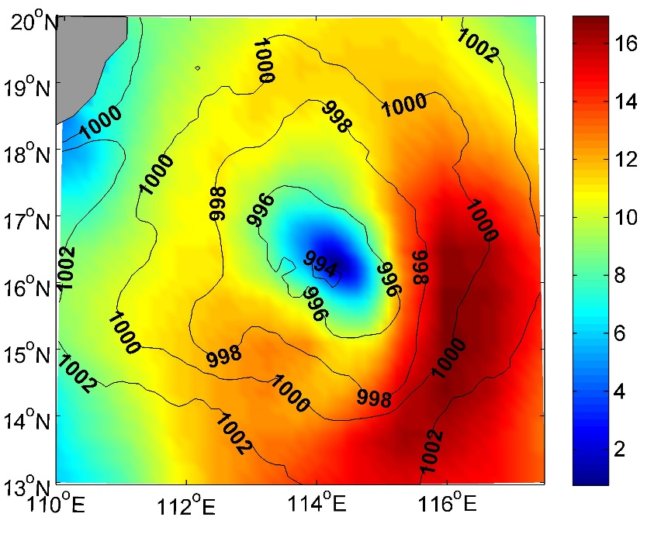
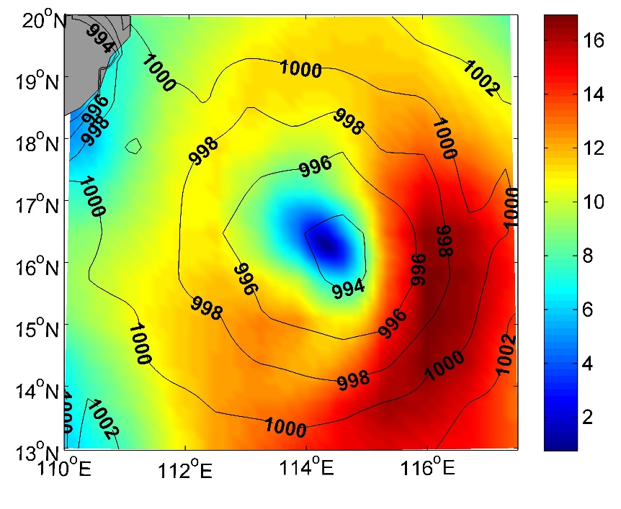
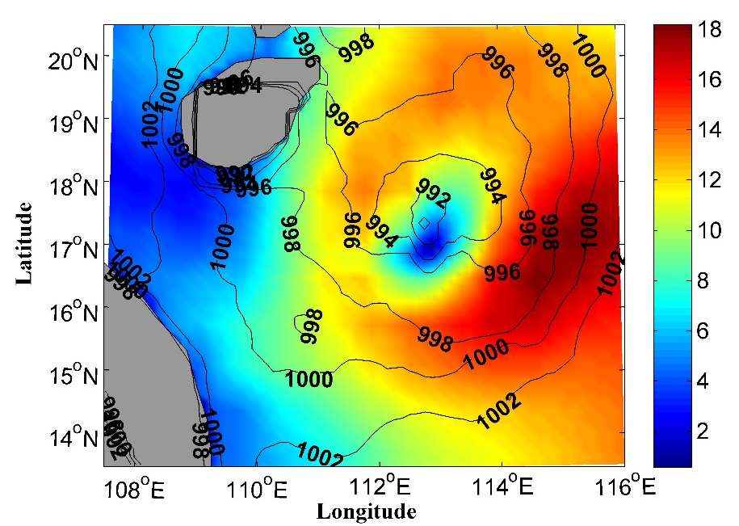
Preliminary assessment by comparing the retrievals from SNPP/ATMS data with NCEP GDAS/FNL analysis data
Progress of task CV-23-06
Retrievals
NCEP analysis
Retrievals correlate well with the NCEP GDAS/FNL surface pressure analysis data.
The TC structure described by the retrieved surface pressure fields agree well with that described by the NCEP GDAS/FNL 10m wind speeds.
Retrievals
NCEP analysis
Retrieved surface pressure shown using contour, and NCEP GDAS/FNL 10m wind speeds shown using shade for tropical storm Jebi at 0604 UTC (top) and 1835 UTC (bottom)1 August 2013.
31

Slide 32
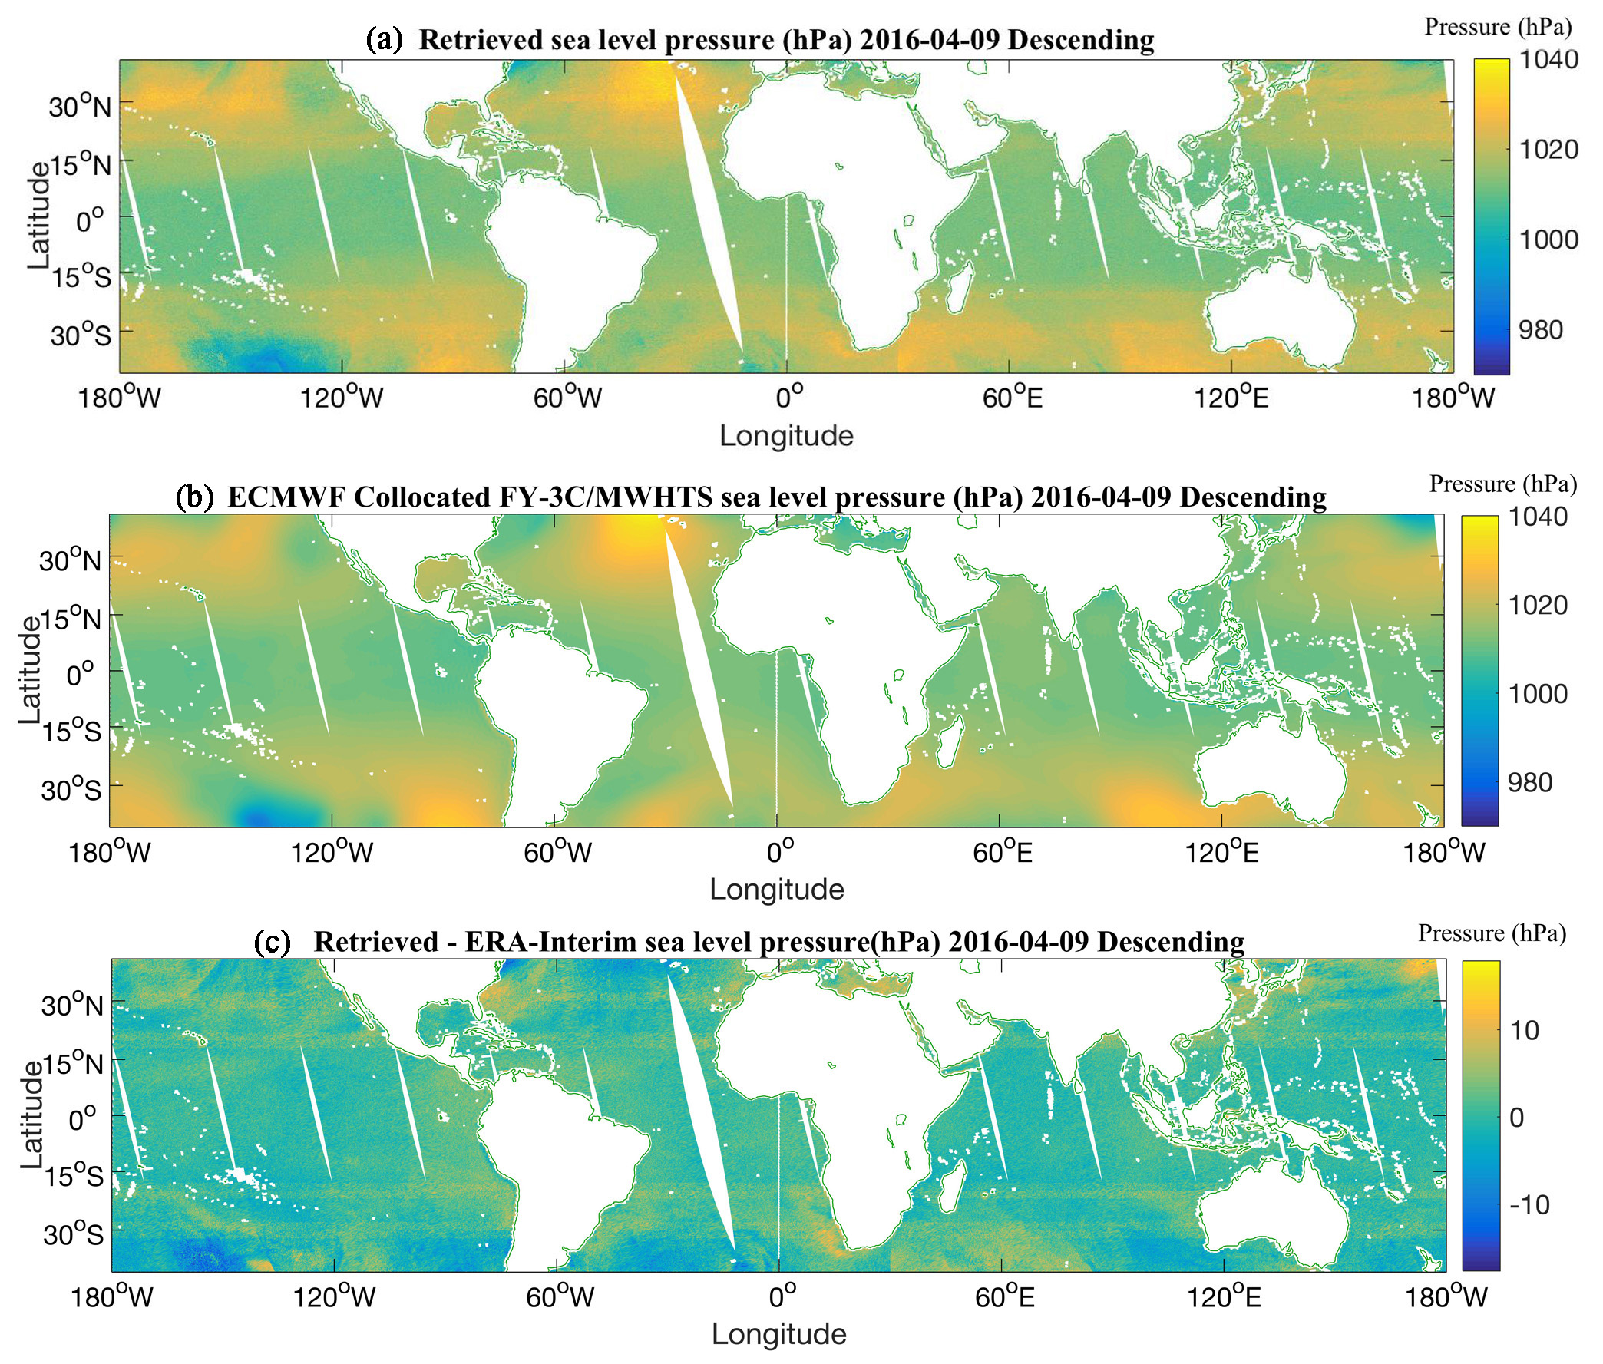
Preliminary assessment of by comparing the retrievals from FY-3C/MWHTS data with ERA-Interim reanalysis
Progress of task CV-23-06
Progress
Retrievals correlate well with the ERA-Interim reanalysis surface pressure data.
Retrieval results using the FY-3C/MWHTS descending data in April 9, 2016.

Slide 33
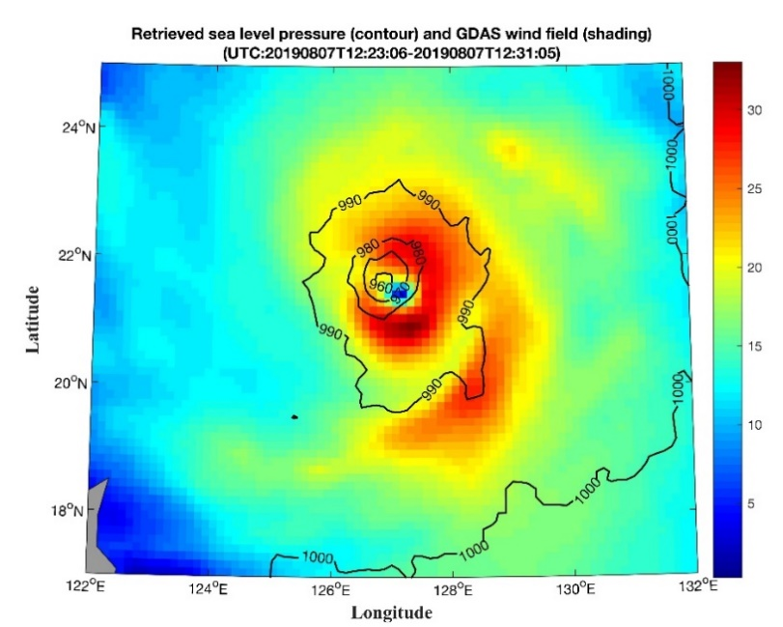
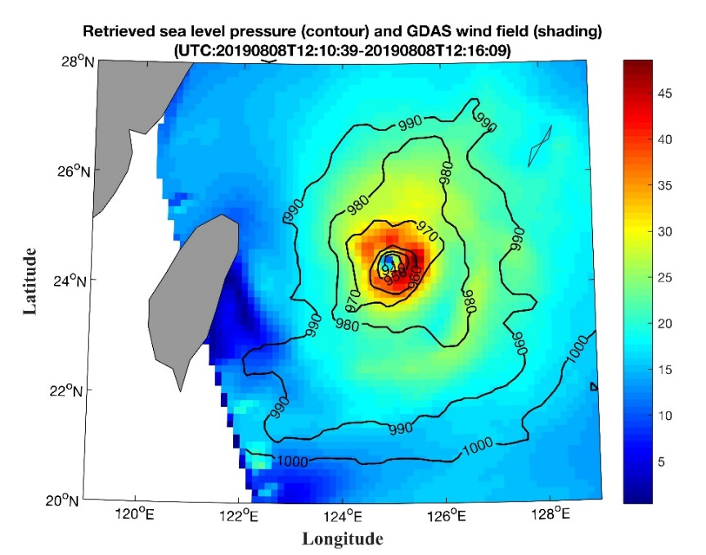
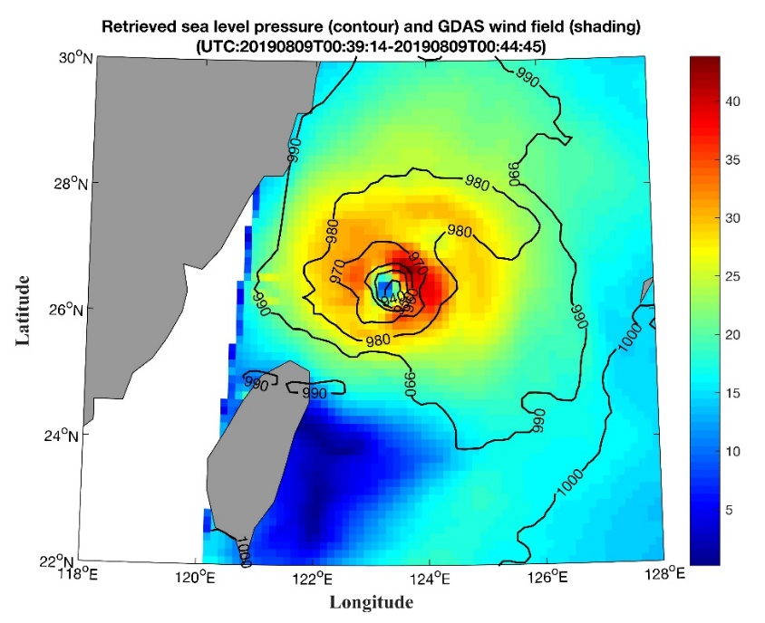
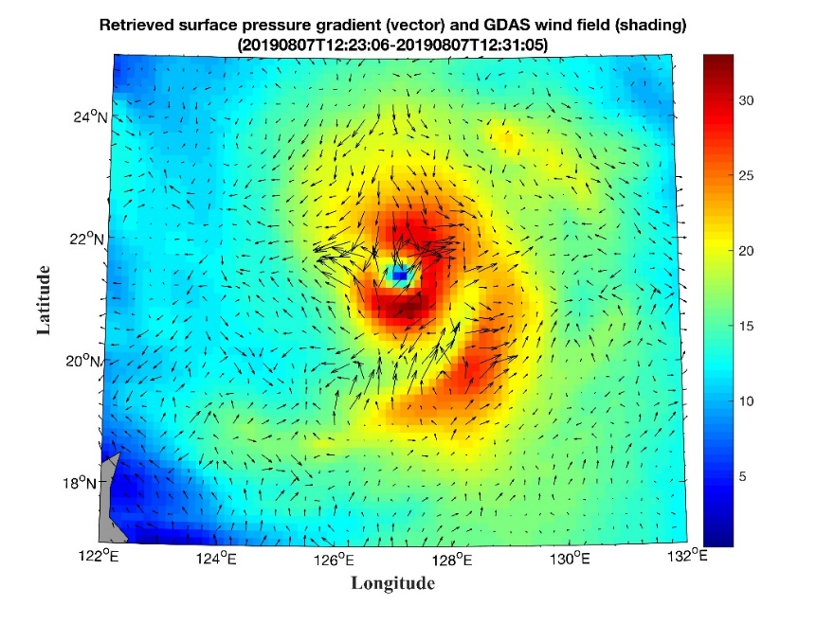
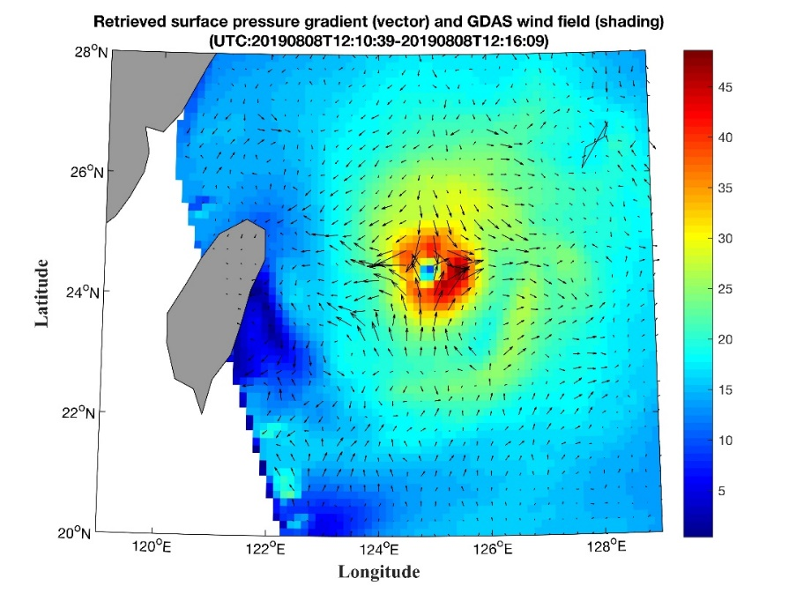
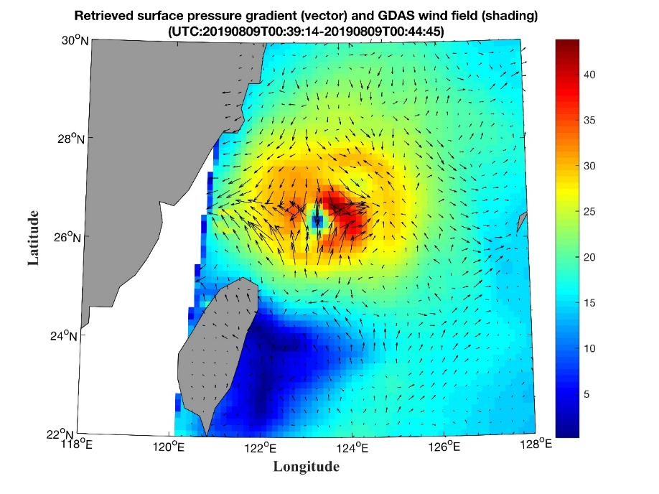
Preliminary assessment by comparing the retrieved surface pressure and pressure gradients from FY-3C/MWHTS data with NCEP 10m wind analysis data
Progress of task CV-23-06
The TC structural features described by the retrieved surface pressure fields agree well with that described by the NCEP 10m wind speeds.
The retrieved surface pressure gradients correlate well with surface winds.
Retrieved surface pressure (top) shown using contour, surface pressure gradients (bottom) shown using vector and NCEP GDAS/FNL 10m wind speeds shown using shade for typhoon lekima (1909).
33

Slide 34
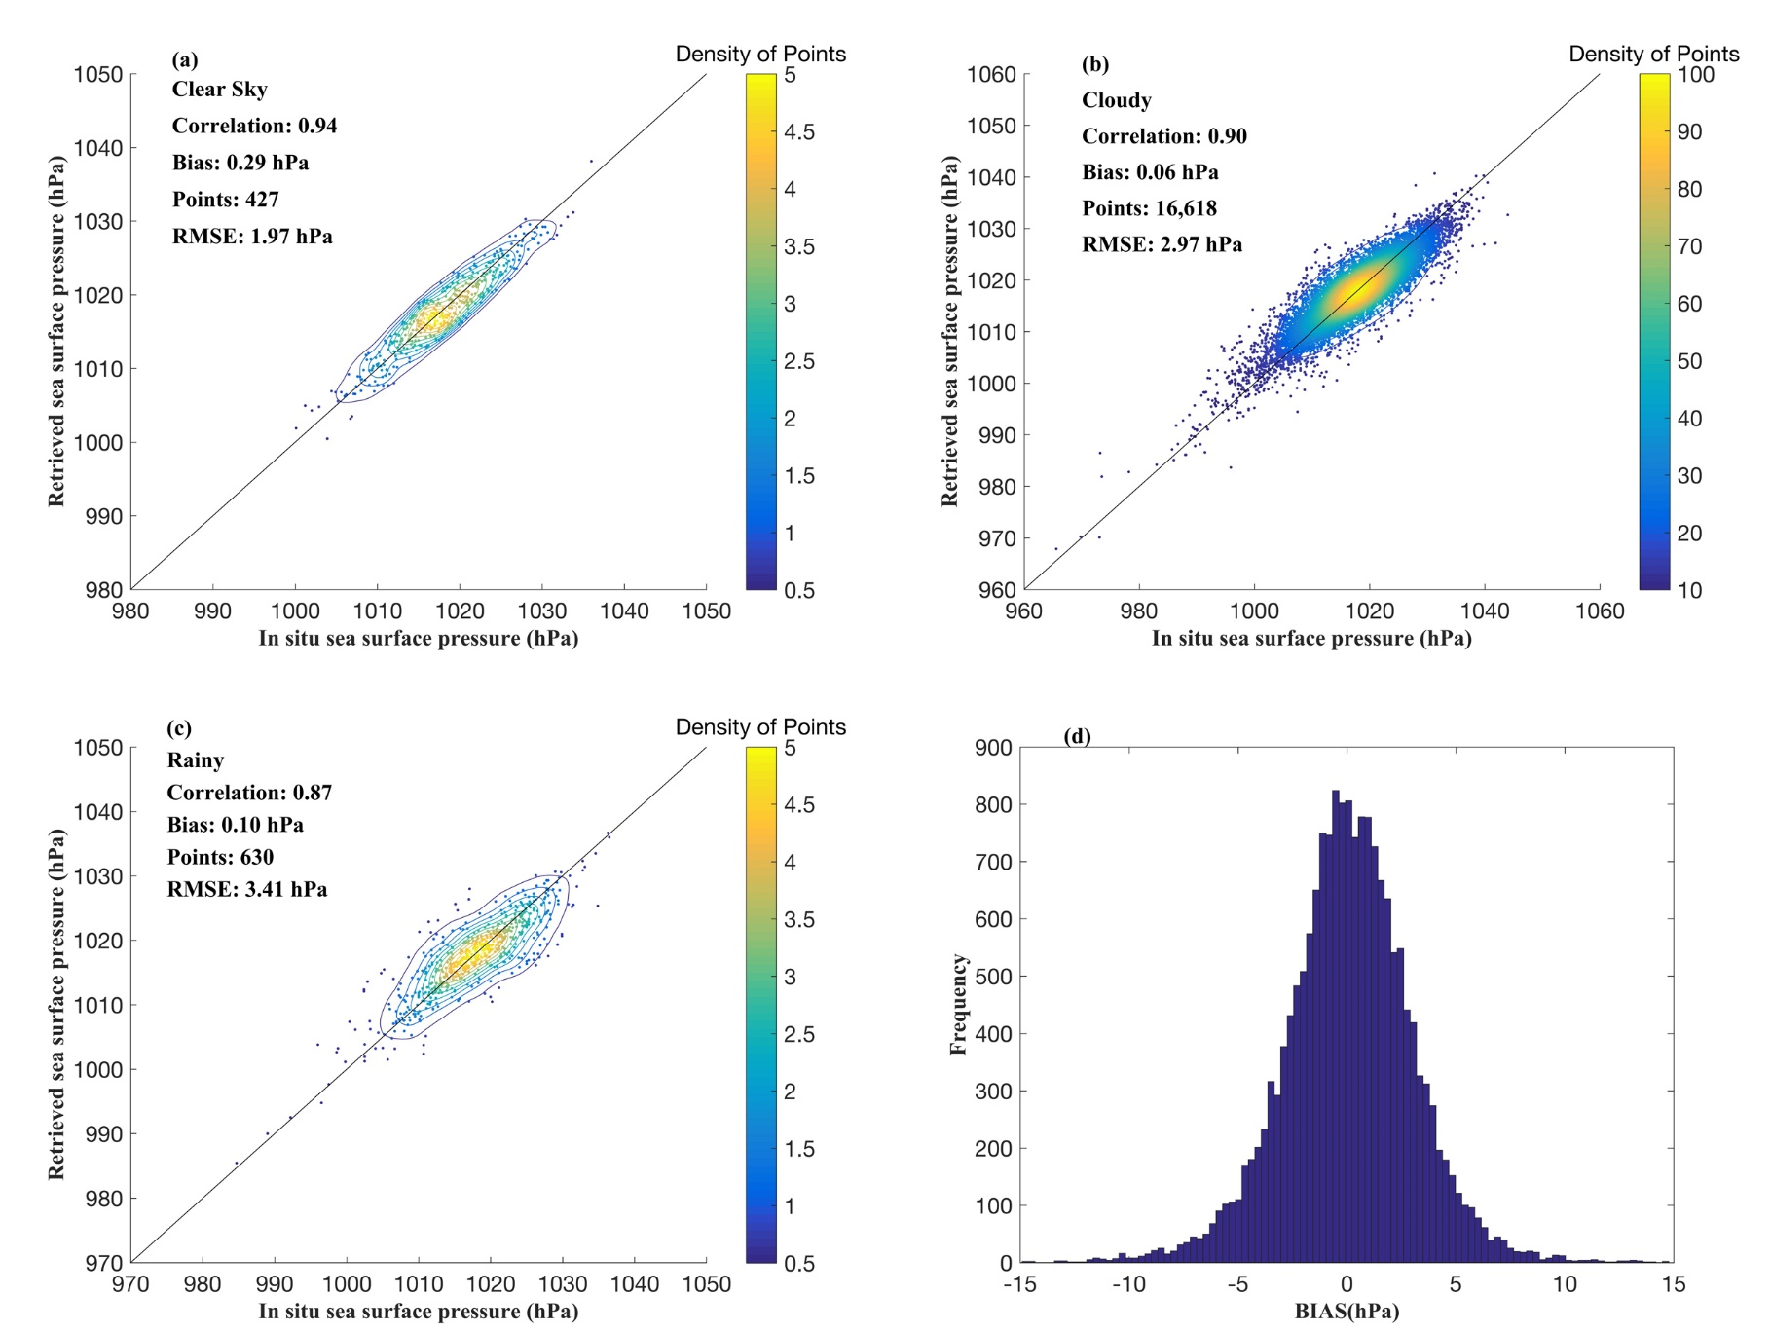
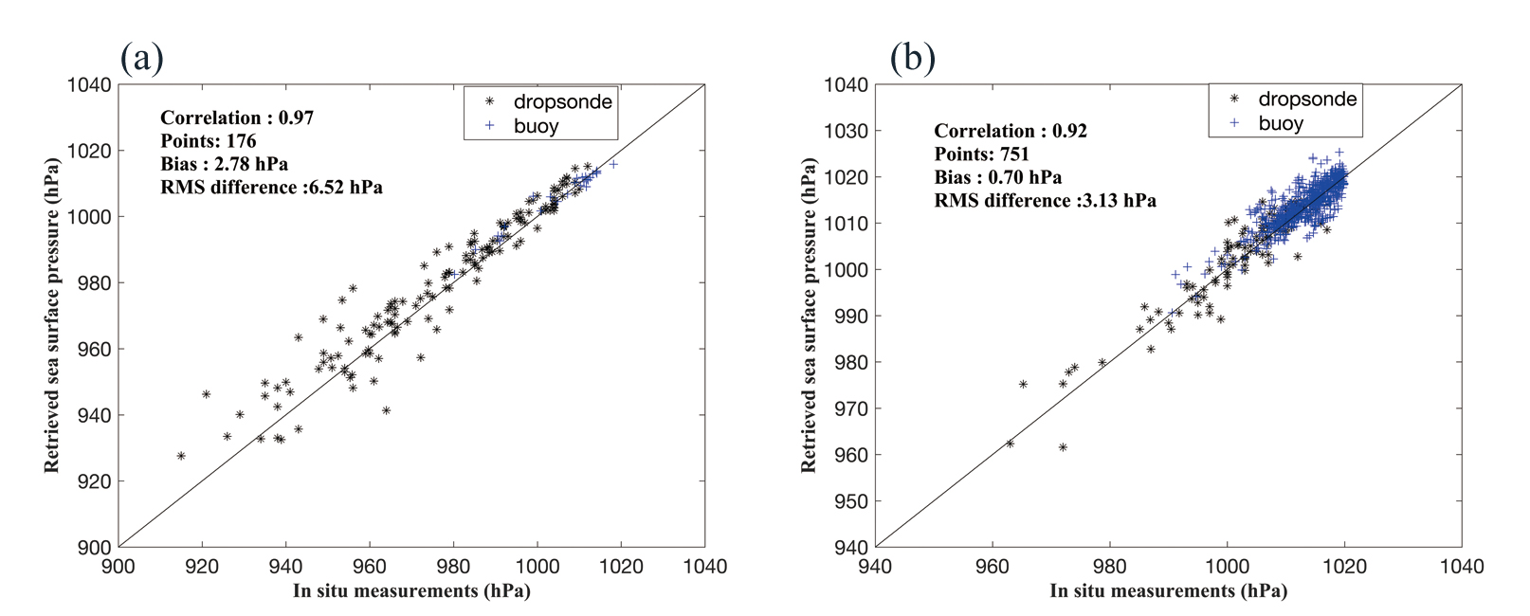
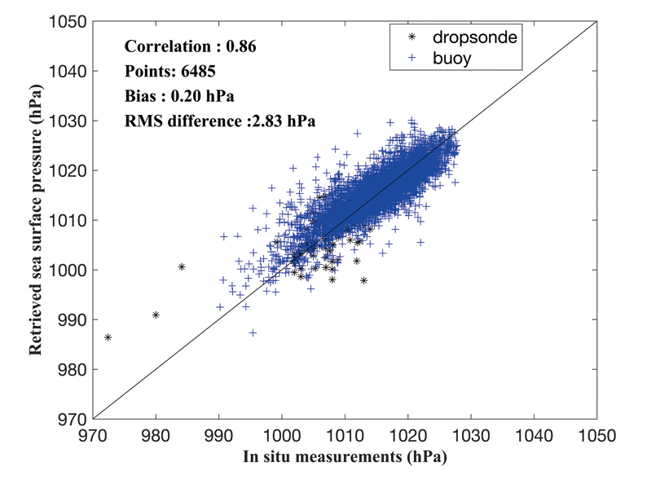
Preliminary assessment by comparing the retrievals from SNPP/ATMS data with in situ data
Progress of task CV-23-06
TC centers
TC core area
TC periphery

Slide 35
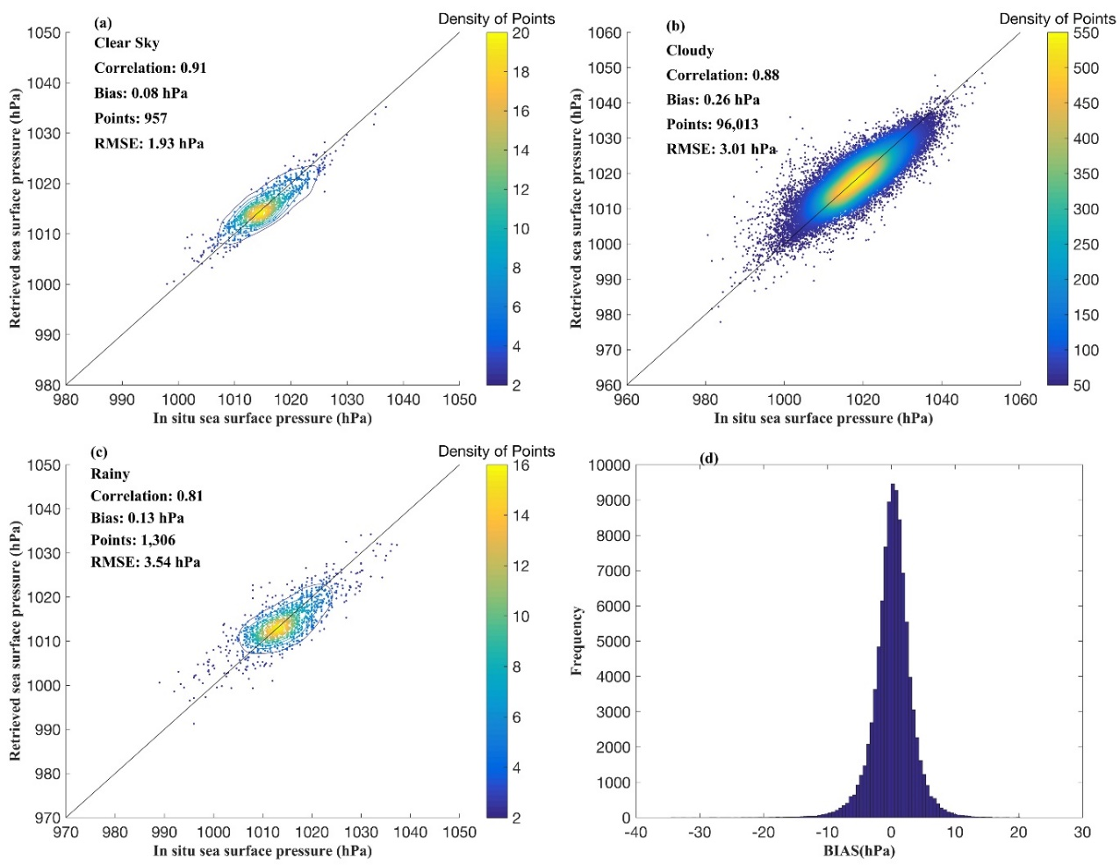
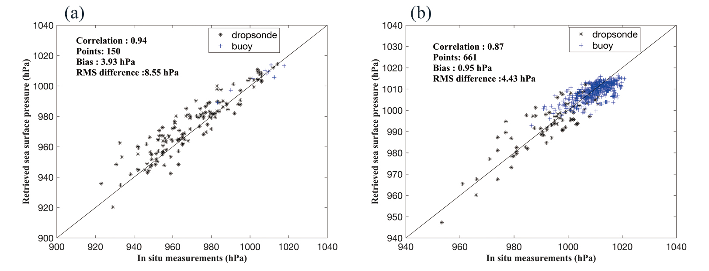
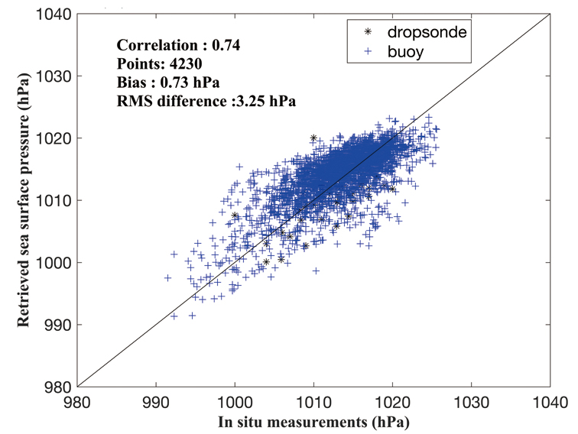
Preliminary assessment by comparing the retrievals from FY-3C/MWHTS data with in situ data
Progress of task CV-23-06
TC centers
TC core area
TC periphery

Slide 36
Summary of the preliminary assessment comparison results between retrievals and In situ data
Progress of task CV-23-06
Data source | RMSE (hPa)
 | Clear sky | Cloudy | Rainy | TC centers |  |  | TC core area | TC periphery
 |  |  |  | TD and TS | TY and HU | STY and Major HU
SNPP/ATMS | 1.97 | 2.97 | 3.41 | 4.26 | 6.38 | 9.61 | 3.13 | 2.83
FY-3C/MWHTS | 1.93 | 3.01 | 3.54 | 3.62 | 7.98 | 9.68 | 4.43 | 3.25
50-60 and 118 GHz microwave radiometer has a similar surface pressure sounding ability？
(Requires further validation because the FOVs of SNPP/ATMS and FY-3C/MWHTS are not overlap)

Slide 37



Progress of task CV-23-06
Comparison of retrievals using FY-3D/MWTS-II and FY-3D/MWHTS data
FY-3D/MWTS-II (50-60 GHz )
FY-3D/MWHTS(118 GHz)
The oxygen absorption characteristics are different
Their FOVs are partially overlap
50-60 and 118 GHz microwave radiometer, which has a better surface pressure sounding ability？
Using the joint passive microwave observations of 50-60 and 118 GHz for surface pressure retrieval, can retrieval accuracy be improved?

Slide 38

Comparison the retrievals from FY-3D/MWTS-II and FY-3D/MWHTS data with ERA-Interim reanalysis
Progress of task CV-23-06
MWTS-II
MWTS-II
MWTS-II
MWHTS
MWHTS
MWHTS
38

Slide 39

Compare the retrievals from FY-3D/MWTS-II and FY-3D/MWHTS data with ERA-Interim reanalysis
Progress of task CV-23-06
For clear-sky condition, the retrieval performance are similar;
For cloudy and rainy conditions, the retrieval performance of MWTS-II is better than MWHTS
MWTS-II
higher information content
less sensitive to cloud and rain
39

Slide 40




Comparison of the retrievals from FY-3D/MWTS-II and FY-3D/MWHTS data with NCEP analysis data
Progress of task CV-23-06
Retrievals using MWTS-II data for hurricane Humberto (AL092019).
Retrievals using MWHTS data
Retrievals correlate well with the NCEP GDAS/FNL analysis data.
NCEP GDAS analysis
1750 UTC, 15 Sep 2019
0614 UTC, 16 Sep 2019
1731 UTC, 16 Sep 2019
40

Slide 41

Comparison of the retrievals from FY-3D/MWTS-II and FY-3D/MWHTS data with NCEP analysis data
Progress of task CV-23-06
For tropical depressions, the performance are similar.
For tropical storms, typhoons and hurricanes, the retrieval performance of MWTS-II is slightly better than MWHTS.
MWTS-II
Higher surface pressure information content
Less sensitive to cloud and rain
Lower spatial resolution
41

Slide 42
Combined retrieval with the 50-60 and 118 GHz observations for surface pressure retrieval
Progress of task CV-23-06
Sensor | Central Frequency (GHz) | BW (MHz) | Sensitivity (K) | Information content of single channel | Cumulative information content
MWTS-II +MWHTS | 51.76 | 400 | 0.28 | 1.7164 | 1.7164
 | 50.3 | 180 | 0.37 | 0.2517 | 1.9681
 | 118.75±5.0 | 2000 | 0.27 | 0.0932 | 2.0613
 | 118.75±3.0 | 1000 | 0.27 | 0.0543 | 2.1155
 | 52.8 | 400 | 0.21 | 0.0344 | 2.1500
 | 54.4 | 400 | 0.19 | 0.0285 | 2.1785
 | 54.94 | 400 | 0.19 | 0.0148 | 2.1932
 | 53.596 | 400 | 0.18 | 0.0085 | 2.2017
 | 118.75±2.5 | 200 | 0.49 | 0.0071 | 2.2088
 | 118.75±1.1 | 200 | 0.52 | 0.0035 | 2.2123
 | 55.5 | 330 | 0.23 | 0.0028 | 2.2152
 | 118.75±0.8 | 200 | 0.65 | 0.0021 | 2.2172
Channels used for joint retrieval were selected based on the information content;
The weighted average method was used to match the FY-3D/MWHTS observations (~16km) to the FY-3D/MWTS-II (~32 km) resolution level;
Using the 60 and 118.75 GHz oxygen absorption bands together for surface pressure retrieval, more surface pressure information can be obtained;
The selected channel set is mainly composed of channels centered at the wing of the oxygen absorption band；

Slide 43

Comparison of the retrievals from FY-3D/MWTS-II + FY-3D/MWHTS data with ERA-Interim reanalysis
Progress of task CV-23-06
MWTS-II+MWHTS achieves better retrieval accuracy.
Using the 50-60 and 118 GHz passive microwave observations together for surface pressure retrieval, more surface pressure information can be obtained, and better retrieval accuracy can be achieved.
Data source | RMSE (hPa)
 | Clear sky | Cloudy | Rainy
MWTS-II | 1.95 | 2.77 | 3.47
MWHTS | 1.98 | 2.91 | 3.53
MWTS-II+MWHTS | 1.86 | 2.34 | 3.20

Slide 44
Progress of task CV-23-06
Main development issues
Ocean surface atmospheric pressure data with high spatiotemporal resolution can be retrieved from satellite passive microwave observations for both low and high wind conditions. In situ comparison demonstrates that the retrieval accuracy is better than 2.0 hPa for clear-sky, 3.0 hPa for cloudy, and 3.5 hPa for rainy, 6.0 hPa for TD and TS centers, 8.0 hPa for TY and HU centers, and 10.0 hPa for STY and Major HU centers, respectively; a joint retrieval algorithm is proposed to retrieve surface pressure over oceans using the observations of FY-3D/MWTS-II and FY-3D/ MWHTS together, which shows better retrieval accuracy;
Further optimization of the retrieval model and algorithm still needed;
Validation methodology and data sets need to be developed.
Next step
Combined retrieval with 50-60GHz and 118GHz data, validation and evaluation with reanalysis and in situ data
Team meeting for refining and review of deliverables

Slide 45
Other work in preparation
Promote the ISO TS on calibration and retrievals of sea surface wind by radar scatterometry, which furthers the deliverable of task CV-20-05.
CAL/VAL for sea surface wind and soil moisture data by GNSS-R.
Thanks!
dongxiaolong@mirslab.cn

