Slide 1
WGCV-53
TIRCalNet
Philippe Goryl, ESA/ESRIN,
Aimé Meygret, CNES,
Steffen Dransfeld, ESA/ESRIN
Agenda Item 2.4
WGCV-53, Córdoba, Argentina
5th - 8th March 2024

Slide 2
TIRCALNet Context
As per CNES WGCV presentation last year:
Several TIR missions operational: ECOSTRESS, ASTER, LANDSAT-8&9, MODIS, VIIRS, SLSTR, SEVIRI…
TIR future missions with higher resolution: TRISHNA, LSTM, SBG
More and more demanding LST accuracy requirements better than 0.1 K for climate studies
Importance of vicarious calibration for the validation of on-board calibration systems (black bodies) or direct calibration
L2 products (temperature & emissivity) validation need
In addition numerous new space TIR companies are about to be launched: ConstellR, Ororatech, Aistech,…

Slide 3
TIRCALNet Objectives
To collect surface temperature and emissivity, and atmospheric data necessary for the simulation of observations by TIR optical sensors and thus verify their radiometric calibration
To increase the number of matchups between in-situ measurements and space sensor observations and reduce the overall uncertainties, and reduce the efforts of individual agencies
To ensure traceability of the space sensor radiometry to the “Système International” (SI)
To support the establishment of the Global Earth Observation System of Systems by providing measurements to verify the radiometric consistency between EO space sensors
The success and experience return from RadCalNet network dedicated to VNIR-SWIR optical sensors cal/val

Slide 4
Current Limitations of LST Sites
Spatial representativeness of the in situ reference measurements
Directional effects
Lack of emissivity measurements
Data access
Data harmonization
Do not provide TOA radiances
Data quality assurance (error budget traceable to SI)
In situ instruments calibration quality and traceability
Needs for the development of denser ground-based reference Network

Slide 5
First activities for TIRCALNet
ESA and CNES defined after discussions with domain and agency (CNES, ESA & NASA) experts that TIRCALNet should be able to provide TOA Brightness Temperature signals propagated from BOA measurements of ~ 0.5K uncertainty and a set of tasks were identified :
Task 1 → Identification of uncertainty contributors to TOA-derived BT
Task 2 → Sensitivity analysis of uncertainties on TOA BT estimation
Task 3 → Definition of best site characteristics, optimal instrumentation and forward propagation scheme
Task 4 → Selection of potential candidate sites based on Task 3
Task 5 → Interaction with Working Groups and network roadmap

Slide 6
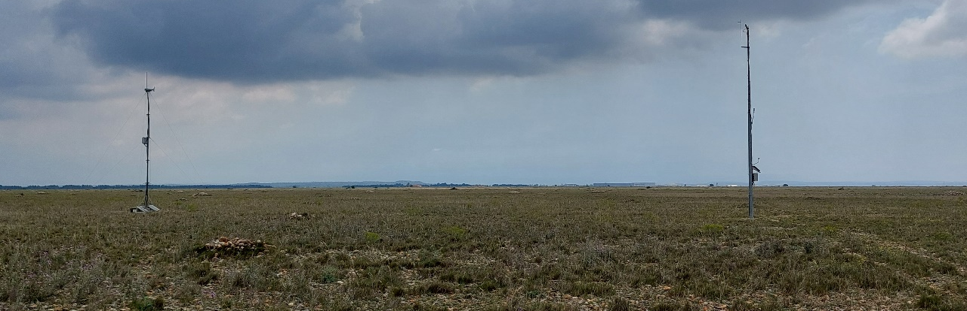
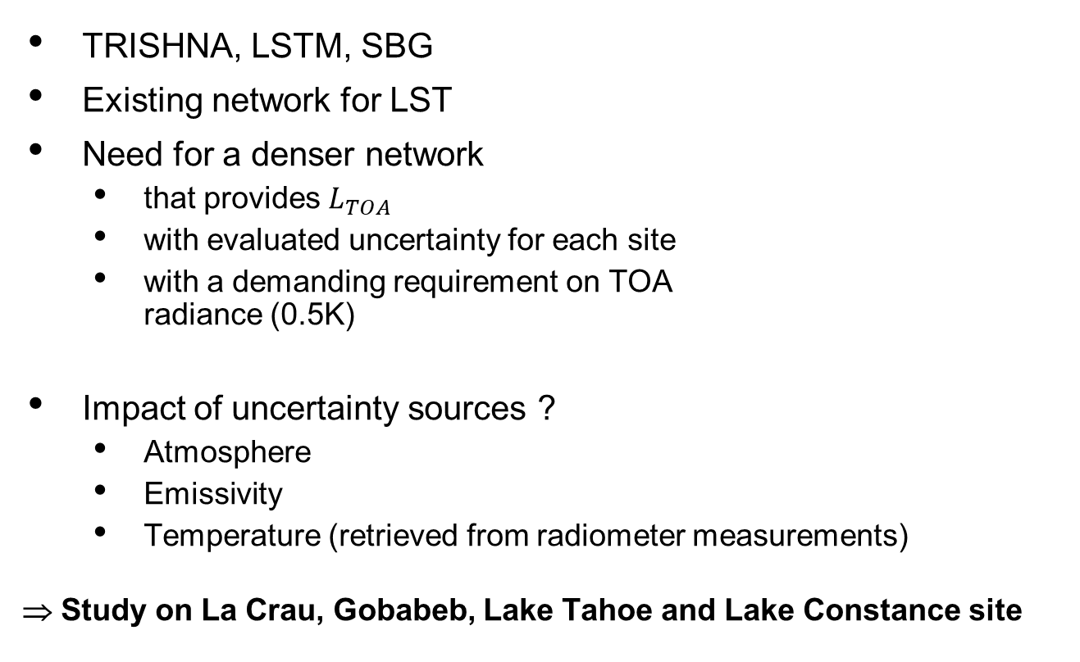
Site Study Objectives
TRISHNA, LSTM, SBG
Existing network for LST
Need for a denser network
  that provides $L_{TOA}$
  with evaluated uncertainty for each site
  with a demanding requirement on TOA
  radiance (0.5K)
Impact of uncertainty sources ?
  Atmosphere
  Emissivity
  Temperature (retrieved from radiometer measurements)
  ⇒ Study on La Crau, Gobabeb, Lake Tahoe and Lake Constance site
6

Slide 7







TIR instrumented site
Uncertainty budget (Tasks 1 & 2)
  Radiative transfer equation
  $$L_{TOA}=L_{atm}^{↑}+τ^{↑} \left( ε L_{BB}\left(T_{S}\right)+\left(1 −ε\right) L_{atm}^{↓} \right)$$
  Assumptions:
    Lambertian surface
    Nadir satellite
    Atmospheric profiles (ECMWF) + RTTOV with IASI high resolution spectral bands: $L_{atm}^{↑}\left(λ\right)$ , $L_{atm}^{↓}\left(λ\right)$, $τ^{↑}\left(λ\right)$
    Surface emissivity $ε\left(λ\right)$:
        - La Crau: Labed 91 for soil
        - Gobabeb: MAST2 (ONERA measurement, FICE campaign)
        - Lake Constance: Tap Water (JHU)
        - Lake Tahoe: Tap Water (JHU)
    Radiometer measurement $L_{radiometer}$ simulated for surface temperature retrieval
    ⇒ Derived quantities: surface temperature ${\tilde{T}}_{S}$ + uncertainty
⇒ Emissivity uncertainties drive the overall TOA uncertainty.
$$L_{TOA}\left(λ\right)$$
$$L_{atm}^{↓}\left(λ\right)$$
$$L_{atm}^{↑}\left(λ\right) \\ τ^{↑}\left(λ\right)$$
$$L_{radiometer}$$
$T_{s}$ , $ε\left(λ\right)$
Notes:
IASI : high spectral resolution 0.25 cm-1 (1 to 5 nm in [8-12]µm interval).

Slide 8
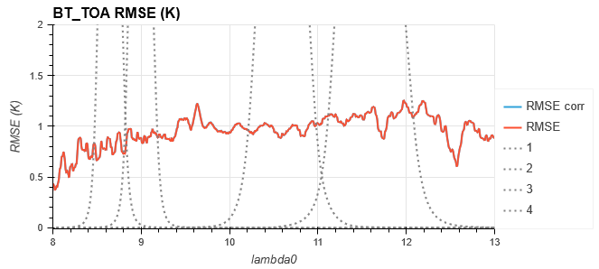
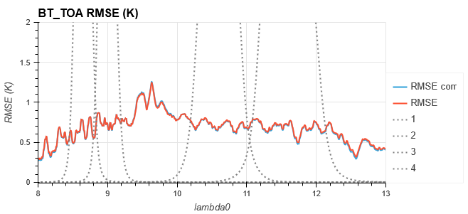
Uncertainty budget : La Crau
  Uncertainty on emissivity at IASI spectral resolution : std 0.02 (+ std 0.01 on mean emissivity)
  Emissivity spectrum : Labed&Stoll91
  JPL radiometer
  Better performance for wet months because of the higher atmosphere contribution (reduce the impact of the emissivity errors on TOA radiance)
Driest month : January
Wettest month : November

Slide 9
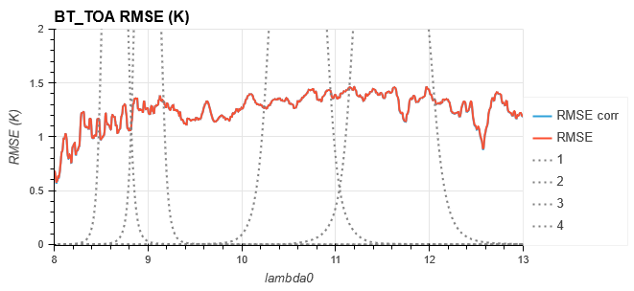
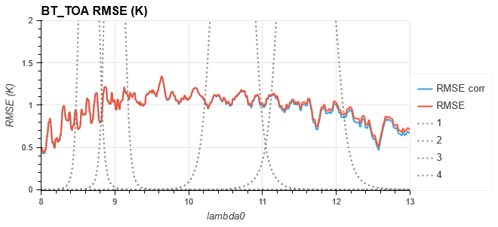
Uncertainty budget : Gobabeb
  Uncertainty on emissivity at IASI spectral resolution : std 0.02 (+ std 0.01 on mean emissivity)
  Emissivity spectrum : MAST2 (ONERA measurement, FICE campaign)
  KT15 radiometer
Driest month : September
Wettest month : February
Notes:
Same uncertainty on radiometer, just another instrument spectral response function

Slide 10
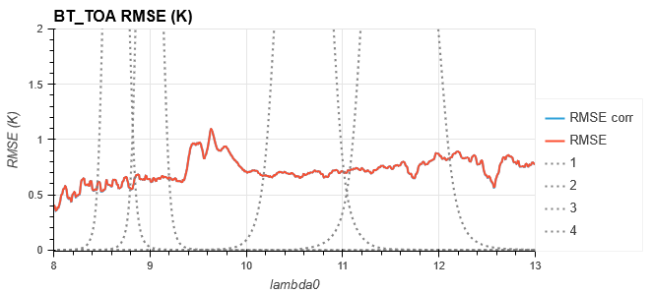
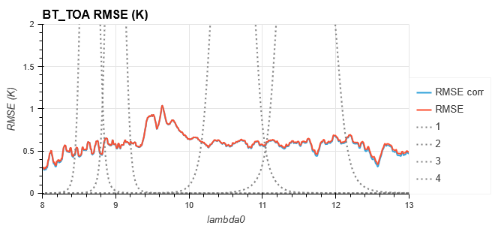
Uncertainty budget : Lake Constance
  Uncertainty on emissivity at IASI spectral resolution : std 0.015 (+ std 0.01 on mean emissivity)
  Emissivity spectrum : Tap Water (JHU)
  KT15 radiometer
  0.5 K objective marginally reached for Lake Constance
Driest month : March
Wettest month : June

Slide 11
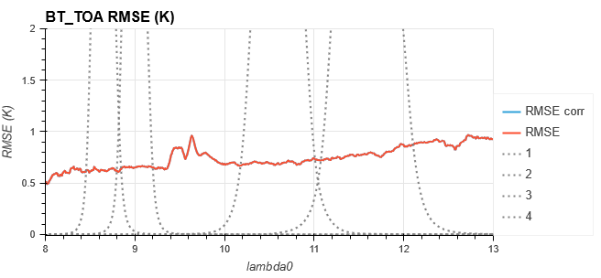
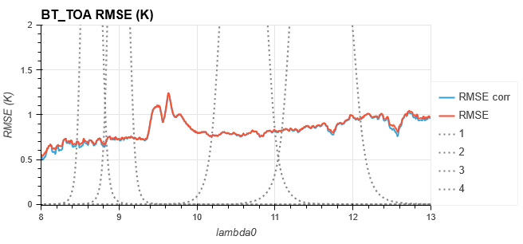
Uncertainty budget : Lake Tahoe
  Uncertainty on emissivity at IASI spectral resolution : std 0.015 (+ std 0.01 on mean emissivity)
  Emissivity spectrum : Tap Water (JHU)
  JPL radiometer
  ECMWF surface temperature for Lake Tahoe to be consolidated for this case (higher than expected)
  ⇒ A better performance is expected…
Driest month : February
Wettest month : September

Slide 12
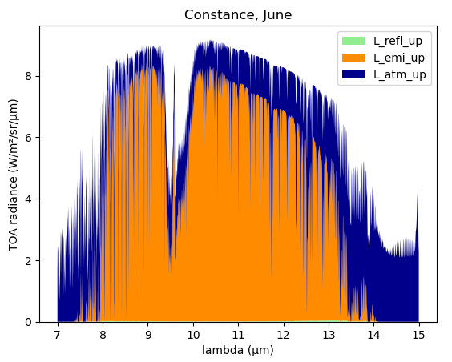
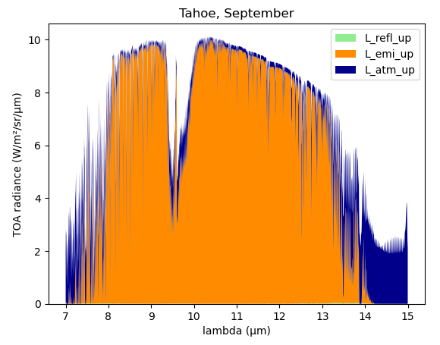
CNES study - synthesis
Confirmation that the main impact on TOA Brightness Temperature is the uncertainty on the ground emissivity. Uncertainties on the atmospheric profiles is an issue but of lesser impact.
Atmosphere (L_atm_up ) tends to compensate errors on surface emissivity: lower errors for Lake Constance than Lake Tahoe
Emissivity and atmosphere errors hypothesis have to be consolidated
Wettest month : June
Lake Tahoe, wettest month : September
12

Slide 13
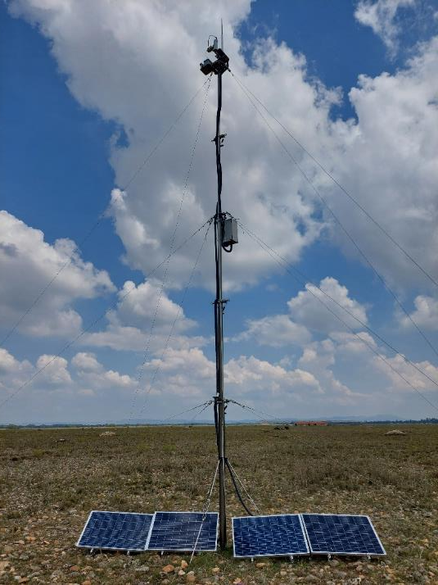
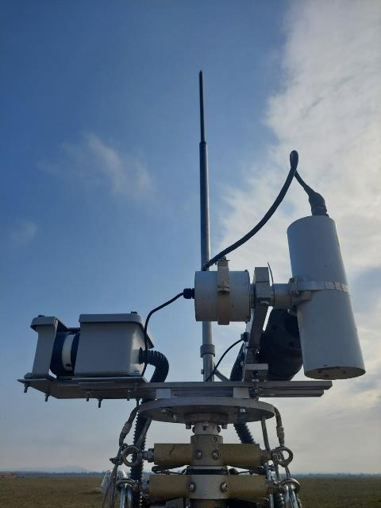
CNES study – next steps
To improve the surface emissivity caracterization :
- Deploying and comparing dedicated instrumentation for Temperature/Emissivity separation:
- CIMEL CE312 (6 spectral bands)
- 4 KT 15 (with TRISHNA like bands)
- Emissivity box under construction
Assess the performances of a radiance based method (that is pushing TOA the BOA surface radiance measured by in situ radiometers without retrieving Temperature and Emissivity)
Delivery: Error budget technical note + code (beginning of march)

Slide 14
Next steps towards other sites
ESA have started a TIRCALNet Preparation Study end of 2023:
Transfer of CNES La Crau uncertainty budget template to other sites (e.g. from ESA LAW project) and perform similar simulations to gain an understanding how site environment may influence the uncertainty.
Develop a full site uncertainty budget template inclusive of atmospheric, forward propagation, instrumentation and site environment uncertainties
Development of a site measurement and forward propagation protocol to minimise uncertainties at TOA
Analysis of site characteristics (surface, cloud cover, etc.) to find possible candidate sites (e.g. Lake Tahoe, Acqua Alta platform, Russel Ranch
Develop a roadmap to equip and operate sites
Discussions with partnering agencies on how to collaborate and set up and operate networks (funding for instrumentation, site operation, data analysis, supporting studies, etc.)

Slide 15
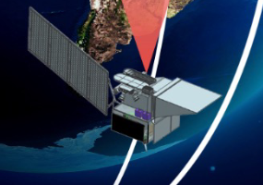
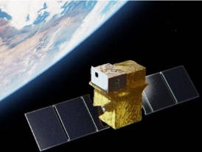
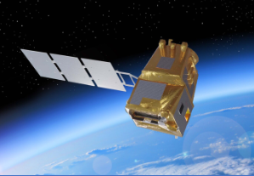
Internation Working Group
The study aims to create and provide input to an International Working Group aiming to set up TIRCALNet
JPL-NASA
Operating Lake Tahoe and Salton Sea Calibration sites
Long data record since 1998
Providing operational Cal/Val for several TIR missions and preparing for SBG-TIR
CNES
Operating La Crau calibration site
Ramping up Cal/Val facility for TRISHNA mission
ESA
Sentinel-3 LST operator, CCI-LST, FRM4STS
LSTM Cal/Val preparation
Support to new space companies
CSIRO
Interest to assess and set up a site at Pinnacles Desert
INGV
Operating a radiometer at Acqua-Alta platform in Venice lagoon
Preparations for SBG-TIR mission Cal/Val

Slide 16
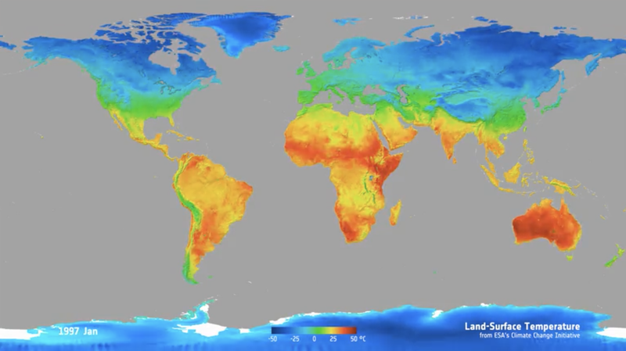
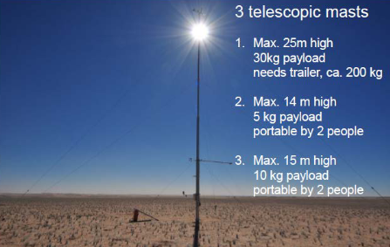
Link to other Projects & Networks
ASTeRN: Advanced Surface Temperature Radiometer and global Network
Network consisting of 6 new sites for LST led by RAL SPACE
Deployments starting in 2024
SLSTR and LSTM L2 Processor Development and associated Cal/Val expertise at University of Leicester
LST-CCI involving both University of Leicester and KIT
Provides the needs for stability criteria at L1 for climate datasets
Strong driver for a network and longterm operation scheme
FRM4STS project led by KIT
Field radiometer intercomparison exercises (FICE)
In situ and lab-based emissivity characterisations

Slide 17
Outlook for TIRCALNet
Current ESA preparatory study started and going on for 18 Months
Main project output will be a site prototype design and a roadmap towards an operational network that provides much needed TIR ToA anchoring points for radiometry cal/val
The Working Group will then have to establish similar to Radcalnet a framework to equip sites as needed and start operating them.
Still early to say when but at some stage beta-users from TIR mission operating entities will need to be included in the data uptake and assessment as this is ultimately a support to ensuring well calibrated thermal data !
Thank you very much for your attention !

