Slide 1
WGCV-53
CEOS FRM MM tool Exercise
Paolo Castracane, Rhea for ESA/ESRIN
Nigel Fox, NPL
Agenda Item 2.6
WGCV-53, Córdoba, Argentina
5th - 8th March 2024

Slide 2
ToC
CEOS FRM Maturity Matrix exercise
Outcomes from the pilots
General Considerations
Feedback about the tool
Discussion

Slide 3
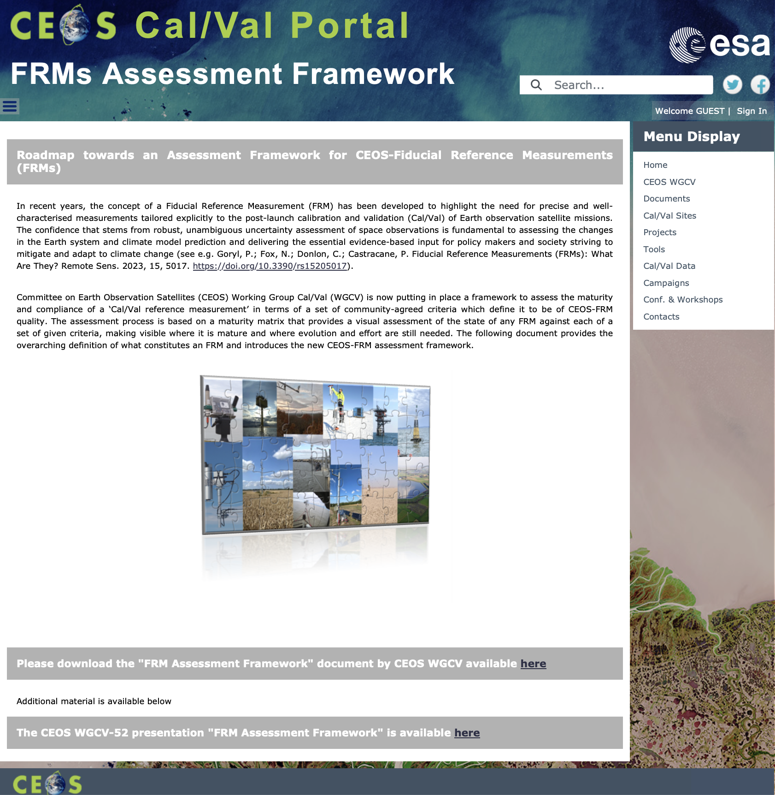
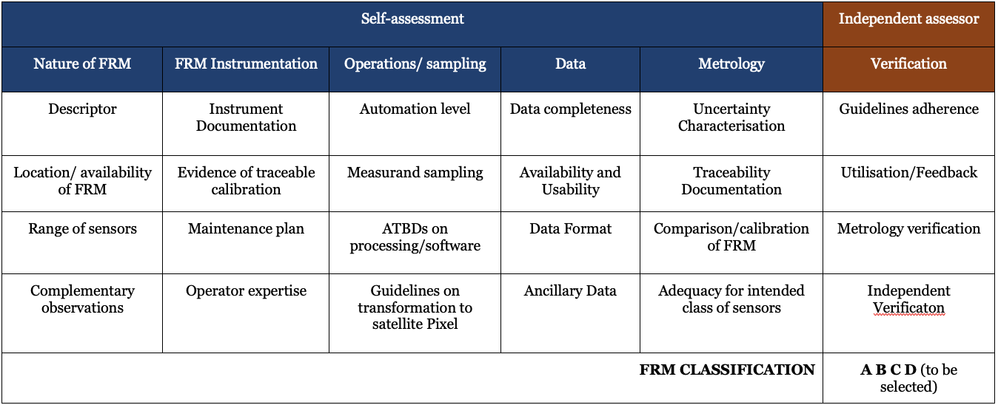
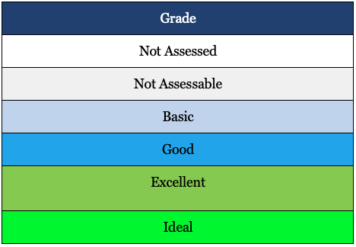
CEOS FRMs Assessment Framework
Roadmap towards an Assessment Framework for Fiducial Reference Measurements (FRM)
https://calvalportal.ceos.org/web/guest/frms-assessment-framework
The purpose of the document is to propose a roadmap towards an assessment framework to endorse a specific class of measurements as a Fiducial Reference Measurement (FRM).
Background and Objectives
FRM Definition and Principles
FRM Endorsement Process
FRM Maturity Matrix
FRM Overall Classification
Goryl, P.; Fox, N.; Donlon, C.; Castracane, P. Fiducial Reference Measurements (FRMs): What Are They? Remote Sens. 2023, 15, 5017. https://doi.org/10.3390/rs15205017.

Slide 4
Pilots for CEOS FRM Assessment
CEOS FRM MM – PGN (Pandonia Global Network) - Stefano Casadio
CEOS FRM MM - RadCalNet (Radiometric Calibration Network) - Marc Bouvet
CEOS FRM MM – ICOS (Integrated Carbon Observation System – Ecosystem Component) - Fabrizio Niro
CEOS FRM MM - FRM4DOAS (Ground-Based DOAS Air-Quality Observations) - Michel Van Roozendael Jean-Christopher Lambert
CEOS FRM MM- BAQUNIN (PREDE-POM LUNAR) – Stefano Casadio
CEOS FRM MM – CSIRO (DION) – Matt Garthwaite/Janet Anstee.
CEOS FRM MM - Brewer Spectrometer Measurements - Henri Diemoz. (in progress)
CEOS FRM MM - Hypernets - Nigel Fox. (in progress)
Maturity Matrix Tool
https://mmt.skytek.dev
Dedicated credentials provided for all the selected pilots
Support provided by Jarek Dobrzanski (Skytek, Ireland https://skytek.com/)
Slide ‹#›

Slide 5
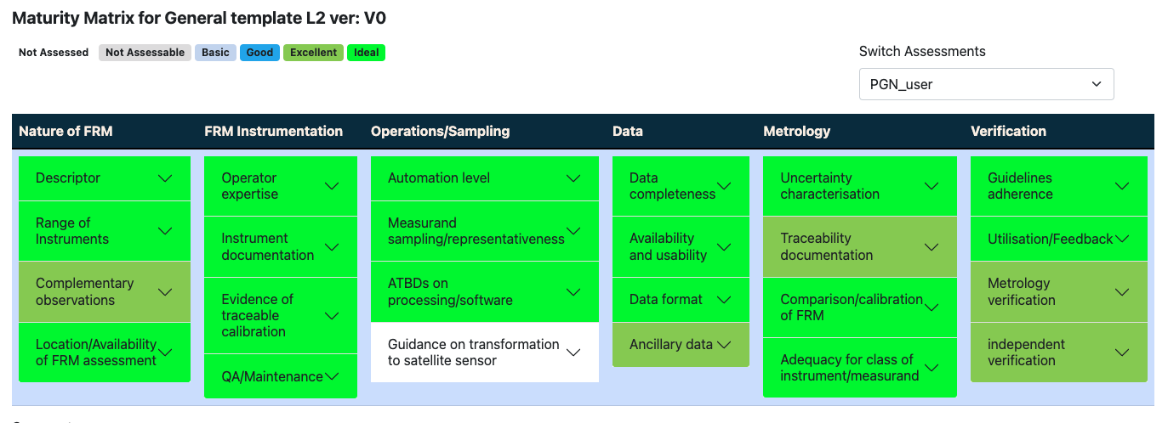
CEOS FRM – PGN Assessment
CEOS FRM
Class A
Slide ‹#›

Slide 6
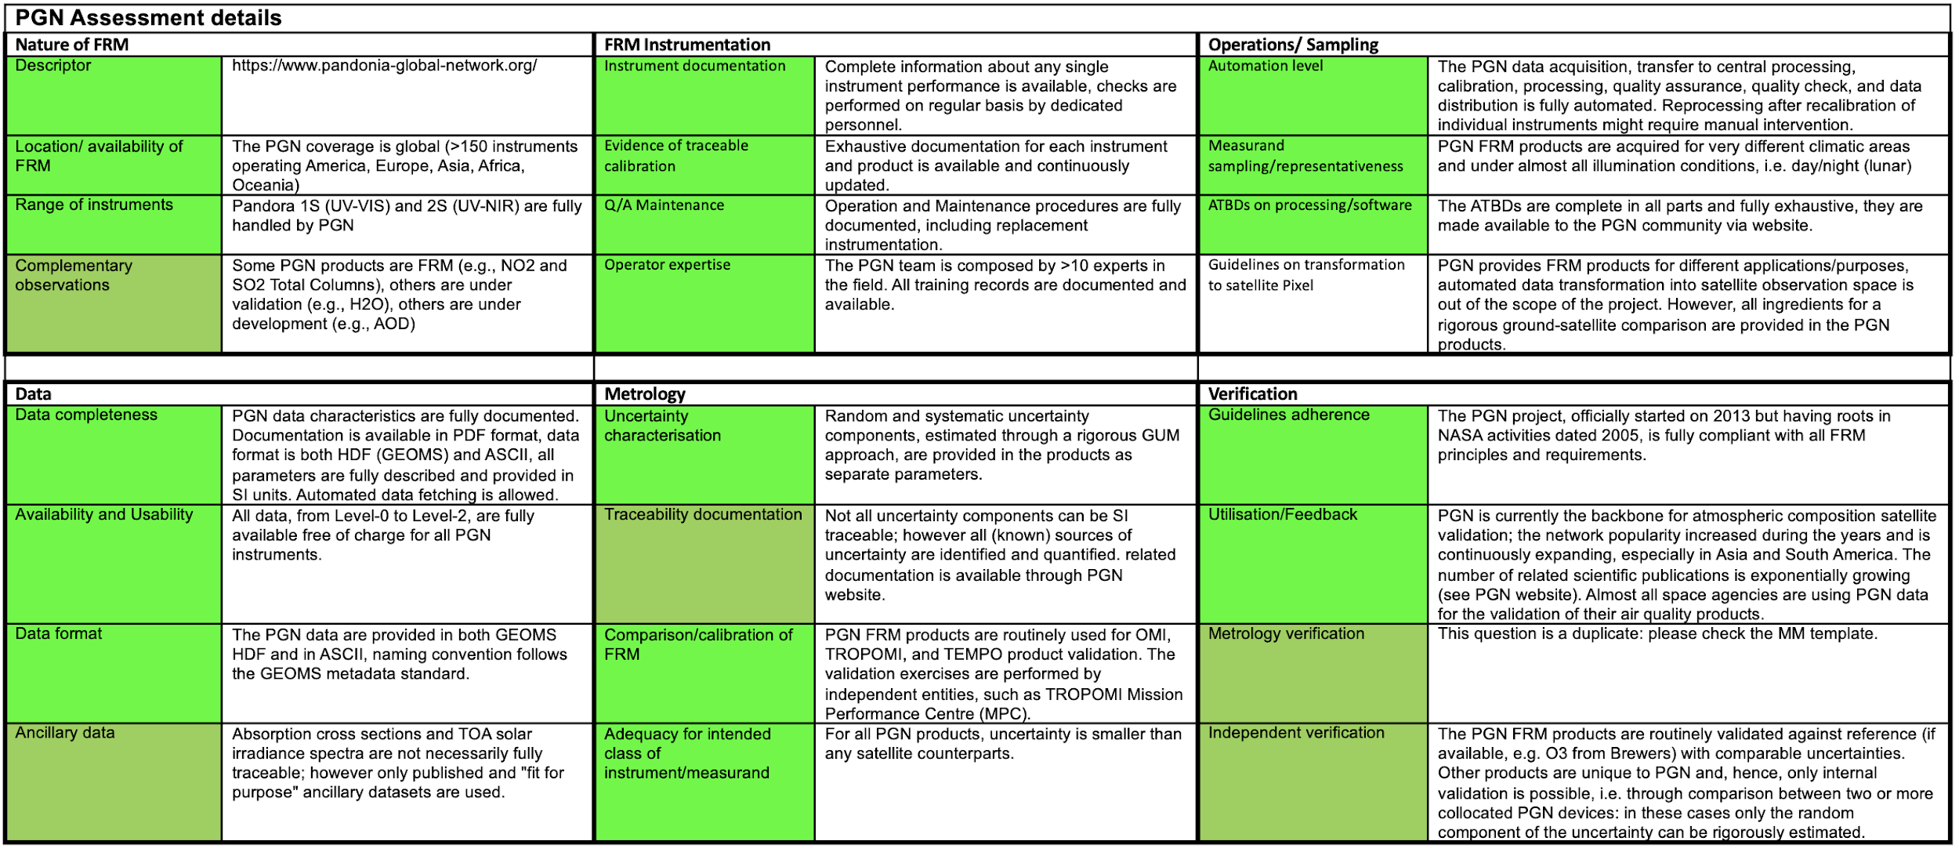
CEOS FRM – PGN Assessment: Details

Slide 7
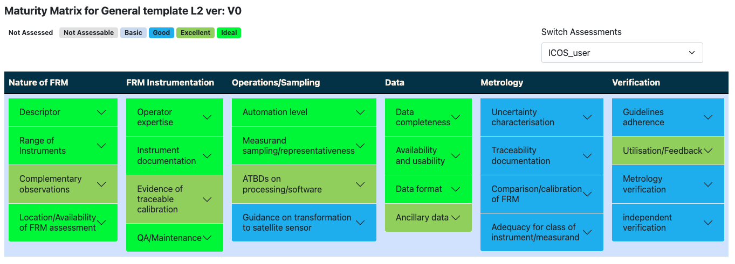
CEOS FRM – ICOS (Ecosystem Component) Assessment
CEOS FRM
Class C
General considerations about ICOS
ICOS is an environmental monitoring network, whose main objective is to monitor ecosystem responses to natural and human-induced changes. The main infrastructure at the ICOS sites are the eddy-covariance flux towers, for measuring GHG and energy fluxes at ecosystem scale.
ICOS is divided in three main components: atmosphere, marine and ecosystem. Within this exercise, I focused on the Ecosystem component.
ICOS was not originally designed for satellite validation. However, ICOS measurements include a number of variables, which are of interest for satellite validation. In this assessment I focused on radiation and vegetation variables, mainly FAPAR and LAI. For those variables, there are no existing validation networks, while the common approach (e.g., GBOV) is to build on existing infrastructure (ICOS, NEON, TERN) to perform satellite validation at global scale.
Overall, ICOS appears to be a good/excellent source of reliable validation data. Yet, the issue of upscaling to satellite pixel is not addressed. The main gap at the moment is the compliancy to metrological guidelines, with no use of rigorous uncertainty tree diagrams and little information about traceability. This gap mainly impact the Ecosystem component, while stricter requirements for traceability exist for the Atmospheric component, with tight links to WMO standards.
There is a strong willingness and a clear path towards fostering the use of ICOS data for satellite validation. As part of this endeavor, best practices are being refined with stronger attention to uncertainty and traceability requirements. One example, is the prototyping of an automated SI-traceable network of PAR sensors for FAPAR/LAI validation. This set-up is now being considered as the reference and the intention is to deploy it in all ICOS Ecosystem sites.
As a result of the above mentioned and other on-going R&D projects, the compliancy of ICOS Ecosystem component to FRM criteria is expected to improve in the coming 2-3 years. The CEOS-WGCV-LPV is closely following this evolution and will facilitate those improvements.

Slide 8
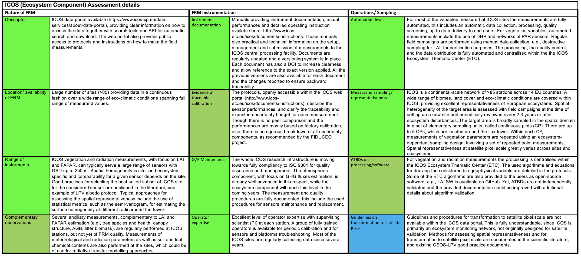
CEOS FRM – ICOS (Ecosystem Component) Assessment Details 1/2

Slide 9
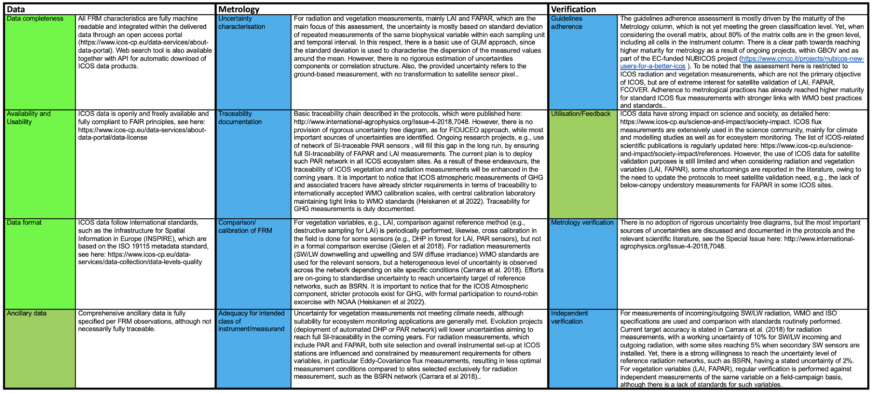
CEOS FRM – ICOS (Ecosystem Component) Assessment Details 2/2

Slide 10
CEOS FRM – RadCalNet Assessment
CEOS FRM
Class C
General Comments:
Main gaps at the moment for FRM Instrumentation – “QA/Maintenance”; Operations/Sampling – “Guidance on transformation to satellite sensor”; Metrology – “Adequacy for class of instrument/measurand”. For the Verification category the “Independent Verification” appears to be the main lack.
Notes:
“

Slide 11
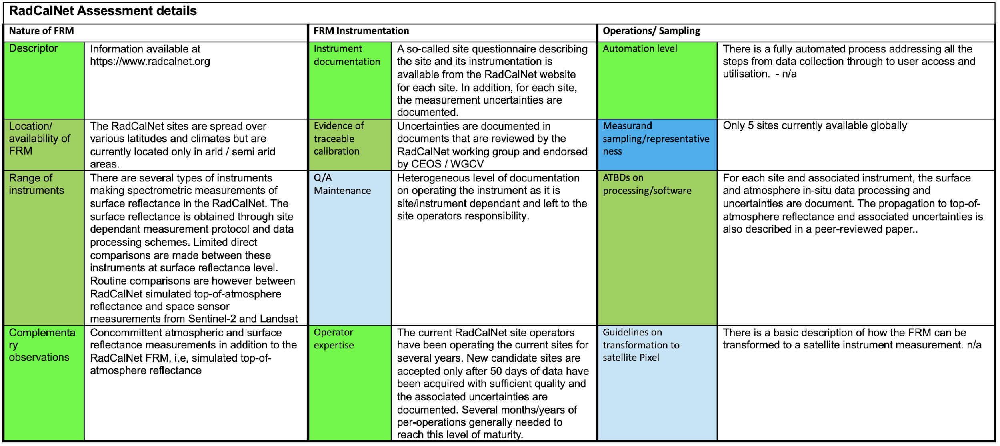
CEOS FRM – RadCalNet Assessment: Details 1/2

Slide 12
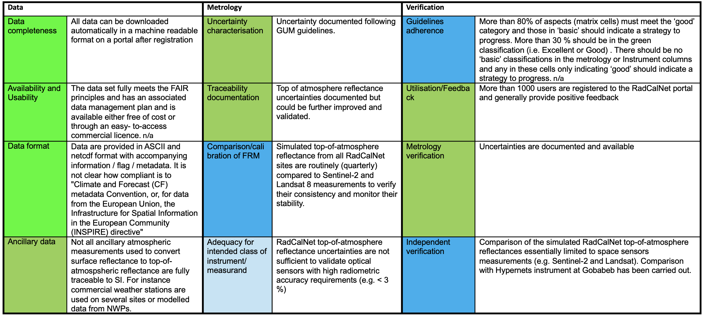
CEOS FRM – RadCalNet Assessment: Details 2/2

Slide 13
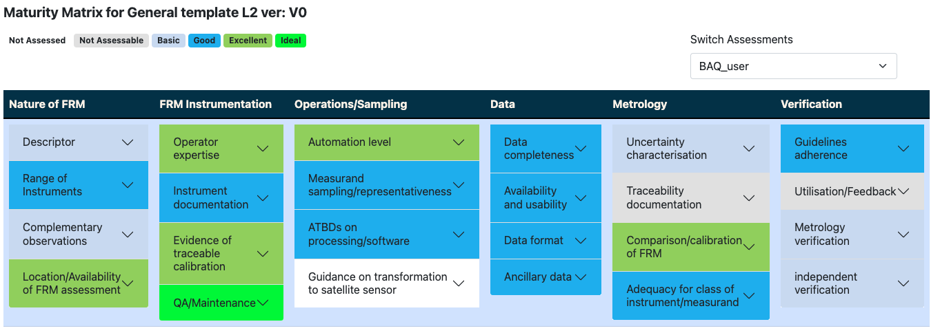
CEOS FRM – PREDE-POM LUNAR Assessment
CEOS FRM
Class D

Slide 14
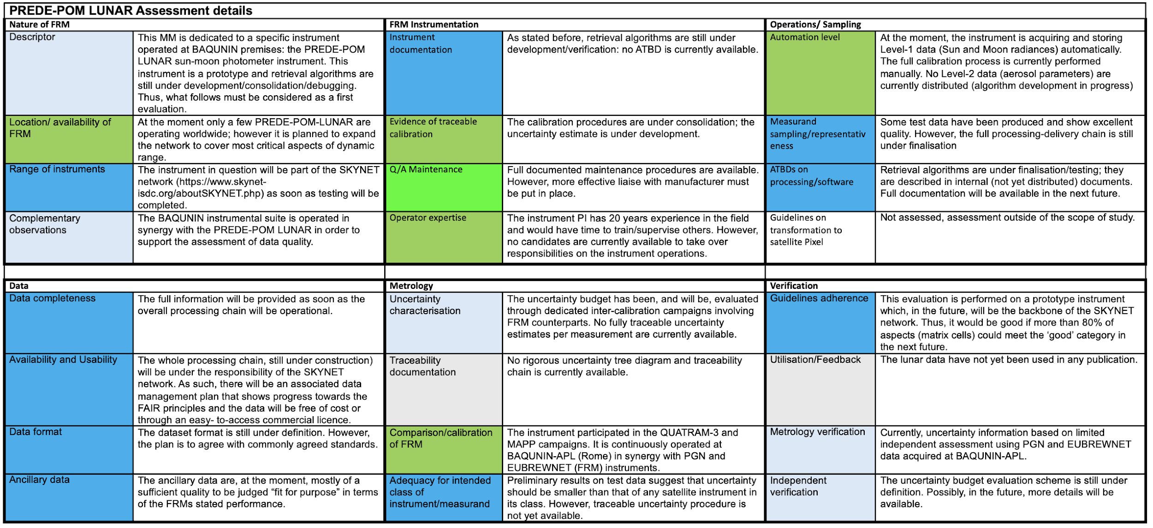
CEOS FRM – PREDE-POM LUNAR Assessment: Details

Slide 15
CEOS FRM – FRM4DOAS (Ground-Based DOAS Air-Quality Observations)
CEOS FRM
Class D

Slide 16
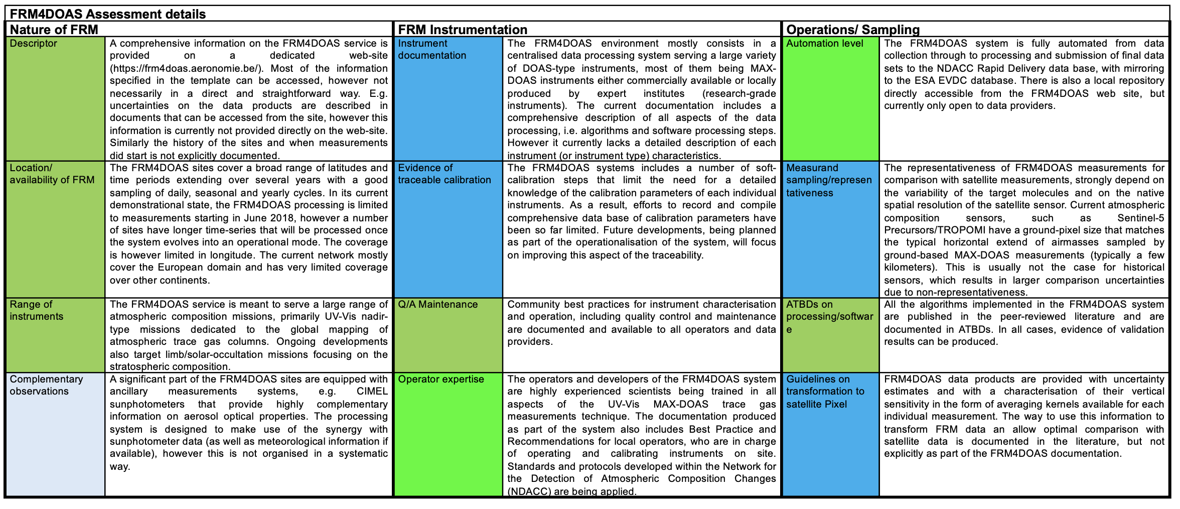
CEOS FRM – FRM4DOAS Details

Slide 17
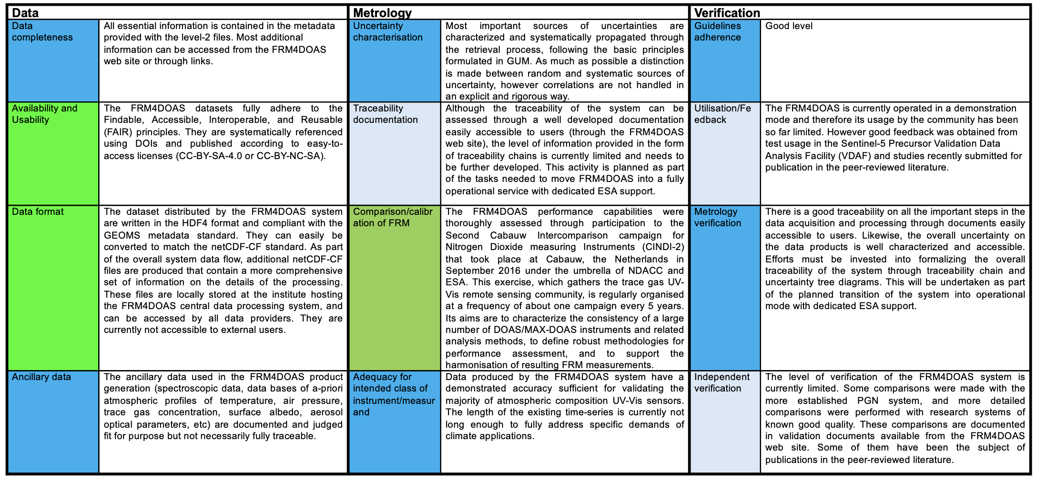
CEOS FRM – FRM4DOAS Details

Slide 18
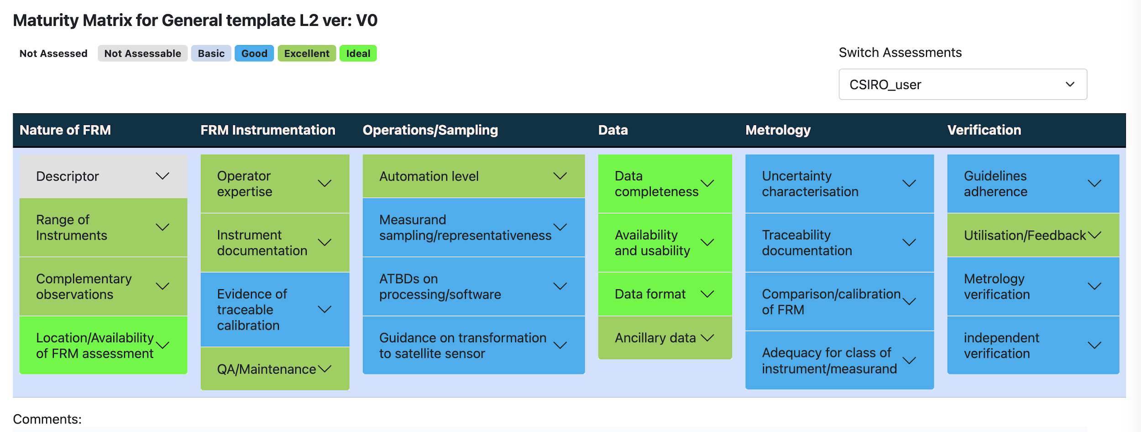
FRM MM CSIRO user
CEOS FRM
Class C

Slide 19
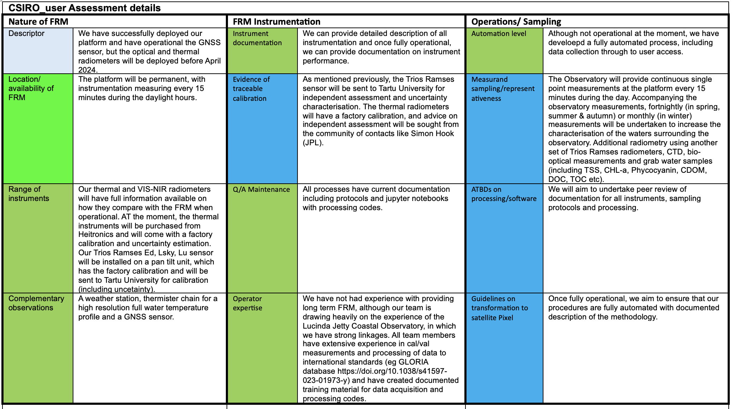
CSIRO FRM MM Details 1/2

Slide 20
CSIRO FRM MM Details 2/2

Slide 21
General considerations/discussion:
FRM Classification A,B,C,D is – by definition - related to the Verification category (last column).
This may affect measurements that are of high maturity for most of the categories except for Verification see e.g.: ICOS, RadCalNet or FRM4DOAS examples.
There is room for subjectivity in providing answers. Mitigation: Verification from an independent actor(s) – this triggers an essential interactive process ; Important to add comments, references and any other additional info/proofs for the assessment.

Slide 22
Feedback about the Tool
Overall, the tool is quite easy to use and well designed. In the “View Matrix” mode, and clicking on the single cell, I don’t like the very long and difficult to read text, I think it would be better to have a larger textbox, which appears when hovering with the mouse, or something like that.
Concerning the actual matrix compilation, we should find ways to better explain the possible answers, especially for data providers, which are not familiar with uncertainty tree diagrams and other metrological concepts. You can add textbox with examples, or links, or any other documentation.
It would be useful to generate an assessment report in pdf at the end, where you find the full matrix together with the detailed answers to all questions.
Finally and more importantly, we should find ways to encourage the assessor to provide evidence of his assessment, it could be reference papers, links, reports, sample data. Otherwise we cannot verify the FRM assessment. Perhaps, you can add a textbox when compiling the matrix, under the “Comments” textbox, it could be something like “Supporting documents/references”.

