Slide 1
WGCV-53
WGCV response to Cal/Val related GCOS IP actions: Discussion
Philippe Goryl, ESA/ESRIN,
Agenda Item 2.8
WGCV-53, Córdoba, Argentina
5th - 8th March 2024

Slide 2
Table of Contents
Implementation Plan – intro
Actions for Agencies
Priority for WGCV – TBC
Activities B1.3 and B5.1 proposed
Discussion

Slide 3
The 2022 GCOS Implementation Plan Space Agencies Supplement
This Implementation Plan aims at identifying the major practical actions that should be undertaken in the next 5-10 years. It identifies six major themes that should be addressed. Within each theme, several actions are identified.
This supplement only lists those actions within each theme that are targeted at the Space agencies. Within each action the specific activities for the Space agencies are highlighted in bold.

Slide 4
Actions for Space Agencies
Theme | Actions | WGCV involvement
A: ENSURING SUSTAINABILITY | A2. Address gaps in satellite observations likely to occur in the near future
 | A3. Prepare follow-on plans for critical satellite missions
B: FILLING DATA GAPS | B1. Development of reference networks (in situ and satellite Fiducial Reference Measurement (FRM) programs) | X (Wenying Su)
 | B3. New Earth observing satellite missions to fill gaps in the observing systems
 | B5. Implementing global hydrological networks | X (Wenying Su)
 | B6. Expand and build a fully integrated global ocean observing system
 | B9. Improve estimates of latent and sensible heat fluxes and wind stress
C: IMPROVING DATA QUALITY, AVAILABILITY AND UTILITY, INCLUDING REPROCESSING | C1. Develop monitoring standards, guidance and best practices for each ECV
 | C2. General improvements to satellite data processing methods
 | C4. New and improved reanalysis products
 | C5. ECV-specific satellite data processing method improvements
D: MANAGING DATA | D4. Create a facility to access co-located in situ cal/val observations and satellite data for quality assurance of satellite products
F: OTHER EMERGING NEEDS | F1. Responding to user needs for higher resolution, real time data
 | F2. Improved ECV satellite observations in polar regions
 | F3. Improve monitoring of coastal and Exclusive Economic Zones
 | F5. Develop an Integrated Operational Global GHG Monitoring System
Level of priority for WGCV (TBC):
High | Medium | Low

Slide 5
Activities proposed B1.3
Theme | Actions | Activities
B: FILLING DATA GAPS | B1. Development of reference networks (in situ and satellite Fiducial Reference Measurement (FRM) programs). | 1. Continue development of GRUAN.
 |  | 2. Implement the GSRN.
 |  | 3. Better align the satellite FRM program to the reference tier of tiered
 |  | 4. Develop further the concept of a reference network tier across all earth observation domains.
 |  | 5. Establish a long-term space-based reference calibration system to enhance the quality and traceability of earth observations. The following measurables are to be considered: high-resolution spectral radiances in the reflected solar (RS) and infrared (IR) wave bands, as well as GNSS radio occultations.

Slide 6
Activity proposed B5.1
Theme | Actions | Activities
B: FILLING DATA GAPS | B5. Implementing global hydrological networks | 1. Improve the collection of hydrological observations, in particular: a) Improve global reporting of river discharge (e.g. to Global Runoff Data Center – GRDC) and water level data (e.g. to WMO Hydrological Observing System - WHOS), from a selected set of stations; b) Increase the number of in situ river level observations that are exchanged internationally and can be used to calibrate satellite observations of water levels; c) Increase global exchange of in situ water level observations of lakes and reservoirs to the International Data Centre on Hydrology of Lakes and Reservoirs (HYDROLARE); d) Increase the number of in situ observations of soil moisture in the International Soil Moisture Network (ISMN), including below-ground measurements.
 |  | 2. Include in situ observations of Groundwater Level from national authorities (or other sources) that are minimally impacted by human influence into the Global Groundwater Monitoring Network (GGMN) to establish a global system.
 |  | 3. Report anthropogenic water use to Food and Agriculture Organization of United Nations (FAO) AQUASTAT in areas where data are missing.

Slide 7
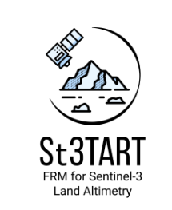
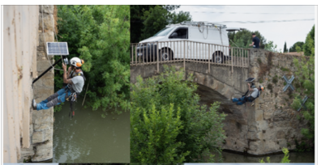
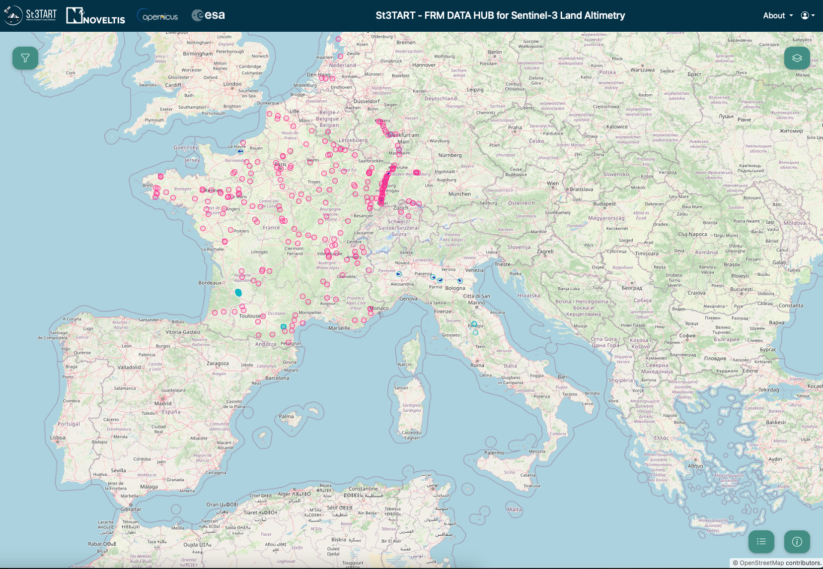
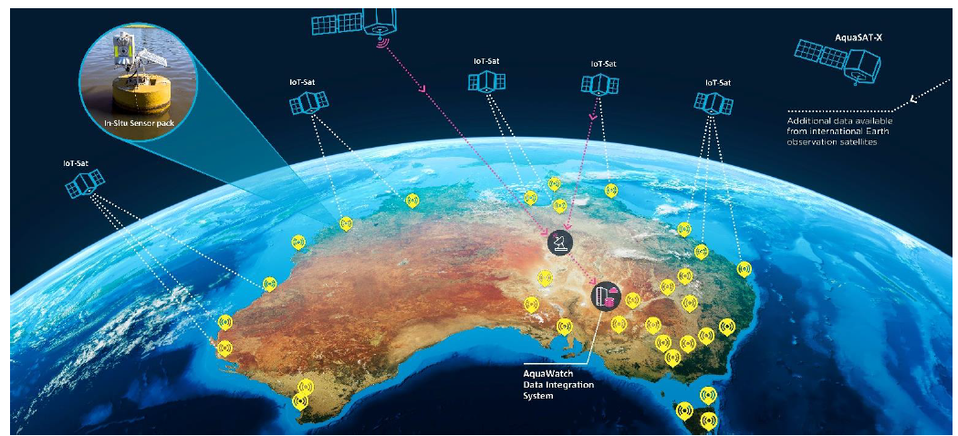
St3TART and AquaWatch activities
St3TART
ESA 18 months project ended in April 2023 (Follow On to be KO in 2024).
Project Goal:
To produce protocols and procedures for FRM provision in support of S3 mission, over sea ice, land ice and inland water
Project Achievements for hydrological targets:
Consolidated FRM protocols and procedures (free access here)
Roadmap for FRM operational provision (free access here)
12 micro stations deployed over Europe (7 pressure sensors) for inland waters – more to come with St3TART FO !
FRM data freely accessible via the St3TART FRM Data Hub
FRM Data Hub has also the functionality to upload your own FRMs ☺
AquaWatch
Australian Mission by CSIRO
Mission Goal:
To establish an integrated ground-to-space national water quality monitoring system to help safeguard our freshwater and coastal resources.
Prospectives:
Combine satellite sensors and in-situ water quality sensors with data analysis and artificial intelligence
Accurate water quality monitoring and forecasting across Australia and the world
Strength the network of ground-based water quality sensor
Provide end user platforms
CSIRO is looking for partners and collaborations !
AquaWatch Mission Concept

