Slide 1
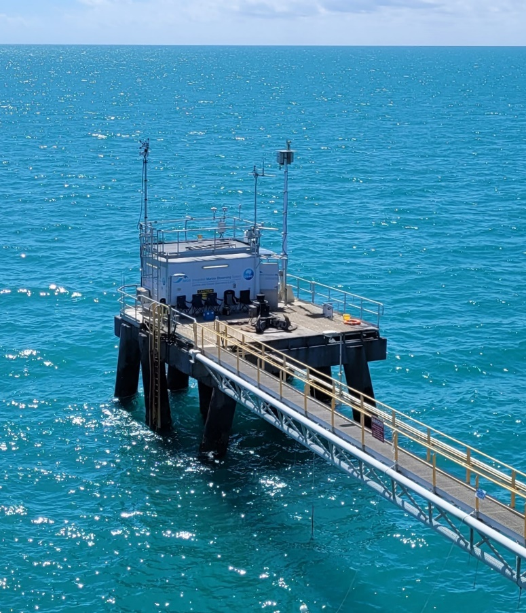
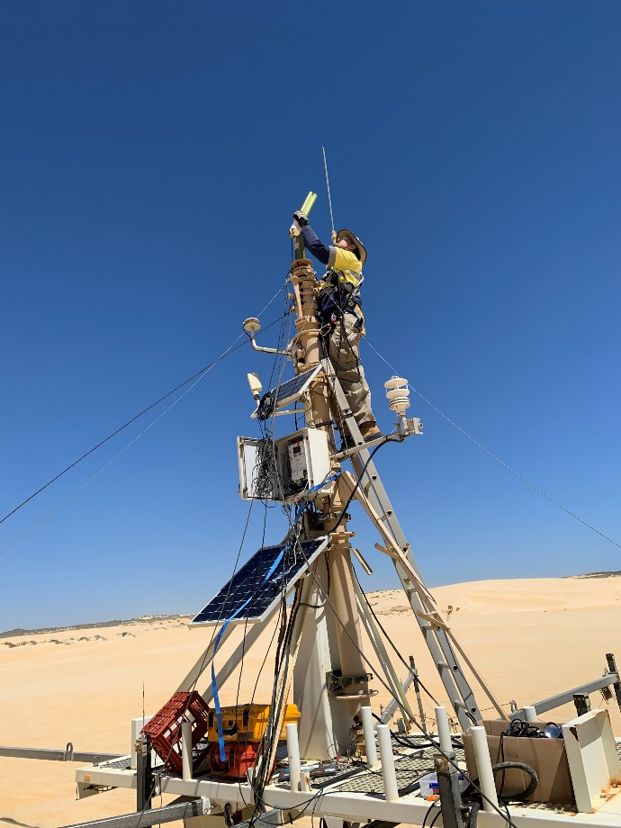
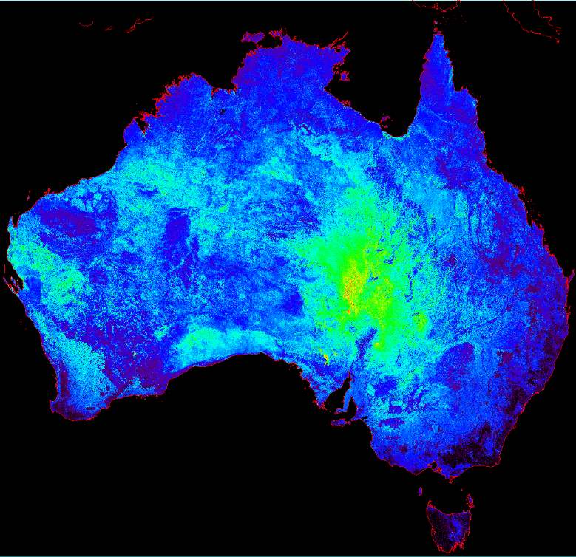
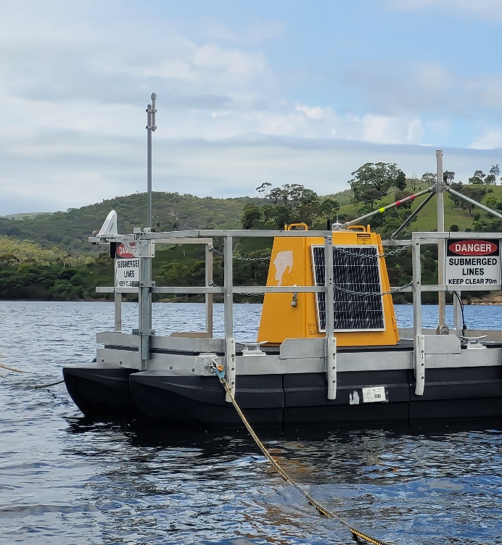
CSIRO agency report CEOS WGCV-53 plenary 5-8 March 2024
Matt Garthwaite on behalf of CSIRO

Slide 2
AusCalVal
The CSIRO AusCalVal program was introduced at WGCV-52
Part of the Australian National Space Mission for Earth Observation (NSMEO)
Included federal government investment to sustain Australian cal/val infrastructure and establish new cal/val capabilities
Federal government announced NSMEO cancellation on 28 June 2023
CSIRO Space and Astronomy is currently exploring the possibility of continuing with an “AusCalVal facility” and refining the scope of such a facility

Slide 3
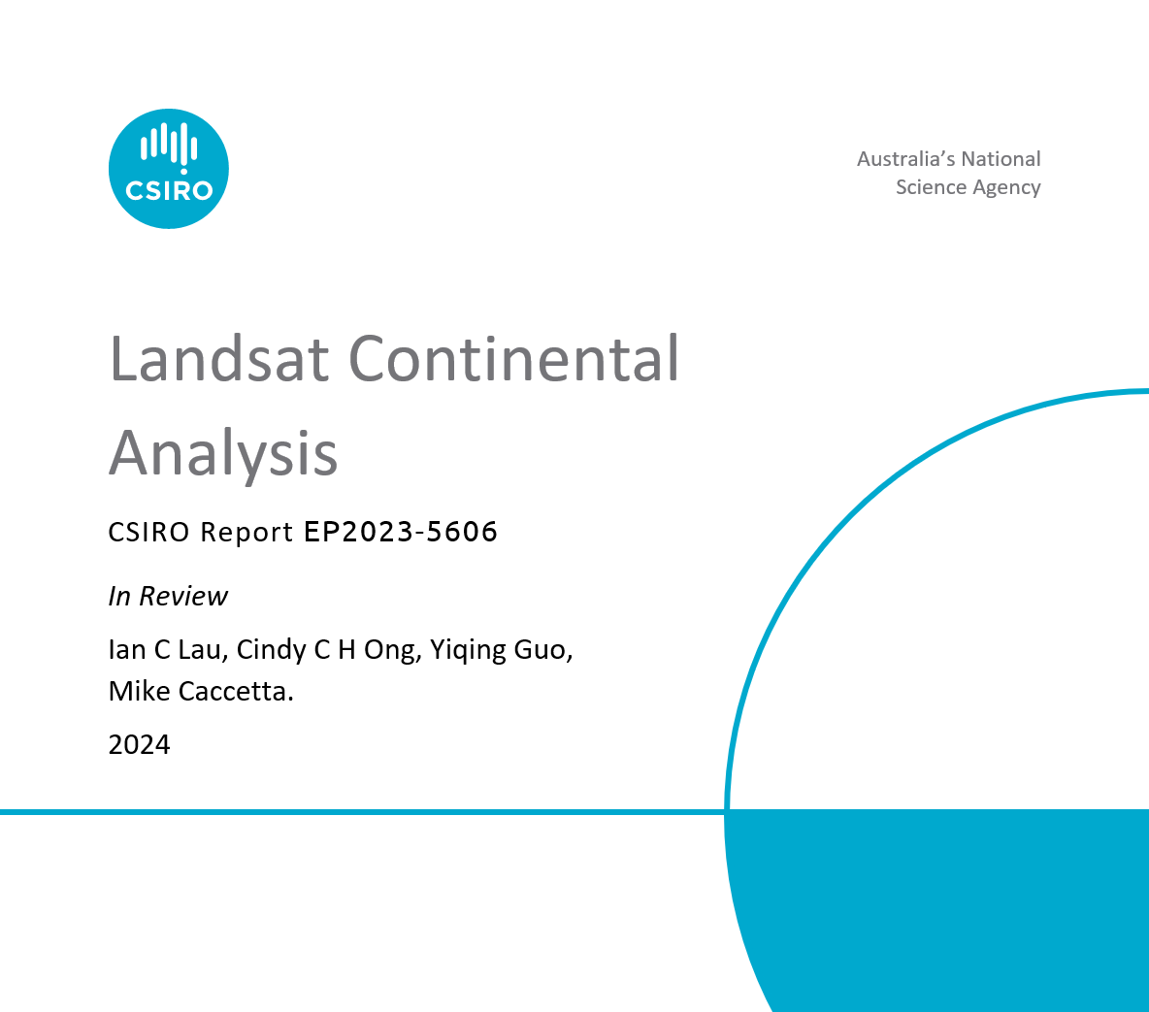
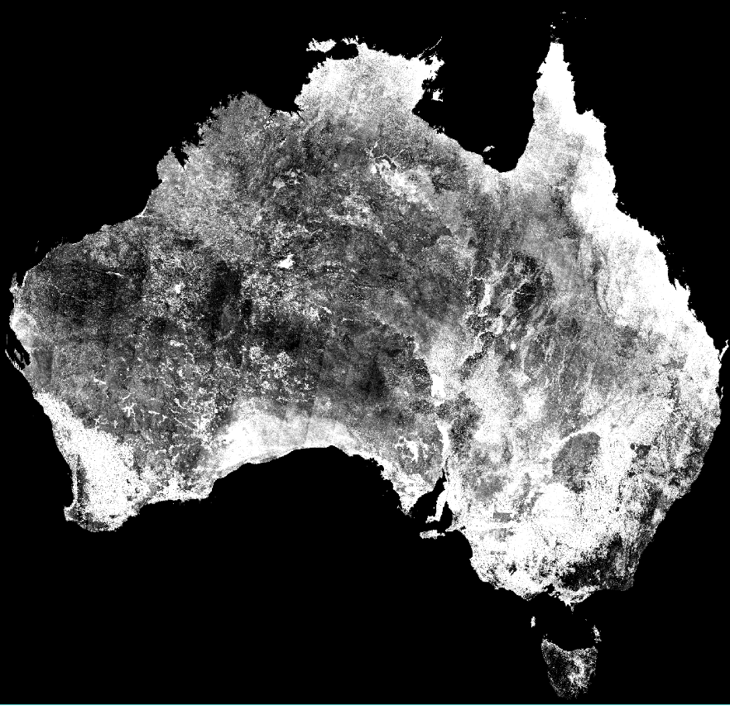
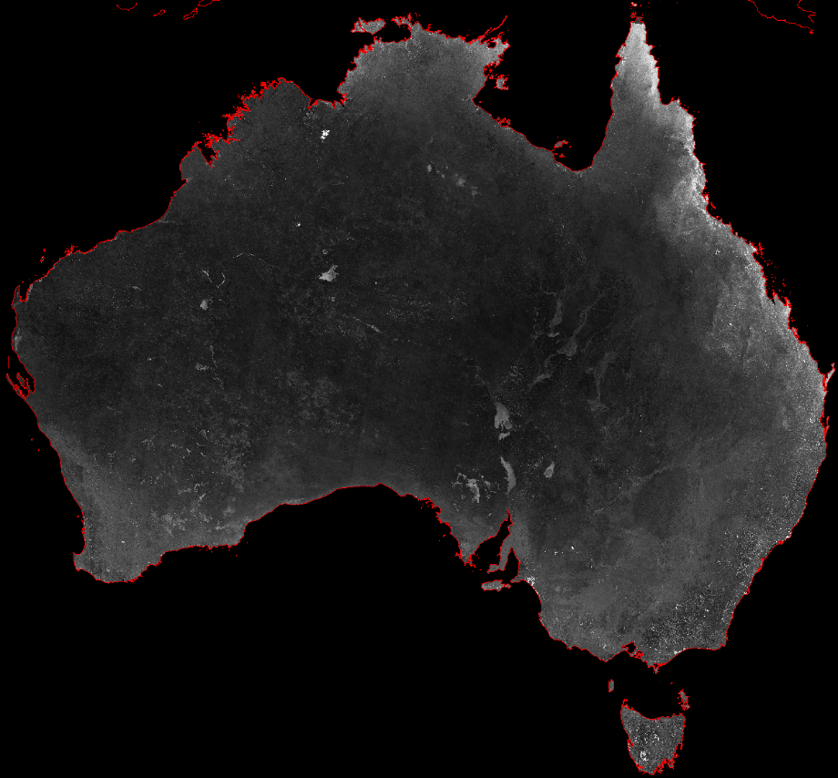
Search for new calibration sites
Completed a desktop Australia-wide Landsat-8 analysis
Leverages 10 years of USGS Landsat-8 collection 2 level 2 SR products
Open code and workflow re-usable globally on CSIRO’s EASI hub
Results align with previous Landsat 5 analysis
Challenges with standard cloud layer (from USGS & DEA) validating the need for CMIX activity.
Albedo across VNIR-SWIR (6 bands)
Mean
Std Dev
Coeff of Variation

Slide 4
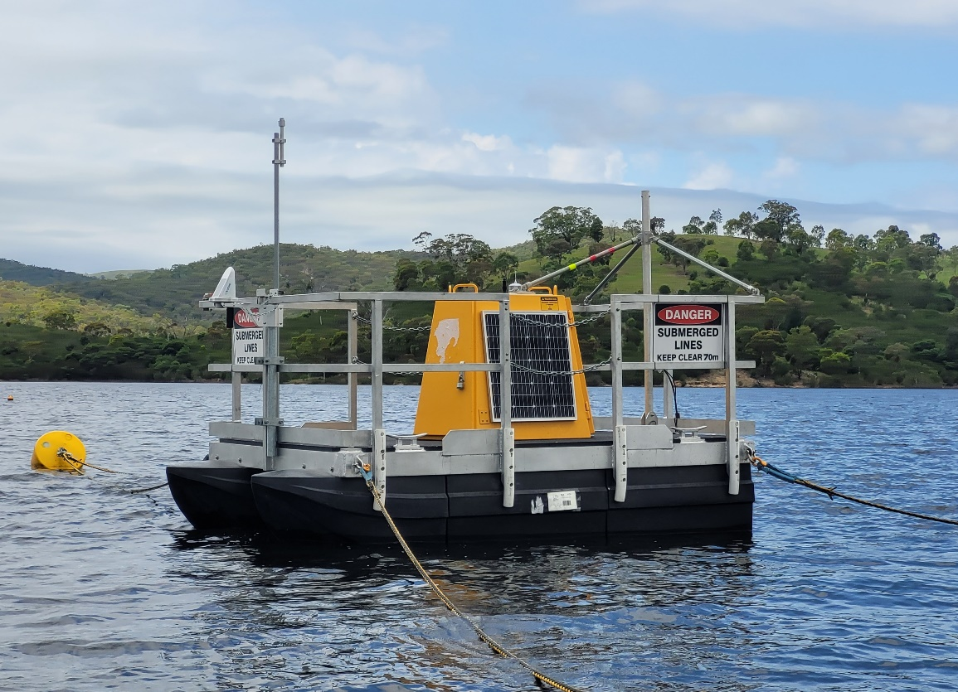
Darkwater Inland Observatory
Contact: Janet Anstee, Gemma Kerrisk, Nathan Drayson
Googong platform floated in January 2024
First instrument (Kurloo GNSS) installed 1 Feb 2024
Further instrumentation to be installed Mar 2024:
TriOS Ramses E_{d}, L_{sky} and L_{w} on pan/tilt unit
Weather station
Cameras horizontal and forward-looking
Water temperature at 3 depths (0/4/8 m) + thermistor chain
2 x Heitronics thermal radiometers
Autonomous power and communications
FRM maturity matrix assessment
Relative water height data from Kurloo – support to SWOT water height validation

Slide 5
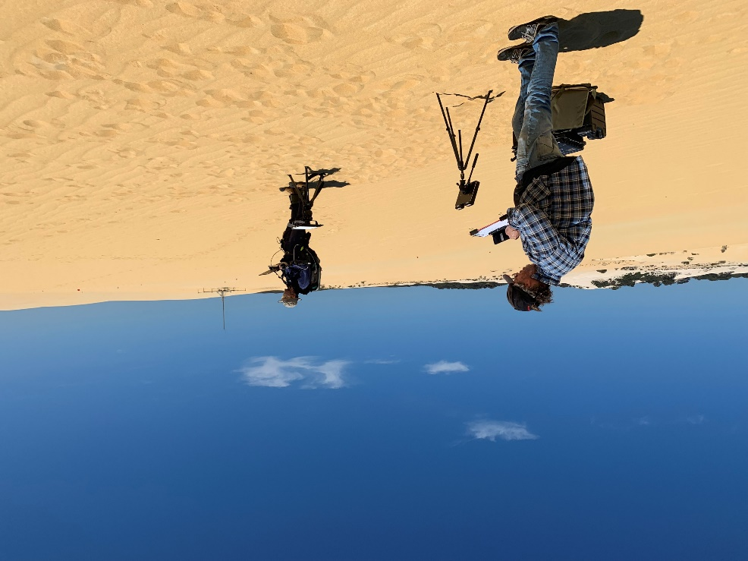
Pinnacles
Contact: Cindy Ong, Ian Lau
TIRCalNet
Ian Lau & Cindy Ong have joined the TIRCalNet study team
Working with NASA JPL on the deployment of a TIR radiometer at Pinnacles (current schedule/plan is for April 2024)
Preliminary ground TIR characterisation conducted and results indicate that the ground spectral characteristics align with ECOSTRESS
RadCalNet
Performed a swap of the CIMEL instrument. Instrument currently in rest/sleep mode to work on a few glitches related to the cable entanglement and mechanical issues related to the mast
Working with CNES on some technical issues data processing ahead of submission to RadCalNet
Other activities
Recent campaigns for EnMAP, DESIS and PRISMA inter-comparison to understand the disparity between the sensors. Similar inter-comparisons may be conducted at Calperum (SRIX4Veg-II location) if time permits

Slide 6
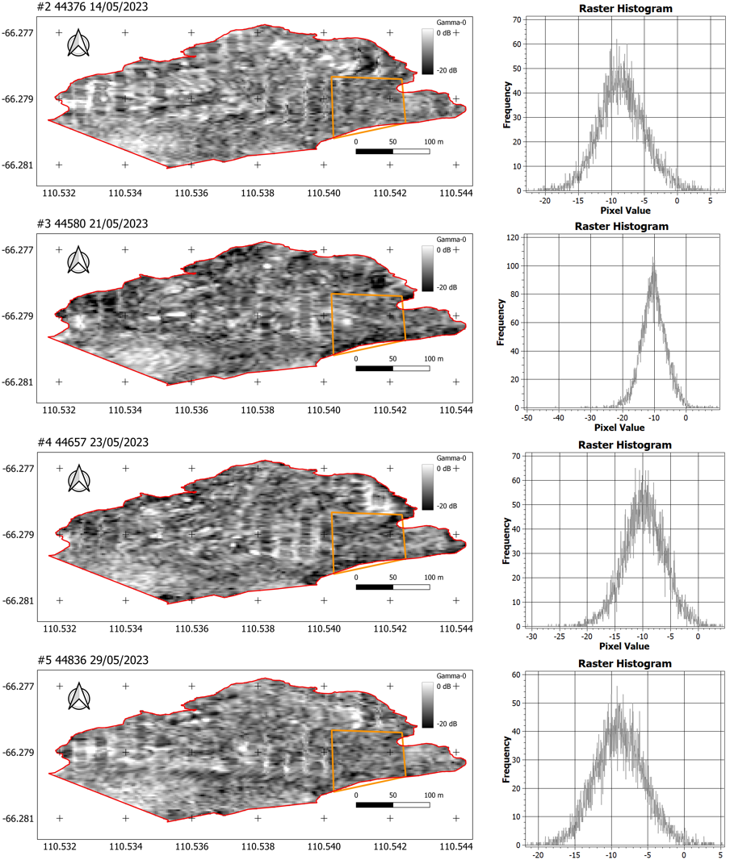
SAR cal in Antarctica
Contact: Matt Garthwaite
We have been working with Australian Antarctic Division (AAD) to deploy a temporary corner reflector at Casey station in the Antarctica
Immediate goal is to help support NISAR calibration after launch
Future aspiration to install permanent large targets at all AAD bases (Mawson, Casey, Davis in continental Antarctica, and Macquarie Island)
Desktop analysis of NovaSAR-1 S-band data to find quietest locations within the permitted Casey station area

Slide 7
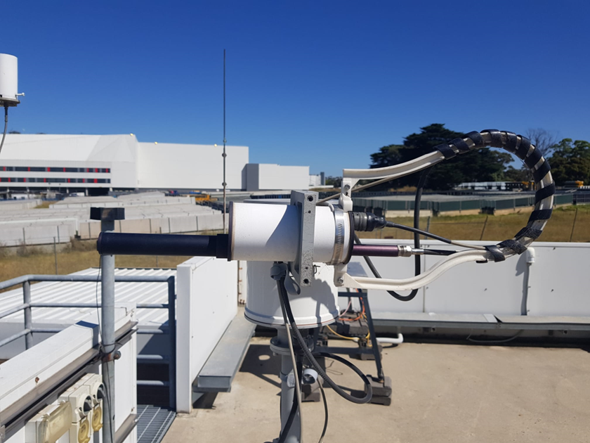
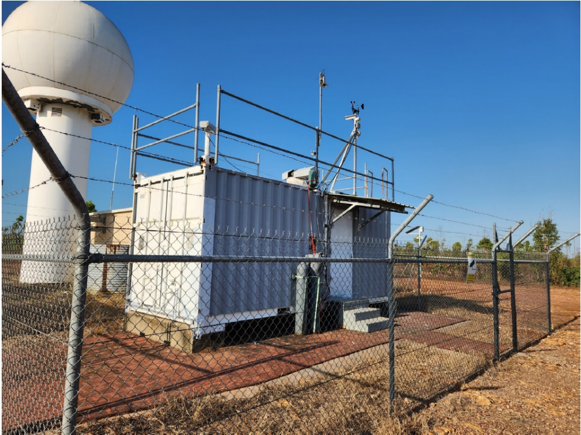
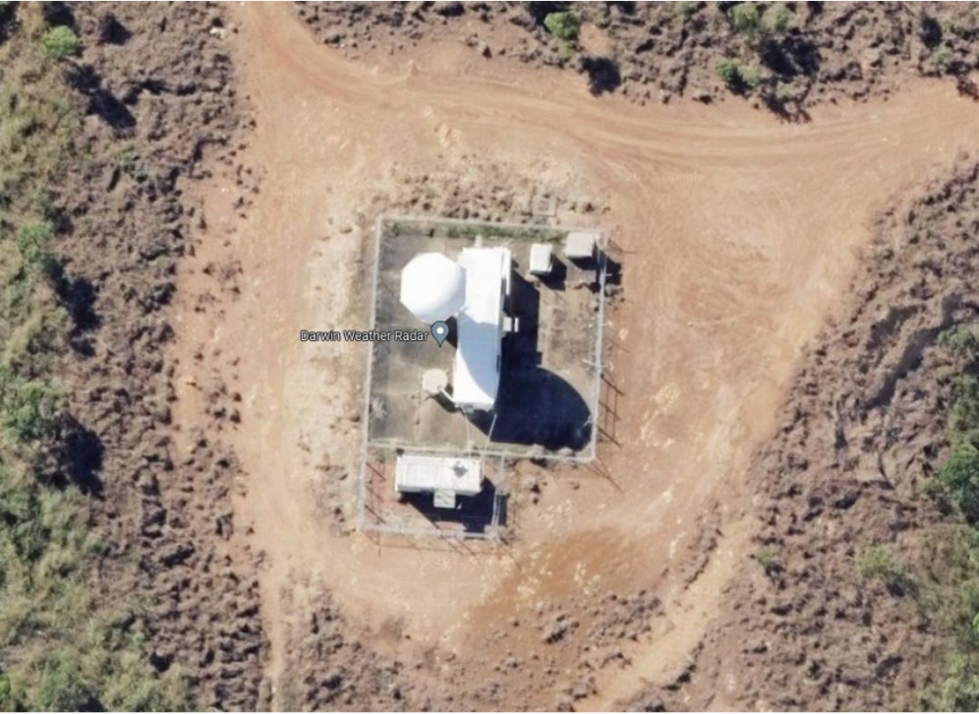
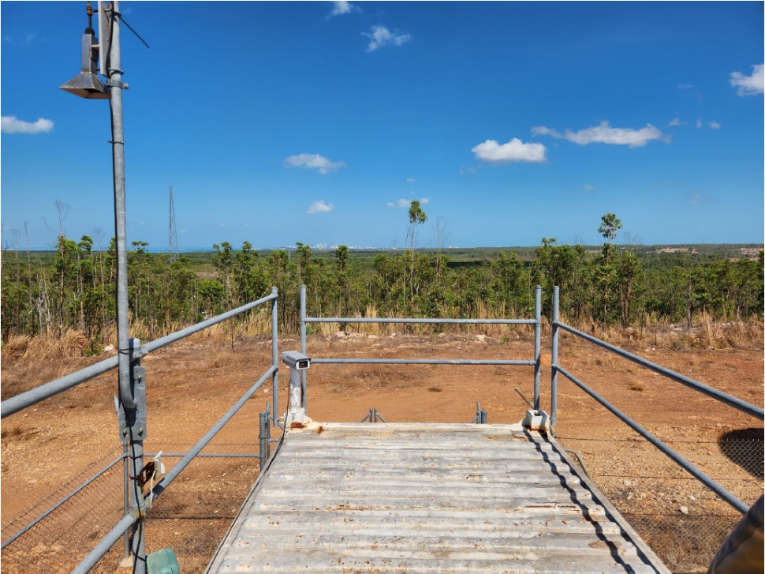
Pandonia
Broadmeadows
Contact: Matt Garthwaite
In support of ESA, we are discussing the addition of Pandora spectrometer at Darwin with University of Wollongong and Bureau of Meteorology
Would be co-located with TCCON at Darwin
Third Pandora site in Australia after Alice Springs (GA) and Broadmeadows (Melbourne; BoM)
Darwin TCCON
TCCON view west

Slide 8
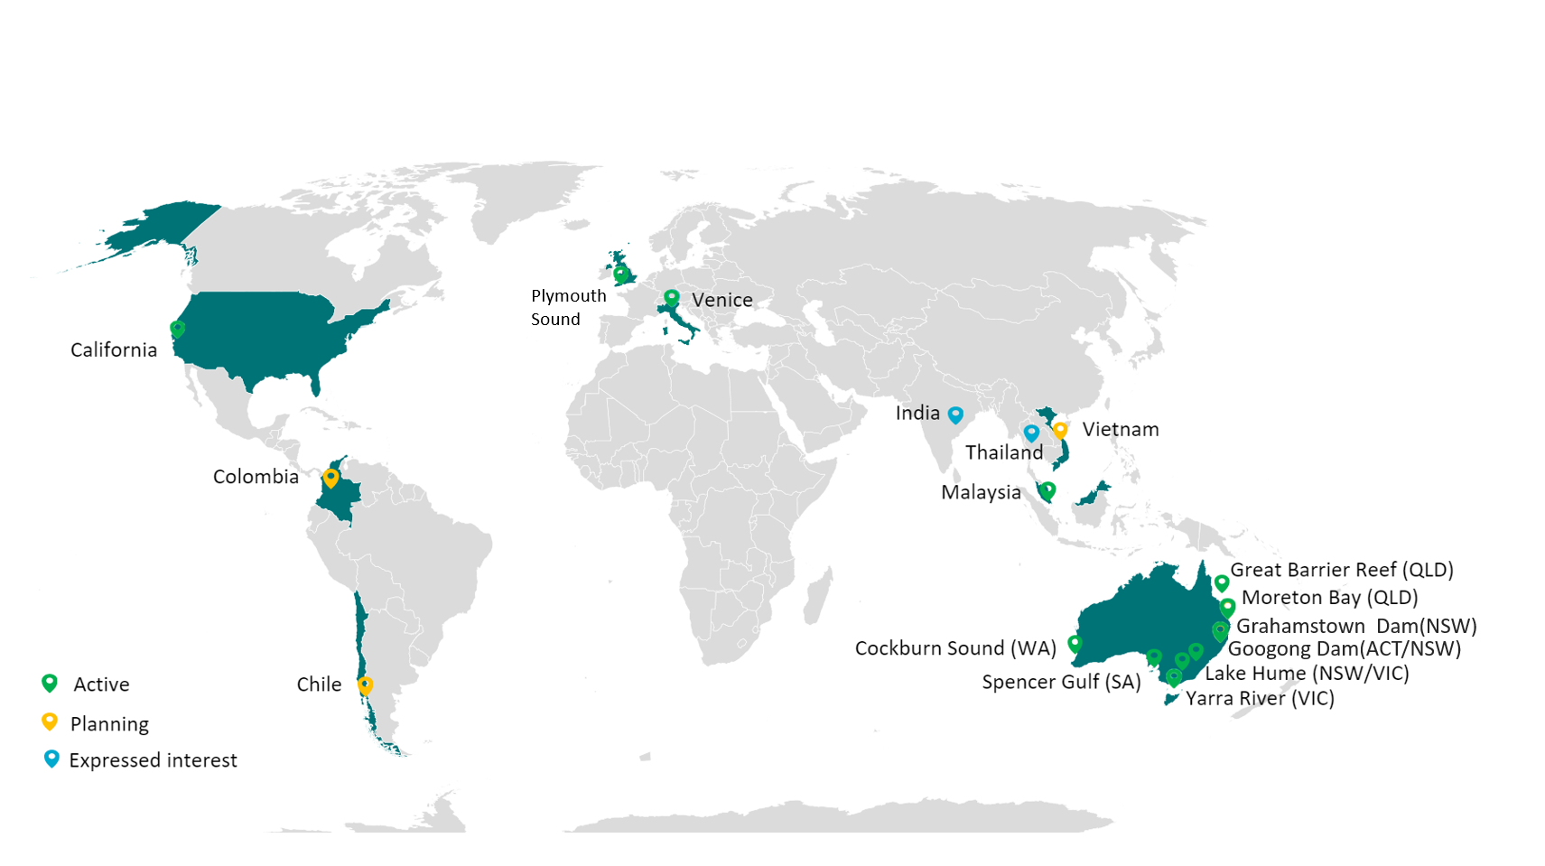
The Aquawatch Pilot Sites
Officially launched in 2023, AquaWatch's portfolio has grown to include pilot projects in a variety of international locations.
1) Lake Hume
2) Cockburn Sound
3) Moreton Bay
4) Spencer Gulf
5) Fitzroy River (GBR Pilot)
6) Melbourne Wastewater Treatment Plant
7) Grahamstown Dam
8) DION
9) Venice, Italy
10) California, US
11) Chile
12) Vietnam
13) Malaysia
14) Colombia
15) Plymouth Sound, UK
15
Contact: Alex Held, Xiubin Qi

Slide 9
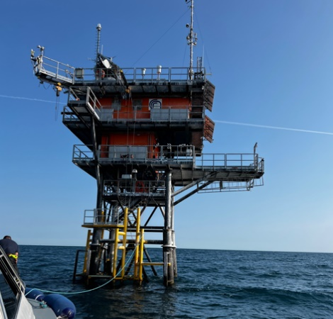
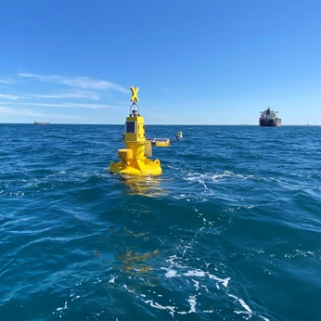
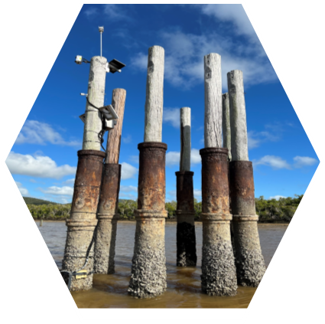
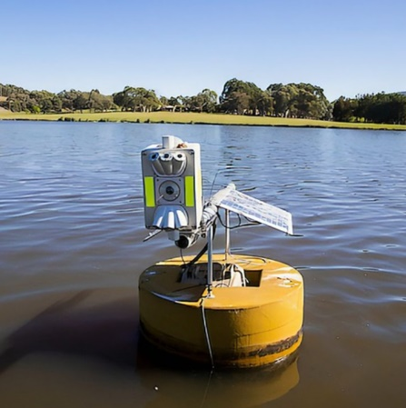
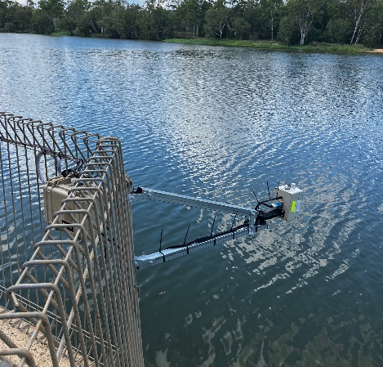
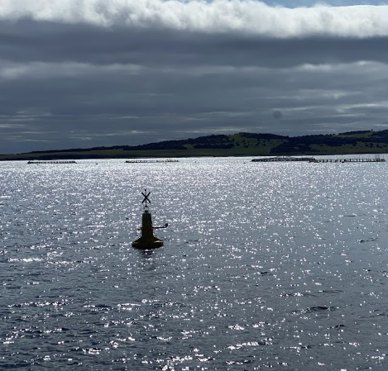
Configuration of Insitu Stations at AquaWatch Pilot Locations
Typical insitu observations include both above-water radiometry and In-water optics, progressively being implemented across pilot sites. Key features include:
Autonomous sensor measurement at 10-15 min intervals
Realtime data telemetry via mobile network
A live dashboard for monitoring system status and various water quality parameters, with remotely programable system for efficient power management
The currently deployed instruments, tailored to suit different pilot sites include:
Above-water sensors:
HydraSpectra
Water velocity sensor
Weather station
In-water sensors
Multiparameter water quality sensors
Nutrient sensor
Harmful Algal Bloom (HAB) sensor
ADCP
Monthly or bimonthly system maintenance, water sampling and lab analysis
Central data management through AquaWatch Data Integration and Analytics System
Contact: Alex Held, Xiubin Qi

Slide 10
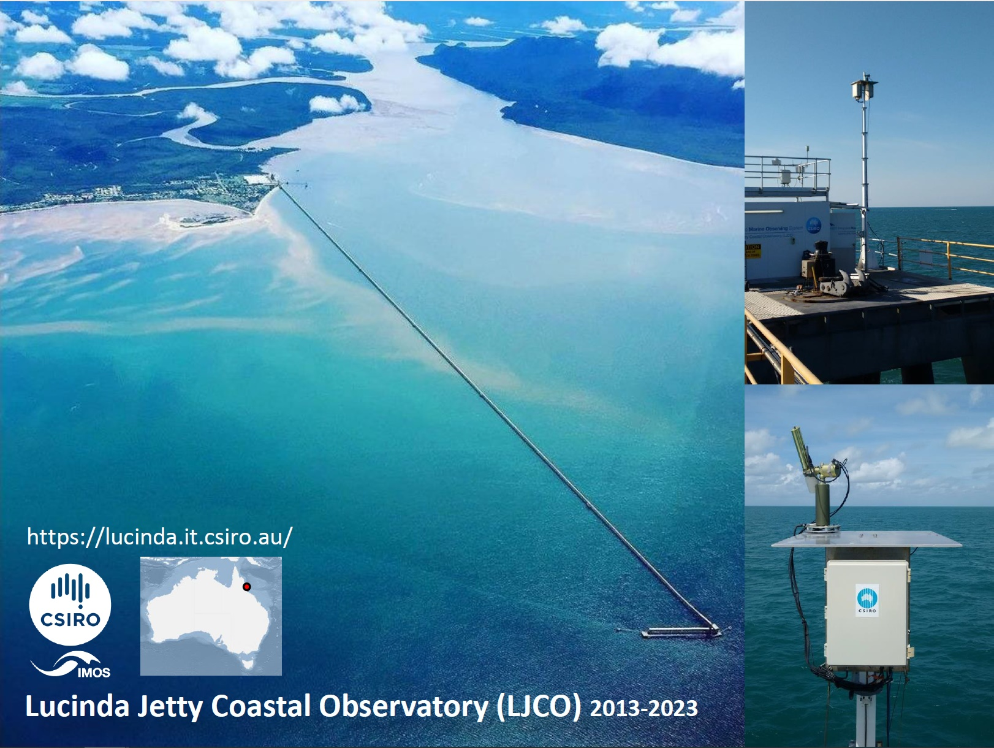
Cimel SEAPRISM 2013->
Satlantic hyperspectral system 2020->
Hypstar late 2024
Contact: Thomas Schroeder
Notes:
This is a nice aerial view of the 6 km long Lucinda Jetty, which is a bulk sugar terminal located on the
Australian east coast, in tropical coastal waters for the Great Barrier Reef. At the end of this Jetty we
operate the Observatory now continuously since end of 2013. The images on the right-hand side show you
the Cimel or SeaPRISM radiometer that is integrated into the Aeronet-OC network.

Slide 11
Contact: Thomas Schroeder
Notes:
For this instrument we quantified at the impact of the structure on the radiometry. In collaboration with
the Oceanographic Lab in Villefranche, France (LOV) we performed Monte Carlo Radiative Transfer (RT)
simulations for different water conditions and sun and observing geometries. The outputs of these RT
computations can be summarized in polar plots like these for the different pointing geometries, inherrent
optical properties (IOPs) sets and spectral bands. Conclusion is that any platform perturbations are
negligible below 2%, which provides further assurance of the high quality of these radiometric
observations at Lucinda.

Slide 12
Contact: Thomas Schroeder
Notes:
In one of the previous CEOS meetings we briefly presented on the IMOS Radiometry Task Team activity
that we undertook back in 2017 when we looked at a laboratory and field inter-comparison for a range of
radiometer systems. One key finding was that sensor temperature has an influence on the magnitude of
spectral calibration coefficients up to 0.56% per deg C in the blue and -0.42%/degC in the NIR. To
compensate for that temperature corrections have now been routinely implemented for our ship-borne
underway radiometric observations with the DALEC instrument.

Slide 13
Contact: Thomas Schroeder
Notes:
These plots are to illustrate you effect of the temperature correction on some coastal observations. We
looked at the effect of the T-correction on a median Rrs spectrum that was sampled over a 15 min interval
at relatively stable but very hot conditions at sea with Lsky and Ed internal temperatures exceeding 45
degC. These plots show that the absolute magnitude of the T-correction (difference between black and red
spectra) is similar to the SD that is observed with the sampling interval (difference between black and blue
spectra – point to zoom-in plot lower left hand side). Looking at the relative difference between a
processing with and without T-correction (center plot) this equates to about 2-4% in the blue green spectral
range. This variance provides another element required for a more complete uncertainty budget of our
radiometric measurements.

Slide 14
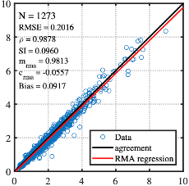
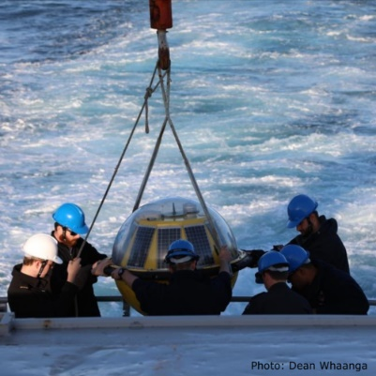
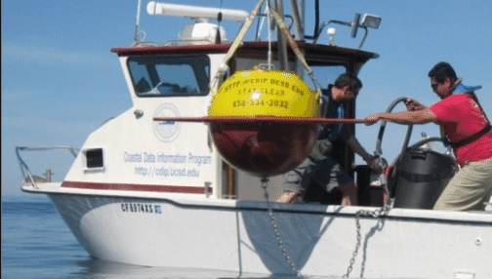
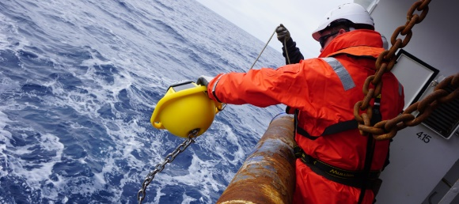
Cal/Val of satellite ocean surface waves and wind
Contact: Salmansaeed Khan
Waves
Australian coastal wave buoys (mostly operated by State Govt., Commonwealth agencies, Universities and Research Organisations) record wave conditions at several coastal locations
Large gaps exist in the Southern coast, Northern WA and the top end
Low-cost wave buoys (~4 kg; Sofar spotter) are improving the network coverage
Wave buoy measurements are crucial for:
monitoring wave conditions, coastal impacts
tuning regional and coastal wave models
cal/val of SRS wave measurements
Wind
Australian offshore wind measurements are scarce
Australia’s emerging offshore wind industry requires accurate wind measurements
Existing measurements are on coastal infrastructure and confounded by land effects
Satellites also provide ocean wind observations (Scatterometers, SARs, Radiometers), which need in-situ measurements for cal/val
Typical satellite altimeter wave height calibration
Australian wave conditions are captured by:
(i) Coastal wave buoy network
(ii) Radar Altimeter and SAR satellites
(iii) Numerical wave models
https://imos.org.au/facilities/srs/surface-waves
Traditional to low-cost, miniature drifting wave buoys
Salman Khan (CSIRO) Ian Young (UMelb)
Notes:
ongoing improvement in coastal wave buoy network due to proliferation of low-cost wave buoys (updated graphic) so better coverage for wave conditions and satellite cal/val around Australia. Both wave and wind data streams are up to date and enhanced with new wind and wave measuring satellites.

Slide 15
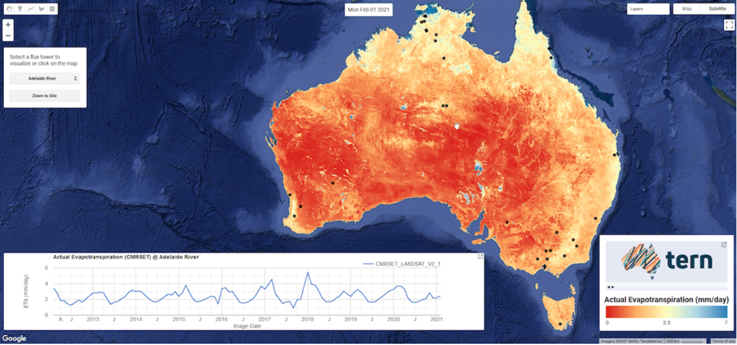
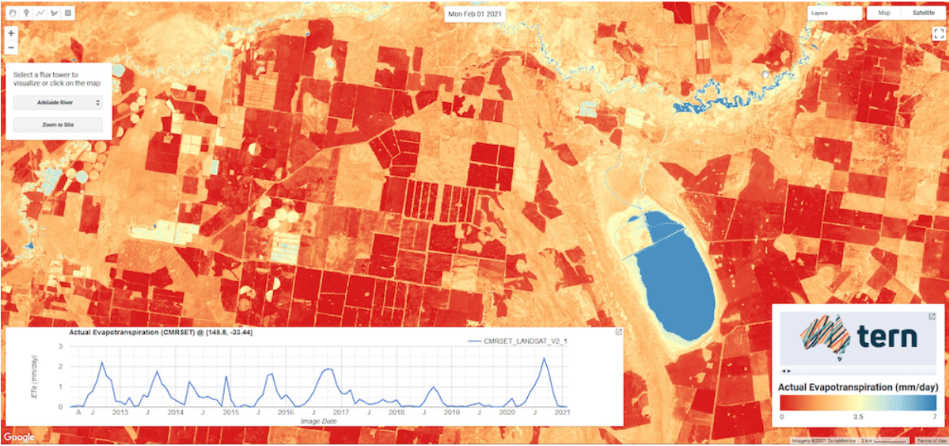
Actual Evapotranspiration
Contact: Tim Mcvicar
CMRSET – CSIRO MODIS Reflectance based Scaling EvapoTranspiration is an algorithm that blends Landsat, MODIS and VIIRS to achieve monthly, 30 m resolution, continuous (no gaps due to clouds) AET across continental Australia.
demand limit transpiration (near) surface water availability rainfall interception loss
Notes:
CMRSET is an empirical model to estimate actual ET (AET) by scaling the demand limit, Priestley-Taylor potential ET (PET)
Uses satellite vegetation greenness (Enhanced Vegetation Index; EVI) to estimate transpiration and interception
Uses satellite surface wetness (Residual Moisture Index; RMI) to estimate evaporation from standing water and wet surface soils
Requires gridded PET and Precipitation (P) data, generated daily and operationally by Bureau of Meteorology (BoM)

Slide 16
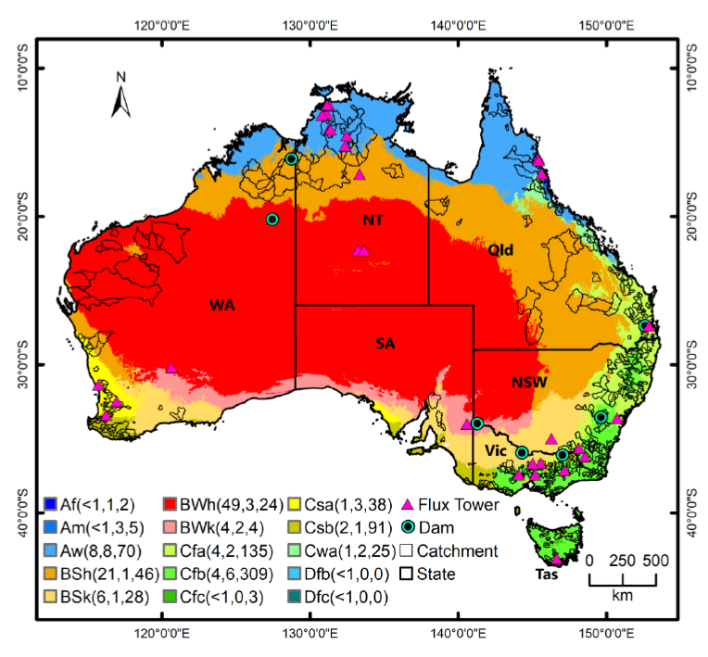
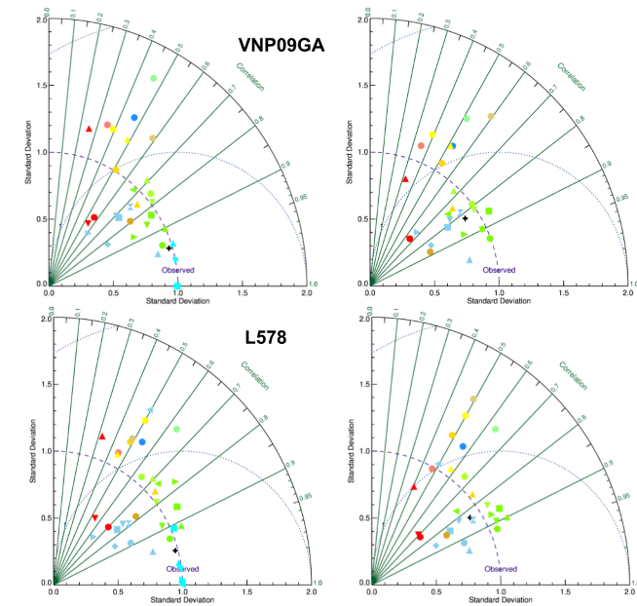
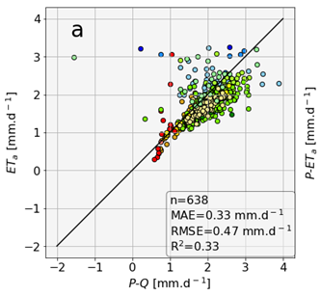
CMRSET model calibration
Contact: Tim Mcvicar
CMRSET calibrated to:
30 flux towers (pink triangles)
7 standing water bodies (circles)
Evaluated at 638 catchments
Similar stats to global models
Notes:
CMRSET is an empirical model to estimate actual ET (AET) by scaling the demand limit, Priestley-Taylor potential ET (PET)
Uses satellite vegetation greenness (Enhanced Vegetation Index; EVI) to estimate transpiration and interception
Uses satellite surface wetness (Residual Moisture Index; RMI) to estimate evaporation from standing water and wet surface soils
Requires gridded PET and Precipitation (P) data, generated daily and operationally by Bureau of Meteorology (BoM)

Slide 17
Thank you
CSIRO Space and Astronomy
Matt Garthwaite SAR & Cal/Val Facilities Lead
+61 492 166 671
Matt.Garthwaite@csiro.au
Contact CSIRO colleagues at <Firstname>.<Lastname>@csiro.au

